Slide 1
FleetCommander
New User Training
September 26, 2023

Slide 2


What We’ll Learn
What is FleetCommander?
  FleetCommander Overview
Accessing FleetCommander
  Log-in
  Welcome Page
Driver/Requestor Interface
  Information Links (including New User Registration)
  Vehicle Use Links (including Make Reservation)
Admin Interface
  Admin Menu (Configure, Tools, Reports, and Manage
  Manage > User
  Manage > Vehicle
  Manage > Make Reservation
  Manage > Reservation
    View, Modify, and Cancel
  Dispatching a Vehicle
  Manage > Fleet
    View, Make, and Move Reservations
  Dashboard – Vehicle Use Tab
Don’t worry…it’s not
rocket science!

Slide 3




New User Training Session and Best apprOach to Leverage The System
New User Training Session and Best apprOach to Leverage The System
AND
it’s

Slide 4
What is FleetCommander?

Slide 5
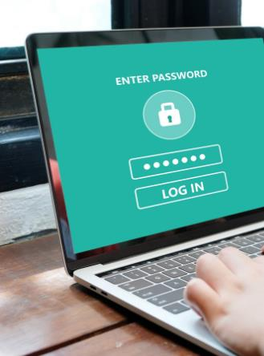

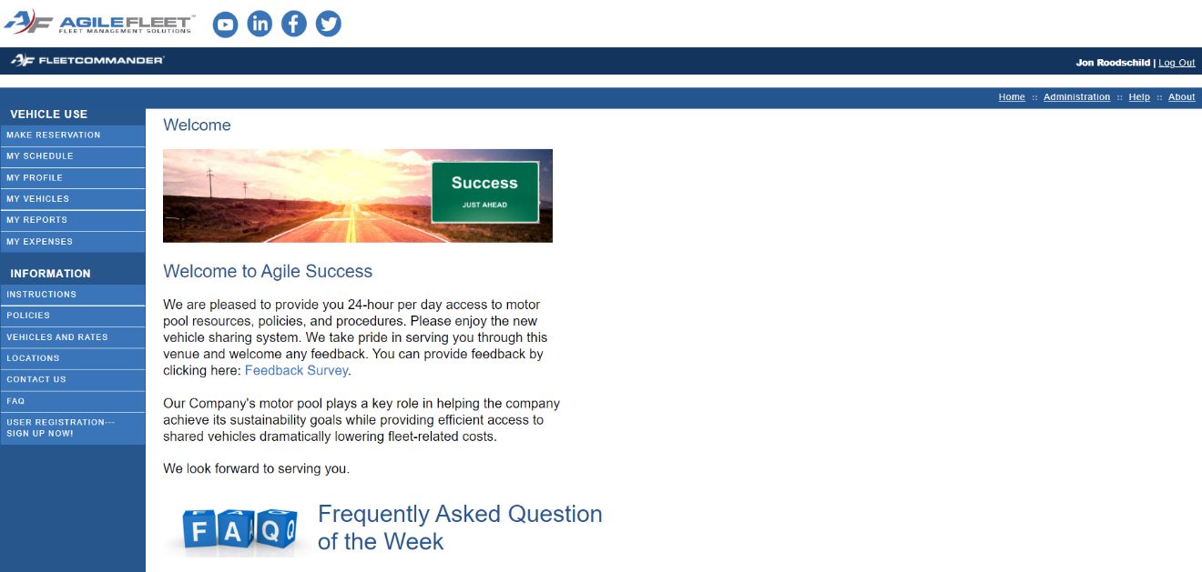
FleetCommander Overview
Cloud-based Fleet Management Solution
  Can oversee centralized or disbursed operations
  Scalable from 25 to 25,000+ vehicles
  Able to administer unlimited drivers/users
Highly configurable to support precise
business needs
Optional modules can include:
MotorPool/Vehicle Sharing
Maintenance & Parts
Fuel Management
Risk Management
Telematics

Slide 6
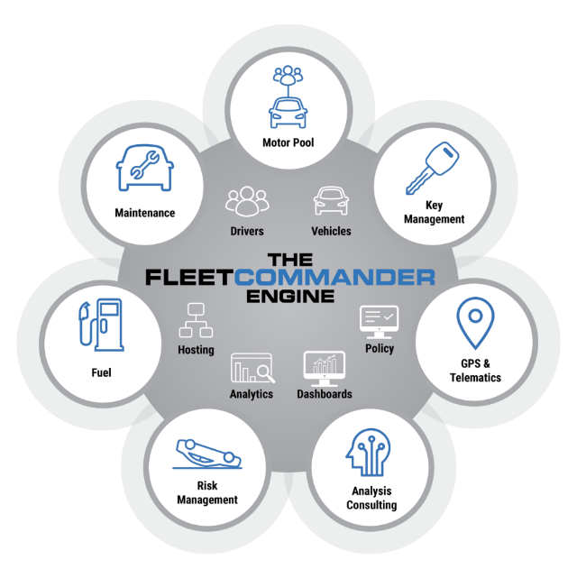
FleetCommander Overview
FleetCommander Core Product Engine
  User/Driver Management
  Vehicle/Asset Management
  Analytics & Reports
  Policy Oversight
  Admin Interface/Dashboards
  Hosting
FleetCommander Modules
  Motor Pool/Vehicle Sharing
  Key Management
  Maintenance
  Fuel
  Risk Management
  GPS & Telematics
Today’s training will feature these items

Slide 7
FleetCommander Overview
FleetCommander Core Product Engine
  User/Driver Management
  Vehicle/Asset Management
  Analytics & Reports
  Policy Oversight
  Admin Interface/Dashboards
  Hosting
FleetCommander Modules
  Motor Pool/Vehicle Sharing
  Key Management
  Maintenance
  Fuel
  Risk Management
  GPS & Telematics
Today’s training will feature these items

Slide 8

What is a profile in FleetCommander?
A profile is a centralized repository of your fleet data
and is unique to each associated user and asset/vehicle.
Profiles are essential components of the
“FleetCommander Engine”

Slide 9






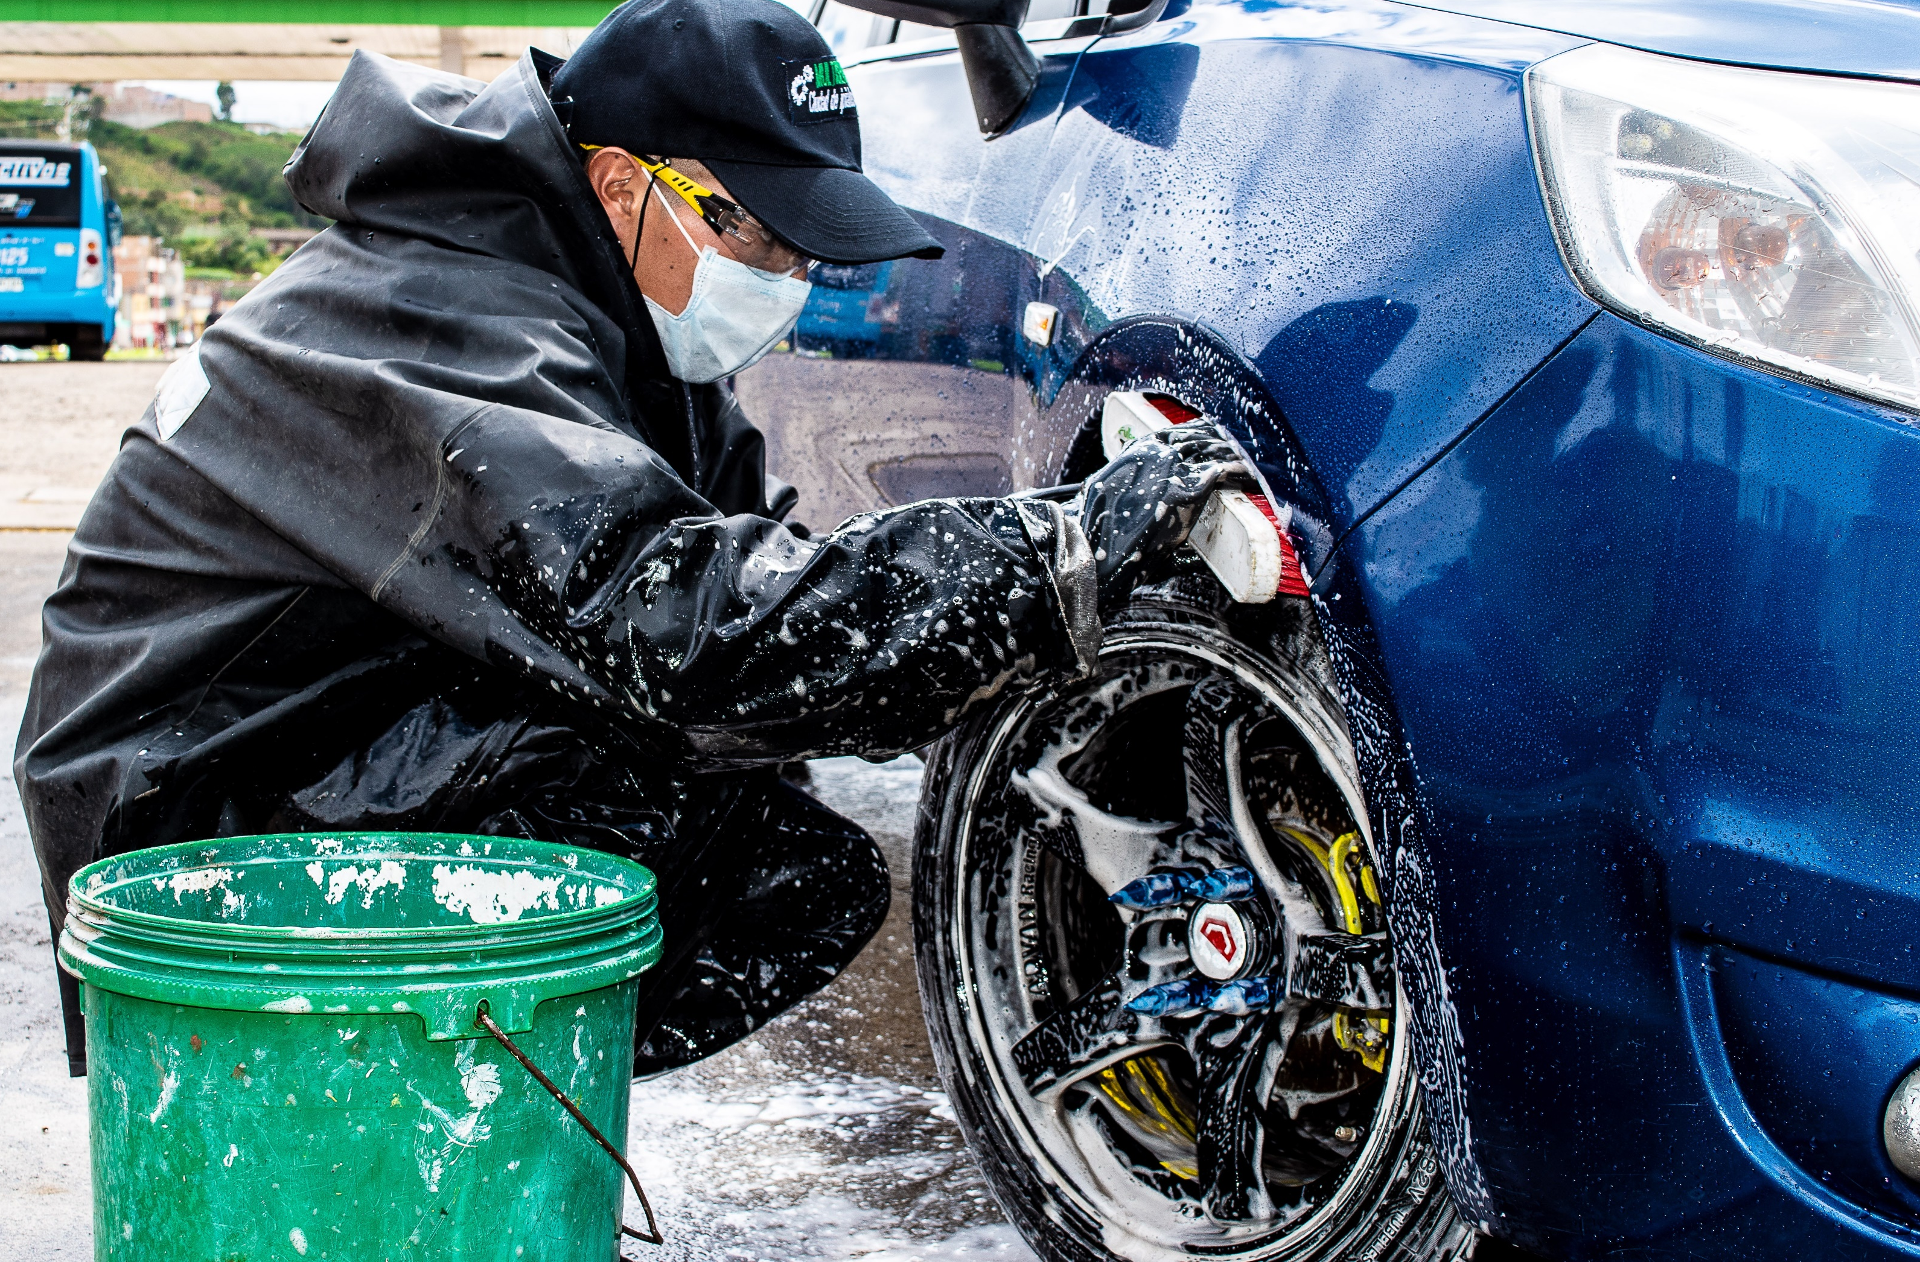


FleetCommander Users
Drivers
Requestors
Fleet
Administrators
Motor Pool
Dispatchers
Maintenance
Staff
Inspectors & Prep
Risk
Managers
HR
Administrators
This Photo by Unknown Author is licensed under CC BY

Slide 10
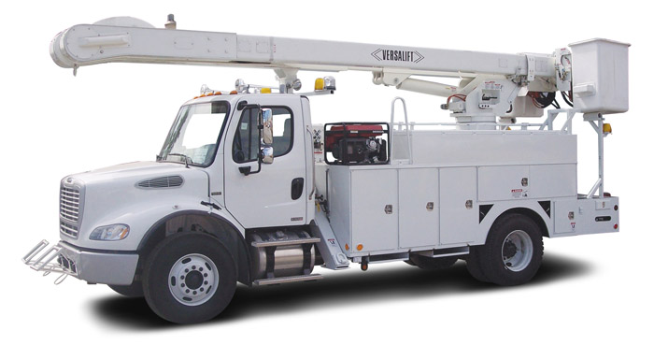
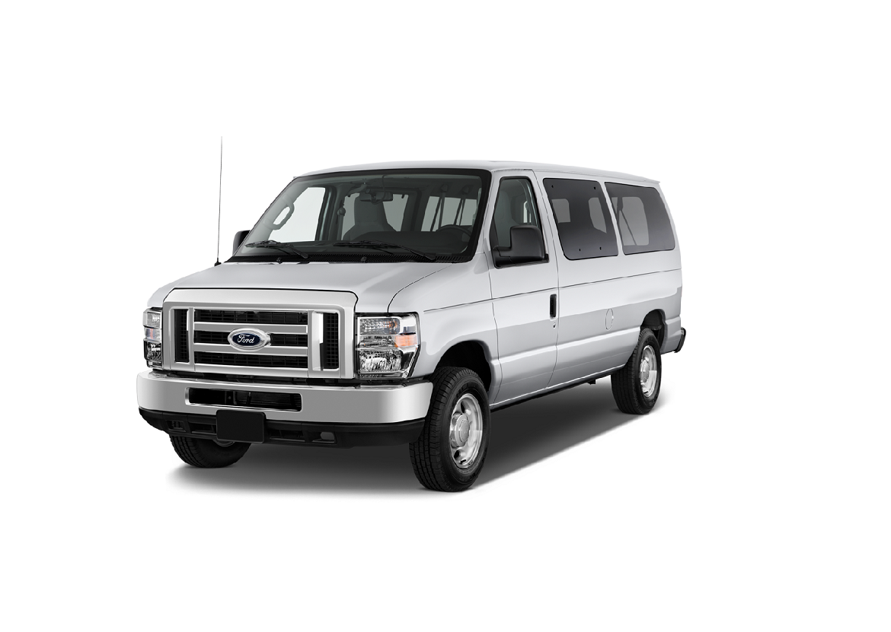
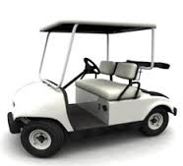
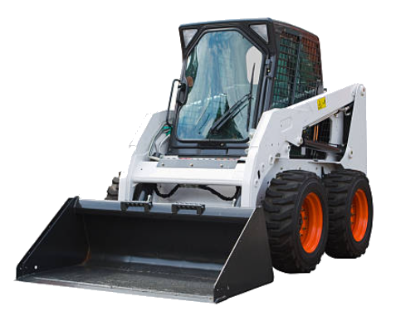
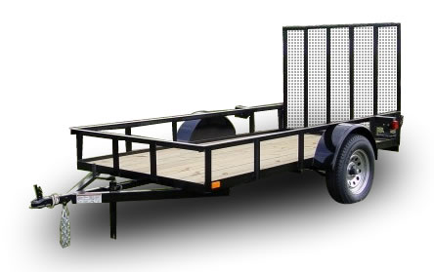
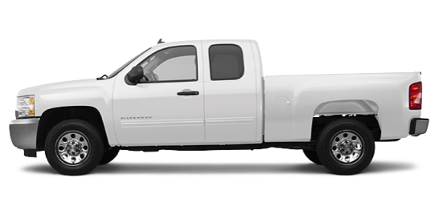
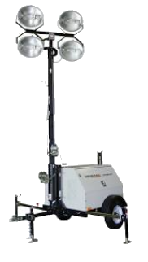
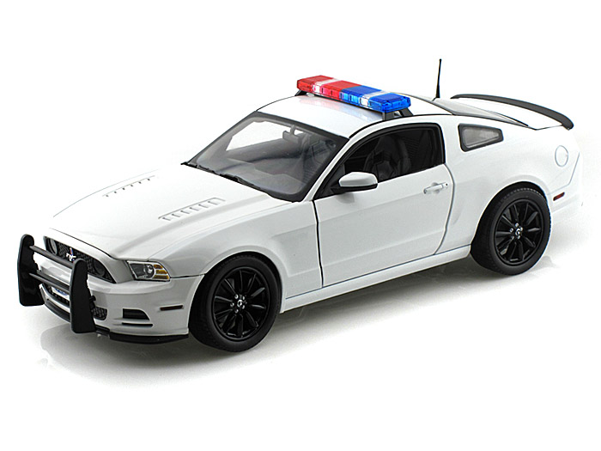
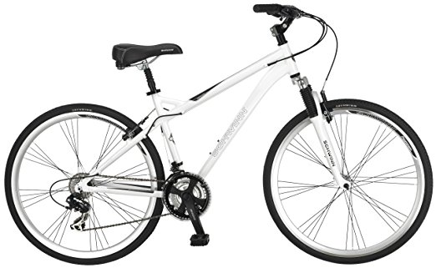
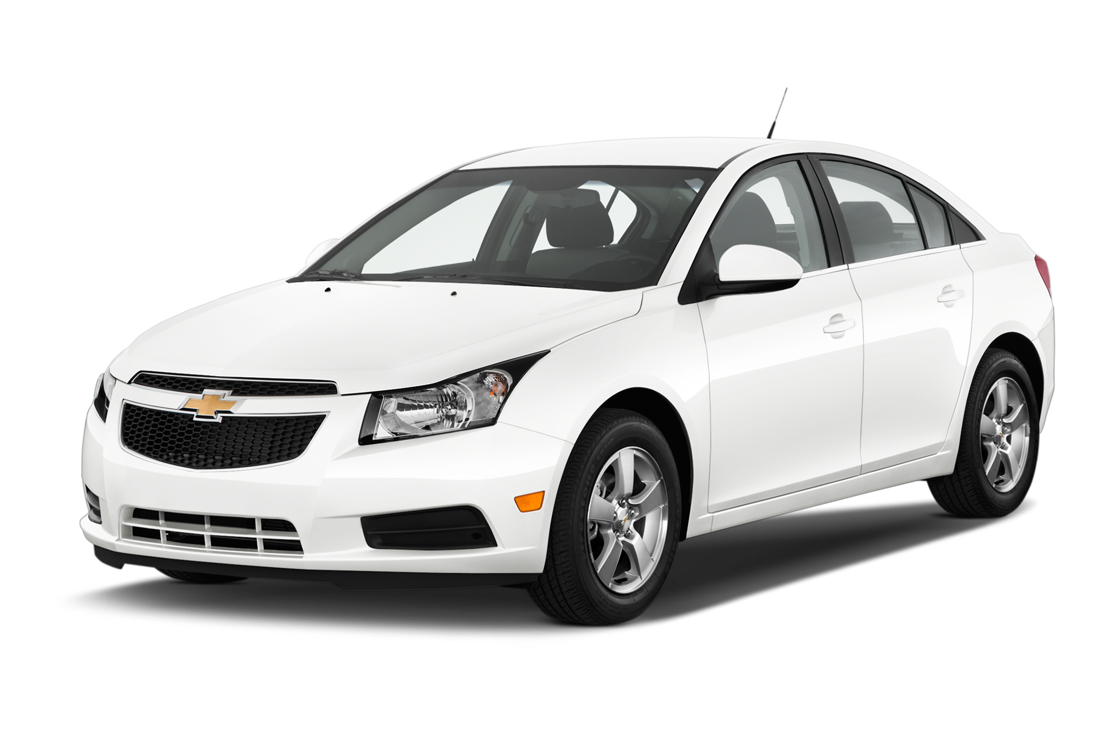
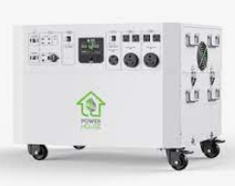
What assets can you place
in FleetCommander?
Answer: ALL OF THEM!
Light Duty
Bicycles
Patrol Cars
Sedans
Yellow Iron
Trailers
Generators
EVs
Pick-up Trucks
Heavy Duty
Golf Carts

Slide 11
Accessing FleetCommander

Slide 12
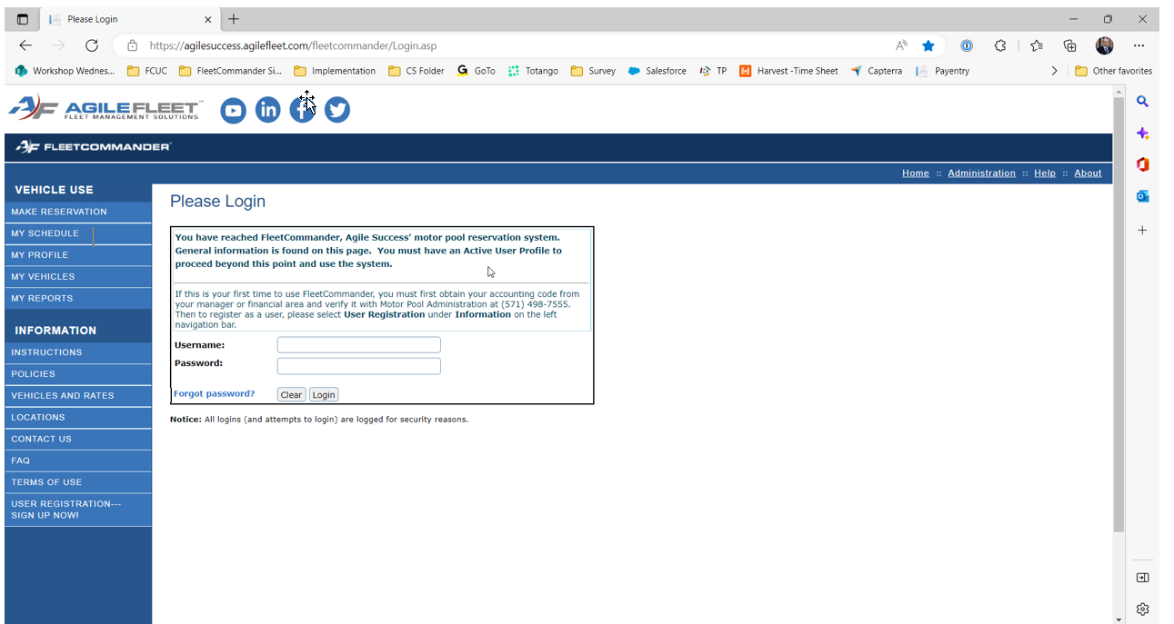
Accessing FleetCommander: Login
Go to
yourURL.agilefleet.com
EXAMPLE:
“Native- login”

Slide 13
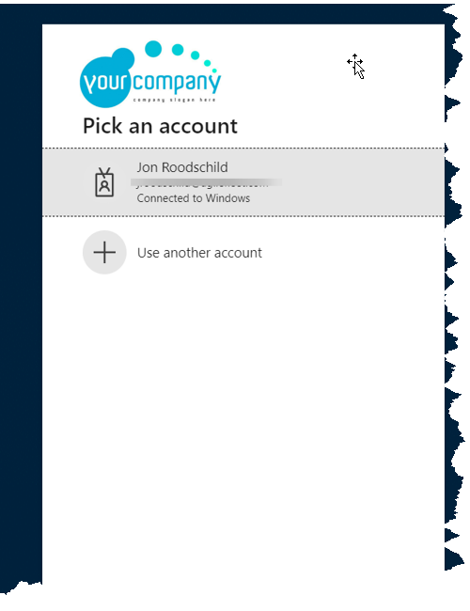
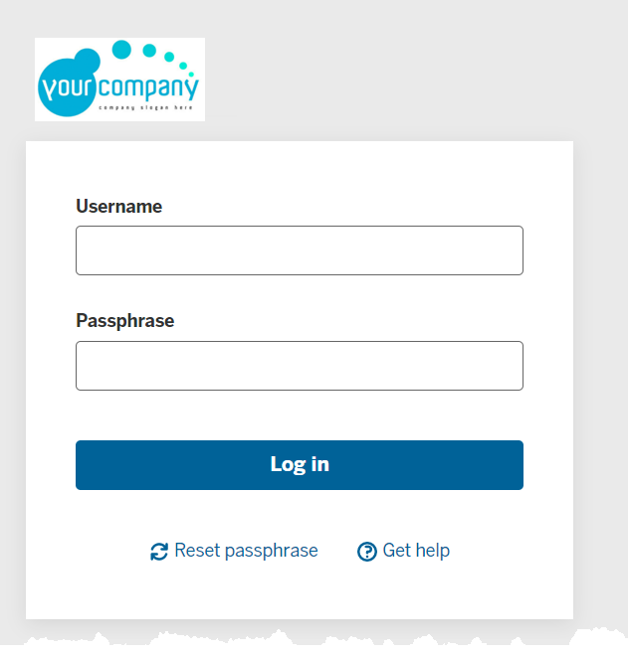
Accessing FleetCommander: Login
EXAMPLE:
“Custom Authentication”

Slide 14
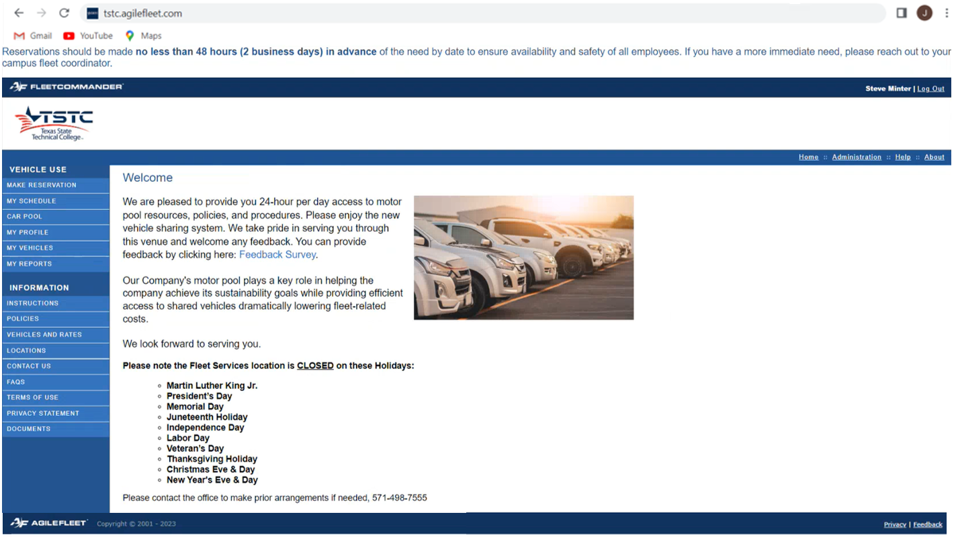
Accessing FleetCommander: Welcome Page
Successful login brings you to FleetCommander
Welcome Page
UPDATE SLIDE
Welcome Page highlights important information including fleet policies

Slide 15
Forgot Password?

Slide 16
Accessing FleetCommander: Login
TIP:
If you forgot your password, you can receive a reset prompt

Slide 17
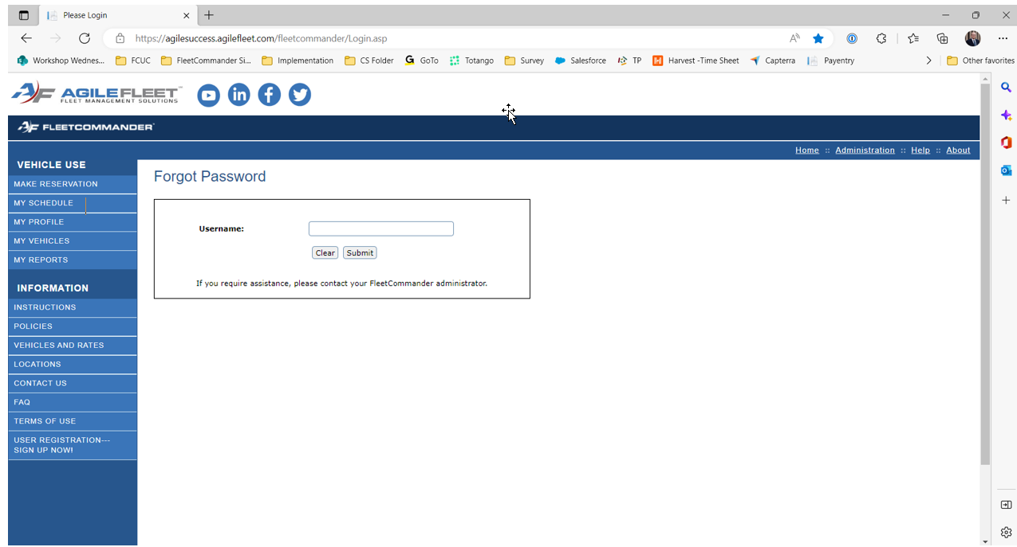
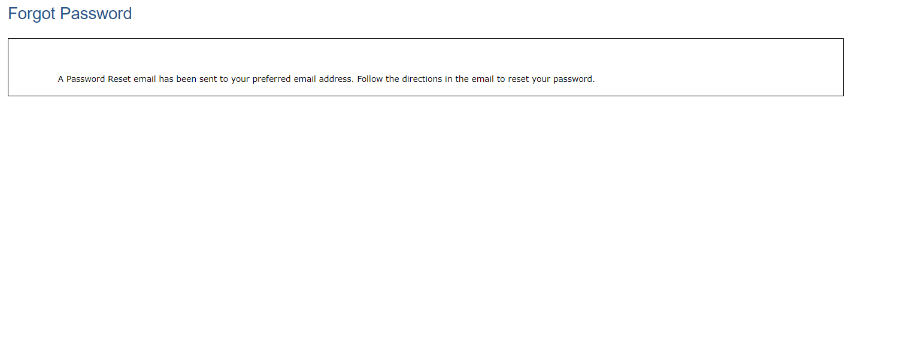
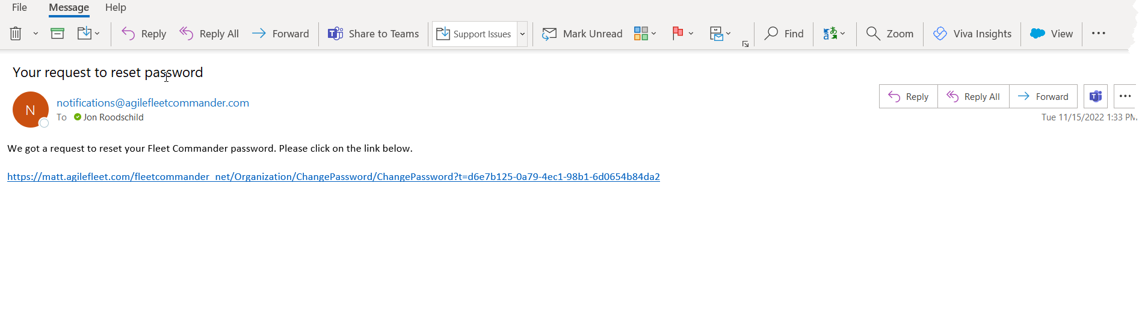
Accessing FleetCommander: Login
EXAMPLE:
Password Reset Email

Slide 18
Driver/Requestor Interface

Slide 19
Driver/Requestor Interface
  Information Links
    Instructions
    Policies
    Vehicles and Rates
    Locations
    Contact Us
    FAQs
    Terms of Use
    Privacy Statement
    Documents
  Vehicle Use Links
    Make a Reservation
    My Schedule
    My Profile
    My Reports
The WELCOME PAGE is the launching point for all Driver/Requestor interaction with FleetCommander
Interfaces includes:
INFORMATION LINKS
and
VEHICLE USE LINKS

Slide 20
Information Links

Slide 21
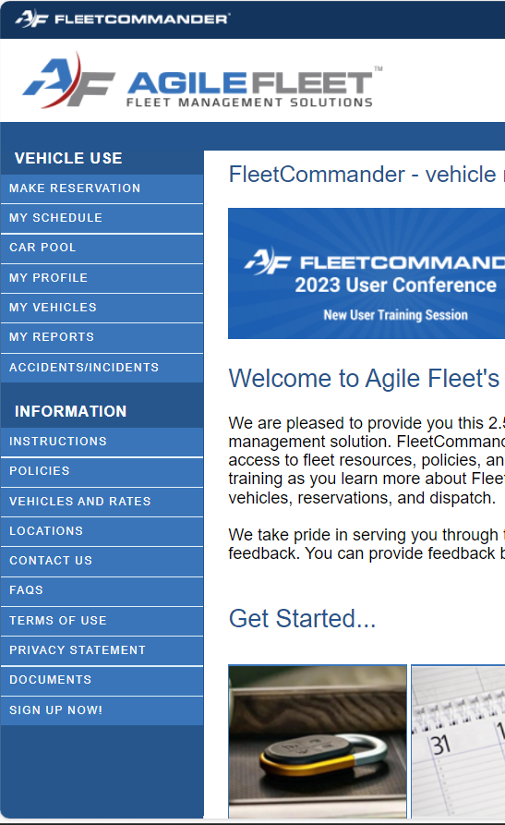
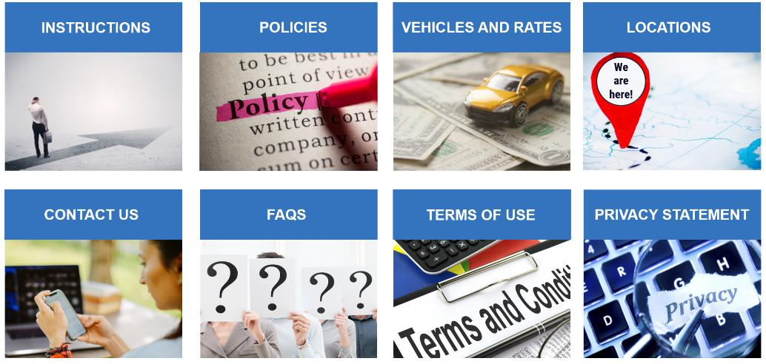
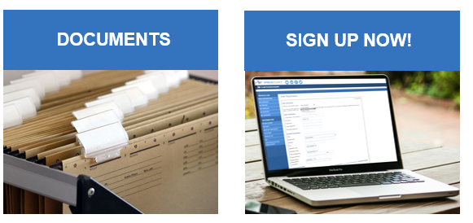
Driver/Requestor Interface
  Information Links
  Shares specific information regarding fleet with requestors/drivers
INSTRUCTIONS: “how to’s”
of making reservations

Slide 22
Driver/Requestor Interface
  Information Links
  Shares specific information regarding fleet with requestors/drivers
POLICIES: the “must agrees”
of using vehicles

Slide 23
Driver/Requestor Interface
  Information Links
  Shares specific information regarding fleet with requestors/drivers
VEHICLES AND RATE:
what types of vehicle are offered & the cost to rent.

Slide 24
Driver/Requestor Interface
  Information Links
  Shares specific information regarding fleet with requestors/drivers
LOCATIONS: where
to go to get vehicle

Slide 25
Driver/Requestor Interface
  Information Links
  Shares specific information regarding fleet with requestors/drivers
CONTACT US: who
to ask for help

Slide 26
Driver/Requestor Interface
  Information Links
  Shares specific information regarding fleet with requestors/drivers
FAQ’s: answers
to popular questions

Slide 27
Driver/Requestor Interface
  Information Links
  Shares specific information regarding fleet with requestors/drivers
TERMS OF USE:
the rules of using application

Slide 28
Driver/Requestor Interface
  Information Links
  Shares specific information regarding fleet with requestors/drivers
PRIVACY STATEMENT:
protecting your privacy

Slide 29
Driver/Requestor Interface
  Information Links
  Shares specific information regarding fleet with requestors/drivers
DOCUMENTS:
additional important information to access

Slide 30
Driver/Requestor Interface
  Information Links
  Shares specific information regarding fleet with requestors/drivers
SIGN UP NOW:
register to use
FleetCommander

Slide 31
Vehicle Use Links

Slide 32
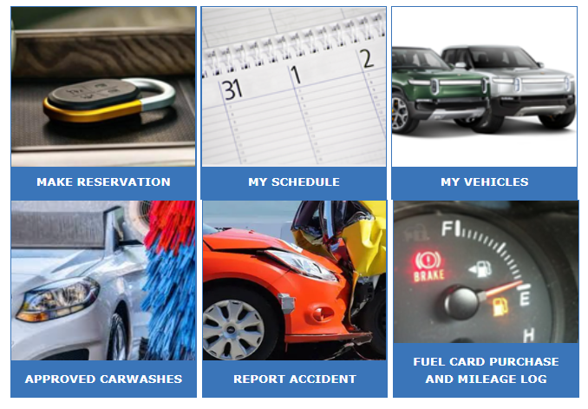
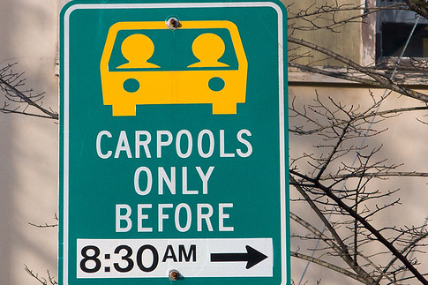



Driver/Requestor Interface
  Vehicle Use Links
  Launch point for requestor/driver interaction with FleetCommander
We will cover three of these VEHICLE LINKS today

Slide 33
Make Reservation

Slide 34
Making Reservations in FleetCommander
Vehicle reservations CAN BE ENTERED into FleetCommander via SEVERAL LAUNCHING points.
The following process illustrates how your
END-USERS request vehicles.

Slide 35
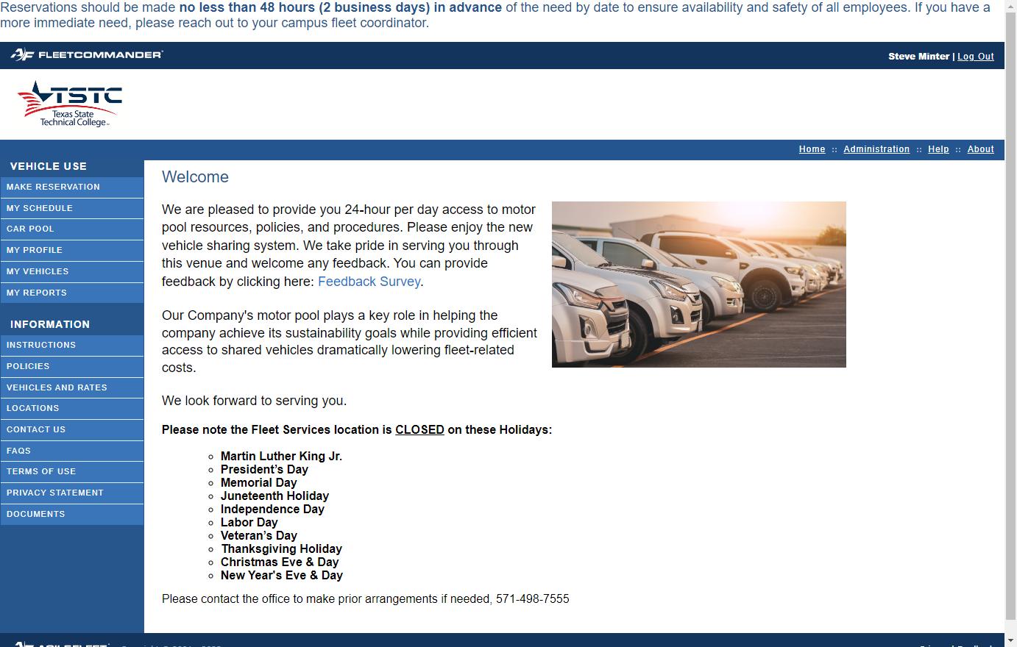

Make a Reservation – End Users
From the Navigation select “Make Reservation”

Slide 36
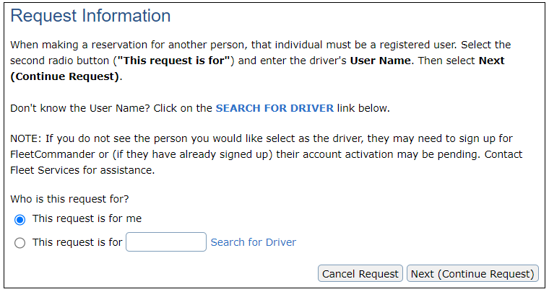
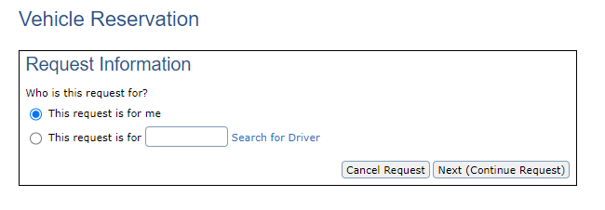
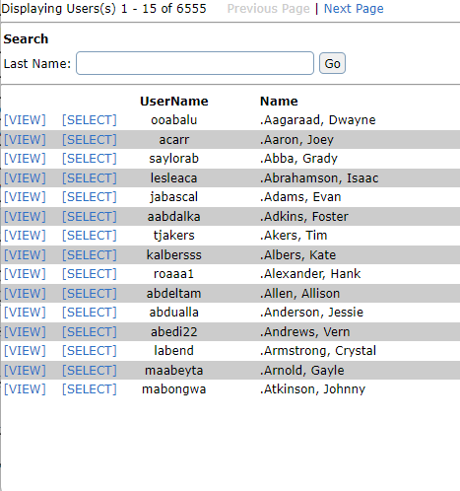
Make a Reservation – End Users
Type in Last Name and click “Go” to find Driver
Customize this layout via CONFIGURE>ENTERPRISE>LAYOUT
MAKE RESERVATION HELP TEXT
“This Request is for me” is selected by default.
Requestors can make a reservation for someone else by selecting “Search for Driver””
Select
“Next (Continue Request)”
NOTE: make sure
to click appropriate radio button!
This field requires USERNAME not LAST NAME

Slide 37
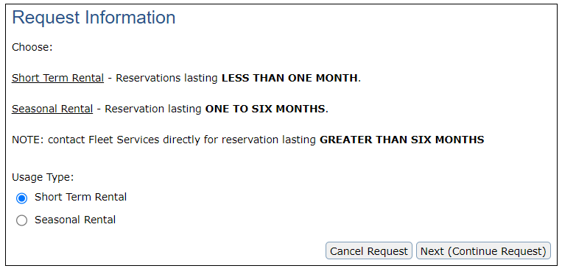
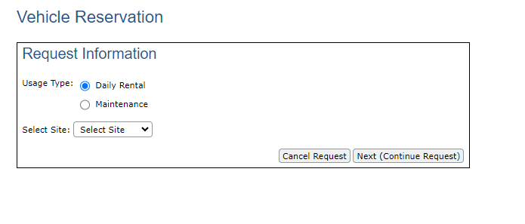
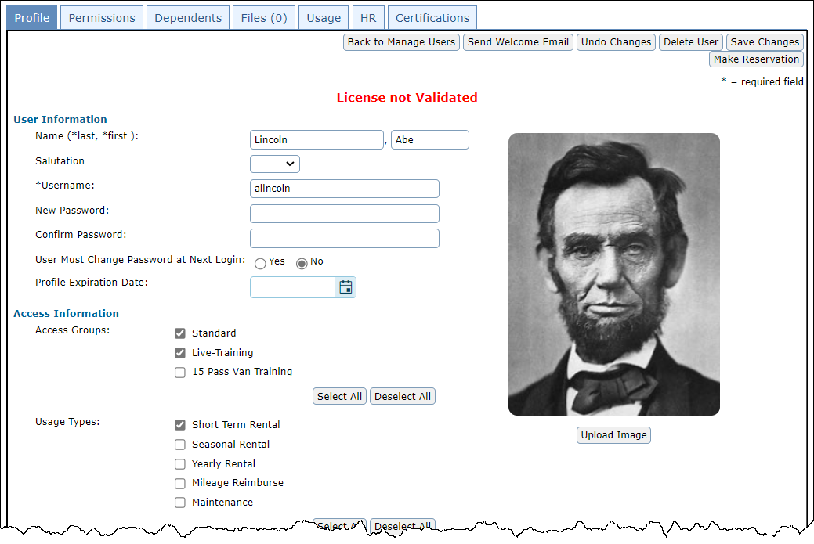


Make a Reservation – End Users
Select the appropriate Usage Type
Customize this layout via CONFIGURE>ENTERPRISE>LAYOUT
MAKE RESERVATION HELP TEXT - USAGE TYPE SELECTION
NOTE: Not all staff will have access to all “Usage Types”

Slide 38
Make a Reservation – End Users
Some staff may have access to multiple Sites
NOTE: If additional Sites are needed by a Requestor, they will need to contact an administrator.

Slide 39
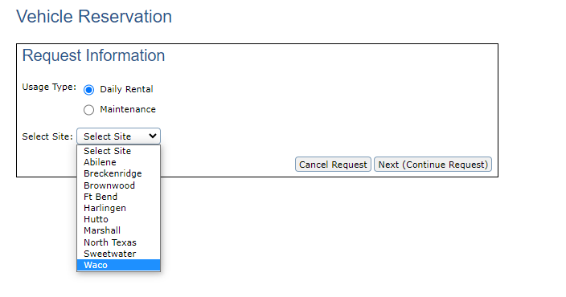
Make a Reservation – End Users
The site determines the location a reservation will leave from.
Select
“Next (Continue Request)”
Select the Site

Slide 40
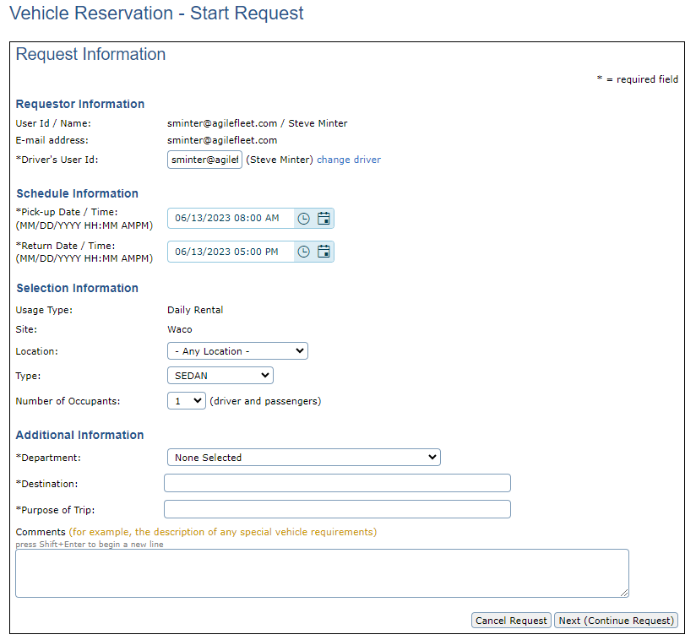
Make a Reservation – End Users
Chose “Pick-Up Date and Time”
Chose “Return Date and Time”
Be sure to fill out the Additional Information section.
All fields with leading “*” are required.
Select the “Location” to retrieve and return the vehicle.
Select “Vehicle Type”

Slide 41
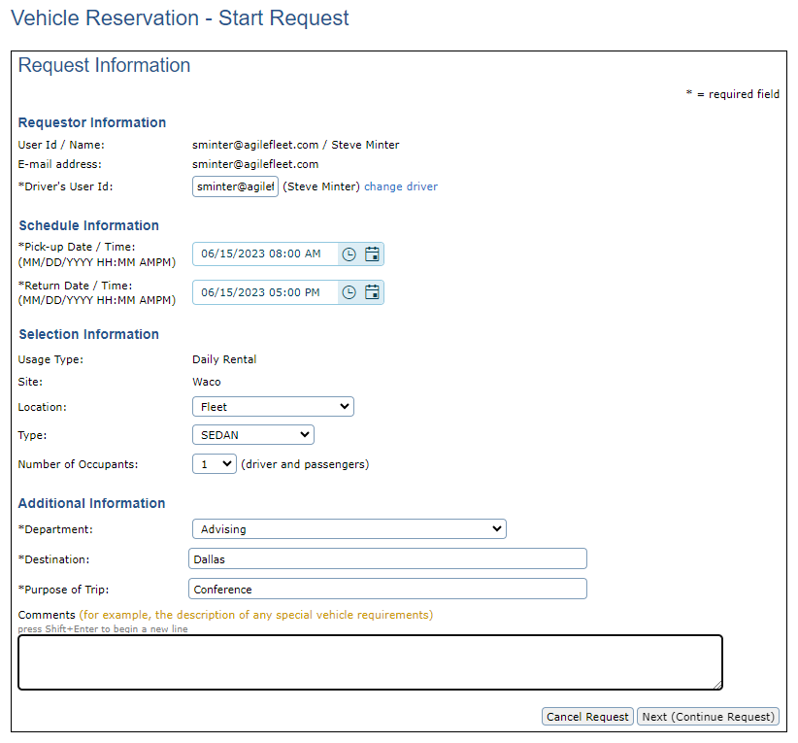
Make a Reservation – End Users
When information is completed select “Next (Continue Request)”

Slide 42
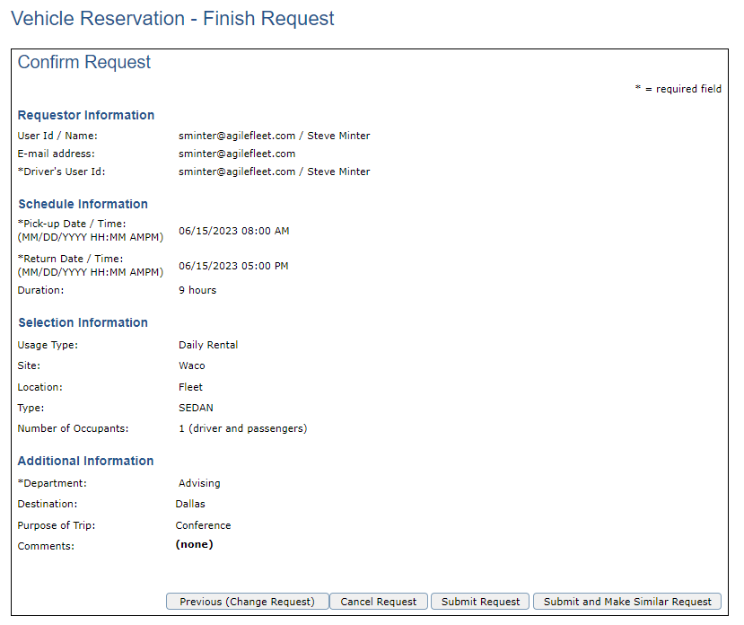
Make a Reservation – End Users
If all selected information is correct select “Submit Request”
If Changes need to be made select “Previous (Change Request)”
Selecting “Submit and Make Similar Request” submits the current request and takes the Requestor back to start another request.
Reservation fields will be pre-populated.

Slide 43
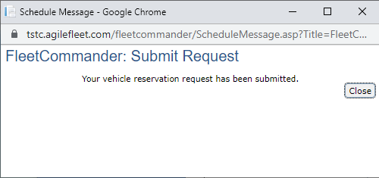
Make a Reservation – End Users
Once the reservation request is completed the Requestor will receive this confirmation notification. Select “Close”
NOTE: “Close” will automatically redirect the Requestor to view
“My Schedule”

Slide 44
My Schedule

Slide 45
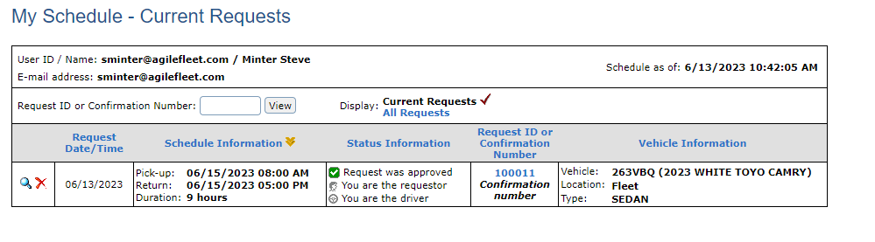
Make a Reservation
From your schedule you can “View Your Reservation” or “Cancel”
You can see when the request was made
The scheduled Pick-up and Return date and times
The Status of your reservation
The Request ID or Confirmation Number
Vehicle information location and type

Slide 46
Request a Change to a Reservation

Slide 47
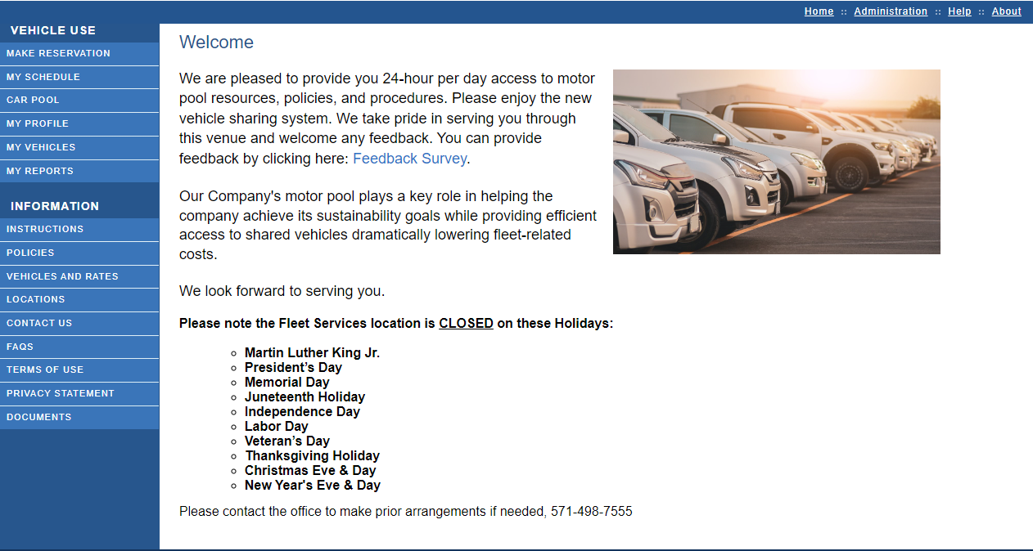
Request a Change to a Reservation
From the Navigation select “My Schedule”

Slide 48
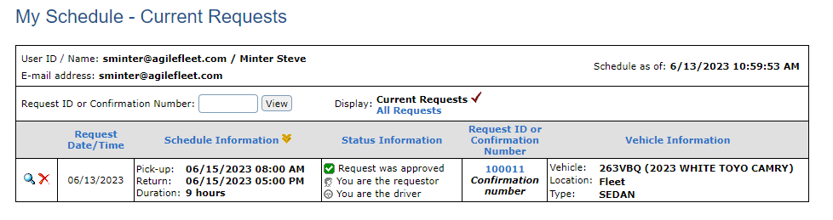
Request a Change to a Reservation
select View icon

Slide 49
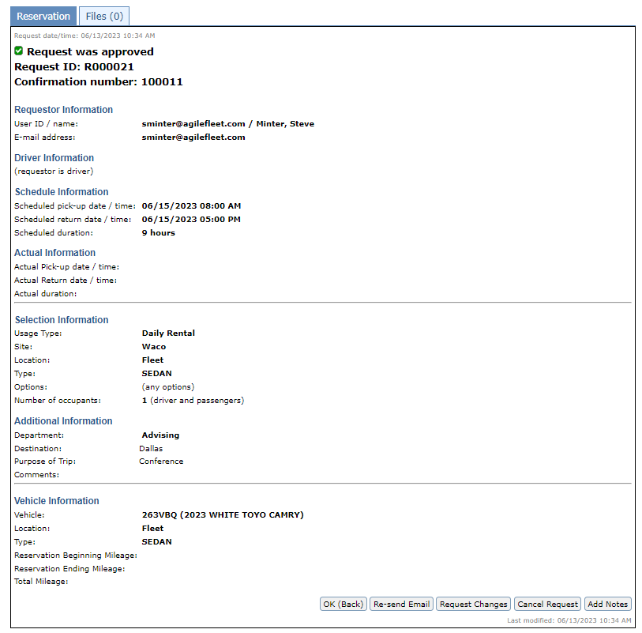
Request a Change to a Reservation
Select “Request Changes”

Slide 50
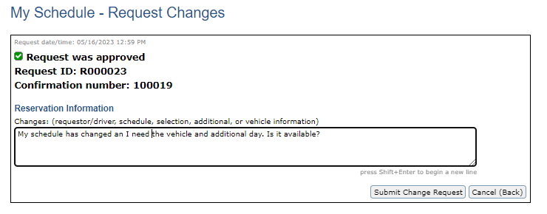
Request a Change to a Reservation
Express your requested change to the reservation and select “Submit Change Request”
NOTE: When submitted, the reservation will go into a PENDING status for the Administrator to review.

Slide 51
Admin Interface

Slide 52
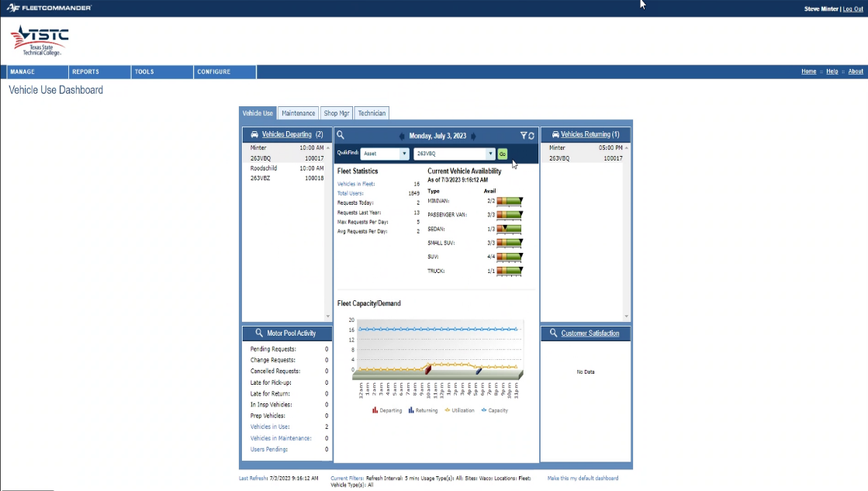
Admin Interface
Five Notable Sections of the Admin Interface
  Manage
  Reports
  Tools
  Configure
  Dashboard

Slide 53
Accessing the Admin Interface
Click here to get to the Admin side.

Slide 54

What are User and Vehicle Profiles?
Notes:
Go to next slide

Slide 55
What is a profile in FleetCommander?
A profile is a centralized repository of your fleet data
and is unique to each associated user and asset/vehicle.
Profiles are essential components of the
“FleetCommander Engine”

Slide 56
FleetCommander Overview
FleetCommander Core Product Engine
  User/Driver Management
  Vehicle/Asset Management
  Analytics & Reports
  Policy Oversight
  Admin Interface/Dashboards
  Hosting
FleetCommander Modules
  Motor Pool/Vehicle Sharing
  Key Management
  Maintenance
  Fuel
  Risk Management
  GPS & Telematics

Slide 57
FleetCommander Users
Drivers
Requestors
Fleet
Administrators
Motor Pool
Dispatchers
Maintenance
Staff
Inspectors & Prep
Risk
Managers
HR
Administrators
This Photo by Unknown Author is licensed under CC BY

Slide 58
What assets can you place
in FleetCommander?
Answer: ALL OF THEM!
Light Duty
Bicycles
Patrol Cars
Sedans
Yellow Iron
Trailers
Generators
EVs
Pick-up Trucks
Heavy Duty
Golf Carts

Slide 59
Benefits of User and Vehicle Profiles
Notes:
Go to next slide

Slide 60

Benefits of User Profiles
All of your driver and fleet staff information in one place
Standard, demographic data (e.g. name, contact info)
System and vehicle permissions
Accountability for vehicle use
Policy acceptance, certifications, training, etc.
Default billing & charge-back info

Slide 61
Benefits of Asset Profiles
All of your vehicle information in one location
Standard data across the enterprise
Establish rules-of-use through permissions, access, and usage
Clear visibility of vehicle-related costs (e.g. maintenance and fuel)
Manage custody of vehicles through the life-cycle

Slide 62
User Profiles – Overview & Configurations

Slide 63
User Profiles

Slide 64
Vehicle Profiles – Overview & Configurations

Slide 65
Vehicle Profiles

Slide 66
User & Vehicle Manage Screens
Notes:
Go to next slide

Slide 67
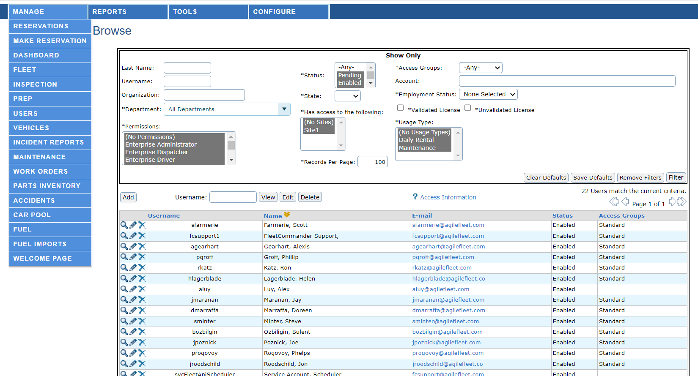
Manage User: Browse
let your ideas SHINE!
Use Manage Users
to search for Users

Slide 68
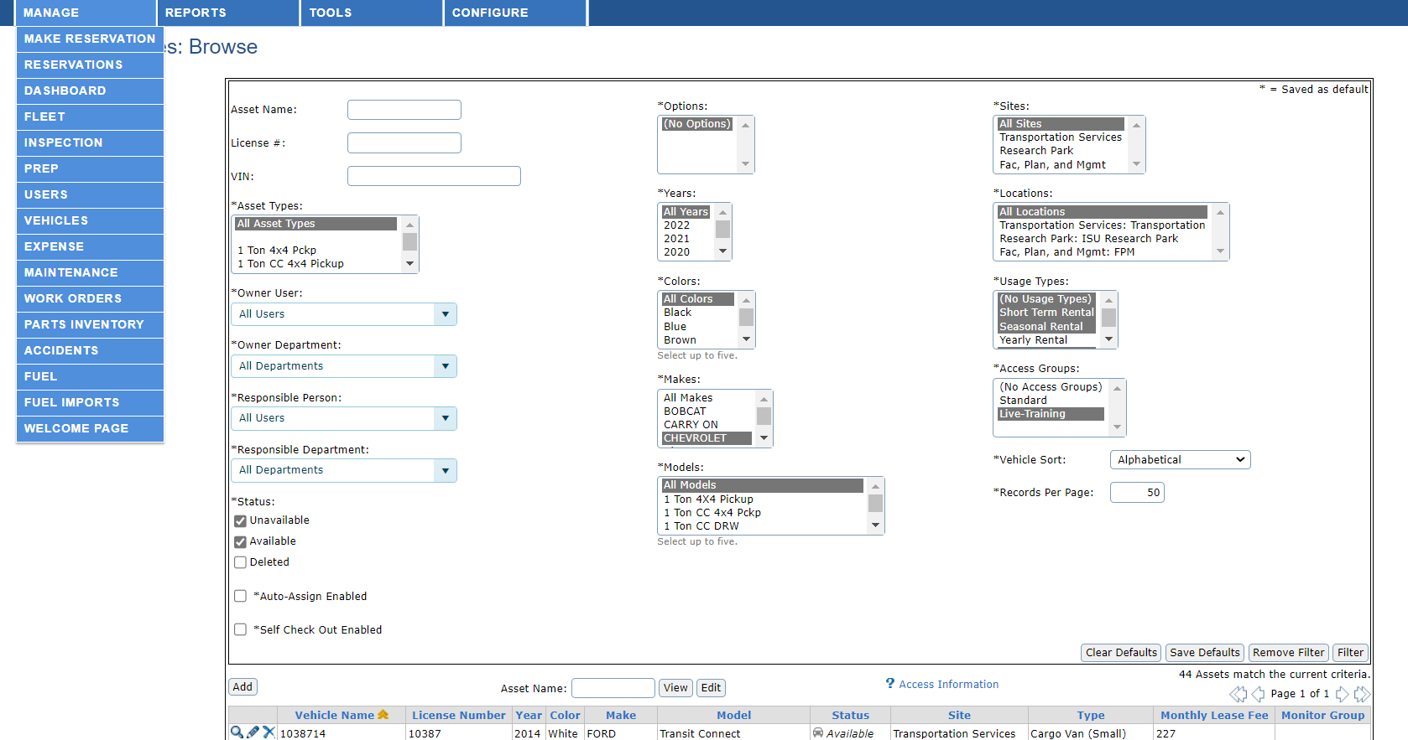
Manage Vehicle: Browse
let your ideas SHINE!
Use Manage Vehicles
to search for Assets

Slide 69
User & Vehicle Reports

Slide 70


User and Asset Reports
User Reports
Asset Reports
User Summary
User Details
User Details Extra
Account Summary
Department Summary
Driver Eligibility
Drivers License Currency
Invalid Driver
Lost and Found
User Citations
User HR
User Certification Currency
User System Activity
Asset Summary
Asset Details
Asset Data Dump
Mileage-Cost
Asset Mileage
Asset In/Out
Tag/Vehicle Exception
Owner/Responsible Asset Summary
Maintenance and Fuel
Cost
Inspections
Prep
Accident Summary
Accident Detail
TCO Data Dump
TCO Expense Summary
Now available with v5.10!

Slide 71
Reports You Should Be Using
Report Name | What it Does | Type | Navigation
User Detail Extra Report | Exports almost all of the fields (citations and courses are excluded) in the Profile tab of the User’s profile. | User Data Integrity | Reports > Users> User Detail Extra Report
Driver Eligibility | Lists the eligibility and validity of each user’s license. | User Currency | Reports > Users> Driver Eligibility
Drivers License Currency | Driver's license information found in the User's profile | User Currency | Reports > Users > Drivers License Currency
Asset Data Dump | Dumps all the information found on the vehicle’s Profile tab. | Asset Data Integrity | Reports> Assets > Asset Data Dump
Mileage-Cost | Lists vehicle’s distance and expenses in a specified date range and calculates the cost-per-mile for that timeframe | Asset Data | Reports > Assets > Mileage-Cost
Asset Mileage | Lists vehicle’s mileage data in a specified date range and by data source. | Asset Data | Reports> Assets > Asset Mileage
Asset In/Out | List of vehicles leaving, returning, or in maintenance by day | Asset Data | Reports> Assets > Asset In/Out

Slide 72
Manage > Make Reservations

Slide 73
The following section
illustrates one of several places where Admins/Dispatchers
can make vehicle reservations

Slide 74
Make Reservation
Click here to get to the Admin side.

Slide 75
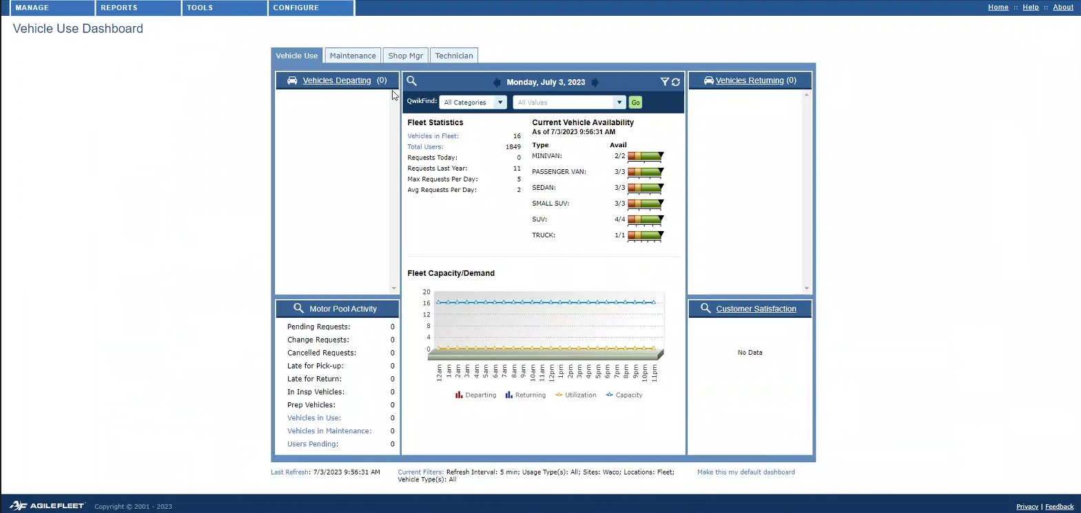
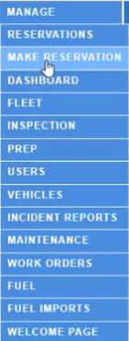
Make Reservation
Select
Make Reservation
Click on Manage Menu

Slide 76
Make Reservation
Unlike the Driver/Requestor Interface, “THIS REQUEST IS FOR OTHER” is selected by default in the ADMIN INTERFACE
Select
“Next (Continue Request)”

Slide 77
Make Reservation
Follows the same process as
with the Driver/Requestor Interface
Select the appropriate Usage Type.
NOTE: Admin/Dispatcher HAVE ACCESS to ALL “Usage Types and Sites”

Slide 78
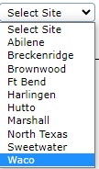
Make Reservation
Follows the same process as
with the Driver/Requestor Interface
Select appropriate Site
Select
“Next (Continue Request)”
NOTE: Admin/Dispatcher HAVE ACCESS to ALL “Usage Types and Sites”

Slide 79
Make Reservation
Chose your “Pick-Up Date and Time”
Follows the same process as
with the Driver/Requestor Interface
Chose your “Return Date and Time”
Select the “Location” to retrieve and return the vehicle.
All fields with leading “*” are required.
Select your “Vehicle Type”

Slide 80
Make Reservation
Follows the same process as
with the Driver/Requestor Interface
When information is completed select “Next (Continue Request)”

Slide 81


Make Reservation
Three NEW ELEMENTS appear for
Admins/Dispatchers on this page
Buffer setting is configured at the Site level
Auto-assign to a vehicle
Ignore buffers?
Submit Request and Assign
HINT: check if you want to ignore reservation Buffer time
HINT: uncheck if you want to assign a specific vehicle to reservation
HINT: if you are NOT ready to assign a vehicle, choose another Submit option, otherwise click Submit Request and Assign
NOTE: TSTC
End Buffer is set for 60 minutes

Slide 82
Manage Reservations

Slide 83
Manage Reservation
Select Reservation
Click on Manage Menu

Slide 84

Manage Reservation
Manage> Reservations is the best way to work with reservations
Select View Request

Slide 85

Manage Reservation
Action buttons allows you to interact with reservation
Request information
and vehicle specifics
The Audit log shows the step-by-step progression of the Reservation Request

Slide 86
Modify Request

Slide 87
Manage Reservation – Modify Request
Sometimes it is necessary to make changes to a reservation.
This is done through Manage>Reservation
Select View Request

Slide 88
Manage Reservation – Modify Request
Select Modify Request

Slide 89

Manage Reservation – Modify Request
NOTE: modifications include items like
DRIVER
DATE / TIMES
VEHICLE TYPE
NUMBER OF OCCUPANTS
DESTINATION
ETC.
Make changes
and select
“Next (Continue Request)”

Slide 90


Manage Reservation – Modify Request
Review the request information and select “Submit Request”
NOTE: You may be prompted to send a confirmation email. Select “OK” if you want the requestor & driver receive the email.
If an email is not necessary, hit “Cancel”.

Slide 91
Cancel a Reservation

Slide 92
Manage Reservation – Cancel Reservation
Select the Cancel action button

Slide 93

Manage Reservation – Cancel Reservation
Select “Yes (Cancel Request)
Insert a comment
(not required) and then select a Cancelation Type from the drop down.

Slide 94
Dispatching a Vehicle

Slide 95
Manage > Vehicles is one of several places in FleetCommander where reservations can be dispatched

Slide 96
Manage Reservation - Dispatch
To dispatch a vehicle via Manage> Reservations…
…select View Request

Slide 97



Manage Reservation – Dispatch Out
Click on “Dispatch”
to bring up the
Dispatch Window
Dispatch Pop-up Window appears

Slide 98
Manage Reservation – Dispatch Out
DISPATCH HINTS:
Make sure you’re in the right reservations!
Use Dispatch Window to
verify reservation details including NAME OF DRIVER, END DATE, VEHICLE TYPE, etc.

Slide 99
If you discover changes that need to be made, you can accomplish this from the Dispatch Window!

Slide 100


Manage Reservation – Dispatch Out - Changes
Change a VEHICLE
within Dispatch:
Click “Change Vehicle”
Window view changes to show available vehicles
Adjust vehicle filters and “Refresh List” as needed

Slide 101

Manage Reservation – Dispatch Out - Changes
Change a DRIVER
within Dispatch:
Click “Change” next to Driver’s Name
Type in Last name and click “Go” to find Driver
User pop-up
window appears

Slide 102
When it comes to the “when” a reservation
is dispatched, you have the choice of two time considerations:
Current Date/Time
Request Date/Time

Slide 103
Manage Reservation – Dispatch Out
Two Dispatch Options
Current Date and Time

Slide 104
Manage Reservation – Dispatch Out
Two Dispatch Options
Original Reservation Date and Time

Slide 105
Other Dispatch Window Items

Slide 106
Manage Reservation – Dispatch Out
Odometer Fields
Departure/Start Mileage
auto-populates from the most recent record

Slide 107
Manage Reservation – Dispatch Out
DISPATCH HINTS:
Watch out for information or instructions in COMMENTS before submitting
Click Submit to finalize Dispatch Out
Communicate to driver any previous damage noted in
VEHICLE CONDITION

Slide 108
Return Vehicle/Dispatch In

Slide 109
Manage Reservation – Dispatch In
Choose from the same options to CHECK a vehicle BACK IN
Current Date and Time
Original Reservation Date and Time

Slide 110
Manage Reservation – Dispatch In
Odometer Fields
End Mileage MUST be typed in
Total mileage
self-calculates based on Odom End

Slide 111
Manage Reservation – Dispatch In
DISPATCH HINTS:
Type any NEW DAMAGE on the vehicle in
VEHICLE CONDITION.
Details will appear here again with next reservation

Slide 112
Manage Reservation – Dispatch In
DISPATCH HINTS:
Send email to
ADMIN STAFF if you need to relay any information to them regarding this reservation/vehicle
(example: damages)
Click Submit to finalize Dispatch In

Slide 113
Other places vehicles can be Dispatched include
  Dashboard - considered best practice
  (see Slide 113)
  Manage Vehicles
  Manage Users

Slide 114
Manage Fleet

Slide 115

Manage Fleet
Use the filters to narrow your view

Slide 116
Manage Fleet
Search by Site

Slide 117
Manage Fleet
Search by Vehicle Type

Slide 118
Manage Fleet
Search by specific vehicle information

Slide 119

Manage Fleet
You can change your chart view from Day View to Hour View
Notice the view on the chart is a two-week period

Slide 120

Manage Fleet
You can change your chart view from Day View to Hour View
Notice the view on the chart is a two-day period

Slide 121

Manage Fleet
Use the legend to understand the status of vehicles
The status of vehicles will appear in the first column

Slide 122
Manage > Fleet is one of several places in FleetCommander where reservations can entered

Slide 123
Manage Fleet
To start a reservation, select the date and time to the corresponding vehicle in either day view or hour view

Slide 124

Manage Fleet
Follow the steps for Making a Reservation

Slide 125

Manage Fleet
Modifying a request
Select the reservation that you would like to modify the request

Slide 126

Manage Fleet
Select Modify Request and follow the steps for modifying a reservation.

Slide 127

Manage Fleet
Changing the vehicle assigned to a reservation
Reservations that have been dispatched are not able to have the vehicle changed

Slide 128
Manage Fleet
While in hour view select the first time in the chart to change the vehicle

Slide 129

Manage Fleet
Select the radio button beside Change Vehicle the select Submit

Slide 130

Manage Fleet
Select the vehicle to move the reservation to then select “Submit”

Slide 131
Fleet Commander Dashboard

Slide 132
FleetCommander’s Dashboard is the primary workspace for Admins/Dispatchers to interface with the system

Slide 133

FleetCommander Dashboard
Click here to get to the Admin side’s Dashboard

Slide 134

Dashboard – Vehicle Use Tab
Dashboard helps you see reservation schedule for the day
Click on Vehicle Use tab
(if not set as default)
Dashboard default

Slide 135
Dashboard – Vehicle Use Tab
Various sections of the dashboard include:
Departing Reservations
Returning Reservations

Slide 136


Dashboard – Vehicle Use Tab
Various sections of the dashboard include:
Mouseover line for RESERVATION DETAILS
Mouseover for RESERVATION DETAILS

Slide 137
Dashboard – Vehicle Use Tab
Various sections of the dashboard include:
Click hyper-link to access Manage Reservation view of this reservation

Slide 138
Dashboard – Vehicle Use Tab
Various sections of the dashboard include:
Motor Pool Activity:
gives you real time status
of Reservations & Users
HINT: click on hyperlinks
as they appear to take
action on that item

Slide 139
QwikFind Search

Slide 140

Dashboard – QwikFind
QwikFind: allows you
to search for Assets, Reservations, and Users

Slide 141

Dashboard – QwikFind
QwikFind: select “Asset
Click “Go” to view Vehicle Profile
Type vehicle’s NAME or LICENSE

Slide 142


Dashboard – QwikFind
QwikFind takes you to “Asset Lookup”
Dispatch Vehicle Out on scheduled
reservation
Make a Reservation for this Vehicle
Dispatch Vehicle Out on scheduled
reservation
Update Vehicle Mileage
NOTE: Dispatcher Permission DOES NOT allow editing a Vehicle Profile
(this link is deactivated)

Slide 143

Dashboard – QwikFind
Start a new QwikFind
NOTE: If all action buttons are grayed out, then the vehicle is most likely associated with another TSTC Site.
This vehicle is for the Waco site

Slide 144

Dashboard – QwikFind
QwikFind: select “User”
Click “Go” to view
User Profile
Type USERNAME or LAST NAME

Slide 145

Dashboard – QwikFind
Start a new QwikFind
QwikFind takes you to “User Lookup”
NOTE: Dispatcher Permission DOES NOT allow viewing
a User Profile
(this link is deactivated)
Make a new Reservation
Dispatch a Reservation

Slide 146

Dashboard – QwikFind
QwikFind: select
“Reservation”
Click “Go” to view Reservation
Type either Request ID (example R000029) or Confirmation Number (example 100017)

Slide 147

Dashboard – QwikFind
QwikFind takes you
to the Reservation’s Schedule/View Request

Slide 148
Dashboard Dispatch

Slide 149
Dashboard – Dispatch
Double-click line to
Dispatch Out
Same function to
Dispatch In

Slide 150
Dashboard Filter

Slide 151

Dashboard – Vehicle Use Tab
Various sections of the dashboard include:
Dashboard Filter:
refines what and how items are shown
on the Dashboard
TIP: use Two-line Display to enhance your Dashboard view

Slide 152
Dashboard – Vehicle Use Tab
Various sections of the dashboard include:
Two-line Display adds VEHICLE NAME and CONFIRMATION NUMBER

Slide 153
FleetCommander’s Manage Menu

Slide 154






Manage Menu
FleetCommander’s MANAGE MENU
is your LAUNCHING POINT for
engaging with the various profile and
module data.
The links shown vary with the
modules you purchased.

Slide 155
Manage> Make Reservation

Slide 156
Making Reservations in FleetCommander
Admins/Dispatchers can make vehicle reservations in multiple places within
FleetCommander.
Following section demonstrates reservations
placed via MANAGE>MAKE RESERVATION

Slide 157
Manage > Make Reservation
Click here to get to the Admin side.

Slide 158
Manage > Make Reservation
Select
Make Reservation
Click on Manage Menu

Slide 159
Manage > Make Reservation
Unlike the Driver/Requestor Interface, “THIS REQUEST IS FOR OTHER” is selected by default in the ADMIN INTERFACE
Select
“Next (Continue Request)”

Slide 160



Manage > Make Reservation
Follows the same process as
with the Driver/Requestor Interface
If you select a Usage Type NOT in a User Profile, a warning message will appear
BUT…Admin/Dispatcher HAVE ACCESS to ALL “Usage Types”

Slide 161
Manage > Make Reservation
Follows the same process as
with the Driver/Requestor Interface
Unlike Usage Types, only PERMITTED SITES appear
Select appropriate Site
Select
“Next (Continue Request)”

Slide 162
Manage > Make Reservation
Chose your “Pick-Up Date and Time”
Follows the same process as
with the Driver/Requestor Interface
Chose your “Return Date and Time”
Select the “Location” to retrieve and return the vehicle.
All fields with leading “*” are required.
Select your “Vehicle Type”

Slide 163

Manage > Make Reservation
BONUS TIP! Requested/Required Fields
can be configured based on WHERE the Reservation form is engaged.
Make New Reservation – Admin
Make New Reservation - User
View/
Modify
QwikPik
Kiosk
Check-out/in
Grab and Go
CONFIGURE>SITE>SITE NAME> RESERVATIONS>CUSTOM FIELDS>
USAGE TYPE

Slide 164
Manage > Make Reservation
When information is completed select “Next (Continue Request)”

Slide 165
Manage > Make Reservation
Three NEW ELEMENTS appear for
Admins/Dispatchers on this page
Buffer setting is configured at the Site level
Auto-assign to a vehicle
Ignore buffers?
Submit Request and Assign
HINT: check if you want to ignore reservation Buffer time
HINT: uncheck if you want to assign a specific vehicle to reservation
HINT: if you are NOT ready to assign a vehicle, choose another Submit option, otherwise click Submit Request and Assign

Slide 166
Manage > Reservations

Slide 167
Manage > Reservations
Select Reservations
Click on Manage Menu

Slide 168

Manage > Reservations
Manage> Reservations is the best way to work with reservations
Select View Request

Slide 169
Manage > Reservations
Action buttons allows you to interact with reservation
Request information
and vehicle specifics
The Audit log shows the step-by-step progression of the Reservation Request

Slide 170
Modify Request

Slide 171
Manage > Reservations – Modify Request
Sometimes it is necessary to make changes to a reservation.
This is done through Manage>Reservation
Select View Request
action icon

Slide 172
Manage > Reservations – Modify Request
Select Modify Request

Slide 173
Manage > Reservations – Modify Request
NOTE: modifications include items like
DRIVER
DATE / TIMES
VEHICLE TYPE
NUMBER OF OCCUPANTS
DESTINATION
ETC.
Make changes
and select
“Next (Continue Request)”

Slide 174
Manage > Reservations – Modify Request
Review the request information and select “Submit Request”
NOTE: You may be prompted to send a confirmation email. Select “OK” if you want the requestor & driver receive the email.
If an email is not necessary, hit “Cancel”.

Slide 175
Assign a Vehicle

Slide 176

Manage > Reservations
Manage> Reservations is the best way to work with reservations
Select Assign Vehicle action icon

Slide 177
Cancel a Reservation

Slide 178
Manage > Reservations – Cancel Reservation
Select the Cancel
action icon

Slide 179
Manage > Reservations – Cancel Reservation
Select “Yes (Cancel Request)
Insert a comment
(not required) and then select a Cancelation Type from the drop down.

Slide 180
Dispatching a Vehicle

Slide 181
Dispatching a Vehicle
MANAGE > RESERVATIONS is one of several places in FleetCommander where RESERVATIONS can be DISPATCHED

Slide 182
Manage Reservation - Dispatch
To dispatch a vehicle via Manage> Reservations…
…select View Request
action icon

Slide 183

Manage Reservation – Dispatch Out
Click on “Dispatch”
to bring up the
Dispatch Window
Dispatch Pop-up Window appears

Slide 184
Manage Reservation – Dispatch Out
DISPATCH HINTS:
Make sure you’re in the right reservations!
Use Dispatch Window to
verify reservation details including NAME OF DRIVER, END DATE, VEHICLE TYPE, etc.

Slide 185
Dispatching a Vehicle
If you discover CHANGES that need to be made, you can accomplish this from the Dispatch Window!

Slide 186


Manage Reservation – Dispatch Out - Changes
Change a VEHICLE
within Dispatch:
Click “Change Vehicle”
Window view changes to show available vehicles
Adjust vehicle filters and “Refresh List” as needed

Slide 187
Manage Reservation – Dispatch Out - Changes
Change a DRIVER
within Dispatch:
Click “Change” next to Driver’s Name
Type in Last name and click “Go” to find Driver
User pop-up
window appears

Slide 188
Dispatching a Vehicle
When it comes to the “WHEN” a reservation is dispatched, you
have the choice of TWO time-frames:
Current Date/Time
Request Date/Time

Slide 189
Manage Reservation – Dispatch Out
Two Dispatch Options
Current Date and Time

Slide 190
Manage Reservation – Dispatch Out
Two Dispatch Options
Original Reservation Date and Time

Slide 191
Other Dispatch Window Items

Slide 192
Manage Reservation – Dispatch Out
Odometer Fields
Departure/Start Mileage
auto-populates from the most recent record

Slide 193
Manage Reservation – Dispatch Out
DISPATCH HINTS:
Watch out for information or instructions in COMMENTS before submitting
Click Submit to finalize Dispatch Out
Communicate to driver any previous damage noted in
VEHICLE CONDITION

Slide 194
Return Vehicle/Dispatch In

Slide 195
Manage Reservation – Dispatch In
Choose from the same options to CHECK a vehicle BACK IN
Current Date and Time
Original Reservation Date and Time

Slide 196
Manage Reservation – Dispatch In
Odometer Fields
End Mileage MUST be typed in
Total mileage
self-calculates based on Odom End

Slide 197
Manage Reservation – Dispatch In
DISPATCH HINTS:
Type any NEW DAMAGE on the vehicle in
VEHICLE CONDITION.
Details will appear here again with next reservation

Slide 198
Manage Reservation – Dispatch In
DISPATCH HINTS:
Send email to
ADMIN STAFF if you need to relay any information to them regarding this reservation/vehicle
(example: damages)
Click Submit to finalize Dispatch In

Slide 199
Dispatching a Vehicle
Other places vehicles can be Dispatched include
  Manage>Reservations – Dispatch Icon
  QwikFind – Assets
  QwikFind - Users
  Dashboard - Departing/Returning
  (considered best practice)

Slide 200
  Manage>Reservations – Dispatch Icon

Slide 201
Manage Reservation - Dispatch
To dispatch a vehicle via Manage> Reservations…
…select Dispatch
action icon

Slide 202
QwikFind Search

Slide 203
Dashboard – QwikFind
QwikFind: allows you
to search for Assets, Users, & Reservations

Slide 204
QwikFind -Asset

Slide 205
QwikFind - Asset
QwikFind: select “Asset
Click “Go” to view Vehicle Profile
Type vehicle’s NAME or LICENSE

Slide 206

QwikFind - Asset
QwikFind takes you to “Asset Lookup”
Dispatch Vehicle In from scheduled
reservation
Make a Reservation for this Vehicle
Dispatch Vehicle Out to scheduled
reservation

Slide 207
QwikFind - User

Slide 208
QwikFind - User
QwikFind: select “User”
Click “Go” to view
User Profile
Type USERNAME or LAST NAME

Slide 209

QwikFind - User
QwikFind takes you to “User Lookup”
Make a new Reservation
Dispatch a Reservation

Slide 210
QwikFind - Reservation

Slide 211
QwikFind - Reservation
QwikFind: select
“Reservation”
Click “Go” to view Reservation
Type either Request ID (example R000029) or Confirmation Number (example 100017)

Slide 212
Dashboard – QwikFind
QwikFind takes you
to the Reservation’s Schedule/View Request

Slide 213
Dispatching a Vehicle – Departing/Returning
Double-click line to
Dispatch Out
Same function to
Dispatch In

Slide 214
Questions?

