Slide 1
Maintenance Overview
FCUC 2023

Slide 2

Maintenance

Slide 3
Maintenance
  Monitor, organize, and manage maintenance activities
  Track maintenance and operating costs
  Improve efficiency
  Reduce asset downtime
  Extend useful life of assets
Notes:
Our Maintenance Module helps you to keep your PM program running on time, which reduces asset downtime and extends their useful life and helps you track total cost associated with particular vehicles.

Slide 4
Setting Up Scheduled Maintenance
Ford Taurus 261
Profile
PM Task
Miles
Days
Warning Miles/Days
Default costs
Default provider
Maintenance Plan
PM task 3
PM task 4
PM task 8
PM task 9
PM task 12
PM task 16
1. Define PM Tasks
2. Add tasks to create a maintenance plan
Maintenance Plan
(plan tasks)
3. Assign the maintenance plan to the vehicle

Slide 5
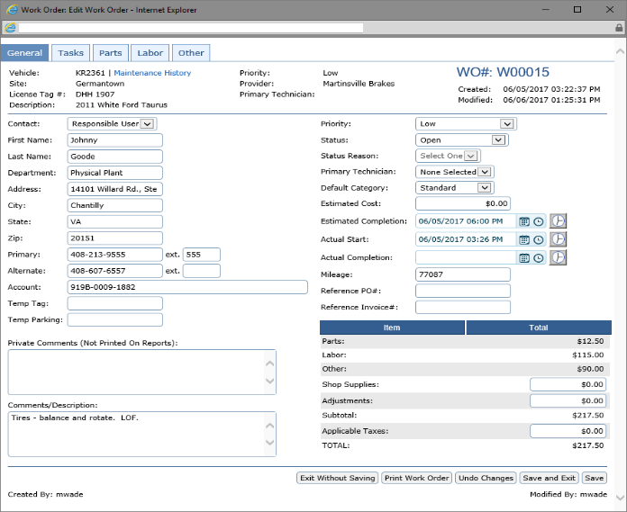
Setting Up Scheduled Maintenance
Manage Maintenance
Asset | Meter | Task
Taurus 261 | 11,029 | Oil Change
Pick-up 424 | 138,982 | Rotate Tires
Ford Taurus 261
Profile
Work Order
Maintenance Plan
(plan tasks)
UPDATE

Slide 6
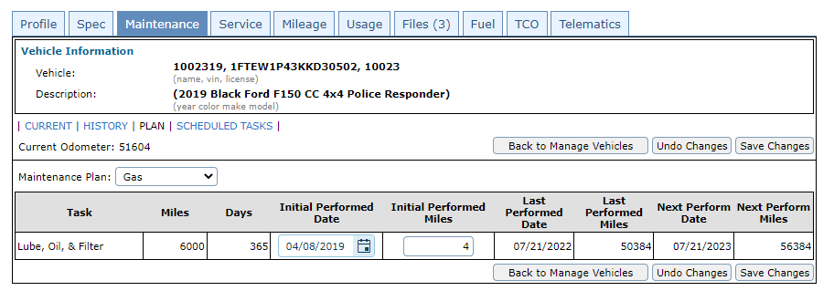
Setting Up Scheduled Maintenance

Slide 7
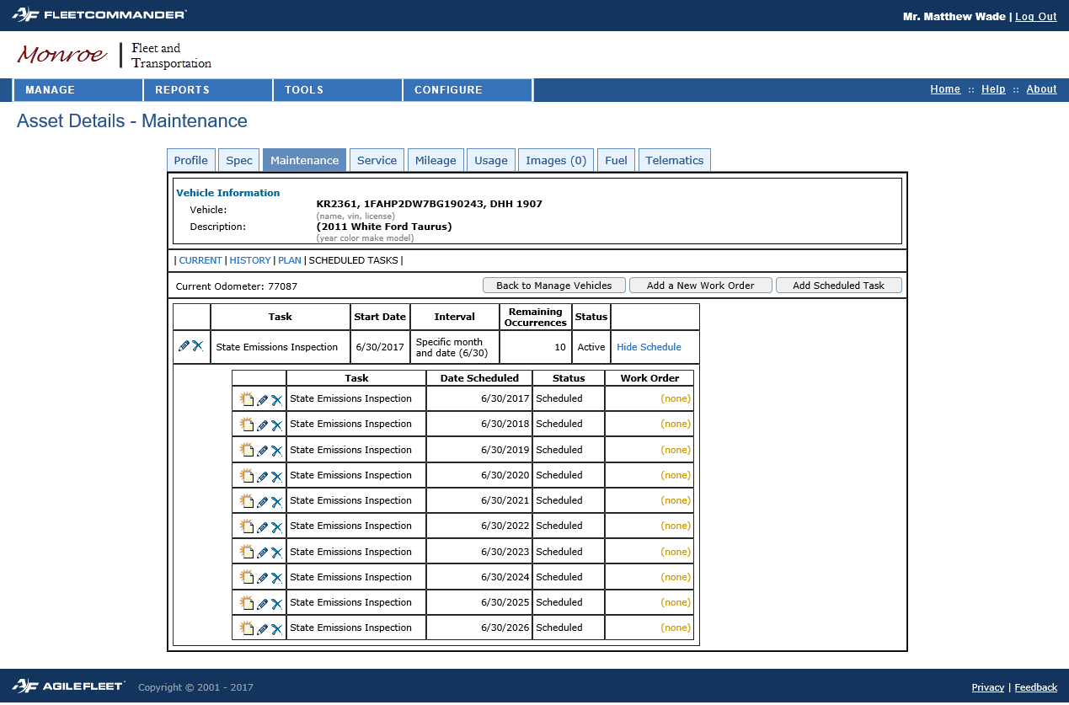
Setting Up Scheduled Maintenance

Slide 8
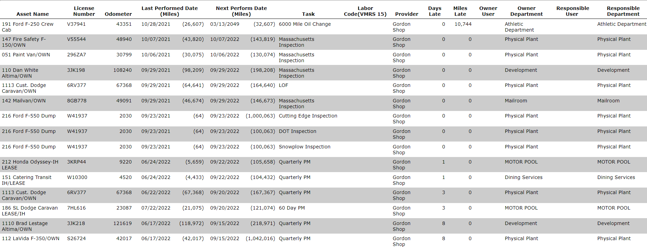
Maintenance Due Report

Slide 9
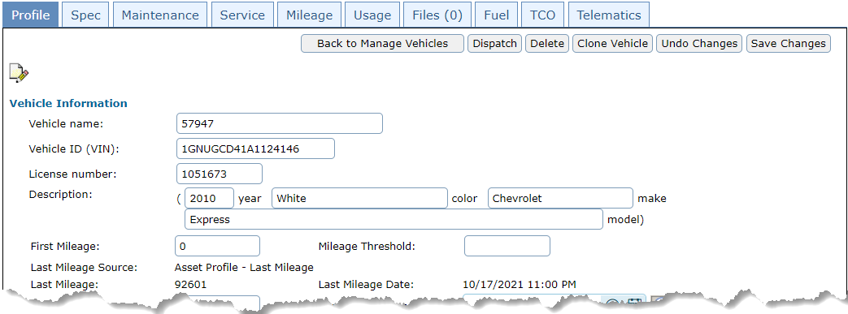
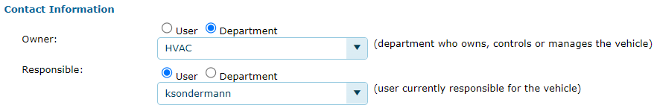
Setting Up Who to Notify

Slide 10
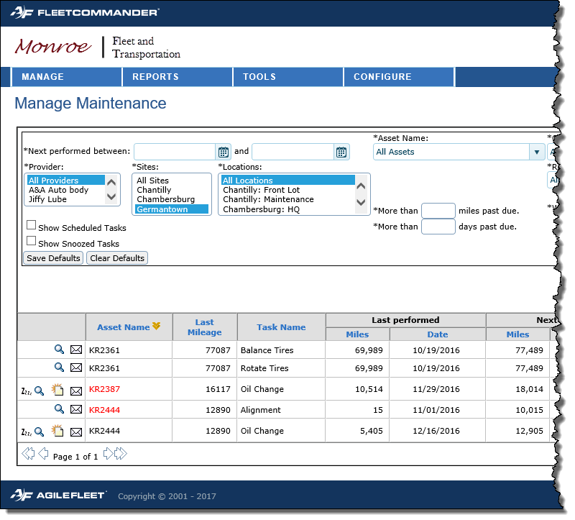
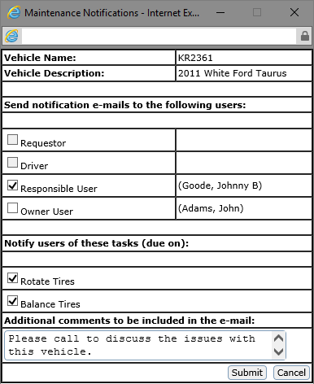
Generating notices for services
Reminders can be sent one at a time
Send an email notification

Slide 11
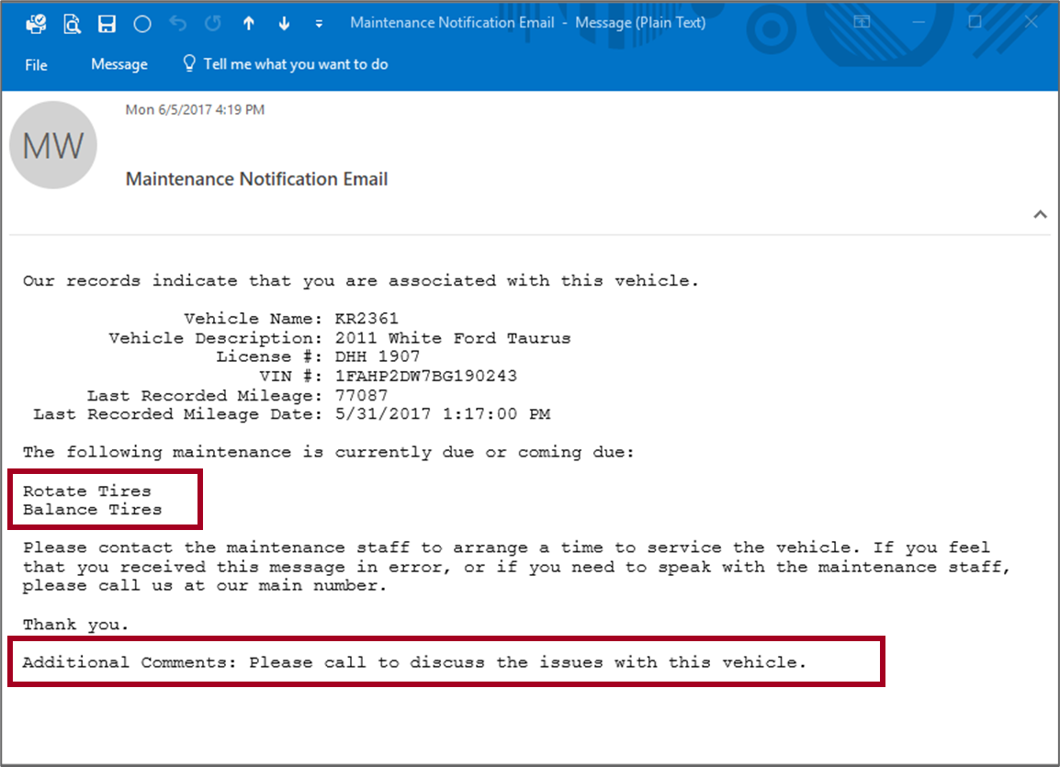
Generating notices for services

Slide 12
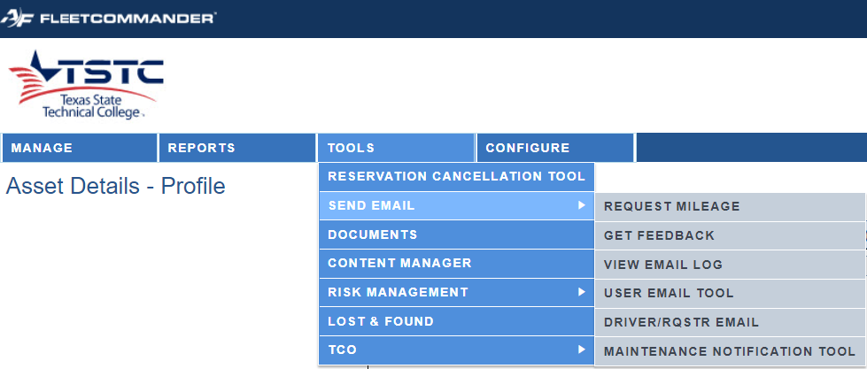

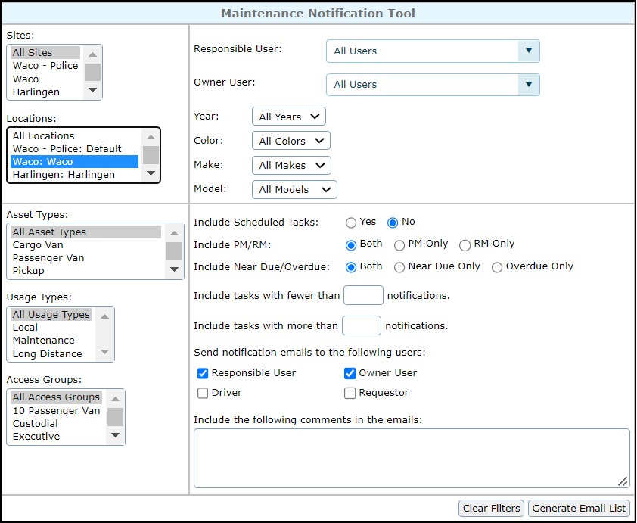
Generating notices for services
Reminders can be sent en masse

Slide 13
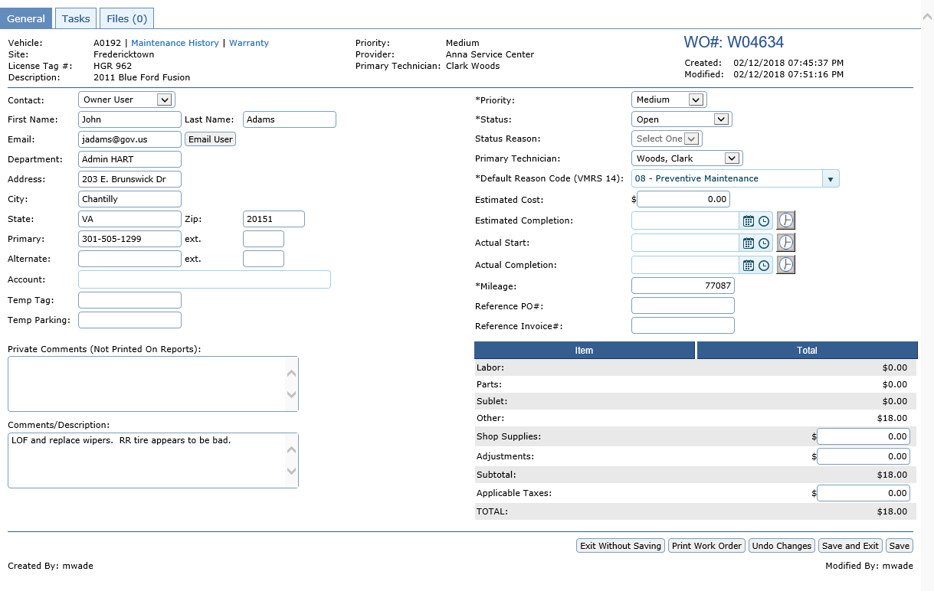
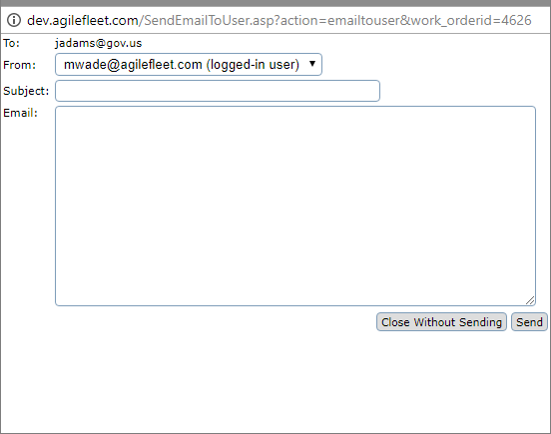
Service Communication
Emails can also be sent from a Work Order

Slide 14
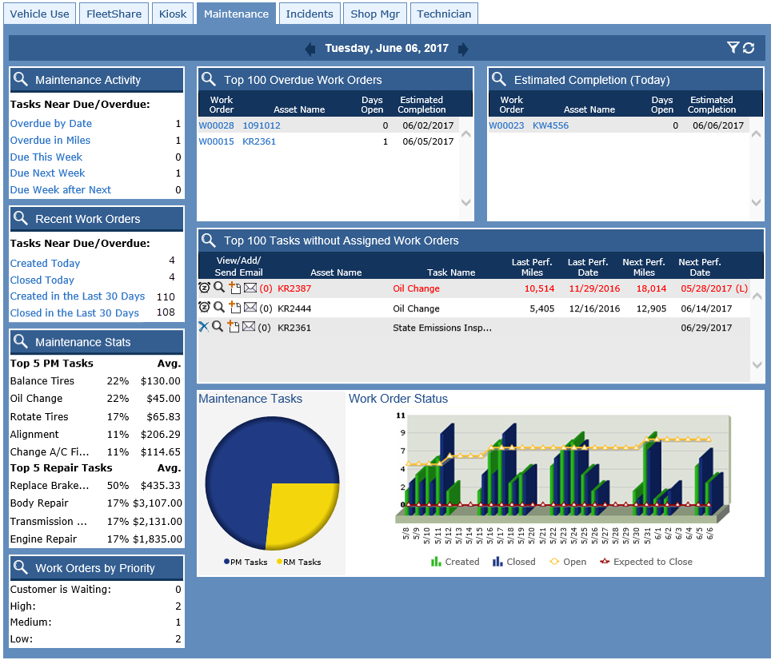



Maintenance Dashboard

Slide 15
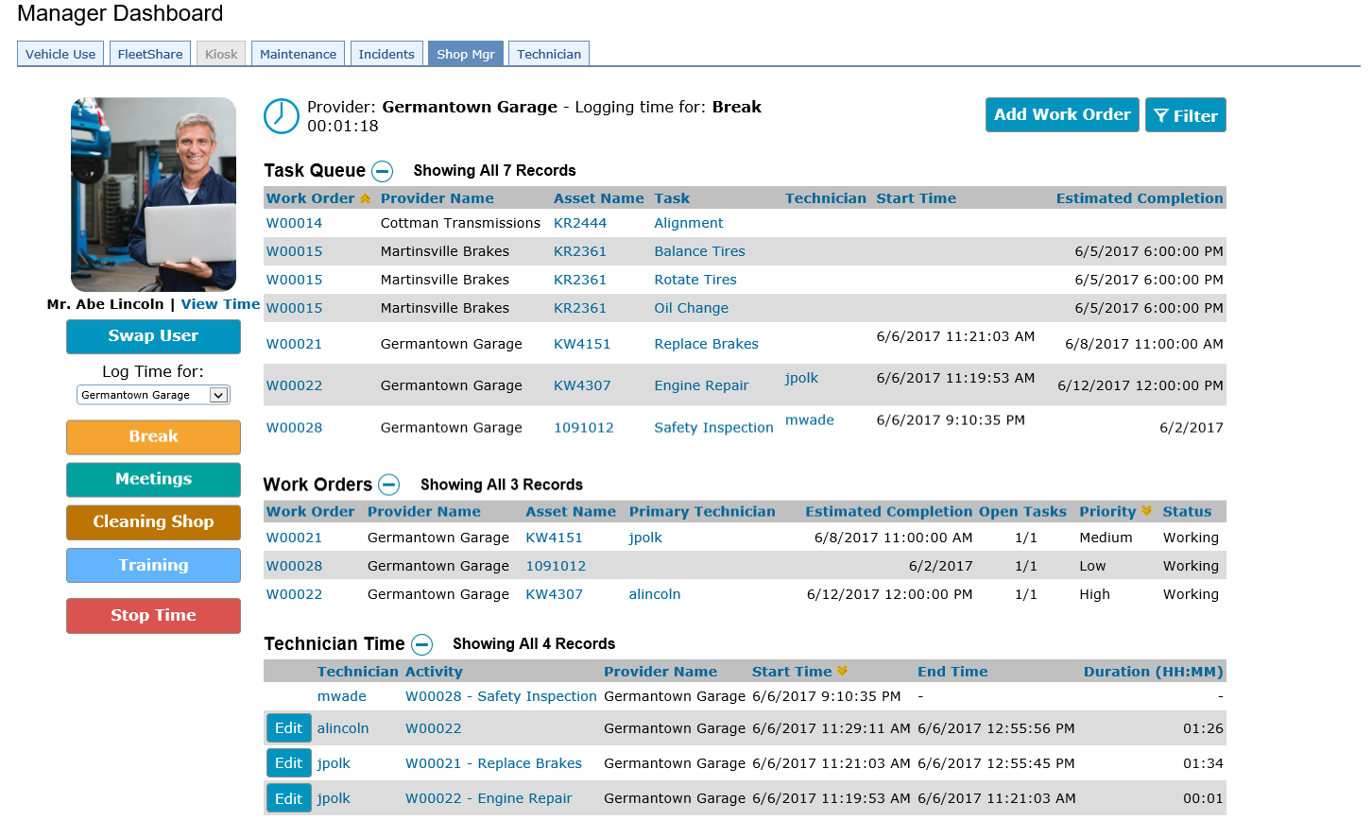
Shop Manager Dashboard
Notes:
Here’s a look at the shop manager dashboard.

Slide 16
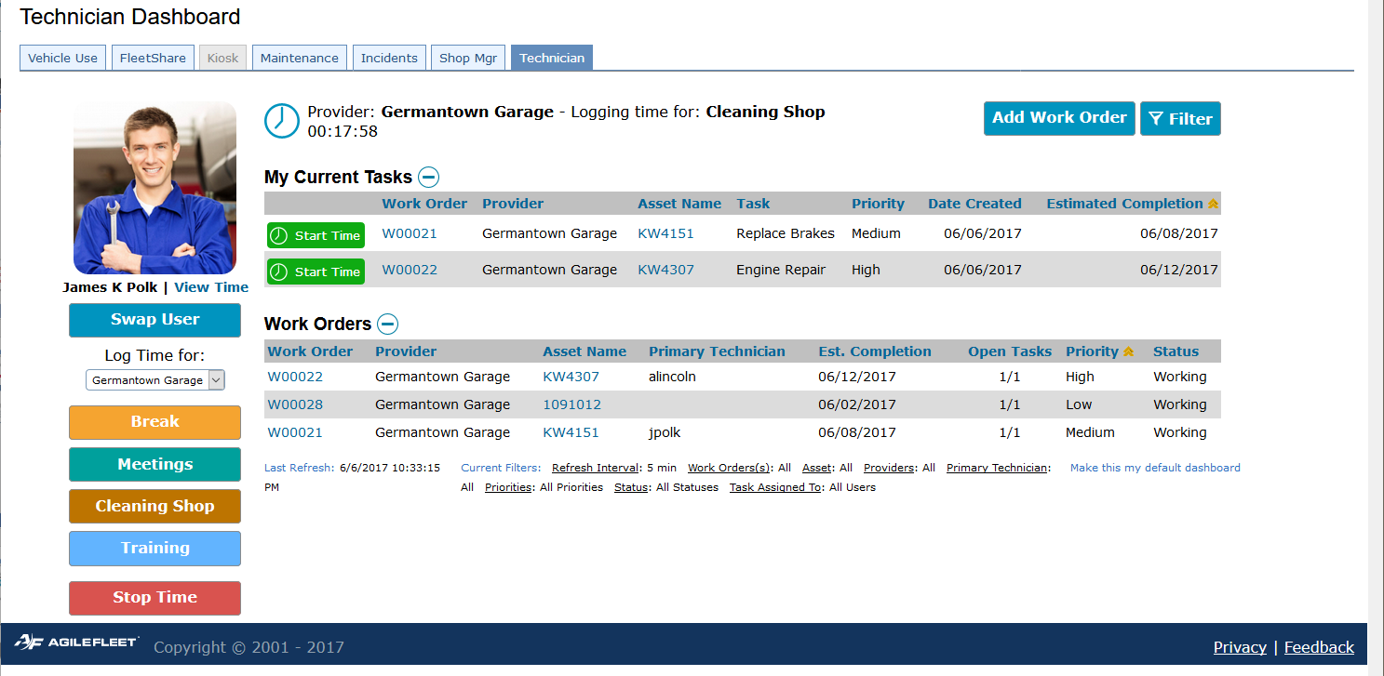
Technician Dashboard
Notes:
Here’s the technician dashboard. The technician photo eliminates confusion as to who is logged in, which is handy when technicians are using a shared workstation. He can quickly launch his time tracking by clicking this green button. He can track time on a work order or on a task that is on the work order.

Slide 17
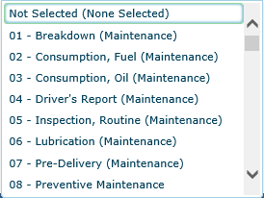
Work Orders

Slide 18
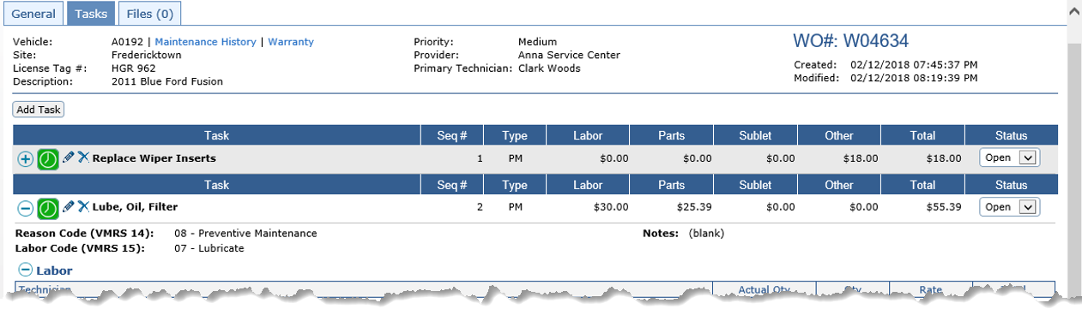
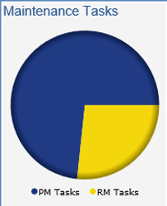
Work Orders
Ratio of PM to RM

Slide 19
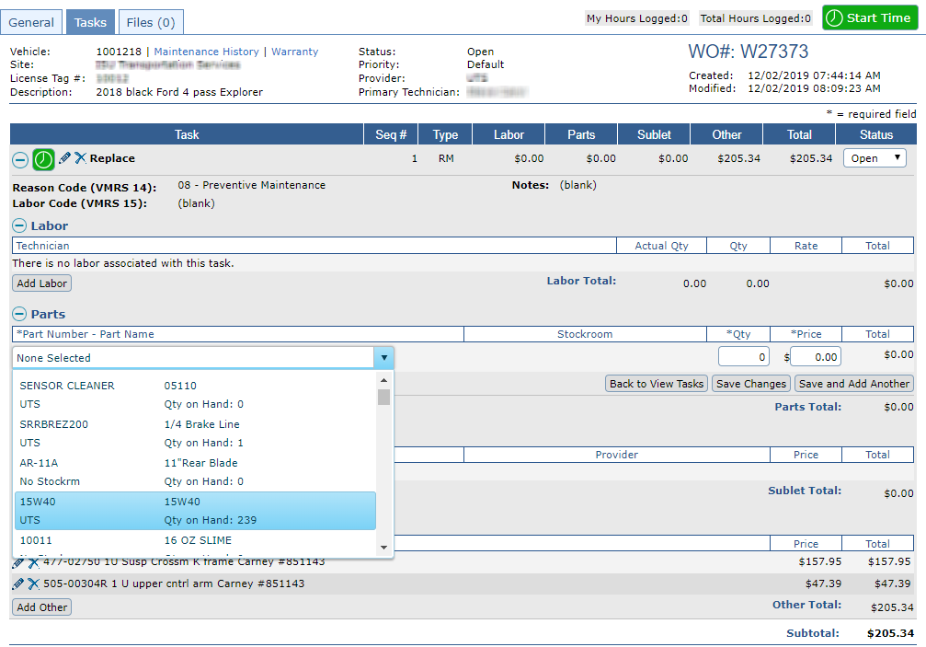
Work Orders- Parts

Slide 20
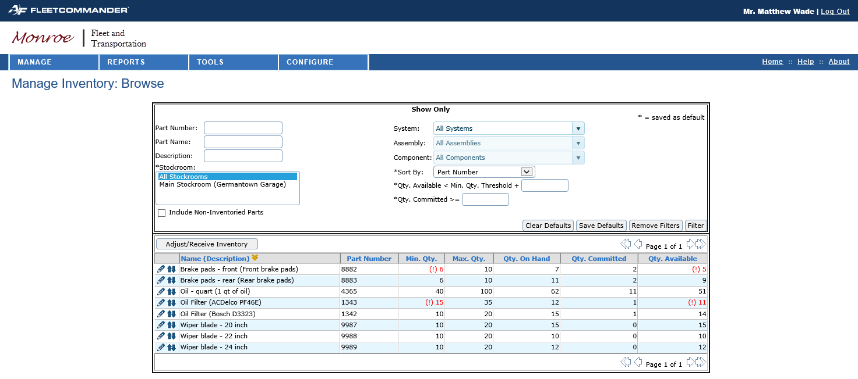
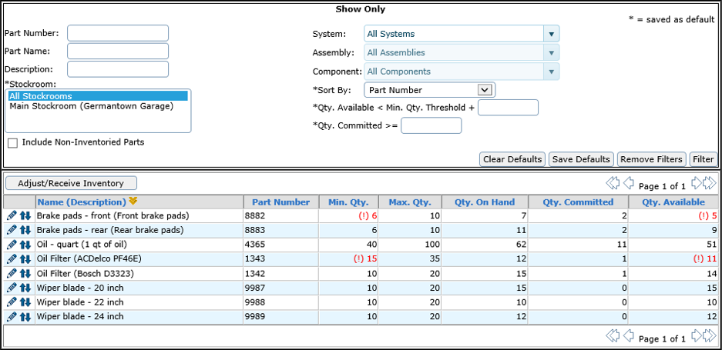
Parts

Slide 21
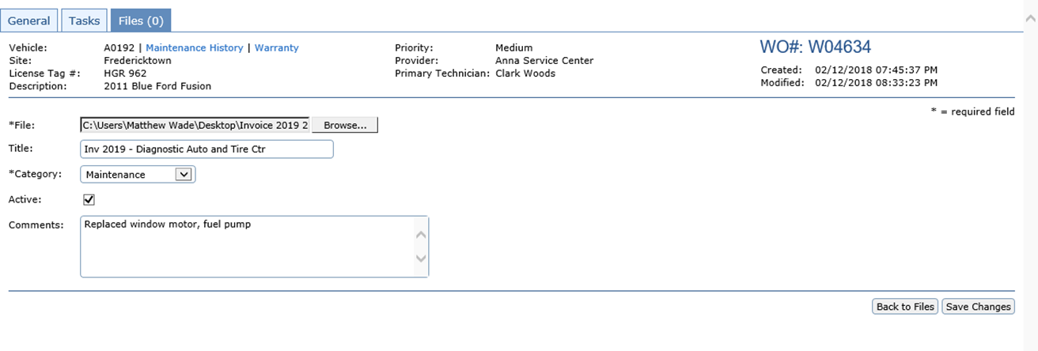
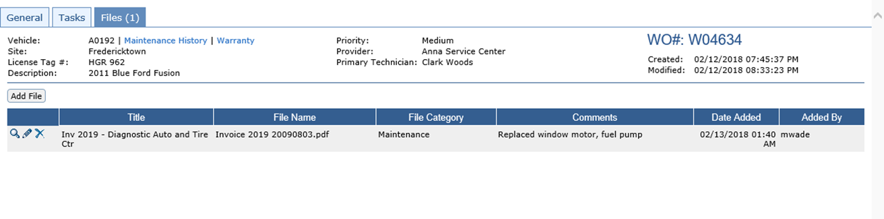
Upload Receipts to Work Order

Slide 22
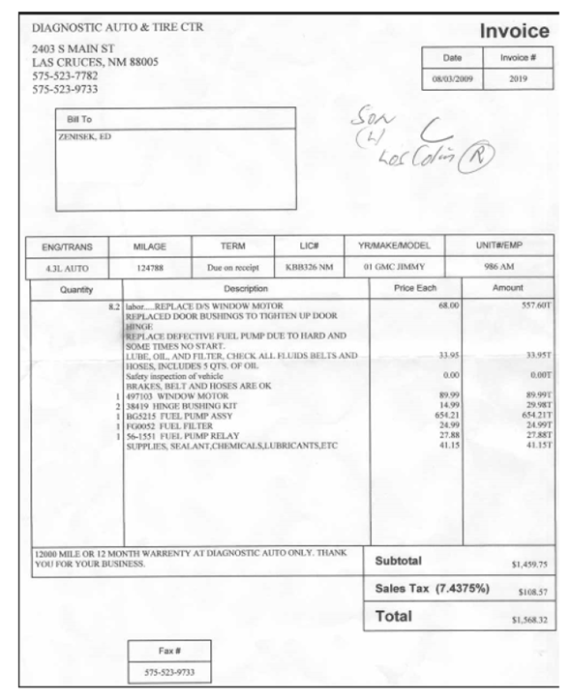
Upload Receipts to Work Order

Slide 23
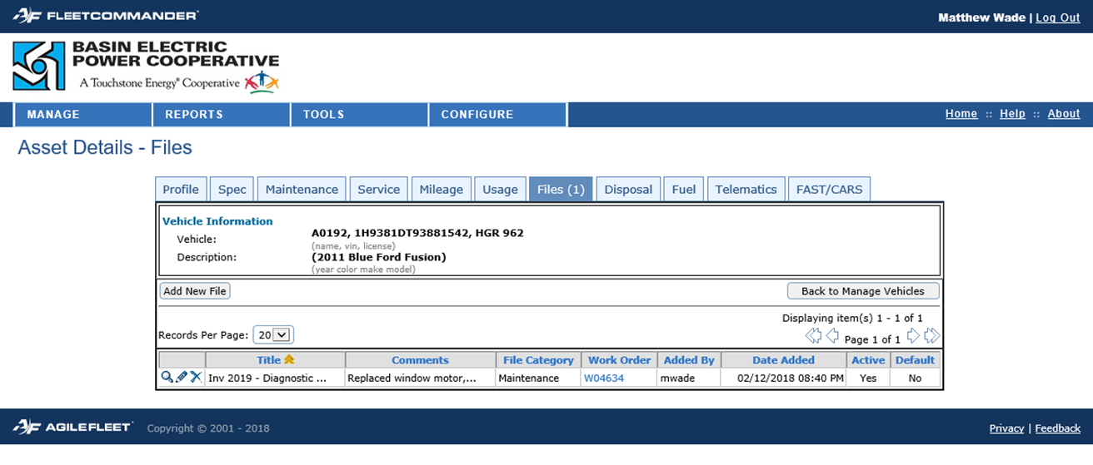
Upload Receipts to Work Order
Receipt is automatically captured in the vehicle profile

Slide 24
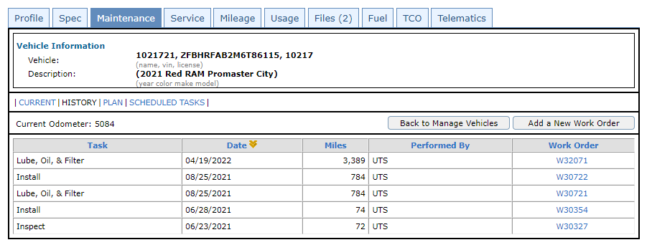
Service History for Individual Vehicle

Slide 25
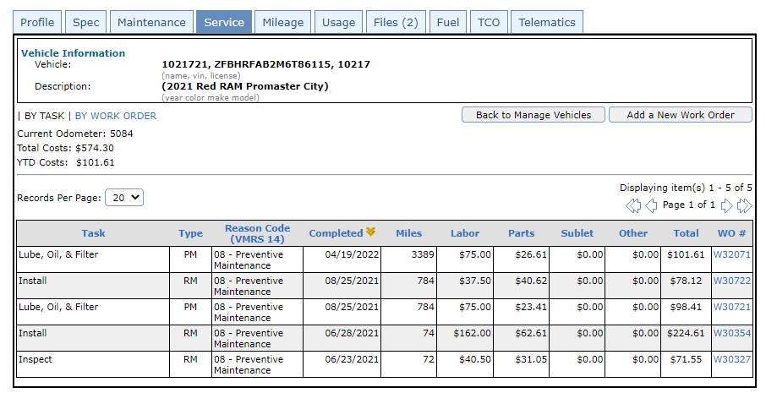
Service Cost for Individual Vehicle

Slide 26
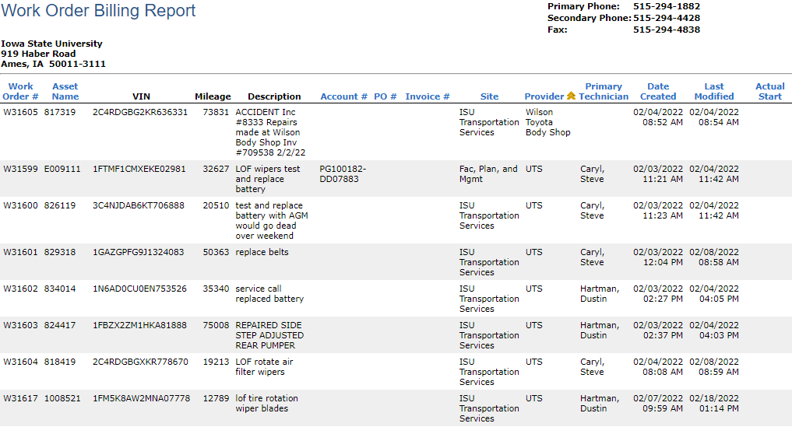
Service Reports

Slide 27
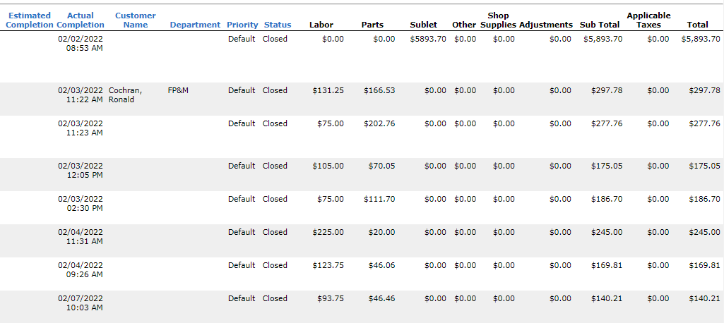
Service Reports Continued

Slide 28

Questions

