Slide 1
FleetCommander Enhancements 5.10, 5.11, 5.12
Dave Kennerley

Slide 2
Agenda
Platform Modernization
5.10 New / Updated Functionality
5.11 / 5.12 New / Updated Functionality
Vehicle Import Tool
Vehicle Replacement (Phase 1)

Slide 3


Release Notes
https://support.agilefleet.com/

Slide 4
Platform Modernization

Slide 5
.NET Platform Modernization
In addition to FleetCommander application code updates, the following report interfaces have been upgraded. Report functionality remains unchanged.
5.10 below:
Reports > Users > User Summary
Reports > Users > User Detail Extra
Reports > Users > User Detail
Reports > Users > Account Summary
Reports > Users > Department Summary
Reports > Users > Driver Eligibility
Reports > Users > User Certification Currency
Reports > Users > User Citations
Reports > Users > User System Activity
Reports > Users > User HR
Reports > Users > User Dependent
Reports > Users > Lost and Found
Reports > Users > Expense Detail
Reports > Users > Expense Summary
Reports > Users > Expense Totals by Reason
Reports > Fuel > Fuel Detail
Reports > Fuel > Fuel Summary
Reports > Statistics > Vehicle Usage Report
Reports > Car Pool > Car Pool Summary

Slide 6
.NET Platform Modernization
In addition to FleetCommander application code updates, the following report interfaces have been upgraded. Report functionality remains unchanged.
5.11/12 below:
.NET Transition > Reports > Maintenance > Parts Markup Detail Report
.NET Transition > Reports > Maintenance > Work Order Status History Report
.NET Transition: Reports > Maintenance > Inventory Summary Report
.NET Transition: Reports > Maintenance > Maintenance and Fuel Cost Report
.NET Transition: Reports > Maintenance > Maintenance Cost Detail
.NET Transition: Reports > Maintenance > Maintenance Cost Summary by Cost Type
.NET Transition: Reports > Maintenance > Maintenance Cost Summary by Task Type
.NET Transition: Reports > Maintenance > Maintenance Due Summary Report
.NET Transition: Reports > Maintenance > Maintenance Schedule Report
.NET Transition: Reports > Maintenance > Maintenance Tasks Report
.NET Transition: Reports > Maintenance > Part Detail Report
.NET Transition: Reports > Maintenance > Part Sales Report
.NET Transition: Reports > Maintenance > Part Summary Report
.NET Transition: Reports > Maintenance > Service Providers Report
.NET Transition: Reports > Maintenance > Technician Task and Labor Hours Report
.NET Transition: Reports > Maintenance > Technician Time Summary by Category Report
.NET Transition: Reports > Maintenance > Technician Time Summary Report
.NET Transition: Reports > Maintenance > Technician Work Report
.NET Transition: Reports > Maintenance > Work Order Billing Report
.NET Transition: Reports > Maintenance > Work Order Parts Report
.NET Transition: Manage > Users
.NET Transition: Manage > Vehicles
.NET Transition: Manage > Work Orders
.NET Transition: Manage > Maintenance
.NET Transition: Manage > Fuel
.NET Transition: Manage > Inspection
.NET Transition: Manage > Prep
.NET Transition: Reports > Statistics > Aging by Miles Report
.NET Transition: Reports > Statistics > Aging by Time
.NET Transition: Reports > Statistics > Audit Log Report
.NET Transition: Reports > Statistics > Feedback Report
.NET Transition: Reports > Statistics > Product Key Survey Report
.NET Transition: Reports > Statistics > Statistics Summary Report
.NET Transition: Reports > Statistics > System Report
.NET Transition: Reports > Statistics > Vehicle Demand Report

Slide 7
5.10 Release

Slide 8
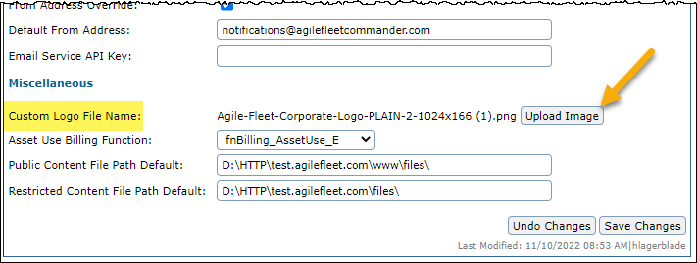
Custom Logo Upload
System Administrators can now upload their own Custom Logos
To configure, navigate to: Configure > Enterprise Settings > Advanced tab, an Upload Image button is available for the Custom Logo File Name.
Standard image types are supported, including PNG, JPG, and GIF (non-animated).
The image height can be up to 80px tall; however, 60px is the recommended height.

Slide 9
Configurable OAuth
Always contact FleetCommander Support fcsupport@agilefleet.com or 571-498-7555 x2 before attempting to setup OAuth.
There may be important differences between existing system Usernames and authenticated values.
OAuth integration does NOT update User information
OAuth 2.0 is the industry-standard open protocol for access delegation as a way for internet users to grant websites or applications access to information without giving them the passwords
OAuth allows Authentication for FleetCommander and FleetCommander Kiosk
Users MUST have the necessary understanding and required information to successfully enable OAuth. The new configurations are available in Configure>Enterprise Settings, on the ‘Advanced’ tab.

Slide 10
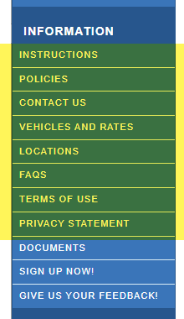
Configurable Information Page Titles
Introduced Page Titles
On the Welcome Page, the page titles can now be changed for the configurable user content under the “Information” section.
This includes the following headings:
Instructions
Policies
Contact Us
Vehicles and Rates
Locations
FAQs
Terms of Use
Privacy Statement

Slide 11
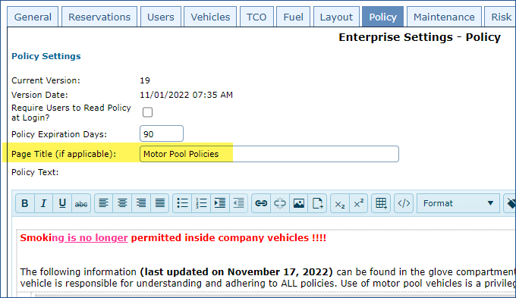
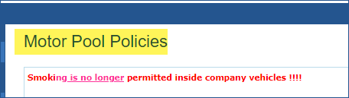
Configurable Information Page Titles
All the titles can be modified under their respective texts on the Configure > Enterprise Settings > Layout tab except for Policies.
The Policy title configured on the Configure > Enterprise Settings > Policy tab. For each text, a Page Title setting has been added where the page title can be modified.
Be sure to save your changes.

Slide 12
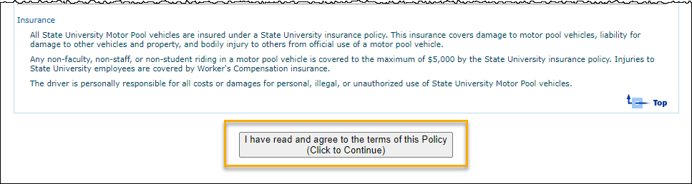
Policy Button Centered
The button to accept the Policy has been moved to the center from the left-hand side.
“(Click to Continue)” has been added to the verbiage for clarity.

Slide 13
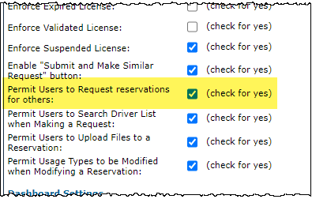
Permit/Prevent Request For Others
Permit/Prevent users from making reservations for other drivers
A new setting called Permit Users to Request reservations for others has been added to the system, allowing improved control over the reservation request process.
By default, this setting will be enabled (checked), and users will be able to make reservations for other drivers.
To change the setting navigate to Configure > Enterprise Settings > Reservations tab.

Slide 14
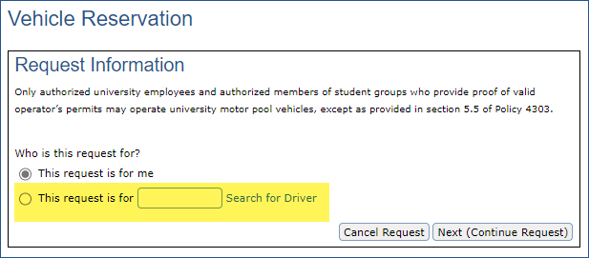
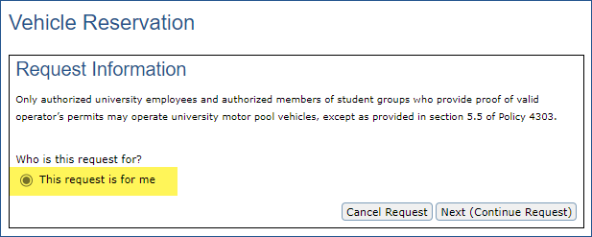
Permit/Prevent Request For Others
When enabled - the form displays the ability to make a reservation for another driver
When disabled - the form only allows a driver to make a reservation for themself

Slide 15
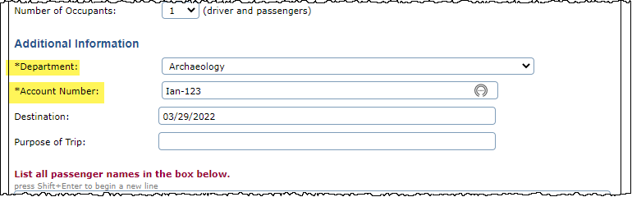
Required Field Asterisks
Make and Manage Reservations
On the Make Reservation Request form, asterisks have been added next to the Department and Account labels if those fields are required.

Slide 16
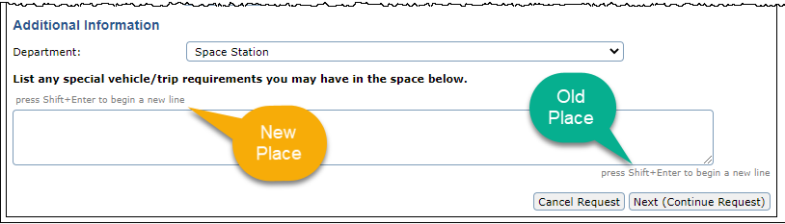
Comments Help Text
Help text for reservation comments moved.
The reservation comments help text found on the reservation form was moved directly under the comments and above the comments box.
This provides increased visibility for the user in the reservation process

Slide 17
Tool enhancements
Manage Fuel and Fuel Imports
Code changes have been made to significantly improve the performance of fuel import postings, reducing processing time.
Fuel Mapping Tool: Accuracy enhancements have been made to the correlation of fuel transactions to billing charges.

Slide 18
Report Enhancements
Utilization by Miles Report: Asset Status added to the filters to improve report granularity
Completed Reservation Summary Report: Corrected Asset filter operation.
Travel Sheet Report: Resolved UTC-to-local time conversion issue.
Some reservations were not showing up due to incorrect time conversion.
Usage By Department Report: Improved error handling, making the report more accurate.
Late Return Report: Resolved issue where the Hours Late were not calculated correctly.

Slide 19
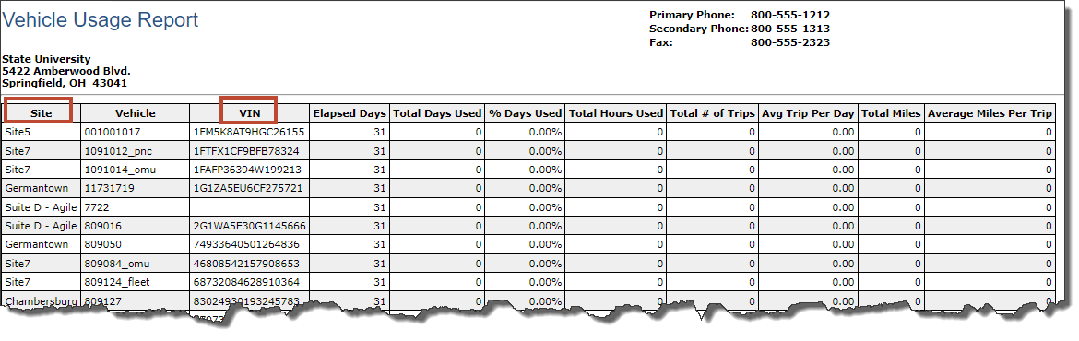
Report Enhancements
Vehicle Usage Report: Added columns for Site and VIN to the output.

Slide 20
5.11/12 Release

Slide 21
Next Release - 5.12
Content from 5.11 and 5.12 will be released together!
Testing is completing
Beta Testing targeted to complete during October
General availability, targeted to November

Slide 22
Vehicle Import Tool

Slide 23
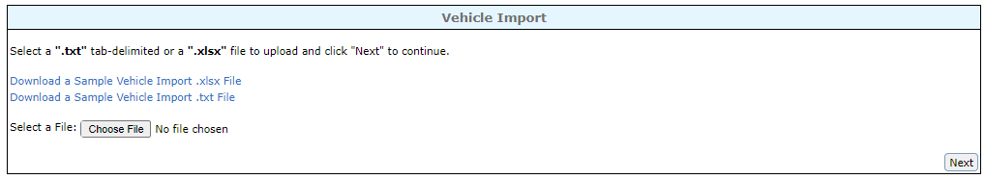
Vehicle Import Tool
System Administrators can now batch import vehicles into FleetCommander!
Tools > Import > Vehicle Import Tool
2 import file types – Excel (.xlsx) or Text (.txt)
Download the sample file for the template and layout
The template must maintain all columns to ensure a successful import.

Slide 24
Vehicle Import Tool
Required Fields:
Asset Name
VIN
License Number
Year
Make
Model
First Mileage
Last Mileage
Last Mileage Date
Site
Location
Asset Type
Maximum Occupants
First Available Date
Acquisition Value
Expected Max Age in Months
Expected Max Age in Miles
Eligible for Manual Assign?
Eligible for Auto-Assign?
Eligible for Automatic Approval?
Enable Self Checkout
Expected Miles per Month
Fuel Capacity
Optional Fields:
Color
Owner User or Department
Responsible User or Department
Acquisition Date
Last Available Date
Public Notes
Private Notes
Vehicle Condition
Fuel Type
Gross Weight (GVWR)
Asset Custom Fields 1-20
Maintenance Plan
Account Number
Depreciation Information
Salvage Value Percentage
Expected Cost Increase Percentage
Do Not Depreciate
Disposal Date

Slide 25
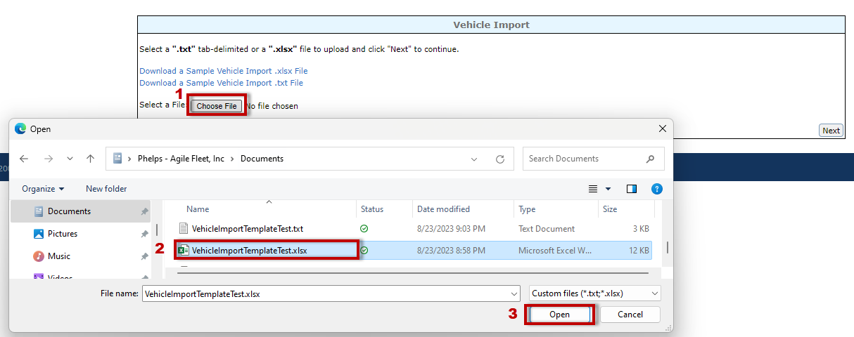
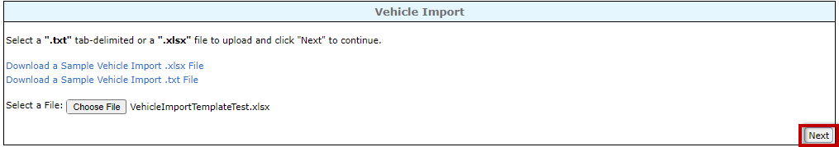
Vehicle Import Tool
System Administrators can now batch import vehicles into FleetCommander!
After completing the upload file, in the Tool select “Choose File” and follow the window prompts to select the correct file
After file is selected, click “next”

Slide 26
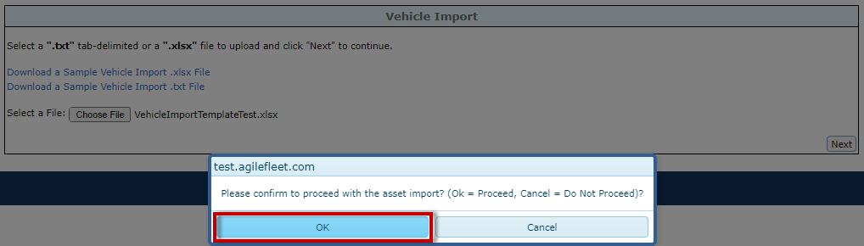
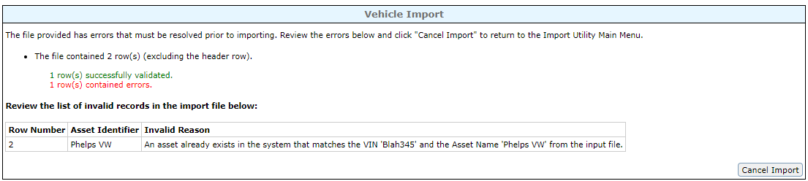
Vehicle Import Tool
Confirm the import
The file will only be imported if all records are in the correct format, all required fields are completed, and all vehicles are new to FleetCommander. If there are errors, it will display
The file must be updated before the import can be processed. Click “cancel import” to select the newly updated file

Slide 27
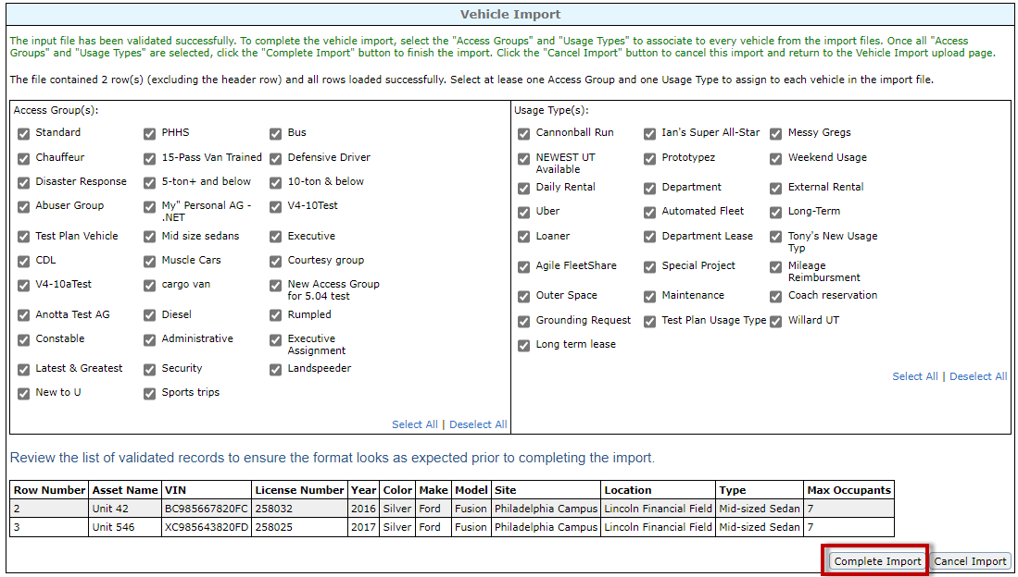
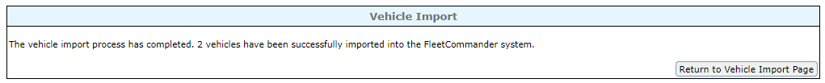
Vehicle Import Tool
Once the file has been validated successfully, you are now able to select the Access Groups and Usage Types to assign the vehicles.
1 Access Group and 1 Usage Type must be selected.
This will apply to all of the vehicles being imported.
Also review the list of assets to be imported, then press “complete import.”
After processing, a confirmation page will display

Slide 28
Vehicle Replacement

Slide 29
Vehicle Replacement
The vehicle replacement tool groups functionality that allows administrators to determine which vehicles in their fleet are most appropriate to replace as well as the approximate cost of acquisition to replace those vehicles.
There will be multiple releases for this functionality, each adding additional capability
Phase 1 will include the following:
First 3 Configurable Categories for Scoring and Weighting
Age of Vehicle
Odometer
Replacement Condition
Changes to Vehicle Profile to include Replacement Condition
Vehicle Replacement Report

Slide 30
Vehicle Replacement – Phase 1
Configure Vehicle Replacement Categories
Configure > Vehicles > Replacement
4 segments to modify
Categories
Age
Meter
Replacement Condition
Age + Odometer + Replacement Condition = Total Points that determines the Category it falls under
All ranges behave the same – Enter the upper limit for the range for each row and the corresponding points for each row.
You cannot overlap the range.
Points can be the same number for multiple ranges.
Fewer points means better quality (e.g. 1=excellent, 2=good)

Slide 31
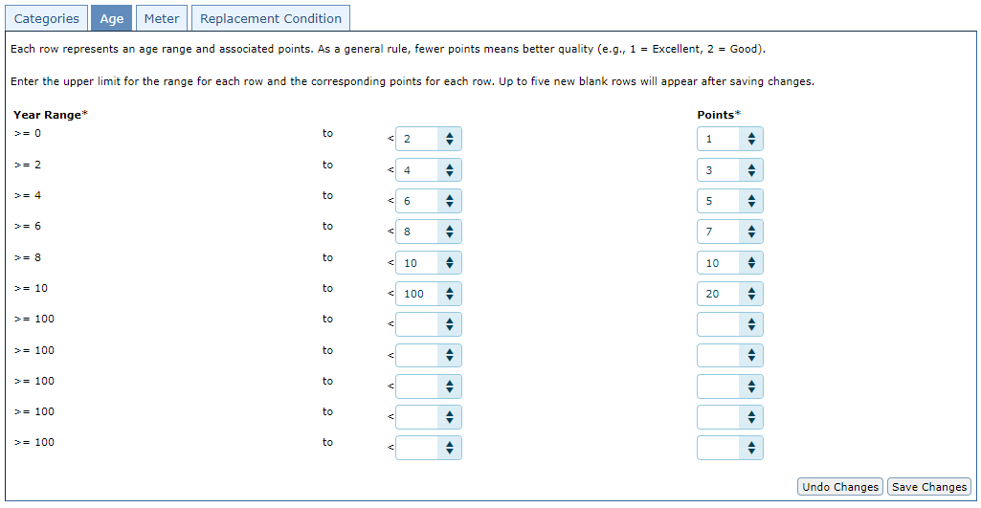
Vehicle Replacement – Phase 1
Configure Vehicle Replacement Categories - Age
Based on the Model Year of the vehicle correlate age of the vehicle with points

Slide 32
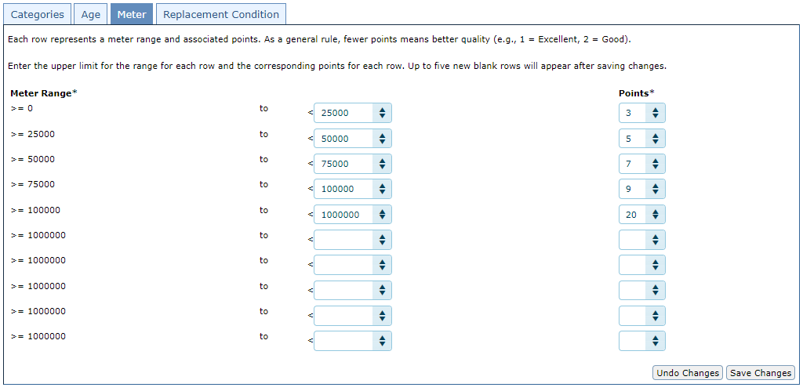
Vehicle Replacement – Phase 1
Configure Vehicle Replacement Categories - Meter
Based on the Mileage of the vehicle correlate meter range of the vehicle with points

Slide 33
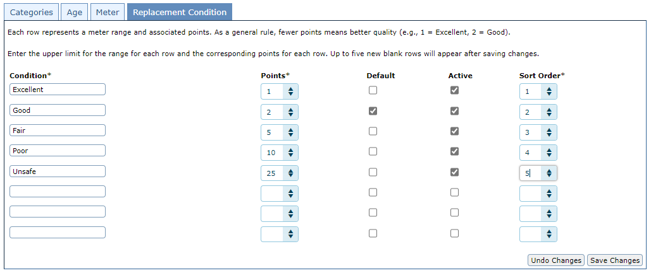
Vehicle Replacement – Phase 1
Configure Vehicle Replacement Categories – Replacement Condition (condition of the vehicle)
Set categories for the condition of a vehicle and assign points to that condition.
‘Default’ – The default replacement condition of the vehicle

Slide 34
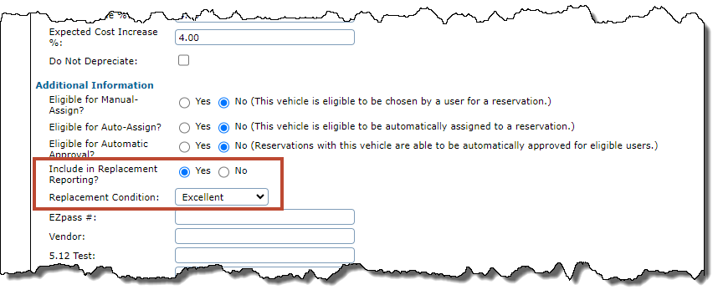
Vehicle Replacement – Phase 1
Vehicle Profile
2 fields added to Vehicle Profiles
“Include in Replacement Report” toggle
“Replacement Condition” dropdown that matches the options configured.
Will display the Defaulted option

Slide 35
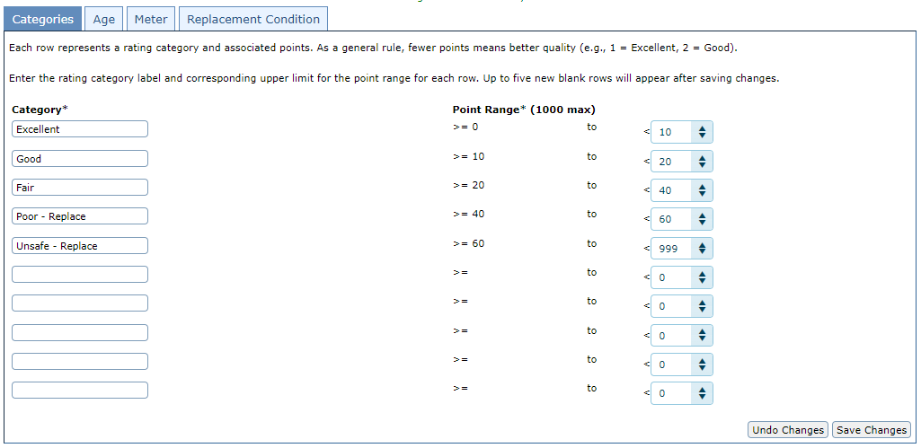
Vehicle Replacement – Phase 1
Configure Vehicle Replacement Categories - Categories
A vehicle’s points will be summarized, and its total points will place it into one of these categories

Slide 36
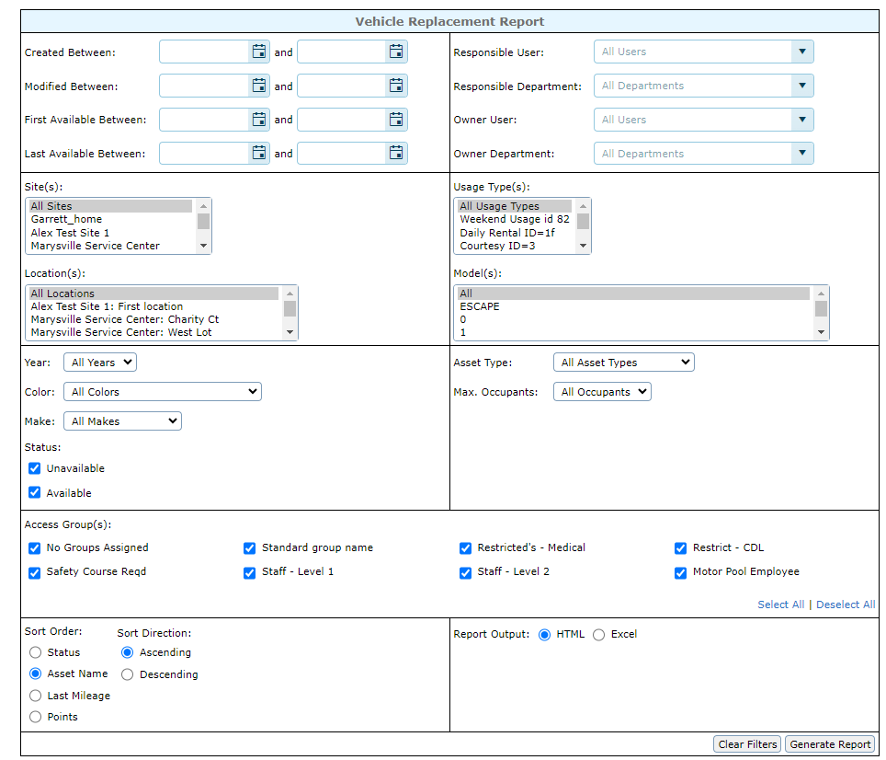
Vehicle Replacement – Phase 1
Replacement Report
Reports > Assets > Vehicle Replacement
“Include in Replacement Report” toggle
“Replacement Condition” dropdown that matches the options configured.
Will display the Defaulted option
Export options in HTML and Excel

Slide 37
Vehicle Replacement – Phase 1
Replacement Report
HTML Export will be grouped by Replacement Category
Export Fields
Vehicle Status
Vehicle Name
Year
Year Replacement Points
Meter
Meter Replacement Points
Replacement Condition
Replacement Condition Points
Total Replacement Points

Slide 38
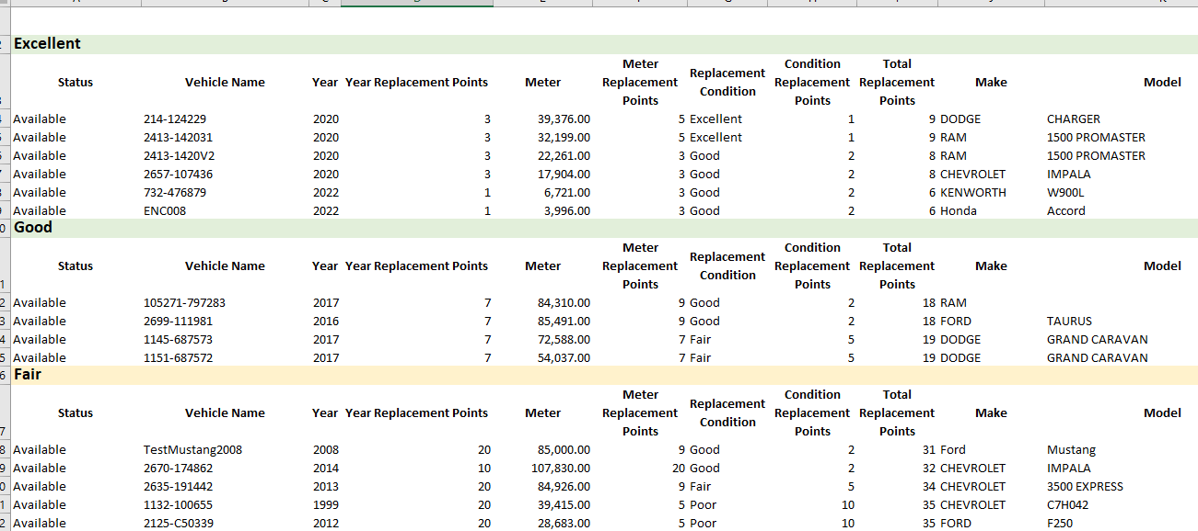
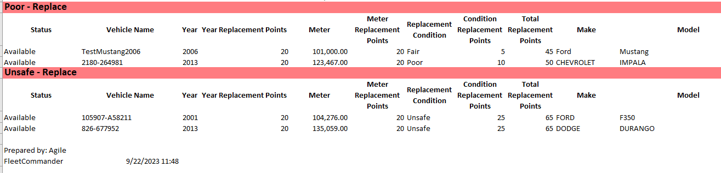
Vehicle Replacement – Phase 1

Slide 39
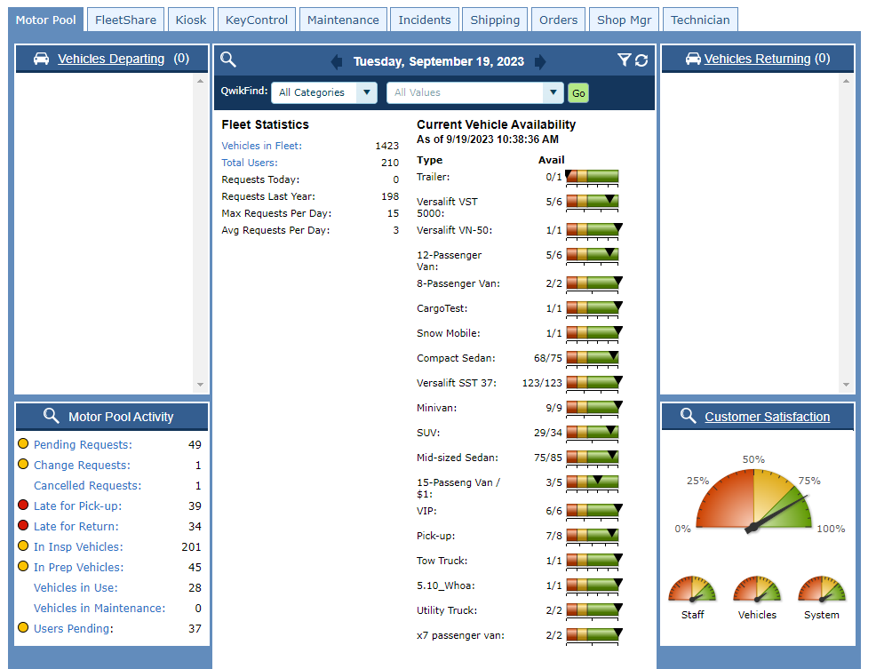
“Late Return” Reservations Count in “Vehicles in Use”
Reservations that are “Late Returns” will now count in the “Vehicles in Use” count in the following areas:
Vehicle Use Dashboard
Current Vehicle Availability
Motor Pool Activity – “Vehicles in Use”

Slide 40
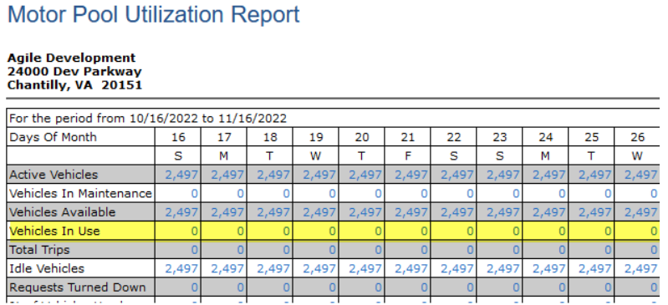
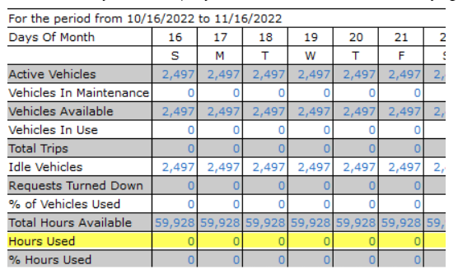
“Late Return” Reservations Count in “Vehicles in Use”
Reservations that are “Late Returns” will now count in “Vehicles in Use” and “Hours Used” count in the following areas:
Motor Pool Utilization Report
MPU by Asset Type

Slide 41
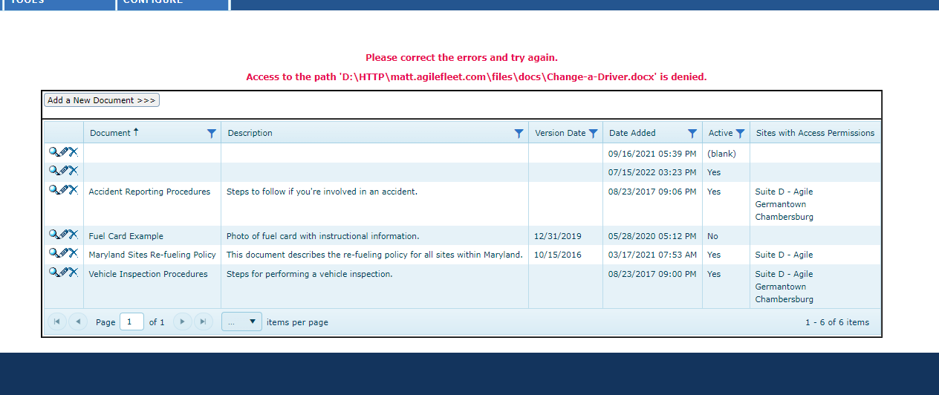
Documents & Content Manager
Resolved ‘Access’ errors when deleting some files

Slide 42
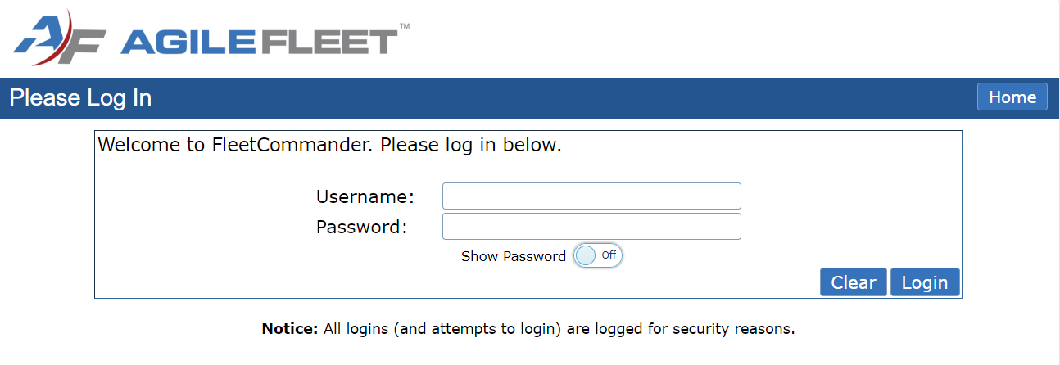
Kiosk
FCUC 2022
Request
Added option to allow user to show password at kiosk

Slide 43
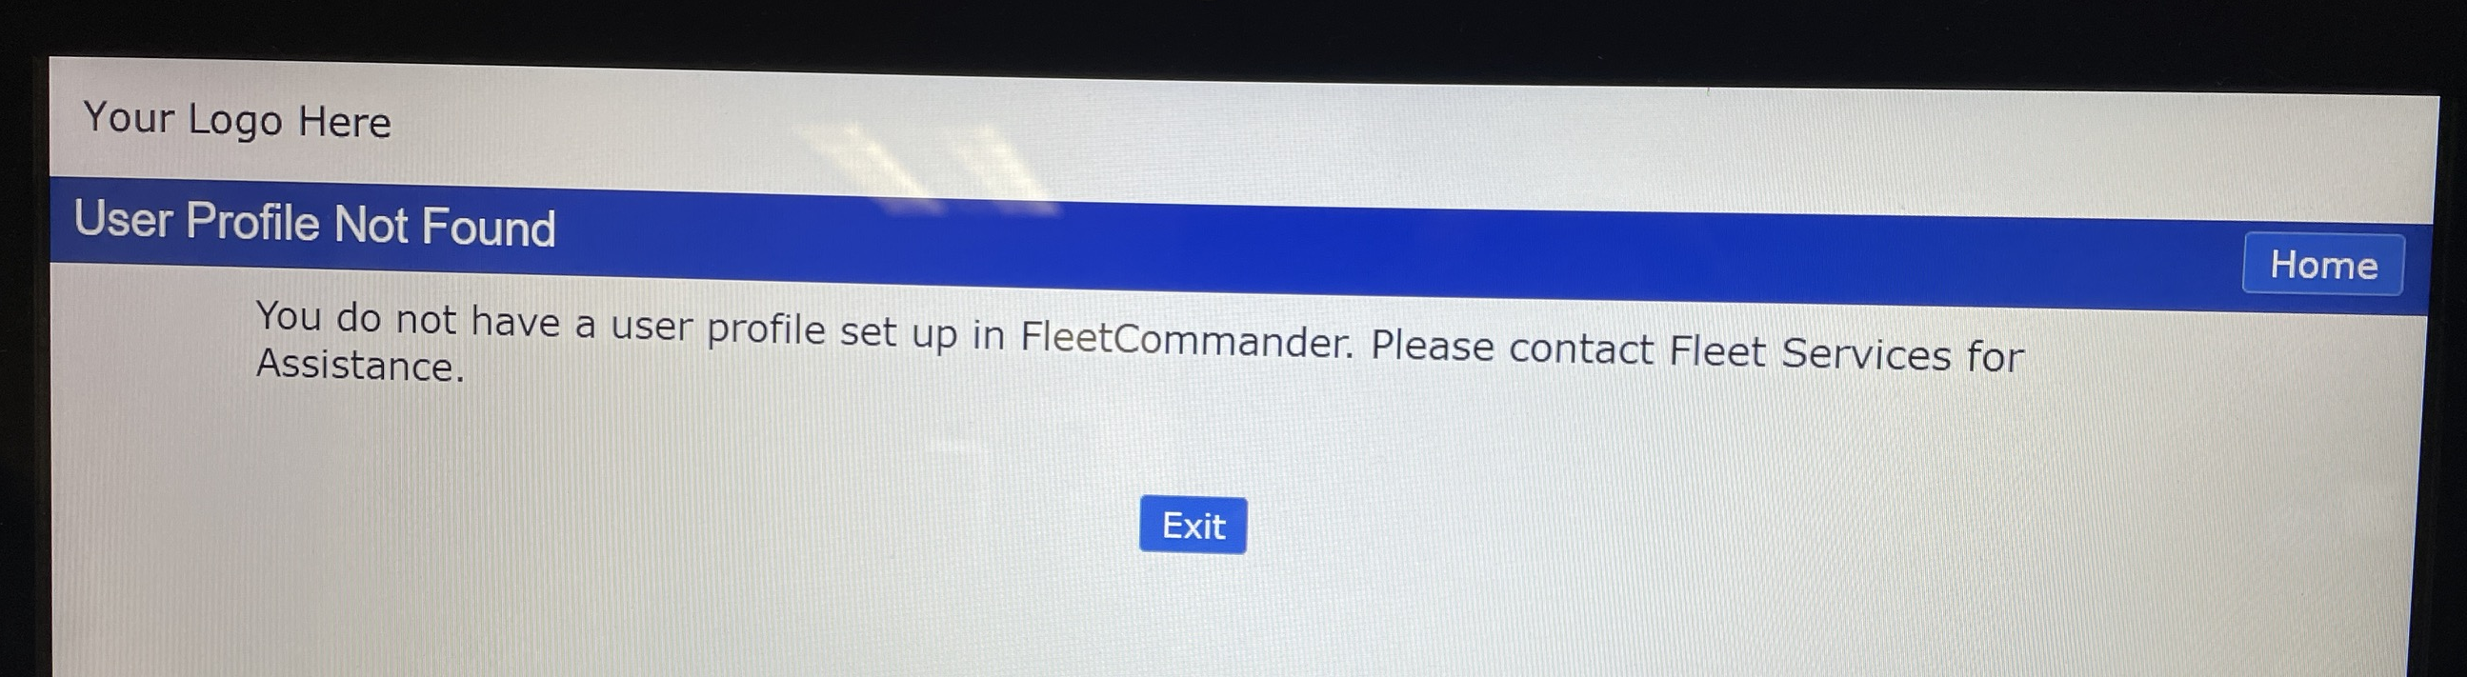
Kiosk
OAuth Configuration: Added kiosk message if user is not an active user in FleetCommander.
The message says, “You do not have a user profile set up in FleetCommander. Please contact Fleet Services for Assistance.”

Slide 44
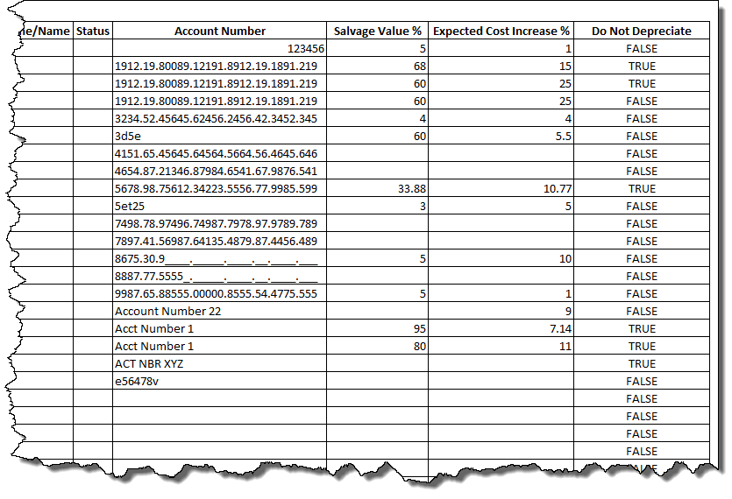
Report Enhancements
Asset Data Dump Report
Added Fields that were recently added to the vehicle profile page:
Account Number
Salvage Value %
Expected Cost Increase %
Do Not Depreciate

Slide 45
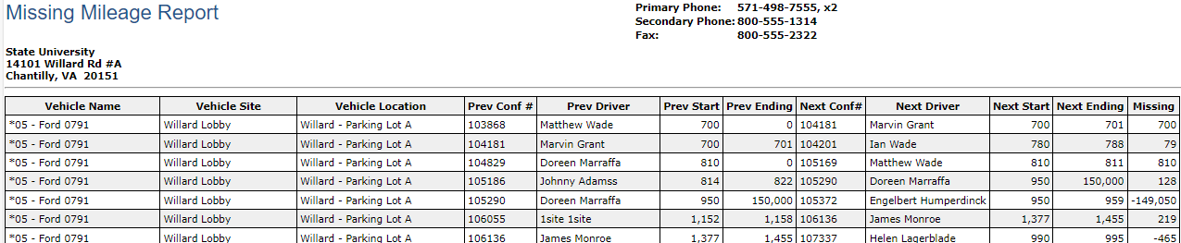
Report Enhancements
FCUC 2022
Request
Added Vehicle Site and Location columns to missing mileage report

Slide 46
Report Enhancements
Detailed Billing Report
“Duration in Days” column will reflect the correct number of days from the duration
Vehicle Usage Report
Modifications to “Reservation Usage Type” Filter
Enhanced filter query to make the results more precise.
Corrected the wrapping of the filter where the filter label and the usage types were not appearing together for some clients.
Mileage Cost Report
Maintenance total now displays proper value when running for more than 1 year.
Aging by Time Report
Site filter now works as expected.

Slide 47
Report Enhancements
Usage by Department Report
Removed duplicate "Unspecified" Rows / Hours
Reservation Detail Extra Report
Misalignment of column titles has been resolved

Slide 48
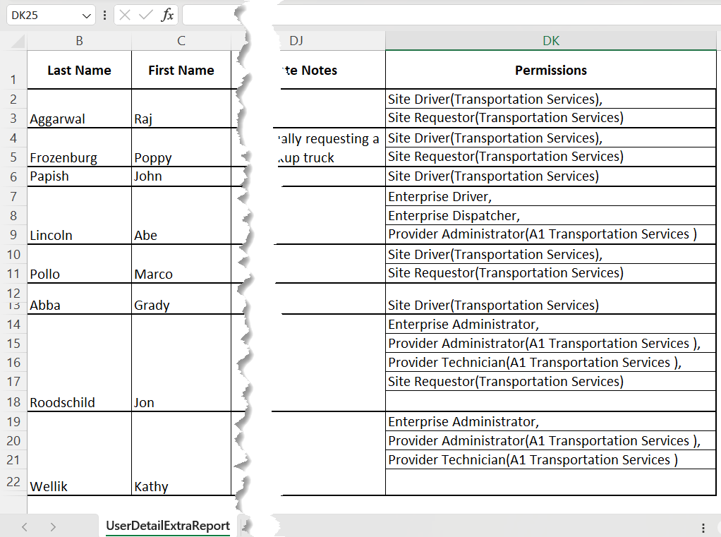
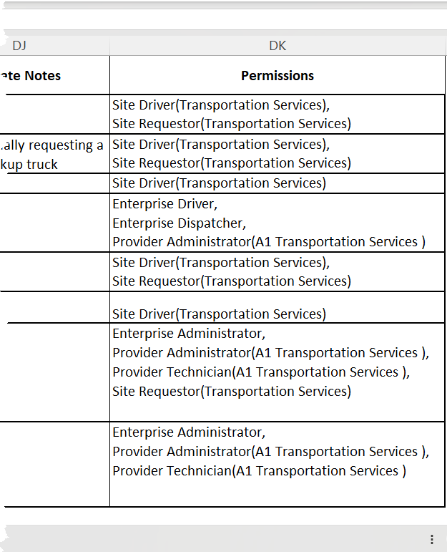
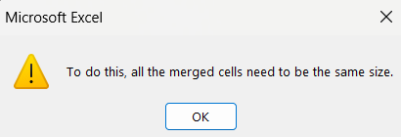
Report Enhancements
User Detail Extra Report: Removed merged Permission cells to allow for easier sorting
Previously
Now

Slide 49
Reservations
Modify Reservations
Inactive Locations no longer display in Location Dropdown during Modification

Slide 50
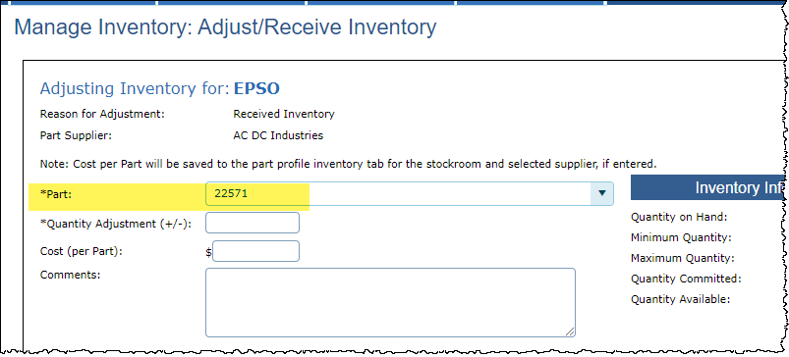
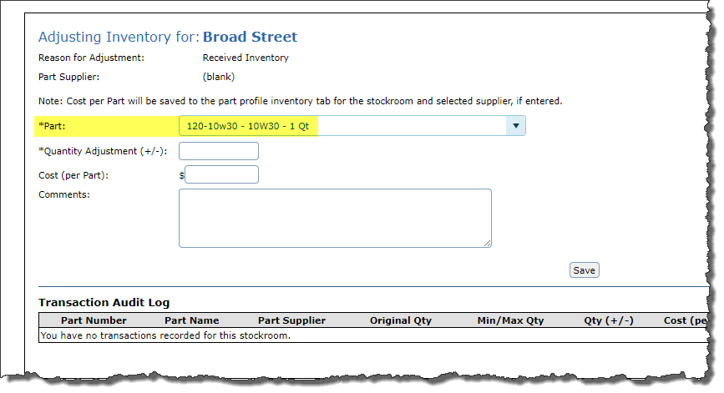
Maintenance & Parts
Parts Inventory
When adjusting inventory, corrected an issue where the Part ID displayed in the “Part” field instead of the Part Number/Part Name.
Previously
Now

