Slide 1
Storytelling with Data & Reports, KPIs - I Need Them, but Where Can I Find Them?
September 27, 2023

Slide 2
Objectives
Learn the importance of telling your fleet story
Identify reasons to track Key Performance Indicators (KPIs)
Identify key KPIs and where to run reports and find data in the FleetCommander System
Learn best practices for making sure your FleetCommander system is set up to maximize security of vehicles
Learn tips and tricks to have a successful audit
Build the confidence to tell the world your fleet story

Slide 3
Agenda
Exercise – Know your audience
Discuss KPIs in the fleet industry
Review what reports FleetCommander has to offer to find your story data
What does your data tell you about your fleet?
Review best practice set ups to maximize security practices as well as audit tips and tricks
Celebrate your successes by telling your fleet story

Slide 4
Exercise

Slide 5
What is the Story?
Notes:
Today we are going to focus on telling your fleet story. To start off I would like to do a quick exercise with all of you in the room. So in this particular example I am going to be a bit personal with all of you because as most of you know. I am a pretty wide open book, meaning I love to help people and I always have a story. I will very quickly get to how this relates to fleet but I want you to think outside the box for the next 90 minutes.
I am going to ask for a little audience participation here. When you look at this picture what is the story you see?
I will take a few answers and I will respond accordingly.
Okay so this is a picture of my daughters wedding reception. It was in June and we were blessed to have so many friends and relatives with us. A couple of interesting points of this picture regarding fleet is the following: Jim Ervin, who is in the audience from Iowa State University, he is right there in the middle of the picture. Jim was an employee who has gotten to learn about Agile Fleet Commander but he is also heavily involved in the contracts of the fleet software. Then I will point to the bride and she worked with Tricia Pugh, who is in today’s audience at the University of Northern Iowa Fleet as a dispatcher. Now UNI was not part of the Agile Fleet Family at that time but they are now and Kaylee the bride learned fleet from the dispatcher perspective. Then there is Rita who is a fleet customer at ISU and wants to know how she can lease a vehicle from the fleet for the lowest cost possible because she is the director of her department and wants to minimize expenses and maximize profits.

Slide 6
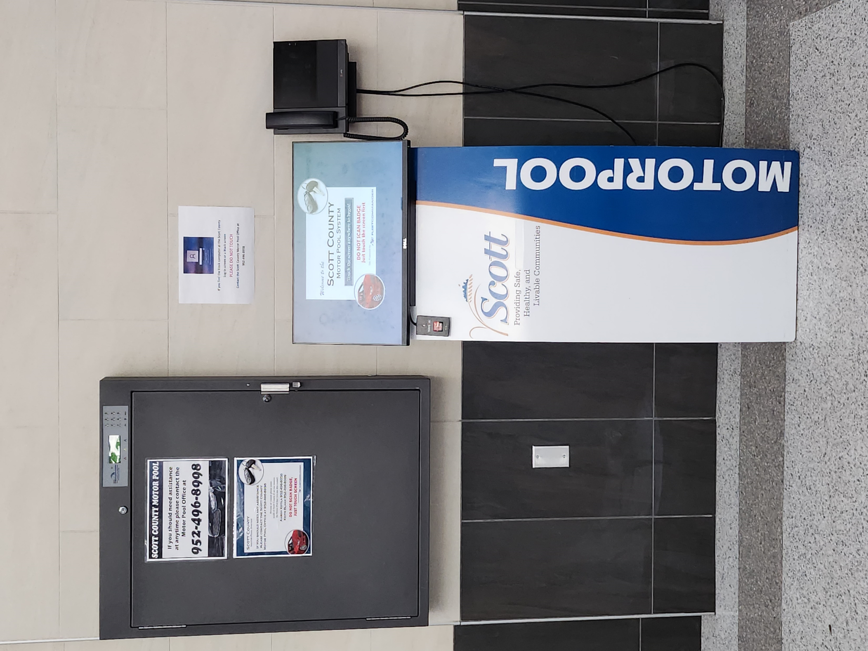
What is the Story?
When you see this picture of a key box and kiosk, what do you think of?
Notes:
So now, I would like audience participation one more time. When you see this picture what do you think of.
I will respond to some answers.
For me, as I had the chance to work my way from the dispatcher up to the director in fleet I can see many things.
My user/driver hat says – wow a convenient and time saving way to get my keys after hours and not have to make two trips to fleet for my car that I need to use on the weekend. Time savings and Convenience
My dispatcher hat says – This is great, the client can dispatch in and out their keys so I have more time to work on my other duties such as fuel, pending requests etc. Efficiencies
My director hat says – Having a key box and kiosk with allow for users to share vehicles thus increasing utilization and reducing costs. The automation also provides accountability for users and an accurate records. Increase Utilization and Reduced Costs & Accountability & Automation & Accurate Records
My Vice President hat says – This system will allow for a potential reduction in staffing which helps since it is so difficult to find employees these days. It also will allow for fantastic customer service with the cost saving initiatives. Reduced Staffing & Excellent Customer Service & Cost Savings

Slide 7
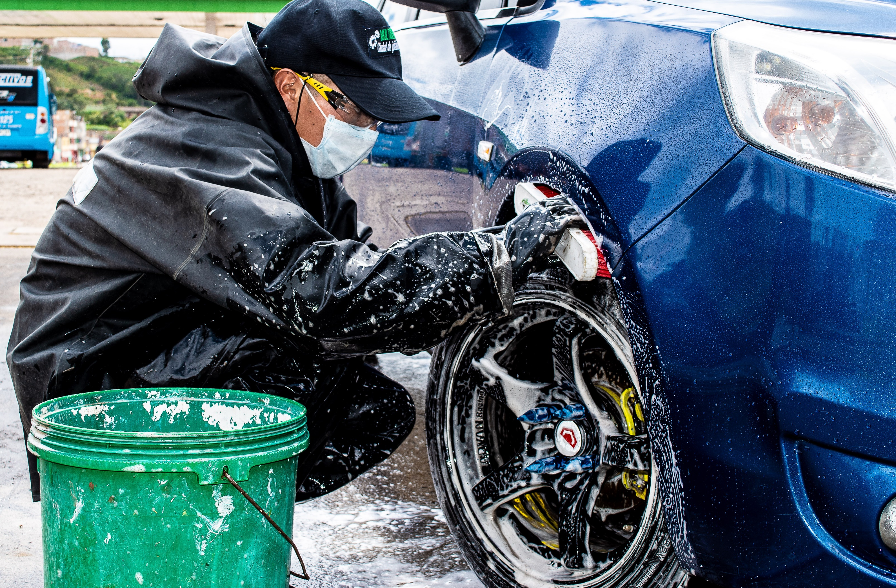
Story Telling
Drivers
Requestors
Fleet Administrators
Motor Pool Dispatchers
Maintenance Staff
Inspectors & Prep
Risk Managers
HR Administrators
This Photo by Unknown Author is licensed under CC BY
Notes:
So as you tell your fleet story remember that it may not be just one big story but several smaller stories depending on the audience and the story. In fleet you have many people such as those you see on the screen:
Drivers
Requestors
Fleet Administrators
Motor Pool Dispatchers
Maintenance Staff
Inspectors and Prep
Risk Managers
HR Administrators

Slide 8
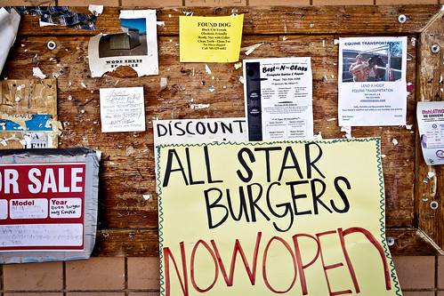
Story Telling
Books
Online Videos
Trade Publications
Webinars
Presentations
Broadcasts
Peer to Peer
Bulletin Boards
Notes:
There are also many places and ways to tell your fleet story and your Agile Fleet Staff are here to assist you with sharing your successes and stories. You can share through many different story telling artforms such as books, online videos, trade publications, webinars, presentations, broadcasts, peer to Peer and Bulletin Boards. If you need help with a report or how to show savings etc. just reach out to us and let us help. I know the marketing department is also very happy to write white papers or articles about your fleet story.

Slide 9
Key Performance Indicators to Help Tell Your Fleet Story

Slide 10
The Importance of KPIs
Provides values to strive for to ensure peak performance
Serves as a visual indicator of whether you are meeting your goals or not
Measures progress
Organizes your data for meaningful feedback
Notes:
When you tell a story in business you want the story to be non-fiction or true so it is important that you are able to have back up to support your story. So what do I mean by back up? Key performance indicators or KPIs are important to tract. KPIs are similar to goals and they provide values to strive for to ensure peak performance that you can then discuss. You then track the values for the proof of the performance.
KPIS are also provide visual indicators of if you are meeting your goals or not.
They measure progress and they organize your data for meaningful feedback.

Slide 11
KPIs
Utilization
Completed reservations
Total cost of ownership
Cost per mile
Preventative maintenance on time percentage
Technician productivity
Customer feedback
Number of work orders completed
Scheduled versus unscheduled maintenance
Notes:
So today we are going to take a deeper dive into some common KPIs, why they are important to your fleet story, where you can find the reports to monitor those KPIs and ways you graph or discuss the above KPIs. Now the list we have above here may or may not be the ones you use for your fleet but they are common ones that can really provide some deeper dives into your fleet performance. The KPIs we are going to take a closer look at today include Utilization, Completed reservations, total cost of ownership, cost per mile, preventative maintenance on time percentage, technician productivity, and customer feedback.

Slide 12
Utilization
Notes:
So the first KPI I would like to take a closer look at is utilization which is a main driver in the rightsizing and streamlining of fleets. Proper utilization is where you can get the most cost savings quickly for your fleet.

Slide 13
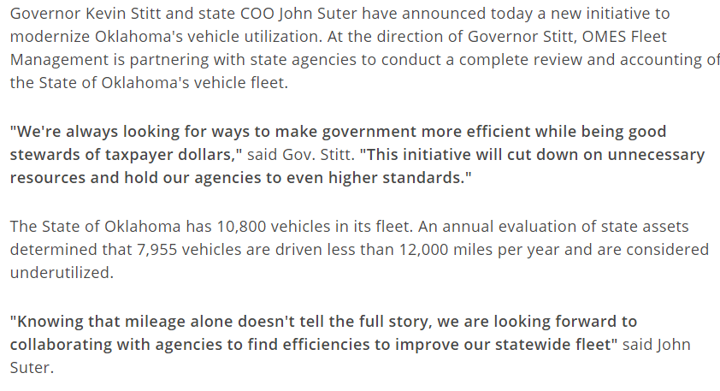
Why Utilization Matters
https://oklahoma.gov/governor/newsroom/newsroom/2023/february2023/governor-stitt-announces-new-state-government-efficiency-initiat.html
Notes:
So here is a real life-life example of a true story about utilization.

Slide 14
Utilization
Time vehicles are in use
vs. time vehicles are idle or
underutilized
Notes:
So what is Utilization? Vehicle utilization is a metric that measures the effectiveness of a fleet of vehicles in terms of their usage and productivity. It is often expressed as a percentage and reflects how much time vehicles are being utilized versus how much time they are idle or underutilized. Vehicle utilization is an essential factor in determining the efficiency of a fleet and it can have a significant impact on the overall cost and profitability of your business. Higher utilization rates generally indicate that a fleet of vehicles is being used efficiently and effectively, while lower utilization rates may indicate a need for improvement in fleet management factors.

Slide 15
Examples of Utilization
50%
Utilization Rate
=
Vehicles in Fleet
Vehicles in Use
Notes:
So how do we calculate utilization? Here is a quick example. There are 10 vehicles in your fleet and only 5 vehicles are used. Your utilization is then at 50% because you are only using half of your vehicles.

Slide 16
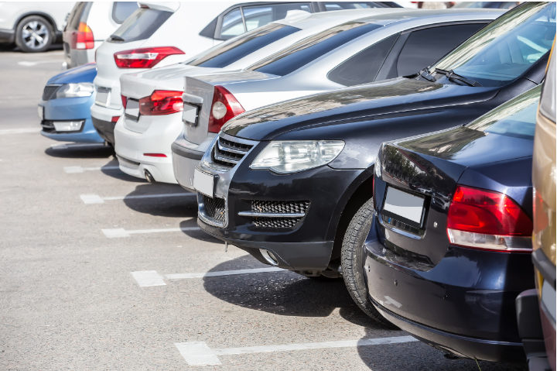
Reasons to Track Underutilized Vehicles
Increased Cost
Decreased Efficiency
Wasted Resources
Reduced Customer Satisfaction
Missed Opportunities
Notes:
It is important to track utilization because underutilized vehicles have an increased cost to the fleet, decreased efficiencies, wasted resources, reduced customer satisfaction and missed opportunities for drivers.

Slide 17
Motor Pool Utilization
Decide parameters and consistently use those same parameters
Source
REPORTS>STATISTICS>MOTOR POOL UTILIZATION
REPORTS>STATISTICS>MPU BY ASSET TYPE
Notes:
This slide I am not going to spend much time on but there are a couple of Utilization reports that you can run in Fleet Commander and the important thing to remember is that you run these reports consistently month after month so you are comparing apples to apples and not apples to oranges.

Slide 18
Motor Pool Utilization
Goal is 80%
Notes:
A great goal or KPI is to have utilization at 80 % or higher. When you look at your fleet you will want to break it down in different areas potentially and I also want you to remember that you can graph KPIs many different ways. Over the next few screens you will see different ways to graph the numbers. Some you will like more than others but it is personal preference and remembering the audience you are speaking to when deciding how to visually show your KPI numbers. This is the traditional bar graph

Slide 19
Utilization
Goal is 80%
Notes:
This is the same information but on a line graph. Again just a different visual depending on how you like to see things.

Slide 20
Monthly Utilization Comparison by Vehicle Type
Notes:
This is another bar graph, but it is comparing the different types of vehicles utilization monthly as well as the average. It is when you get down to the granular detail and peel back the onion that it starts to really show what you can do with your fleet to maximize savings.

Slide 21
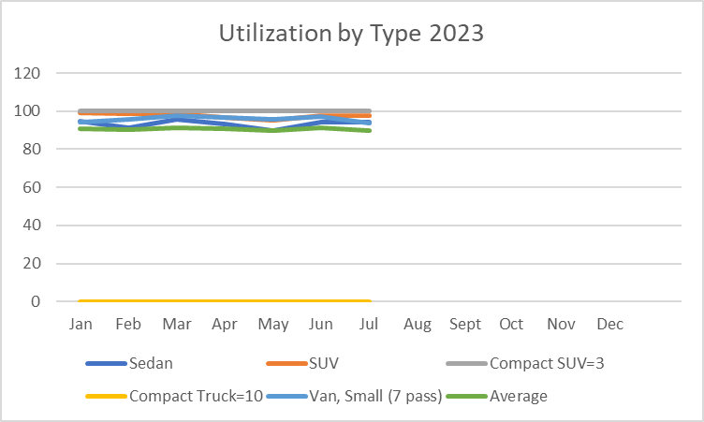
Utilization Trends
A Fleet could save $200,000 in Cap Ex and $35,000 a year in Op Ex by right-sizing
Notes:
Now I know that this graph is somewhat hard to see but I want you to focus on a couple of things. This graph is showing utilization by type for a group of vehicles in 2022 and in 2023. There are two sets of vehicles in the first graph that catch my eye as a fleet manager. The gray line which is the compact SUVs and the Yellow Line which is Compact Trucks.
In this story the gray line shows no utilization until April but that is when they purchased the Compact SUVs. Then the utilization starts to pick up slowly but then in November and December is maxed out. This type of vehicle was new and once the fleet had these vehicles in and educated their drivers about these vehicles the demand went through the roof and as you can see in the 2023 graph those vehicles have been highly used ever since.
The yellow line is a different story. The 10 compact pickups are not being used barely at all in 2022 or 2023. If the fleet manager would sell those 10 vehicles the fleet would save over $200,000 in Capital Expenditures and $35,000 a year in Operating Expenditures.

Slide 22
ABC Fleet Saved $200K by Right-Sizing Their Fleet!
Notes:
Now that is a headline and a story. “ABC Fleet saved $200,000 in Capital Expenditures by Right-Sizing their Fleet.” Where could you share that story if that is the savings you found in your fleet? Your website, a local newpaper or newsletter. If you can tell your boss how to increase efficiencies and save money don’t you think you should do that. But so many of us don’t have time to stop and think about just how much you are saving. So hopefully these examples will help you create your story and again at the end we will put them all together.

Slide 23
Completed Reservations
Notes:
Completed Reservations is a KPI I always tracked but I know some people do not track it because they do not find it necessary. Here is why I like to track the completed reservations.

Slide 24
Completed Reservations
Shows increases or decreases in the number of reservations over a given period of time
Provides trend lines for business decisions for budgets
Great report to run when you want to calculate staff savings!
Year | Reservations
2020 | 878
2021 | 3,514
2022 | 4,874
2023 | 3,221
Source
REPORTS>RESERVATIONS>COMPLETED RESERVATIONS
Notes:
Completed reservations shows increases or decreases in the number of reservations over a given period of time. This information also provides trend lines for business decisions for budgets and is a fantastic report to run when you want to calculate staff savings! Again, where you go to run the report in Fleet Commander is listed under the source at the bottom of the screen.
So what does this little graph from year 2020 to 2023 tell us?

Slide 25
Completed Reservations
Reservation activity demonstrates a positive, upward trend annually.
YTD activity is 3,221 reservations, with a projected 2023 total of 5,521 a ~11.7% increase over 2022.
Notes:
So, in this example the number of completed reservations can show many different things so you will want to make sure you use this in conjunction with other KPIs like utilization that we just looked at.
I personally liked to know how many reservations we had at our location every year. But the reason I also needed to watch utilization was to make sure that the increased reservations didn’t add more cars. Car sharing is where you get your real bang for your buck in fleets. Lots of drivers think they want to have their own vehicle but should they really. When people share vehicles, the vehicles get replaced sooner and the fleet ends up with newer vehicles with more safety features.

Slide 26
Reservations and Savings
Cumulative Program Savings of $124K have been realized to date!
Savings are based on 30 minutes per reservation at $20 an hour.
Notes:
So for the next chapter in your fleet savings story can be staff savings. If you use the reservations completed report you can graph the staff savings from using automation and a key control unit. Before automating with Fleet Commander most of our customers were still using paper intramural or request forms for reservations, the driver would have to fill out the request, get the form signed by their boss, and then send it via interoffice mail, email or snail mail to the fleet department. The fleet department would then need to create the reservations, email the customers, manually check in and out the vehicle keys, and on and on…… All of that takes staff staff and conservatively you can save approximately 30 minutes per reservation by automating these steps. This is true cost savings let alone the convenience and ease of use factors. If you do the simple math on these reservation savings, the fleet has another $124K in staff savings. It is huge.

Slide 27
Total Cost of Ownership (TCO)
Notes:
Total Cost of Ownership is very important and you can track your total costs of ownership in the Fleet Commander System. This isn’t a KPI that you are necessary going to say the Total Cost of Ownership needs to be X but you need to monitor the total cost of ownership and watch for trends.

Slide 28
Understanding Total Cost of Ownership
Insurance
Depreciation
Overhead
Fixed Operating Cost
Variable
Operating Cost
Disposal/
Salvage
Value
Incidental Costs
Acquisition
Cost
Asset
Fuel Maintenance
Helps you provide the lowest possible cost vehicles in your fleet to serve your mission.
Other Vehicle Costs
Notes:
So lets take a look at understanding total cost of ownership or TCO as we call it for short.
It’s a standard framework that can be used on any asset type. Including vehicles, and equipment, in addition to other asset classes to compare overall performance
By understanding TCO you can identify all costs, direct and indirect costs, and special that are associated with a purchase
It levels the playing field allowing for the direct comparison of similar assets
TCO is the sum of net acquisition costs, direct or indirect operating costs, incidental costs, and disposal /salvage necessary to support the vehicle or asset
It helps you operate your fleet in the most efficient way possible based on requirements
It helps you understand the real costs of operating your assets

Slide 29
Operating Cost Per Mile
Notes:
Operating Cost Per Mile is another KPI that you need to watch for trends.

Slide 30
Benefits of Managing Operating Cost Per Mile
Identify Trends
Identify the optimal time for vehicle replacement
Provides the lowest costs
Compare vehicles of similar type
Provides detail for proper rate setting
Notes:
Watching the costs per mile offers multiple benefits including but not limited to
Identifying trends
Identifying the optimal time for vehicle replacement
And provides detail for proper rate setting which can make or break a fleet.

Slide 31
Operating Cost Per Mile
Year | Make | Model | License | Cost Per Mile
2022 | Chevy | Malibu | 12345 | $0.11
2022 | Chevy | Malibu | 12349 | $0.11
2022 | Toyota | Camry | 12352 | $0.10
Source
REPORTS>ASSETS>MILEAGE COST REPORT
Notes:
In this particular example, again I know it is hard to see but the Cost per mile goes from .11 to .10 these are things that need to be investigated. You can get averages from certain vehicle classes, you can identify outliers that you may need to remove from the average (i.e. we had a couple of Turbos that went out on 2 diesel pickups one year) Those were outliers that were not normal. They were still true costs but helped us in identifying outliers and getting warranty $$$ for failure of the same engine.

Slide 32
On-Time Preventative Maintenance
Notes:
On-time preventative maintenance is important for many reasons and should be the top priority of any fleet.

Slide 33
Why On-Time Preventative Maintenance
Increases safety
Reduces downtime
Reduces costs
Reduces breakdowns
Source
REPORTS>MAINTENANCE>MAINT DUE SUMMARY
Notes:
Having your preventative maintenance done on time.
Reduces costs
Reduces Breakdowns
Increases Safety
And Reduces fleet downtime
You should be able to identify what percentage of your PMs are done on time and show trends such as reduction in past due PMs over time.

Slide 34
Maintenance Due Summary
PM Compliance Rate goal should be that all pm activity is completed within 14 days of the due date
Preventative Maintenance = 80% or more work orders
Repair Maintenance = 20% or less work orders
Notes:
Making sure that the PMs are complete should also help make sure that at least 80% of your work orders are PMs and 20% or less are RMs these are real numbers that you can report on that make a significant difference in your fleet. In this example, the work orders are showing the opposite so what can we do to get the proper 80/20 mix? Use the tools to send emails to clients to bring their vehicles in for service. Use the maintenance due summary report. Use your dashboard to make good solid business decisions.

Slide 35
Fuel
Notes:
Fuel is a major expense to most fleets and it is important that you monitor fuel consumption. You want to be able to report that vehicles are running efficiently and identify if there are any outliers that may indicate fuel fraud.

Slide 36
Fuel Costs and What to Monitor
Source
REPORTS>FUEL>FUEL SUMMARY
REPORTS>FUEL>FUEL DETAIL REPORT
Notes:
Exceptions to the fuel. How many fuel transactions have exceptions wrong grade, too much, where did they buy it, odometer accuracy, idling telematics summary avg mpg. Fuel is an important resource and you can report many different things. Fuel is part of the total cost of ownership and you need to make sure that you watch for trends and patterns that could skew your numbers.

Slide 37
Technician Productivity

Slide 38
Technician Productivity
Source
REPORTS>MAINTENANCE>TECHNICIAN HOURS
Notes:
Technician Productivity is important to your bottom line. If your technicians aren’t turning wrenches, then they aren’t making money. It is important for budgeting and rate setting that you have technician productivity information. According to the 100 Best Fleets Benchmarking Metrics for 2023 The average goal for Technician productivity was 79.29% The actual average reported in 2023 was 80.82% Now if you take the median of the last three years data the goal would average 76.54% and the actual average was 78.86%.
In this example Technician B is not nearly as productive as Technician A. Why is that and what is this telling us. Is it telling us that we are overstaffed in the Shop and we do not need to have two technicians? Or does it tell us that we have a new technician that is learning and therefor spending more time training than turning wrenches. It also could show trends that Technician B is missing a lot of work and therefore you may need a third technician. You will have to provide the narrative for your shop based on the information you are tracking and the knowledge you have about your fleet.

Slide 39
Technician Labor Hours Best Practice
Direct Labor goals for technicians should be 75%-80%
What does this mean? Out of 2,080 work hours for an employee in a year, at least 1,560 hours should be direct labor billed to a work order. The other time is spent in indirect labor such training, meetings, cleaning the shop, other non-maintenance activities, PTO, Holiday, etc.
75%
Notes:
A good rule of thumb is 75% which would equal 1,560 hours for a technician who works a normal 40 hour week which equals 2080 work hours a year. When you set your technician rate per hour you need to know their productivity.

Slide 40
Customer Feedback
Notes:
Customer feedback is sometimes something that people don’t track but it is so important to track. Without customers your job isn’t needed.

Slide 41
Customer Feedback Survey
Surveys can be conveniently accessed via computer
Notes:
When people fill out the survey the information feeds into the Customer Satisfaction area on the dashboard and if you click on the Customer Satisfaction link . So in this case the average of 4.49 = 89.8%. You take 4.49/5 to get your percentage.

Slide 42
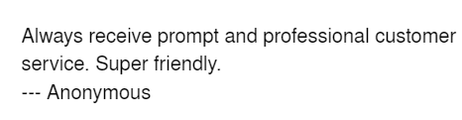
Customer Feedback Survey
The customer feedback form provides feedback regarding the system, the vehicles, and the staff.
Having a high overall customer approval rating is something to celebrate!
Individual kudos from customers is also something to congratulate staff on when a note is written. Make sure they are aware of it.
Does your website have quotes from your customers about how well your team serves your clients? Where can people find out more about your team?
Notes:
Customer feedback provides feedback regarding the system, the vehicles, and the staff. The system will average the scores of the forms filled out and provide your fleet with a running percentage of happiness. It also provides great information for your staff, Testimonials from clients and overall awareness of the fleet.

Slide 43
Customer Feedback Survey
Goal is 90% or higher for Customer Satisfaction!
Source
TOOLS>SEND EMAIL>GET FEEDBACK
Notes:
The customer feedback survey is easy to send out and is such a helpful tool to make sure your story is a positive one. Clients send this out at different intervals so you can send it out when it is best for your fleet. Examples include monthly, quarterly, or annually. Customers can also do the survey at the time of vehicle return if you so choose to have that link in your kiosk screen. The advantages to sending it out more often is that if there is an issue that needs addressed it can be addressed sooner rather than later.

Slide 44
Recap of Key Performance Indicators to Help Tell Your Fleet Story

Slide 45
KPI Best Practice Recap
Utilization: 80% goal and can save $$$ with right-sizing
Track number of completed reservations: A to B
Cost per mile: Manage expenses by using the lowest cost vehicles to support your activity
Track total cost of ownership to find most cost-effective vehicles
On-time preventative maintenance: 100% within 14 days
Technician productivity: 75% or higher, this equates to an average of 6 Hours of direct time per day
Customer Satisfaction: >90%
Notes:
To recap the story telling and where to find your story remember this list of KPIs may be good for your fleet but it may also be different because each fleet is different. But it is a starting point. KPI's should ALWAYS support the goals of the business and can be made up of a variety of items. If there is a certain calculation that you want to figure out or a number that you need ask us and we can help you find that information in the system.

Slide 46
Important Stories To Share
Saved $200K in Capital Expenditures by reducing the fleet by 10 vehicles
Increased technician productivity from 74.8% to 75.2% over the last 12 months
Traveled 1.8 Million miles in 2021
Completed 12,000 reservations resulting in $124K in Staff Savings
Implemented car sharing that resulted in better utilization of the fleet.
Notes:
Remember the stories are different but no matter how little or big of a story your story deserves to be told. These are just a few examples of stories.

Slide 47
What is Your Headline to Your Story?
Notes:
While listening to this presentation I am sure that you started thinking about some things about your fleet. What you are doing well and what you could maybe improve on.
So, we are back at audience participation now. It looks like this gentleman is celebrating something. We all have something to celebrate. I want to know what is the Headline of a story you could tell about your fleet in the last 24 months. Ask for audience participation. Call on a few people if necessary.
My job is to get your wheels turning because I know you are all doing great things.
Thank you for sharing for all of you that did. I appreciate it and if you want help developing the charts or taglines you let the staff know and we are here to help.

Slide 48
Best Practices for Audit Compliance
Notes:
Okay I know that was a long group of slides and we are going to move onto the next topic but first I want everyone in the room to stand up. I want you to first just stretch a bit but then I want you to look at the person next to you and tell them something positive about them. It may be their hair looks great or you like their watch. Just spread that kindness for just a few seconds then I want you to go ahead and take your seats again. Now this isn’t permission to leave the room it is just a minute stretch break because you are doing so well.
Now we are going to move on to our next topic which is near and dear to my heart because prior to my fleet life I was a manager for Norwest/Wells Fargo Banks and I always said that you better be able to prove every move you make to the auditors. In other words be honest and follow the rules. That is true in fleet as well.
The great news about Audit Compliance is the Fleet Commander System has many automations that you can activate to make sure your fleet is following policy and best practices. The last headline any fleet wants is that thousands of dollars were embezzled in parts from ABC Fleet. So lets take a look at these automations and I challenge you to look at the set up in your system and make sure you have all of the proper settings set up properly.

Slide 49
Make Sure Users Acknowledge Your Fleet Safety Policy
It is important to have users acknowledge the policy electronically prior to using vehicles and then on a set schedule there after
CONFIGURE>ENTERPRISE SETTINGS>POLICY
Notes:
It is vital that you have a good strong fleet safety policy and that policy needs to be acknowledged by the drivers/users of the system. Making sure that they have to electronically acknowledge the policy prior to using it and then at a set incremental time frame afterwards is important. This will time date stamp when an employee excepted the policy and acknowledged that they read the policy. If in accident should occur or the driver breaks a rule this is so important to have in your line of defense.

Slide 50
Track Certifications by User
MANAGE>USERS> (Pick the User) >CERTIFICATIONS
Notes:
Tracking certifications are also important if certain training requirements are needed to drive certain vehicles. I know that the worst accident we had while I was a fleet manager required me to prove all kinds of information and Fleet Commander allows you to track the training and also keep copies of the certifications via user.

Slide 51
Assign Users Appropriate Access Groups
MANAGE>USERS (pick appropriate user)>EDIT
Notes:
Fleet Commander also allows administrators to assign users appropriate access groups based on individual access groups created specifically for your fleet. In this example the driver can have access to standard vehicles and vehicles that require Live training but the driver can not have access to 15 Passenger vans because they do not have the training.

Slide 52
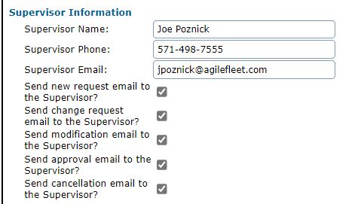
Set up Emails Appropriately for Audit
MANAGE> USERS>
(pick appropriate user)> EDIT
Notes:
This is one of the sections of the system that I think fleet managers and fleet staff need to really think about. So this has to do with what emails get sent to the supervisor of a driver.
When my fleet had purchased the system this is how we satisfied Audit’s need for an intramural purchase order. Remember that piece of paper that we talked about when we discussed the time savings. To the director or person responding to audit it is important that these boxes are checked so if this person is not to have a vehicle the supervisor will get an email and they can tell fleet that that particular employee should no longer be allowed to take the car. Think about this. If the dispatcher doesn’t know the purpose of these check boxes and has a customer come up to them and say hey my boss is tired of getting emails about my reservations can you please not send those and the dispatcher unchecks the box then the supervisor is no longer going to get those emails. Before the dispatcher should uncheck that box, I would require an email from the supervisor stating they are requesting to not get the emails and why so if an issue comes up you are protected from audit. The president’s office staff is about the only one I can think of that I shut it off for but I also had them send me an email.
It is the little things that we don’t always think of the repercussions. That is why it is important that staff have an understanding of the system and that you openly communicate about these settings etc.

Slide 53
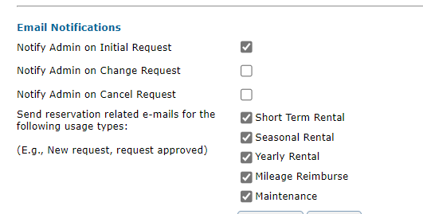
Site Setting Automation
CONFIGURE>
SITE SETTINGS>
(pick appropriate site) >
RESERVATIONS
Notes:
You also can set specific sites up for certain emails. Again just think about the process from the beginning to the end. What is the purpose of you checking or unchecking the box. Why is your system set up like it is.

Slide 54
Site Setting Automation
CONFIGURE>
SITE SETTINGS>
(pick appropriate site) >
RESERVATIONS
Notes:
Automation on site settings can really create efficiencies in your fleet. Enabling emails for late pick ups and returns. Setting up automatic cancellation of reservations for no shows. These automations save time and money that goes directly to your bottom line.

Slide 55
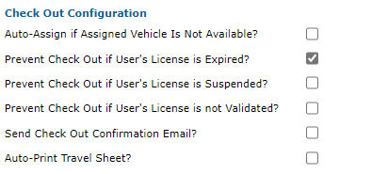
Prevent Check Out at Kiosk if User's License is Expired
CONFIGURE>SITE SETTINGS>(choose kiosk)>KIOSKS> (Check as appropriate for your fleet)
Notes:
Settings around License checks and license expirations etc. Know how to set up your system. What is the end goal and ask before you just change a setting in case you do not know the impacts.

Slide 56
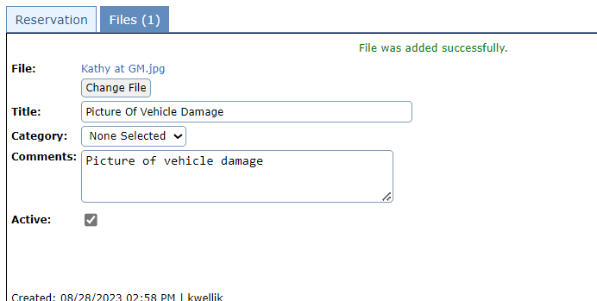
Add Files to Reservations, Vehicles, or Users as Needed
After adding the document or picture you can access it by clicking the blue hyperlink.
Notes:
You can add files and attachments to reservations, vehicles, or users as needed. You can never have too much information.
Do you store training certificates under the user?
Do you store a copy of the title and registration under the Vehicles?
Do you store a copy of accident reports and pictures of the vehicles under the vehicle tab?
Do you store copies of the traffic ticket or toll bill under the reservation tab to bill back to whomever didn’t pay a toll during their trip?

Slide 57
Files You Can Save..anything!
Pictures of vehicles
Accident reports
Receipts
Purchase orders
Training
Copies of Insurance
Anything that you want
“We do not recommend storing Drivers Licenses numbers or personal information.”
Notes:
Here are some more examples of files you can save. Also, please note we do not recommend saving drivers licenses numbers or personal information in the system for privacy purposes.
Does anyone have any unique things they keep copies of in the file sections of the system?

Slide 58
You Have Your Data. You Know Your Story. You Are Ensuring Compliance. Now Go Tell Your Story!

Slide 59
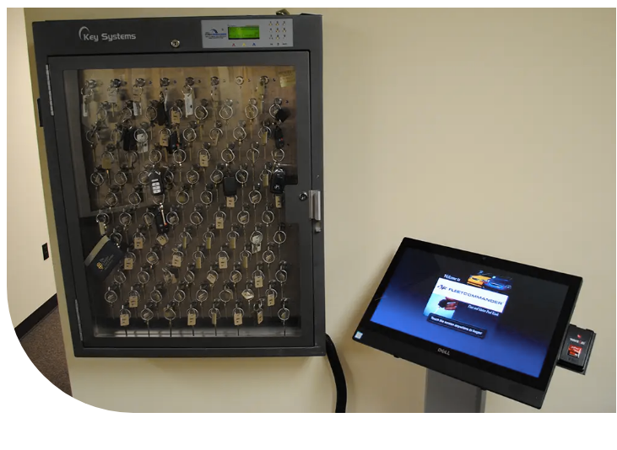
Tell Your Story
Relate the story to your audience
Customers - Advantages of the system
Finance Staff - Money savings
Fleet Staff - Convenience of auto approval and other automation
Fleet Director - The number of vehicles that can be adjusted to right-size the fleet.
Auditors - Built-in safety nets of ensuring people only use vehicles they are trained for. Making sure supervisors approve of the trips.
One picture equals at least five different stories.
Notes:
So now when you look at a picture or think of a situation in fleet, I hope you can look at the situation more than one way. Put yourself in your audience’s shoes so you know what story to tell.

Slide 60
Celebrate Success
Watch trends and celebrate milestones such as the 50,000 reservation!
Celebrate high utilization reports and the money you are saving to your operation managers
Celebrate high customer satisfaction scores or comments customers have left
Celebrate number of work orders closed by technicians
Celebrate your customers success
Notes:
Go celebrate success in any way. Here are some ideas.
Watch trends and celebrate milestones such as the 50,000 reservation! Give the customer a prize
Celebrate high utilization reports and the money you are saving to your operation managers
Celebrate high customer satisfaction scores or comments customers have left with a prize for your staff members
Celebrate number of work orders closed by technicians or turn it into a friendly competition to see who can be the most productive
Celebrate your customers successes. One of the things that Ed does is sends the staff information about our clients and the work that they do and just knowing that we are a part of getting those DHS workers to pick up a child in the middle of the night because we have automated key boxes for clients. Knowing that your vehicles take students to conferences where they learn skills to change the future. Celebrate the little things for one day they are the big things.

Slide 61
Apply for Awards to Highlight Your Fleet
100 Best Fleets with NAFA
50 Leading Fleets with GFX
NAFA’s Green Fleet Contest
NCSFA Fleet Excellence Award
Notes:
I also encourage you to apply for different awards for your fleet.
These awards help raise awareness of your fleet
Show management the great job your staff is doing
Provide confidence in your clients that they are being served by people who care and want to do the best they can to make sure their vehicles are Safe, Reliable, & Cost Effective to get their job done. I know many of you and you are doing great things. Apply and the judges will help you if you don’t make it to teach you where you could improve but most of these contests it comes down to your metrics and I showed you today where to find those metrics.

Slide 62
Questions

Slide 63
Thank you for being part of the Agile Fleet Family!
Notes:
Thank you for being a great audience and for your participation. Remember this week is a great time to see what your peers are doing and to ask our Agile Fleet staff questions. Let us help you and Thank you for being part of the Agile Fleet Family!

