Slide 1
Welcome
Sammy Parcell
Director of Fleet Management
University of TN, Knoxville

Slide 2
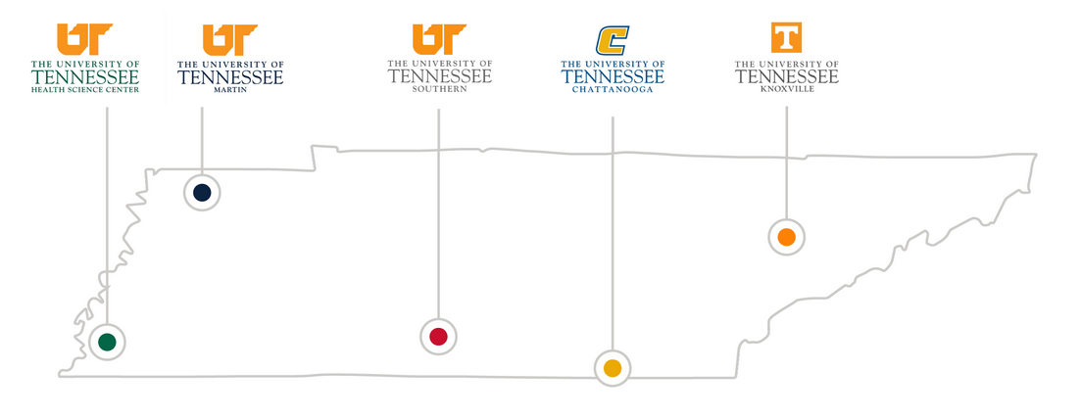
You’re in Big Orange Country now
Flagship campus for the UT System

Slide 3
Where the rubber meets the road
Location and services offered
Fleet composition
Customer base

Slide 4
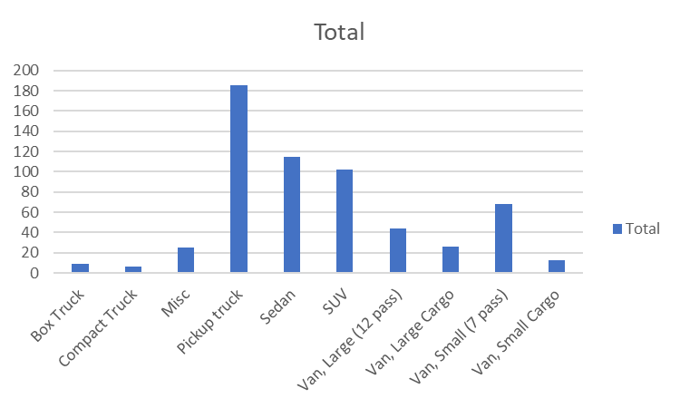
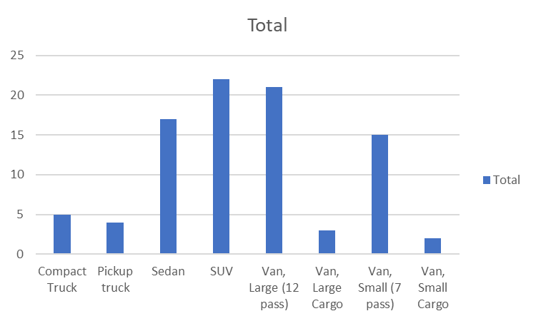
What are we driving?
~600 asset ‘managed’ fleet ~90 asset STR fleet

Slide 5
A little ‘long in the tooth’
‘Managed’ asset count by fleet model year

Slide 6
Stats
During FY22, 4000+ rental reservations – average of 2.5 days
Over 3000 users with a potential of 70k+ renters
Of the 3.7m miles travelled in FY 22, 42% was within a 10-mile radius
Over 2000 service-related work orders including 700 PMs

Slide 7
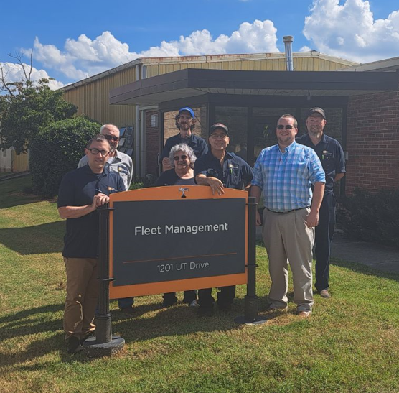
The Reason for our Success
Varied backgrounds, training, and certifications
Years of service
Current staff of eight FTEs encompassing 75 years of fleet experience who own their areas

Slide 8
Where we came from…
Transition from System to Campus
Technology
Fleet practices
Staff size and structure

Slide 9
We’re on a highway to…progress!
Streamlining our operation
Rates and chargeback changes
Digitization of records and processes
Increasing our value proposition

Slide 10
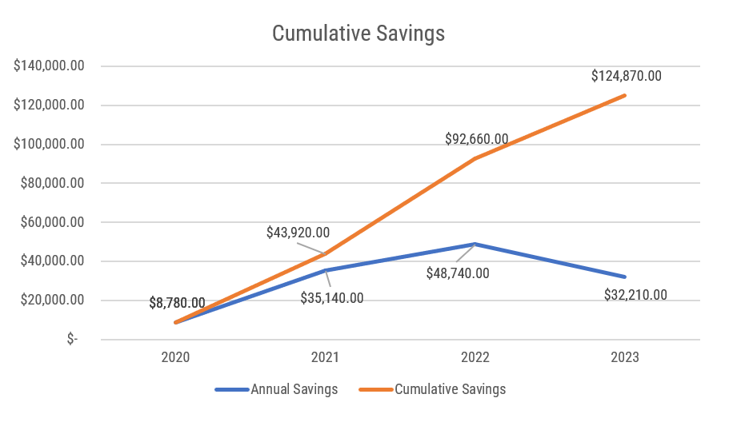
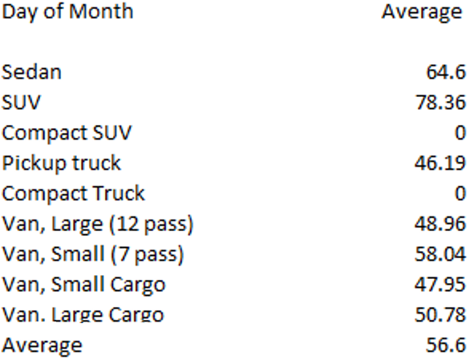
The Agile Advantage
FleetCommander software & key boxes
Consolidated and customized billing processes
Customer Support in association with their Core Values

Slide 11
Where we stand today…
Experienced staff
Satisfied customers
Cyclic business
Software and process strength
State of mind

Slide 12
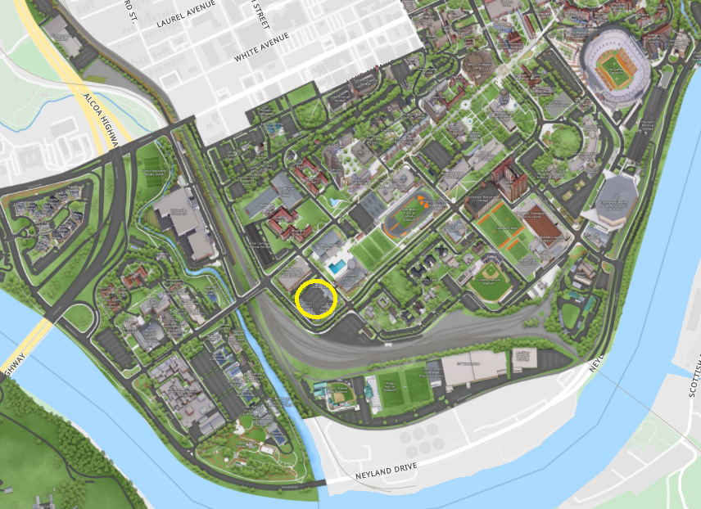
Current opportunities for improvement
Fleet composition
Fleet products
Policies
Hiring
Relocation

Slide 13
Where we’re headin’…
New vehicle technologies
Creation and enforcement of fleet policies
Fleet composition
Progress towards a more consolidated software hub
Telematics integration
Find interactive ways to engage users
Explore the growing topic of AI

Slide 14
Videos
Testimonial
Instructional Explainer

Slide 15
No matter where you are. No matter how far.
The University of Tennessee, Knoxville – Fleet Management Department
1201 UT Drive, Knoxville, TN 37996
fleetmanagement@utk.edu, sparcell@utk.edu
865.974.2134
Fleetmanagement.utk.edu

