Slide 1
Managing Your Site
Introduction to FleetCommander Web Design
September 27, 2023

Slide 2
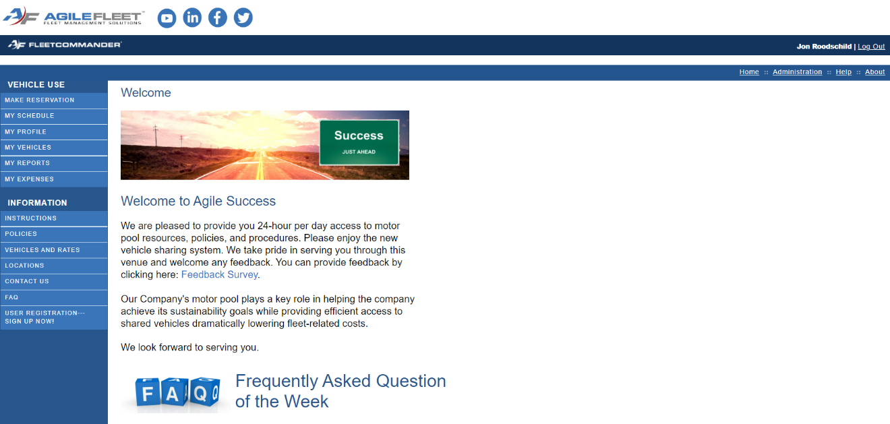
What We’ll Learn
Introduction to FleetCommander Web Design
Importance of a Great First Impression
Understanding the Anatomy of Web Pages
FleetCommander: Areas of Editable Content
Content Areas (Page vs Zone)
Enterprise and Site Level Content
BONUS: FCUC Bright Idea
FleetCommander’s In-Solution Layout Editor
Before You Make Changes – NotePad
Using WYSIWYG vs HTML
SESSION TEAM EXERCISES (throughout presentation)
FleetCommander Layout Templates (NEW!)
QUESTIONS?
BONUS TEAM ACTIVITY: “Building on What You Know”
Additional “Study” Materials

Slide 3
Importance of a Great First Impression

Slide 4
Making a GREAT First Impression
What you do and say IN PERSON has a BIG IMPACT on your relationship with those around you.
Your presence ONLINE ALSO has a BIG IMPACT on your relationship with those you engage with.
Warm Smile
Dressed For Occasion
Welcoming Posture
Overall Presence of Confidence

Slide 5
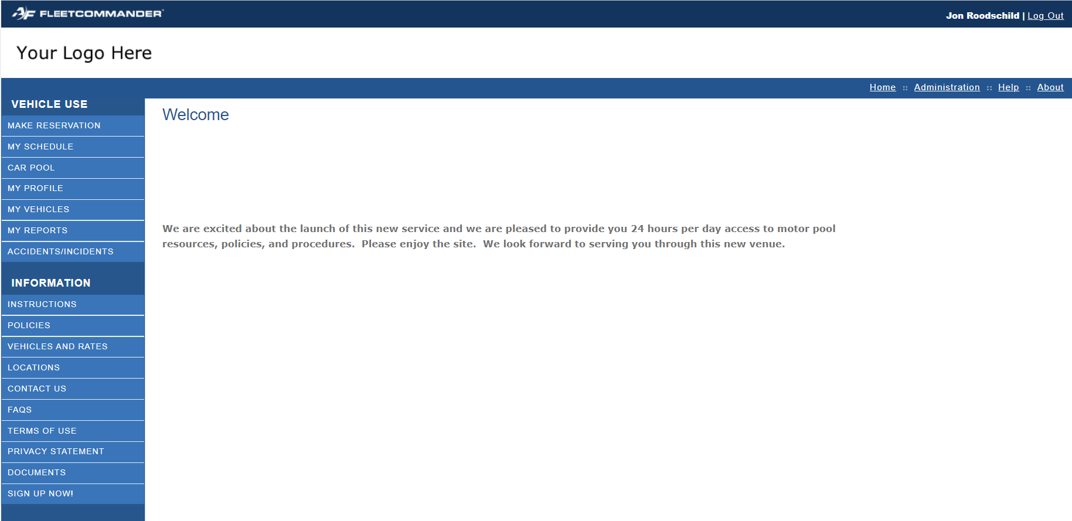
Is this your FleetCommander site?
What IMPRESSION are you making?

Slide 6
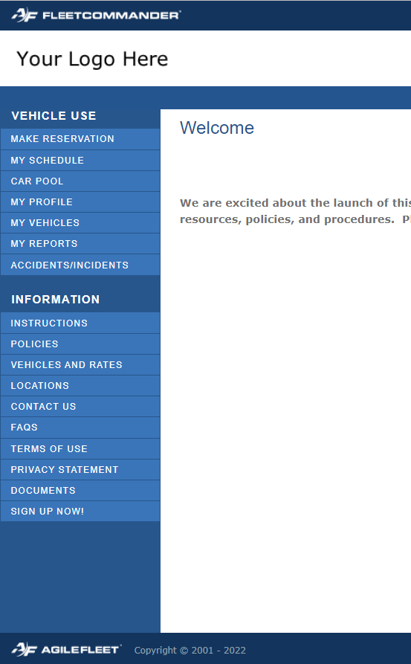
What’s wrong with defaults?
Content is stale, i.e., never changes
Fleet guidance is not shared (driving and safety tips)
Fleet policy is not communicated
Unneeded Navigation/Menus are displayed
Your successes are not told
Your “brand” is not reflected well (logo, messaging)
POOR FIRST IMPRESSION!
GOOD NEWS: you CAN spruce up your FleetCommander site!

Slide 7
Tailor FleetCommander To Your Operation!
Step beyond static, non-engaging default settings…
… to a presence that demonstrates and celebrates the value of your operation!

Slide 8
Understanding the Anatomy of Web Pages

Slide 9
Understanding the Anatomy of a Web Page
The anatomy of a website refers to the way a website is structured.
Websites are a sum of many individual parts
There are SIX standard website parts found in FleetCommander
Da Vinci’s Dude says: “It’s time to make your FleetCommander site ROCK!”

Slide 10
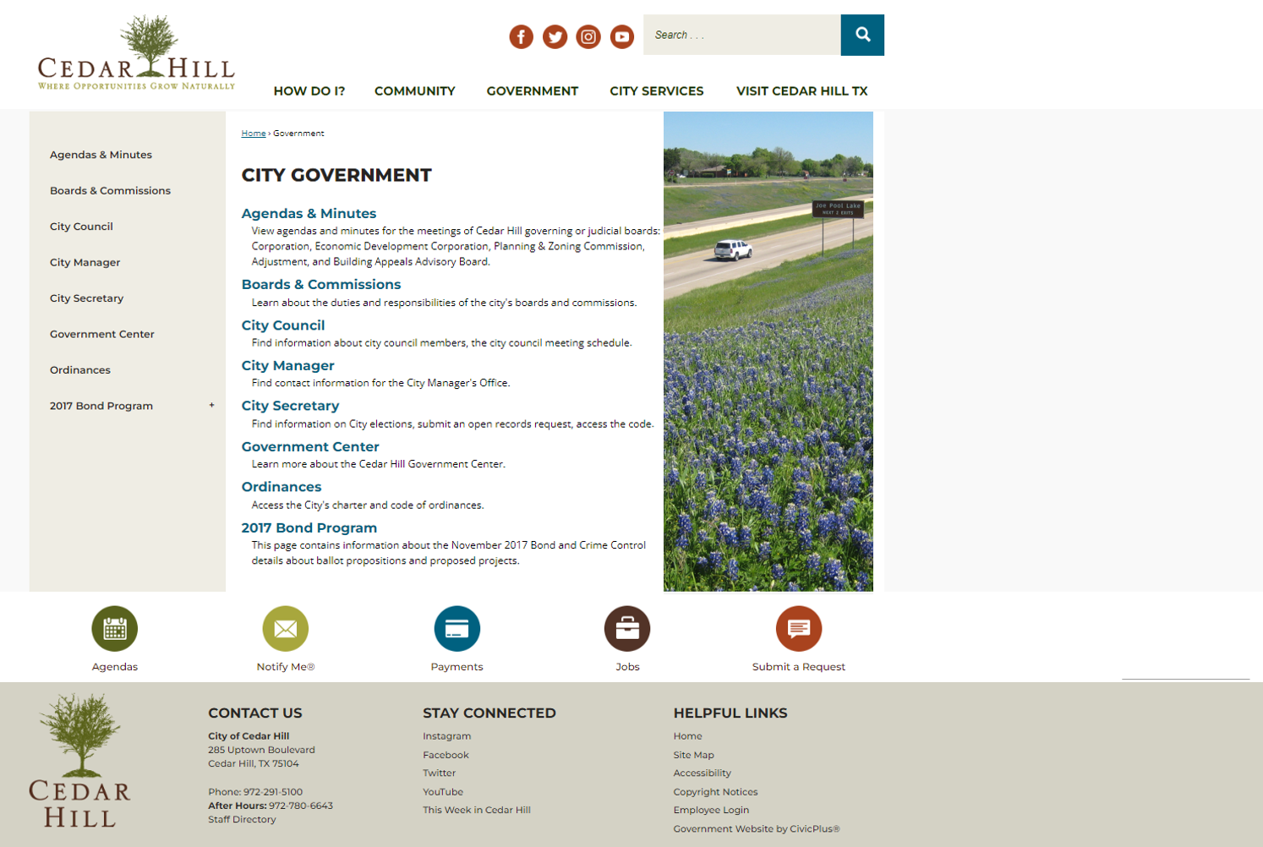
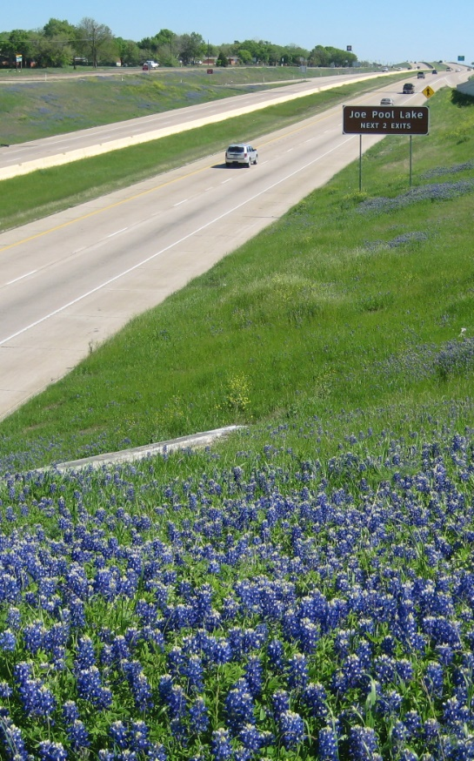
Standard Website Parts To Know
The Header
User Navigation and General information
Shared images and content
Your organization’s messaging
Call to Action (CTA) buttons (aka do something)
The Footer

Slide 11
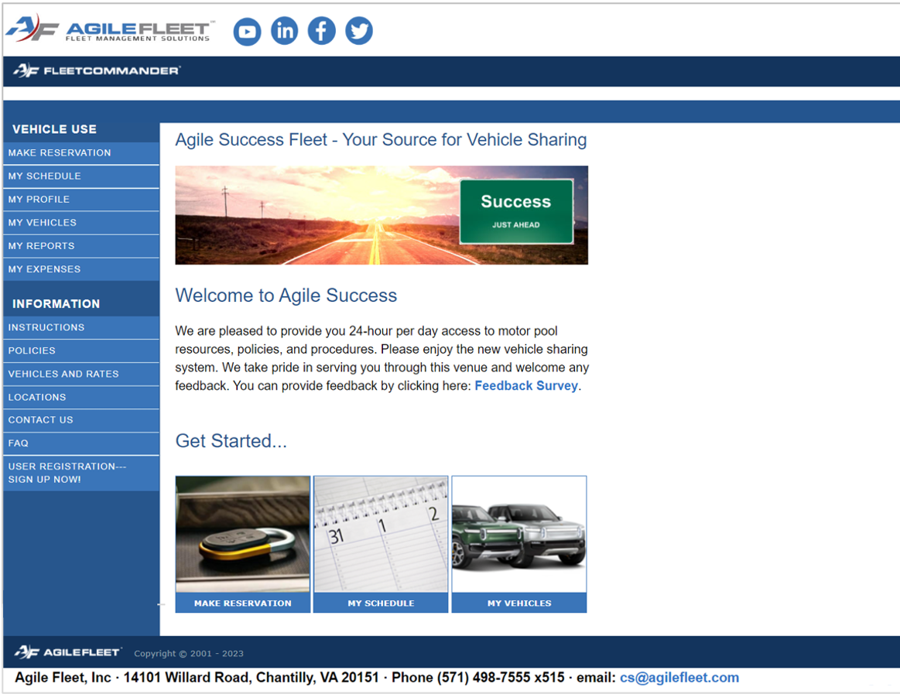
Standard Website Parts To Know
The Header
User Navigation and General information
Shared images and content
Your organization’s messaging
Call to Action (CTA) buttons (aka do something)
The Footer

Slide 12
FleetCommander: Areas of Editable Content

Slide 13
FleetCommander: Areas of Editable Content
Page Content SHARES INFORMATION about the SELECTED TOPIC
Make content relevant to the user and site
Keep information up to date
Embed links to resources
Remove links not used
Zone Content HIGHLIGHTS important points, gives INSTRUCTIONS, and offers CLARIFICATION
Focus on ease of use
Answer questions before they are asked!
Be concise

Slide 14
Page Content Areas

Slide 15
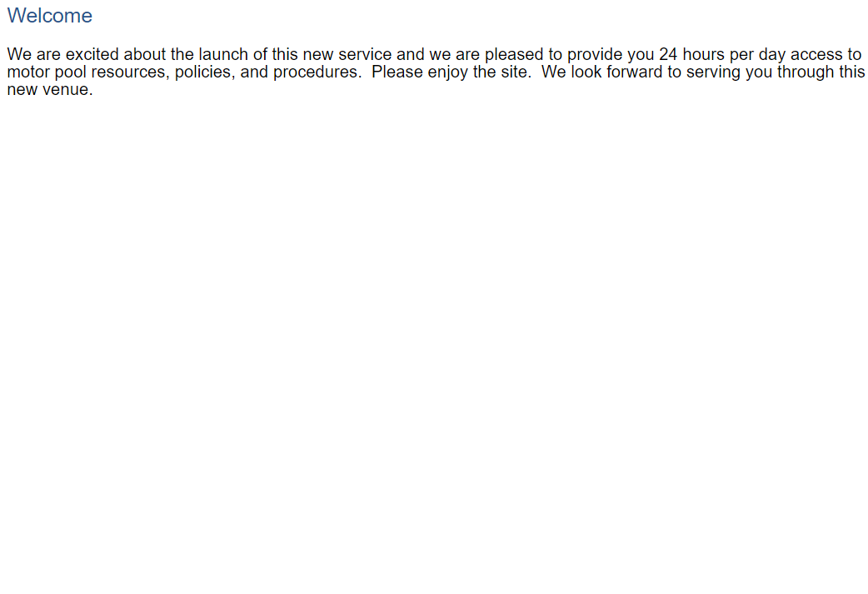
FleetCommander: Areas of Editable Content
Main Body of Welcome Page (as shown)
Main Body of the Information Pages (excluding Sign-up)
Page Content

Slide 16
FleetCommander: Areas of Editable Content
Layout Location | Page Content
Enterprise Setting>Layout | Contact Us Text
 | Document
 | FAQ Text
 | Instructions Text
 | Locations Text
 | Welcome Text
 | Privacy Policy Text
 | Terms of Use Text
 | Vehicle Rates Text
Enterprise Setting>Policies | Policies
There are 10 PAGE CONTENT areas can be configured in FleetCommander

Slide 17
Zone Area Content

Slide 18
FleetCommander: Areas of Editable Content
The Header
The Footer
Areas within the Vehicle Use Links
Areas within the Sign-up Now Link
Zone Content

Slide 19
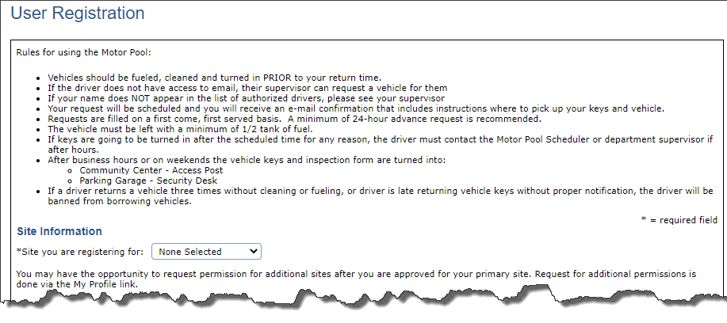
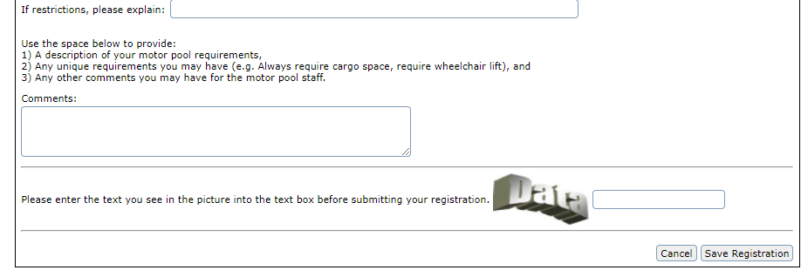
FleetCommander: Areas of Editable Content
Areas within the Vehicle Use Links
Registration > Text
Registration >Text -Comments Description
Zone Content

Slide 20
FleetCommander: Areas of Editable Content
Areas within the Vehicle Use Links
Make Reservation>
Help Text
Make Reservation> Help Text - Usage Type Selection
Zone Content

Slide 21
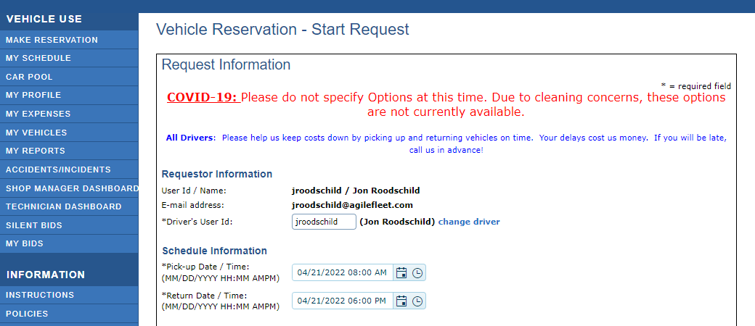
FleetCommander: Areas of Editable Content
Areas within the Vehicle Use Links
Make Reservation>
- Help Text Reservation Form
Zone Content

Slide 22
Additional Zone Content Areas

Slide 23
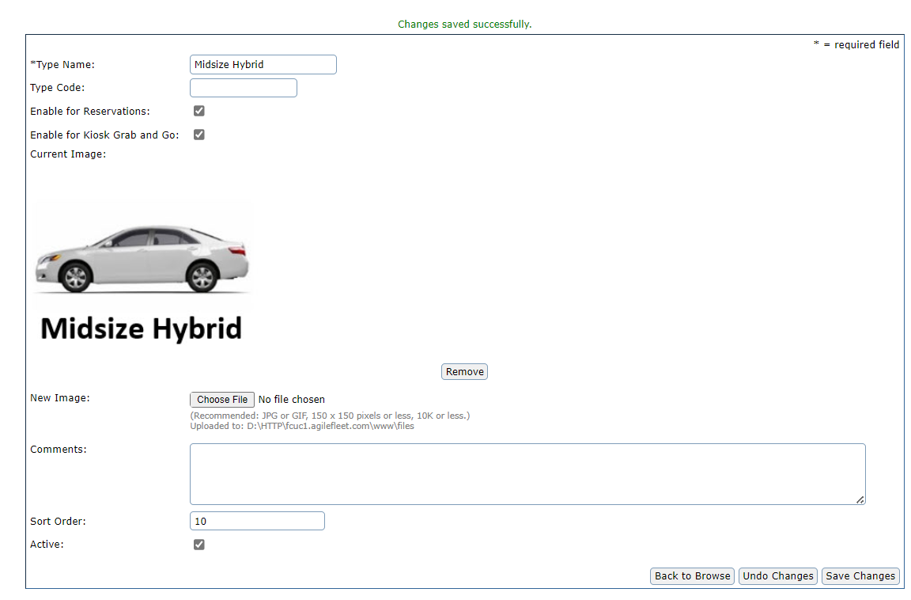
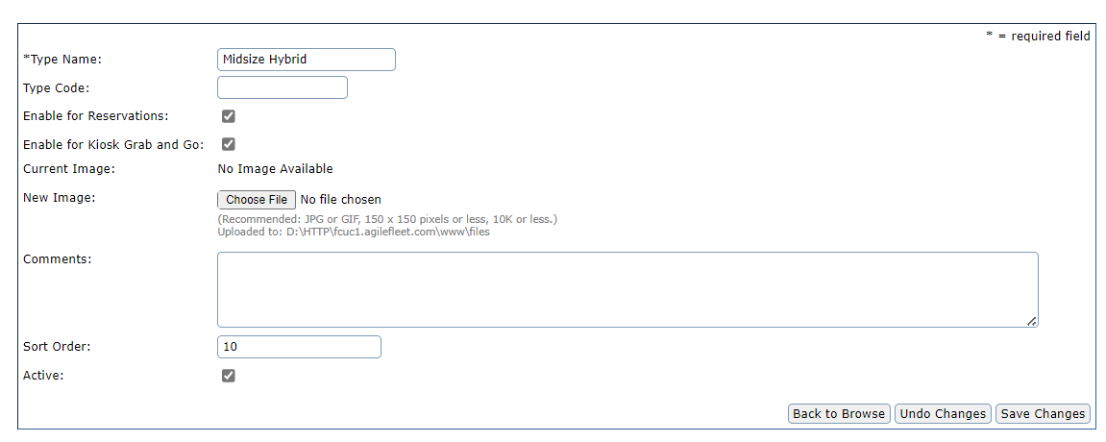
FleetCommander: Sectors of Editable Content
Vehicle Type
Images can be added via CONFIGURE>VEHICLES>TYPES
NOTE: these images will appear on the Kiosk Grab-n-Go Dashboard
Zone Content

Slide 24
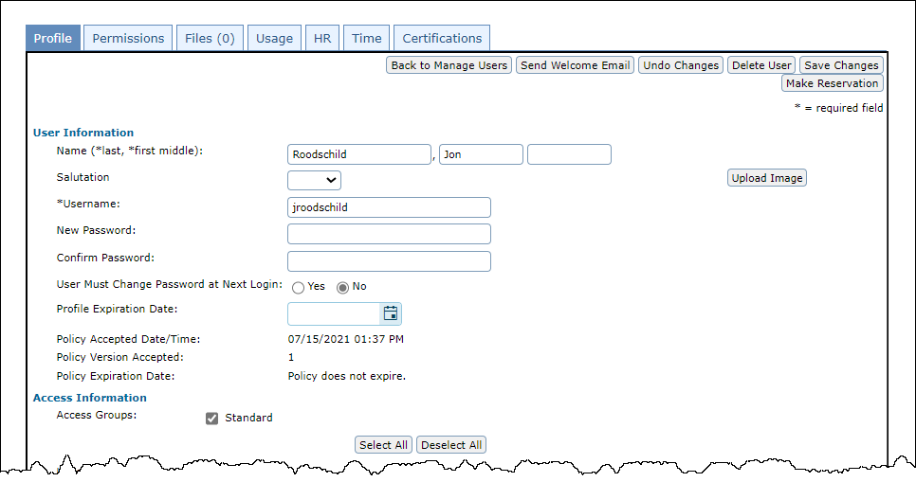
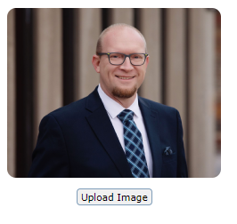
FleetCommander: Sectors of Editable Content
User Profile
Images can be added via MANAGE>USERS>PROFILE
Zone Content

Slide 25
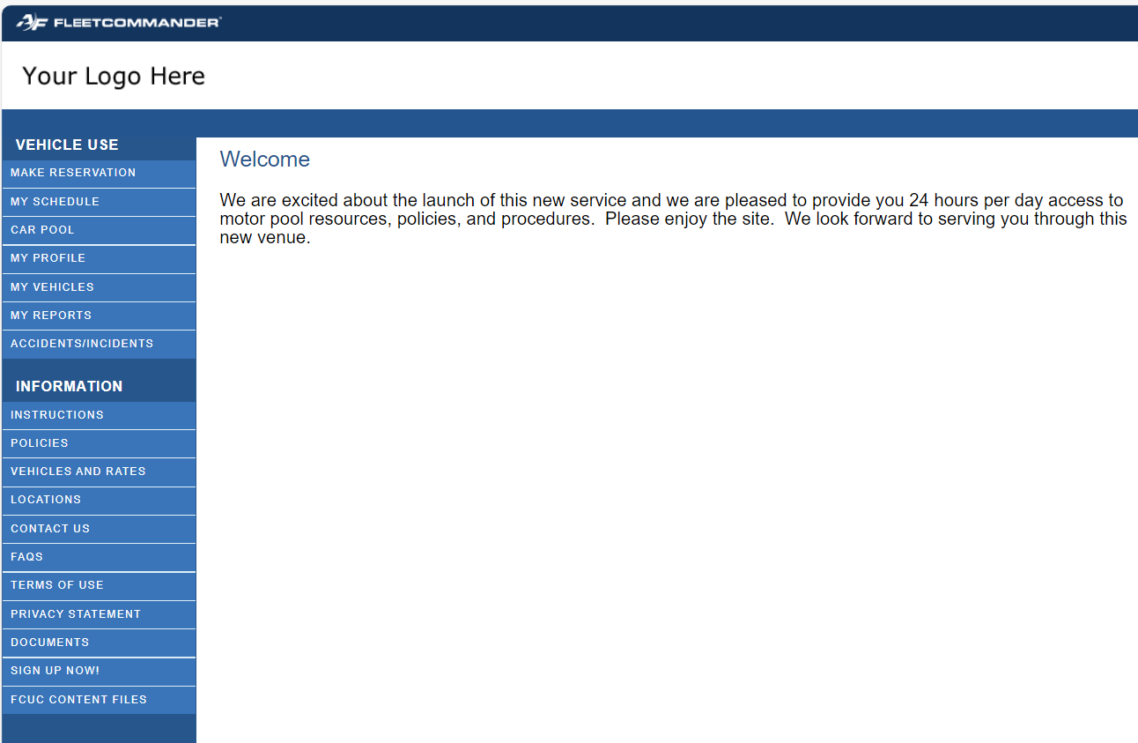
FleetCommander: Sectors of Editable Content
Custom Logo
Logo can be added via CONFIGURE>ENTERPRISE> CUSTOM LOGO FILE NAME
Zone Content

Slide 26
FleetCommander: Areas of Editable Content
There are 18 ZONE CONTENT areas can be configured in FleetCommander
Layout Location | Zone Content
Enterprise Setting>Layout | Feedback Form – Instructional Text
 | Footer Text – All Main Website Pages
 | Header Text – All Main Website Pages
 | Login Help Text
 | Make Reservation Help Text
 | Make Reservation Help Text - Usage Type Selection
 | Mileage Collection Instructions
 | My Profile - Dependents Text
 | My Profile Text
 | Registration Text
 | Registration Text – Comments Description
Layout Location | Zone Content
Site Setting>Layout | Make Reservation – Comments Description
 | Make Reservations Help Text - Confirm Page
 | Make Reservations Help Text - Reservation Form
Site Settings
Enterprise Settings

Slide 27
Enterprise and Site Level Content

Slide 28
Enterprise and Site Level Content
FleetCommander can be used to manage assets, users, and reservations at a single facility or at multiple facilities.
“Enterprise”
- is used to describe FleetCommander settings, and capabilities COMMON across the ENTIRE FLEETCOMMANDER INSTANCE, regardless of how many DIFFERENT FACILITIES the operation is dispersed across.
“Site”
- settings, and capabilities UNIQUE to each FLEET SUBSET managed as a GROUP within FleetCommander.
TIP: think of ENTERPRISE as the “umbrella” covering all the SITE “raincoats” under it

Slide 29
Configure > Enterprise Layout Content

Slide 30
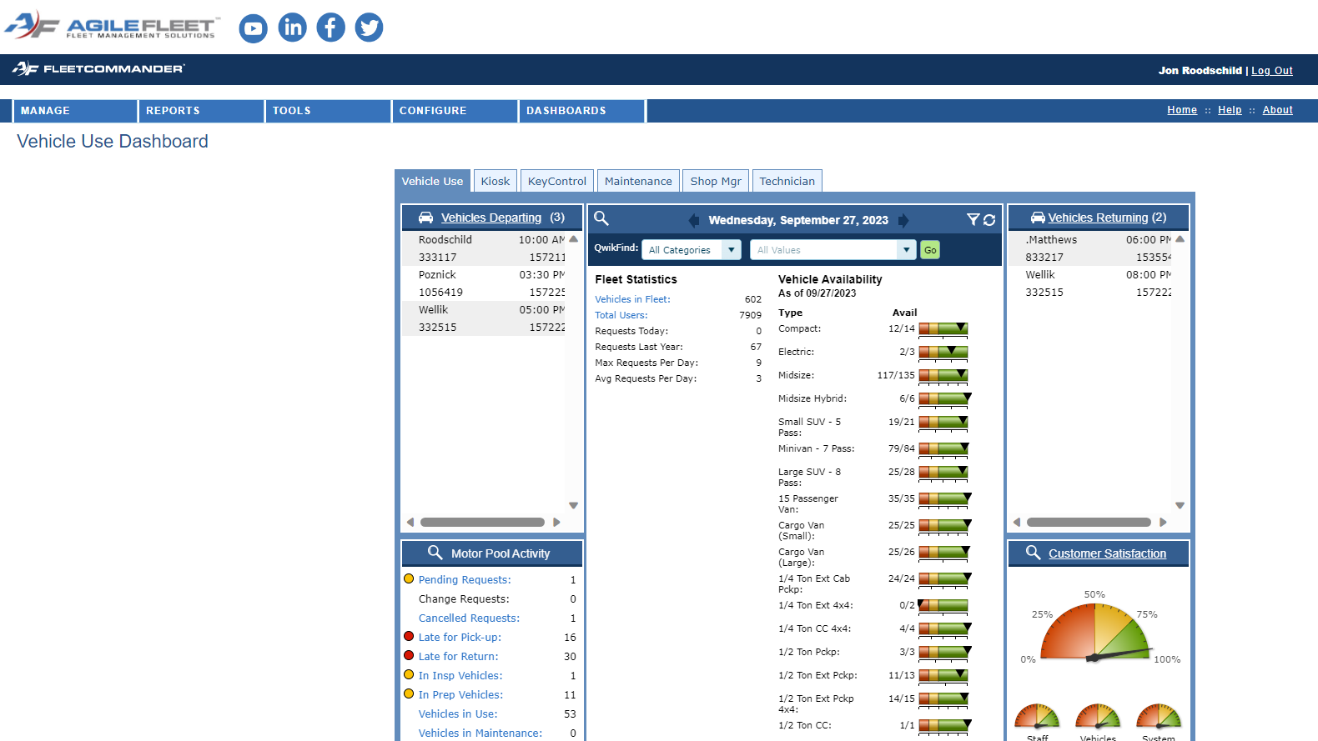
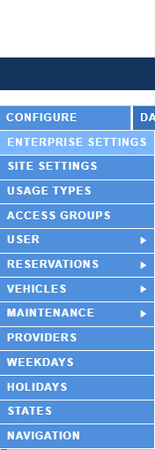
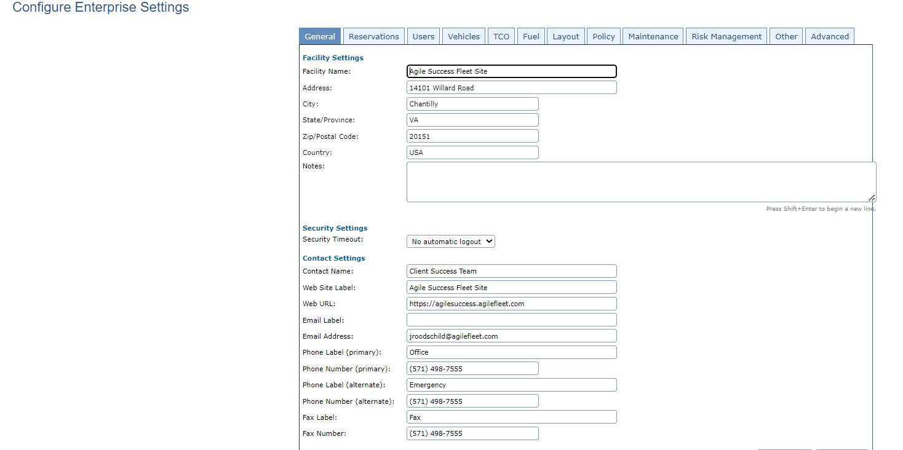
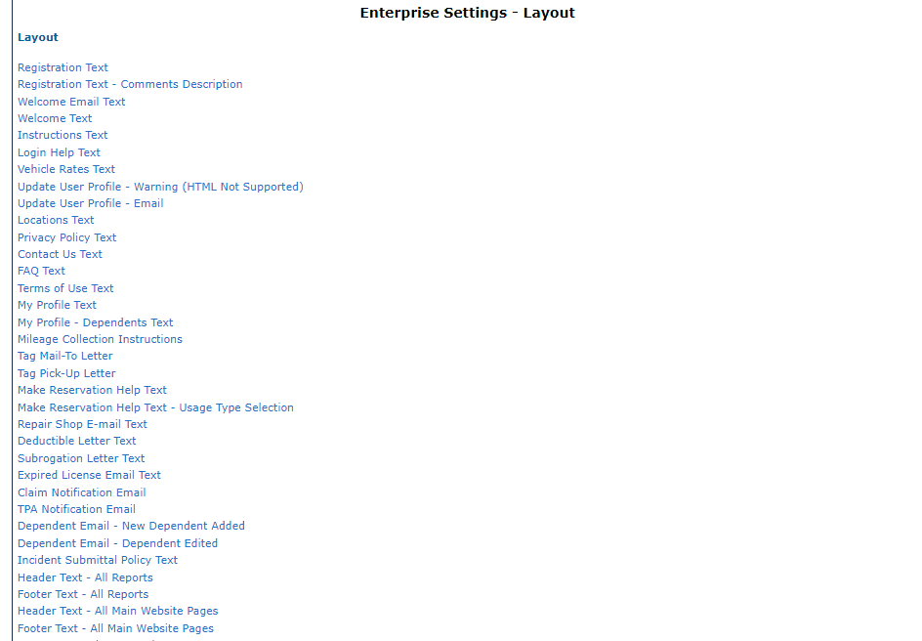
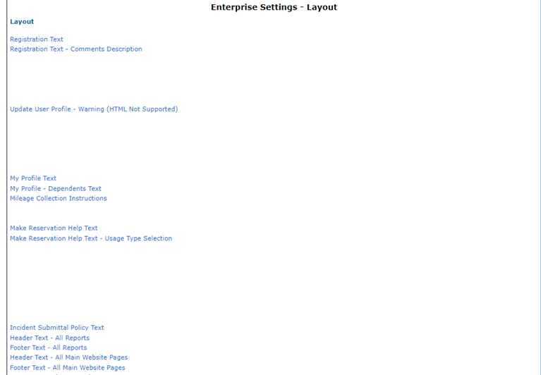
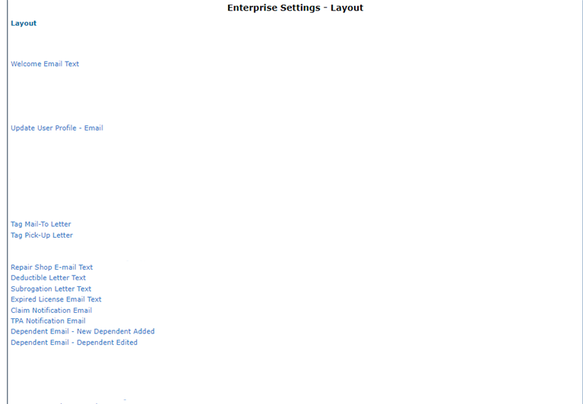
Make ENTERPRISE LEVEL changes via CONFIGURE>ENTERPRISE> LAYOUTS

Slide 31
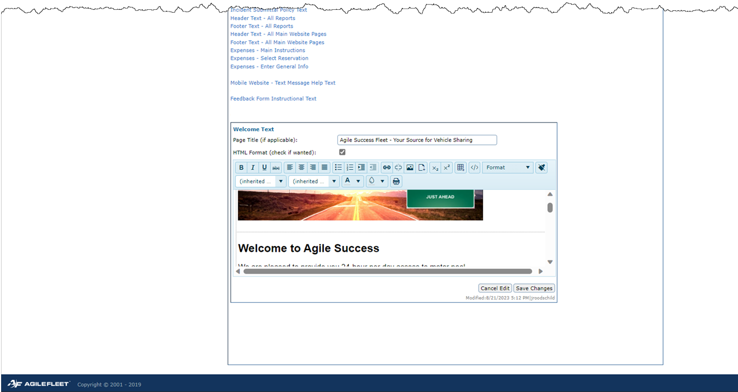
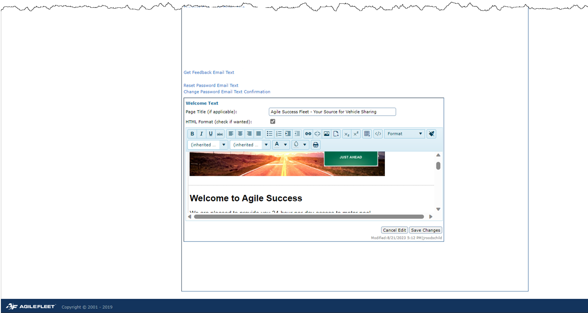
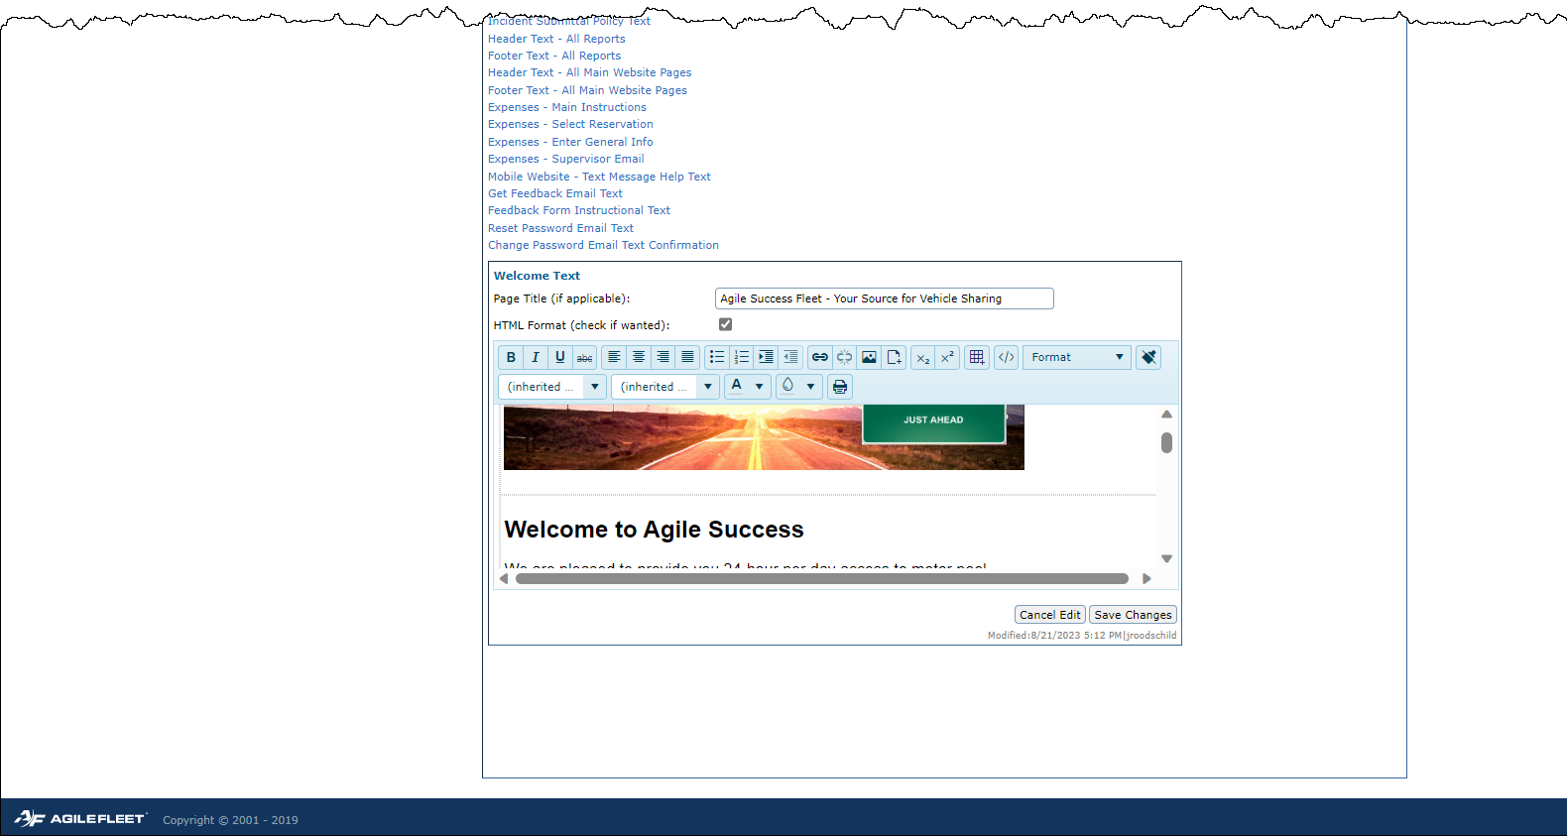
Make ENTERPRISE LEVEL changes via CONFIGURE>ENTERPRISE> LAYOUTS

Slide 32
Configure > Site Layout

Slide 33
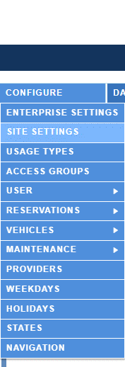
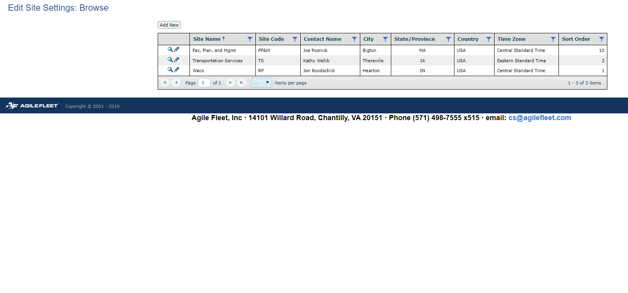
Make SITE LEVEL changes via CONFIGURE>SITE> LAYOUTS

Slide 34
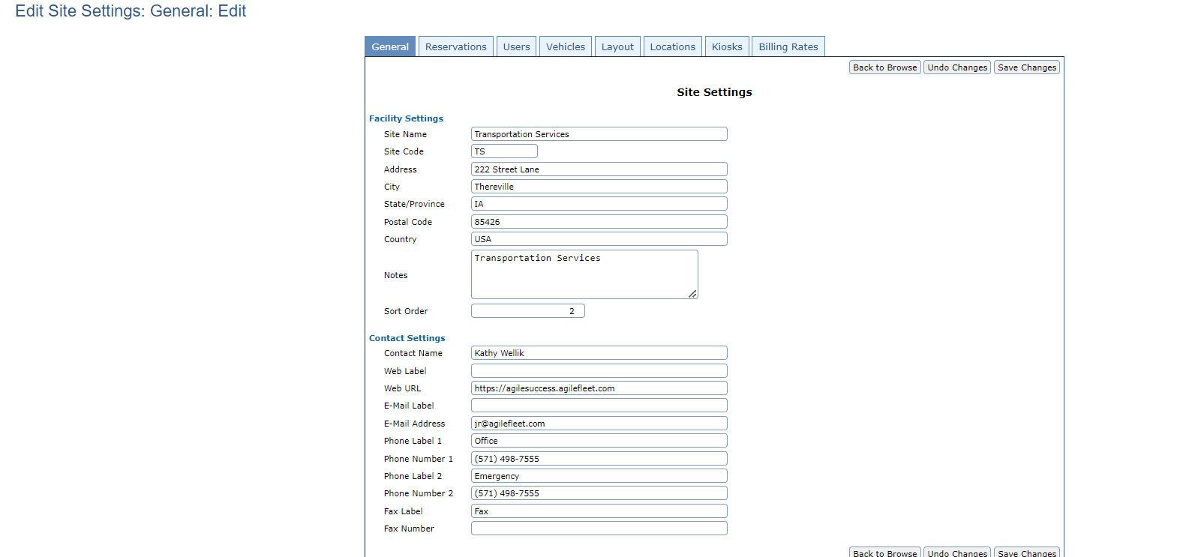
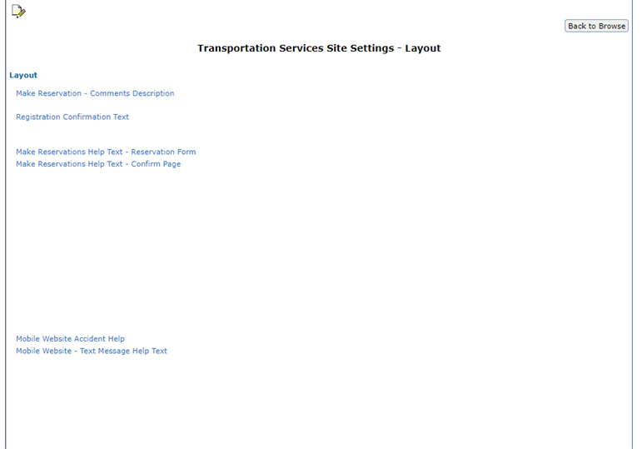
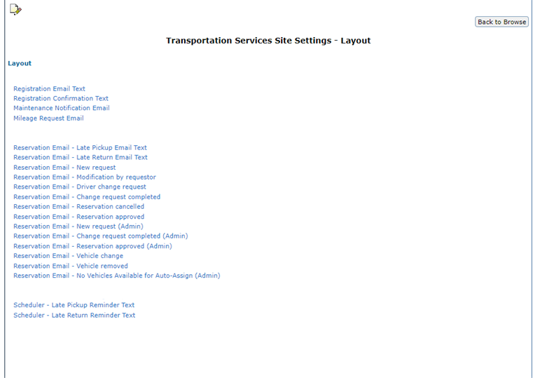
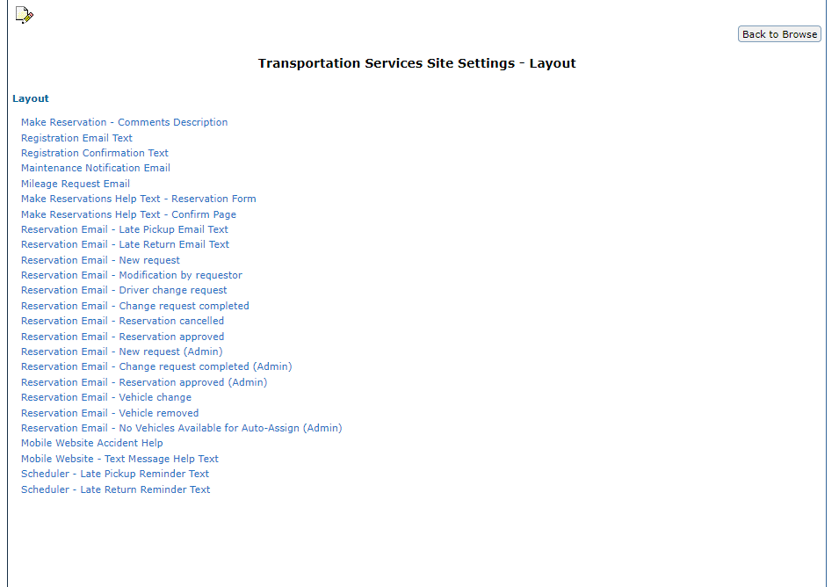
Make SITE LEVEL changes via CONFIGURE>SITE> LAYOUTS

Slide 35
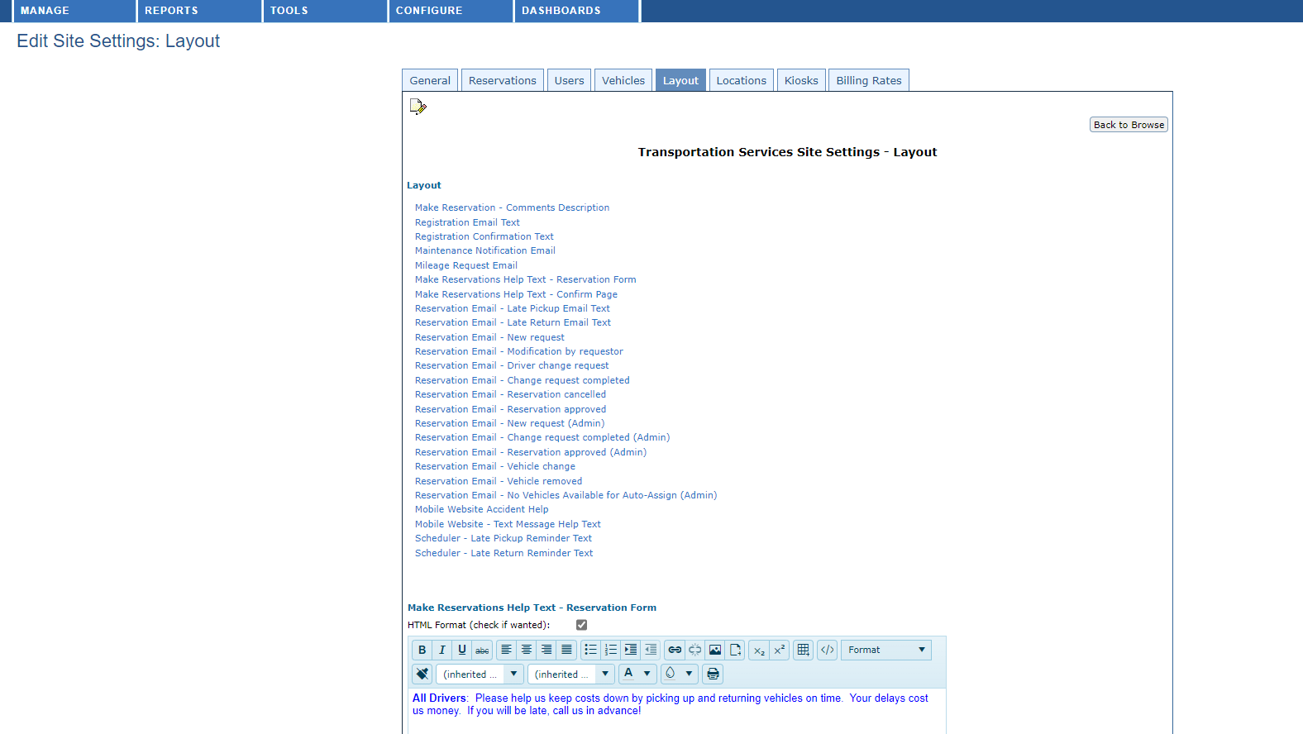
Make SITE LEVEL changes via CONFIGURE>SITE> LAYOUTS

Slide 36
FCUC BRIGHT IDEA: How Do I Find…?

Slide 37
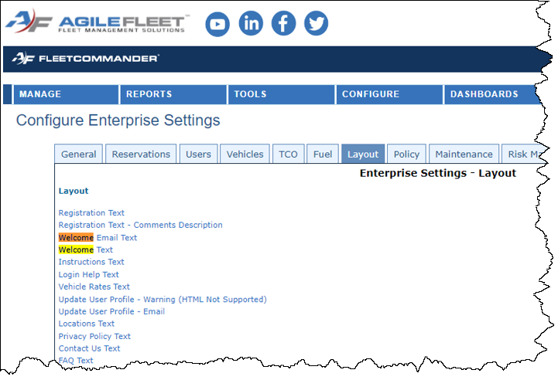
FCUC Bright Idea
Use <ctrl F> to conduct KEYWORDS SEARCHES…
… in Configuration>Layout Tab

Slide 38
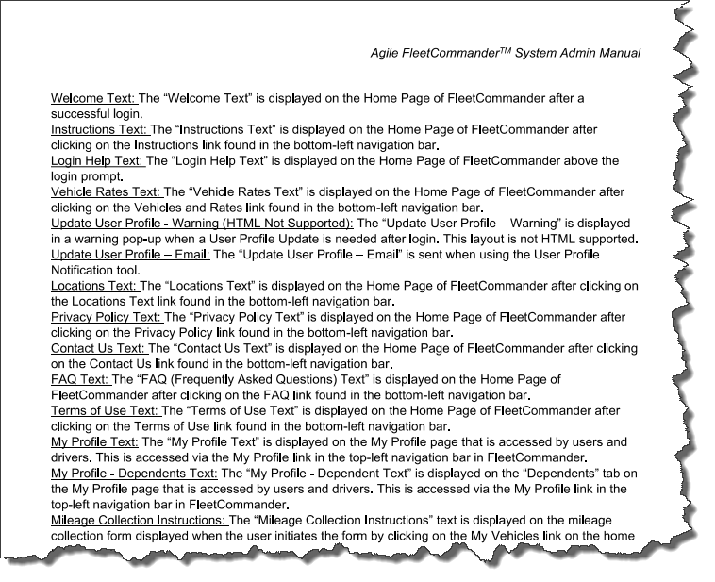
FCUC Bright Idea
Use <ctrl F> to conduct KEYWORDS SEARCHES…
… in FC Admin Manual (PDF)

Slide 39
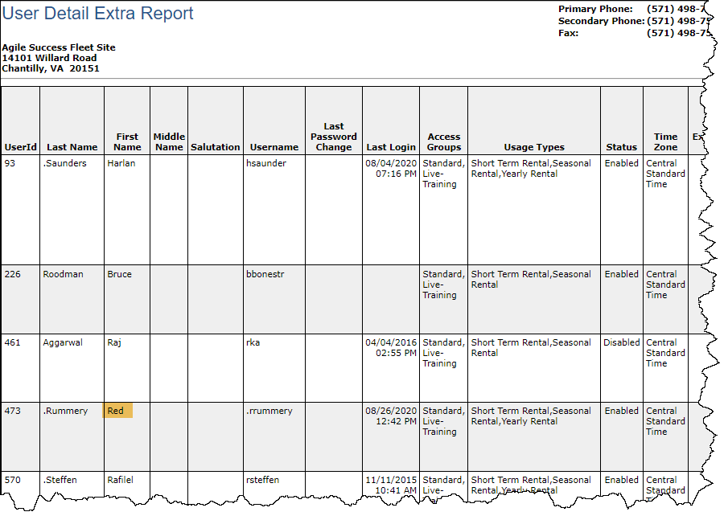
FCUC Bright Idea - BONUS
Use <ctrl F> to conduct KEYWORDS SEARCHES…
… in Report Outputs in HTML

Slide 40
Team Exercise One: Gathering Your Content

Slide 41
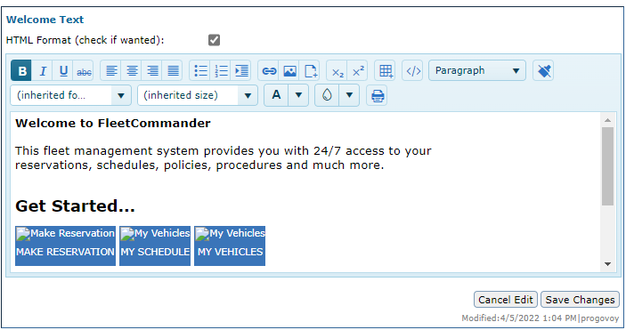
Customizing Pages
Managing your pages
You don’t need to know HTML!
All editors are WYSIWYG based
You can switch from Editor to HTML by clicking the </> button in the editor
Don’t use Word for HTML

Slide 42
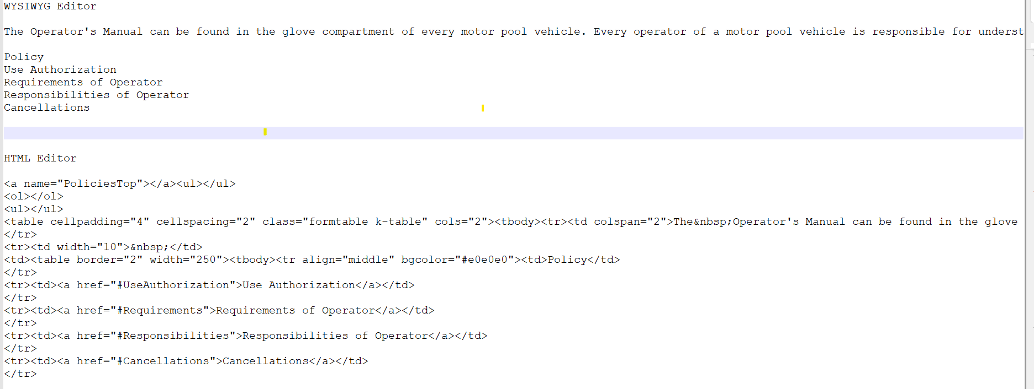
What to use– WYSISYG or HTML?
Select the tool you are MOST comfortable using
You don’t need to know HTML to make great improvements to your site
You can switch from Editor to HTML by clicking the </> button in the editor
Don’t use Word for HTML

Slide 43
Customizing pages – WYSIWYG Editor
Formatting with WYSIWYG uses ‘Word’ like tools.
Important:
DO NOT create your HTML in Word and paste it into the template.
Word adds extra HTML tags that are not usable.

Slide 44
Customizing pages – WYSIWYG Editor
Formatting with WYSIWYG uses ‘Word’ like tools.
Important:
DO NOT create your HTML in Word and paste it into the template.
Word adds extra HTML tags that are not usable.

Slide 45
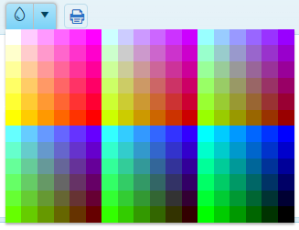
Customizing pages – WYSIWYG Editor
Formatting with WYSIWYG uses ‘Word’ like tools.
Important:
DO NOT create your HTML in Word and paste it into the template.
Word adds extra HTML tags that are not usable.

Slide 46
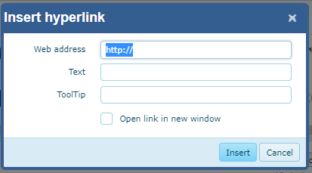
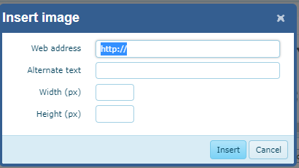
Embedding Links and Images

Slide 47
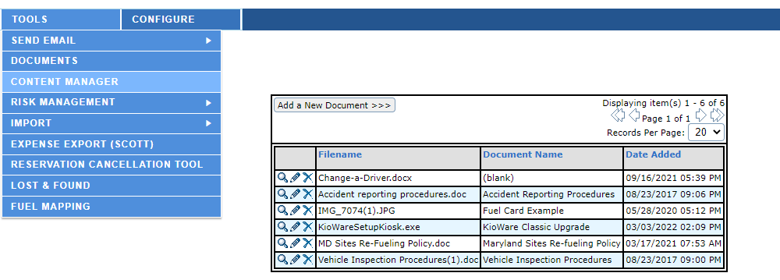
Embedding Links and Images
Use

Slide 48
Embedding Links and Images
64
64

Slide 49
A Note on “Missing” Images
If you have images missing, update the URL!
Image URL are no longer stored in Documents. Use Content Manager for the URL

Slide 50
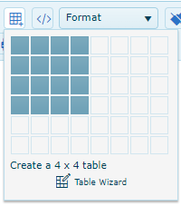
Customizing pages - Tables

Slide 51
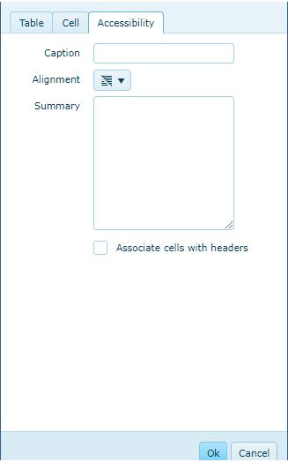
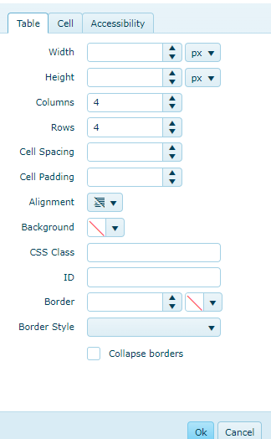
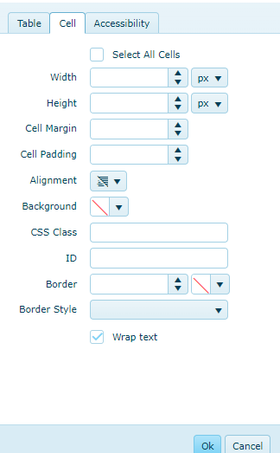
Customizing pages using the WYSIWYG Editor

Slide 52
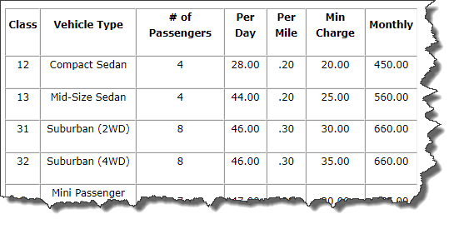
Customizing pages using the WYSIWYG Editor
Tables are great for rates!
TIP: single cell tables can be used as banners!

Slide 53
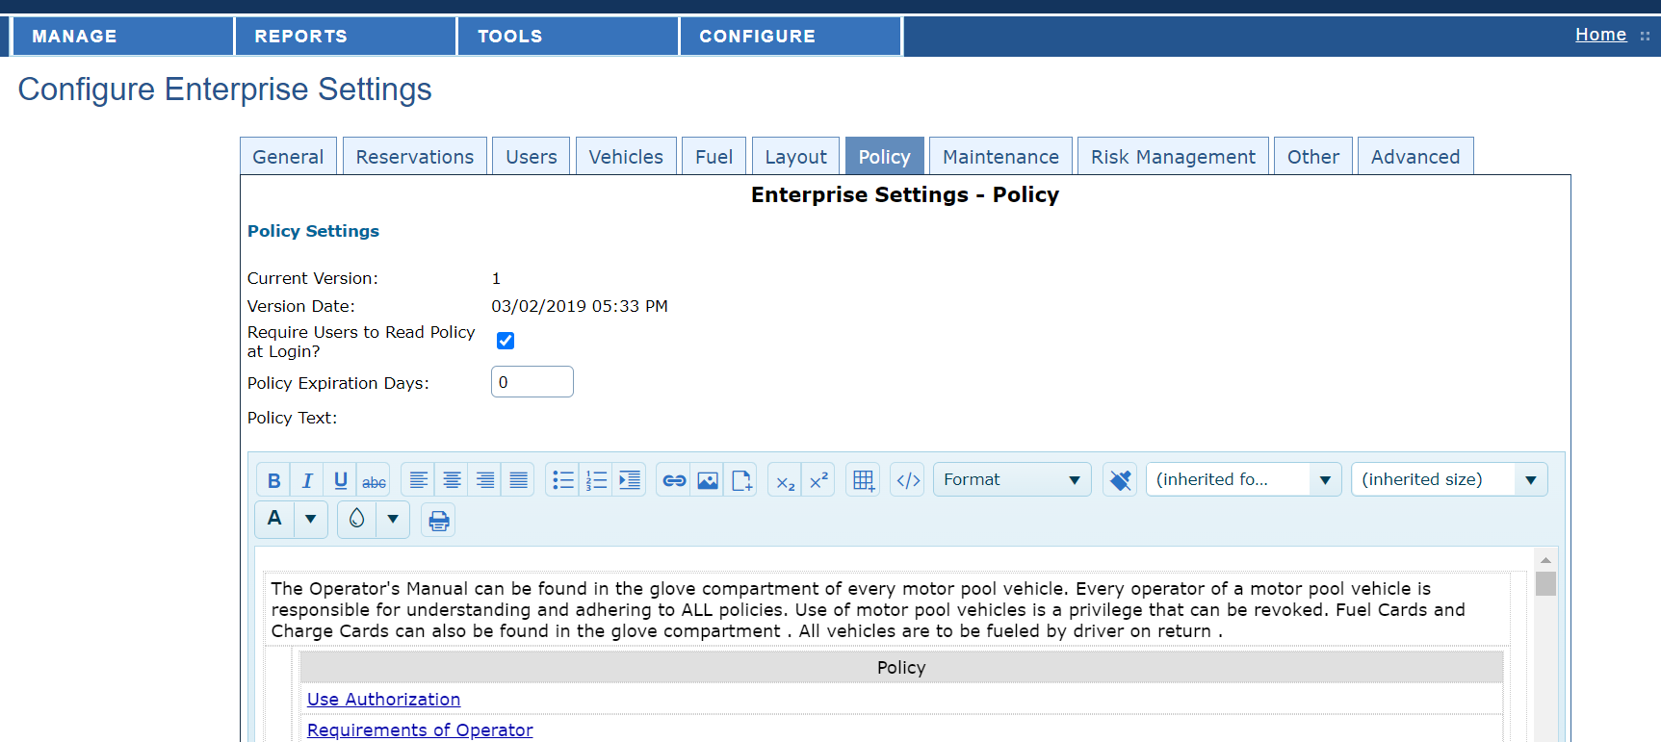
A word on FleetCommander Policy
Page content
Location | Item
Enterprise Setting>Layout | Contact Us Text
Enterprise Setting>Layout | Document
Enterprise Setting>Layout | FAQ Text
Enterprise Setting>Layout | Instructions Text
Enterprise Setting>Layout | Locations Text
Enterprise Setting>Policy | Policies
Enterprise Setting>Layout | Privacy Policy Text
Enterprise Setting>Layout | Terms of Use Text
Enterprise Setting>Layout | Vehicle Rates Text
Enterprise Setting>Layout | Welcome Text
Configure>Enterprise Settings>Policy
Controls version and affirmation
Policy can be updated at any time
Uses a “What You See Is What You Get” (WYSIWYG) editor

Slide 54
Team Exercise Two: Custom Logo
Zone Content>Enterprise

Slide 55
FleetCommander’s In-Solution Layout Editor

Slide 56
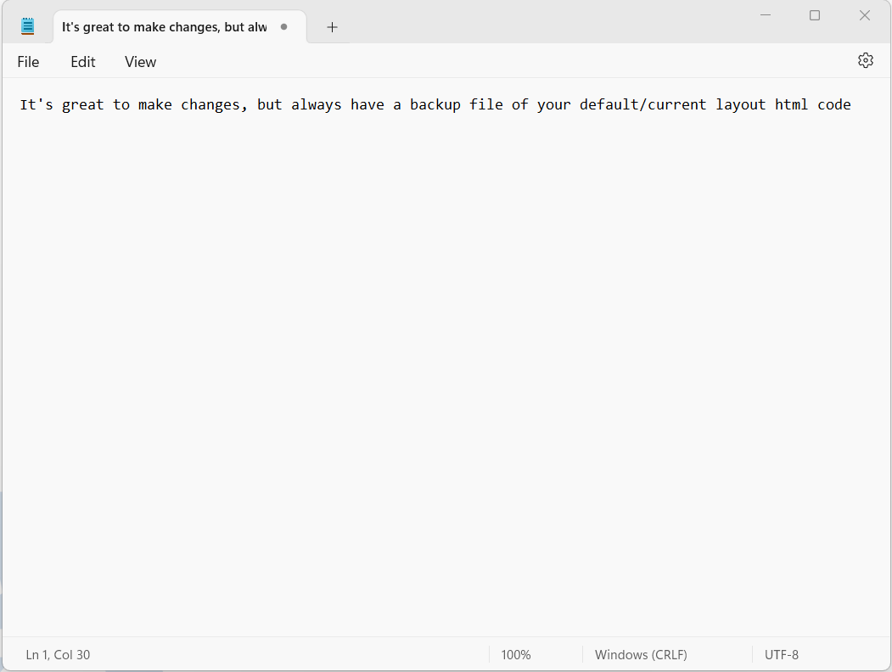
Before you make changes
Memo from Jon: Backup Before Beginning!
Backup the existing content BEFORE beginning
Open Notepad or WordPad
Create a new document
Select <ctrl A> the message text html in CONFIGURE>LAYOUTS
Copy <ctrl C> Message
Paste <ctrl V> into Notepad or Wordpad
Create a filename (example “Original Welcome text 20220401.txt”)
Save the file in a “FC Layout Backups” Folder

Slide 57
Using WYSIWYG vs HTML

Slide 58
Team Exercise Three: Create a Footer
Zone Content>Enterprise

Slide 59
Team Exercise Four: Reservation Help Text
Zone Content>Enterprise

Slide 60
Team Exercise Five: Reservation Help Text
Zone Content>Site

Slide 61
Team Exercise Six: Update Welcome Page
Page Content>Enterprise

Slide 62
Team Exercise Seven: Update Location Page
Page Content>Enterprise

Slide 63
Team Exercise Eight: Update FAQ Page
Page Content>Enterprise

Slide 64
Team Exercise Nine: Update Policy Page
Page Content>Enterprise

Slide 65
FleetCommander Layout Templates

Slide 66
Template One

Slide 67
Available Now!

Slide 68
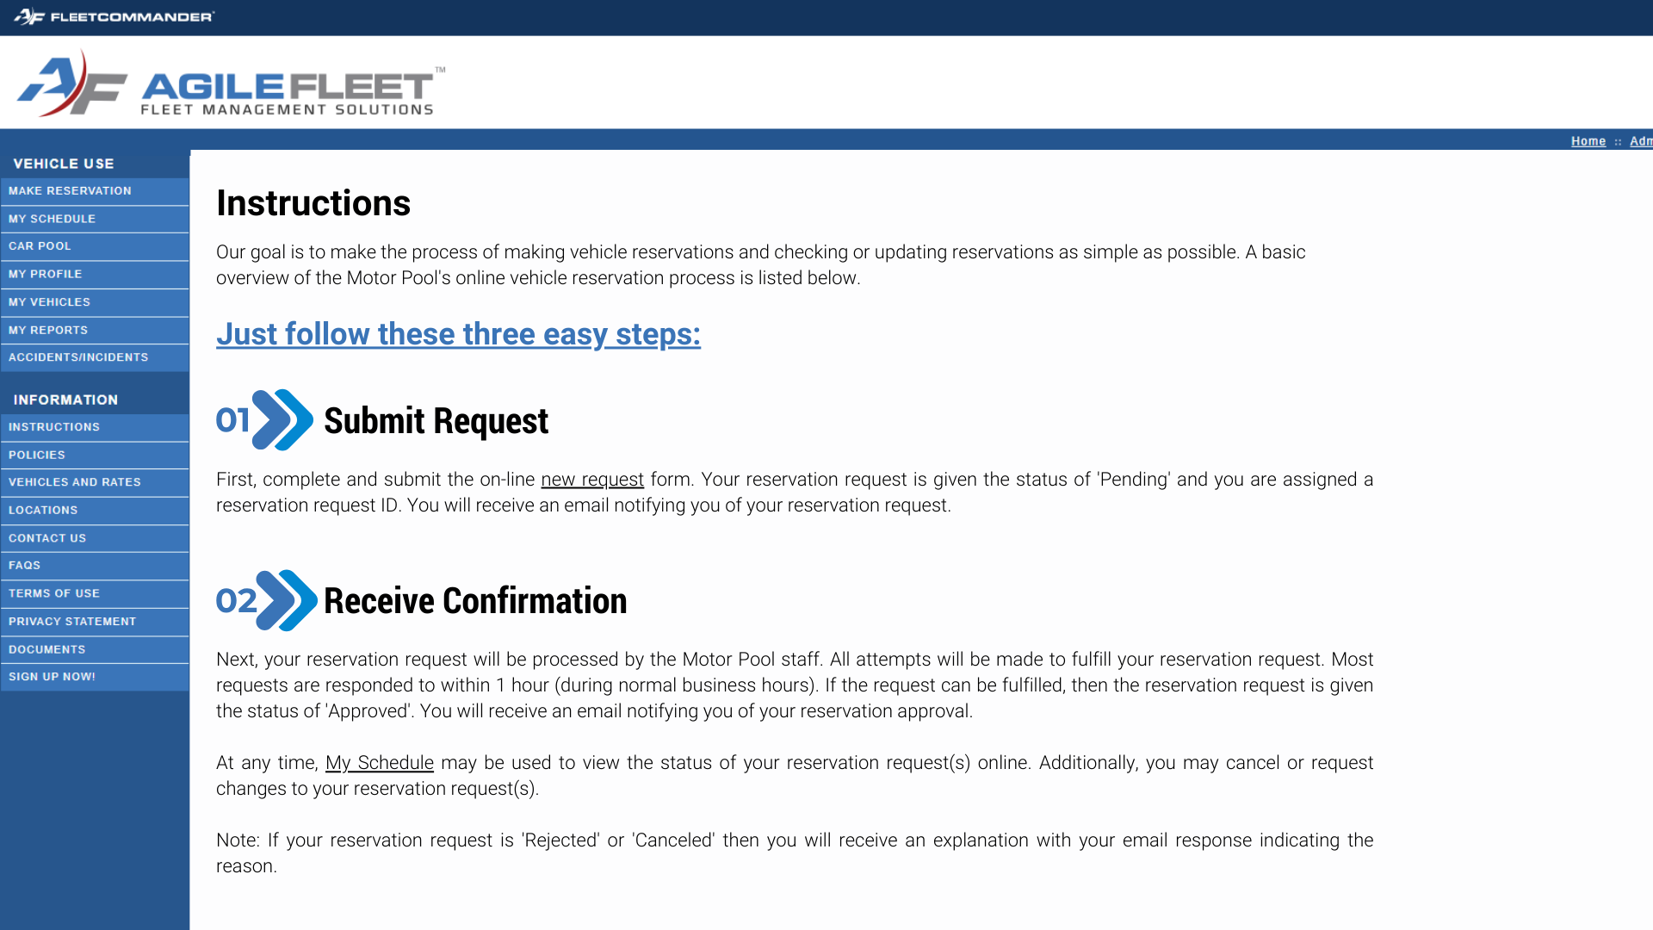
Available Now!

Slide 69
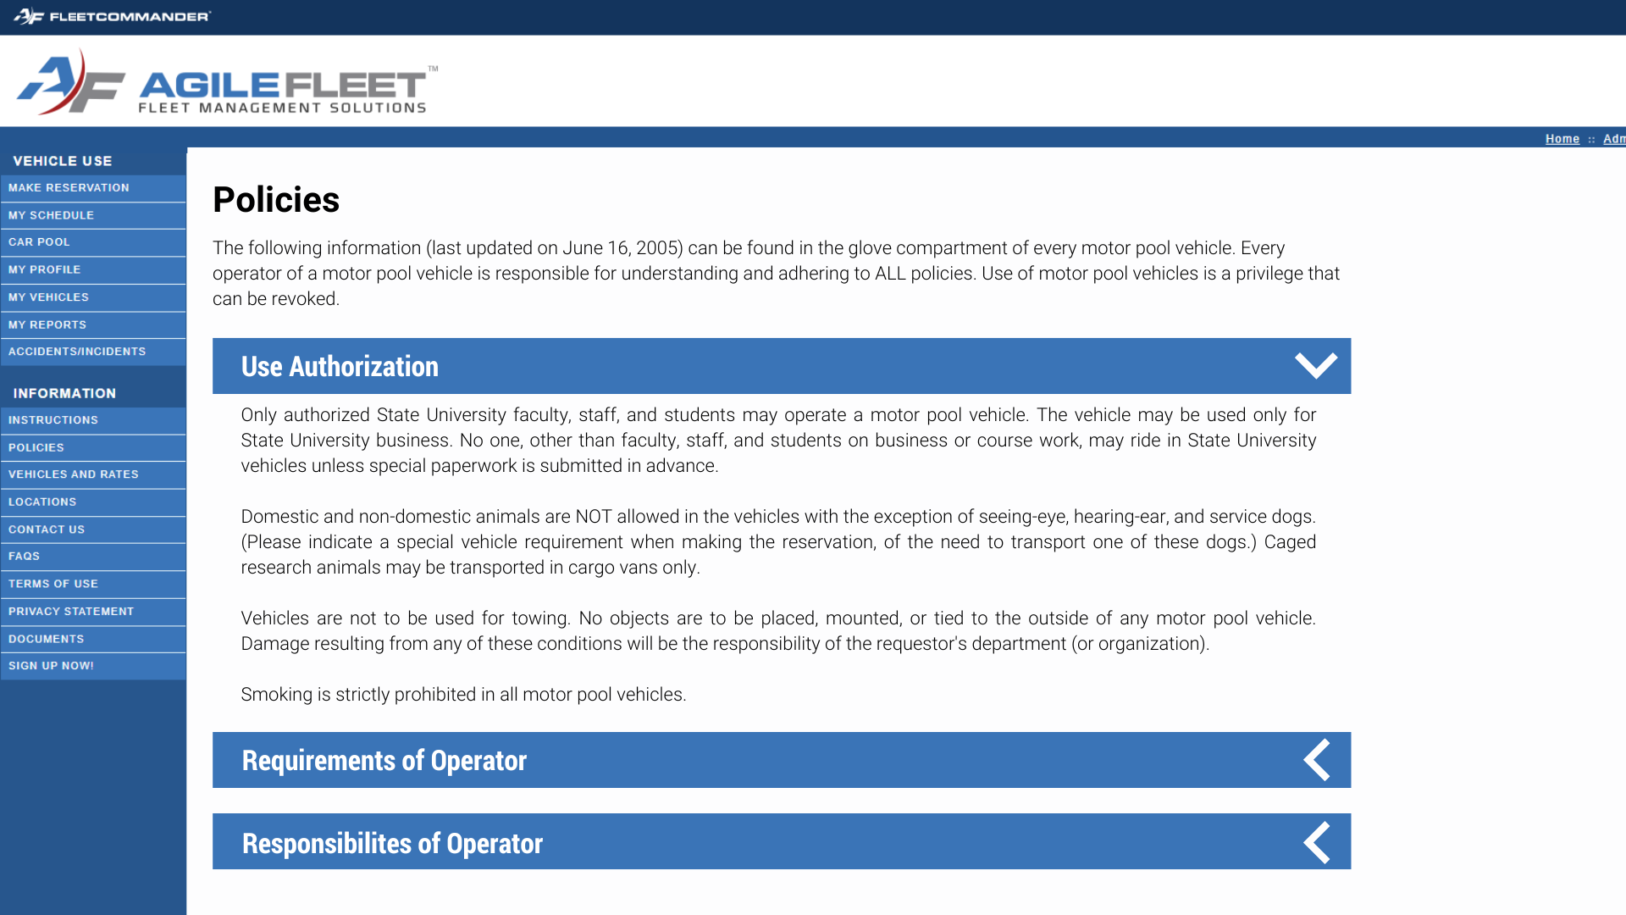
Available Now!

Slide 70
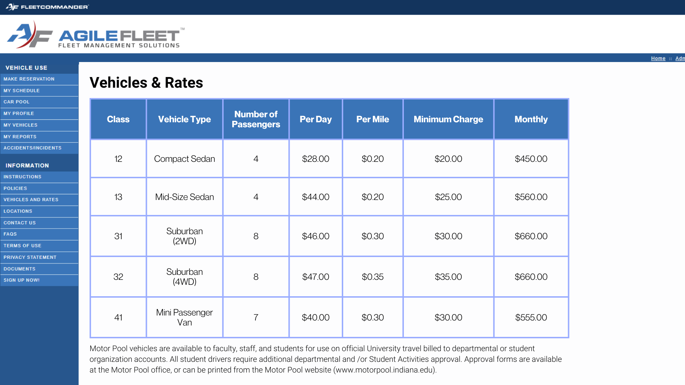
Available Now!

Slide 71
Available Now!

Slide 72
Template Two

Slide 73
Available Now!

Slide 74
Available Now!

Slide 75
Available Now!

Slide 76
Available Now!

Slide 77
Available Now!

Slide 78
Template Three

Slide 79
Coming in 2024!

Slide 80
Coming in 2024!

Slide 81
Coming in 2024!

Slide 82
Coming in 2024!

Slide 83
Coming in 2024!

Slide 84
Questions?

Slide 85
Consult: FleetCommander System Admin Manual
Enterprise Level – List of Layouts, Section 14.1.5.2
CTRL + CLICK to access System Admin Manual

Slide 86
Leverage Your Resources
You may have resources to help you with branding and web-development
Municipalities and businesses often have access to marketing staff
Universities might engage Marketing programs for student-led projects
Your fleet staff may have some great ideas
Consult with FleetCommander peers
Agile Support (custom html enhancements via Change Requests)

Slide 87
“Building on What You Know”
FleetCommander User Conference Bonus Team Activity

Slide 88
Bonus Team Activity
Were you the kid that always did the Extra Credit? Do you like to win? Then put on your competitive, creative thinking cap and spend some additional time making your FCUC Web Session site shine brighter than the rest. The best FCUC Web Session sites will be recognized tomorrow! Suggested Extra Areas You Might Change:
Add Vehicle Type image (Configure>Enterprise>Vehicle Type)
Add User Profile image (Manage> Profile)
Insert content in Reservation Help Text – Usage Type Select (Configure>Enterprise>Layout)
Insert content in Reservation Help Text – Comments Description (Configure>Site>Layout)
Update Contact Us Page (Configure>Enterprise>Layout)
Update Vehicle Rates Page (Configure>Enterprise>Layout)
Additional changes to Welcome, Location, and FAQ Page
and MANY OTHER PLACES!
Remember to make a GREAT FIRST IMPRESSION!

Slide 89
Additional Study Material
Inspiring new ideas and possibilities

Slide 90
Advance Tools and Tips

Slide 91
Make HTML Easier: Upgrade to Notepad ++
CTRL + CLICK to download Notepad ++ from github.com

Slide 92
Hex Color #s – Expand Your Color Options!
FleetCommander’s WYSIWYG editor offers 216 RGB (Red, Green, Blue) colors
HEX colors (via HTML coding) offer over 16.7 MILLION COLORS!!!

Slide 93
Hex Color #s – Expand Your Color Options!
The SIX DIGITS of the Hex code represent an expanded combination of RED, GREEN, and BLUE (#RRGGBB)
NOTE: all Hex codes have a CORESPONDING RGB code
TIP: Hex code COLOR SWATHS can be viewed online in places like HTML-COLOR.CODES

Slide 94
Useful Tools – HTML editors
TIP: find and replace selected content color by SEARCHING for their HEX COLOR VALUE
Open VIEW HTML
Use CTRL + F, enter the HEX # then locate the HIGHLIGHTED item in the
REMEMBER Hex numbers are always SIX DIGITS, preceded by an “#”

Slide 95
PowerPoint Color Selector to find HEX #
TIP: POWERPOINT can help you determine HEX # of colors, INCLUDING your BRAND!
Copy Image/Brand/Text into POWERPOINT and open Color Selector (Shape/Text Fill)
Select Eyedropper
Hover over the image and note the three RGB color numbers
Select MORE COLORS>CUSTOM and enter each RGB (Red, Green, Blue) HEX # will populate.

Slide 96
Converting RGB Color Code to Hex Value
TIP: online COLOR CONVERTORS can also help find HEX COLORS for your HTML CODE
CTRL + CLICK to access RapidTables convertor

Slide 97
Online HTML Editors
TIP: use an online HTML to workout out your design and then COPY and PASTE CODE into FleetCommander
CTRL + CLICK to access HTMLG’s online editor

Slide 98
The fine print regarding online resources
Consult with your IT department and origination's policy regarding content, or changes before you attempt on your own.
Information, applications, and sites are for example only and are not an endorsement by Agile Fleet, Inc.

Slide 99
Welcome Page Examples

Slide 100
Welcome Page

Slide 101
Welcome Page

Slide 102
Instruction Page Examples

Slide 103
Instructions Page

Slide 104
Vehicles and Rates Page Examples

Slide 105
Vehicles and Rates Page

Slide 106
Locations Page Examples

Slide 107
Locations Page

Slide 108
Locations Page

Slide 109
Contact Us Page Examples

Slide 110
Contact Us Page

Slide 111
Video Page Example

Slide 112
Training Videos Page

Slide 113
FAQ Page Example

Slide 114
FAQs Page

Slide 115
Introduction to FleetCommander Web Design
September 26, 2023

