Slide 1
Key Control Tips, Tricks and Troubleshooting

Slide 2
Kiosk Email Notifications

Slide 3
Kiosk Email Notifications
Send Check Out Email
Send Check In Email

Slide 4
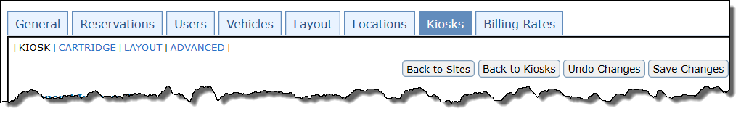
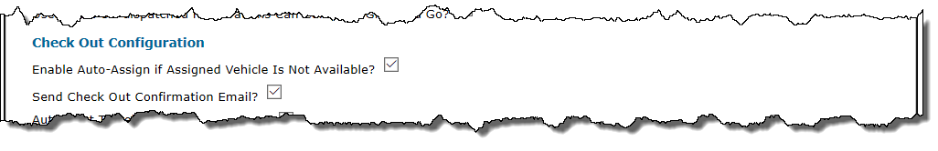
Check out Email
Send email to Driver/Requestor and Admin when vehicle is checked out from kiosk.
This can be configured by going to Configure > Site Settings > Kiosk Tab

Slide 5
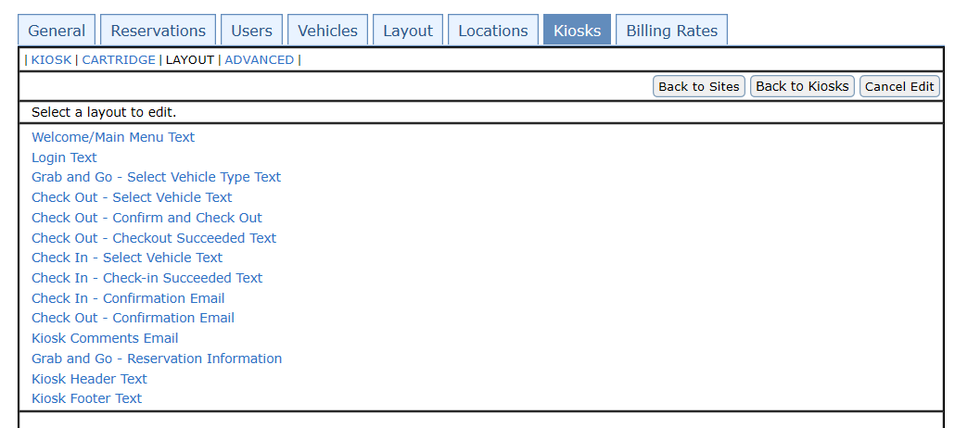
Check In Email
Emails can be configured by going to Configure > Site Settings > Kiosk Tab > Layout.

Slide 6
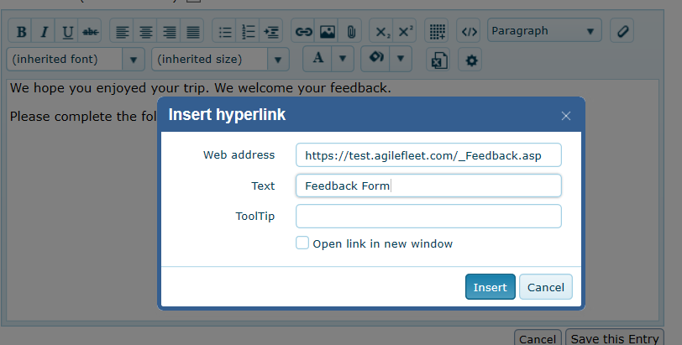
Check In Email
If you want to automate the feedback email, add the feedback link to the Check In email. Select Insert button, add URL and link title.

Slide 7
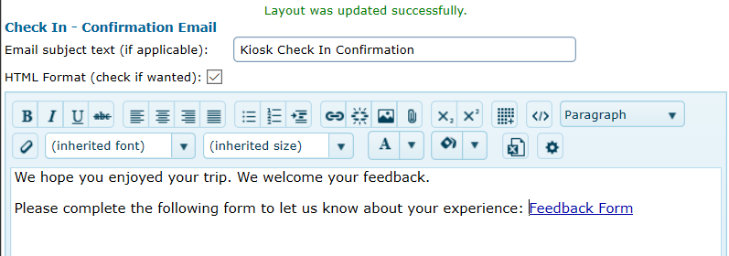
Check In Email
A link to the feedback form will then be automatically sent when the user checks in the vehicle.

Slide 8
Customize Attract Screens

Slide 9
Customize Attract Screens
Screen savers on kiosk
Kiosk ships with default FleetCommander screens
Add your own branded images
Add multiple screens to display instructions, notices, or policies.
Screens are configured in KioWare software on kiosk
You can update with your own images. If you need assistance Agile Fleet support can assist you.

Slide 10
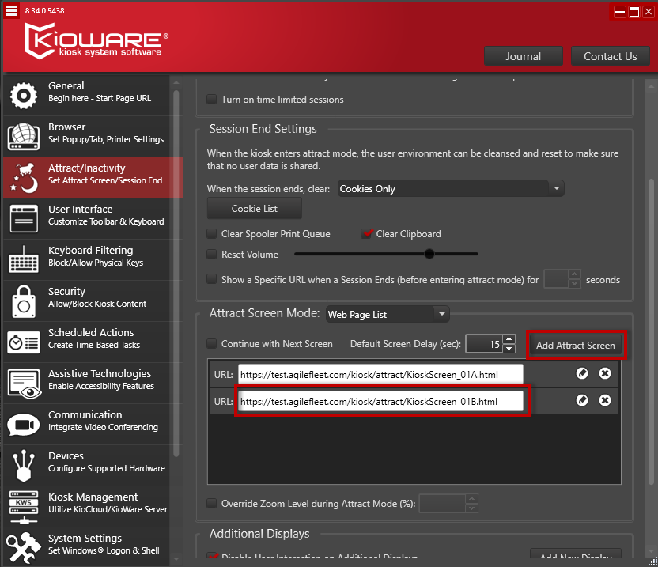
Customize Attract Screens
Kioware configuration tool on Kiosk

Slide 11






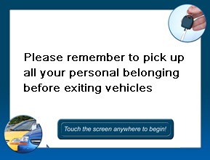
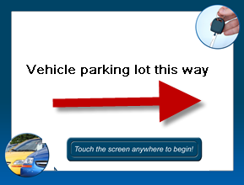

Customize Attract screens

Slide 12
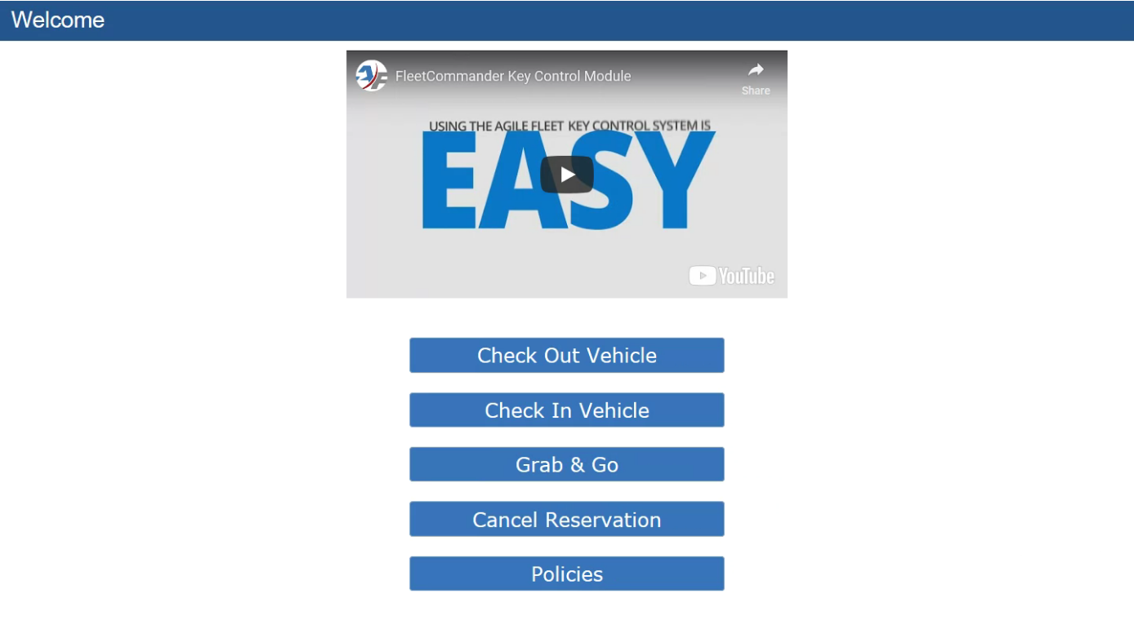
Using Videos
Example of adding a video to kiosk

Slide 13
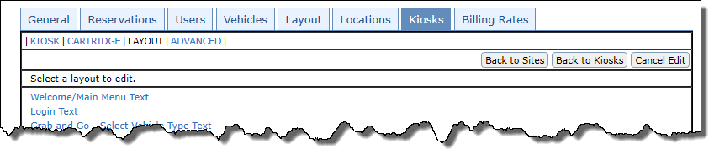
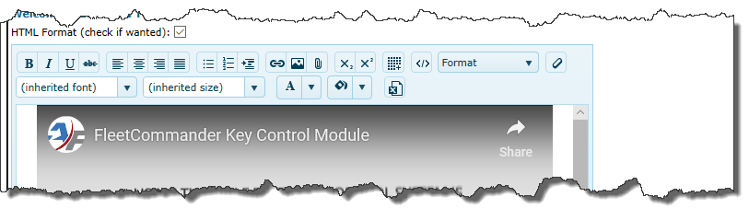
Using Videos
Configure > Site Settings > Kiosk Tab > Layout Sub tab

Slide 14
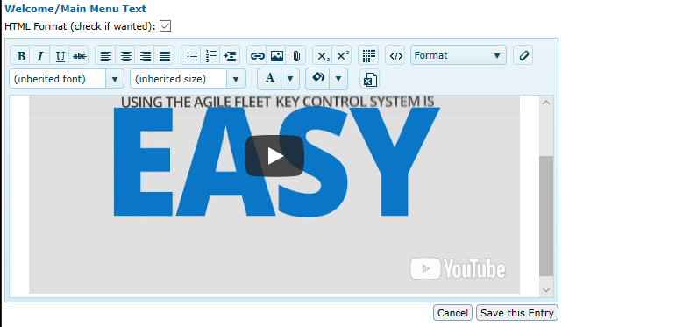
Using Videos
Configure > Site Settings > Kiosk Tab > Layout Sub tab

Slide 15
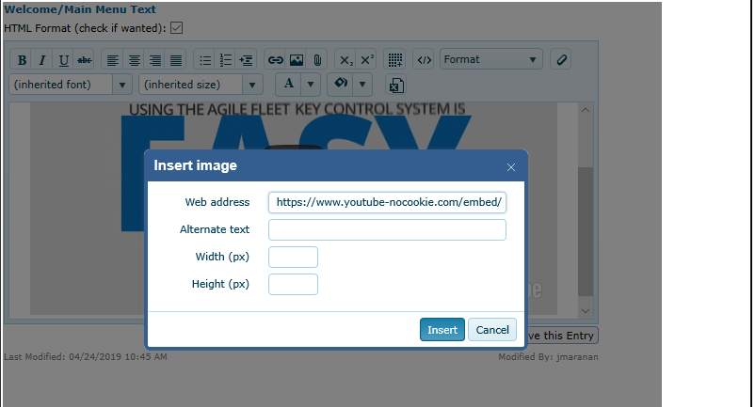
Using Videos
Configure > Site Settings > Kiosk Tab > Layout Sub tab

Slide 16
Add GIF at Kiosk

Slide 17
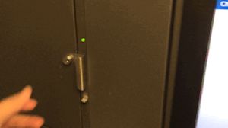
Key Control Options
Add an image or animated GIF to the kiosk

Slide 18
Key Control Options
Add an image or animated GIF to the kiosk
Go to Tools > Content Manager > Add Document > Upload Image
Copy the URL that is generated
Go to Configure > Site Settings > Edit Site > Kiosk Tab > Layout sub-tab
Add URL with Image tool and save changes.
Be careful not to make the image too large or the screen will scroll

Slide 19
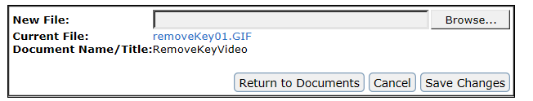
Key Control Options
Add an image or animated GIF to the kiosk
Go to Tools > Content Manager > Add Documents > Upload Image

Slide 20
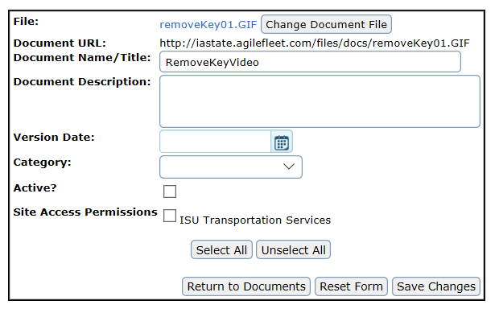
Key Control Options
Add an image or animated GIF to the kiosk
Copy URL
Make it inactive so users can’t gain access

Slide 21
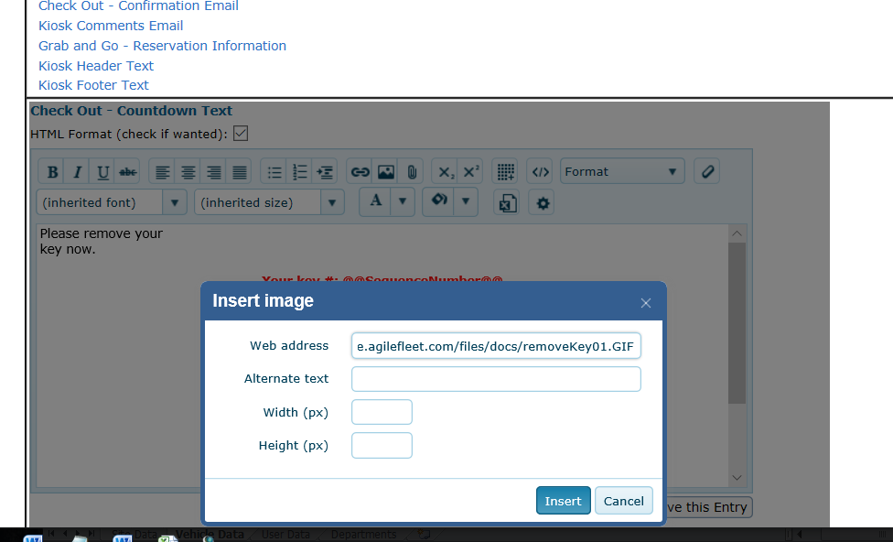
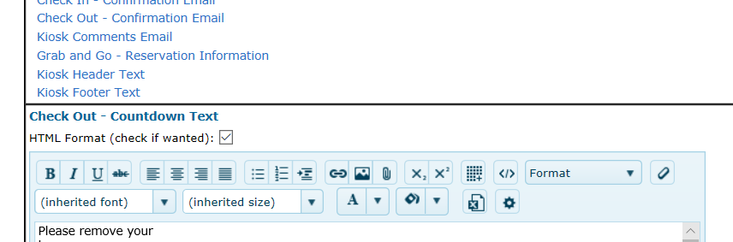
Key Control Options
Add an image or animated GIF to the kiosk
Go to Configure > Site Settings > Edit Site > Kiosk Tab > Layout sub-tab. Add URL with Image tool > Save changes.

Slide 22
Key Control Options
Add an image or animated GIF to the kiosk

Slide 23
RFID Reader at the Kiosk

Slide 24
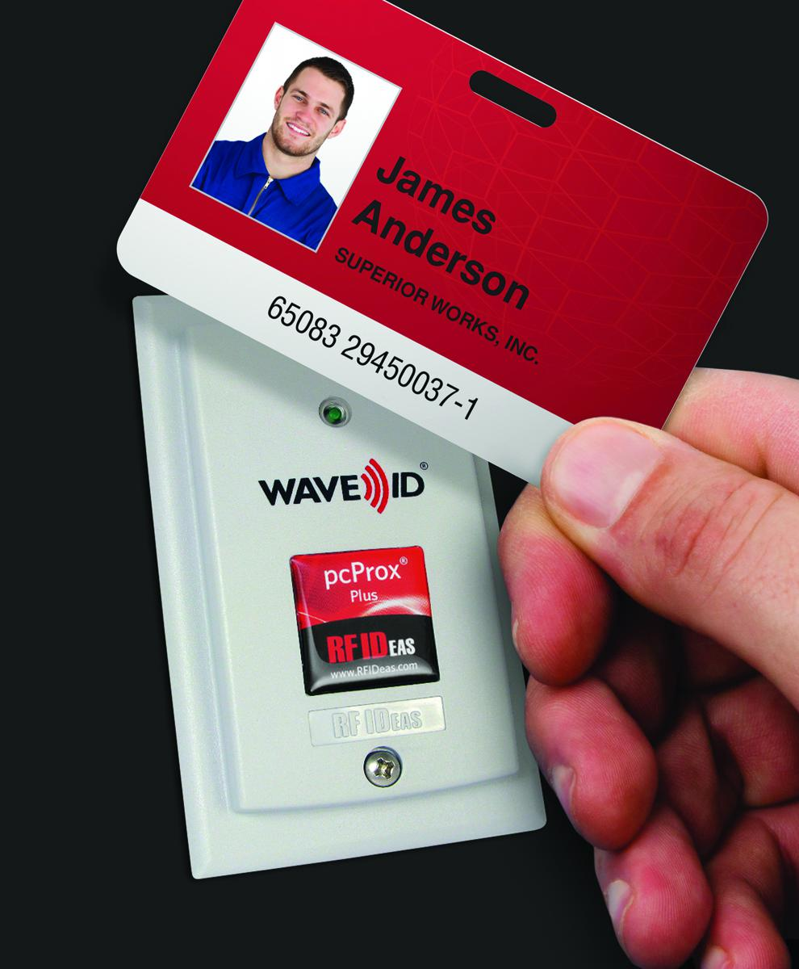
RFID Reader at Kiosk
Overview of the reader
Reads allow for speedy login at the kiosk
Can be used with most RFID proximity cards
Reduces wait time
Good for sites with difficult passwords
Improves customer experience

Slide 25

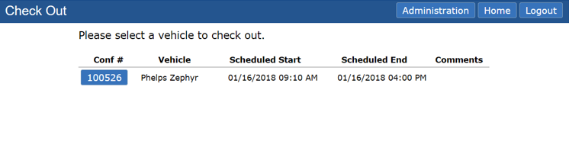
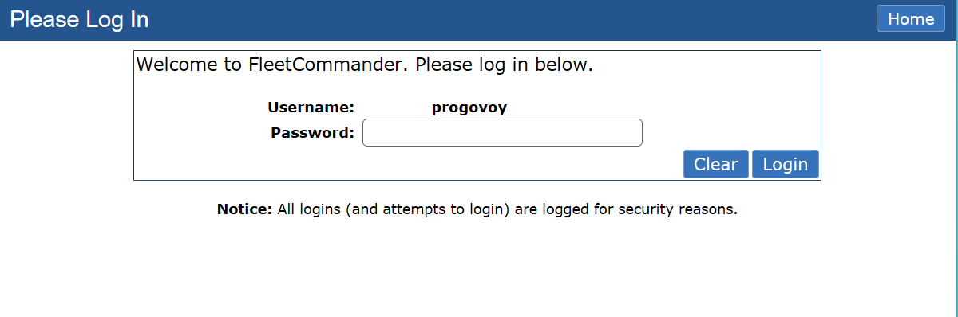
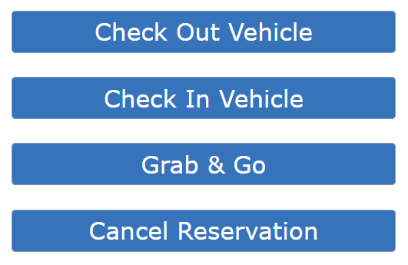
RFID Reader at Kiosk
Single- vs Two-Factor Authentication
* Single-Factor
Bypasses username and password
Two-Factor
Bypasses username
Requires password

Slide 26
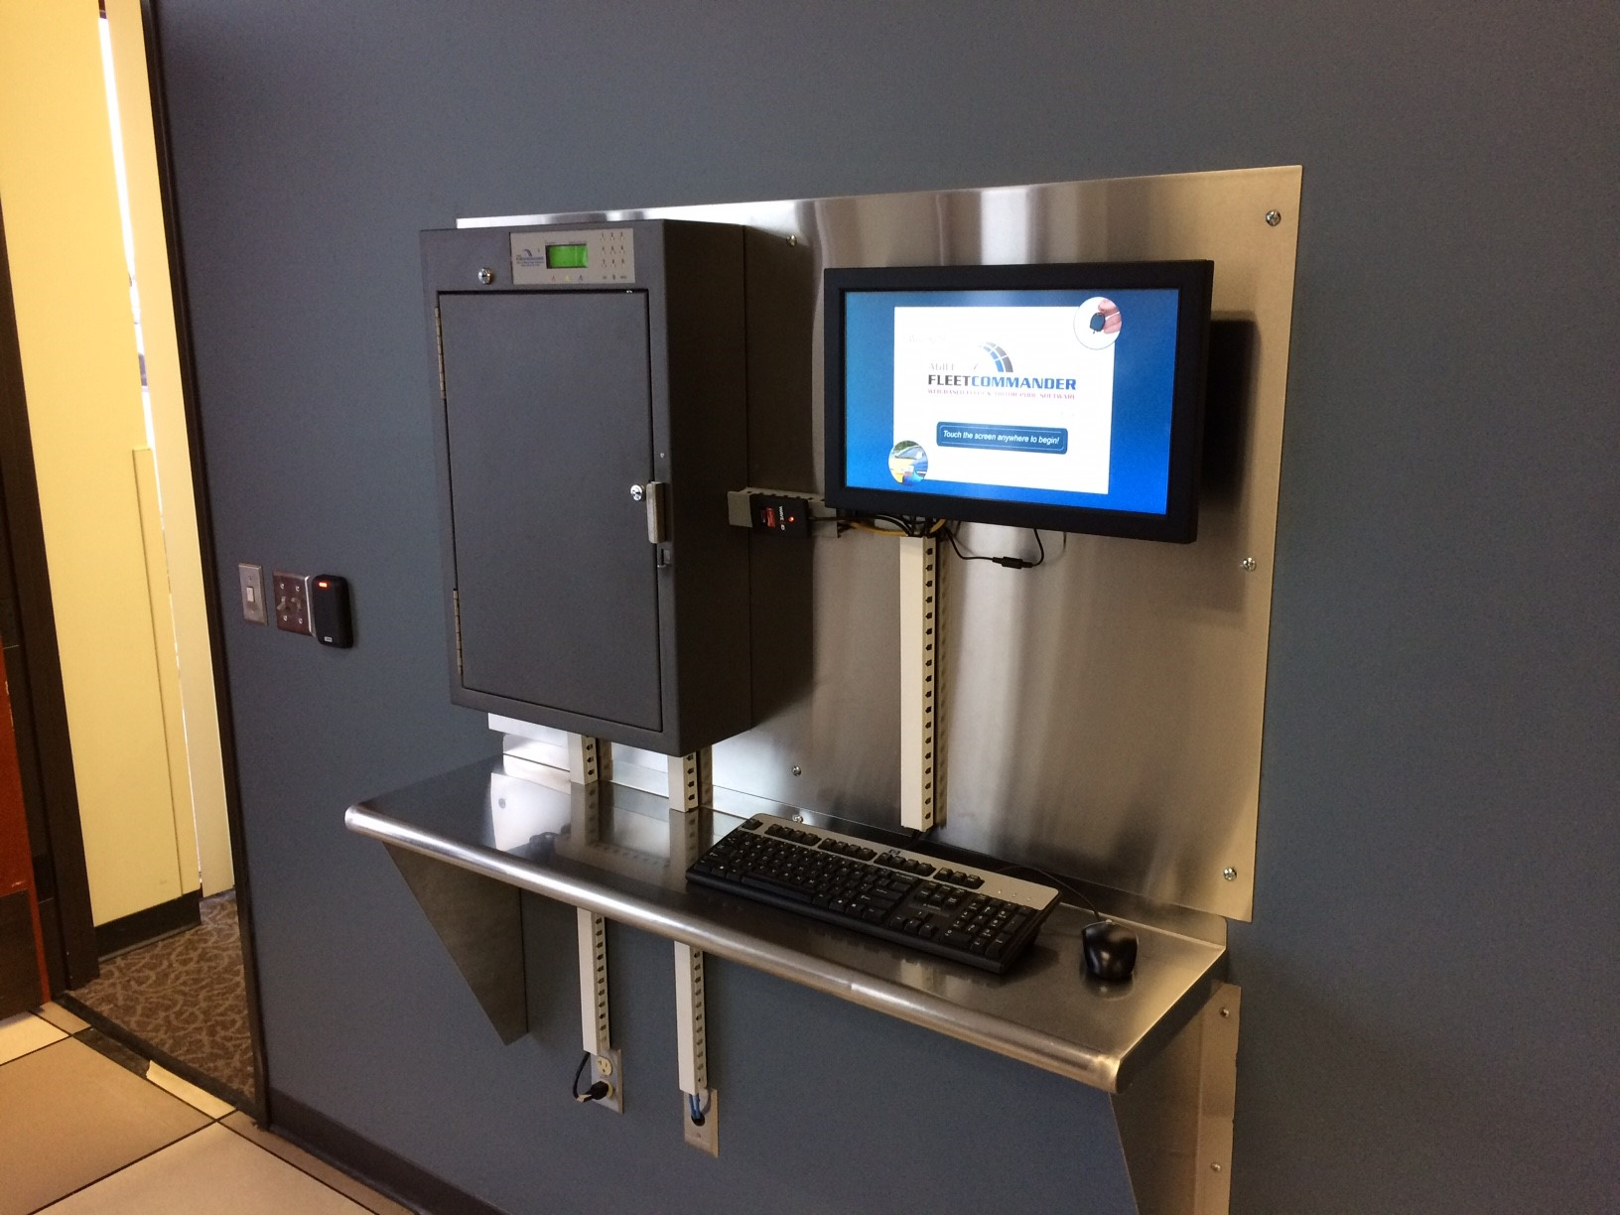
RFID Reader at Kiosk
Process to get it installed
Send Agile two sample test cards
Identify the number that should be read off each card
Complete the RFID questionnaire
Questions regarding configuration and type of cards
Customer approves the configuration
Consider an enrollment reader
Agile will import user electronic IDs
Readers will be shipped to the customer
Agile will work with IT staff to install and test reader

Slide 27
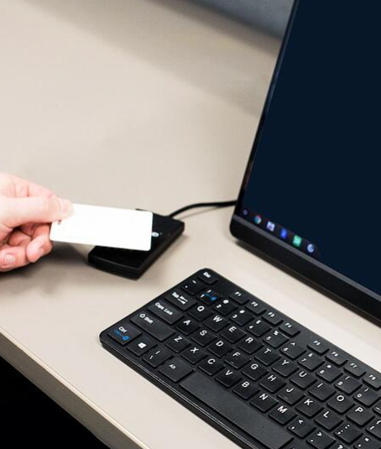
RFID Self-Registration
Example of RFID Reader set-up. (actual equipment may vary)

Slide 28
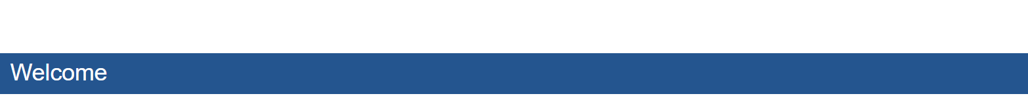

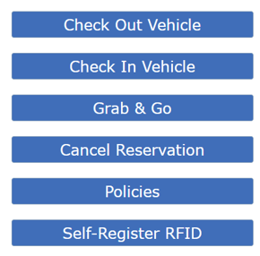
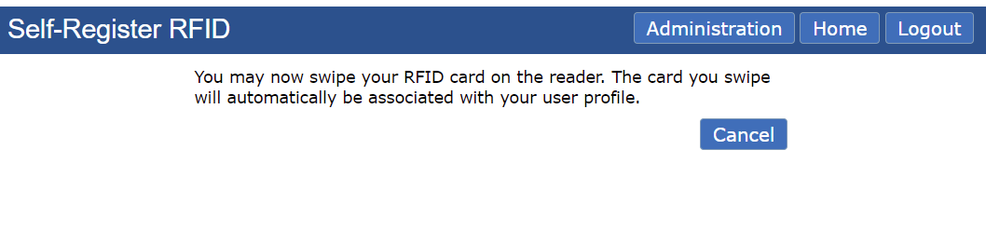
Self Register RFID Card at the Kiosk
Have your users add their RFID Card
Successful registration!

Slide 29
RFID Reader at Kiosk
Single- vs Two-Factor Authentication
* Single-Factor
Bypasses username and password
Two-Factor
Bypasses username
Requires password

Slide 30

Check Out Vehicle for Someone Else
Notes:
Go to next slide

Slide 31
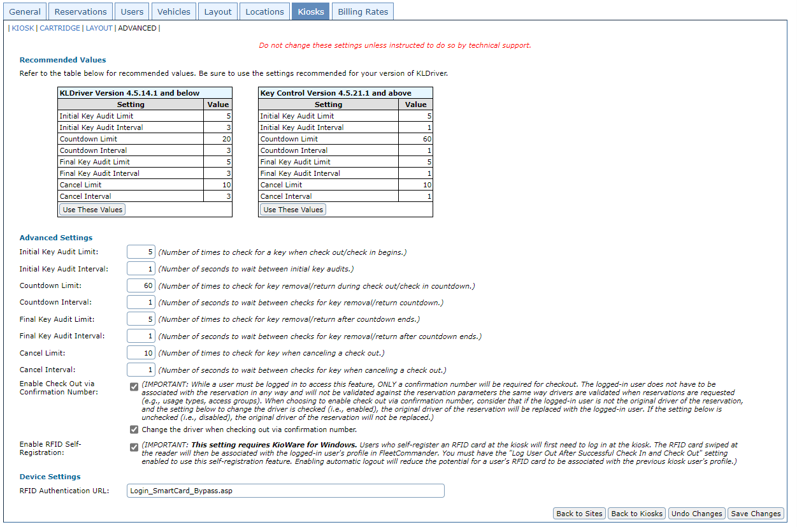
Check Out Vehicle for Someone Else
Site Settings > Kiosk Tab > Advanced

Slide 32
Check Out Vehicle for Someone Else
There is an option to change out the driver
There is an option to change out the driver

Slide 33
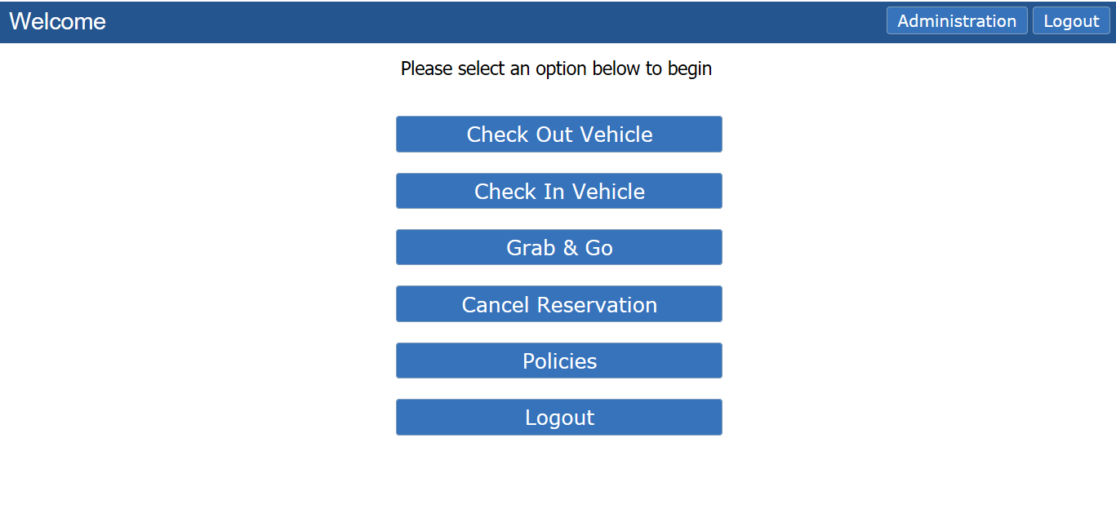
Check Out
Select Check Out Vehicle.

Slide 34
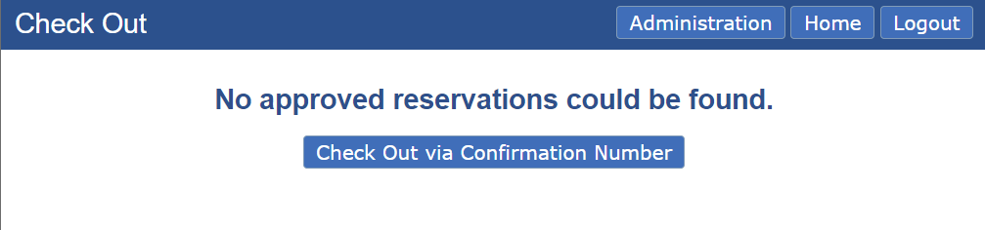
Check Out
Select Check Out via Confirmation Number

Slide 35
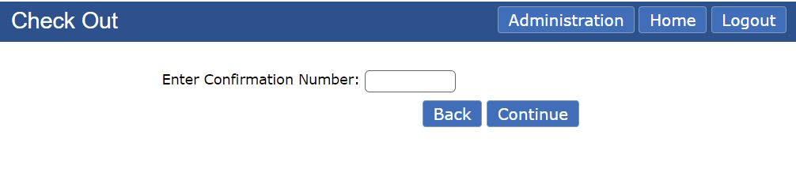
Check Out
Enter Confirmation number of reservation

Slide 36
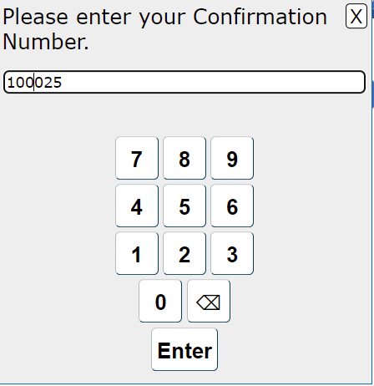
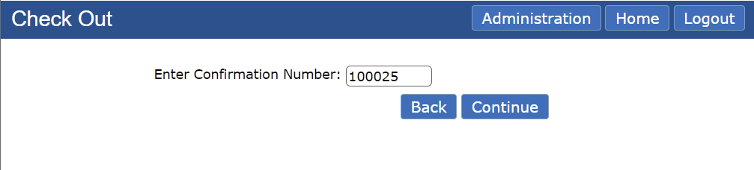
Check Out
Enter Confirmation number of reservation

Slide 37
Check Out
Select Continue and complete reservation process.

Slide 38
Check In Vehicle for Someone Else
(User Interface)
Notes:
Go to next slide

Slide 39
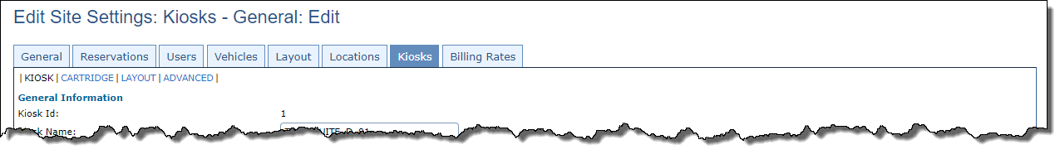
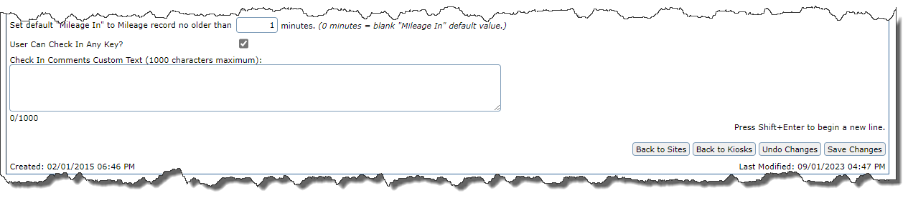
Check In Vehicle for Someone Else
Site Settings > Kiosk Tab

Slide 40
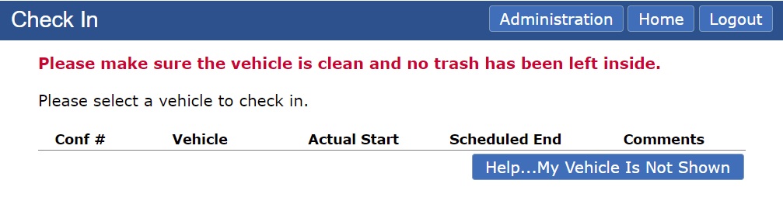
Check In - Main Screen
Select Help…My Vehicle Is Not Shown

Slide 41
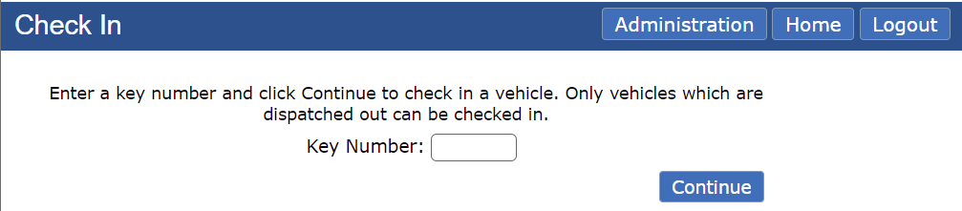
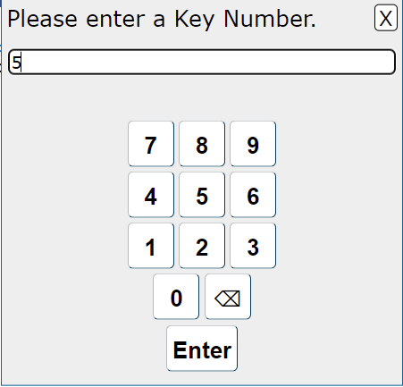
Check In
Enter KEY # of vehicle you are returning

Slide 42
Check In
Select Continue and complete reservation process.

Slide 43
Log Serial Numbers for Key Box Keys

Slide 44

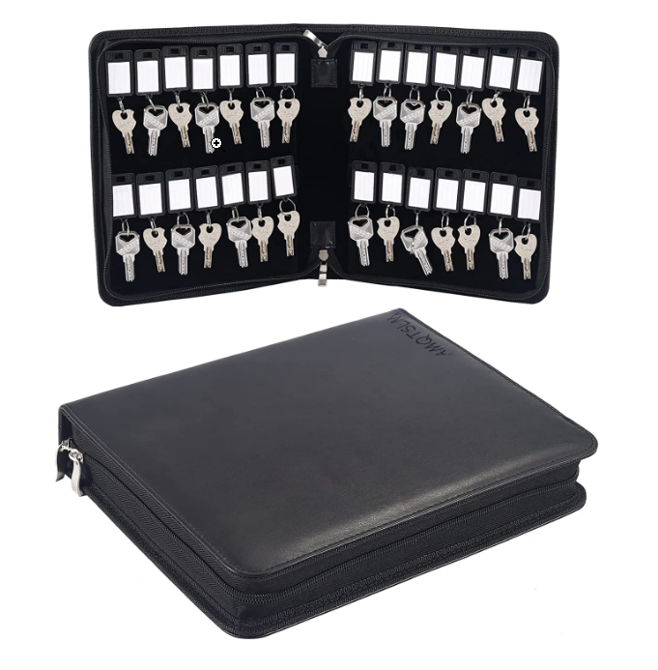
Log Serial Numbers for Key Box Keys
Each key box comes with two sets of keys for each key position
The back up key is in the black portfolio that came with the box.
The keys all have a serial number stamped on them.
The manufacture does not have the number on file. Agile Fleet Support does not know the number.
It is important that you log the number or reach out to Agile Fleet s Support for a new key.

Slide 45
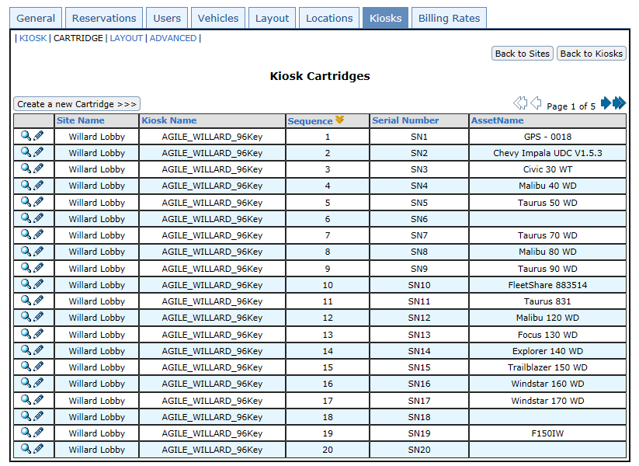
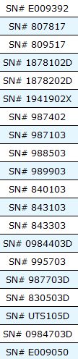
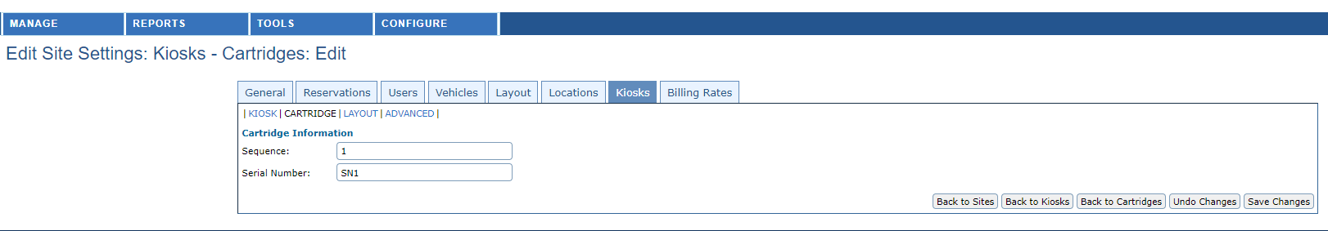
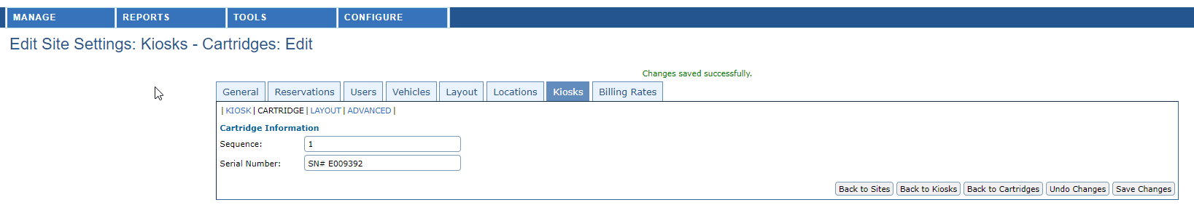
Log Serial Numbers for Key Box Keys
Tip
Log Key Serial Numbers
(Option One)
Click on Pencil Icon to Edit
Activate via CONFIGURE > SITE SETTINGS > KIOSKS TAB > CARTRIDGE

Slide 46
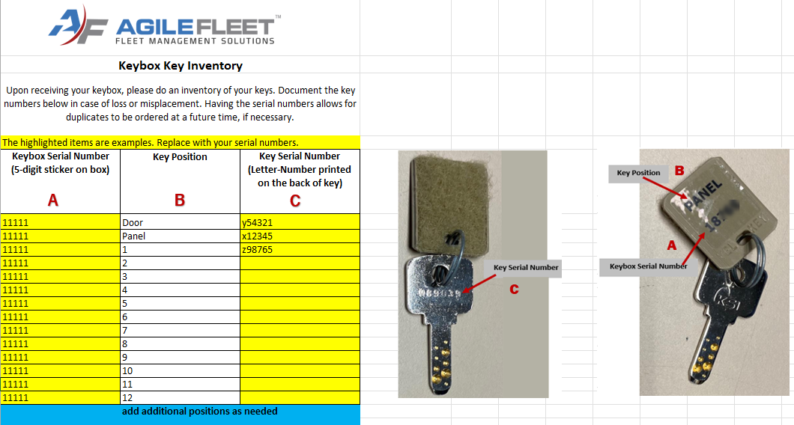
Log Serial Numbers for Key Box Keys
Tip
Log Key Serial Numbers
(Option Two)
Enter in Excel.
Agile Fleet can provide a template

Slide 47
Key Control Tips & Tricks from Support
Tip
Keep Back-up Keys
Handy
Keep the key box keys in a known place, especially the door and panel keys!

Slide 48
Mailslot Key Stem

Slide 49
Mailslot Key Stem
Feedback that the keys were binding
New option is available

Slide 50
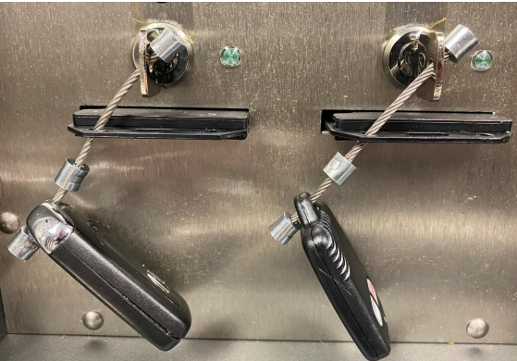
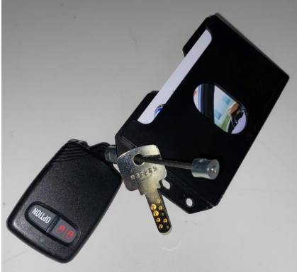
Mail slot Key Stem

Slide 51
Kioware Keyboard

Slide 52
Kioware Keyboard
Can be used on client authentication login screen (SAML, OAuth)
Previous, you had to use a physical Keyboard
Works on all FleetCommander Kiosk screens
Existing virtual keyboard should be turned off before enabling Kioware Keyboard

Slide 53
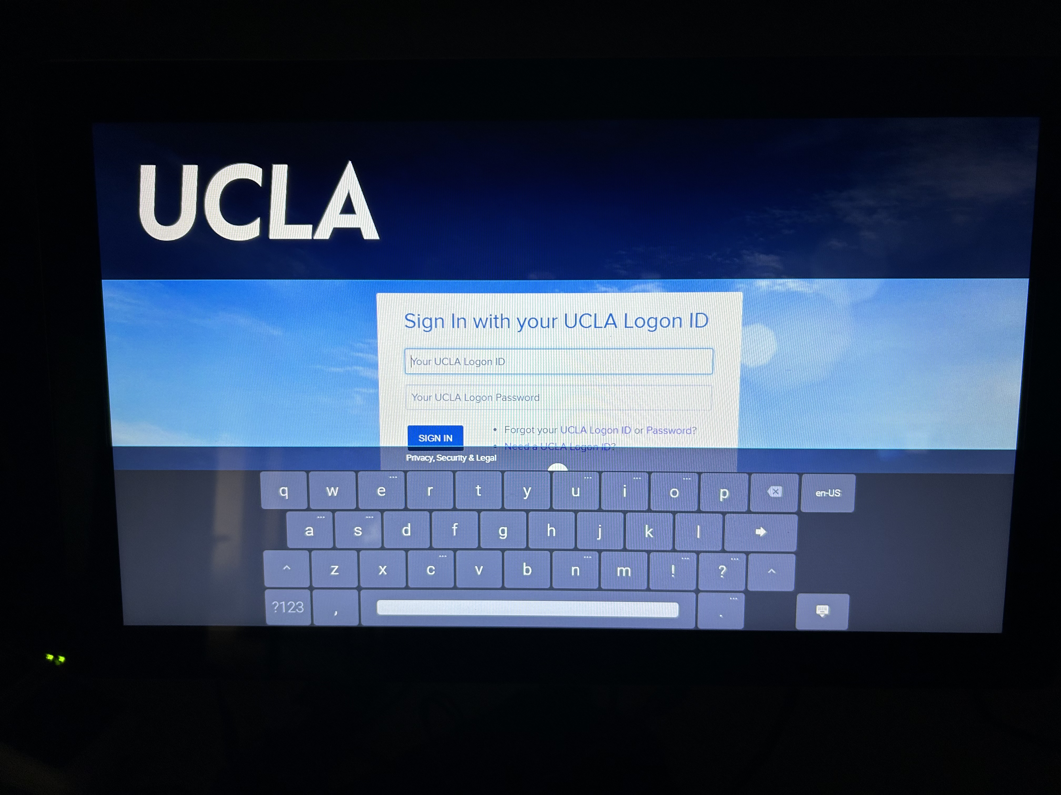
Kioware Keyboard

Slide 54
Key Control Communication
Notes:
Go to next slide

Slide 55
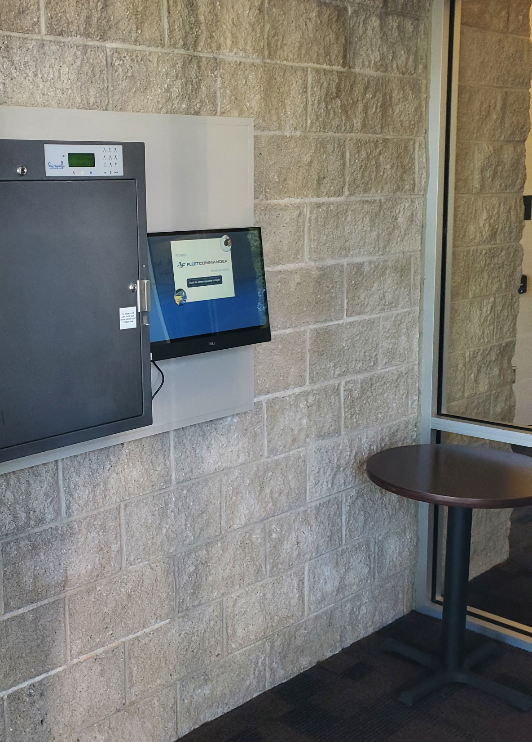
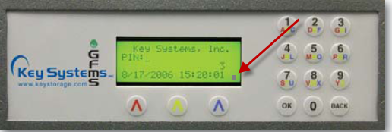
Key Control Communication
There are FOUR places to check when confirming your Key Control’s communication
ONE: LCD screen on key box – dot in lower right-hand corner
Key-box communication is ACTIVE when DOT is PRESENT

Slide 56
Key Control Dashboard
Notes:
Go to next slide

Slide 57
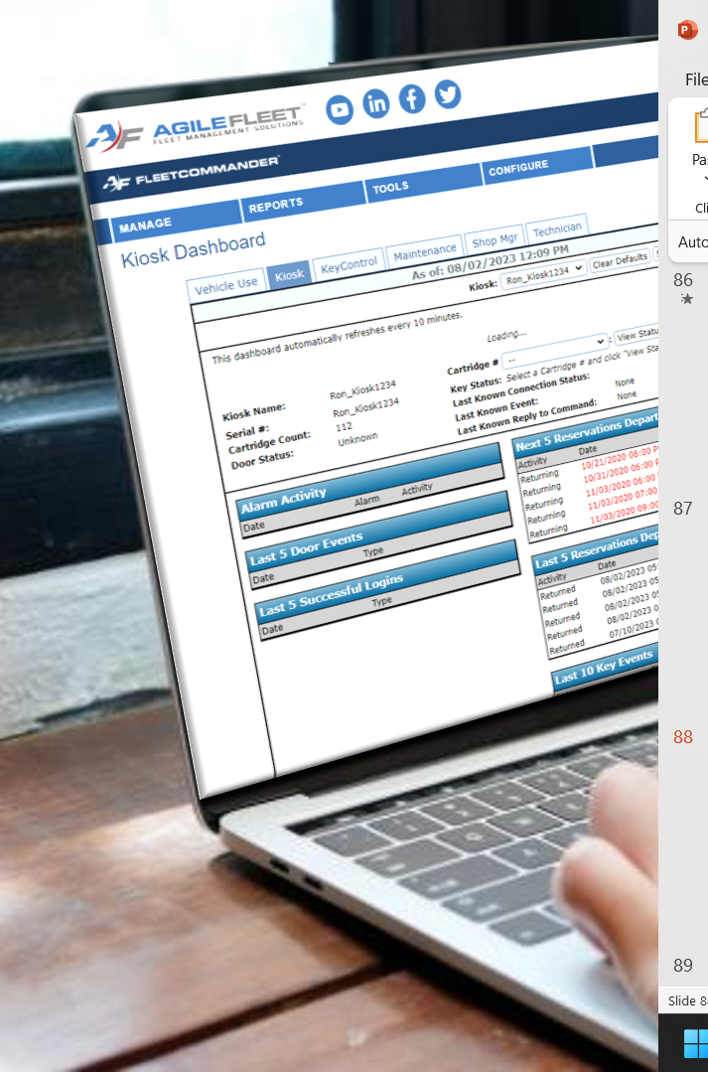


Key Control Communication
There are FOUR places to check when confirming your Key Control’s communication
TWO: Kiosk Dashboard – Communication Message
Kiosk Dashboard keeps you updated on status of Connection, Door, and Key Events
ONLINE

Slide 58


Key Control Communication
There are FOUR places to check when confirming your Key Control’s communication
TWO: Kiosk Dashboard – Communication Message
Kiosk Dashboard keeps you updated on status of Connection, Door, and Key Events
OFFLINE

Slide 59


Key Control Communication
There are FOUR places to check when confirming your Key Control’s communication
THREE: Key Control Service – Watchdog interface
must have access to server.
Client Servers
FleetCommander Support
Server (hosting FleetCommander & Key Control Service)

Slide 60

Key Control Communication
There are FOUR places to check when confirming your Key Control’s communication
THREE: Key Control Service – Watchdog interface
Watchdog will show which key boxes are online
GREEN - Online
RED - Offline

Slide 61

Key Control Communication
There are FOUR places to check when confirming your Key Control’s communication
FOUR: Key Box Web Interface
Client Servers
Must be able to access the IP Address of the key box
FleetCommander Support

Slide 62

Key Control Communication
There are FOUR places to check when confirming your Key Control’s communication
FOUR: Key Box Web Interface
Client Servers
Enter External IP Address of Key Box into web browser
Enter username and password
FleetCommander Support

Slide 63

Key Control Communication
There are FOUR places to check when confirming your Key Control’s communication
FOUR: Key Box Web Interface
Connection Status will show either:
– Connected or Disconnected

Slide 64
Key Box Troubleshooting:
Alarms
Notes:
Go to next slide

Slide 65


Key Box Alarms
Alarms can sometimes be seen or heard at the key box.
Visual: there is a red indicator light on box.

Slide 66


Key Box Alarms
Alarms can sometimes be seen or heard at the key box.
Audible: there is an audible alarm triggered if door is left open.
buzzzzzzzzzzzzzzzzz

Slide 67
Key Box Alarms
Key Box alarms can be diagnosed online
Enter External IP Address of Key Box into your web browser
Enter username and password
Must reflect YOUR IP Address
Use YOUR Username and Password

Slide 68

Key Box Alarms
While in the web interface look for any alarms that may be triggered
Total Alarm Count – Total # of Alarms Triggered
User Alarm Count - Not used with FleetCommander
Key Alarm Count – Triggered if key are removed manually
AC Power – Key box was unplugged
Battery – Battery is disconnected
Box Tamper – The box was shaken or jolted
Door Timeout – Door timeout before gaining access
Duress - Not used with FleetCommander
System Maintenance – Box requires system maintenance
Door Alarm - Door left open
How to CLEAR ALARMS – Select “Ack” or “Ack All” to acknowledge alarm(s)
NOTE: Key Alarms can only be cleared by returning key to its designated slot in the Key Box

Slide 69
Key Box Troubleshooting:
Master Commands
Notes:
Go to next slide

Slide 70




Key Box: Master Commands
Master Commands can be used to change settings and troubleshot the key box.

Slide 71

Key Box: Master Commands
To enter Master Commands, press BACK and then enter master code

Slide 72


Key Box: Master Commands
Master Commands can be entered remotely via the Key Box Interface (Slide 93) Virtual Keypad.
Enter “#” to access code master command.

Slide 73
Key Box Troubleshooting:
Key Count Issues
Notes:
Go to next slide

Slide 74


Key Box: Issue with Key Count
This Photo by Unknown Author is licensed under CC BY-ND
This Photo by Unknown Author is licensed under CC BY-ND

Slide 75
Key Box Troubleshooting:
Soft and Hard Reboots
Notes:
Go to next slide

Slide 76

Key Box: Soft Reboot
Key Boxes can be triggered to SOFT REBOOT remotely via the Key Box Interface (Slide 93)
Login to Key Box Interface>select Panel tab>Reboot
Navigate to PANEL tab
Select REBOOT

Slide 77


Key Box: Hard Reboot
STEP ONE
Door Lock
STEP TWO
Panel Screws
On rare occasions, it may be necessary to be ON LOCATION to initiate a HARD REBOOT
STEP ONE - Open Door
use Admin Code or Door Key
STEP TWO - Remove two panel screws.
requires Philips head screwdriver.
STEP THREE - Open Panel (not shown)
requires panel key
STEP FOUR - Disconnect Power
Remove Green Connector from Power Board
Wait 30 secs
Plug power cable back in.
Open Key Box – Side View
STEP FOUR
Power Board

Slide 78
Key Control Troubleshooting: Key Box OFFLINE / Kiosk ONLINE
Notes:
Go to next slide

Slide 79
Key Box Troubleshooting
What to do when KEY BOX is OFFLINE but KIOSK is ONLINE
If Kiosk is online, most likely the network is up, so:
Check to see if you can get to the WEB INTERFACE of the Key Box. (see slides 92-94)
If NO, Will need to try and reboot from the keypad:
Type in code 7,0,1
If YES, check to see if the key box is communicating (see slide 86?)
If YES, reboot box to drop communication and it can reconnect.
If NO, something may be wrong with the port 1010 communication.
Check with IT staff see if there is a network issue

Slide 80
Key Box Troubleshooting
What to do when KEY BOX is OFFLINE but KIOSK is ONLINE
Use this flowchart to help troubleshoot scenarios
from the previous slide.

Slide 81
Kiosk Troubleshooting:
Key Box ONLINE / Kiosk OFFLINE
Notes:
Go to next slide

Slide 82
Kiosk Troubleshooting
What to do when KEYBOX is ONLINE
but KIOSK is OFFLINE
If Kiosk are offline, REBOOT will likely clear the issue.
You will want to CHECK THE NETWORK CONNECTIONS

Slide 83

Kiosk Troubleshooting
What to do when KEY BOX is ONLINE but KIOSK is OFFLINE
HINT: use this flowchart to help troubleshoot when the
KIOSK SCREEN is BLANK

Slide 84
Kiosk Troubleshooting
What to do when KEY BOX is ONLINE but KIOSK is OFFLINE
HINT: use this flowchart to help troubleshoot when the
KIOSK has an ERROR MESSAGE

Slide 85
Kiosk Troubleshooting:
Key Box OFFLINE / Kiosk OFFLINE
Notes:
Go to next slide

Slide 86
Kiosk Troubleshooting
What to do when KEYBOX is OFFLINE
but KIOSK is OFFLINE
If Key Box and Kiosk are offline, most likely a network issue.
Check power and network.
TIP: Contact your Facilities/IT to have Power and Network issue resolved.
Please keep FCSUPPORT advised of the situation so they can monitor progress/resolution.

Slide 87
Questions?

