Slide 1
FleetCommander Enhancements: TCO
September 28, 2023

Slide 2
What is the Total Cost of Ownership?
It’s a standard framework that can be used on any asset type. Including vehicles, and equipment, in addition to other asset classes to compare overall performance
By understanding TCO you can identify all costs, direct and indirect costs, and special that are associated with a purchase
It levels the playing field allowing for the direct comparison of similar assets
TCO is the sum of net acquisition costs, direct or indirect operating costs, incidental costs, and disposal /salvage necessary to support the vehicle or asset
It helps you operate your fleet in the most efficient way possible based on requirements
It helps you understand the real costs of operating your assets

Slide 3
Total Cost of Ownership Drivers
Fixed Operating Cost
Variable Non
Operating Cost
Disposal/
Salvage
Value
Incidental Costs
Acquisition
Cost
Asset

Slide 4
V5.10 TCO Enhancements
TCO Framework was introduced with v5.09
Total Cost of Ownership (enter definition here)
TCO Capabilities have been extended in v5.10, with more coming in 5.12
New features Include:
Configurable Custom TCO Field Labels and Enterprise TCO Tab
Cost Allocation Tool – Addition of Replacement Fund Calculations (Depreciation)
TCO Expense Summary Report
TCO Data Dump Report
TCO Mapping Tool
Posting Utility Filter Expanded

Slide 5
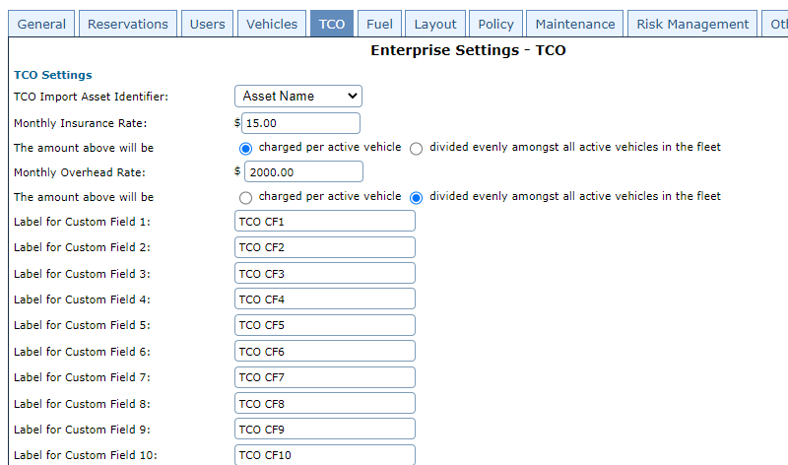
V5.10 TCO Enhancements
Created New Tab on Enterprise Settings to manage common TCO Settings
Simplified administration, operation, and management
Configure to use Asset Name, VIN, or License Number for Import
Set allocation expenses for Insurance or Overhead per vehicle or liquidate a gross expense amount across all active vehicles
Set up to 10 Custom Field Labels

Slide 6
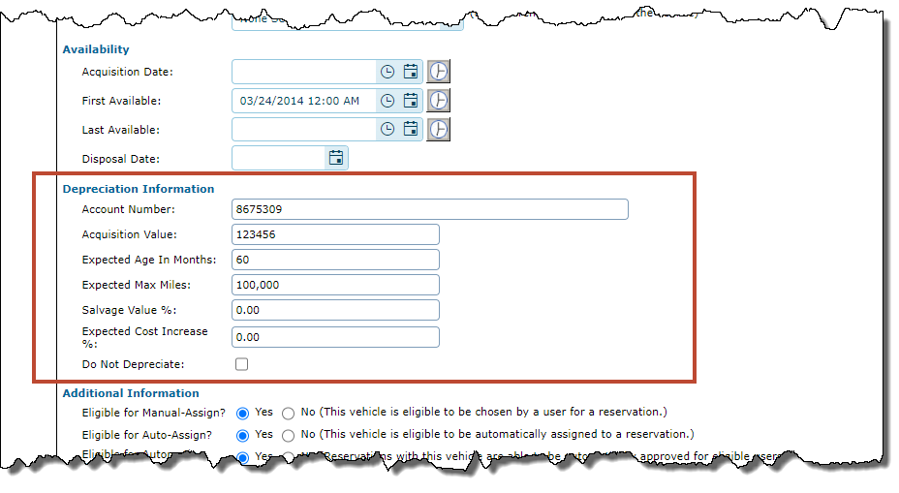
V5.10 TCO Enhancements
Manage Vehicles
Reorganized profile to provide a better grouping of related information.
Added a new header to the vehicle profiles grouping “Availability” and “Depreciation” information fields together.

Slide 7
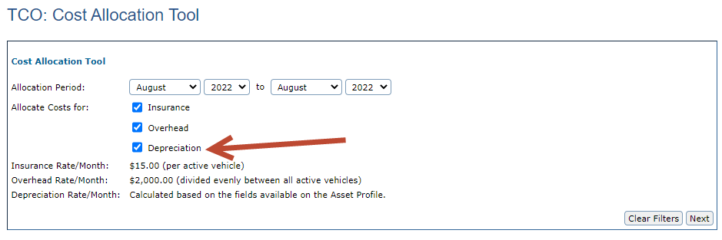
V5.10 TCO Enhancements
TCO Cost Allocation Tool
The Cost Allocation Tool is expanding to include Replacement Funds/Depreciation Costs.
Calculated based on the fields on the Asset Profile

Slide 8
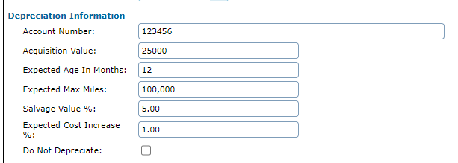
V5.10 TCO Enhancements
You can choose not to depreciate on the Vehicle Profile

Slide 9
V5.10 TCO Enhancements
Depreciation Calculation
Fully Depreciated = ([[Acquisition Value + (Expected Cost Increase % * Acquisition Value)] – (Salvage Value % * Acquisition Value)])

Slide 10
V5.10 TCO Enhancements
Depreciation Calculation
Fully Depreciated = ([[Acquisition Value + (Expected Cost Increase % * Acquisition Value)] – (Salvage Value % * Acquisition Value)])

Slide 11
V5.10 TCO Enhancements
Depreciation Calculation
Fully Depreciated = ([[Acquisition Value + (Expected Cost Increase % * Acquisition Value)] – (Salvage Value % * Acquisition Value)])

Slide 12
V5.10 TCO Enhancements
Depreciation
Monthly Depreciation = ([[Acquisition Value + (Expected Cost Increase % * Acquisition Value)] - (Salvage Value % * Acquisition Value)]) / Expected Age in Months

Slide 13
V5.10 TCO Enhancements
Monthly Depreciation = ([[Acquisition Value + (Expected Cost Increase % * Acquisition Value)] - (Salvage Value % * Acquisition Value)]) / Expected Age in Months

Slide 14
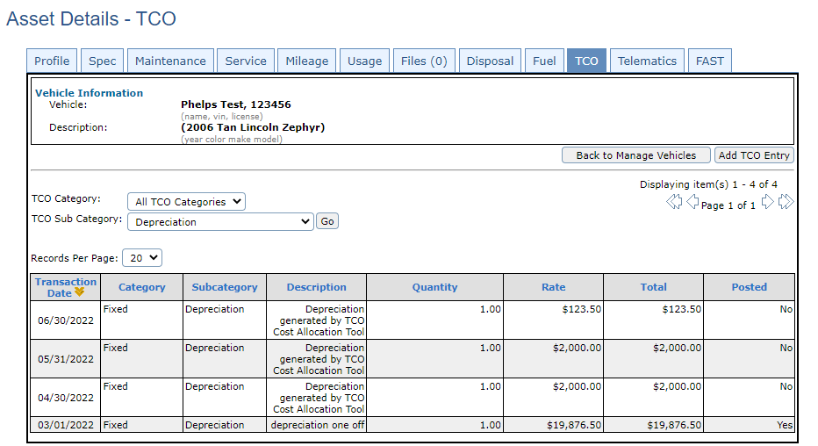
V5.10 TCO Enhancements
Depreciation
Fully Depreciated based on Posted TCO Entries
Either completely stops or charges a partial monthly amount to reach the fully depreciated amount and then stops
Example: Fully depreciated at $24,000. June 2022 charged a partial amount to reach $24,000. Did not charge this vehicle the rest of 2022.

Slide 15
V5.10 TCO Enhancements
Monthly Depreciation will be charged:
For the month of the First Available Date.
Example: First Available is 12/29/22, it will be charged fully for
December 2022
Monthly Depreciation will not be charged:
If the Asset has a “deleted” status
The “Do Not Depreciate” flag is check
After the Last Available Date.
Once the vehicle is fully depreciated
Example: 11/20/22, it will be charged for November 2022, but not December 2022

Slide 16
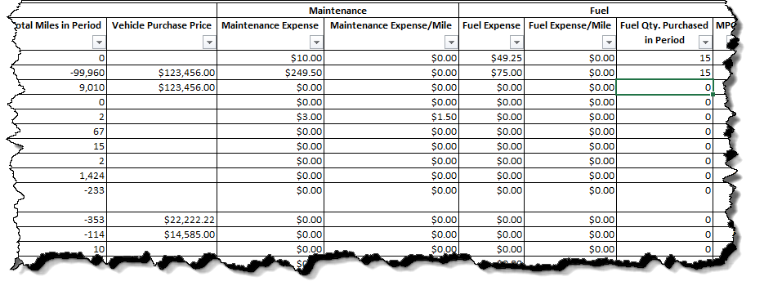
TCO Expense Summary Report
Contains Vehicle and Mileage Information
Groups TCO Expenses together, such as Maintenance and Fuel
TCO Expense Summary Report
NEW Report summarizing TCO expenses by Vehicle
Output in HTML or Excel

Slide 17
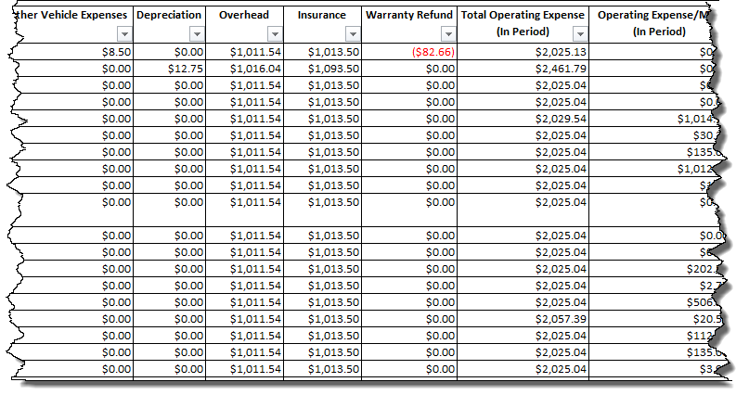
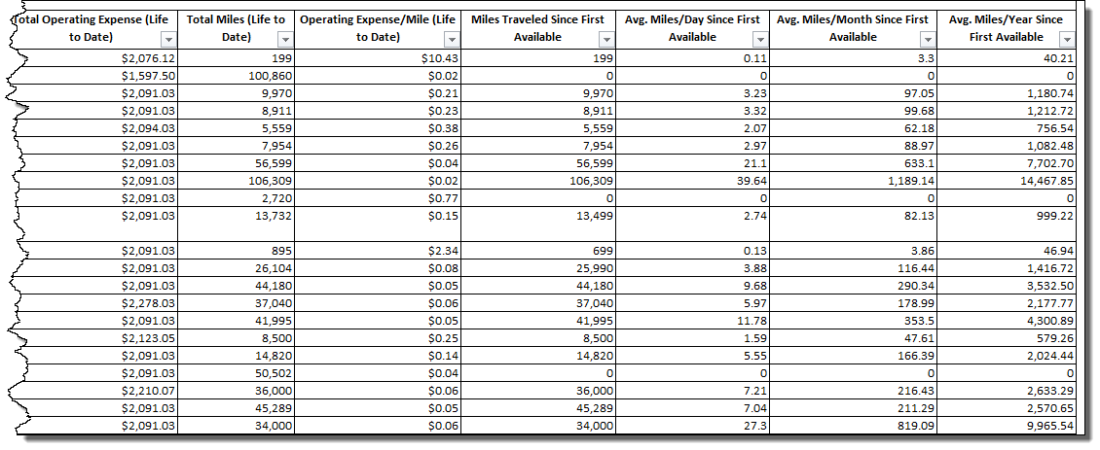
TCO Expense Summary Report
TCO Expense Summary Report
NEW Report summarizing TCO expenses by Vehicle
Output in HTML or Excel
Contains Additional TCO Information, Life to Date Details

Slide 18
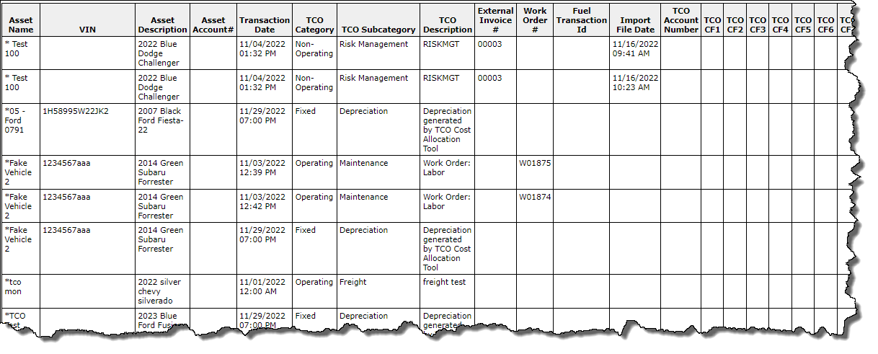
TCO Data Dump Report
Includes FleetCommander Work Order Number & Fuel Transaction ID if using those modules
TCO Data Dump Report
NEW Report containing a line per TCO Record that fits the filter
Output in HTML or Excel
Very similar to the TCO Import Fields

Slide 19
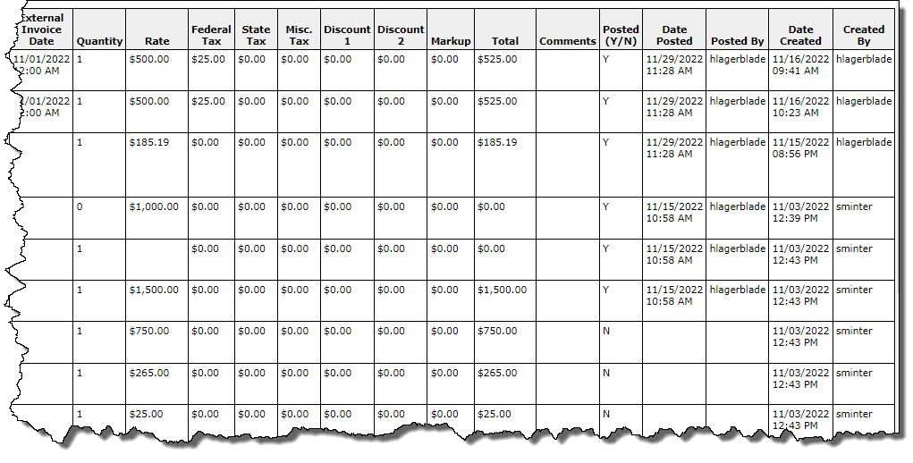
TCO Data Dump Report
TCO Data Dump Report
NEW Report containing a line per TCO Record that fits the filter
Output in HTML or Excel
Data is in number, dollars details, and posted Status

Slide 20
V5.12 TCO Enhancements
TCO Data Dump Report
CSV output option is being added
HTML will be limited to 1000 records to preserve performance

Slide 21
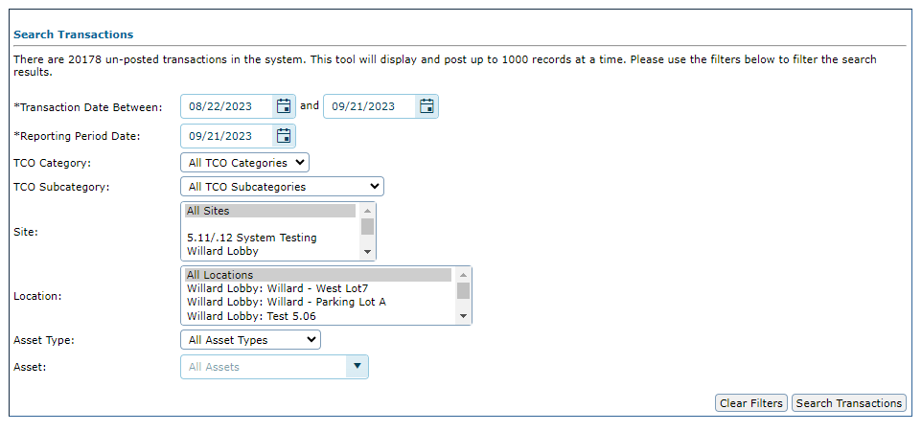
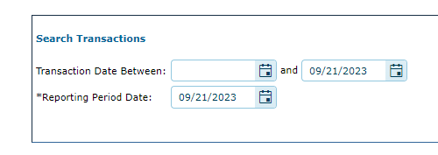
V5.12 TCO Enhancements
TCO Posting Utility
Enhanced filtering for ease of use and to preserve performance
The tool will only display 1000 records at a time.
With v5.12
Previously

Slide 22
TCO Mapping Tool

Slide 23
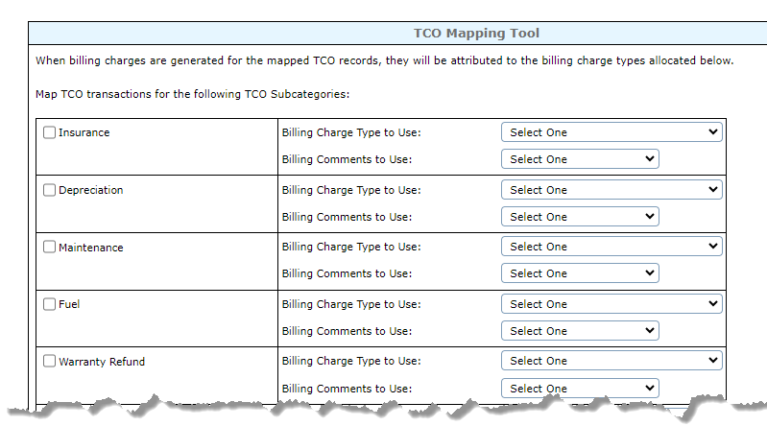
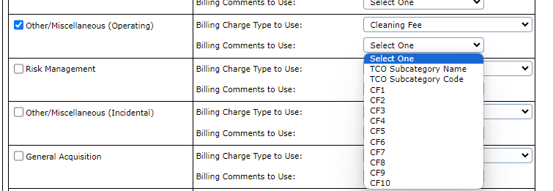
TCO Mapping Tool
With 5.12, Administrators will be able to map TCO charges back to a reservation.
Select the TCO Record Type to map back
Select the billing charge type to use
Select the Billing Comment to use

Slide 24
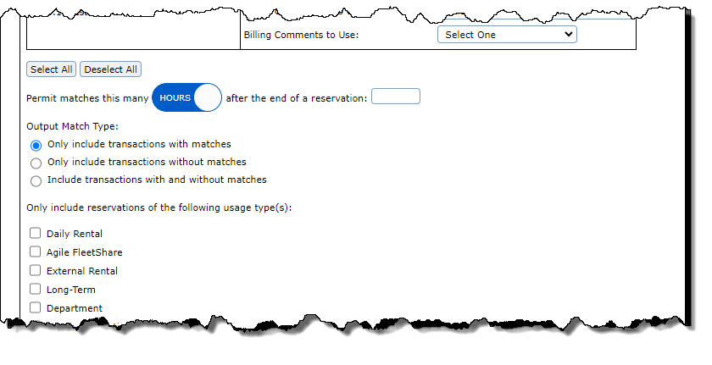
TCO Mapping Tool
To help the matching process, set a time frame to look after the reservation for a match. You can toggle between hours or days
Also select if you want to only see matches, no matches, or all transactions
Then select the reservation usage type to look for
You can also choose to exclude any transactions based on usage types on the vehicle profile

Slide 25
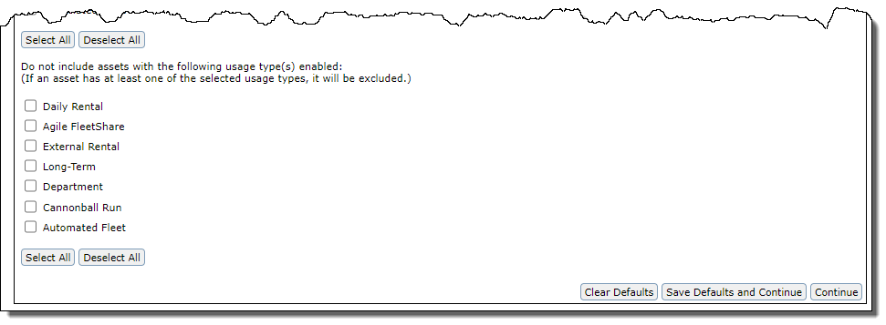
TCO Mapping Tool
You can also choose to exclude any transactions based on usage types on the vehicle profile
Example: you can exclude “department” vehicles if you are looking to map back transactions from motor pool usage
You can “Save Defaults and Continue” or just “Continue

Slide 26
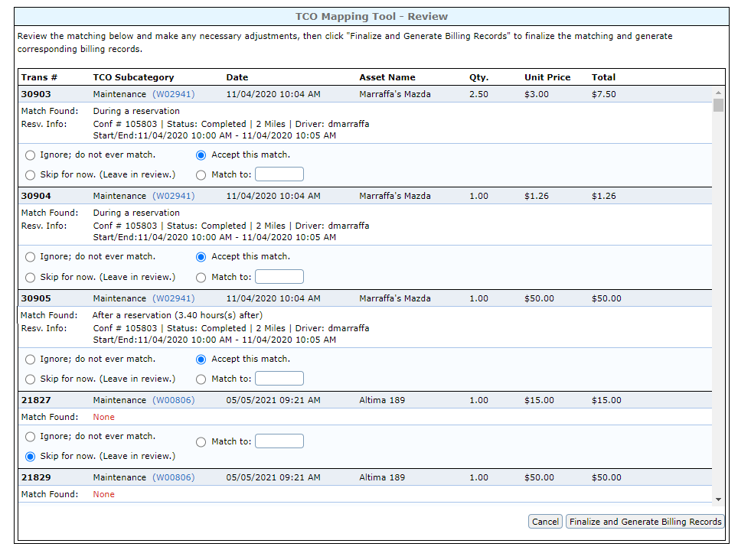
TCO Mapping Tool
Results will appear if there are matches to the filter
Hyperlink to Work Order if Maintenance transaction

Slide 27
TCO Mapping Tool
Results will appear if there are matches to the filter
Action Options:
Ignore; do not ever match
Skip for now (leave in review)
Accept this match
Match to:

Slide 28
TCO Mapping Tool
Results will appear if there are matches to the filter
Reservation information if there is a match will display
Status, mileage, confirmation number, driver, duration of trip
Provides when the transaction was

Slide 29
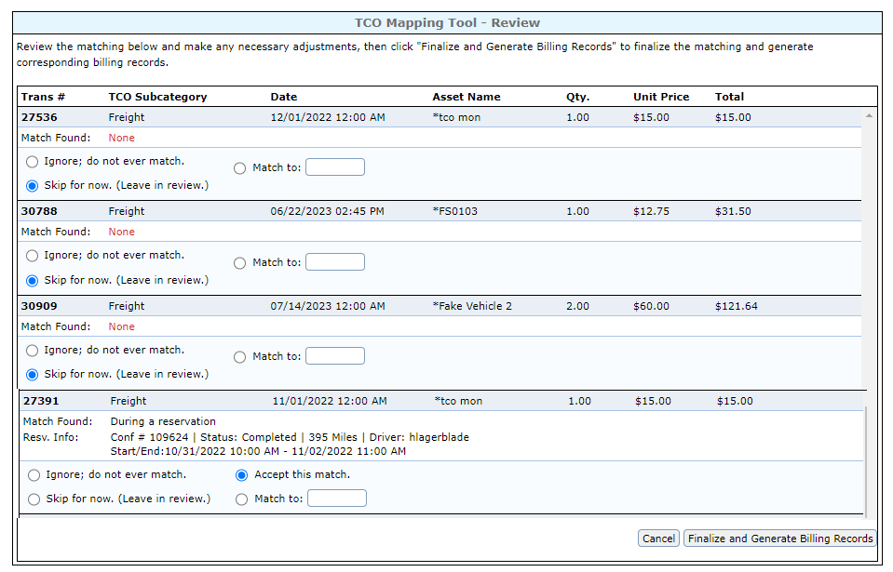
TCO Mapping Tool
Press “finalize and generate billing records” after your thorough review
Confirmation message will appear

Slide 30
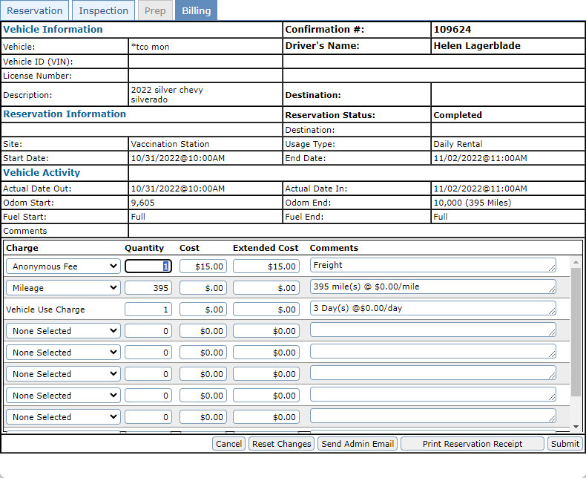
TCO Mapping Tool
After successful mapping,
the details will appear in the reservation’s billing tab

