Slide 1
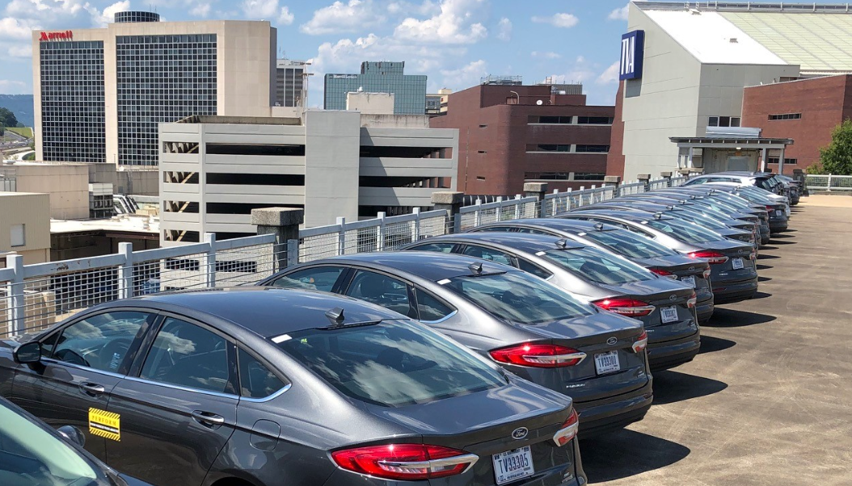
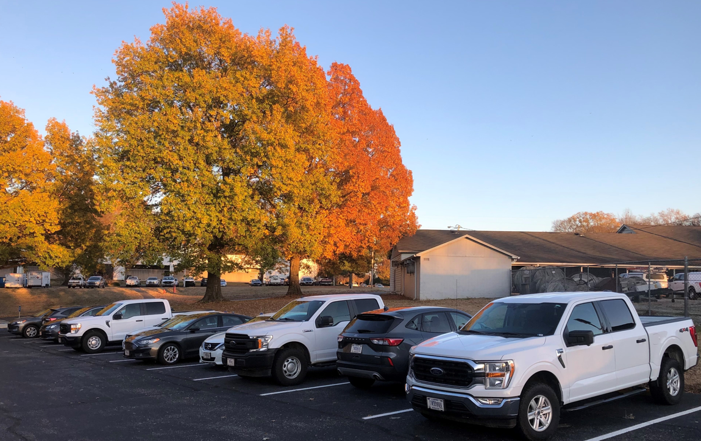
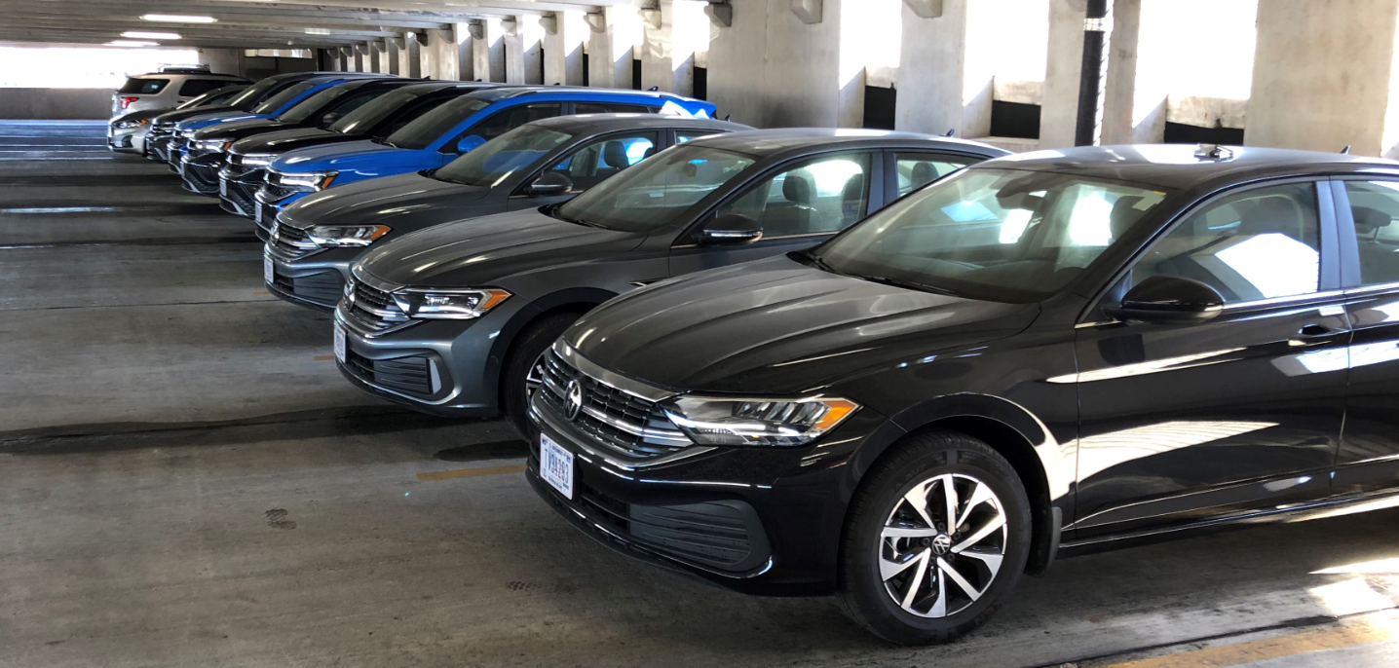
ValleyRide
Greg Burrus
TVA Fleet Services
geburrus@tva.gov
423-876-6814

Slide 2
ValleyRide
Implemented in Chattanooga in 2018
Expanded to three locations (Muscle Shoals, Alabama and Knoxville, Tennessee)
Gas-powered minivans, sedans, SUVs, pickups, and electric sedans and pickups
All employees/contractors/interns able to use for business travel anywhere in the US
Vehicles can be rented for 15 minutes up to 30 consecutive days in a row
$15 per day regardless of vehicle type

Slide 3
Three Main
Benefits
Cost savings
Time savings
Easy way to try out electric vehicles (EVs)
Chattanooga, Tennessee

Slide 4
Cost savings
Reduced number of assigned vehicles
Reduced O&M to maintain underutilized vehicles
Reduced annual spend with Enterprise/other companies
Muscle Shoals, Alabama

Slide 5
Time savings
All vehicles are on-site, eliminating travel to get vehicle
Can make reservations ahead of time or on-demand
Renters not responsible for maintenance or cleaning
Knoxville, Tennessee

Slide 6
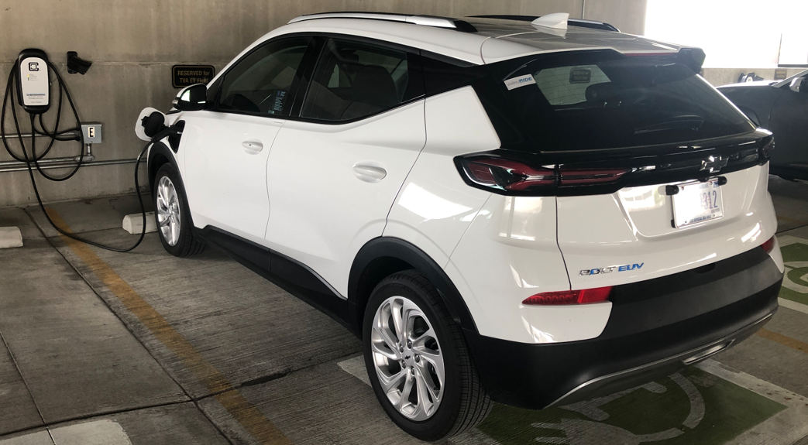
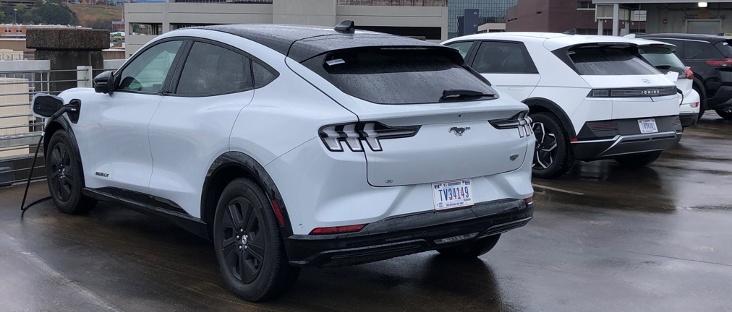
Try EVs
Bolt, Ioniq 5, Kona, EV6, Mach-E, F150 Lightning, Model 3
200 - 250+ mile range
TVA charging available, charger finder links provided

Slide 7
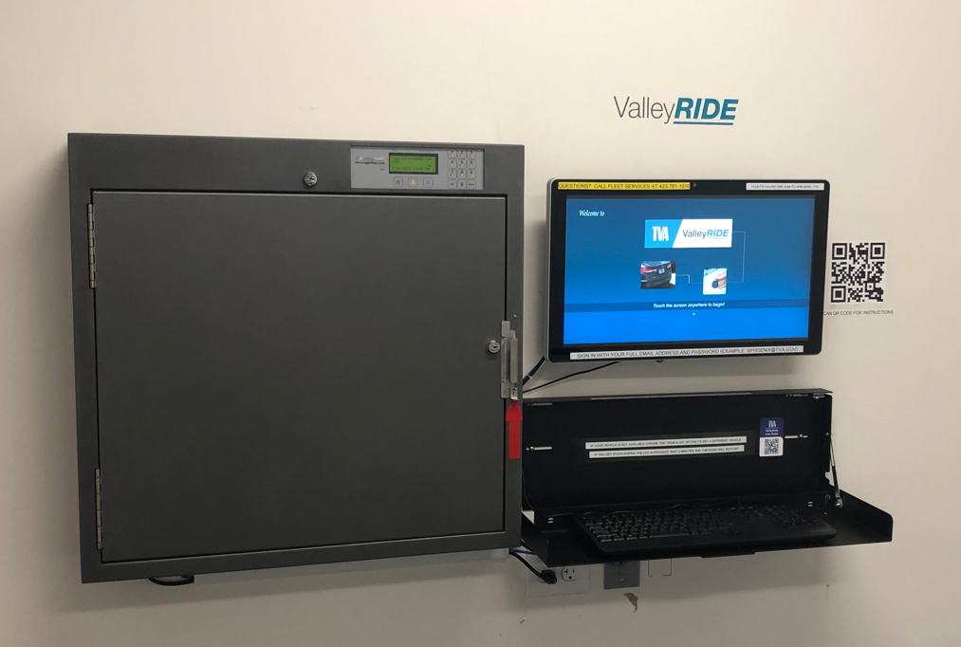
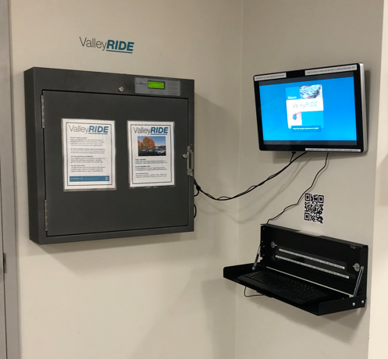
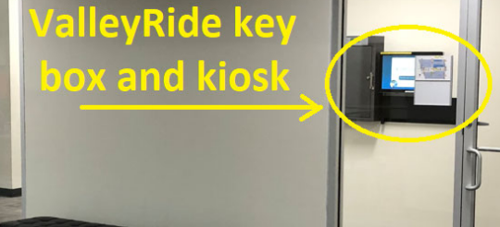
Renters
System is composed of a key box, a kiosk
(touch-screen PC), and keyboard

Slide 8
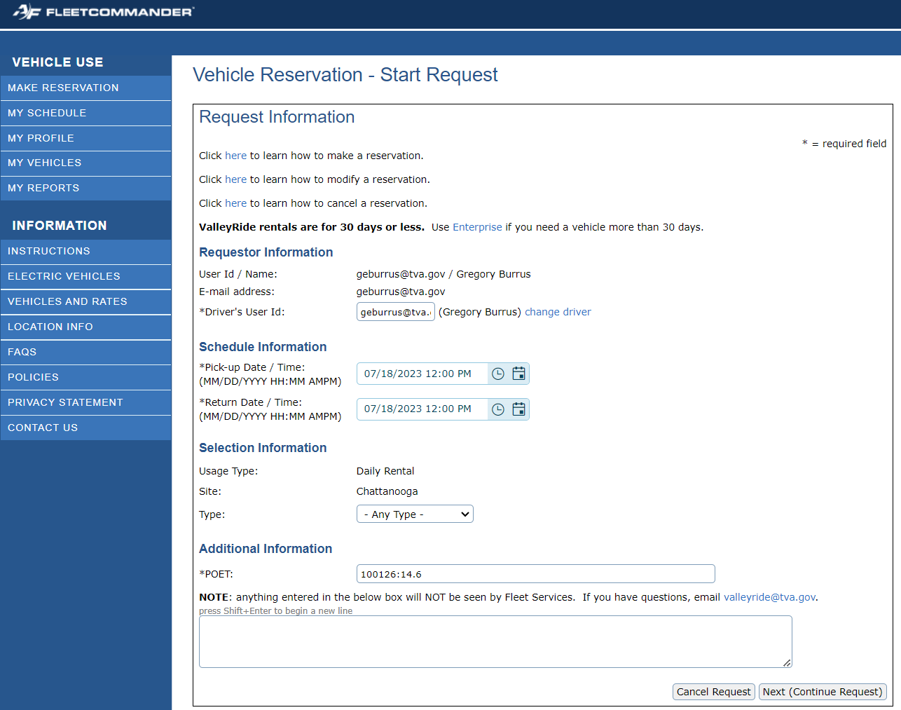
Able to reserve vehicles ahead of time online (left) or ad-hoc at kiosk (right)

Slide 9
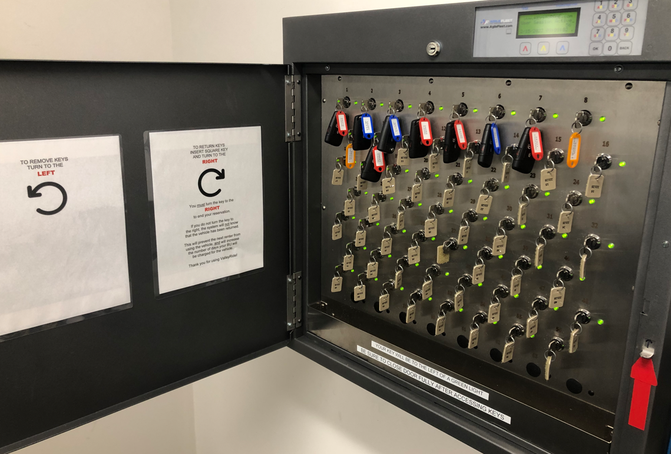
2nd
1st
3rd 4th

Slide 10
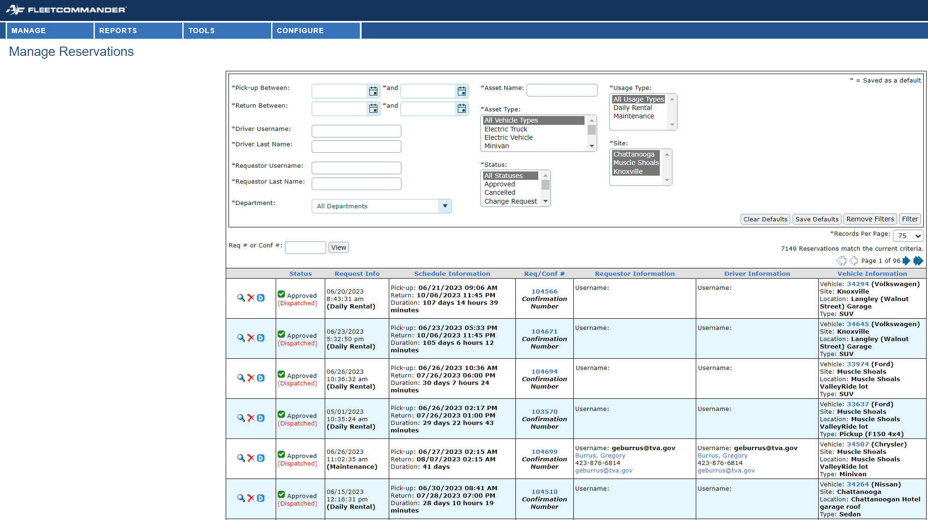
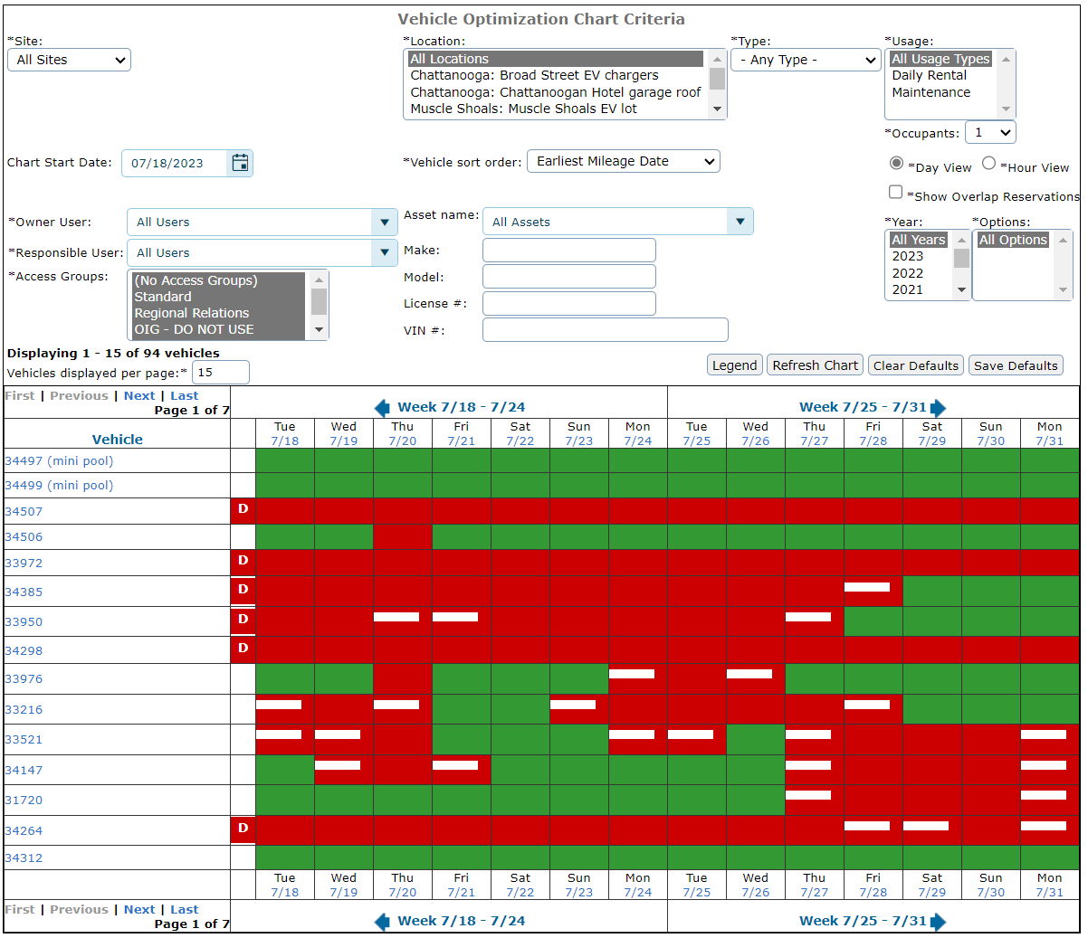
Admins
Can view/modify any reservation, take vehicles in/out of service, make reservations for renters, run reports (usage, billing, etc.)

Slide 11
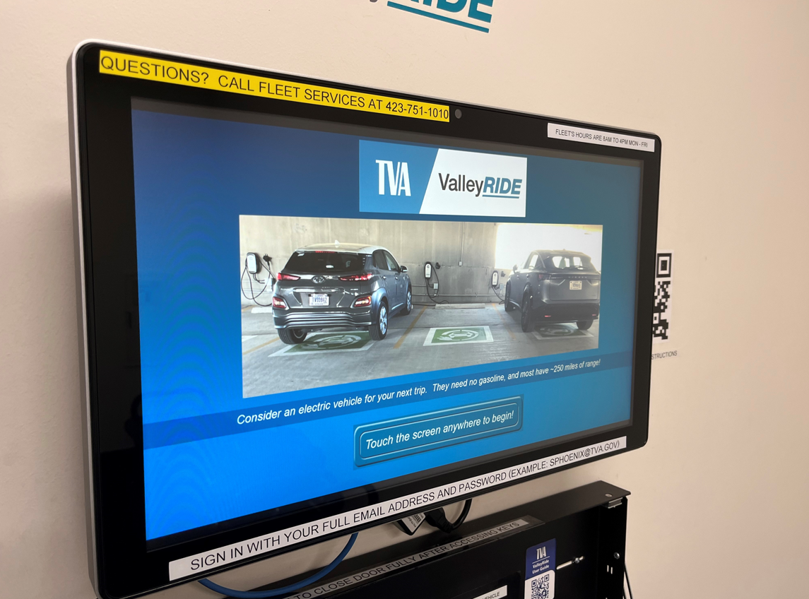
Successes
Intuitive interface for making reservations
ValleyRide solves vehicle rental issues
Many have returned assigned vehicles to Fleet
Attract-mode screen (Knoxville)

Slide 12
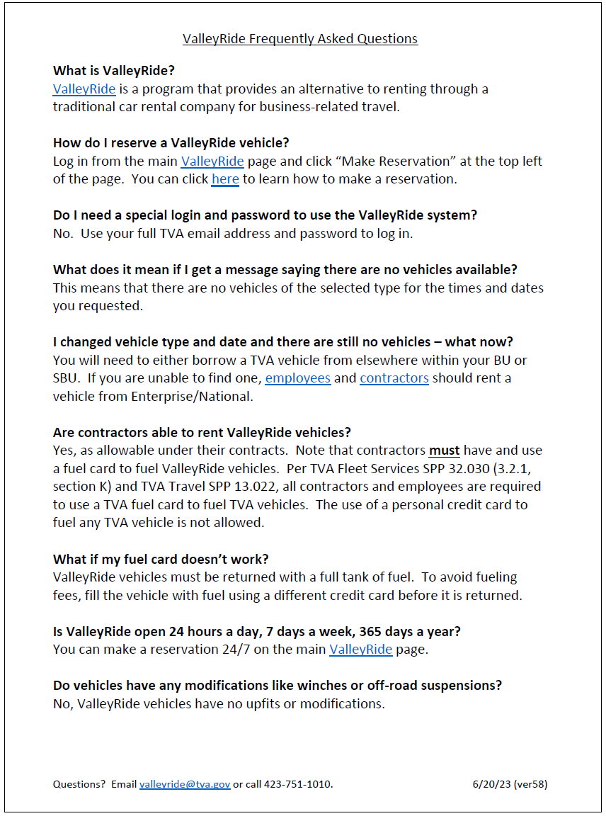
Cost savings
$125 average sedan monthly rent
$80 average service (oil change, tire rotation)
$15 daily ValleyRide rental cost (Enterprise is double+)
= fiscally responsible option for
the average driver
= “Fleet of the Future,” with more
drivers using less vehicles
“FAQ” frequently updated, and always available to
renters through intranet, links in reservation emails

Slide 13

Future plans
More vehicles in Chattanooga (frequent 100% utilization)
More trucks in Muscle Shoals (greater need than sedans)
New locations (Murfreesboro is next, 2nd in Chattanooga?)
Replace assigned vehicles with more ValleyRide vehicles
Per TVA goals, will add only PHEV/EVs starting in 2025

Slide 14

Greg Burrus
TVA Fleet Services
geburrus@tva.gov
423-876-6814

