Slide 1
FleetCommander Roadmap
Dave Kennerley

Slide 2
Agenda
Major Initiatives
Release Plan – 5.13
Future Roadmap - Overview
Roadmap – High level goals
Release Plan – 6.00
Release Plan – 6.01
Kiosk Upgrade Program
CAB

Slide 3
Platform Upgrade Our Core Platform is Built for the Future!
Major platform update to .NET –
All core code in-scope
Over half of development resources have been dedicated to this effort for the past 18+ months
Over 8,000 hours of software development
Almost 700 System Test Cases validated per release (over multiple releases)
Over 1000 focused testing hours per release
$2.5M+ of value delivered without any upgrade fees
Key Benefits –
Security
Scalability
Performance
Upgradeability

Slide 4
FedRAMP
New FedRAMP Environment is up and hosting FleetCommander!
FedRAMP authorization in-process, upcoming milestones
Gap analysis audit, completing 9/30
System Security Plan Development Complete – Q1 2024
Audit w/3PAO, targeted to Q1 2024
FleetCommander FedRAMP ‘Ready’ targeted to mid-2024
Please contact Agile Client Success to discuss this

Slide 5
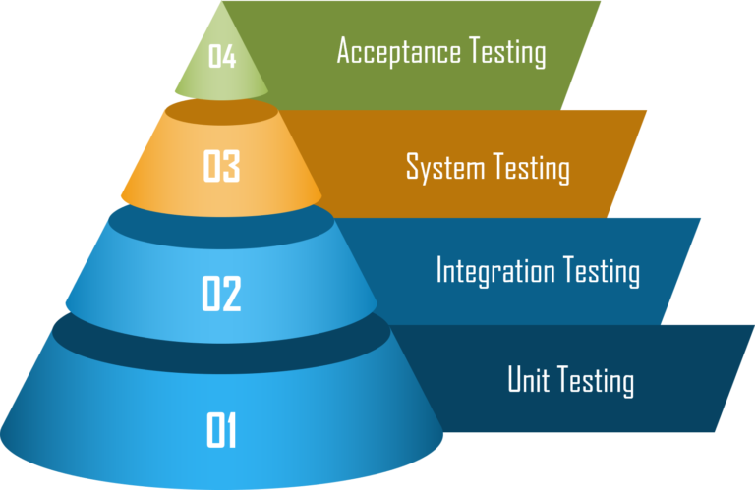
Investing in Software Quality
Investment is increasing
Focusing on Automation to support quality improvements with more frequent releases
Consistency
Frequency
Code coverage

Slide 6
We have a unique opportunity ahead!
Development capacity is freeing up to build NEW value for you
We are investing in our development team
New resources
New capability
New tools
We are building capability to deliver value more frequently

Slide 7
Development Velocity is Increasing

Slide 8
Next Release – 5.13
Complete our multi-year core platform upgrade!
All aspects of our core code base will have been updated
Upgrades completed without client disruption
Status
Development completing in 4-6 weeks
System and Beta Testing cycles to follow
Commercial availability targeted to late Q1 2024

Slide 9
12-Month Roadmap High Level Targets

Slide 10
Introducing: Release – 6.00 Status: High level scope locked
Maintenance improvements from backlog and feedback
TCO enhancements from backlog and feedback
Vehicle Replacement Report – Phase 2
Vehicle Circle-Check Integration
FedRAMP development items
Small enhancements from backlog and feedback
Client specific custom development
Client specific custom code upgrades
Development Timeline: Development targeted through Q1 2024

Slide 11
Release – 6.01 Status: Prioritizing
Maintenance improvements from backlog and feedback
API enhancements from backlog and feedback
Reporting enhancements from backlog and feedback
Vehicle Replacement Report – Phase 3
FedRAMP development items
Small enhancements from backlog and feedback
Client specific custom development
Client specific custom code upgrades
Development Timeline: Development targeted through mid-2024

Slide 12
Time for a kiosk upgrade?
What phone was in your pocket in 2010?
How many of you are still carrying it?
Phone carriers typically offer a "new every two" or similar program to offer the best performing devices and latest technology.

Slide 13
Kiosk Replacement
In the coming weeks, we'll introduce options for the replacement of both indoor and outdoor kiosks
We're gauging interest among FleetCommander users in these new offerings
A 10% discount will be applied to orders received by Nov. 1, 2023
In addition to a one-time replacement, we're also offering a kiosk refresh program

Slide 14
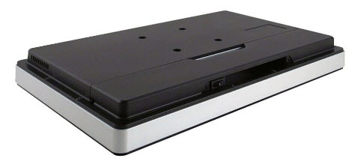
One-Time Kiosk Replacement
Front of kiosk
Back of kiosk

Slide 15
Why upgrade or refresh your kiosk?
 | Current Kiosks | Upgraded Kiosks
Performance | Slow and laggy experience with older processor, older operating system (not upgradable to Win 11) | Fast and responsive experience with solid state drive, upgradable storage, and up-to-date OS (Win 11)
Support | In case of failure, manufacturer involvement and one week or more of downtime | Agile Fleet support with two-day replacement
Cost/Purchase Process | Unpredictable and dependent on time/severity of failure, causes budget exceptions | With kiosk tech refresh, you have a fixed, predictable cost included in your annual renewal with regular upgrades (every 4 years)
Mitigate risk. Reduce downtime. Improve customer experience. Gain peace-of-mind.

Slide 16
Kiosk Tech Refresh
Look for additional info in the coming weeks.
Reach out to client success.
A Key Box Tech Refresh is also in the works.
Scan the code at right to join a mailing list as we roll out additional details.

Slide 17
CAB – Summarized Feedback
Maintenance Priorities (Top 5)
Multi-search capability to find Assets
Provide an easy way to see parts used on a specific vehicle
First In First Out (FIFO) Parts Inventory Pricing
Ad-hoc reporting with custom templates
PMs triggered by hours
FleetCommander (Top 7) Priorities
In-Vehicle Option
Modify/Approve a Reservation in 1 click
Update excel version of reports (xlsx)
Drag-n-drop for vehicle re-scheduling
Self-service reporting
Training videos at the Kiosk
‘Action’ needed for Admin upon vehicle check-in

Slide 18
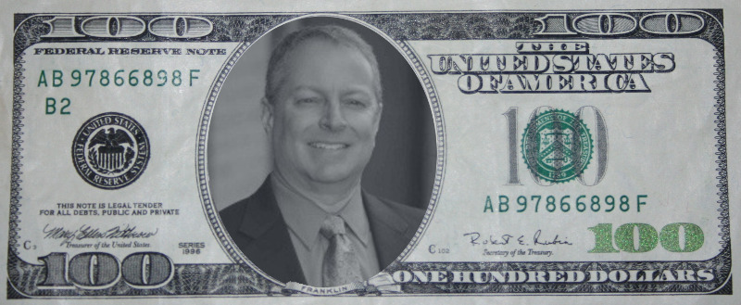
Spend some product $$
Everyone gets $500 ($100 x 5) in ‘Ed Bucks’
Spend it based on your product priorities!

Slide 19
Spend some product $$
In-Vehicle Option
Modify/Approve a Reservation in 1 click
Update excel version of reports (xlsx)
Drag-n-drop for vehicle re-scheduling
Self-service reporting
Training videos at the Kiosk
‘Action’ needed for Admin upon vehicle check-in
Additional Maintenance Improvements
Add texting as a communication option
Reporting Subscriptions
User Upload capability
Easier API Integrations / Additional data available via API
UI Modernization

