Slide 1
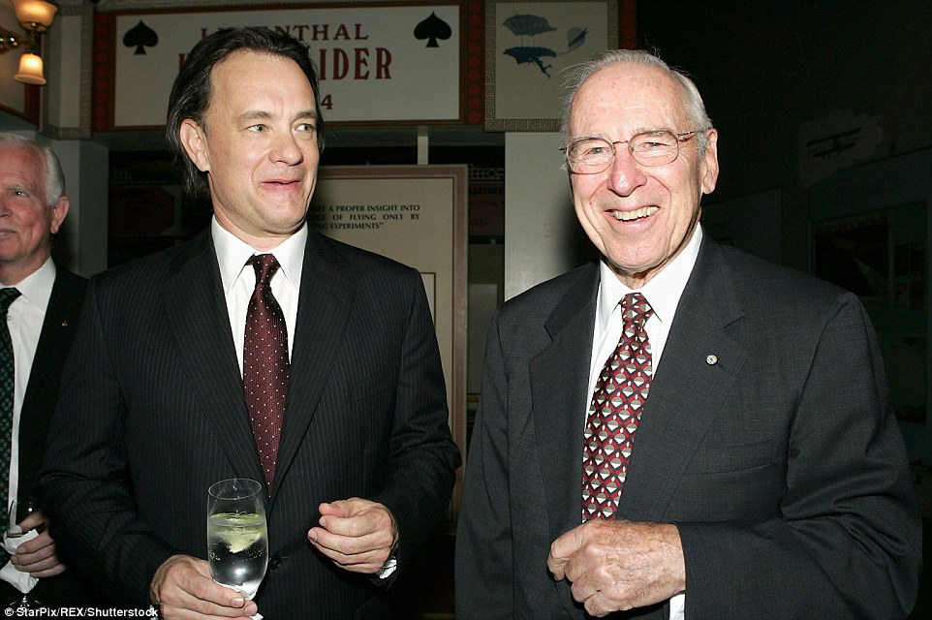
Captain James A. Lovell Federal Health care center and agile fleet commander
TRANSPORTATION DEPARTMENT
MARSHALL FOX: TRANSPORTATION SUPERVISOR/FLEET MANAGER
Notes:
Hello everyone. My name is Marshall Fox and I am the transportation supervisor and fleet manager of the captain james a lovell federal health care center in north Chicago Illinois. We are an actual VA in every sense of what everyone knows with a couple of very special distinctions. One is that we are named after Captain Lovell whom you all know flew on the fateful Apollo 13 mission. (no, I have never met Captain Lovell nor Tom Hanks,) and we are also the first of its kind partnership between the U.S. Department of Veterans Affairs and the Department of Defense. All medical care at our facility has been integrated to serve both our nation’s veteran heroes and also our nation’s current warriors with a single combined VA and Navy mission.

Slide 2
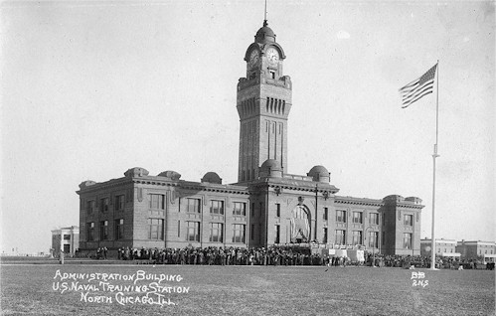
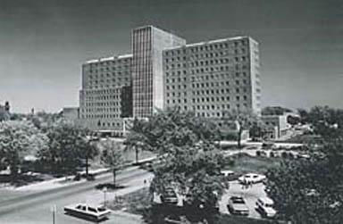
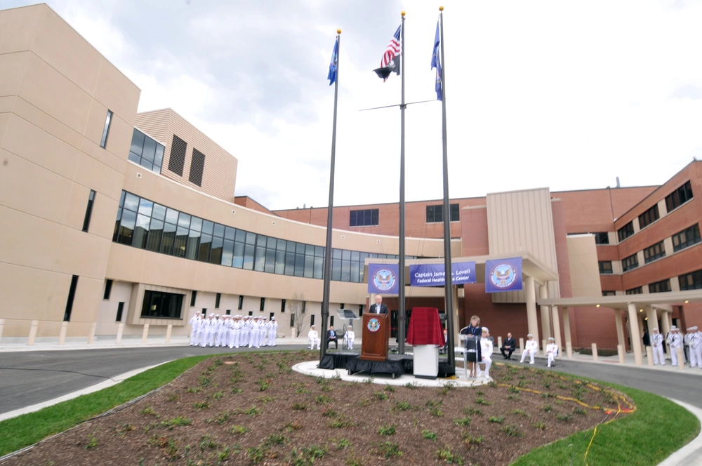
Some history (FHCC)
Naval Station Great Lakes (NSGL) 1911
Naval Hospital Great Lakes (NHGL) 1960
North Chicago Veterans Medical Center (NCVAMC) 1926
Captain James A. Lovell Federal Health Care Center 2010
TRANSPORTATION DEPARTMENT
Notes:
This federal health care center started its history back in 1911 when the navy opened a base to train enlisted recruits from around the Midwest. There were ups and downs in the number of recruits before and after both world wars, but both the Korean and cold wars saw significant growth.
Including, in 1960, the addition of The Naval Hospital Great Lakes.
In the meantime, back in 1926, The North Chicago Veterans Medical Center was established on land originally obtained by the Navy in North Chicago. The initial mission was to treat long-term, chronic psychiatric patients who served in World War 1 but soon was expanded to treat more acute needs such as surgical, general medical and nursing services.
Even though this Federal Health Care Center was officially established around 13 years ago, the idea for a joint VA and department of defense medical facility has been researched and considered since the early 70’s.
But there were many issues to overcome like who works for who. Who’s the boss of who. Military over civilian, civilian over military and transitioning from two platforms, with many facets, into one. Logistically, a challenge to be polite, one of which I still see and deal with today as fleet manager.
Then, in 2010, though with some growing pains, The Captain James A Lovell Federal Health Care Center was officially established. We now serve nearly 75,000 patients per year with 40,000 being Navy personnel and recruits.

Slide 3
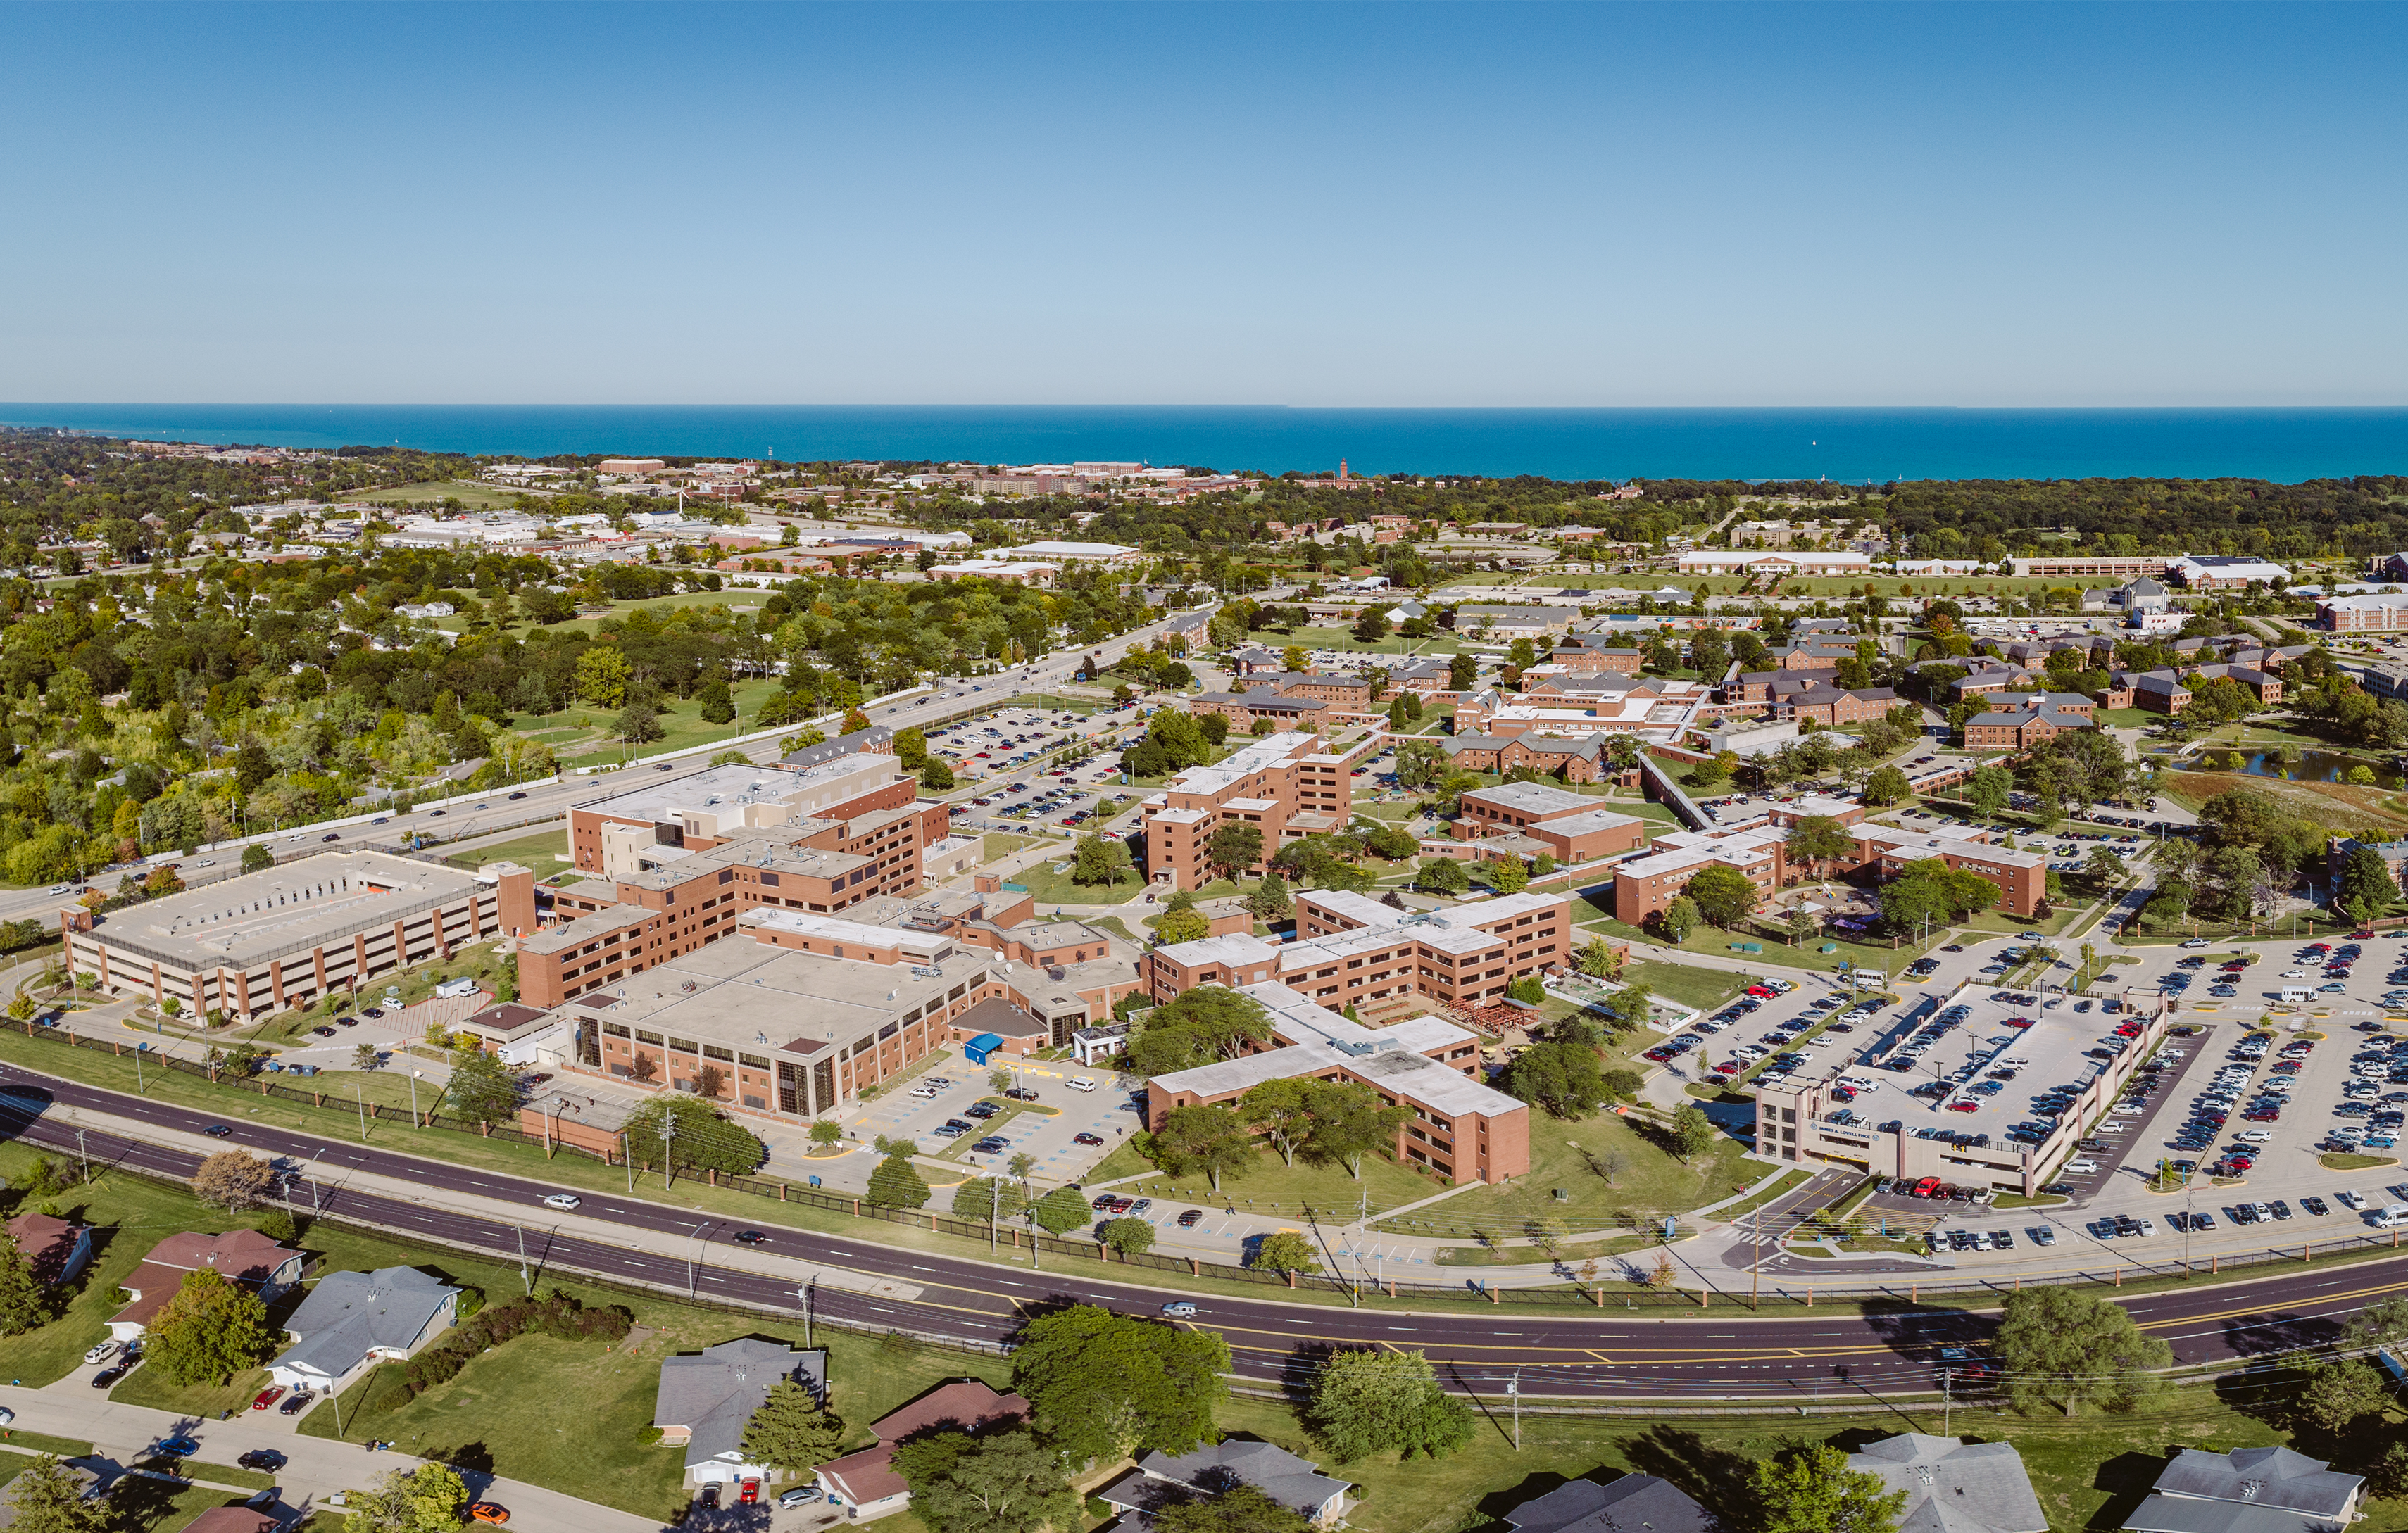
Our facility
Community Based Outpatient Clinics
Evanston, Illinois
Kenosha, Wisconsin
McHenry, Illinois
TRANSPORTATION DEPARTMENT
Notes:
Not only do we service our main campus, shown here on the shores of Lake Michigan, but also 3 Community Based Outpatient Clinics (CBOCS) located in Evanston Illinois, Kenosha Wisconsin and McHenry Illinois. These make access to VA health care easier for those living further away from the FHCC. The Naval Base is located right next to the lake and the VA is in the forefront. Because I could not find a better picture, like Sammy from UT yesterday, our Transportation Department is located somewhere around… here.

Slide 4
Starting from scratch well sort of
LOCAL POLICIES (NEW)
TRANSPORTATION DEPARTMENT
PROPER USE OF A GOV (TRAINING AND TRACKING)
VA DIRECTIVE 1695
COMPLIANCE ISSUES (VA DIRECTIVES)
STANDARD OPERATING PROCEDURES (NEW)
GOV DRIVER RECORDS/ABSTRACTS (30 STATES SO FAR)
DANG SAILORS!!!!
TYPE OF DRIVER (MORE TRAINING REQUIRED?)
VA DIRECTIVE 0637
VEHICLE USAGE TRACKING (MINIMUMS)
VEHICLE MAINTENANCE (FILING CABINET?????)
Notes:
Due to the uniqueness of our facility, there have been some challenges, especially when adding all these sailors to the mix. Everything from creating new local policies, updating or creating new operating procedures, complying with VA directives like 1695 and 0637 (now including active duty) to name of few which cover things like training every Government Owned Vehicle operator on the use of a GOV, getting every driver’s record or abstract, 30 states so far, dang sailors, required minimum vehicle usage AND tracking of said usage (which was done with paper logs), The type of driver, CDL? Do they transport patients? Did they do the proper training if they do transport patients. Maintaining maintenance records currently in a filing cabinet, for all vehicles (a filing cabinet?? Really people who came before me?? PAPER??)

Slide 5
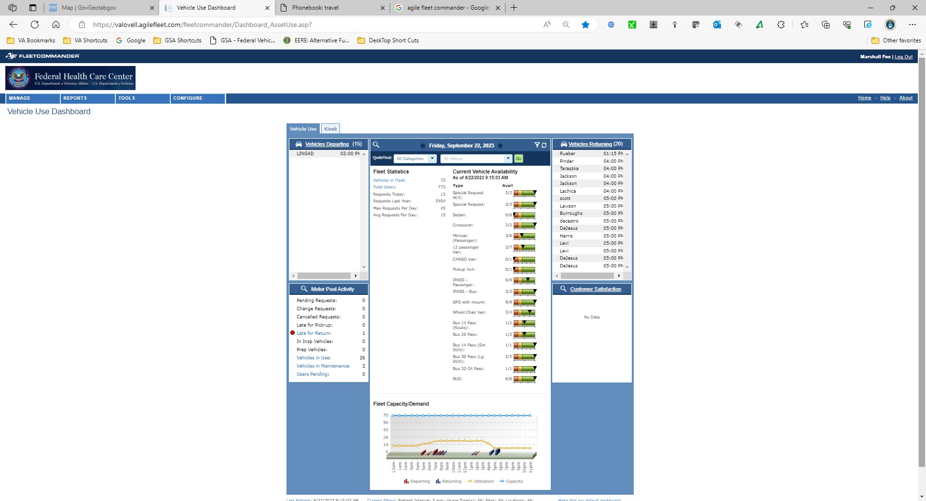
AGILE FLEETCOMMANDER
TRANSPORTATION DEPARTMENT
Notes:
One of the things that I fortunately did not have to start from scratch is Agile Fleet Commander.
When I first started using the interface, I was a driver helping out when not behind the wheel. It made checking out vehicles so much easier when the kiosk system was installed. Well, after I started as fleet manager and transportation supervisor and stopped thinking what the.. Heck did I get myself into, I quickly saw that we were way underutilizing this tool.

Slide 6
AGILE FLEETCOMMANDER
TRANSPORTATION DEPARTMENT
Notes:
So much so that not only does Agile Fleet have a permanent place on our home page, kiosk and reservation instructions included, but ALL GOV driver’s, check out a vehicle from our pool or not, are required to create a profile. This has become THE starting point for all GOV operators compliance. And yes, after listening to conversations yesterday one of the many things I am going to do when I return is adjust our Kiosk hours to 24/7.

Slide 7
AGILE FLEETCOMMANDER
GOV DRIVER RECORDS/ABSTRACTS (30 STATES SO FAR)
TYPE OF DRIVER (MORE TRAINING REQUIRED?)
TRANSPORTATION DEPARTMENT
Notes:
Before getting into the numbers on how this tool benefits the FHCC with the intent to which it was purchased, I wanted to share some of the features that we were able to customize to help us reach our compliance goals. So let’s break down a few things from slide 4. Basically, everything falls under VA Directives 0637 and 1695. Being a new type of facility, we needed some new ways to track compliance. Starting with GOV Operators. Anyone that drives one of our GOV’s starts here. Even if they never check out a vehicle from our fleet but have one assigned to their department, we use this for ALL drivers. It has now become our clearing house for not only basic information but being able to dig deeper. Like this one question that determines how much training they require. Do they transport Patients? We also ask if they are an employee, contractor or volunteer? This answer determines even more possible requirements. And of course, driver’s license information. We have actual DL numbers on an internal data base but have their expiration date here so we can track when they need to renew. FedRamp?? Garret?? Can we use this when you are FedRamp Certified???

Slide 8
AGILE FLEETCOMMANDER
GOV DRIVER RECORDS/ABSTRACTS (30 STATES SO FAR)
TYPE OF DRIVER (MORE TRAINING REQUIRED?)
TRANSPORTATION DEPARTMENT
Notes:
Bottom line is If we were ever to get audited, all I can say is bring it on. Training complete? I even have the dates. Need the actual certificate? Well it is uploaded into Agile Fleet so here you go. Need to see the actual abstract? Uploaded as well. OK. Though I am no longer 5’10” as for some reason I shrunk an inch. 200 pounds? Nope. Brown Hair? Not since I took this job at least…

Slide 9
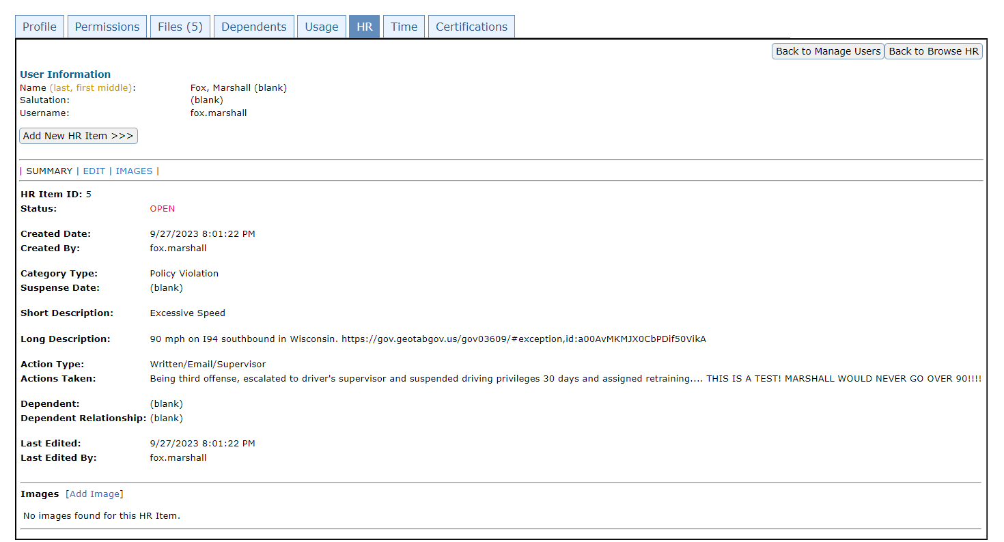
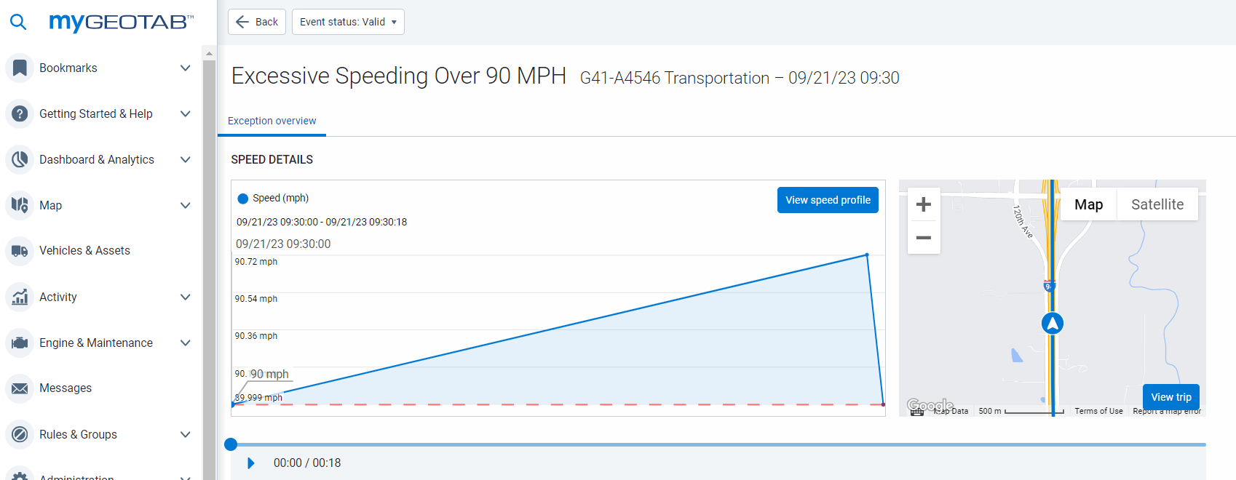
AGILE FLEETCOMMANDER
HR TAB
Who’s been bad, how many times and what you gonna do about it??
TRANSPORTATION DEPARTMENT
Notes:
By the way, you guys have an HR tab? Don’t mind if I do. Now any infraction, any discussion or action that is taken that can lead to a driver losing their GOV driving privileges, I got it covered AND documented. I am also able to put in a URL that leads to the actual infraction as captured in, GeoTab. By the way, This was a test thing, I would NEVER go over 90.

Slide 10
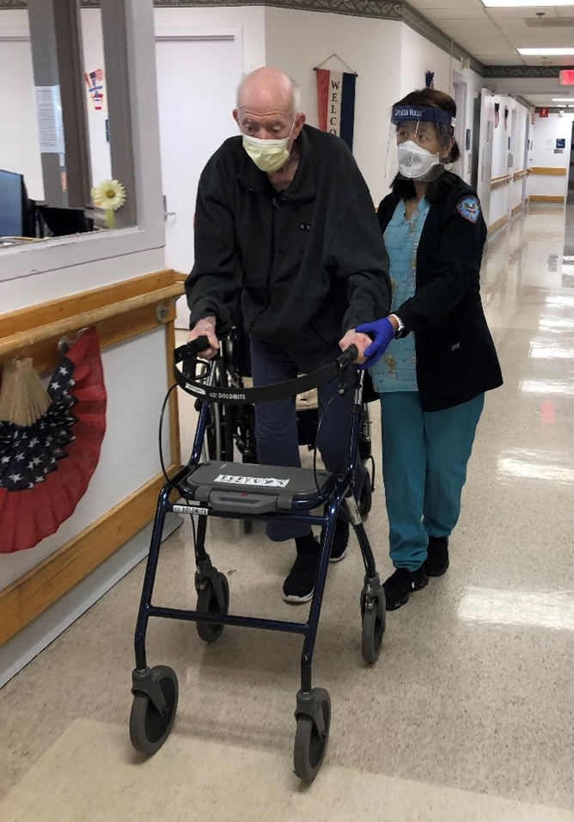
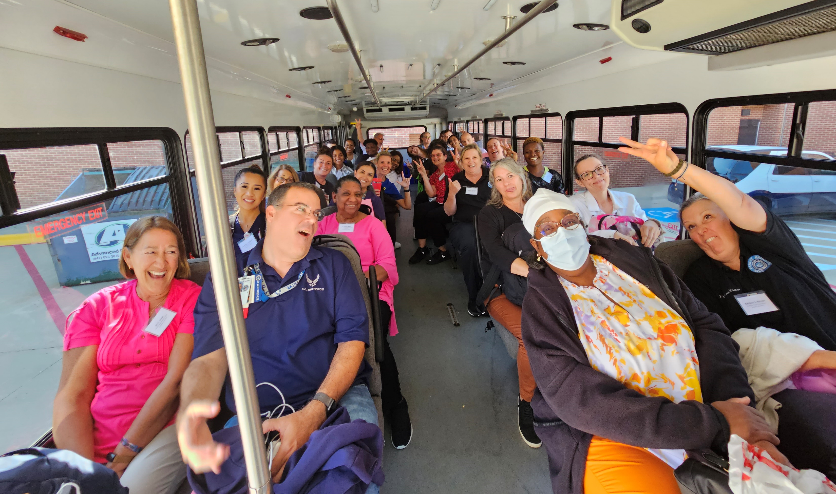
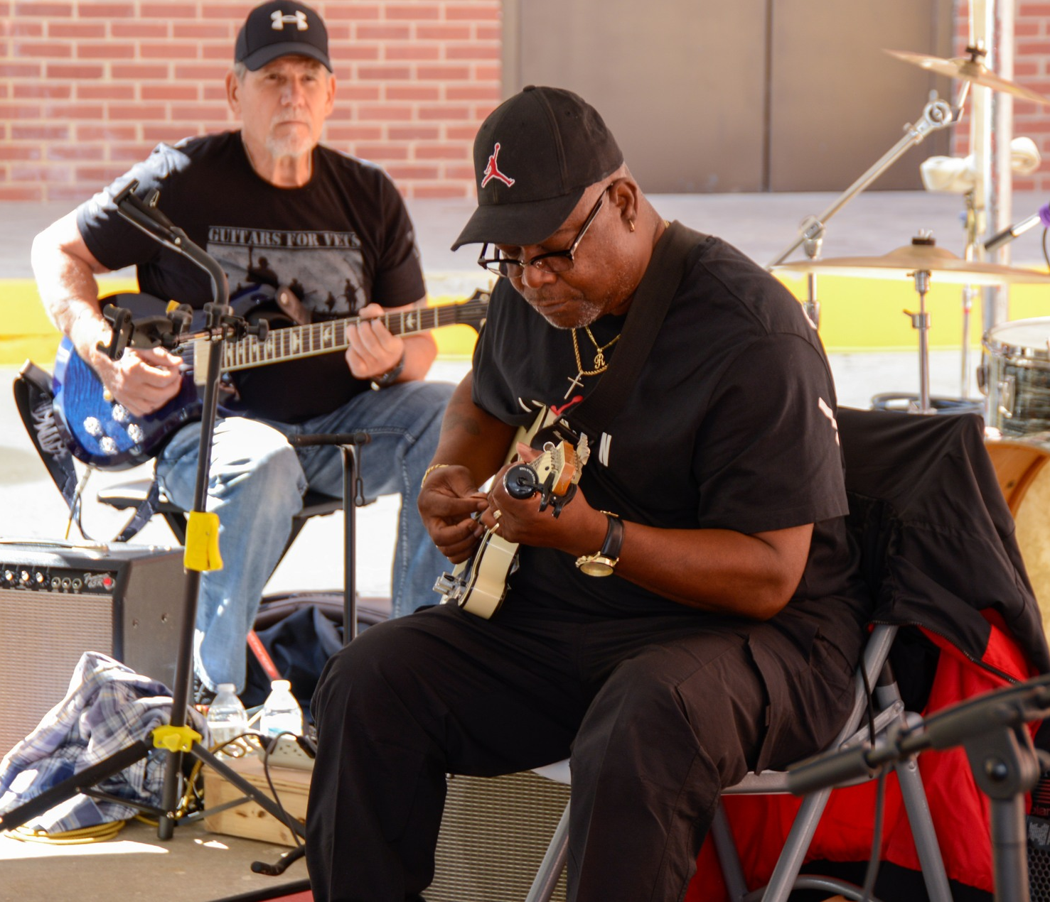
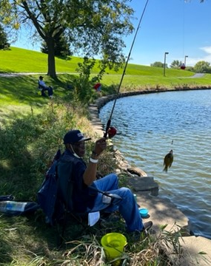
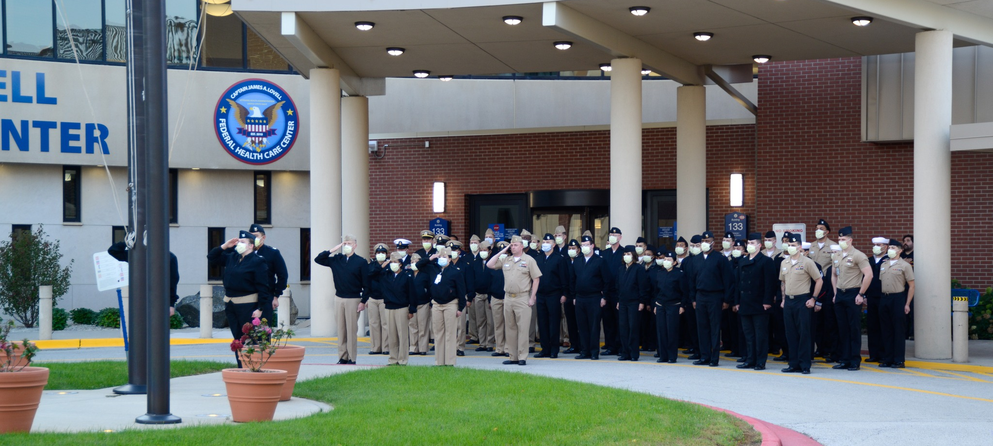
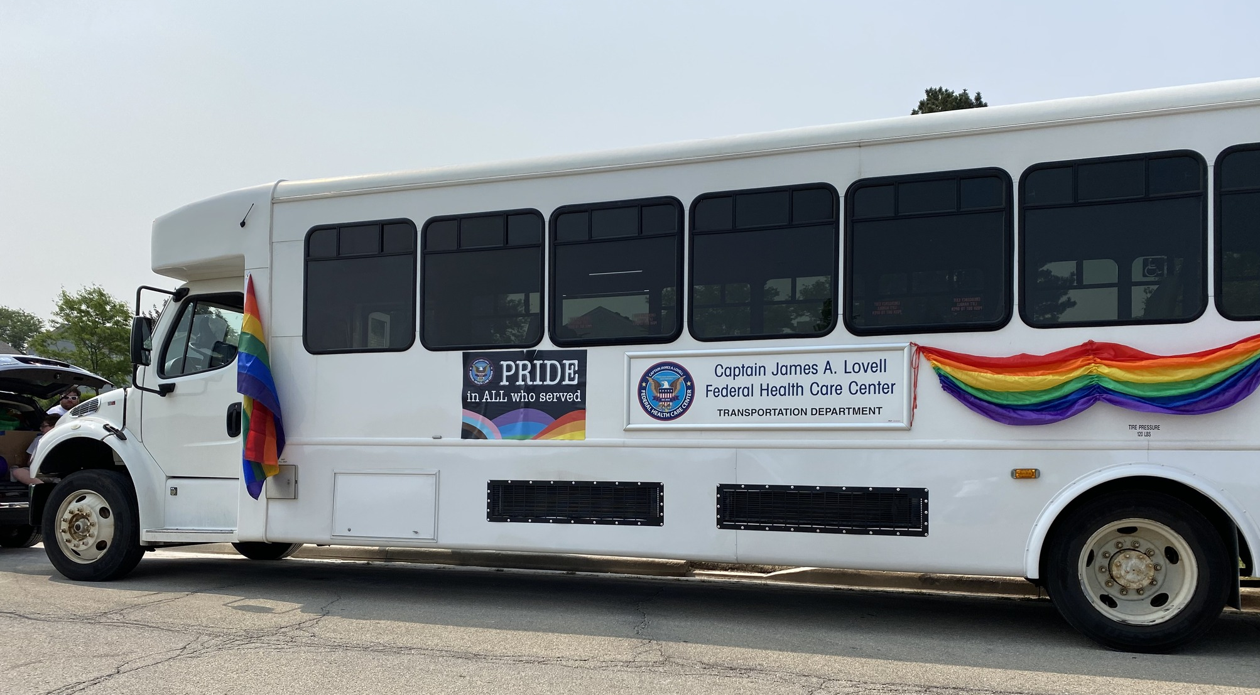
NOT ONLY A FLEET MANAGER
TRANSPORTATION DEPARTMENT
Notes:
Not only am I the fleet manager for all of FHCC’s vehicles, but I am also, as mentioned, the transportation supervisor. My department’s team of drivers is responsible for transporting patients to appointments, shuttling VIP’s between the VA and the Navy Base for all kinds of stuff, taking vets to recreational functions, veterans’ art festivals and parades, (the guy playing guitar is actually one of our driver’s) having professionals from all over the country attend training at our facility and being their uber from the hotels or airports, and one that I am proud of, especially my team for pulling it off…..

Slide 11
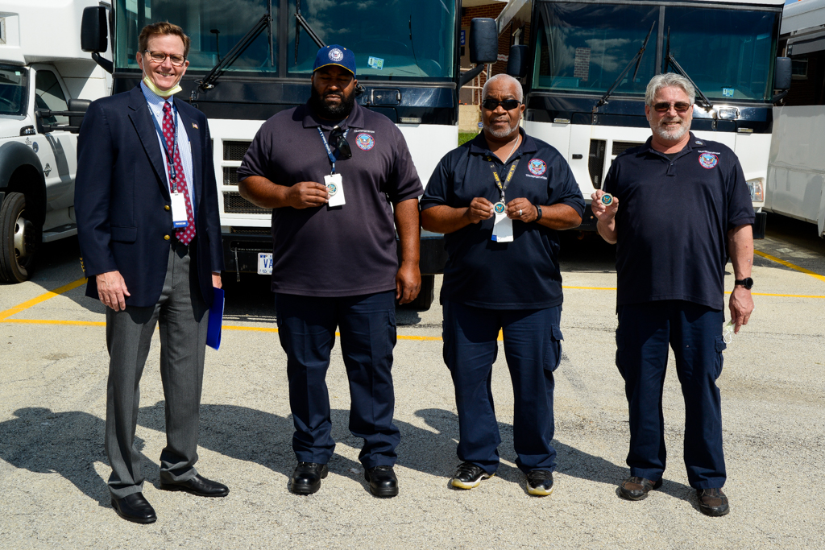
NOT ONLY A FLEET MANAGER
TRANSPORTATION DEPARTMENT
Notes:
Being the main source of transportation for the National Veterans Softball Wheelchair games for two years in a row. Here is the driving team and me receiving a coin from Dr. Buckley, our facility director for this accomplishment.

Slide 12
BEING CREATIVE
TRANSPORTATION DEPARTMENT
Notes:
How does Agile Fleet help me accomplish this as Transportation Supervisor? Operationally, we were able to stretch Commander into even more functionality for us. By creating “asset types”, such as Special Request and Special request W/C, and usage types such as Recreational Trips, more than vehicles can be reserved. Patient appointments and recreational trip requests can now be done online. This saves us time and assures much more accuracy for our patient care then back and forth emails or phone calls.

Slide 13
BEING CREATIVE
TRANSPORTATION DEPARTMENT
Notes:
When one of our recreational therapists wants to schedule an outing for our residential veterans, or a social worker or nurse needs to schedule transportation for a veteran for an appointment, they can make a reservation just like reserving a vehicle. And we have created specific vehicle names like Extra Patient Transport or Buss Filler 1. When we assign the vehicle, we use one of these faux vehicle names.

Slide 14
BEING CREATIVE
TRANSPORTATION DEPARTMENT
Notes:
Are you a social worker or nurse and need a driver and special vehicle for a Patient Appointment? Make an online reservation.

Slide 15
BEING CREATIVE
TRANSPORTATION DEPARTMENT
Notes:
Need a driver and bus to shuttle the big brass around? Make an online reservation.

Slide 16
BEING CREATIVE
TRANSPORTATION DEPARTMENT
Notes:
How about a recreational therapist that wants to take our vets fishing? Make an online reservation.

Slide 17
BEING CREATIVE
TRANSPORTATION DEPARTMENT
Notes:
Partying doctors and nurses using a conference as an excuse to have a great time because we do the driving for them? NO, it’s not an Agile Fleet user conference, but you can use Agile Fleet to Make an online reservation.

Slide 18
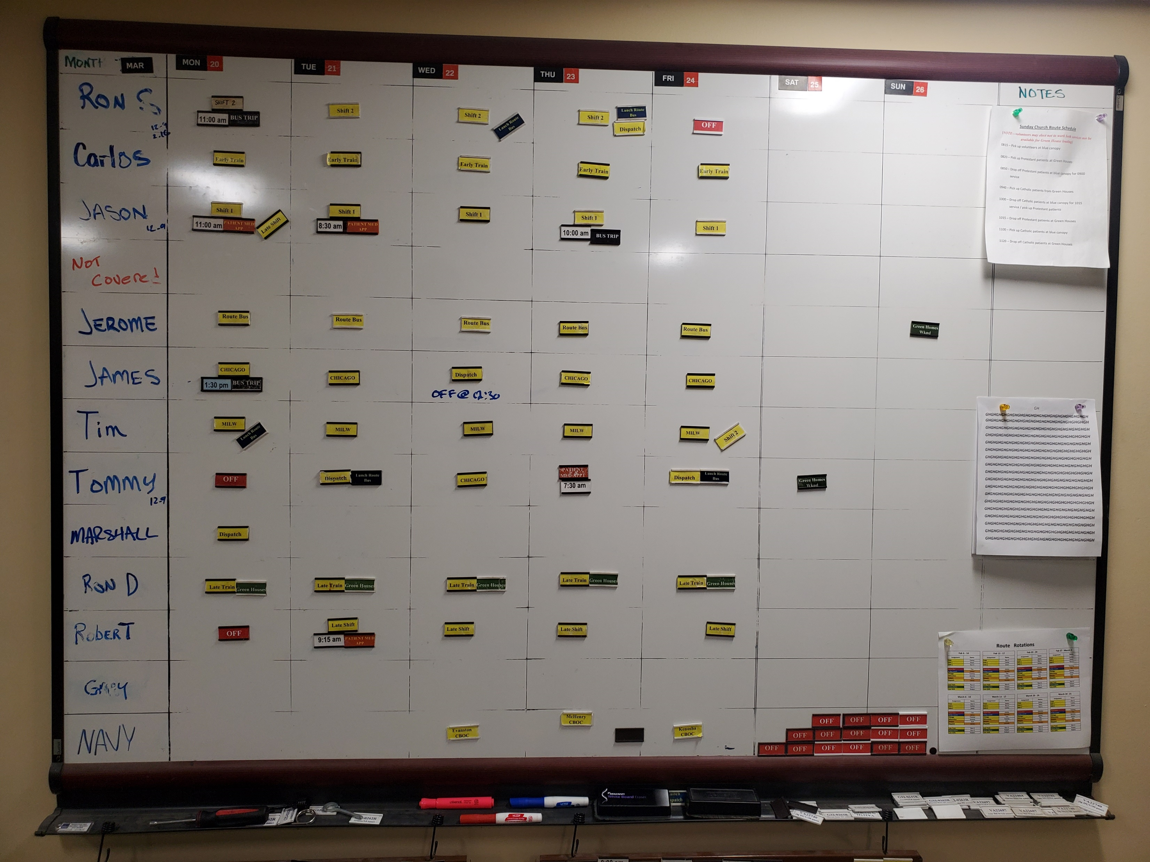
BEING CREATIVE
TRANSPORTATION DEPARTMENT
Notes:
This old timey thingy here is our weekly assignment board. This was a pretty slow week. But for the past couple of months, I have been planning every week using Agile Fleet as one of our tools.

Slide 19
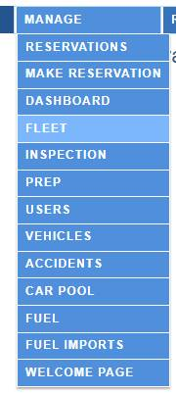
BEING CREATIVE
TRANSPORTATION DEPARTMENT
Notes:
Before even starting that assignment board for the following week, I first go here. From Manage I go to Fleet, and all of transportation’s upcoming activities are there. We do all our assigning from here now. Plus, just like a vehicle, we can track trends which makes future human resource planning that much easier.

Slide 20
MAINTENANCE
TRANSPORTATION DEPARTMENT
Notes:
As you can see here, maintenance is currently greyed out. I am hoping that is our next time saving, stop paper wasting, this.

Slide 21
THE NUMBERS
Key Performance Indicators
Total vehicles - 71 Shared vehicles
Total Users – 408
5,503 total reservations processed
Total reservations approved/completed 5177 - 94%
5,143 Completed to date (99%)
326 Cancelled (1%)
Total logins – 12,597
Unique logins – 305
Driver Adoption 75% - Unique logins/Total Users
Motor Pool Utilization
16.8 average completed transactions (reservations) per unique login
Ratio of Drivers-to-Vehicles = 4.3 per user based on unique logins (408/71)
Incremental vehicles needed to support operations without sharing 234
Capital SAVED due to sharing $4.7M!
Annual operating expense saved due to sharing $819K
Total hours 99,795 – averaging 19.4 hours per completed reservation
Total miles 773,330 averaging 150.4 miles per completed reservation
TRANSPORTATION DEPARTMENT
Notes:
Since we started to use Agile Fleet for more than just to check out a vehicle, these numbers have and will continue to go up. Especially with Covid, hopefully in the rear view mirror…..

Slide 22
Vehicle Statistics
THE NUMBERS
TRANSPORTATION DEPARTMENT
97% of vehicles have under the recommended mileage
39% of vehicles are under the recommended age
Notes:
By the looks of this, we are WAY off! But working with Joe, I just need to reset my vehicle parameters such as days used per month and adjust the mileage. I have not even come close to diving into this. That is why we are all here for sure. Even though this pacman looks like he had his jaws wired shut

Slide 23
Motor Pool Utilization Last 12 months
THE NUMBERS
TRANSPORTATION DEPARTMENT
Opportunities to improve utilization exist
The average utilization is 37%. This indicates vehicles are typically used once a day.
Effective utilization should be 65% or higher
The fleet operation should be reviewed
Based on 26 idle vehicles, the financial impacts are significant with the average OpEx avoidance is estimated at $91K+ annually, GSA leased vehicles.
 | Average
Active Vehicles | 43.59
Vehicles In Maintenance | 1.48
Vehicles Available | 42.12
Vehicles In Use | 15.58
Total Trips | 16.85
Idle Vehicles | 26.54
Requests Turned Down | 0.01
% of Vehicles Used | 36.8
Total Hours Available | 1,010.82
Hours Used | 185.03
% Hours Used | 18.26
Notes:
Because of us adding the additional faux vehicles and are utilization standards needing adjustments, I expect these to increase as well. By far hopefully. Maybe next year when we are here?

Slide 24
THE NUMBERS
TRANSPORTATION DEPARTMENT
Notes:
Now this is the list I look at. Especially during the last two weeks of the month. Call this the most used tool in our toolbox as far as meeting my utilization numbers. People make a reservation and we assign the vehicles. But before assigning, I can see, at a glance, how to rotate vehicles to assure hitting the oh so important monthly usage. 12 days a month or 833 miles. We never hit the miles considering it is mostly local. If there is a really low number it means that vehicle is checked out for an extended period of time and not checked back in. Easily verifiable. Our last utilization report has us up from under 50 percent to above 71 percent in under 3 months. This is almost completely attributed to this simple method for properly rotating resources.

Slide 25
Vehicle Demand – Last 30 DAYS
THE NUMBERS
TRANSPORTATION DEPARTMENT
There are ~26 vehicles underutilized each day, with total vehicles in use at <26 and Max vehicles at ~ 30. The demand trend is increasing, but about 50% of capacity.
Notes:
Notes to add later.

Slide 26
Utilization by Asset Type
THE NUMBERS
TRANSPORTATION DEPARTMENT
 | Average
Special Request W/C | 8.04
Sedan | 3.84
Crossover | 26.94
Minivan (Passenger) | 6.16
12 passenger Van | 62.43
CARGO Van | 45.88
SUV | 29.04
Pickup 4x4 | 0
Wheel Chair Van | 6.3
Bus 14 Pass (Route) | 32.26
Bus 20 Pass | 66.58
Bus 14 Pass (Sm DUV) | 75.89
Bus 30 Pass (Lg DUV) | 31.51
Bus 32-34 Pass | 26.16
LD Van 4x2 (Psgr.) | 53.01
BUS | 0
There are a number of types with activity less than the average
Vehicles with low utilization should be assessed and the fleet rebalanced to better match vehicle type and mission
Alternative transportation may be looked at to provide the same needs instead of having the vehicle in the fleet.

Slide 27
Completed Reservations by Month
THE NUMBERS
TRANSPORTATION DEPARTMENT
Completed reservation activity demonstrates a positive, consistent trend over the last 12 months
Notes:
Notes to be added later

Slide 28
Completed Reservations by Year Since Program Inception
THE NUMBERS
TRANSPORTATION DEPARTMENT
Reservation activity demonstrates a positive, increasing trend
YTD activity is 3,767 reservations, with a projected 2023 total of 5,223 a ~38% increase over 2022
Notes:
Notes to be added later

Slide 29
THE NUMBERS
Staff Savings by Year Since Program Inception
TRANSPORTATION DEPARTMENT
Cumulative Program Savings of $413K! have been realized to date, excluding vehicle savings
Savings are based on 30 minutes per reservation at $20 an hour
Notes:
Notes to be added later

Slide 30
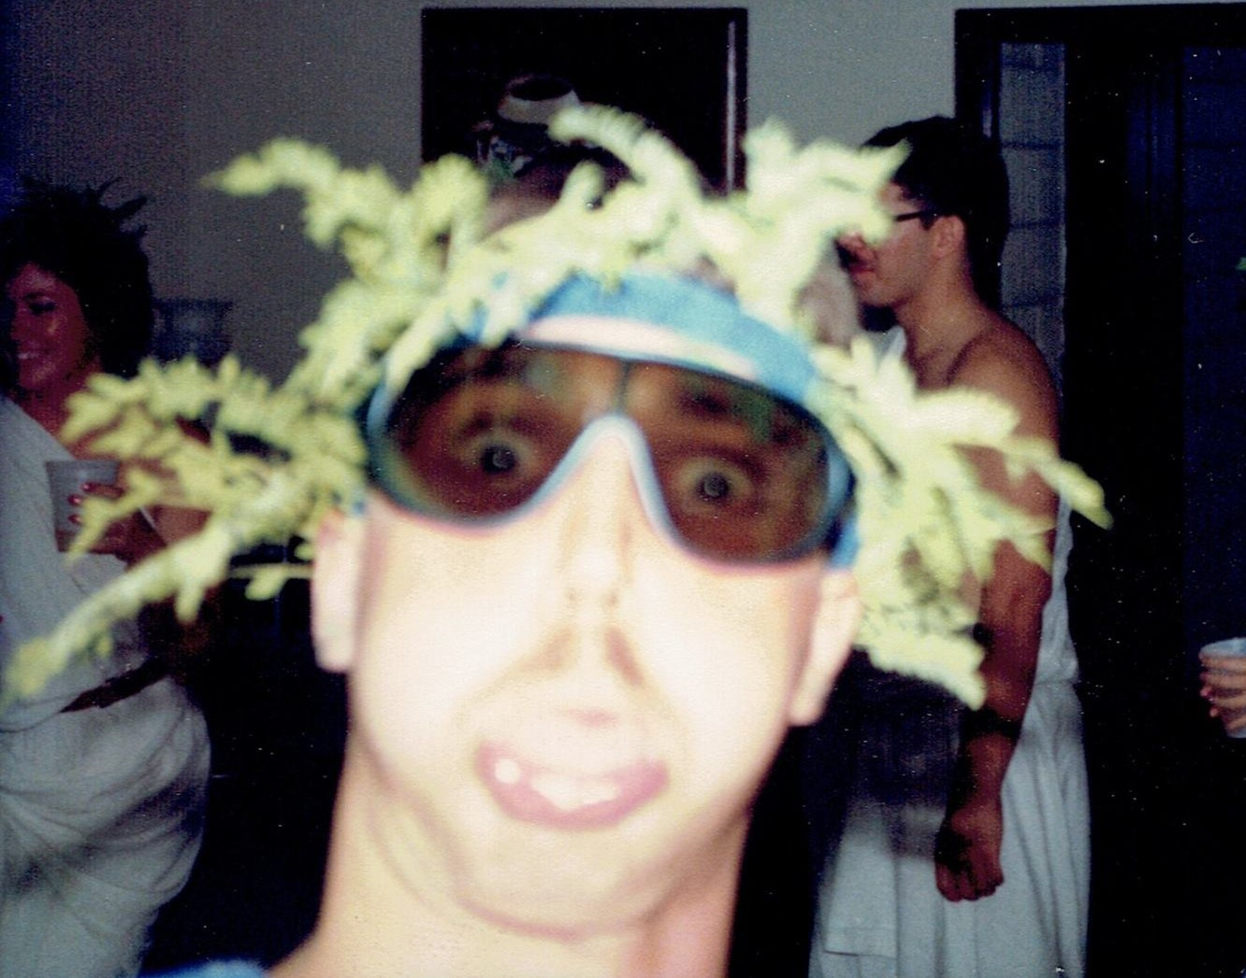
AGILE FLEETCOMMANDER
TRANSPORTATION DEPARTMENT
Questions?
Comments?
Discussion?
Notes:
Before any questions actually, I have a couple of comments myself. One, the Agile Fleet team is amazing. I was a stumbling’ when I took this job last year. Not anymore, and I say thank you. Two, Ed, that Ford Lightning that had another 40 miles to go when it ran out of juice? PLUG IN HYBRIDS. That is how I get around EO 14008 and EO 14507. You don’t need a charging station to operate, but it is still considered an electric vehicle. And third? I keep hearing from these Agile guys claiming to be the selfie king. Well, the year is 1986. Williams Air Force Base. Post major IG base inspection. Toga party. A 35 mm camera that used actual film. BAM. You’re welcome.

