Slide 1

Welcome to command 2025
CAB Discussion

Slide 2

Agenda
Prioritization Survey
Drag and Drop Demo
Guided Discussion

Slide 3
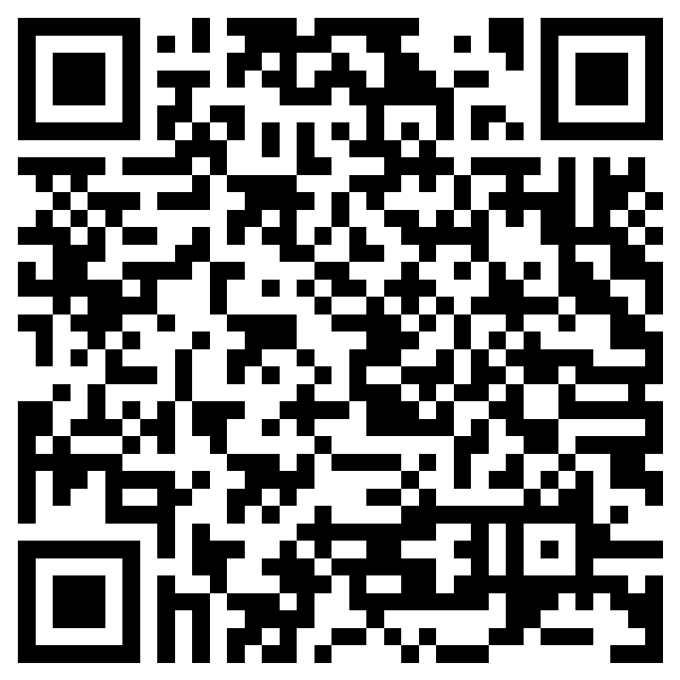

Prioritization survey
https://forms.cloud.microsoft/r/BdKrKYjwxg

Slide 4
Drag and drop reassignment
Navigating the future

Slide 5
moved drag and drop to v6.00
Released
v5.13
Complete
v6.00
In Development
v6.01
Scope Locked
v6.02
v6.00: FAST and Account Validation, Drag & Drop
Drag & Drop originally developed in v6.01.
Scheduled to start rolling out the week of October 20.

Slide 6
drag and drop demonstration
We started with a phased approach, with the initial phase focused on a particular problem to solve (i.e., use case).
Phase 1 Use Case: A vehicle with several reservations scheduled in the future needs to be taken out of the motor pool.
Using the Change Vehicle feature requires too many clicks/takes too long.
Let's look at it together.
We're looking forward to hearing your feedback to help us define the next phase of Drag & Drop!

Slide 7
open discussion
Help us plan for the future

Slide 8
report center
Phase 1 is in v6.02.
Reports you use
Reports you find difficult to use
Why?
Which reports are you merging together?
A little of this…a little of that…
Other reporting gaps (what is missing)

Slide 9
kiosk/key control
Thoughts on a QR code to scan on a digital travel sheet for a quick check-in
Support for kiosk dispatching from a mobile device
Enforcing policy acceptance at the kiosk: How to handle a long agreement on a touch screen?
Reporting:
Grab and Go vs. other
Logins, attempted key removals/returns, actual key removals/returns
Other reporting needs?

Slide 10
kiosk/key control
Improved workflow is coming with UI changes
Wishlist?
What would make Grab and Go easier?
What kiosk monitoring needs are not being met?
Key boxes:
Anyone switching to SmartFob?
Why/why not?
Any interest in wrapping the box (like a vehicle wrap)?

Slide 11
Motor Pool
What motor pool enhancements would you like to see?
Would you use custom fields which could be attached to any "thing" in FleetCommander (e.g., reservation, user profile, asset, TCO transaction, work order, etc.)
What additional information would you like to see in the reservation audit log?
Do you ever need to "un-cancel" a reservation?
Would you or your users want to get reservation notifications by text, instead of or in addition to by email?
Anyone who would not want Asset Type to be required for every new request?

Slide 12
TCO (tOTAL COST OF OWNERSHIP)
Who is using TCO?
Enhancements you'd like to see on current functionality
Any challenges using it?
What is missing from TCO (problems not solved)?

Slide 13
vehicle replacement, disposal
Who is using it so far?
Why/why not?
Challenges using it?
Any other feedback and suggestions?
How are you currently tracking disposals?
What disposal capabilities would you like to see in FleetCommander, if any?

Slide 14
oem telematics
Get telematics data without a device to install
Coverage is likely about 50%, depending on age of fleet
No device cost up front
More data available (e.g., PSI, window and door lock status)
Any interest?
If so, when?
Typical make, models, and average age of fleet?
What other data would you want that you aren't getting from GPS in FleetCommander (e.g., driver behavior, diagnostic codes)?

Slide 15
dashboard enhancements
Which dashboard(s) do you use?
Do you use dashboard(s) external to FleetCommander?
Interest in configurable dashboards?
Create your own?
Also share it with your other FleetCommander users?
Move things around?
Pick KPIs?
What KPIs are missing?
What else?

Slide 16
Artificial intelligence (ai)
How do you feel about AI in general (good, bad, indifferent)?
What policies do you have around AI, if any?
What would you like AI to do for you, your users, your fleet?
Natural language search to help create a report or summarize report data?
Predictive maintenance?
Driver behavior?
Support? (E.g., First response via a chat or auto-reply, then escalated to a human)

Slide 17
API
An API acts like a universal adapter that lets different software programs "talk" to each other automatically, so data flows seamlessly without manual effort.
"Data In": Keep your data current in FleetCommander.
"Data Out": Get your data out of FleetCommander.
Do you currently use the FleetCommander API?
If not, how do you sync data between your external systems (e.g., HR) and FleetCommander?
What would make it easier to adopt the API, if anything?
If you do use it, what do you need the API to do that it doesn't do?
Would you use the API if it provided more "data out" (e.g., for BI)?

Slide 18
auditing/logging
Do you have organizational requirements around logging?
What information do you need/want to see on audit logs for user activity?
For updates of user profiles?
For updates of vehicles?
Do you need/want to report on every change to everything, including exactly what was changed (before state vs. after state)?
How long would it be expected for detailed logging to be retained in the system?

Slide 19
approval workflows
Do you have approval requirements for reservations?
For new users?
For work orders?
For anything else?
How many people are involved in the approval processes?
Are all the people internal to your organization?
Would they have access to your instance of FleetCommander?
If so, what types of roles do they have (e.g., department heads, site admins, etc.)?

Slide 20
Thank you!
Alexis Gearhart
agearhart@agilefleet.com

