Slide 1


Brain Puzzle One
I Fell

Slide 2
Brain Puzzle TWO
na fish
na fish

Slide 3
Brain Puzzle THREE
often
not
often
often
often
often
often
often

Slide 4
Brain Puzzle FOUR
often
not
often
often
often
often
often
often

Slide 5
Brain Puzzle FOUR
T
H
E
R
E
HANG

Slide 6
Brain Puzzle FOUR
a
n
d
S
t
T
r
y
2

Slide 7
Brain Puzzle One
Eiffel Tower
I Fell

Slide 8
Brain Puzzle TWO
na fish
Tuna Fish
na fish

Slide 9
Brain Puzzle THREE
often
not
often
often
often
often
More Often Than Not
often
often

Slide 10
Brain Puzzle FOUR
Hang in there
T
H
E
R
E
HANG

Slide 11
Brain Puzzle FOUR
a
n
d
S
t
Try to
Understand
T
r
y
2

Slide 12

FleetcommandER new User Training
Learn. Network. Engage.

Slide 13

NEW USER TRAINING BINGO

Slide 14

What We’ll Learn Today
What is FleetCommander?
Accessing FleetCommander
Driver/Requestor Experience
Administrator Experience

Slide 15
What is
FleetCommander?

Slide 16
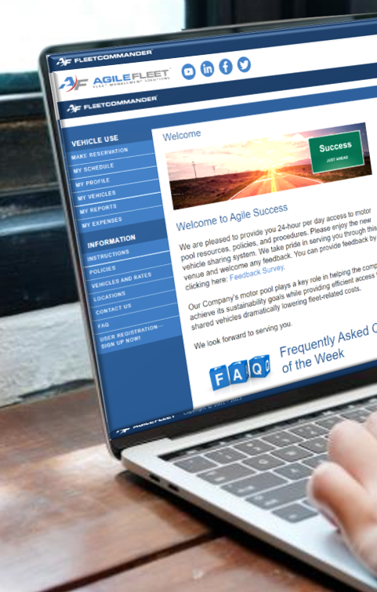
FleetCommander Overview
Cloud-based Fleet Management Solution
Can oversee centralized or disbursed operations
Scalable from 25 to 25,000+ vehicles
Able to administer unlimited drivers/users
configurable to support precise
business needs
MotorPool/Vehicle Sharing
Maintenance & Parts
Fuel Management
Risk Management
Telematics

Slide 17
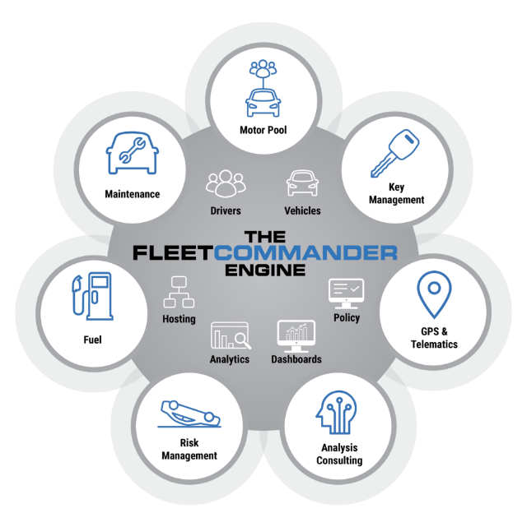

FleetCommander Core Product Engine
  User/Driver Management
  Vehicle/Asset Management
  Analytics & Reports
  Policy Enforcement
  Admin Interface/Dashboards
  Hosting
FleetCommander Modules
  Motor Pool/Vehicle Sharing
  Key Management
  Maintenance
  Fuel
  Risk Management
  GPS & Telematics

Slide 18
FleetCommander Core Product Engine
  User/Driver Management
  Vehicle/Asset Management
  Analytics & Reports
  Policy Enforcement
  Admin Interface/Dashboards
  Hosting
FleetCommander Modules
  Motor Pool/Vehicle Sharing
  Key Management
  Maintenance
  Fuel
  Risk Management
  GPS & Telematics

Slide 19

What is a profile in FleetCommander?
A profile is a centralized repository of your fleet data and is unique to each associated user and asset/vehicle.
Profiles are essential components of
the “FleetCommander Engine”

Slide 20

FleetCommander Users PROFILES
There are EIGHT MAIN USER/PERMISSION levels within FleetCommander
Each permission level determines how far a user can access FleetCommander and what they can do once they get there
8

Slide 21
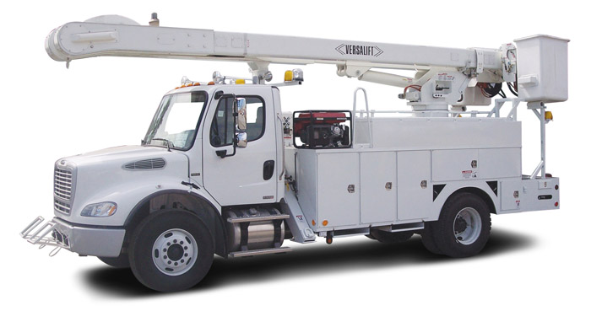
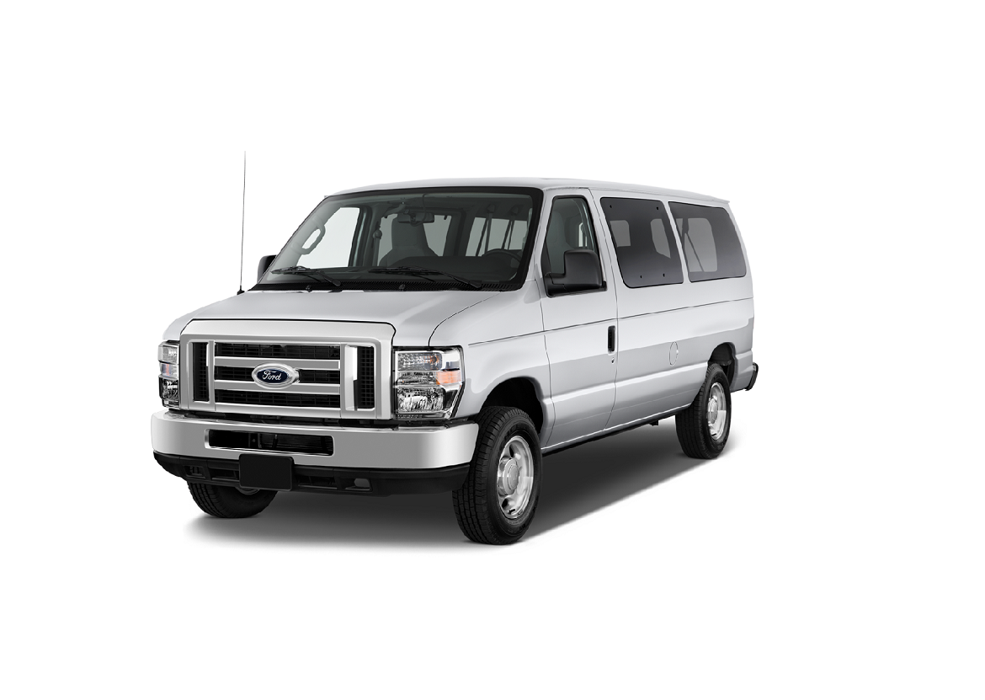
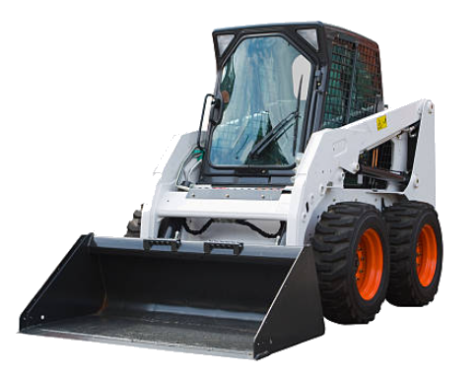
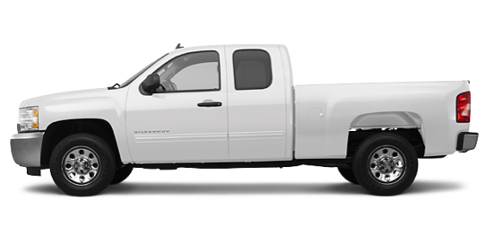
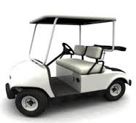
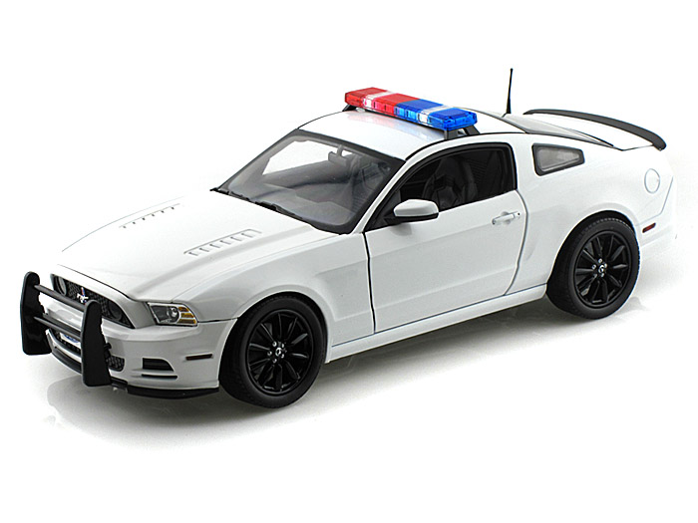
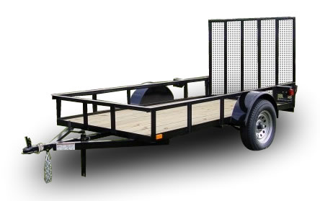
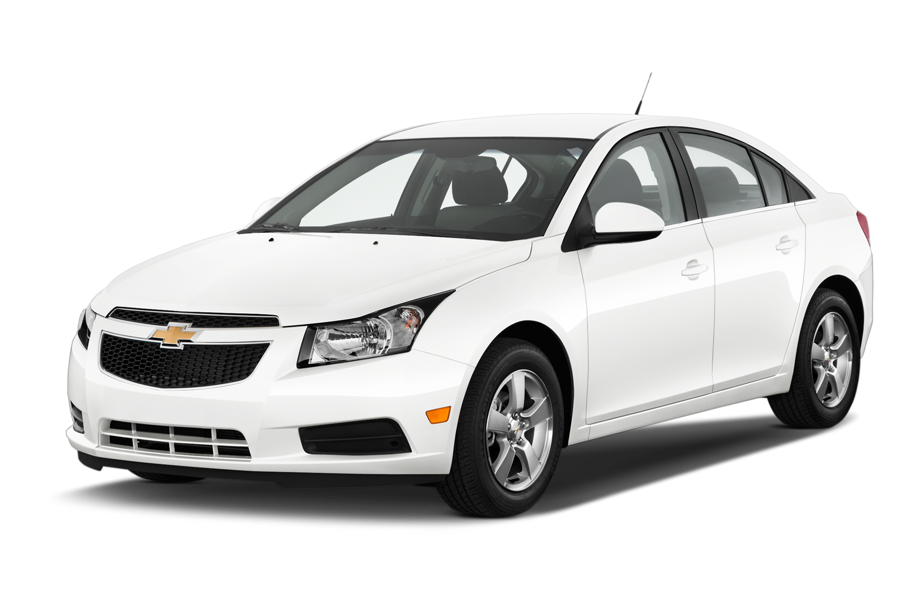
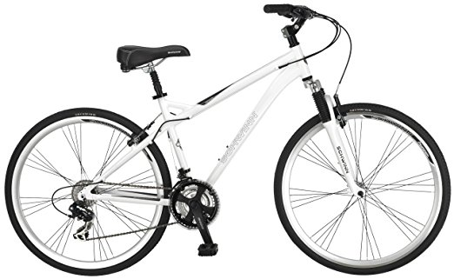
What assets can you place in FleetCommander?
Answer:
ALL OF THEM!

Slide 22
Accessing
FleetCommander

Slide 23
Accessing
FleetCommander:
LOGIN PAGE

Slide 24
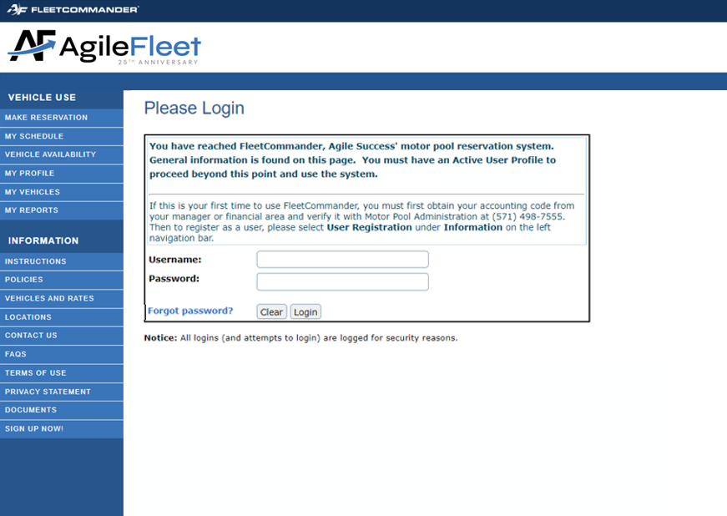
ACCESSING FLEETCOMMANDER: LOGIN PAGE
Go to
yourURL.agilefleet.com
EXAMPLE:
“Native- login”

Slide 25
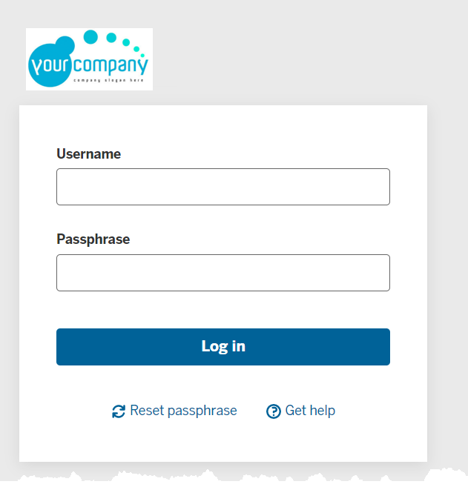
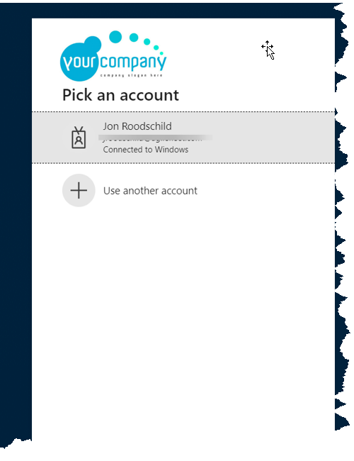
ACCESSING FLEETCOMMANDER: LOGIN PAGE
EXAMPLE:
“Custom Authentication”

Slide 26
Accessing
FleetCommander:
FORGOT PASSWORD

Slide 27
ACCESSING FLEETCOMMANDER: FORGOT PASSWORD
TIP:
If you forgot your password, you can receive a reset prompt

Slide 28
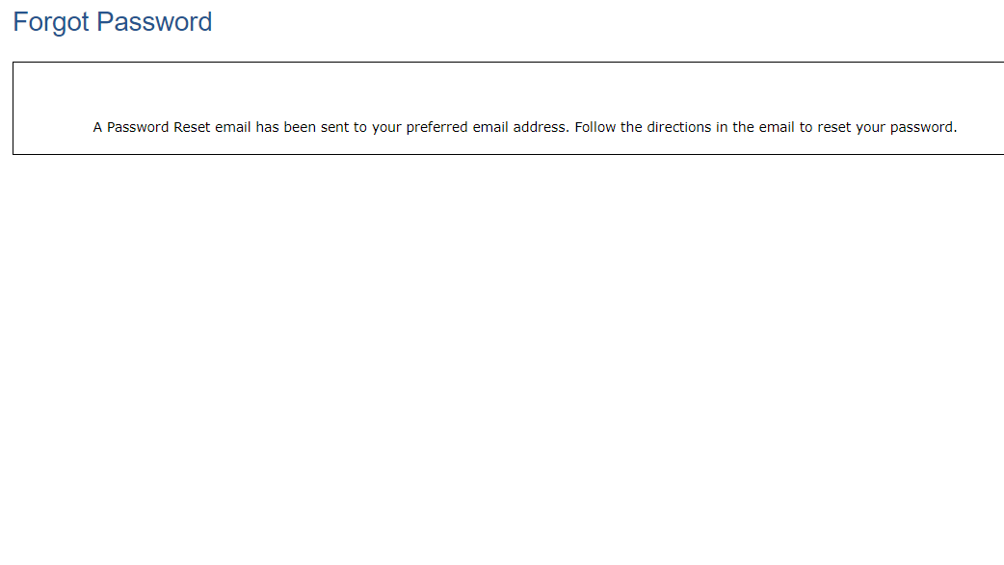
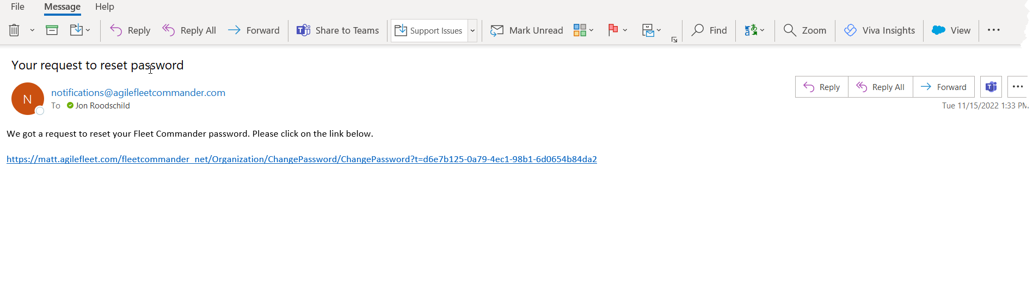
ACCESSING FLEETCOMMANDER: FORGOT PASSWORD
TIP:
If you forgot your password, you can receive a reset prompt
EXAMPLE:
receive a reset prompt
EXAMPLE:
Request to Reset Password email

Slide 29
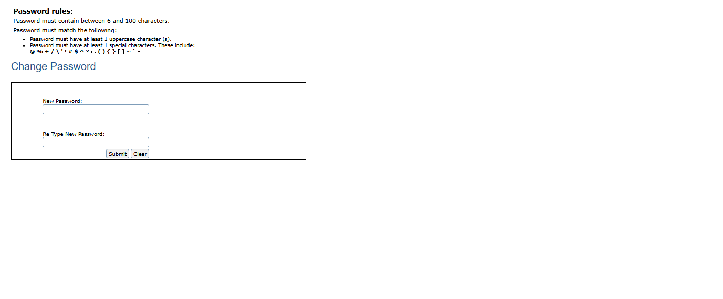
ACCESSING FLEETCOMMANDER: FORGOT PASSWORD
TIP:
If you forgot your password, you can receive a reset prompt
EXAMPLE:
Request to Reset Password email

Slide 30
Accessing
FleetCommander:
WELCOME PAGE

Slide 31
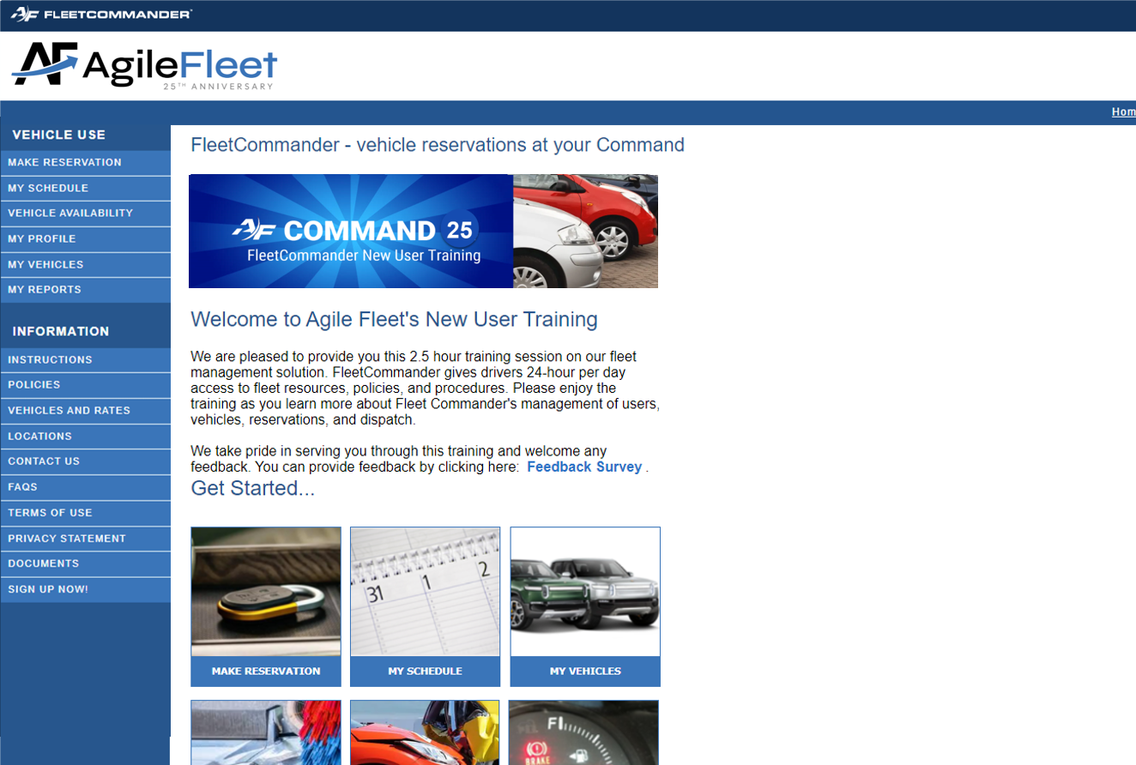
ACCESSING FLEETCOMMANDER: WELCOME PAGE
Successful login brings you to FleetCommander
Welcome Page
Welcome Page highlights important information including fleet policies

Slide 32
DRIVER/REQUESTOR
EXPERIENCE

Slide 33
Driver/Requestor Experience
  Information Links
    Instructions
    Policies
    Vehicles and Rates
    Locations
    Contact Us
    FAQs
    Terms of Use
    Privacy Statement
    Documents
  Vehicle Use Links
    Make a Reservation
    My Schedule
    My Profile
    My Reports
The WELCOME PAGE is the launching point for
all Driver/Requestor interaction with FleetCommander
Interfaces includes:
INFORMATION LINKS
and
VEHICLE USE LINKS

Slide 34
Driver/Requestor
experience:
Information Links

Slide 35
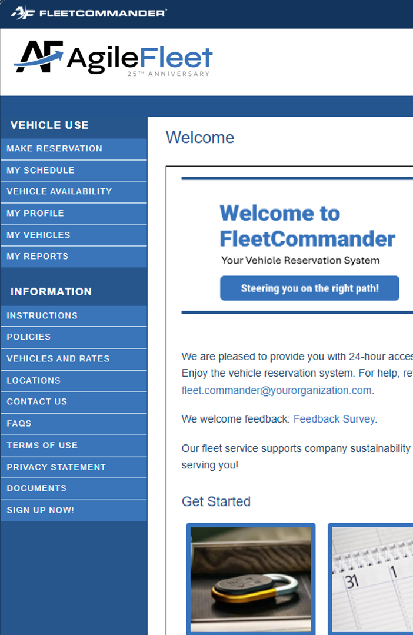
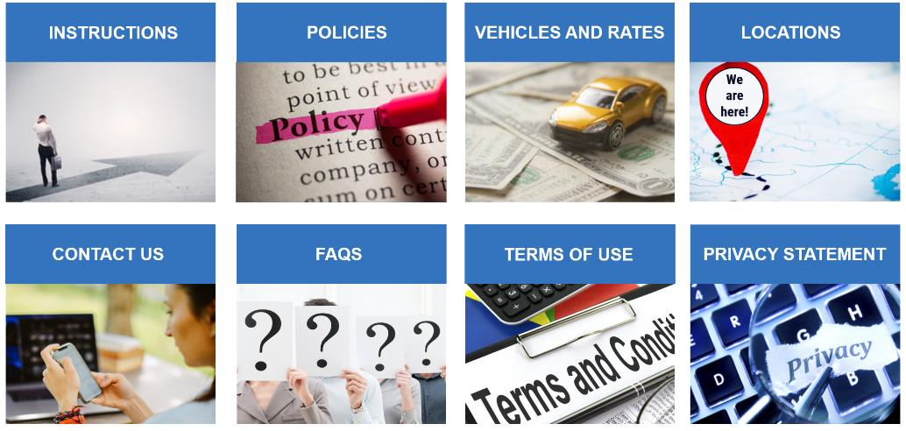
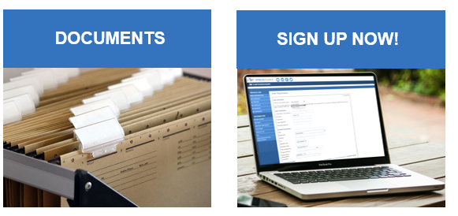
DRIVER/REQUESTOR EXPERIENCE:
INFORMATION LINKS
  Information links share specific information regarding your fleet with requestors/drivers
INSTRUCTIONS: “how to’s”
of making reservations

Slide 36
DRIVER/REQUESTOR EXPERIENCE:
INFORMATION LINKS
  Information links share specific information regarding your fleet with requestors/drivers
POLICIES: the “must agrees”
of using vehicles

Slide 37
DRIVER/REQUESTOR EXPERIENCE:
INFORMATION LINKS
  Information links share specific information regarding your fleet with requestors/drivers
VEHICLES AND RATE:
what types of vehicle are offered & the cost to rent.

Slide 38
DRIVER/REQUESTOR EXPERIENCE:
INFORMATION LINKS
  Information links share specific information regarding your fleet with requestors/drivers
LOCATIONS: where
to go to get vehicle

Slide 39
DRIVER/REQUESTOR EXPERIENCE:
INFORMATION LINKS
  Information links share specific information regarding your fleet with requestors/drivers
CONTACT US: who
to ask for help

Slide 40
DRIVER/REQUESTOR EXPERIENCE:
INFORMATION LINKS
  Information links share specific information regarding your fleet with requestors/drivers
FAQ’s: answers
to popular questions

Slide 41
DRIVER/REQUESTOR EXPERIENCE:
INFORMATION LINKS
  Information links share specific information regarding your fleet with requestors/drivers
TERMS OF USE:
the rules of using application

Slide 42
DRIVER/REQUESTOR EXPERIENCE:
INFORMATION LINKS
  Information links share specific information regarding your fleet with requestors/drivers
PRIVACY STATEMENT:
protecting your privacy

Slide 43
DRIVER/REQUESTOR EXPERIENCE:
INFORMATION LINKS
  Information links share specific information regarding your fleet with requestors/drivers
DOCUMENTS:
additional important information to access

Slide 44
DRIVER/REQUESTOR EXPERIENCE:
INFORMATION LINKS
  Information links share specific information regarding your fleet with requestors/drivers
SIGN UP NOW:
register to use
FleetCommander

Slide 45
Driver/Requestor
experience:
vehicle use Links

Slide 46
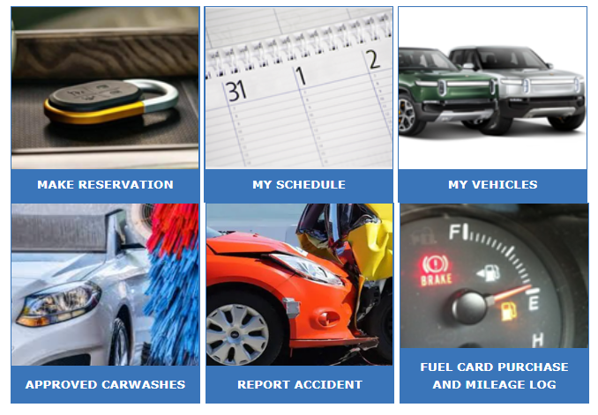
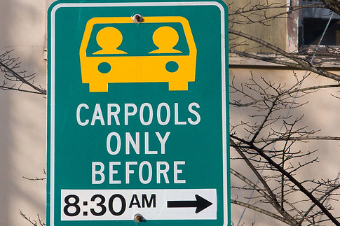



DRIVER/REQUESTOR EXPERIENCE:
VEHICLE USE LINKS
  Vehicle Use is the launch point for driver/requestor reservation interaction within FleetCommander.
We will cover three of these VEHICLE LINKS today

Slide 47
Driver/Requestor
experience:
make reservation

Slide 48
making reservations
Vehicle reservations CAN BE ENTERED into FleetCommander via SEVERAL LAUNCHING points.
The following process illustrates how your
END-USERS request vehicles.

Slide 49
DRIVER/REQUESTOR EXPERIENCE:
MAKE RESERVATION
To begin the reservation
process, click on the
MAKE RESERVATION link

Slide 50
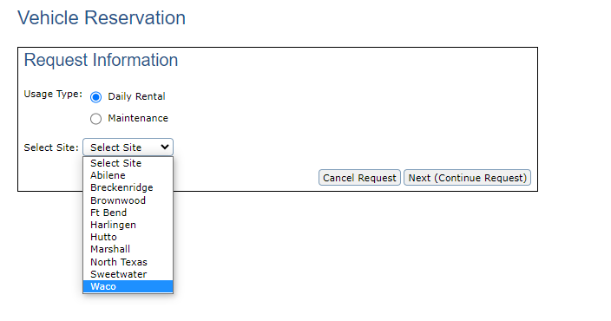
DRIVER/REQUESTOR EXPERIENCE:
MAKE RESERVATION
The site determines the location a reservation will leave from.
Select
“Next (Continue Request)”
Select the Site

Slide 51
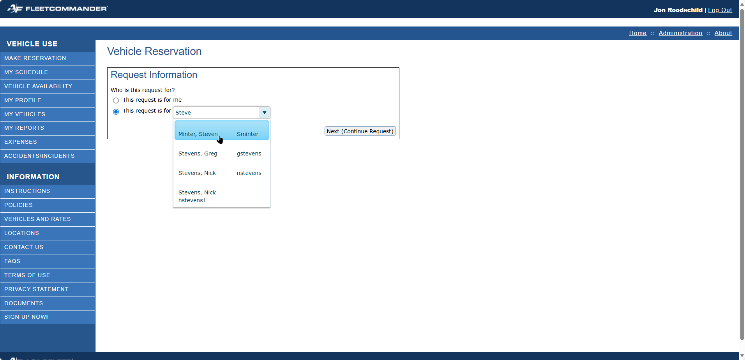

DRIVER/REQUESTOR EXPERIENCE:
MAKE RESERVATION
HELPFUL HINT:
You can search the Combo Box using your choice of USERNAME, FIRST NAME, or LAST NAME
“This Request is for me” is selected by default.
NOTE: change radio button to make request for someone else

Slide 52
DRIVER/REQUESTOR EXPERIENCE:
MAKE RESERVATION
Select
“Next (Continue Request)”

Slide 53
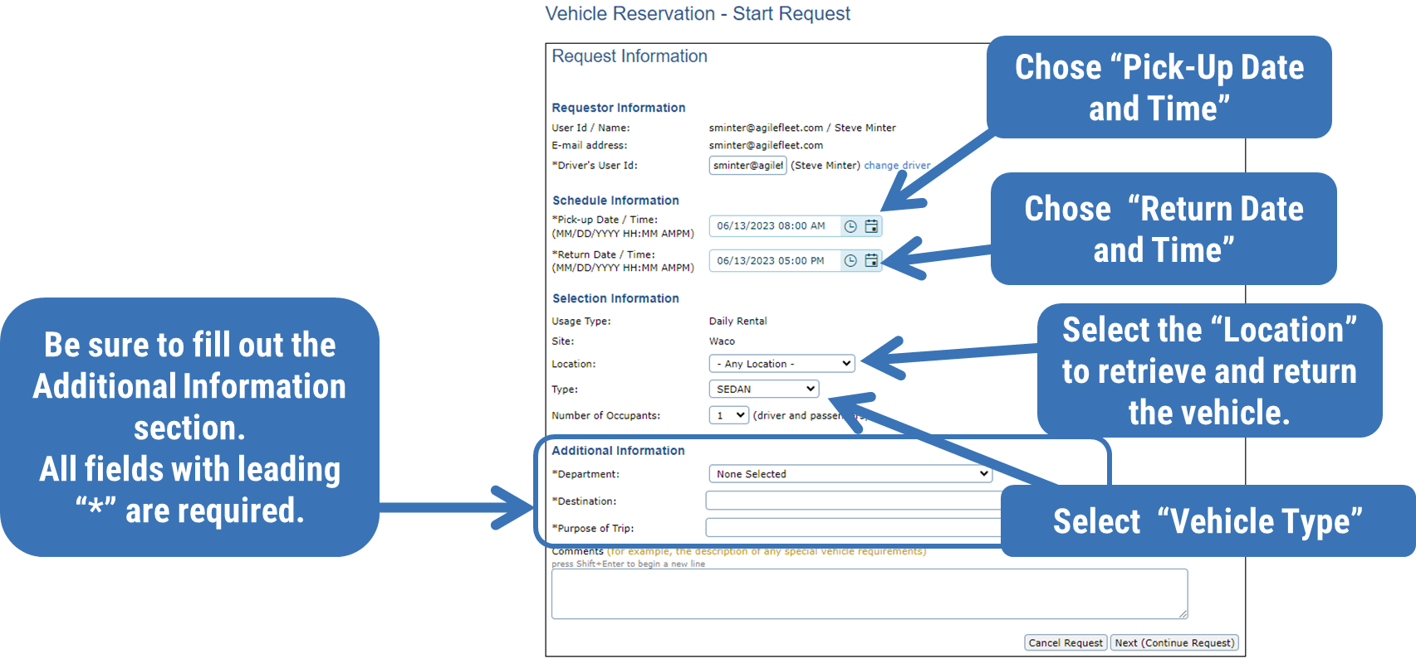
DRIVER/REQUESTOR EXPERIENCE:
MAKE RESERVATION

Slide 54
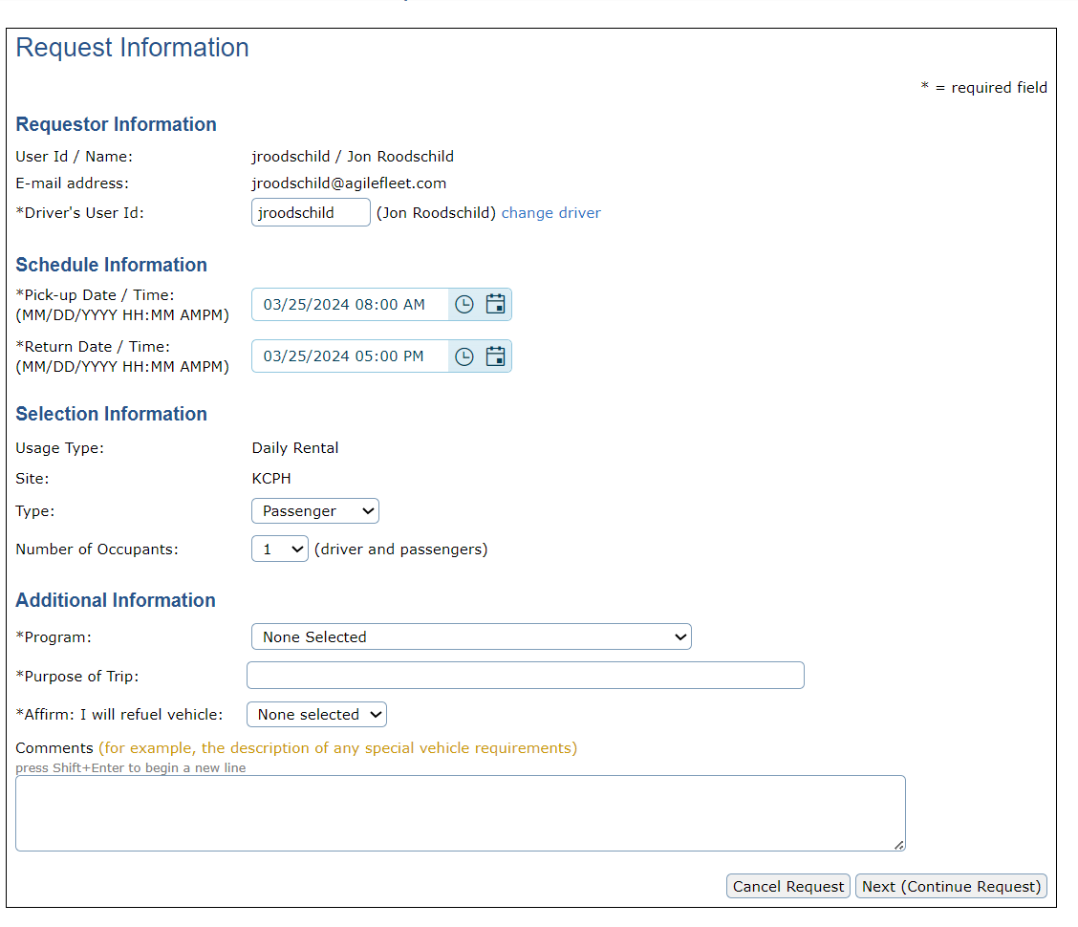
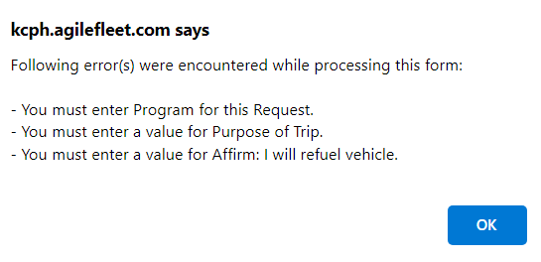
DRIVER/REQUESTOR EXPERIENCE:
MAKE RESERVATION
[CLIENTNAME]. agilefleet.com says
NOTE: All fields with leading “*” are required
Reservations submitted with MISSING REQUIRED FIELDS will generate a prompt

Slide 55
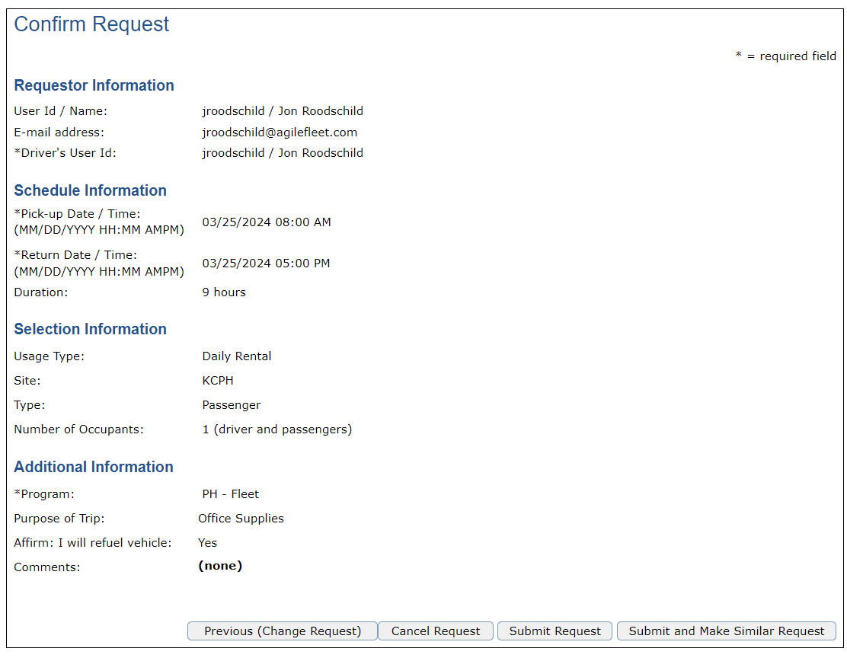
DRIVER/REQUESTOR EXPERIENCE:
MAKE RESERVATION
If all selected information is correct select “Submit Request”
If Changes need to be made select “Previous (Change Request)”

Slide 56
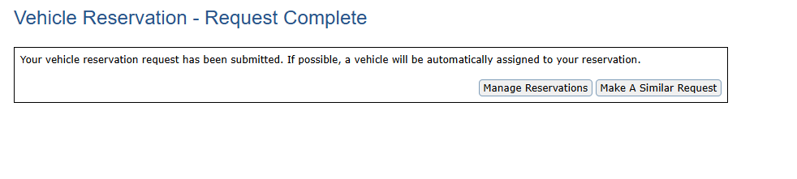
DRIVER/REQUESTOR EXPERIENCE:
MAKE RESERVATION
Once the reservation request is completed you will receive this confirmation notification.
“Make Similar Request” submits the current request and takes the Requestor back to start another request.
Reservation fields will be pre-populated.
Selecting “Manage Reservations” will redirect the you to view
“My Schedule”

Slide 57
Driver/Requestor
experience:
MY SCHEDULE

Slide 58
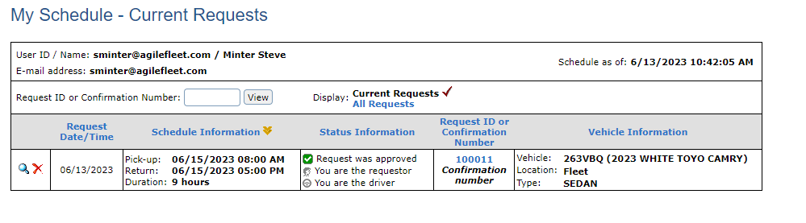
DRIVER/REQUESTOR EXPERIENCE:
My Schedule
From your schedule you can “View Your Reservation” or “Cancel”
You can see when the request was made
The scheduled Pick-up and Return date and times
The Status of your reservation
The Request ID or Confirmation Number
Vehicle information location and type

Slide 59
Driver/Requestor
experience:
MY SCHEDULE
REQUEST A CHANGE TO
A RESERVATION

Slide 60
DRIVER/REQUESTOR EXPERIENCE:
MY SCHEDULE
From the Navigation select “My Schedule”

Slide 61
DRIVER/REQUESTOR EXPERIENCE:
MY SCHEDULE
From your schedule, select “View Your Reservation” (the magnifying glass icon)

Slide 62
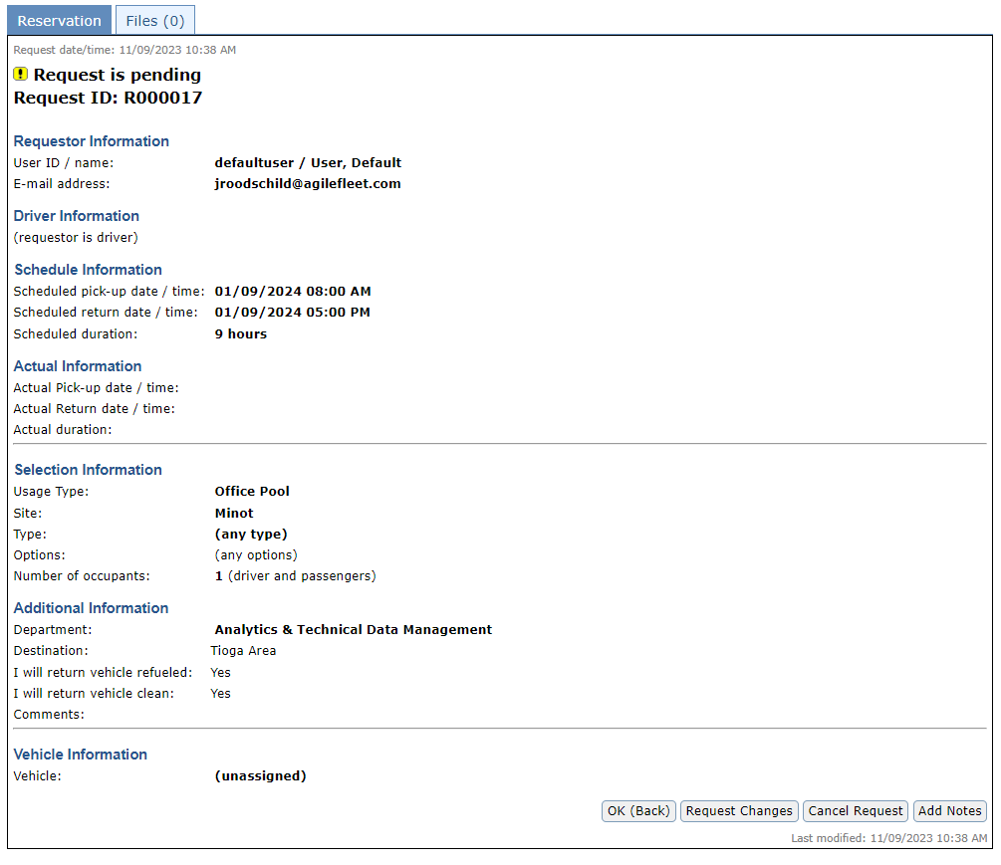
DRIVER/REQUESTOR EXPERIENCE:
MY SCHEDULE
Select “Request Changes”

Slide 63
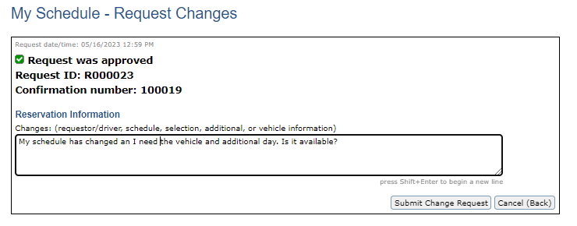
DRIVER/REQUESTOR EXPERIENCE:
MY SCHEDULE
Note: when submitted, the reservation will go into a PENDING STATUS for the Administrator to review.
Express your requested change to the reservation and select “Submit Change Request”

Slide 64
Driver/Requestor
experience:
MY SCHEDULE
CANCEL A RESERVATION

Slide 65
DRIVER/REQUESTOR EXPERIENCE:
MY SCHEDULE
From your schedule, select “Cancel Reservation”
(the red x icon)

Slide 66
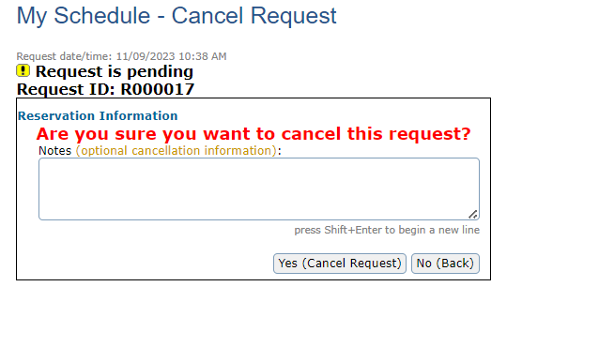
DRIVER/REQUESTOR EXPERIENCE:
MY SCHEDULE
Type in reason for cancelation and select
“Yes (Cancel Request)

Slide 67
Driver/Requestor
experience:
MY PROFILE

Slide 68
DRIVER/REQUESTOR EXPERIENCE:
MY PROFILE
From the Navigation select “My Profile”

Slide 69
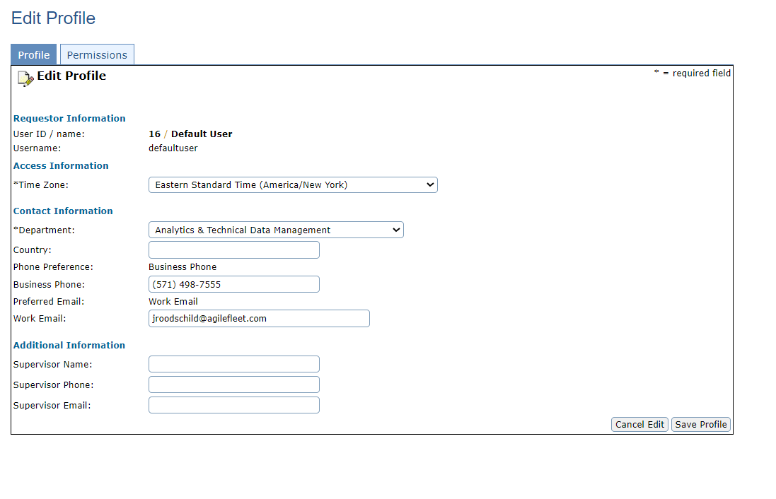
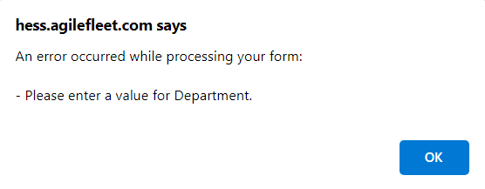
DRIVER/REQUESTOR EXPERIENCE:
MY PROFILE
[CLIENTNAME]. agilefleet.com says
Update your profile as needed to assure accurate contact information
Note: make sure to provide your Department if not already competed
Select ”Save Profile” to finalize edits

Slide 70
Driver/Requestor
experience:
VEHICLE AVAILABILITY

Slide 71
DRIVER/REQUESTOR EXPERIENCE:
VEHICLE AVAILABILITY
From the Navigation select “Vehicle Availability”

Slide 72
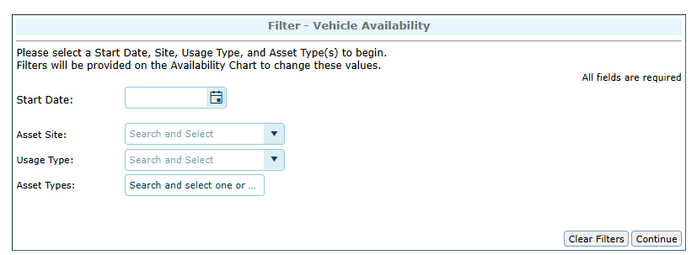
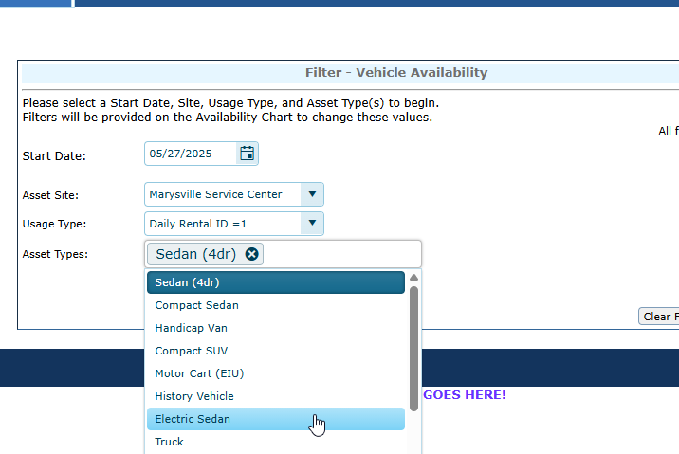
DRIVER/REQUESTOR EXPERIENCE:
VEHICLE AVAILABILITY
On the User side, set filters.
Date, Site, Usage Type and Asset Type are the starting filters.
Multi select is available for Asset Type.

Slide 73
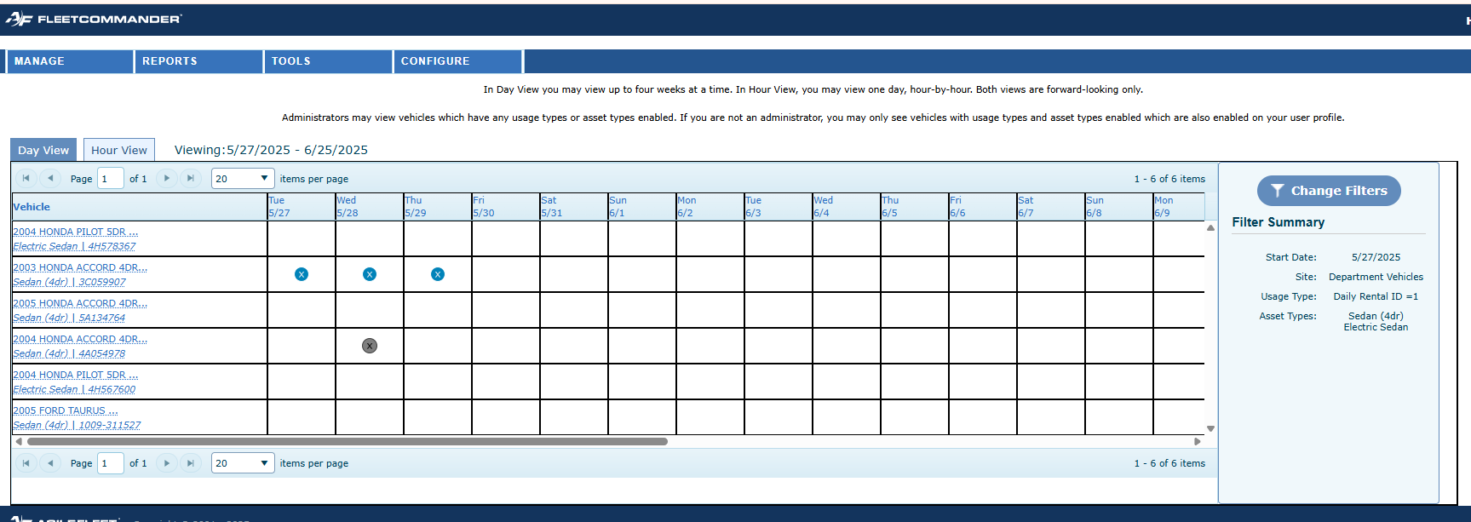
DRIVER/REQUESTOR EXPERIENCE:
VEHICLE AVAILABILITY
Chart view shows that there are vehicles available.
Results will also be filtered based on user’s permissions, access groups, and usage types.
“See and Select” Availability

Slide 74
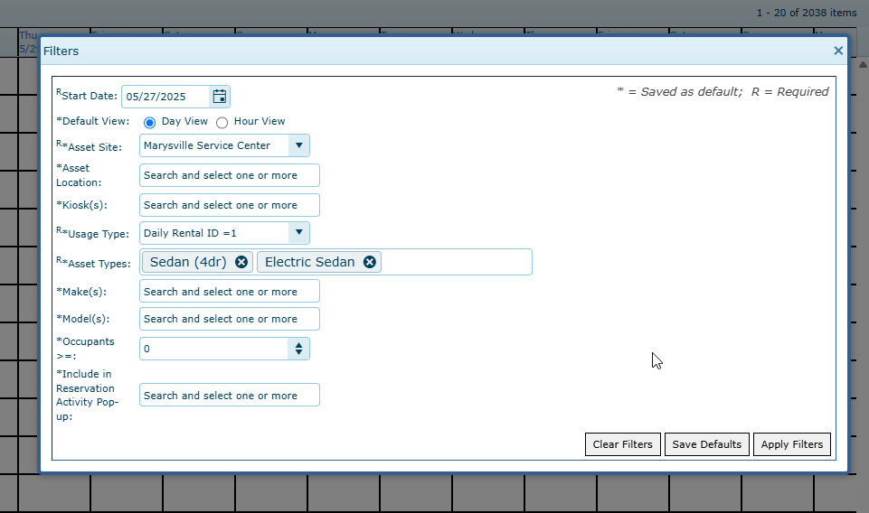
DRIVER/REQUESTOR EXPERIENCE:
VEHICLE AVAILABILITY
Additional Filters are available to use:
  Location
  Kiosk
  Make
  Model
  Occupancy
  Custom Fields
ADDITIONAL
FILTERS

Slide 75
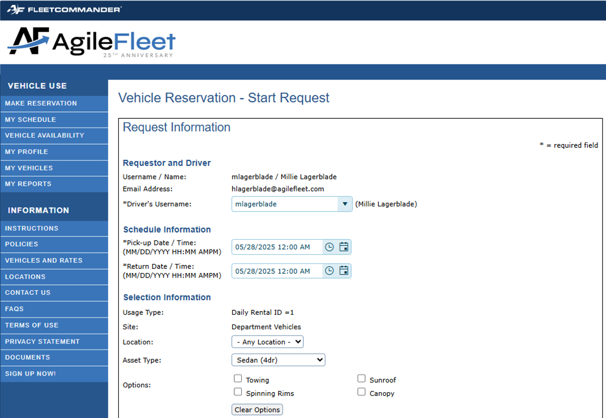
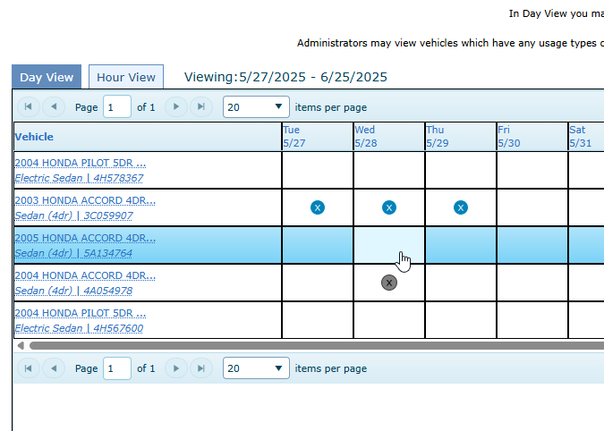
DRIVER/REQUESTOR EXPERIENCE:
VEHICLE AVAILABILITY
Click in a box and user will be taken directly to the reservation form with some details already completed

Slide 76
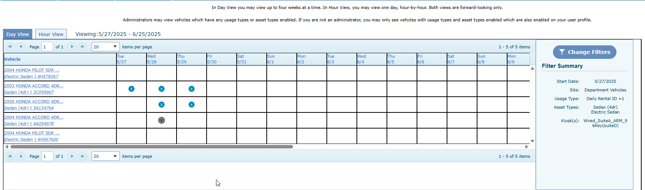
DRIVER/REQUESTOR EXPERIENCE:
VEHICLE AVAILABILITY
Updates in real time
Refresh and you see the newly approved reservation

Slide 77
ADMINISTRATOR
EXPERIENCE

Slide 78
ADMINISTRATOR Experience
  Five Notable Sections of the Admin Interface
    Dashboard
    Manage Menu
    Reports Menu
    Tools Menu
    Configure Menu

Slide 79
Accessing
FleetCommander:
ADMIN PaGE

Slide 80
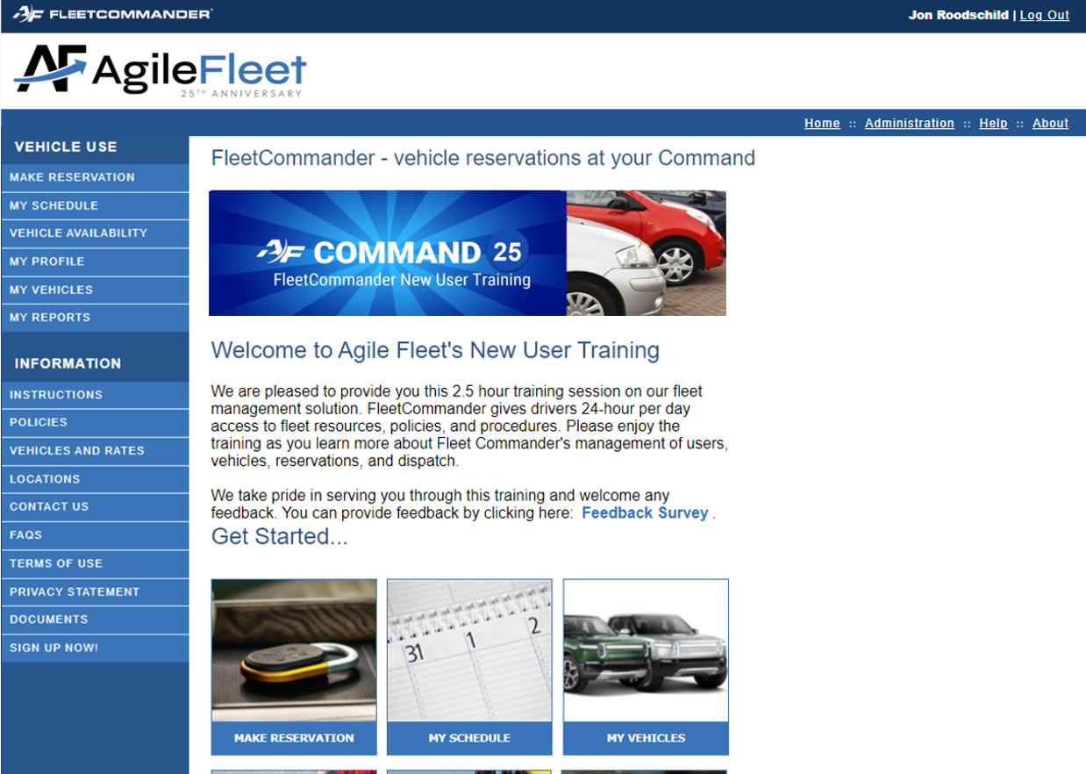
ACCESSING FLEETCOMMANDER: ADMIN PAGE
Click here to get to the Admin side.

Slide 81
ADMINISTRATOR
EXPERIENCE:
DASHBOARD

Slide 82
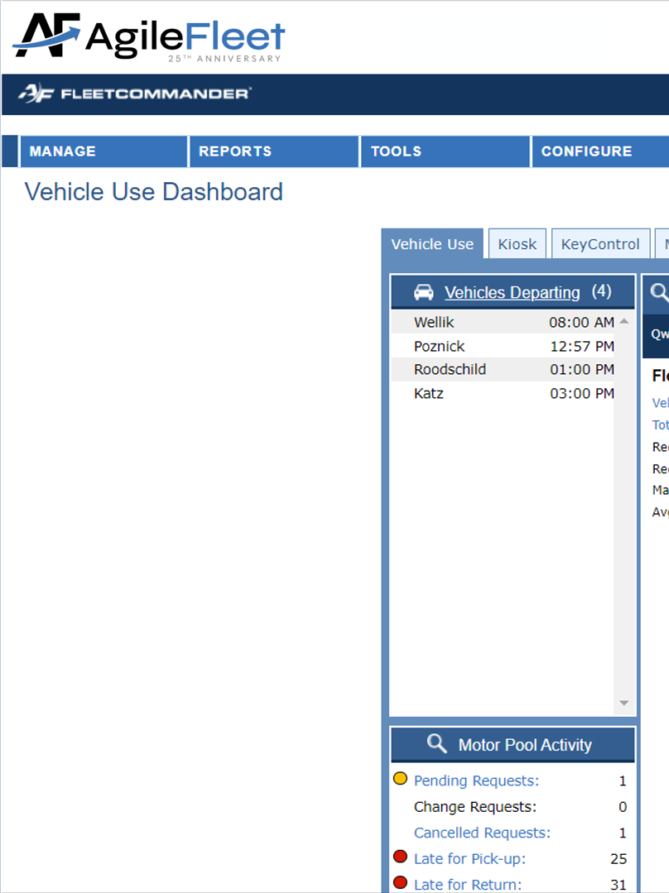
ADMINISTRATOR Experience
  FleetCommander’s DASHBOARD
  is the primary workspace for Admins/Dispatchers to
  interface with the system

Slide 83
ADMINISTRATOR
EXPERIENCE:
MANAGE menu

Slide 84
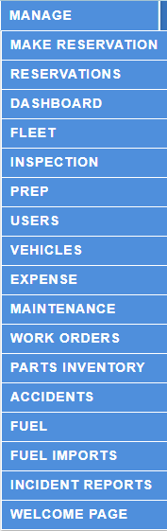




ADMINISTRATOR Experience
  FleetCommander’s MANAGE MENU is your LAUNCHING POINT for engaging with the various profile and module data.
  The links shown vary with the
  modules you purchased.

Slide 85
ADMINISTRATOR
EXPERIENCE:
MANAGE USERS AND VEHICLES

Slide 86
Administrator
experience:
MANAGE MENU
BENEFITS OF USER
AND ASSET PROFILES

Slide 87

Administrator
experience:
MANAGE MENU
BENEFITS OF USER PROFILES
All of your driver and fleet staff information in one place
Standard, demographic data (e.g. name, contact info)
System and vehicle permissions
Accountability for vehicle use
Policy acceptance, certifications, training, etc.
Default billing & charge-back info

Slide 88
Administrator
experience:
MANAGE MENU
BENEFITS OF ASSET PROFILES
All of your vehicle information in one location
Standard data across the enterprise
Establish rules-of-use through permissions, access, & usage
Clear visibility of vehicle-related costs
(e.g. maintenance & fuel)
Manage custody of vehicles through the life-cycle

Slide 89
ADMINISTRATOR
EXPERIENCE:
MANAGE > USERS & VEHICLES

Slide 90
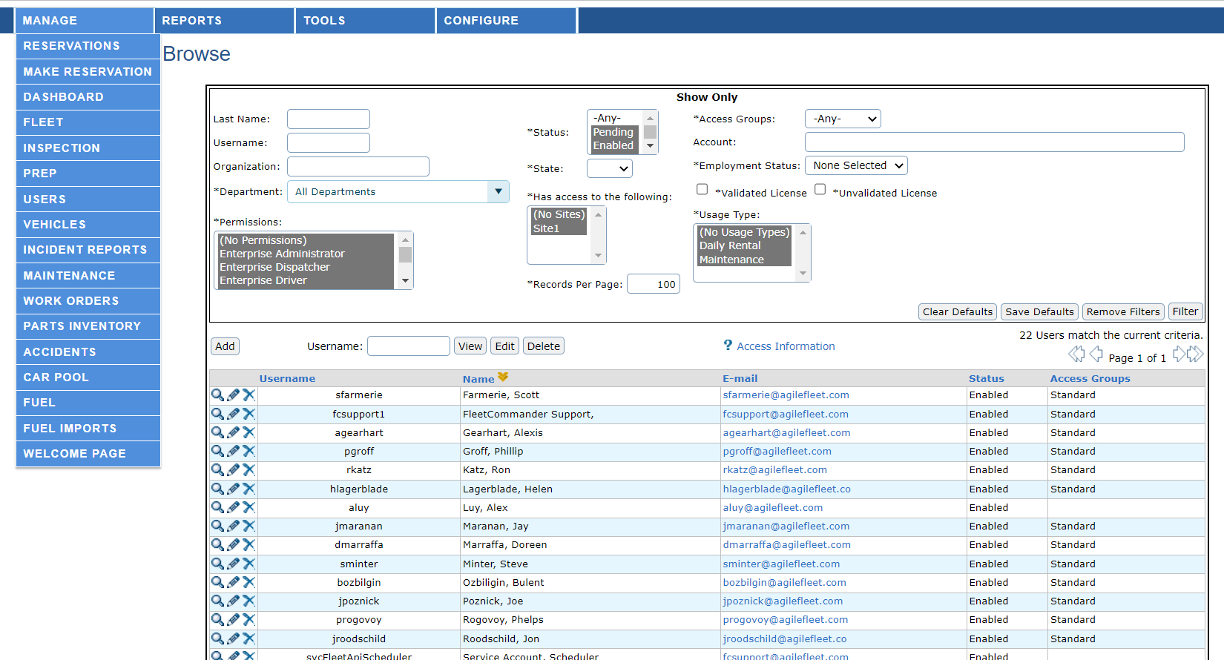
ADMINISTRATOR EXPERIENCE:
MANAGE USERS
Use Manage Users
to search for Users

Slide 91
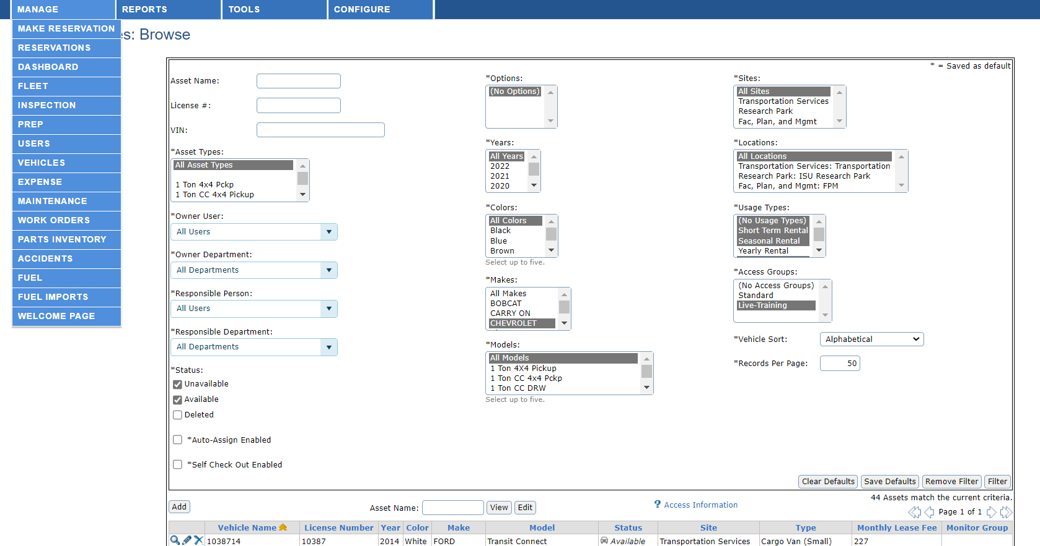
ADMINISTRATOR EXPERIENCE:
MANAGE VEHICLES
Use Manage Vehicles
to search for Assets

Slide 92
ADMINISTRATOR
EXPERIENCE:
REPORTS> USERS & VEHICLES

Slide 93

Administrator
experience:
Reports > Users & Vehicles
User Reports
Asset Reports
Asset Summary
Asset Details
Asset Data Dump
Mileage-Cost
Asset Mileage
Asset In/Out
Tag/Vehicle Exception
Owner/Responsible Asset Summary
Maintenance and Fuel
Cost
Inspections & Prep
Accident Summary
Accident Detail
TCO Data Dump
TCO Expense Summary
User Summary
User Details
User Details Extra
Account Summary
Department Summary
Driver Eligibility
Drivers License Currency
Invalid Driver
Lost and Found
User Citations
User HR
User Certification Currency
User System Activity

Slide 94
ADMINISTRATOR EXPERIENCE:
REPORTS > USERS & VEHICLES
Report Name | What it Does | Type | Navigation
User Detail Extra Report | Exports almost all of the fields (citations and courses are excluded) in the Profile tab of the User’s profile. | User Data Integrity | Reports > Users> User Detail Extra Report
Driver Eligibility | Lists the eligibility and validity of each user’s license. | User Currency | Reports > Users> Driver Eligibility
Drivers License Currency | Driver's license information found in the User's profile | User Currency | Reports > Users > Drivers License Currency
Asset Data Dump | Dumps all the information found on the vehicle’s Profile tab. | Asset Data Integrity | Reports> Assets > Asset Data Dump
Mileage-Cost | Lists vehicle’s distance and expenses in a specified date range and calculates the cost-per-mile for that timeframe | Asset Data | Reports > Assets > Mileage-Cost
Asset Mileage | Lists vehicle’s mileage data in a specified date range and by data source. | Asset Data | Reports> Assets > Asset Mileage
Asset In/Out | List of vehicles leaving, returning, or in maintenance by day | Asset Data | Reports> Assets > Asset In/Out

Slide 95
ADMINISTRATOR
experience:
MANAGE>MAKE RESERVATIONS

Slide 96
ADMINISTRATOR Experience
  Admins/Dispatchers can make vehicle reservations in multiple places within FleetCommander.
  Following section demonstrates reservations entered via MANAGE>MAKE RESERVATION

Slide 97
ADMINISTRATOR EXPERIENCE:
MAKE RESERVATION
Click here to get to the Admin side.

Slide 98
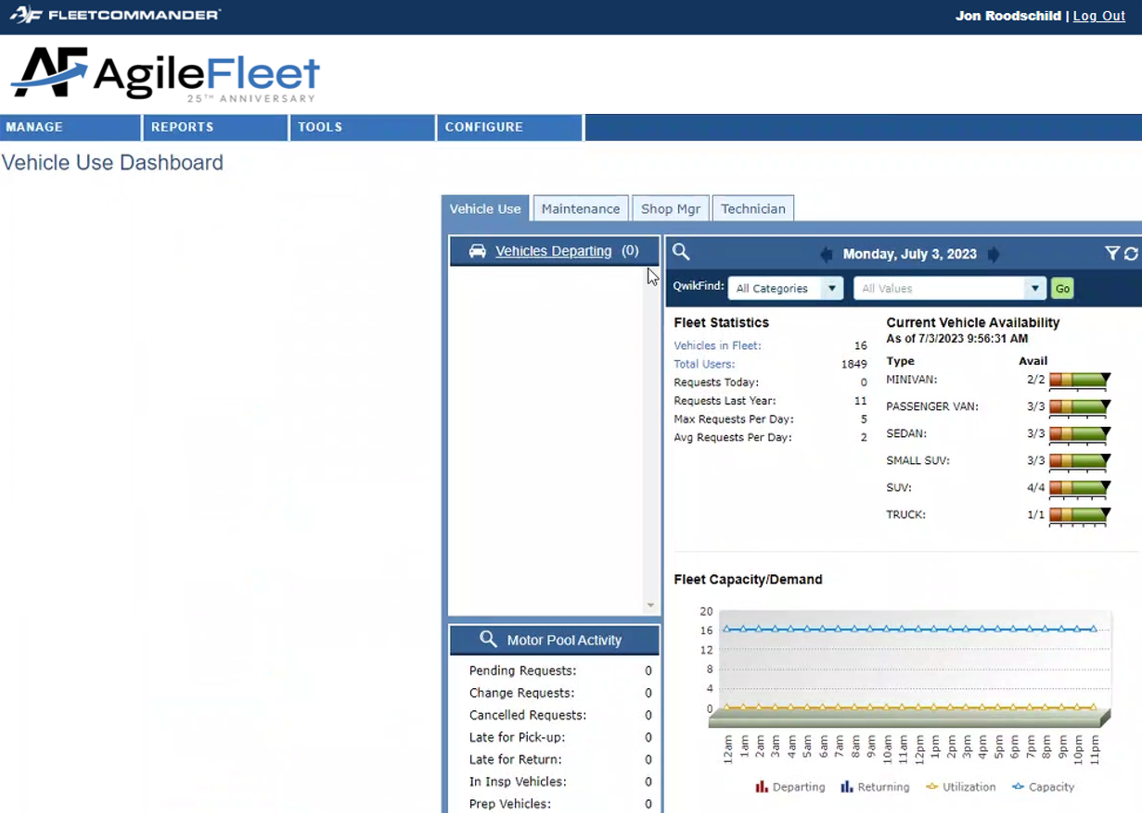
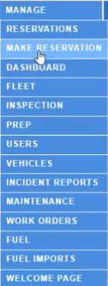
ADMINISTRATOR EXPERIENCE:
MAKE RESERVATION
Select
Make Reservation

Slide 99
ADMINISTRATOR EXPERIENCE:
MAKE RESERVATION
The site determines the location a reservation will leave from.
Select
“Next (Continue Request)”
Select the Site

Slide 100
ADMINISTRATOR EXPERIENCE:
MAKE RESERVATION
HELPFUL HINT:
You can search the Combo Box using your choice of USERNAME, FIRST NAME, or LAST NAME
NOTE: change radio button to make request for someone else
“This Request is for me” is selected by default.

Slide 101
ADMINISTRATOR EXPERIENCE:
MAKE RESERVATION
Select
“Next (Continue Request)”

Slide 102

ADMINISTRATOR EXPERIENCE:
MAKE RESERVATION
NOTE: You can override if a driver’s profile is not currently set-up with the selected Usage Type
Select
“Next (Continue Request)”

Slide 103
ADMINISTRATOR EXPERIENCE:
MAKE RESERVATION

Slide 104
ADMINISTRATOR EXPERIENCE:
MAKE RESERVATION
NOTE: All fields with leading “*” are required
Reservations submitted with MISSING REQUIRED FIELDS will generate a prompt

Slide 105


ADMINISTRATOR EXPERIENCE:
MAKE RESERVATION
Three NEW ELEMENTS appear for
Admins/Dispatchers on this page
Buffer setting is configured at the Site level
Auto-assign to a vehicle
Ignore buffers?
Submit Request and Assign
HINT: if you are NOT ready to assign a vehicle, choose another Submit option, otherwise click Submit Request and Assign
HINT: check if you want to ignore reservation Buffer time
HINT: uncheck if you want to assign a specific vehicle to reservation

Slide 106

ADMINISTRATOR EXPERIENCE:
MAKE RESERVATION
Click on the OK (Assign Vehicle) Action Button to finalize vehicle selection
HELPFUL HINT: See SLIDES ## for more info on Assigning Vehicles

Slide 107

ADMINISTRATOR EXPERIENCE:
MAKE RESERVATION
Concluding “Make Reservation” brings you to “Manage > Reservations”

Slide 108
ADMINISTRATOR
experience:
MANAGE>RESERVATIONS

Slide 109
Administrator
experience:
Manage>Reservations
  As needed, Admins/Dispatchers can make edits to vehicle reservations in FleetCommander.
  Following section demonstrates this process in MANAGE> RESERVATIONS

Slide 110
ADMINISTRATOR EXPERIENCE:
MANAGE> RESERVATIONS
Manage> Reservations is the best way to work with reservations
Select View Request

Slide 111

ADMINISTRATOR EXPERIENCE:
MANAGE> RESERVATIONS
Action buttons allows you to interact with reservation
Request information
and vehicle specifics
The Audit log shows the step-by-step progression of the Reservation Request

Slide 112
Administrator
experience:
Manage>Reservations
MODIFY RESERVATION

Slide 113
ADMINISTRATOR EXPERIENCE:
MANAGE> RESERVATIONS
Sometimes it is necessary to make changes to a reservation.
This is done through Manage>Reservation
Select View Request

Slide 114
ADMINISTRATOR EXPERIENCE:
MANAGE> RESERVATIONS
Select Modify Request

Slide 115

ADMINISTRATOR EXPERIENCE:
MANAGE> RESERVATIONS
NOTE: modifications include items like:
DRIVER
DATE / TIMES
VEHICLE TYPE
NUMBER OF OCCUPANTS
DESTINATION
ETC.
Make changes and select
“Next (Continue Request)”

Slide 116


ADMINISTRATOR EXPERIENCE:
MANAGE> RESERVATIONS
Review the request information and select “Submit Request”
NOTE: You may be prompted to send a confirmation email. Select “OK” if you want the requestor & driver receive the email.
If an email is not necessary, hit “Cancel”.

Slide 117
Administrator
experience:
Manage>Reservations
ASSIGN A VEHICLE

Slide 118


ADMINISTRATOR EXPERIENCE:
MANAGE> RESERVATIONS
Manage> Reservations is the best way to work with reservations
Select Assign Vehicle action icon

Slide 119
Administrator
experience:
Manage>Reservations
CANCEL A RESERVATION

Slide 120
ADMINISTRATOR EXPERIENCE:
MANAGE> RESERVATIONS
Sometimes it is necessary to cancel a reservation.
This is done through Manage>Reservation
Select the Cancel action button

Slide 121

ADMINISTRATOR EXPERIENCE:
MANAGE> RESERVATIONS
Insert a comment
(not required) and then select a Cancelation Type from the drop down.
Select “Yes (Cancel Request)

Slide 122
Administrator
experience:
Manage>Reservations
DISPATCH A RESERVATION
Manage > Reservations is one of several places in FleetCommander where reservations can be dispatched

Slide 123
ADMINISTRATOR EXPERIENCE:
MANAGE> RESERVATIONS
To dispatch a vehicle via Manage> Reservations…
…select View Request

Slide 124


ADMINISTRATOR EXPERIENCE:
MANAGE> RESERVATIONS
Click on “Dispatch”
to bring up the
Dispatch Window
Dispatch Pop-up Window appears

Slide 125
ADMINISTRATOR EXPERIENCE:
MANAGE> RESERVATIONS
DISPATCH HINTS:
Make sure you’re in the right reservations!
Use Dispatch Window to
verify reservation details including NAME OF DRIVER, END DATE, VEHICLE TYPE, etc.

Slide 126
Administrator
experience:
Manage>Reservations
If you discover changes that need to be made, you can accomplish this from the Dispatch Window!

Slide 127


ADMINISTRATOR EXPERIENCE:
MANAGE> RESERVATIONS
Change a VEHICLE
within Dispatch:
Click “Change Vehicle”
Window view changes to show available vehicles
Adjust vehicle filters and “Refresh List” as needed

Slide 128

ADMINISTRATOR EXPERIENCE:
MANAGE> RESERVATIONS
Change a DRIVER
within Dispatch:
Click “Change” next to Driver’s Name
Type in Last name and click “Go” to find Driver
User pop-up
window appears

Slide 129
Administrator
experience:
Manage>Reservations
When it comes to the “when” a reservation
is dispatched, you have the choice of two
time considerations:
Current Date/Time
Request Date/Time

Slide 130
ADMINISTRATOR EXPERIENCE:
MANAGE> RESERVATIONS
Two Dispatch Options
Current Date and Time

Slide 131
ADMINISTRATOR EXPERIENCE:
MANAGE> RESERVATIONS
Two Dispatch Options
Original Reservation Date and Time

Slide 132
Administrator
experience:
Manage>Reservations
Additional Dispatch
Window Items

Slide 133
ADMINISTRATOR EXPERIENCE:
MANAGE> RESERVATIONS
Odometer Fields
Departure/Start Mileage
auto-populates from the most recent record

Slide 134
ADMINISTRATOR EXPERIENCE:
MANAGE> RESERVATIONS
DISPATCH HINTS:
Watch out for information or instructions in COMMENTS before submitting
Click Submit to finalize Dispatch Out
Communicate to driver any previous damage noted in
VEHICLE CONDITION

Slide 135
Administrator
experience:
Manage>Reservations
Return Vehicle/
Dispatch-In

Slide 136
ADMINISTRATOR EXPERIENCE:
MANAGE> RESERVATIONS
Choose from the same options to CHECK a vehicle BACK IN
Current Date and Time
Original Reservation Date and Time

Slide 137
ADMINISTRATOR EXPERIENCE:
MANAGE> RESERVATIONS
Odometer Fields
End Mileage MUST be typed in
Total mileage
self-calculates based on Odom End

Slide 138
ADMINISTRATOR EXPERIENCE:
MANAGE> RESERVATIONS
DISPATCH HINTS:
Type any NEW DAMAGE on the vehicle in
VEHICLE CONDITION.
Details will appear here again with next reservation

Slide 139
ADMINISTRATOR EXPERIENCE:
MANAGE> RESERVATIONS
DISPATCH HINTS:
Send email to
ADMIN STAFF if you need to relay any information to them regarding this reservation/vehicle
(example: damages)
Click Submit to finalize Dispatch In

Slide 140
Administrator
experience:
Manage>Reservations
Other places vehicles can be dispatched include:
  Dashboard - considered best practice
  (see Slide 154)
  Manage > Reservations (Vehicle Icon)
  Manage Vehicles
  Manage Users
  QwikFind - Assets
  QwilkFind - Users

Slide 141
ADMINISTRATOR
experience:
MANAGE>FLEET

Slide 142
Administrator
experience:
Manage>FLEET
  As needed, Admins/Dispatchers can make edits to vehicle reservations in FleetCommander.
  Following section demonstrates this process in MANAGE> FLEET

Slide 143

ADMINISTRATOR EXPERIENCE:
MANAGE> FLEET
Use the filters to narrow your view

Slide 144
ADMINISTRATOR EXPERIENCE:
MANAGE> FLEET
Search by Site

Slide 145
ADMINISTRATOR EXPERIENCE:
MANAGE> FLEET
Search by Vehicle Type

Slide 146
ADMINISTRATOR EXPERIENCE:
MANAGE> FLEET
Search by specific vehicle information

Slide 147
ADMINISTRATOR EXPERIENCE:
MANAGE> FLEET
You can change your chart view from Day View to Hour View
Notice the view on the chart is a two-week period

Slide 148

ADMINISTRATOR EXPERIENCE:
MANAGE> FLEET
You can change your chart view from Day View to Hour View
Notice the view on the chart is a two-day period

Slide 149

ADMINISTRATOR EXPERIENCE:
MANAGE> FLEET
Use the legend to understand the status of vehicles
The status of vehicles will appear in the first column

Slide 150
Administrator
experience:
Manage>FLEET
  Manage > Fleet is one of several places in FleetCommander where reservations can be entered.

Slide 151
ADMINISTRATOR EXPERIENCE:
MANAGE> FLEET
To start a reservation, select the date and time to the corresponding vehicle in either day view or hour view

Slide 152

ADMINISTRATOR EXPERIENCE:
MANAGE> FLEET
Follow the steps for Making a Reservation

Slide 153
Administrator
experience:
Manage>FLEET
  Manage > Fleet is also one of several places in FleetCommander where reservations can be modified.

Slide 154
ADMINISTRATOR EXPERIENCE:
MANAGE> FLEET
Modifying a request
Select the reservation that you would like to modify the request

Slide 155

ADMINISTRATOR EXPERIENCE:
MANAGE> FLEET
Select Modify Request and follow the steps for modifying a reservation.

Slide 156
Administrator
experience:
Manage>FLEET
  Vehicle assignments can even be modified via Manage > Fleet.

Slide 157
ADMINISTRATOR EXPERIENCE:
MANAGE> FLEET
Changing the vehicle assigned to a reservation
NOTE: Reservations that have been dispatched are not able to have the vehicle changed

Slide 158
ADMINISTRATOR EXPERIENCE:
MANAGE> FLEET
While in hour view select the first time in the chart to change the vehicle

Slide 159

ADMINISTRATOR EXPERIENCE:
MANAGE> FLEET
Select the radio button beside Change Vehicle the select Submit

Slide 160

ADMINISTRATOR EXPERIENCE:
MANAGE> FLEET
Select the vehicle to move the reservation to then select “Submit”

Slide 161
ADMINISTRATOR
experience:
DASHBOARD (Continued)

Slide 162
Administrator
experience:
Dashboard
  FleetCommander’s Dashboard
  is the primary workspace for Admins/Dispatchers to
  interface with the system

Slide 163

ADMINISTRATOR EXPERIENCE:
DASHBOARD
Various sections of the dashboard include:
Departing Reservations
Returning Reservations
Dashboard helps you see reservation schedule for the day

Slide 164


ADMINISTRATOR EXPERIENCE:
DASHBOARD
Various sections of the dashboard include:
Mouseover for RESERVATION DETAILS
Mouseover line for RESERVATION DETAILS

Slide 165
ADMINISTRATOR EXPERIENCE:
DASHBOARD
Various sections of the dashboard include:
Click hyper-link to access Manage Reservation view of this reservation

Slide 166
ADMINISTRATOR EXPERIENCE:
DASHBOARD
Various sections of the dashboard include:
Motor Pool Activity:
gives you real time status
of Reservations & Users
HINT: click on hyperlinks
as they appear to take
action on that item

Slide 167
Administrator
experience:
Dashboard
  FleetCommander’s QwikFind Search interface allows access to data without having to navigate away from the Dashboard.

Slide 168
Administrator
experience:
Dashboard
  FleetCommander’s QwikFind Search interface allows access to data without having to navigate away from the Dashboard.

Slide 169

ADMINISTRATOR EXPERIENCE:
QWIKFIND
QwikFind: allows you
to search for Assets, Reservations, and Users

Slide 170

ADMINISTRATOR EXPERIENCE:
QWIKFIND
QwikFind: select “Asset
Type vehicle’s NAME or LICENSE
Click “Go” to view Vehicle Profile

Slide 171

ADMINISTRATOR EXPERIENCE:
QWIKFIND
QwikFind takes you to “Asset Lookup”
Dispatch Vehicle Out on scheduled
reservation
Update Vehicle Mileage
Make a Reservation for this Vehicle
Dispatch Vehicle Out on scheduled
reservation
NOTE: Dispatcher Permission DOES NOT allow editing a Vehicle Profile
(this link is deactivated)

Slide 172

ADMINISTRATOR EXPERIENCE:
QWIKFIND
QwikFind: select “User”
Type USERNAME or LAST NAME
Click “Go”
to view
User Profile

Slide 173

ADMINISTRATOR EXPERIENCE:
QWIKFIND
Start a new QwikFind
NOTE: Dispatcher Permission DOES NOT allow viewing
a User Profile
(this link is deactivated)
QwikFind takes you to “User Lookup”
Make a new Reservation
Dispatch a Reservation

Slide 174

ADMINISTRATOR EXPERIENCE:
QWIKFIND
QwikFind: select
“Reservation”
Click “Go” to view Reservation
Type either Request ID (example R000029) or Confirmation Number (example 100017)

Slide 175

ADMINISTRATOR EXPERIENCE:
QWIKFIND
QwikFind takes you
to the Reservation’s Schedule/View Request

Slide 176
Administrator
experience:
Dashboard
  FleetCommander’s Dashboard is the PRIMARY interface for vehicle Dispatch.

Slide 177
ADMINISTRATOR EXPERIENCE:
DISPATCH
Double-click line to
Dispatch Out
Same function to
Dispatch In

Slide 178
Administrator
experience:
Dashboard
  Like other places within FleetCommander, you can customize the Dashboard default and filters.

Slide 179
ADMINISTRATOR EXPERIENCE:
DEFAULTS
Bottom of page show current filters for this
Dashboard view

Slide 180

Dashboard Filter:
refines what and how items are shown
on the Dashboard
ADMINISTRATOR EXPERIENCE:
DEFAULTS
TIP: use Two-line Display to enhance your Dashboard view

Slide 181
Thank you
Jon Roodschild
jroodschild@agilefleet.com

Slide 182
Financial overview
Our financial overview reflects a robust and resilient fiscal performance.
Key indicators show consistent revenue growth over the past quarter, attributed to strategic cost management and successful marketing.
Operating margins have improved, signaling operational efficiency, while strengthåening our reserves.
This underscores our commitment to financial stability, positioning us for sustained growth.

Slide 183
Tables are great
Quarter | Revenue growth (%) | Market share increase (%) | Customer acquisition
Q1 | 12 | 2 | 500
Q2 | 15 | 3 | 600
Q3 | 18 | 4 | 700
Q4 | 20 | 5 | 800
Market expansion
Product innovation
Customer retention
Operational efficiency

Slide 184
We love tables
Metric | Current value | Previous quarter | Change (%)
Revenue | $2,500,000 | $2,200,000 | +14%
Operating expenses | $1,200,000 | $1,400,000 | -14%
Net profit | $1,000,000 | $800,000 | +25%
Operating margin | 40% | 36% | +4%
Cash reserves | $5,000,000 | $4,500,000 | +11%

Slide 185
Future initiatives
Product enhancement
  Introduce regular updates and features to enhance product offerings.
Technology integration
  Explore emerging technologies for potential integration into our operations.
Collaborative partnerships
  Foster collaborations with tech innovators and industry leaders to drive innovation.
Green supply chain
Reduced carbon footprint
Waste reduction
Water conservation

