Slide 1
Maintenance Training

Slide 2

Your FleetCommander Maintenance Tools
Manage Maintenance
Create a
Work Order
Snoozing a Task
Creating Providers/Vendors
Add a Task to Work Order
Adding a Maintenance Plan to a Vehicle Profile
Adding a File to a Work Order
Add Tasks
Checking Vehicle Repair History
Create a Maintenance Plan

Slide 3

Creating a provider

Slide 4
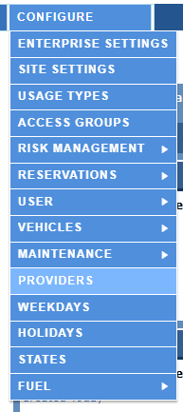
Creating a Provider
Select “Configuration” then “Providers”

Slide 5
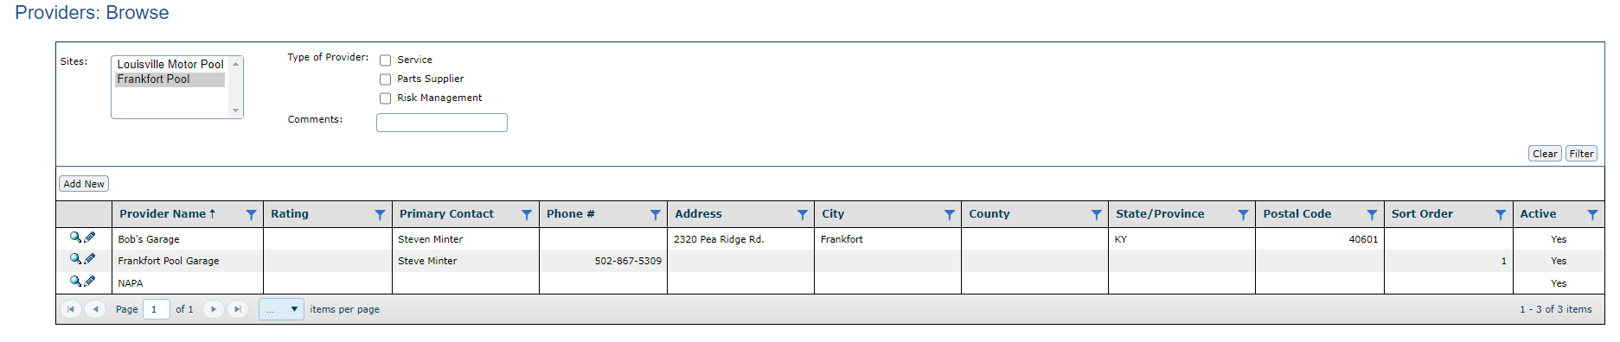
Creating a Provider
Select “Add New”

Slide 6
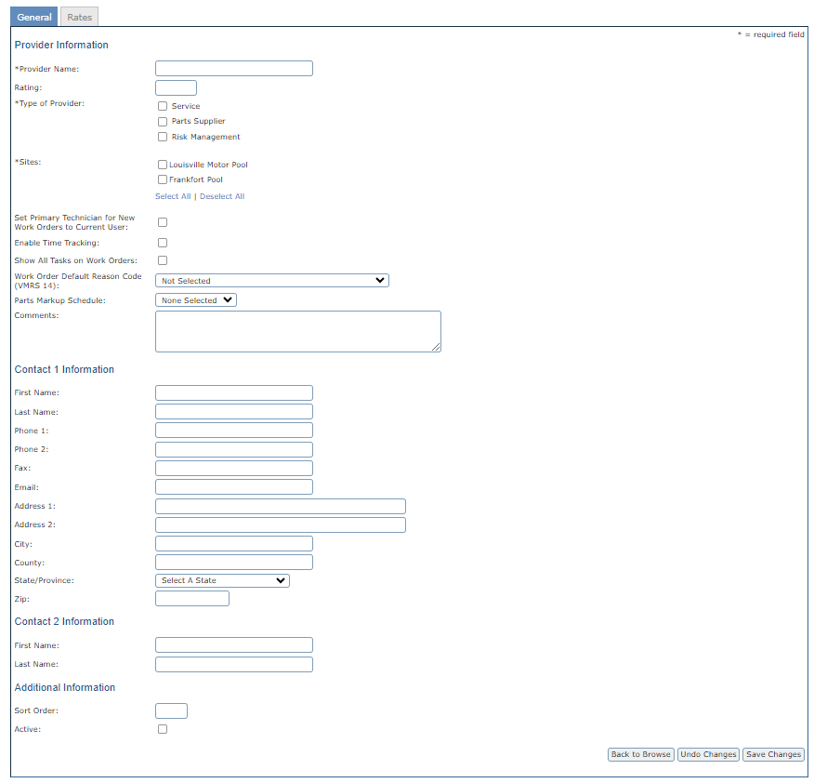
Creating a Provider
Fill out all necessary information.
Note: Be sure to select all the sites this provider is available for

Slide 7
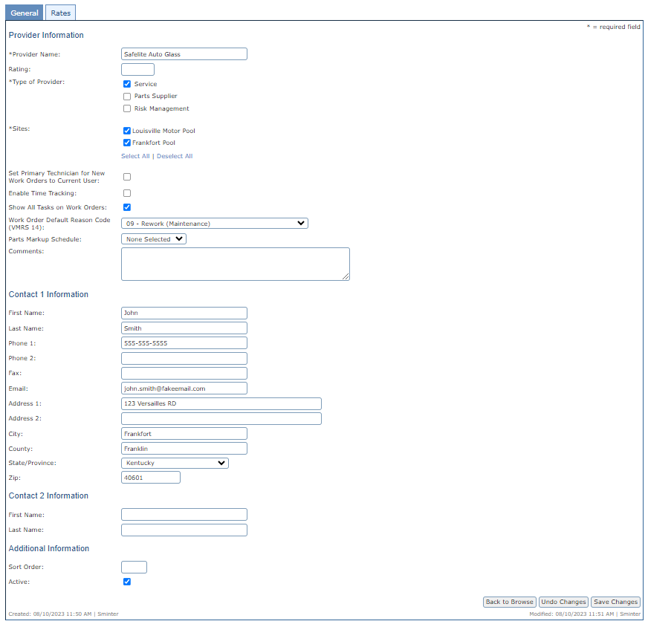
Creating a Provider
Provider Name
Select the Type of Provider
Select the Sites
Select Show All Tasks on Work Orders
Set a Default Reason Code Note: Not Required
Fill in the Contact Information
Note: The more complete information provided will allow for better reporting
Finally make sure you select “Active”.
Then “Save Changes”

Slide 8
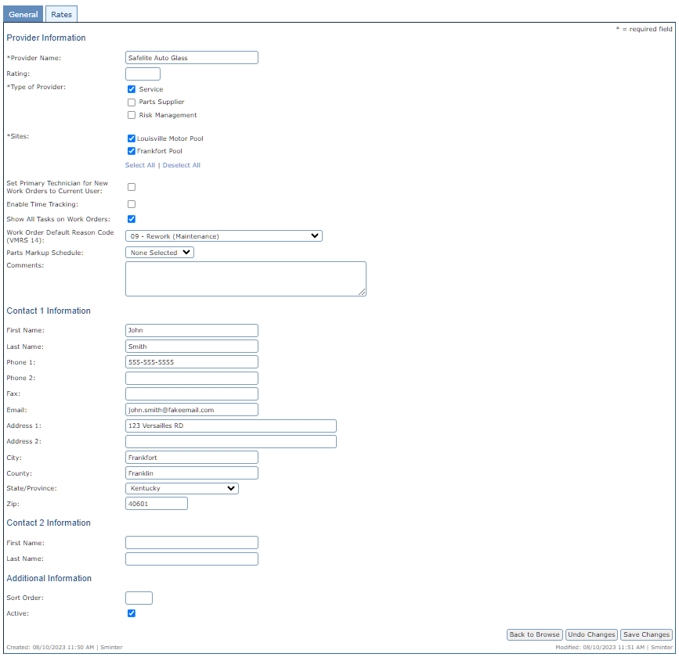
Creating a Provider
After completing the Provider Information Select the Rates Tab at the top of the page.

Slide 9
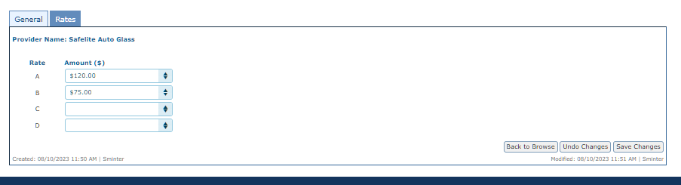
Creating a Provider
Fill in the hourly rate to Default labor entries in a Work Order
Note: If a provider charges different rates you can add up to 4 default amounts

Slide 10
Adding a task

Slide 11
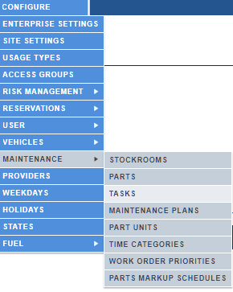
Adding a Task
Go to Configure> Maintenance then Select Tasks

Slide 12
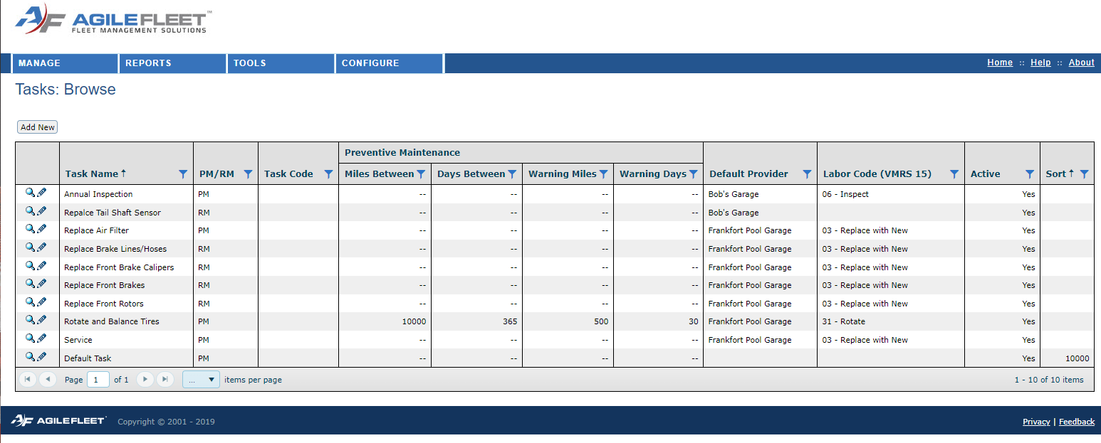
Adding a Task
Select “Add New”

Slide 13
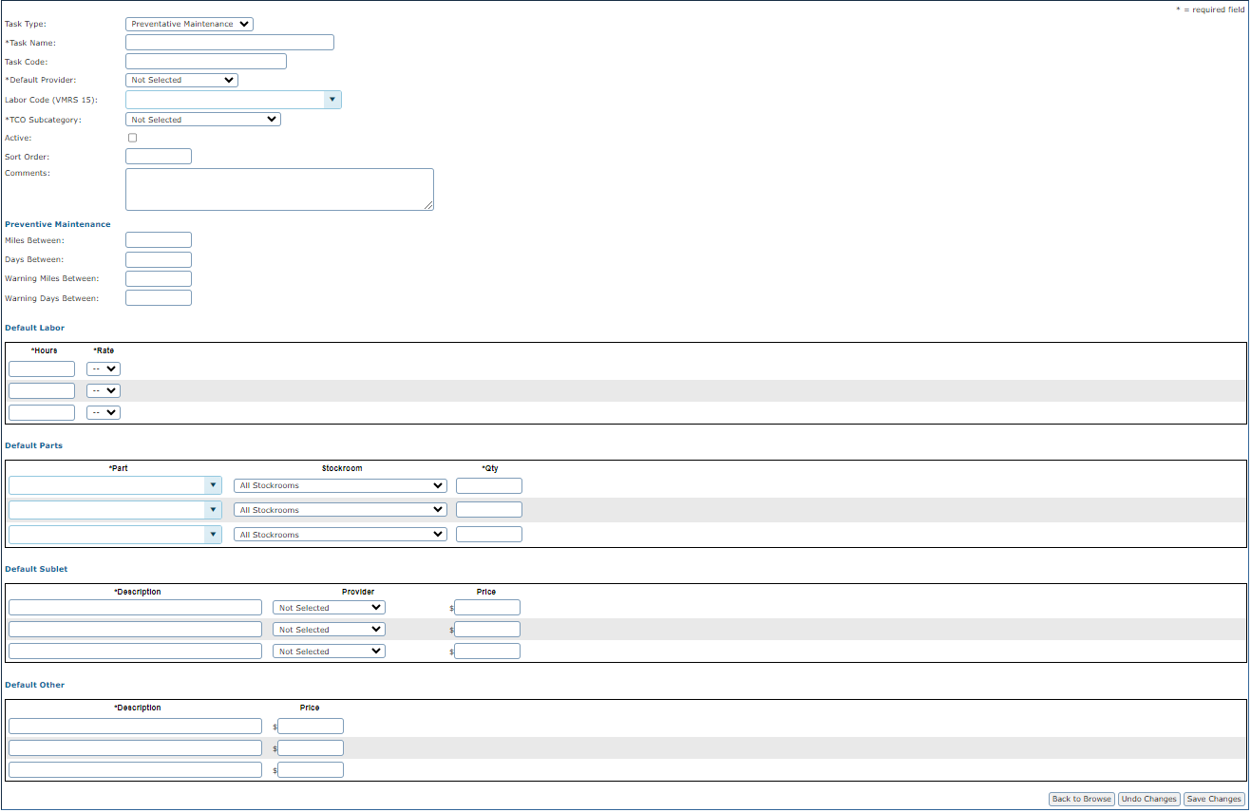
Adding a Task
Select the Task Type.
Note: This is not a configurable field

Slide 14
Adding a Task
Give the Task a Name. i.e. Oil Change

Slide 15
Adding a Task
Select the Default Provider.
Note: This can be a generic provider name

Slide 16
Adding a Task
Select the TCO Subcategory i.e. “Maintenance”

Slide 17
Adding a Task
Be sure to select “Active”

Slide 18
Adding a Task
If this Task is Preventive Maintenance provide the default intervals

Slide 19
Adding a Task
You can set up other default setting but is not necessary.

Slide 20
Adding a Task
Select Save Changes

Slide 21
Create a maintenance plan

Slide 22
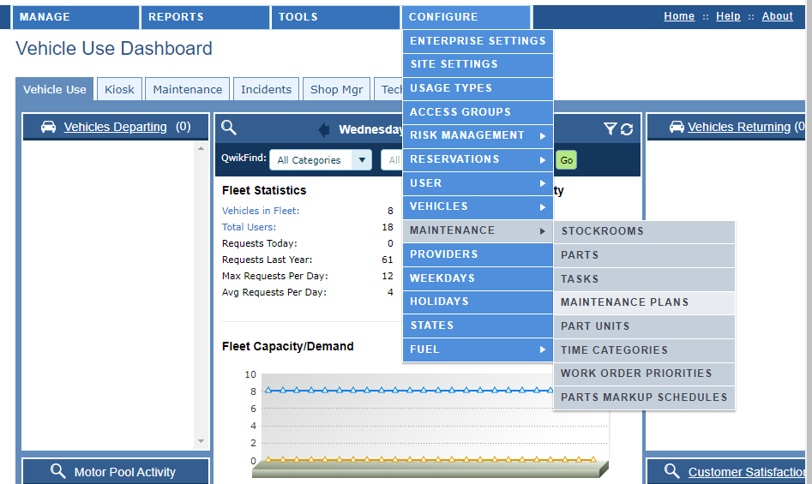
Create a Maintenance Plan
Go to Configure>Maintenance>Select Maintenace PLans

Slide 23
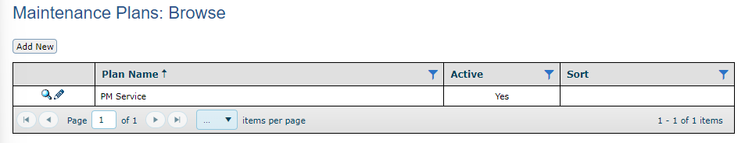
Create a Maintenance Plan
Select “Add New”

Slide 24
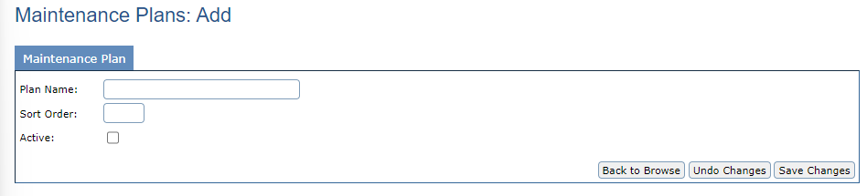
Create a Maintenance Plan
Give the Maintenance Plan a Name
Example: 5000 Mile Service

Slide 25
Create a Maintenance Plan
Make Sure that you select that the plan is active
Select “Save Changes”

Slide 26
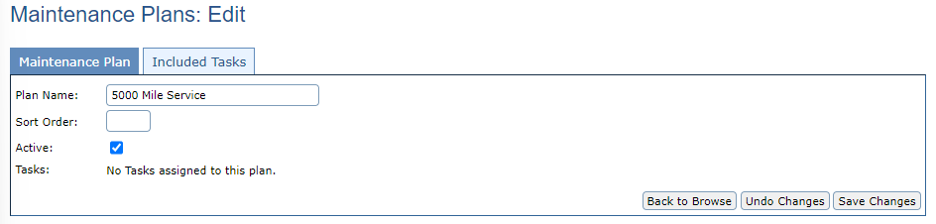
Create a Maintenance Plan
Notice that after you have saved your changes a new tab appears. Select the Included Task tab to add the Tasks to the plan

Slide 27
Create a Maintenance Plan
Notice that after you have saved your changes a new tab appears. Select the Included Task tab to add the Tasks to the plan

Slide 28
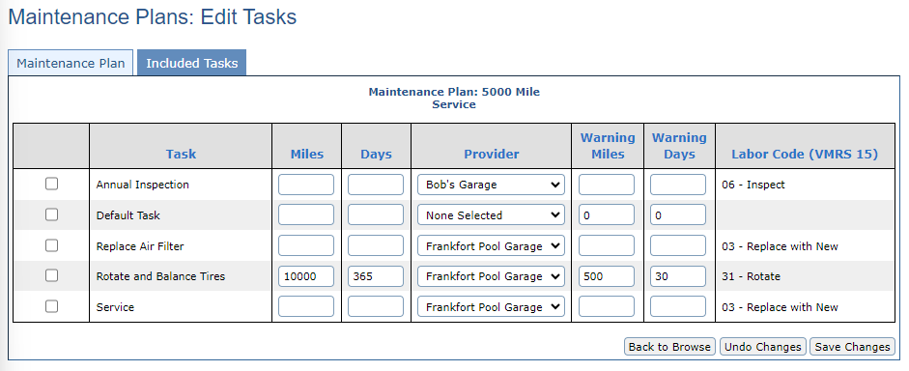
Create a Maintenance Plan
Select the Tasks that you would like to have added to the new Maintenance Plan

Slide 29
Create a Maintenance Plan
Adjust the Miles, Days, Warning Miles, and Warning Days intervals
Note: These intervals will trigger a notification that the tasks is either near due or is past due

Slide 30
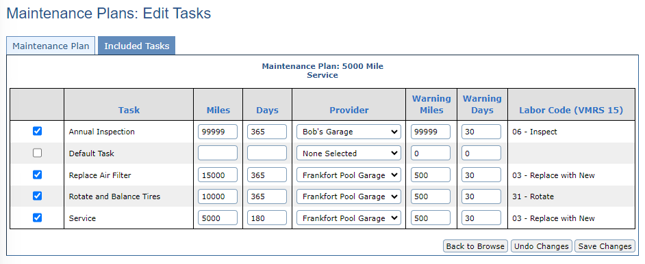
Create a Maintenance Plan
Select “Save Changes”

Slide 31
Adding a maintenance plan to a vehicle profile

Slide 32
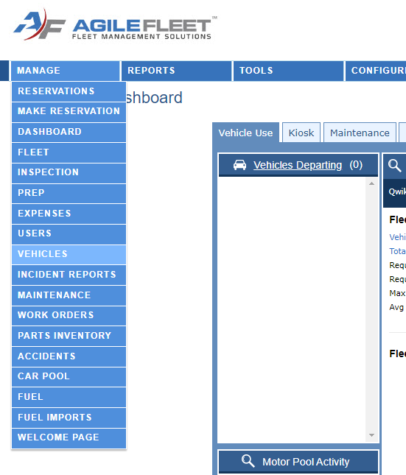
Adding a Maintenance Plan to a Vehicle
Go to Manage>Vehicles

Slide 33
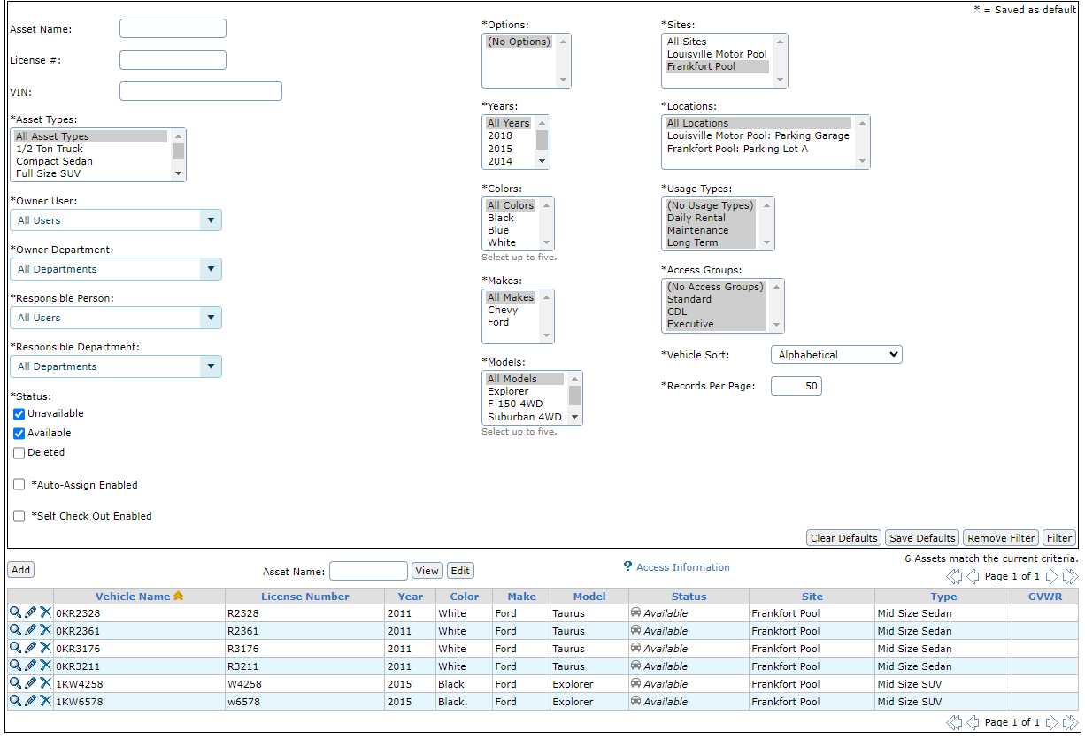
Adding a Maintenance Plan to a Vehicle
Select the Edit action button next to the vehicle you wish to add the Maintenance Plan to

Slide 34
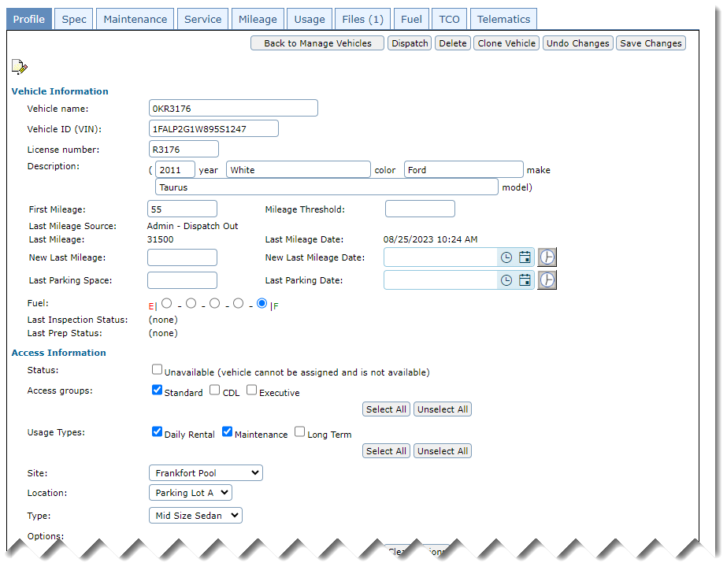
Adding a Maintenance Plan to a Vehicle
In the vehicle profile locate and select the Maintenance tab

Slide 35
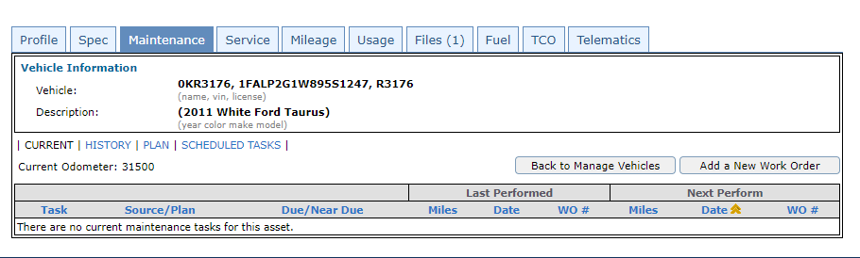
Adding a Maintenance Plan to a Vehicle
On the Maintenance Tab in the sub-navigation select “Plan”

Slide 36
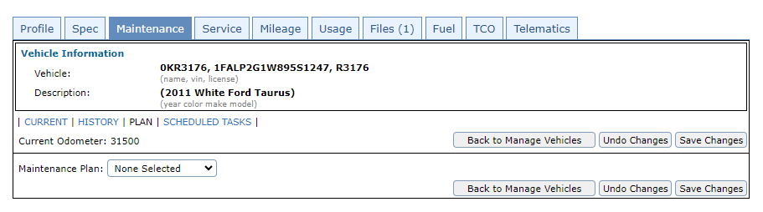
Adding a Maintenance Plan to a Vehicle
Select the drop down for the Maintenance Plan, then select the name of the plan you wish to assign

Slide 37
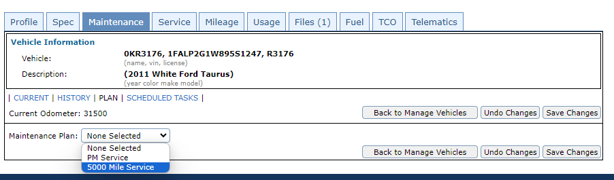
Adding a Maintenance Plan to a Vehicle

Slide 38
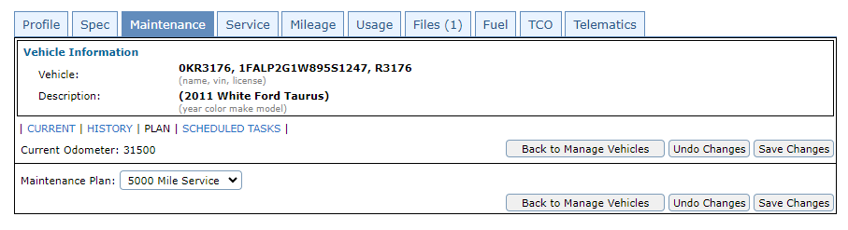
Adding a Maintenance Plan to a Vehicle
Select “Save Changes”

Slide 39
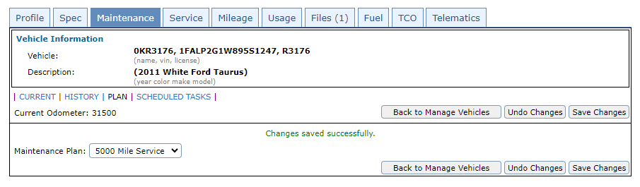
Adding a Maintenance Plan to a Vehicle

Slide 40
Creating a scheduled task

Slide 41
Creating a Scheduled Task
First it is important to understand the difference between a Scheduled Task and a Maintenance Plan Task. A Maintenance Plan Task comes due based on the odometer reading and the number of days between the task interval. A Scheduled Task comes due on the same date and time at each interval each time. A Maintenance Plan Task can move to the right depending on when the task was performed. For instance, if an oil change is scheduled for every 5,000 miles but isn’t performed until 6,000 miles the next oil change will come due at 11,000 miles. A scheduled task will always come due at the same date and time no matter when it is performed.

Slide 42
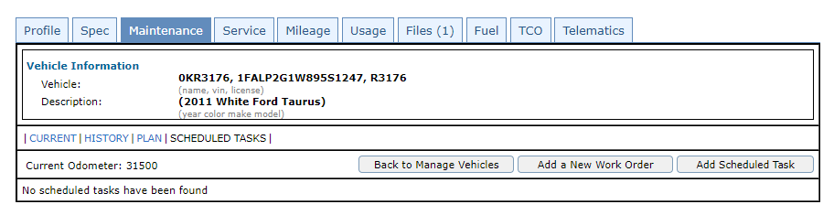
Creating a Scheduled Task
Select “Add Scheduled Task”

Slide 43
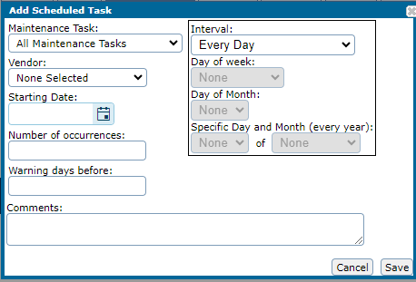
Creating a Scheduled Task
Give the Scheduled Task a Name
Select a Vendor to perform the scheduled task
Use the tool to determine the intervals
Chose a start date
List the total number of occurrences, should be figured by how many times the scheduled task will occur over the life span of the vehicle
Set the number of Warning Days before.
Note: This triggers the reminders

Slide 44
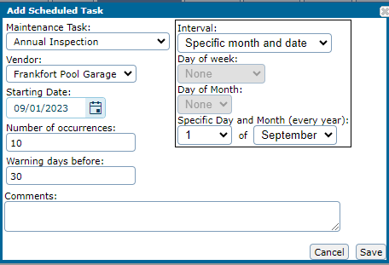
Creating a Scheduled Task
Select “Save”

Slide 45
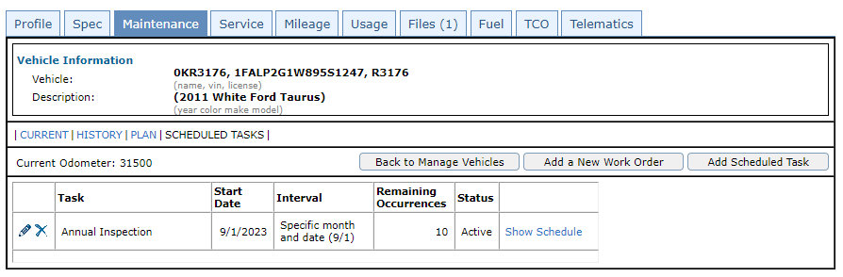
Creating a Scheduled Task
You can use the action buttons to Edit or Delete the Scheduled Task
Select Show Schedule to expand the view to show all occurrences scheduled for the Scheduled Task

Slide 46
Manage maintenance

Slide 47
Manage Maintenance
Manage Maintenance is used for tracking tasks assigned to maintenance plans that are coming due or have reached the warning mileage/warning days. Using filters can help you get the view to only include the information you're wanting to see. Action buttons allow you to snooze a task, view a task, create a work order, and notify the Requestor, Driver, Response User, or Owner User.

Slide 48
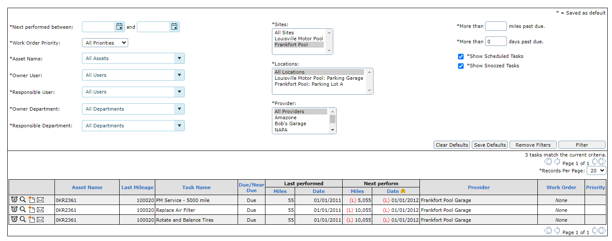
Manage Maintenance
Action Buttons

Slide 49
Manage Maintenance
Action button to snooze a task

Slide 50
Manage Maintenance
Action button to view a task

Slide 51
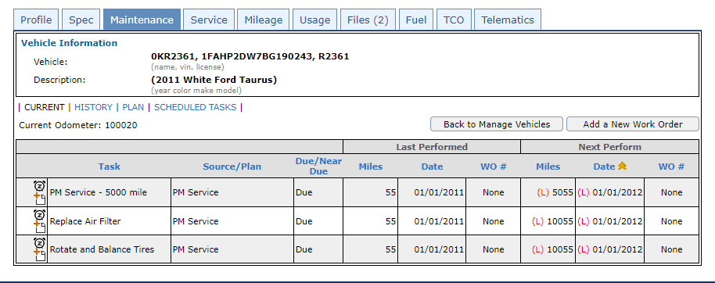
Manage Maintenance

Slide 52
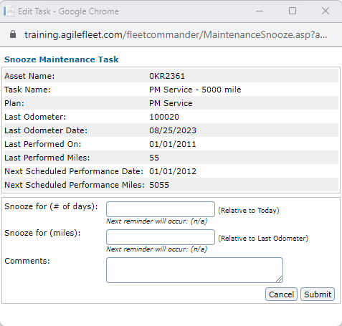
Manage Maintenance
Tasks can be snoozed for either a number of days or miles. Once the number of days or miles is exceeded again the task will once again show up in your default view

Slide 53
Manage Maintenance
Action button to create a work order

Slide 54
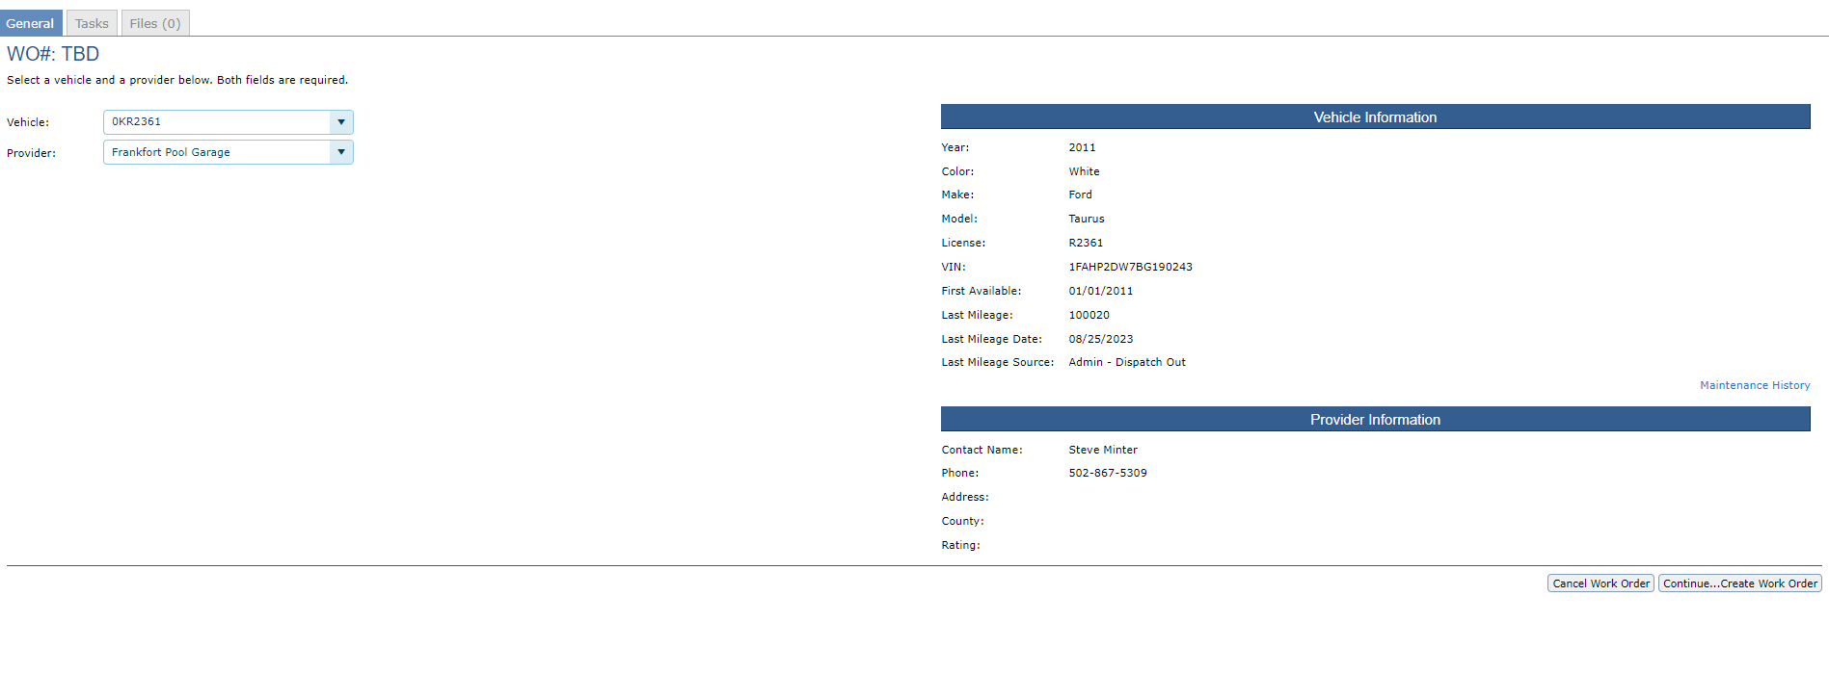
Manage Maintenance

Slide 55
Manage Maintenance
Action button to email a notification to either a Requestor, Driver, Responsible User, or Owner User

Slide 56
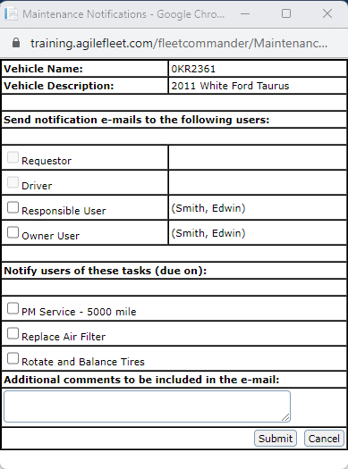
Manage Maintenance
Chose the task that you wish to include in the notification.

Slide 57
Create a work order

Slide 58
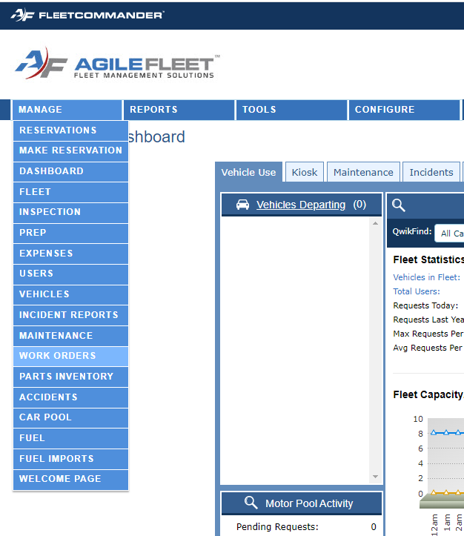
Create a Work Order
Go to Manage>Work Orders

Slide 59
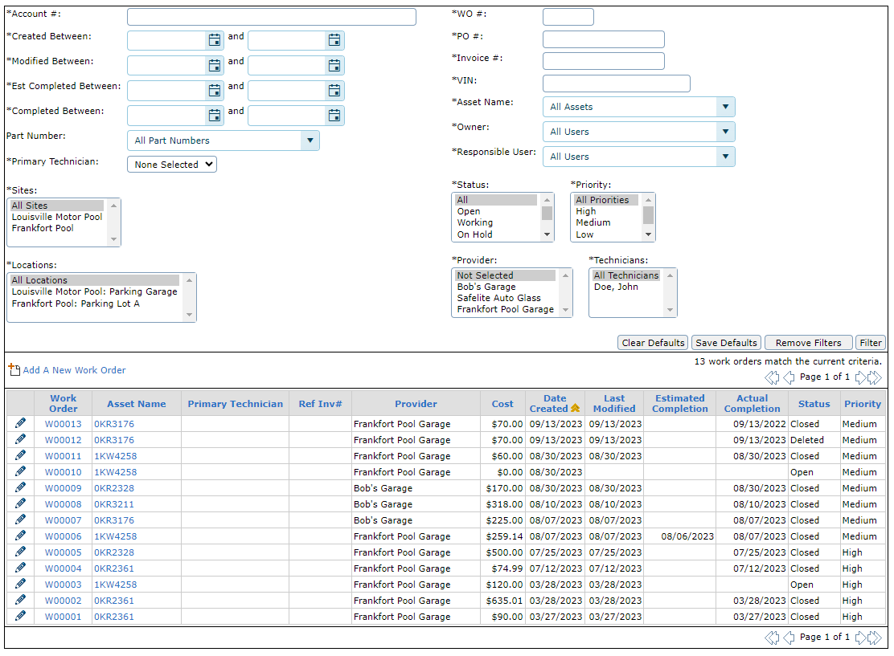
Create a Work Order
Select “Add a New Work Order”

Slide 60
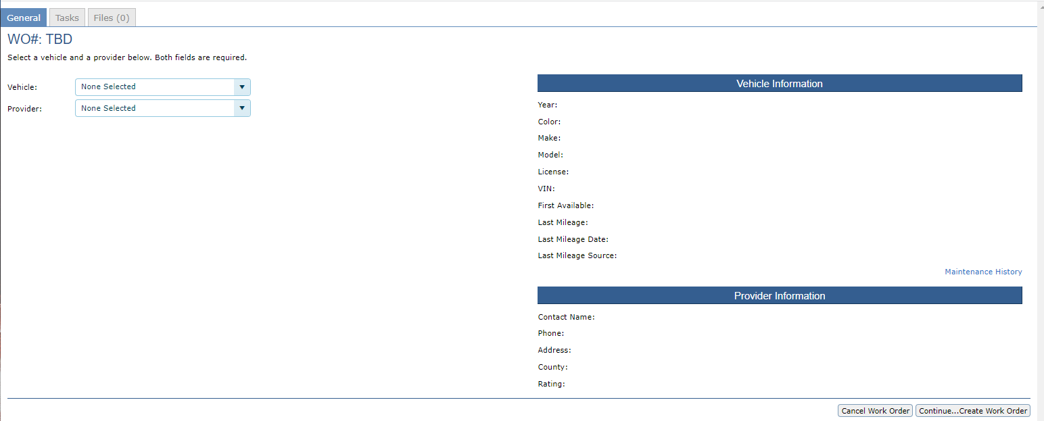
Create a Work Order
Select the Vehicle Name from the Drop Down
Select the Provider Name

Slide 61
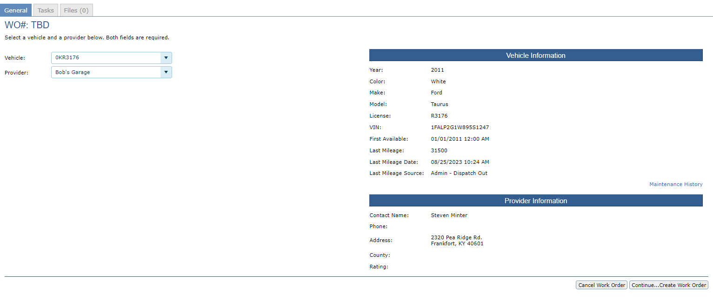
Create a Work Order
The Vehicle Information and the Provider Information will update once selected from the drop downs

Slide 62
Create a Work Order
The Vehicle Information and the Provider Information will update once selected from the drop downs
Select “Continue…Create Work Order”

Slide 63
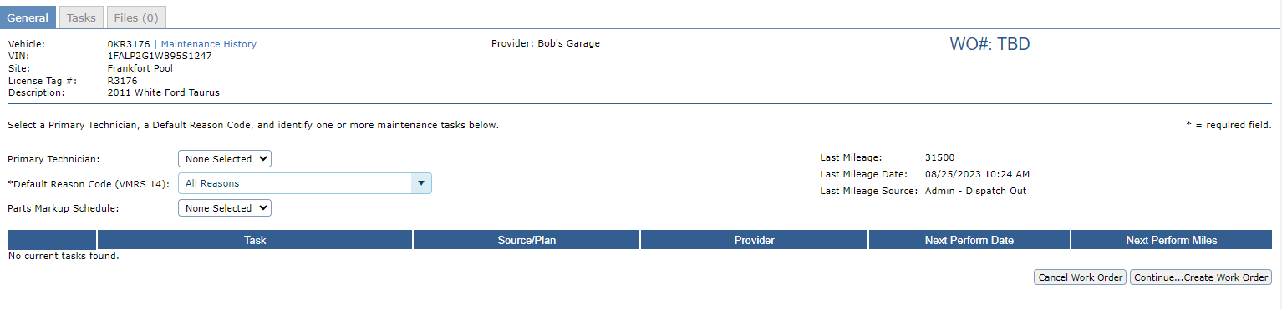
Create a Work Order
The Only required field is the Default Reason Code. If configured, you can add a Primary Technician and a Parts Markup Schedule

Slide 64
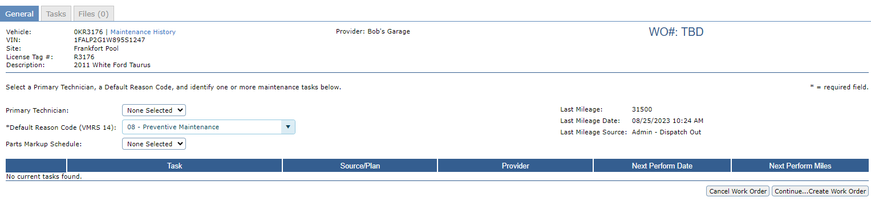
Create a Work Order
Select “Continue…Create Work Order”

Slide 65
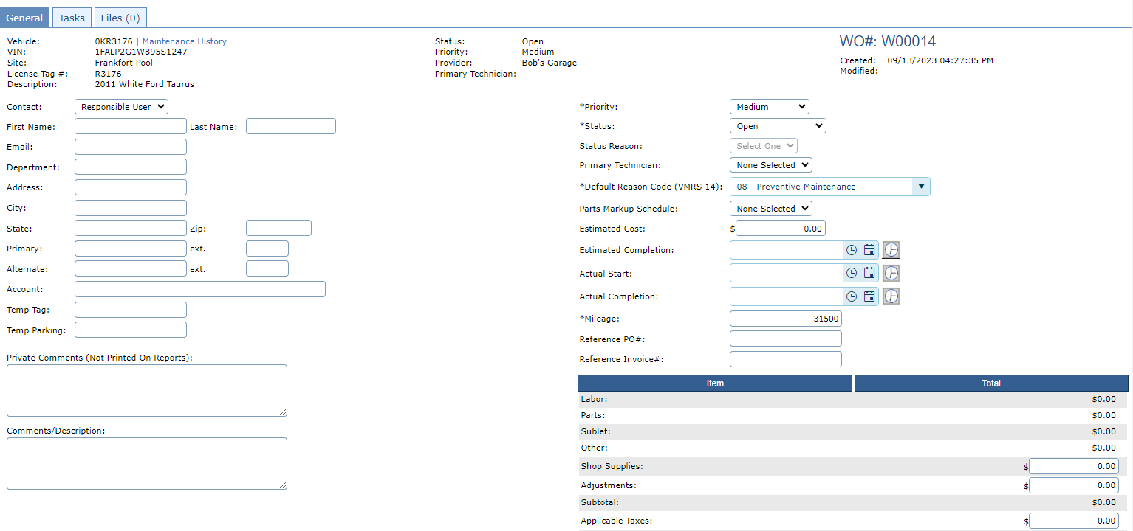
Create a Work Order
From the Work Order Screen, you can check the vehicle Maintenance History

Slide 66
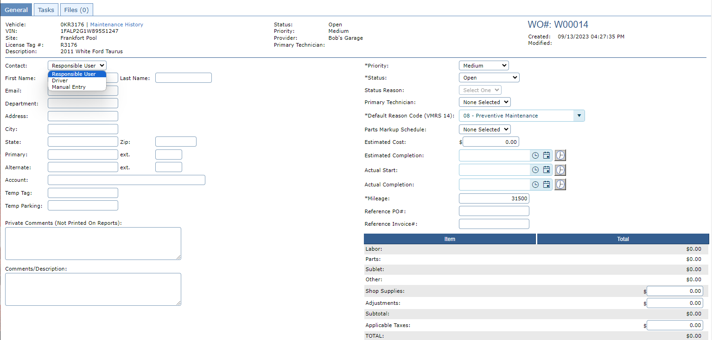
Create a Work Order
Chose the option for Contact

Slide 67
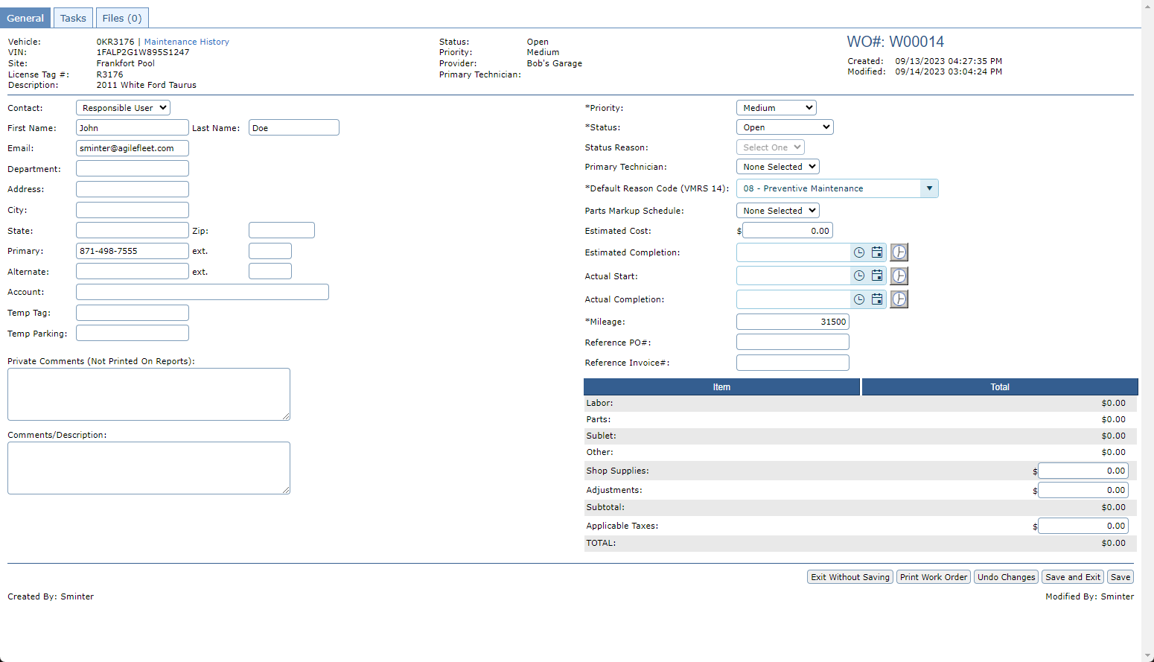
Create a Work Order
Enter any comments about the Work Order
Note: Private Notes are not included in any reports

Slide 68

Create a Work Order
Chose the appropriate Status for the stage of the Work Order

Slide 69
Create a Work Order
Chose a Primary Technician if you have given any permissions at the provider level

Slide 70
Create a Work Order
Chose a Default Reason Code
Note: These are VRMS Reason codes and are an industry standard thus they are not configurable

Slide 71
Create a Work Order
The Estimated Cost, Estimated Completion Date and Actual Start Date are not required, and the Actual Completion date will populate when a Work Order is Closed. However, you can backdate the completion date

Slide 72
Create a Work Order
Update the vehicle Odometer
Note: Entering the current odometer will only update the vehicle record when the Work Order Status is Closed.

Slide 73
Create a Work Order
If the repair is being outsourced, you can list a Reference PO# and a Reference Invoice #

Slide 74
Create a Work Order
If the repair is being outsourced, you can list a Reference PO# and a Reference Invoice #

Slide 75
Create a Work Order
If known at this time you can enter the Shop Supplies, Adjustments, or Applicable Taxes. These fields can only be updated from this General Tab

Slide 76
Create a Work Order
Select “Save”

Slide 77
Adding tasks to a work order

Slide 78
Adding Tasks a Work Order
Select “Tasks Tab”

Slide 79
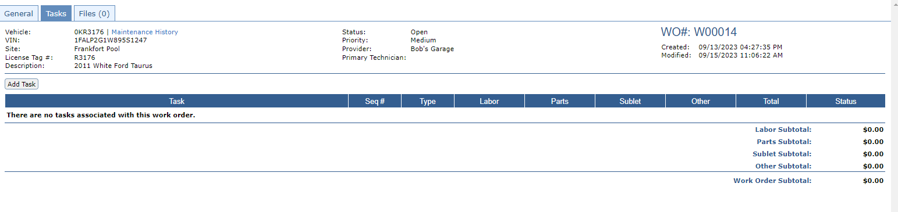
Adding Tasks a Work Order
Select “Add Task”

Slide 80
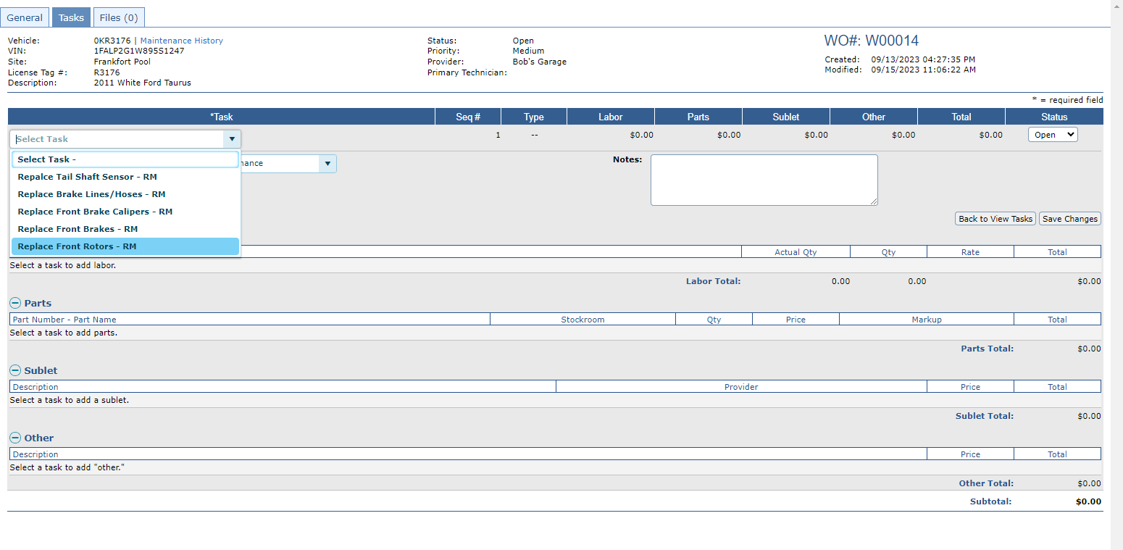
Adding Tasks a Work Order
Select a Task
Note: These are Configured at Configure>Maintenance>Tasks

Slide 81
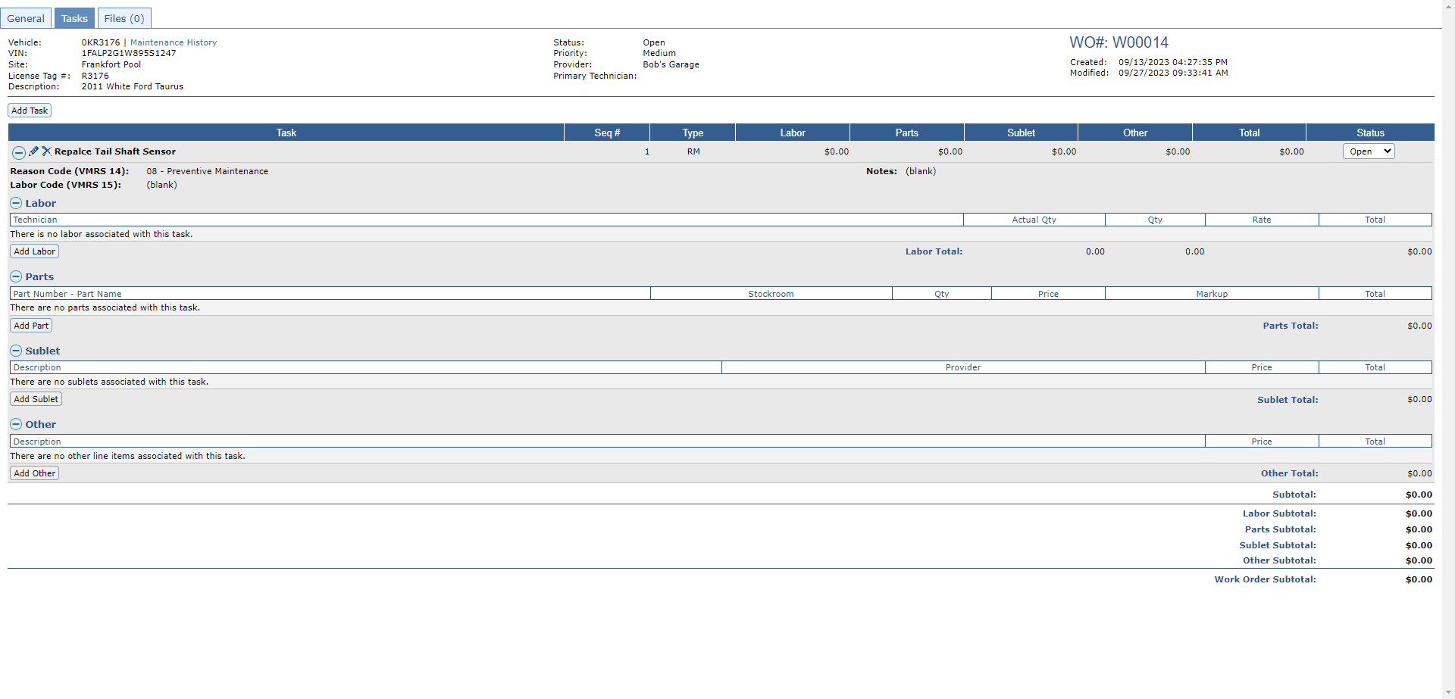
Adding Tasks a Work Order
Add Labor Cost be sure to save your changes

Slide 82
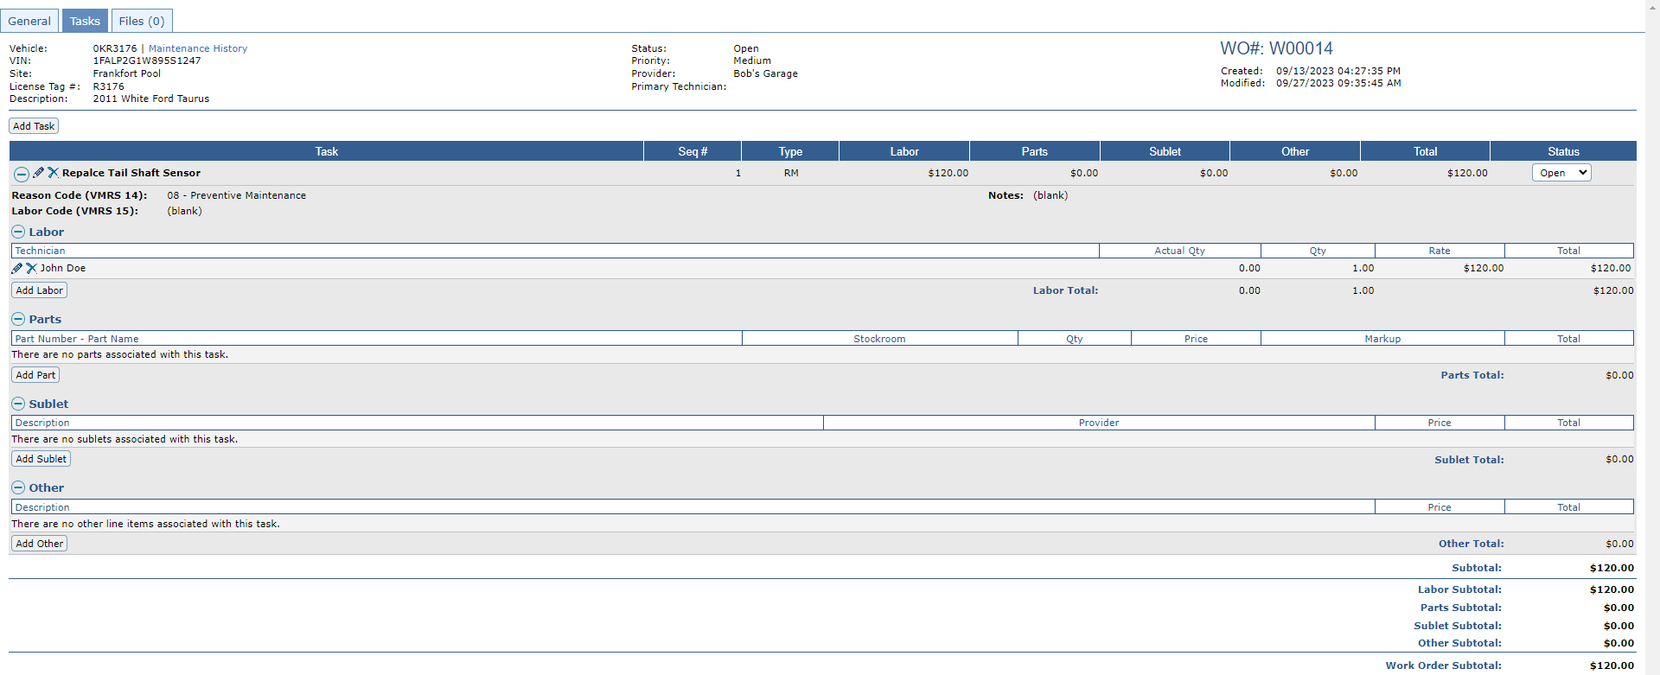
Adding Tasks a Work Order
Add Parts and Parts Cost

Slide 83
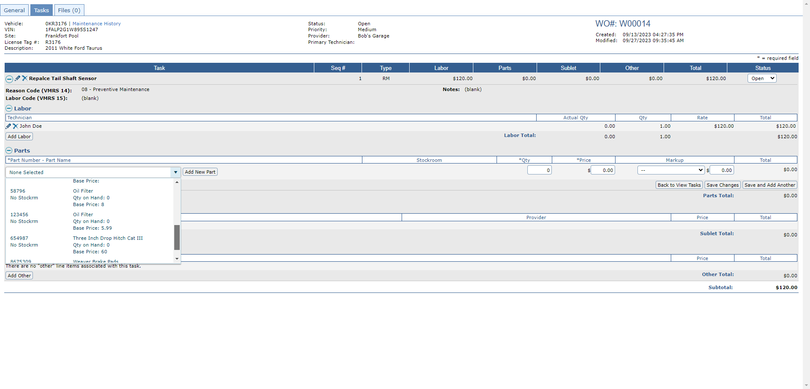
Adding Tasks a Work Order
If the Part is not listed in the drop down, select “Add New Part”
Select the parts from the drop down.
Note: Parts are preconfigured.

Slide 84
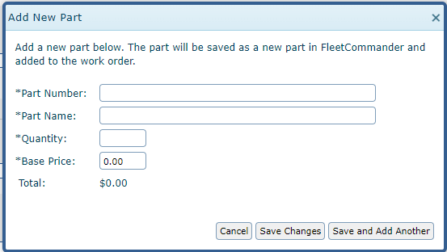
Adding Tasks a Work Order
Insert the Part Number
Insert the Part Name
Insert the Quantity
Insert the individual Part Base Price
Note: The Total should match the Quantity multiplied by the Base Price

Slide 85
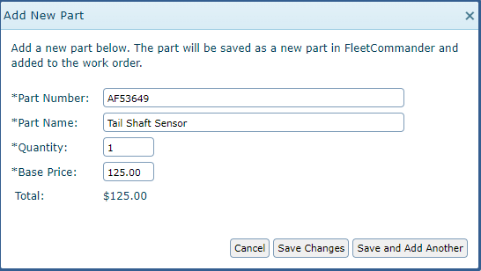
Adding Tasks a Work Order
After the part is added be sure to Save your changes. The part is now configured and will be included on future work orders.

Slide 86
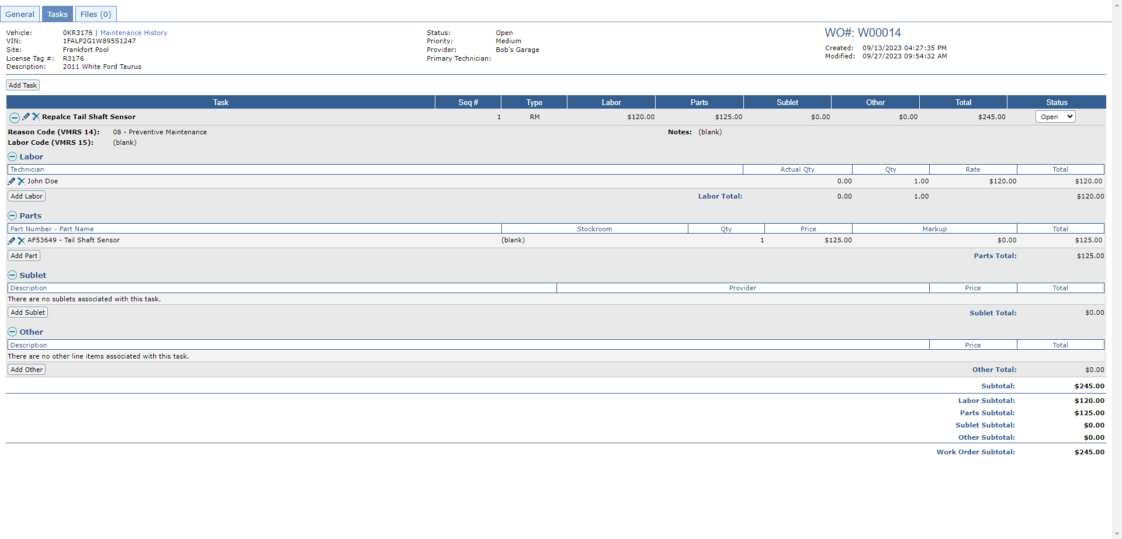
Adding Tasks a Work Order
After adding Labor and Parts you can add Sublet Cost or any other Cost.

Slide 87
Adding a file to a work order

Slide 88
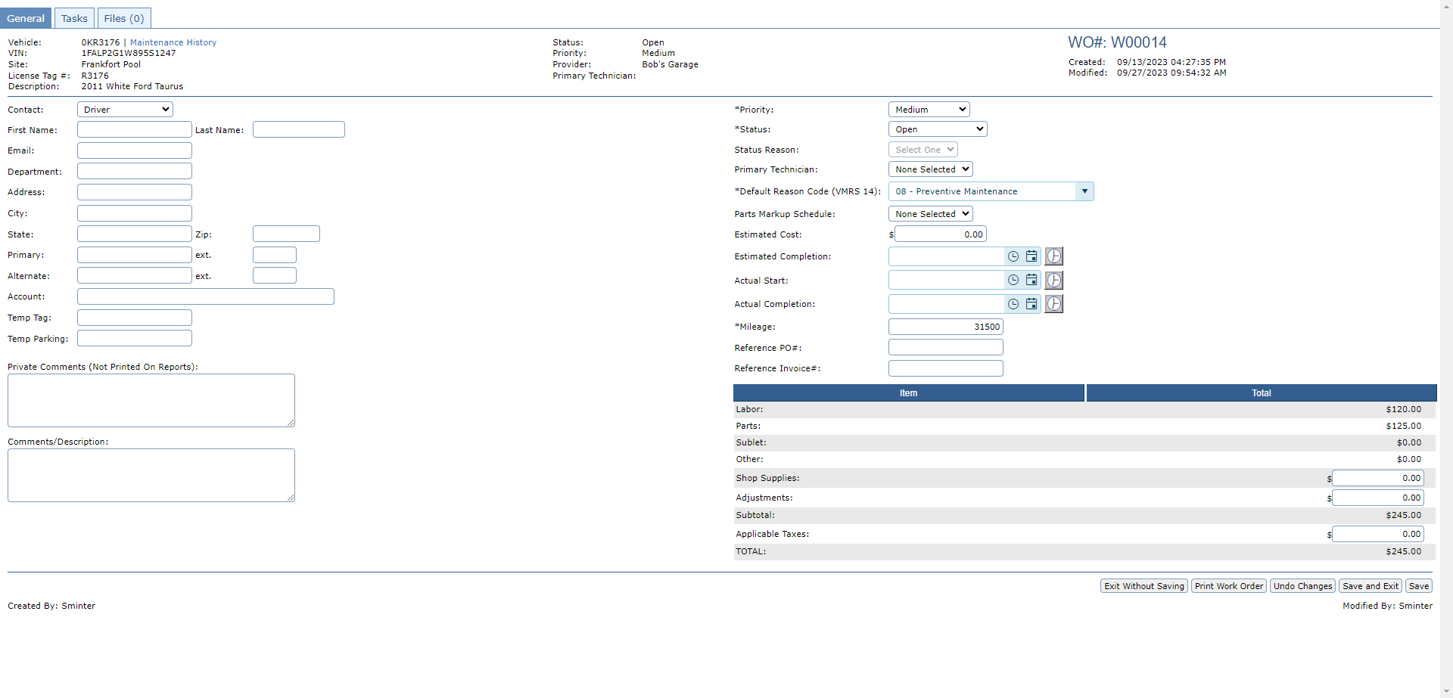
Adding a File to a Work Order
Select the “Files” Tab

Slide 89

Adding a File to a Work Order
Select “Add File”

Slide 90

Adding a File to a Work Order
Give the file a descriptive name

Slide 91

Adding a File to a Work Order
Select a Category

Slide 92
Adding a File to a Work Order
Make sure “Active” is selected then “Save Changes”

Slide 93

Adding a File to a Work Order
File has been added, now you can View, Edit or Delete the File.

Slide 94

Adding a File to a Work Order
Viewing the file downloads, it to your computer for viewing or can be printed

Slide 95

Adding a File to a Work Order
Editing the file takes you back to where you can change the Title, Category, or you can mark it as Inactive

Slide 96
Adding a File to a Work Order
Deleting the file removes it permanently.

Slide 97
Checking vehicle repair history

Slide 98

Checking Vehicle Repair History
In the work order select “Maintenance History”

Slide 99

Checking Vehicle Repair History
Vehicle repair History will only include “Closed” Work Orders.

Slide 100
Checking Vehicle Repair History
The Work Order number is a Hyperlink. When selected it will pull up the Work Order to be viewed.

Slide 101
Checking Vehicle Repair History
The Work Order number is a Hyperlink. When selected it will pull up the Work Order to be viewed.

Slide 102

Thank you
Phelps Rogovoy
phelps@agilefleet.com

