Slide 1

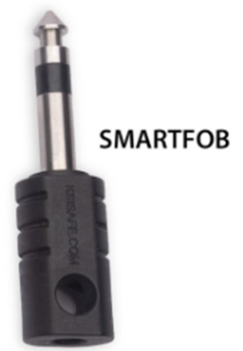
Welcome to command 2025

Slide 2
SmartFob Key Box Update

Slide 3
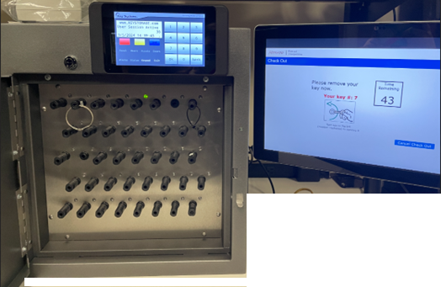
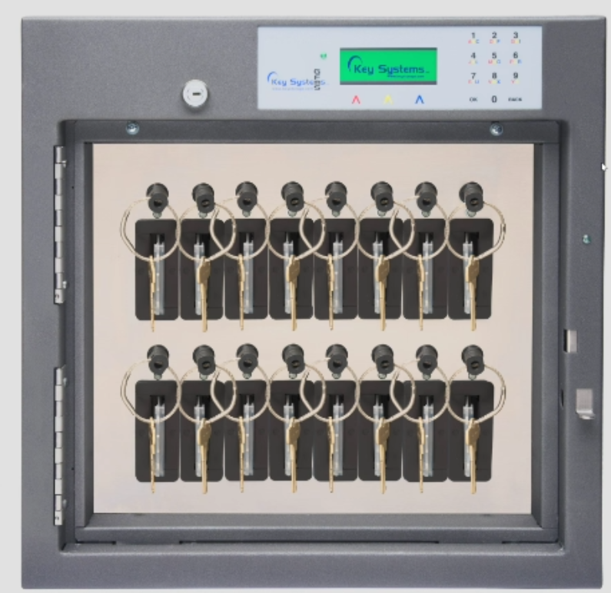

SmartFob Key Box

Slide 4
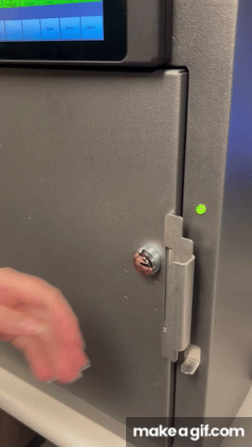
Benefits
No key to turn. Easy in and out.
Can return to any position
If fob is lost, no custom replacement fobs required. Fobs are generic.
Key ring doesn’t bind
Mail-slot no longer has switch in cardholder.

Slide 5
Field Testing
We had two clients who wanted to test the Smart Fob
Swapped their standard panel for Smartfob
Picked local clients in case there were any technical issues.
Went onsite to assist with the panel swap
Ran field test for 6 months.
Clients had option to buy the new panel or go back to the original key panel.

Slide 6
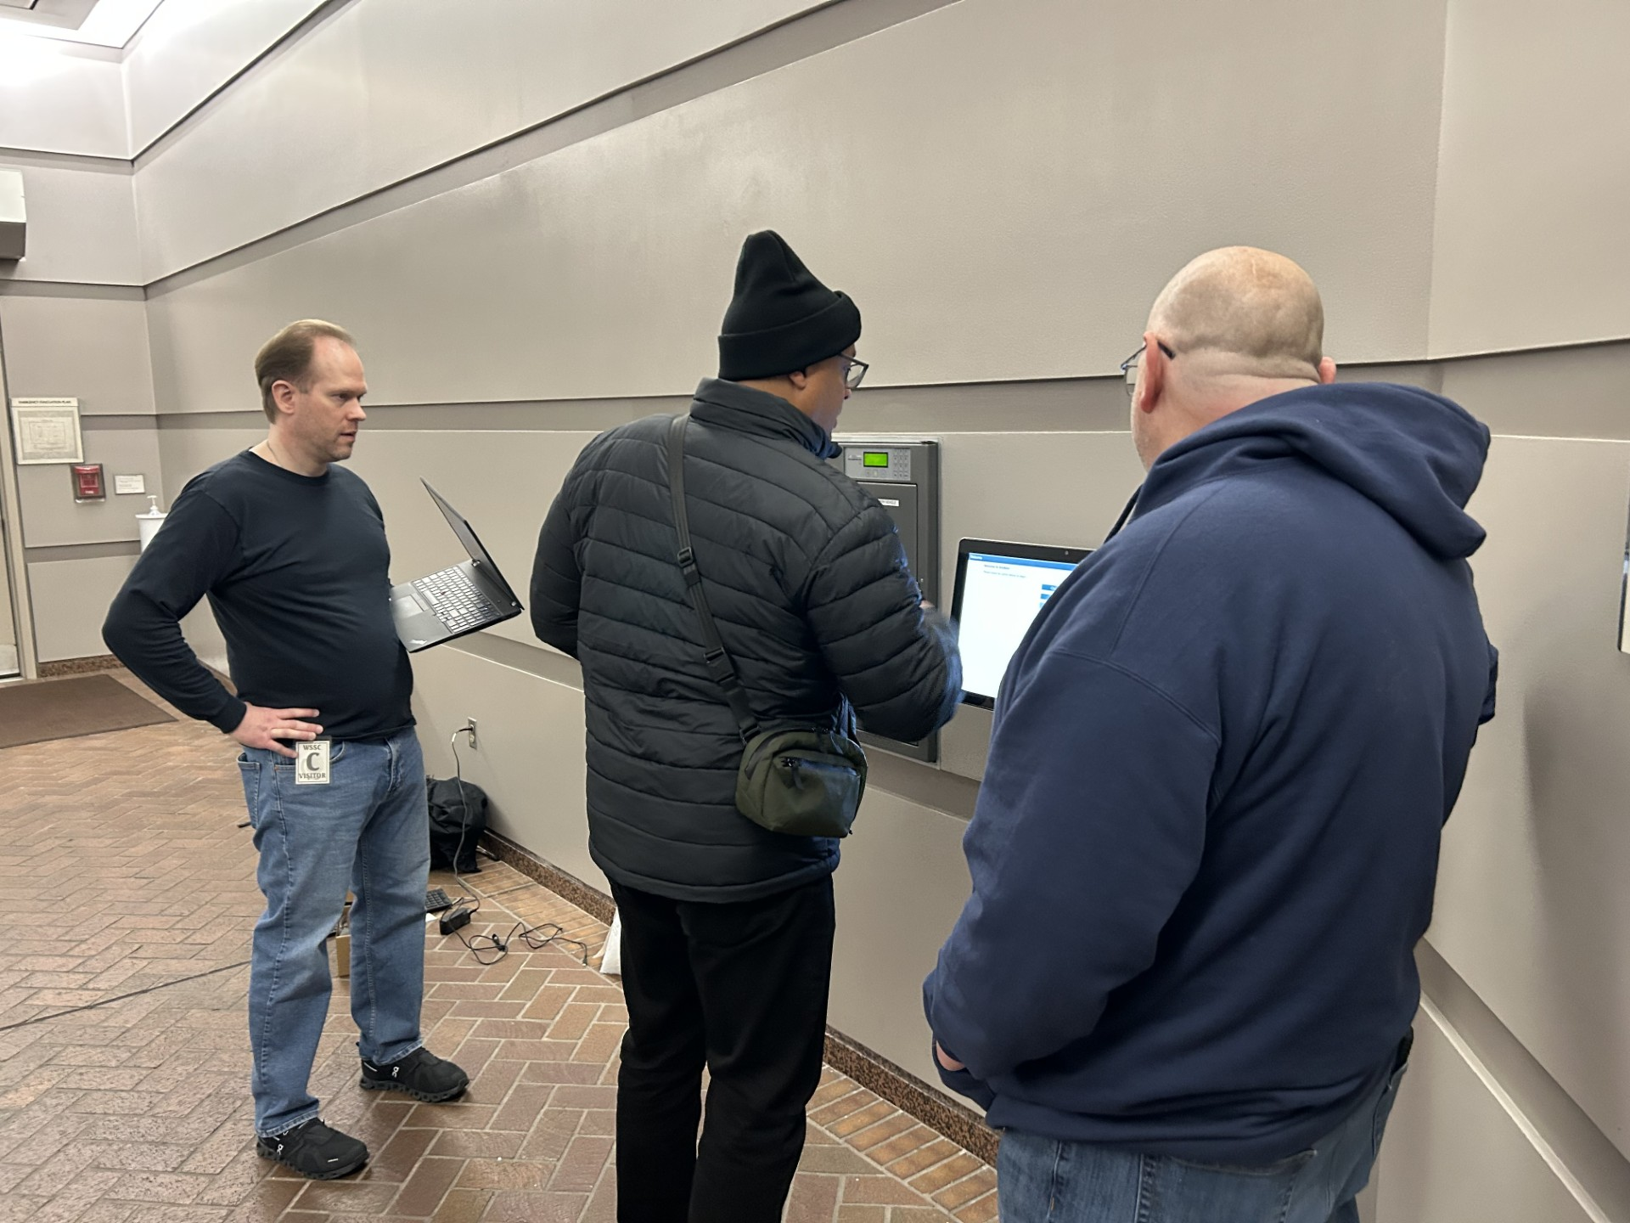
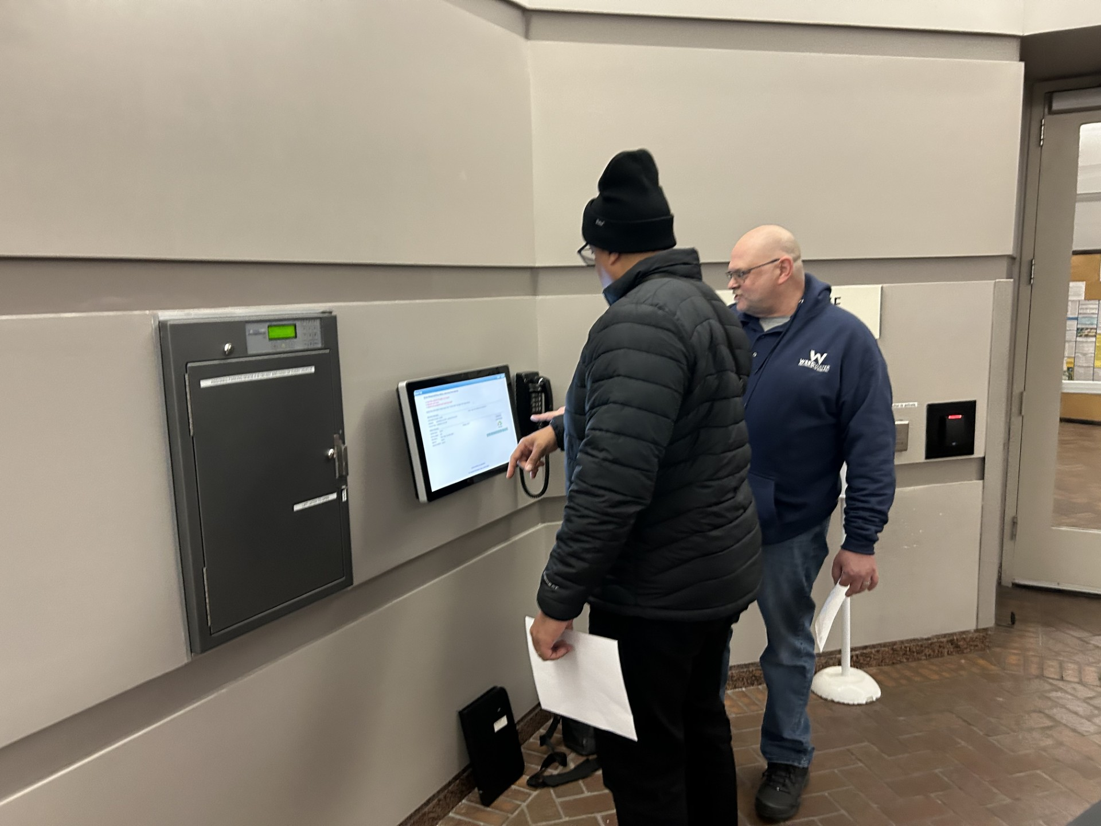
Field Testing - WSSC

Slide 7
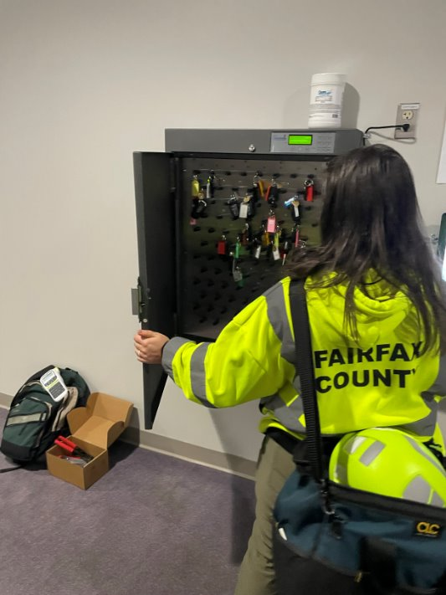
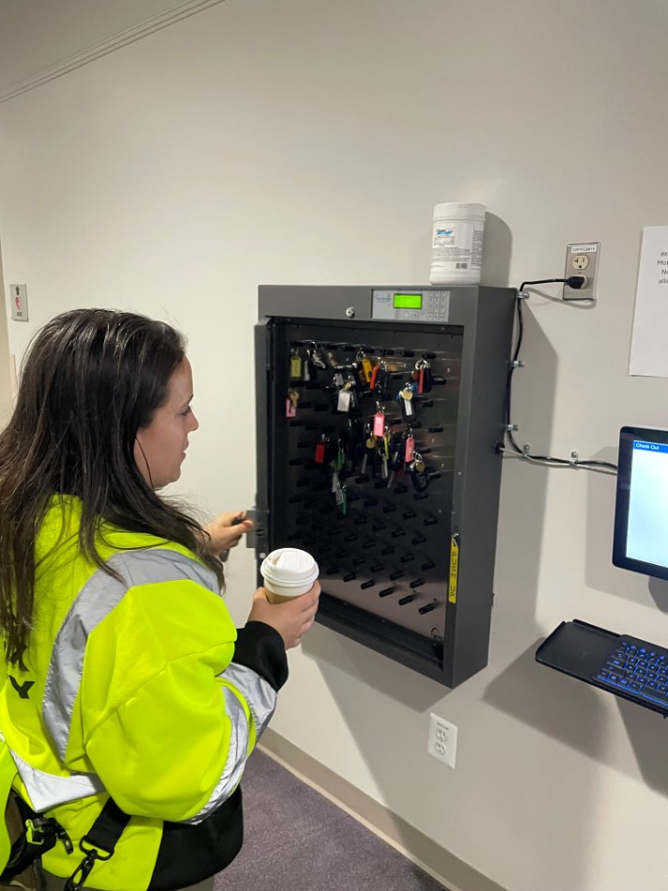
Field Testing – Fairfax County

Slide 8
Field Testing – Results
End Users said it was easier to remove and return keys.
Discovered an issue with a key count. Issue was resolved.
Clients have been using boxes now for more than 10 months
Both clients decided to purchase the SmartFob panel. Fairfax is considering ordering more.
We have sold 14 of new smart fob boxes and panel swaps since last user conference.
We were able to simply the panel exchange process
We add numbers to the panel and the keyfob for easier identification.

Slide 9
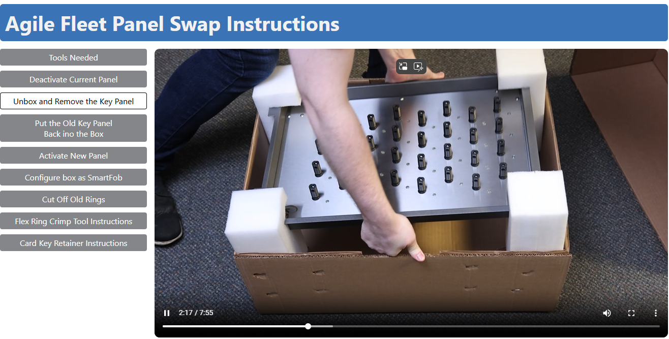
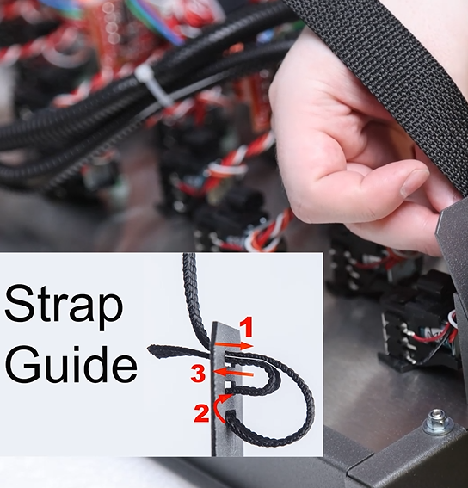
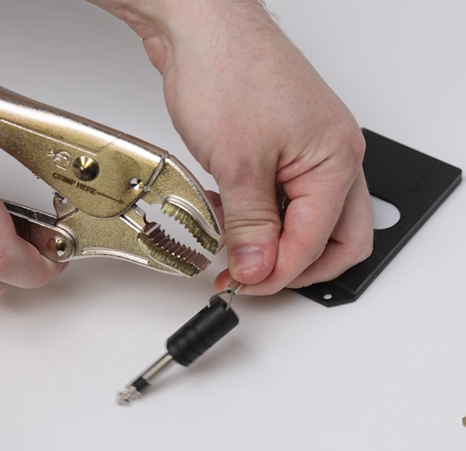
Step-By-Step Instructions
Available as a video or PDF
Can be found on https://fcdrive.agilefleet.com

Slide 10
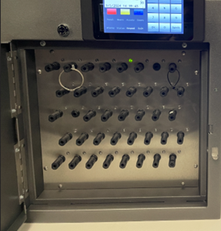
Sizes
Current Standard key | Standard SmartFob
8 | 8
16 | 16
32 | 32
64 | 64
96 | 96
Investigating daisy-chained sizes options
Current Mail slot key panel | New SmartFob panel
12 | 16
20 | 24
32 | 48
56 | 80

Slide 11
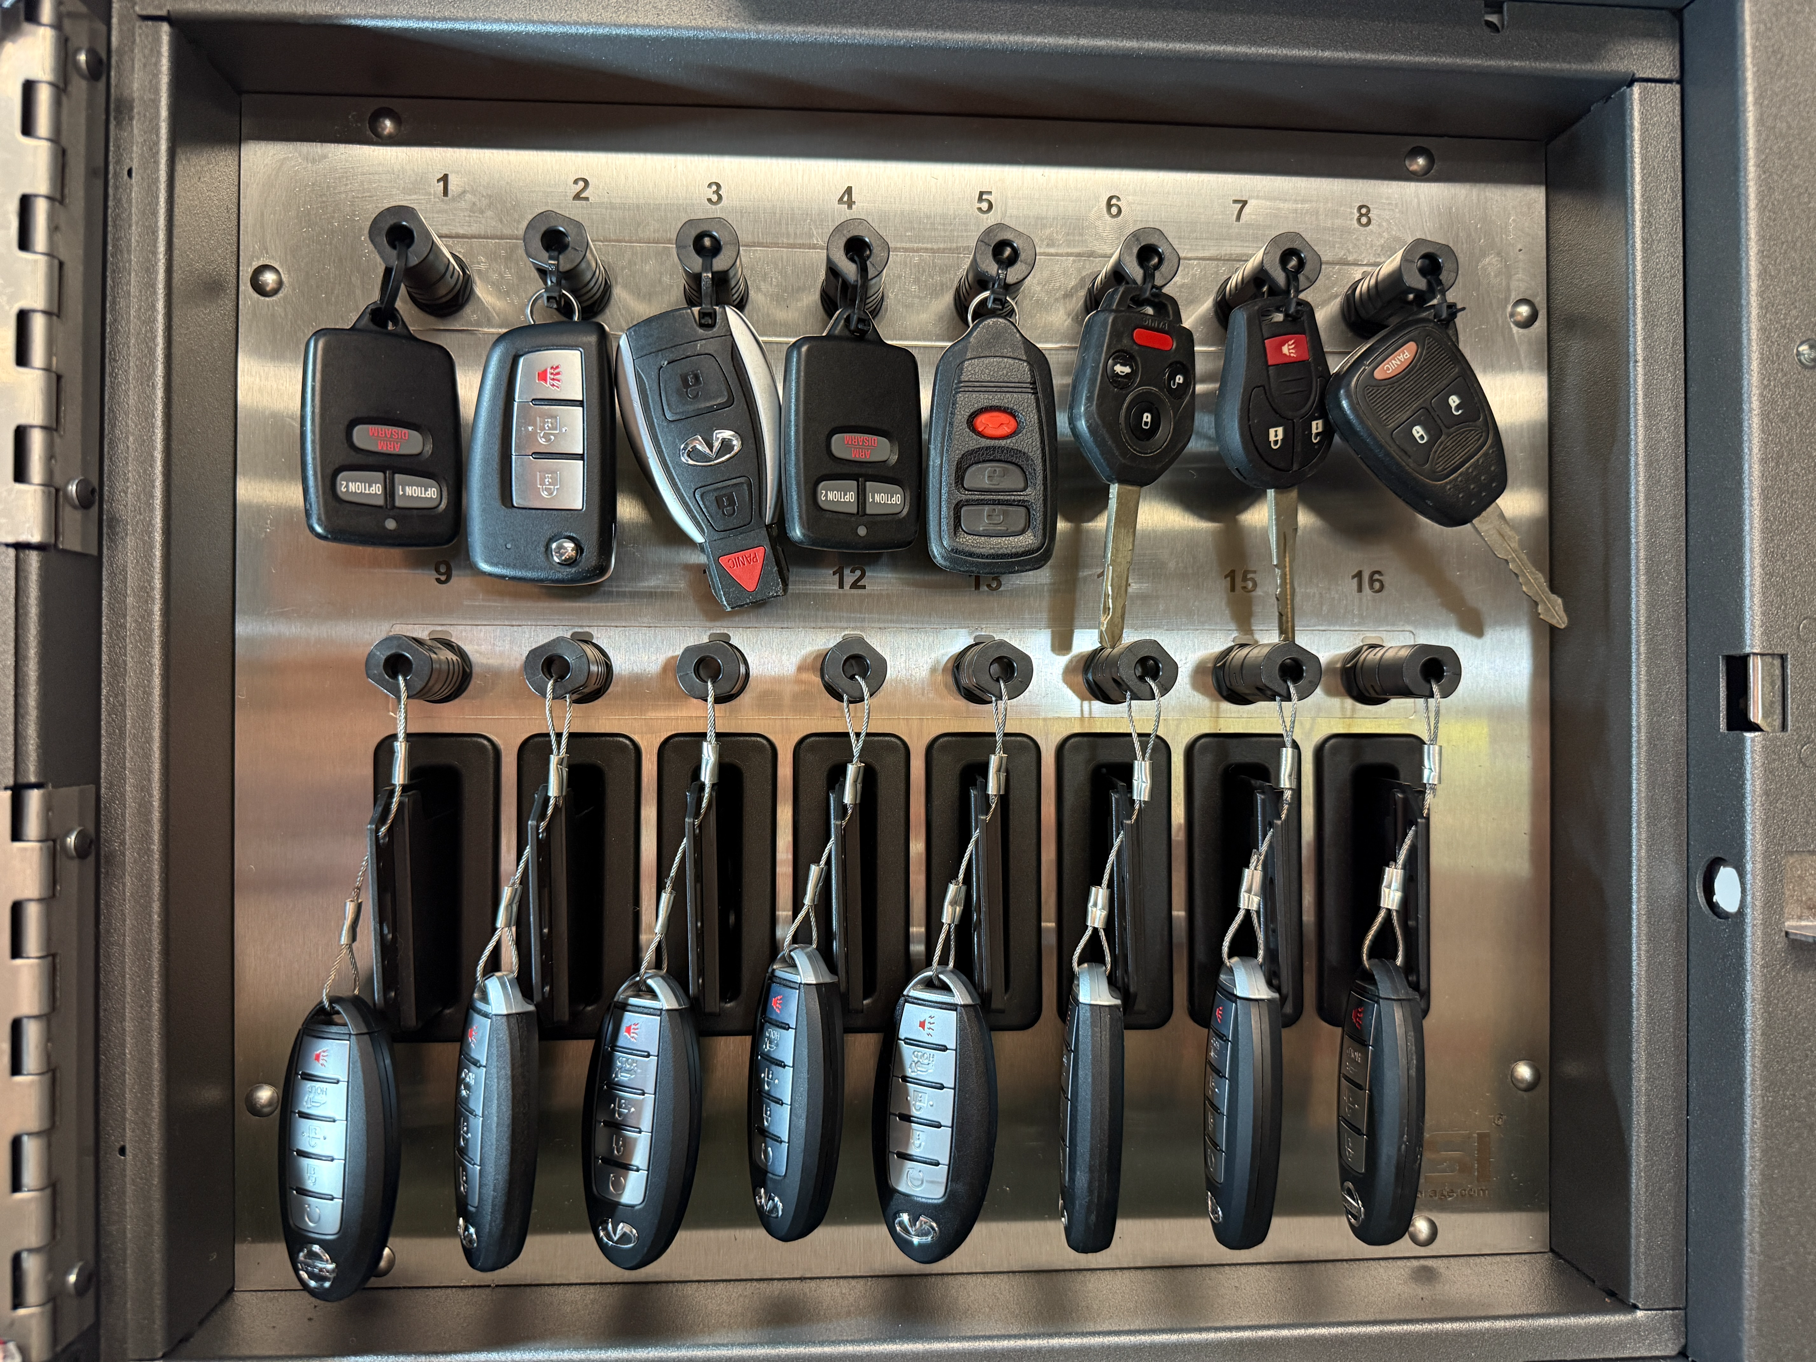
Key Rings

Slide 12
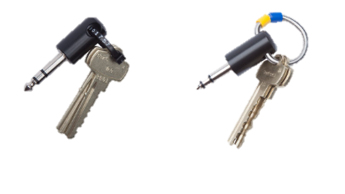

Key Rings
New - Loop Ring (MailSlot)
Serial Tie
Solid or Flex Ring

Slide 13
KIOWARE Server

Slide 14
KIOWARE Server
What is it?
How does it benefit you?
What is required?
How do you get started?

Slide 15
KIOWARE Server
Kiosk #1
(CA)
Kiosk #2
(CA)
Enables AgileFleet to see kiosks from a centralized location
Commands can be sent to the kiosks from the server, and information sent to the server from the kiosks
KioWare Server
(Agile Fleet)
Kiosk #3
(VA)
Kiosk #4
(FL)

Slide 16
Benefits
Kiosk #2
New v8.39
Push out new KioWare versions to kiosk
Kiosk #1
[OFFLINE]
Kiosk #3
Updated Config File
Monitor when the kiosk goes offline & perform troubleshooting steps
KioWare Server
(Agile Fleet)
Make configuration changes remotely
Control Windows Updates
Kiosk #4
{ERROR}
Kiosk #5
Needs Windows Updates
Get screen capture of error

Slide 17
How does it benefit you?
Kiosk #2
(CA)
Kiosk #1
(CA)
Agile Fleet can now:
Push new Kioware version out to your Kiosk(s)
Ability to make configuration changes remotely
If online, we can grab a screen capture of error
Monitor when the kiosk goes offline
Can preform troubleshooting of the kiosk remotely
Can control Windows updates
KioWare Server
Kiosk #3
(VA)
Kiosk #4
(FL)

Slide 18
What is required?
Schedule an upgrade session with FleetCommander Support
Someone to be at the kiosk to perform initial setup
30-60 mins of scheduled kiosk downtime
Install latest version of KioWare
Configure KioWare Server Settings
Install PowerShell module for Windows Updates
153 Kiosks have been added to Kioserver.

Slide 19

key control vpn service

Slide 20
Key Control Standard
Key Box
Requires:
Dedicated IP Address
Internal Firewall Rules
Two network drops
Kiosk
NIC2
NIC1
Network Port or Cradlepoint

Slide 21
Key Control VPN Service
Key Box
Kiosk
Requires:
Internet access
One network drop
NIC2
NIC1
Network Port
Cradlepoint

Slide 22
Key Control VPN Service

Slide 23
Benefits
One network drop
No dedicated IP required
No special firewall rules
All key box data is encrypted
Cheaper than using a Cradlepoint
More appealing to your Network admins
30+ Boxes are already using Open VPN!

Slide 24
CradlePoint Comparison
 | Cradlepoint | Key Control VPN Service
Cost | Monthly usage charge | Lower yearly charge
Reliability | Relies on cell signal | On organization network
Replacement Cycle | Every 3-5 years | Installed on Kiosk
Power Requirements | Three power outlets | Two power outlets

Slide 25
Hardware-as-a-service (HAAS)
Delivering peace-of-mind

Slide 26
What is hardware-as-a-service?
With HaaS, customers trade capital expense headaches, depreciation risk, and unpredictable hardware failures for a single predictable subscription that includes support, upgrades, replacements, compliance, and refreshes.

Slide 27
Financial benefits
No Capital Expense / Budget Approval Needed – HaaS is OpEx, not CapEx, so customers avoid long approval cycles, RFPs, or board approvals.
Predictable Budgeting – One flat recurring fee covers hardware, support, warranty, and refresh → no surprise costs.
No Depreciation Risk – Customers don’t carry the asset on their books, so no depreciation schedules, write-downs, or asset disposal obligations.
Lower Upfront Cash Outlay – Removes the large one-time hit

Slide 28
Technology & service benefits
Always Current Hardware – Automatic refresh cycle keeps technology modern and reliable.
Certified Replacements Included – Shipment of new or certified refurbished units from Agile Fleet’s pool → minimizes downtime.
Proactive Monitoring & Remote Support – Tools like Kioware, Quick Assist, and Watchdog provide remote diagnostics, updates, and fixes without customer IT involvement.
Integrated SaaS Dependency – Hardware isn’t standalone; it is fully integrated with Agile’s FleetCommander SaaS, ensuring reliability and compliance.

Slide 29
Risk reduction
Reduced Internal Burden – Agile handles lifecycle management, logistics, replacement, and OS updates → less strain on customer IT/facilities teams.
Better SLAs & Uptime –2-day replacement windows, proactive monitoring.
No End-of-Life Surprise Costs – Customers don’t face sudden large replacement costs or downtime when hardware fails.
No Obsolescence Headaches – Tech is refreshed before it becomes outdated or unsupported (e.g., Windows/Linux OS cycles).

Slide 30
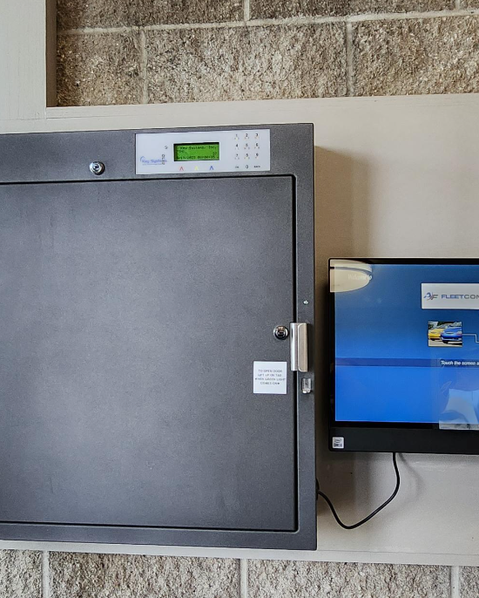
HaaS Program available starting in Q1 2026
Contact your Client Success Representative if Interested.

Slide 31

Thank you

