Slide 1


Welcome to command 2025
Right-Sizing: Proof & Progress

Slide 2

Agenda
The Stakes & Maintaining the Hype
Communicating Like a Marketer
Let AI Do the Heavy Lifting
AI Tools & Processes
KPIs & Storytelling

Slide 3

The stakes
Why do we right-size, anyway?

Slide 4
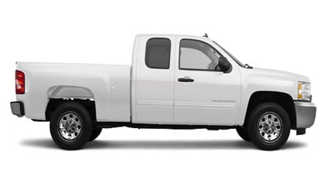
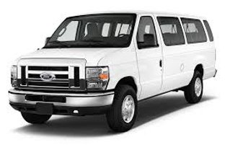
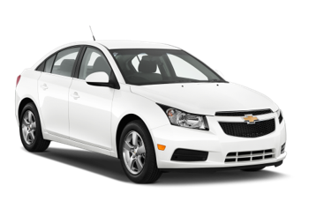
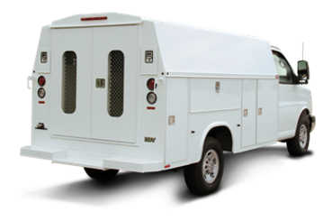
Does optimization save money?
~$4,500annually​
~$5,500annually​
Well, yeah.
The meter is always running, whether or not you are deriving value from the assets.
Underutilized vehicles aren’t just dead weight, they’re robbing you of opportunities to invest in other areas.
~$4,000annually​
~$7,500annually​

Slide 5
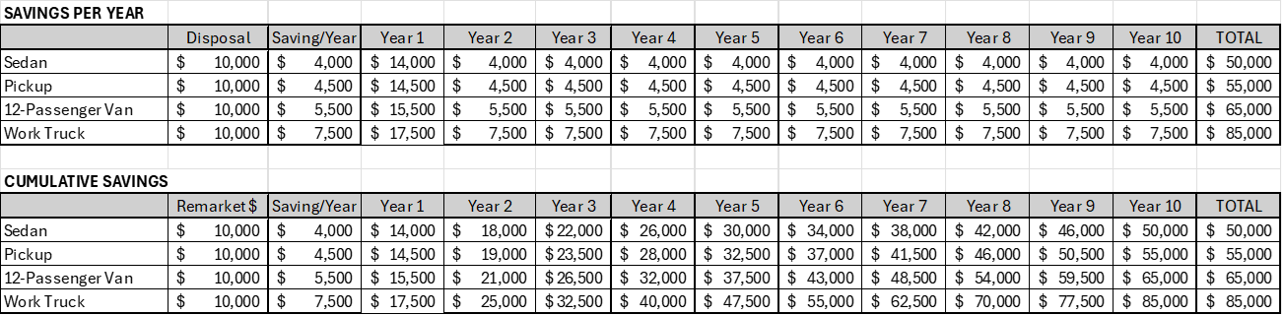
The gift that keeps on giving

Slide 6
Other right-sizing Benefits
Fewer parking spots​
Lower administration costs​
Fewer parts & maintenance-related costs​
Lower insurance​
The ability to update the fleet using remarketing funds

Slide 7
Why think like a marketer?
Fleet managers achieve real savings and efficiencies, but often only the numbers are shared.
To gain organizational support, you must communicate impact like a marketer.
Marketers know:
Audience – Who needs to hear this?
Message – What’s the key takeaway?
Presentation – How do you make it stick?

Slide 8
Know your audience
Executives & Leadership – care about cost savings, risk reduction, ROI.
Department Heads – want operational efficiency and fairness in allocation.
Employees & Drivers – focus on convenience, reliability, and fairness.
Taxpayers / Stakeholders (if public) – value accountability and stewardship.
Tailor your story to what matters most to them.

Slide 9
Crafting your message
Translate metrics into meaning:
“Reduced fleet size by 12%” → “We freed $500K for other strategic initiatives.”
“Cut admin time by 20%” → “Staff can now focus on higher-value projects.”
Emphasize benefits, not just numbers:
Cost savings = smarter resource use
Right-sizing = environmental, risk, and fiscal responsibility
Efficiency = improved employee satisfaction

Slide 10
How are you reporting on Your successes?
How frequently, and to whom?
What does your reporting look like? PowerPoint? Spreadsheets? Documents?
How long does it take you to prepare the data?
Do you have resources to help with reporting?

Slide 11
AI is your friend
Reporting & visibility doesn’t have to be hard.

Slide 12
Bear in mind…
If you’re not the customer, you’re the product.
If you use a ”free” version of any AI product, your data is training the AI and is then “out there” for other users of the product.
Subscriptions are cheap. Your organization may already have CoPilot, and ChatGPT Teams environments are about $30/mo.
These environments are closed and carry the benefit of being trainable. Training your AI with your data, goals, materials, audiences, etc., makes the chats much more productive and beneficial.

Slide 13

Plain slide
Market expansion
Product innovation
Customer retention
Operational efficiency

Slide 14
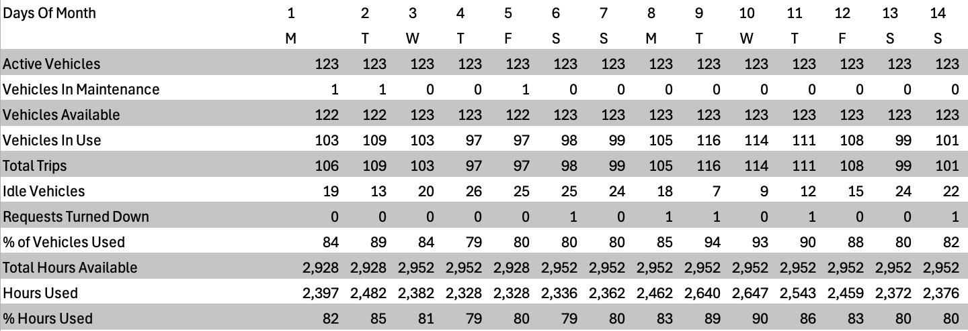
How can AI help? – an example
Four reports, directly from FleetCommander
Motor Pool Utilization Report
MPU by Asset Type Report
Statistics Summary Report
Vehicle Usage Report

Slide 15
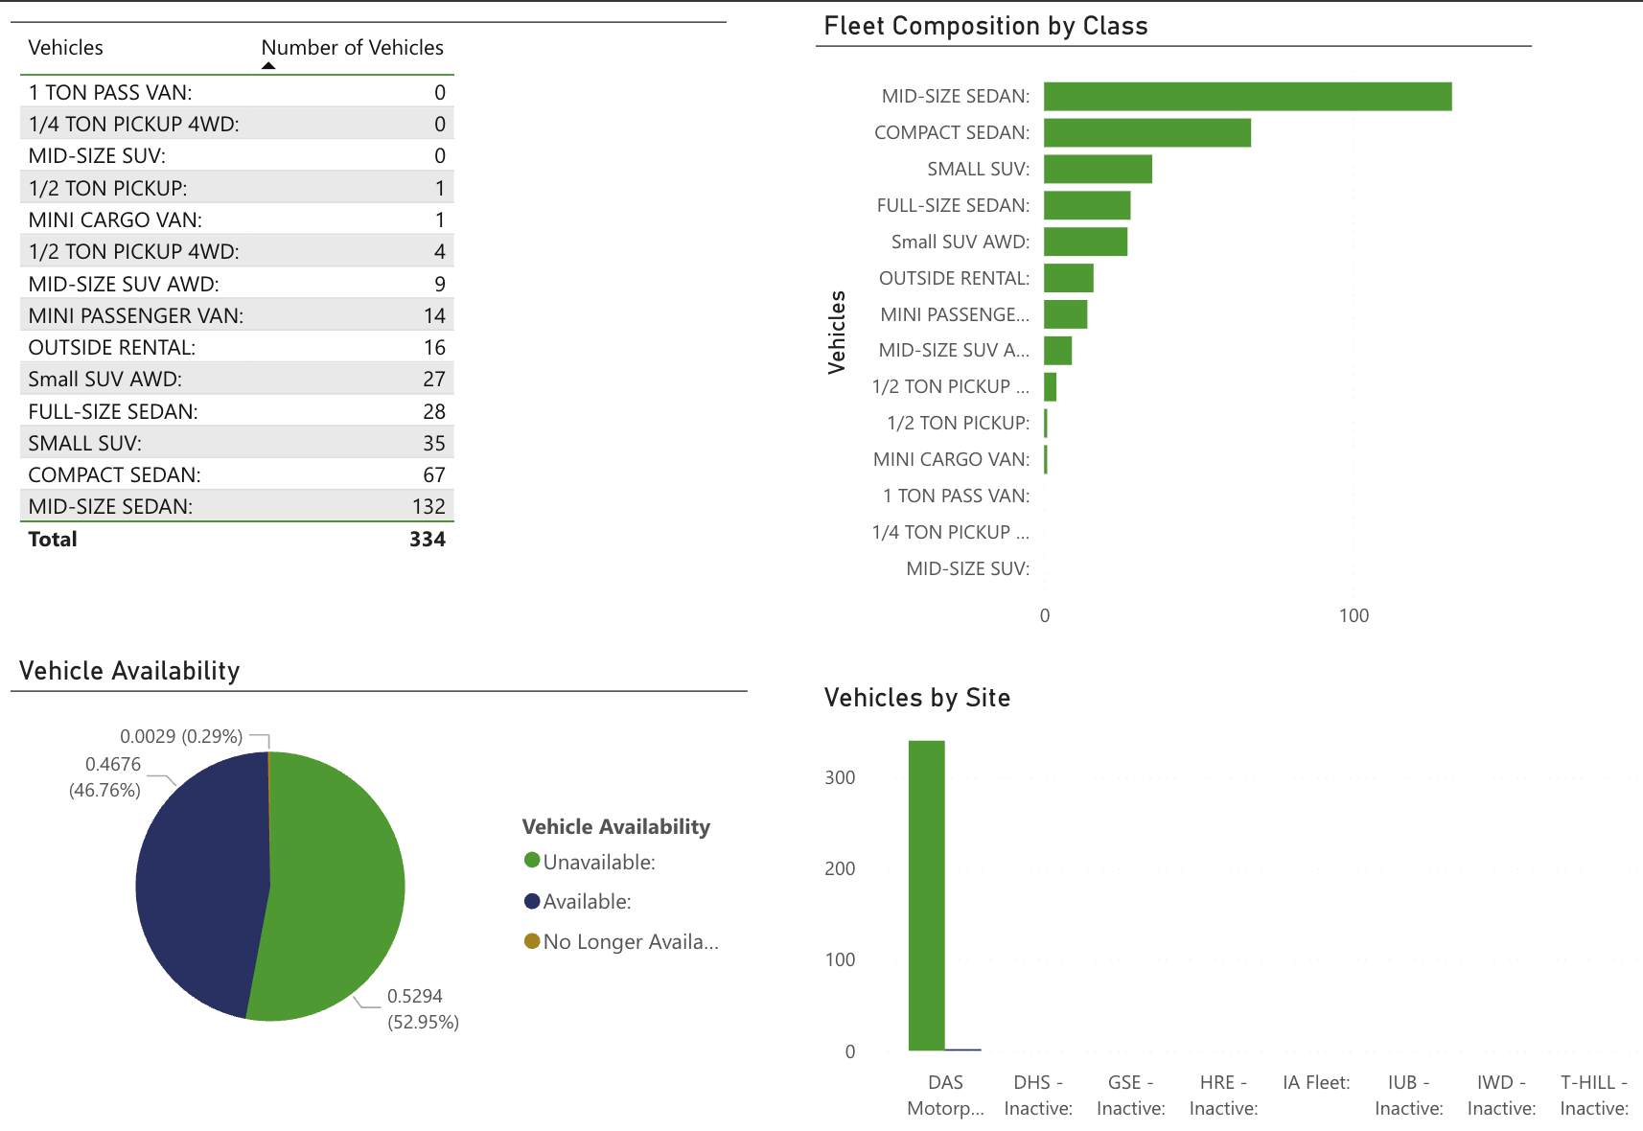
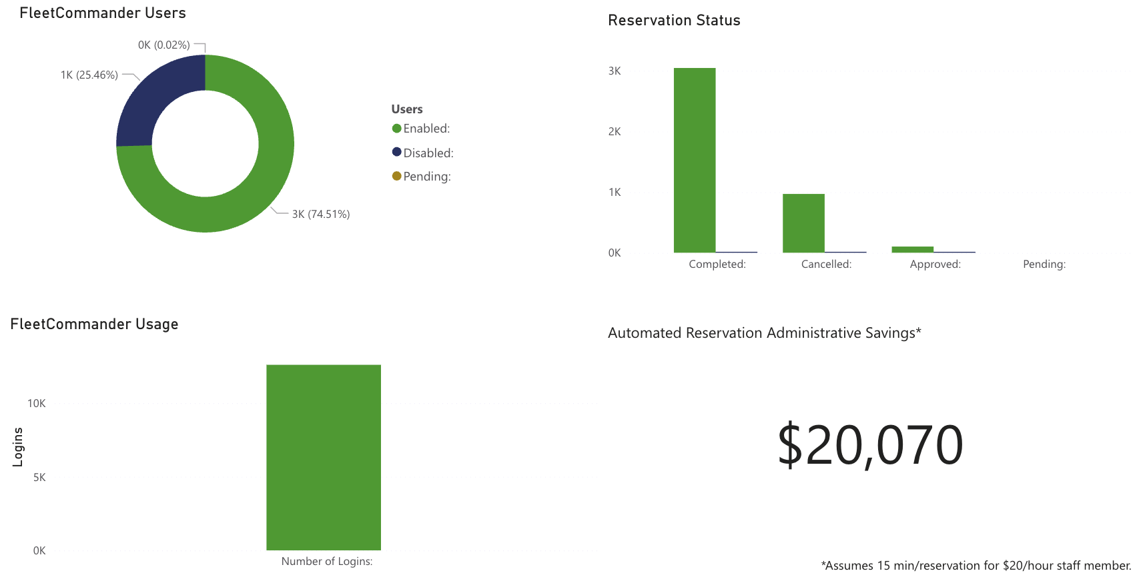
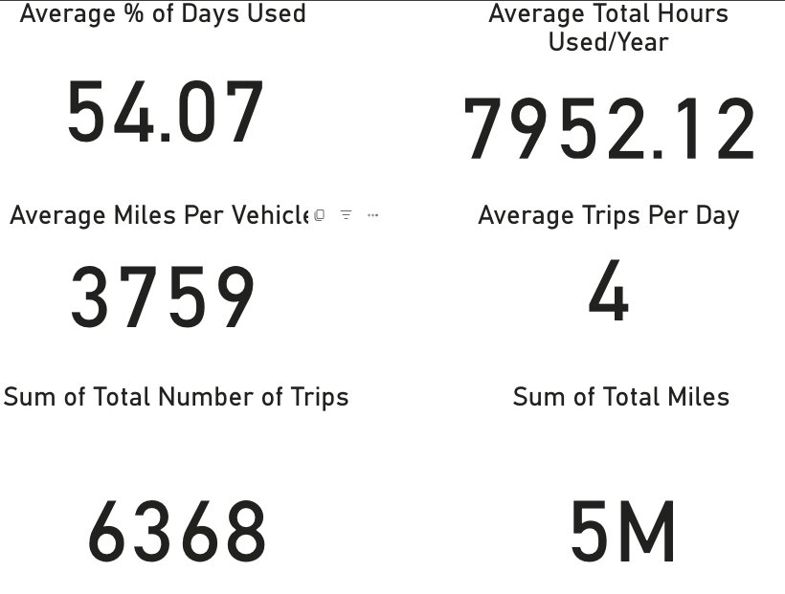
How can AI help? – dashboards

Slide 16
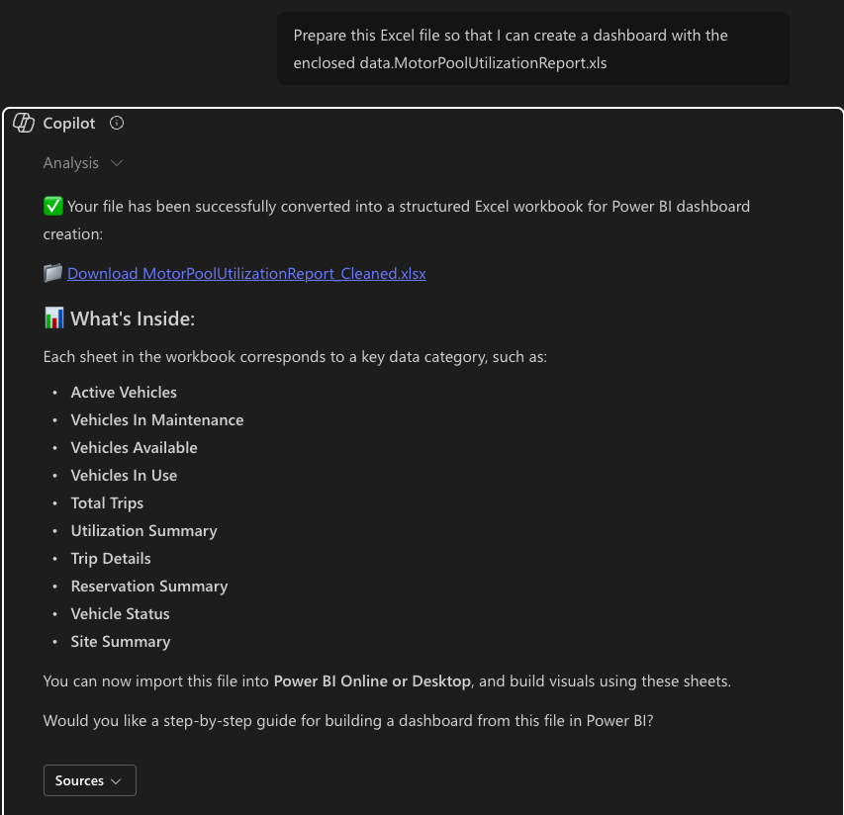

Executive summary dashboard
Ingests the report
Cleans and applies tables
Suggests dashboard elements

Slide 17
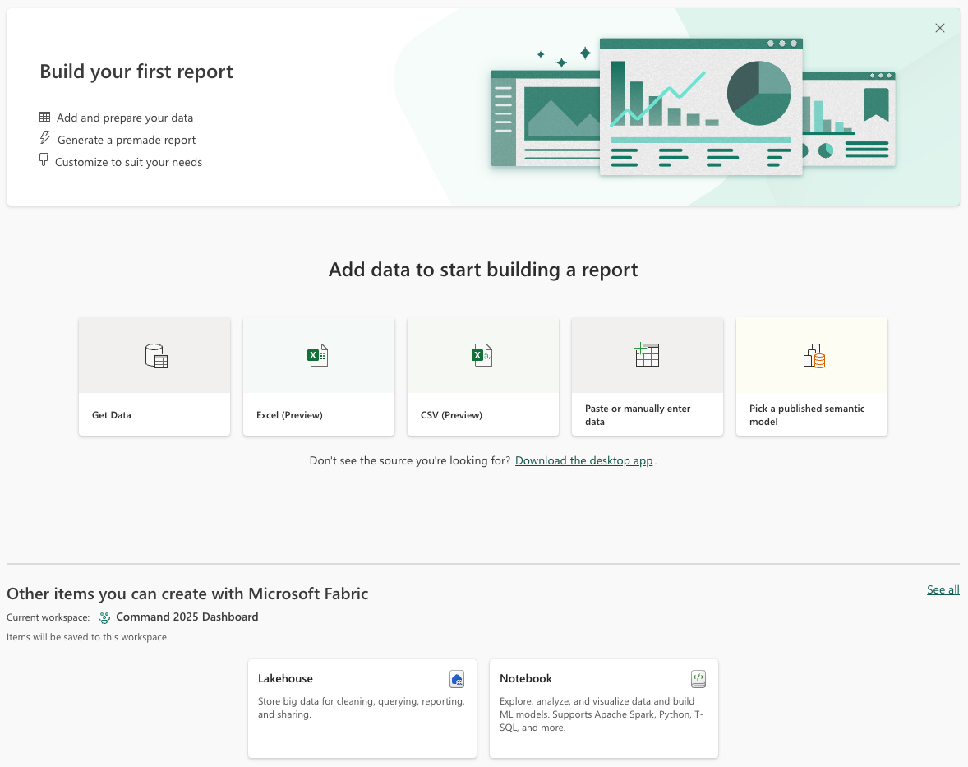
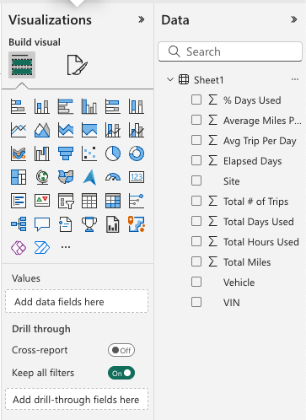

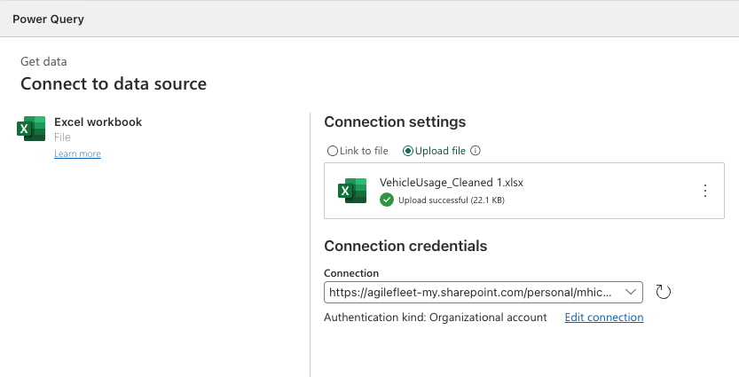
Executive summary - dashboard
Upload the cleaned report
Select the data to be displayed (checkboxes)
Add cards with charts
Tweak and filter, as needed
15 minutes for a beginner

Slide 18
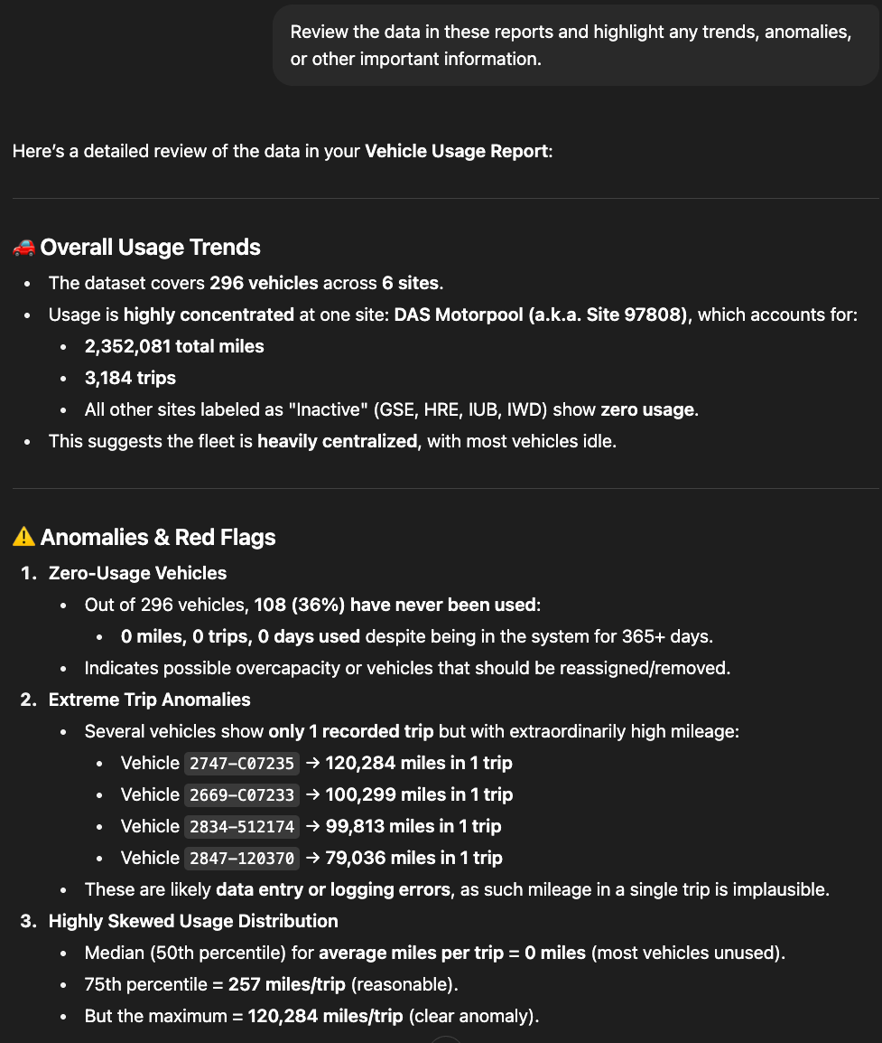

Interpreting data
Upload the cleaned report
Prompt for trends, anomalies, and other important info
Quickly spot bad data
Might catch hidden trends
Quickly writes bullets for operational reporting

Slide 19
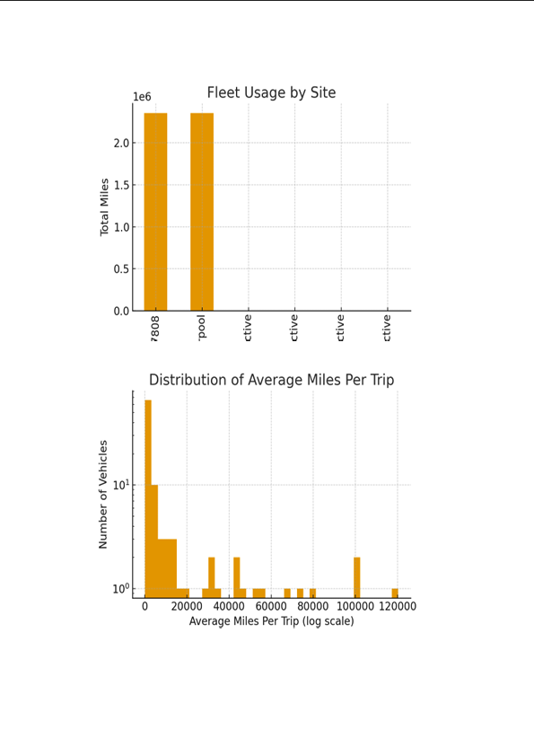
Reporting data
Prompt to create charts, summaries, bullets, etc.
Download as PPT, PDF, Excel, etc.
Be warned that ChatGPT is bad at graphics.
For large datasets, you may have to upload data in pieces

Slide 20
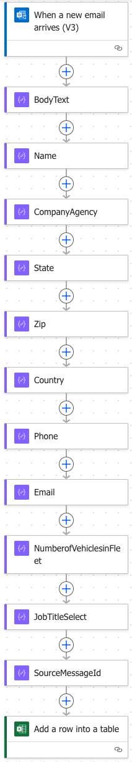


Advanced maneuvers
Automate dashboard maintenance
Simply drop new reports into a folder
Use Copilot to create Power Automate routines to do the rest
Collect and store data coming through email
Trend data over time

Slide 21
How about you?
Anyone doing anything cool with AI that they want to brag on?

Slide 22

KPIs & Measures
Telling the story with compelling evidence

Slide 23
claiming assigned vehicles for the motor Pool
Utilization Rate (%)
% of days/hours the vehicle is in use versus idle.
Annual Mileage (miles/year)
Compare against a minimum benchmark (e.g., 7,000–10,000 miles/year for light-duty vehicles).
Cost per Mile ($/mile)
Operating cost divided by miles driven; highlights inefficiency in underutilized vehicles.
Idle Vehicle Percentage (%)
% of assigned vehicles that sit unused during business hours or over a defined period.
Fleet-to-Demand Ratio
Vehicles available vs. actual booking requests or trip demand.

Slide 24
claiming assigned vehicles for the motor Pool
Utilization Rate "Many assigned vehicles are used less than 20% of the time — sitting idle most workdays while still incurring full costs."
Annual Mileage "Several vehicles log only 3,000–4,000 miles/year, well below the 7,000–10,000 industry benchmark for efficient use."
Cost per Mile "Low utilization drives cost per mile nearly twice that of pooled vehicles — meaning we’re paying more for less value."
Idle Vehicle Percentage "30–40% of assigned vehicles sit unused at any given time, while other employees face shortages in the motor pool."
Fleet-to-Demand Ratio "Shifting low-use vehicles to the pool aligns supply with demand, increasing flexibility and fairness across departments."

Slide 25
takeaways
1. Translate Evidence Into Impact
Show outcomes (ROI, fairness, reliability), not just numbers.
2. Tell the Story Consistently
Tailor right-sizing progress to each audience to build support.
3. Use AI to Simplify Reporting
AI streamlines dashboards and summaries, making communication f aster and more compelling.

Slide 26

Thank you
Michael Hicks
mhicks@agilefleet.com

