Slide 1


Welcome to command 2025
New Horizons, New Features

Slide 2

Agenda
Product Launch
v6.00 Highlights
v6.01 Highlights
v6.02 and Beyond

Slide 3

Product LAUNCH
Navigating the future

Slide 4
Product launch
Released
v5.13
Complete
v6.00
In Development
v6.01
Scope Locked
v6.02
v5.13 concludes the .NET upgrade.
v6.00: FAST and Account Validation, Drag & Drop
v6.01: Maintenance, TCO
v6.02: UI Phase 1, Maintenance, Reporting Phase 1

Slide 5
Product launch
Released
v5.13
Complete
v6.00
In Development
v6.01
Scope Locked
v6.02
v6.00: FAST and Account Validation, Drag & Drop
Scheduled to start rolling
out the week of
October 20.

Slide 6
v6.00 highlights
Themes: FAST Reports, Account Validation, Drag & Drop

Slide 7
FAST Reports
FAST = Federal Automotive Statistical Tool
Covers federal fleet reporting requirements.
We keep up with requirements which change yearly.
We have added a new projections report which was introduced since our original implementation, as well as the data collection to support it.

Slide 8
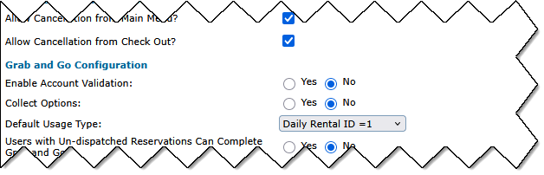
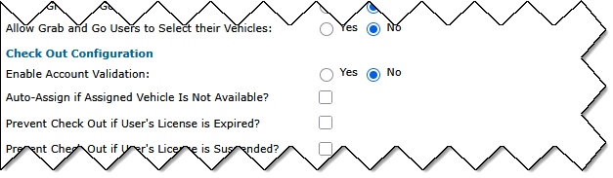

Kiosk Account validation
Enable/disable Account validation for each kiosk.
Enable/disable Account validation separately for Grab and Go, Check Out, and Check In (per kiosk).

Slide 9
accounts on work orders
Previous State: When changing the Contact selected on a work order, both Department and Account would be overwritten with the new contact info.
New State: If your Enterprise is configured to populate the Work Order Account from the Asset Profile, there will be no attempt to overwrite the Account when the Contact selection is changed.

Slide 10
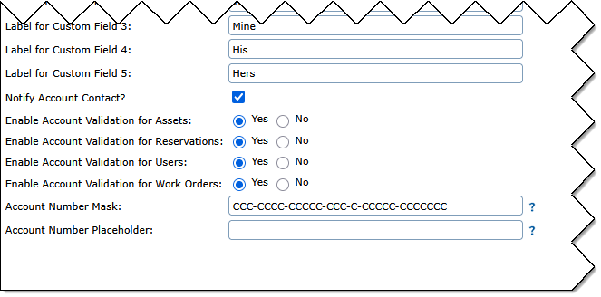
account configuration: enterprise
Previous State: Account validation had to be enabled/disabled for assets, reservations and users all at once.
New State: Account validation can be enabled/disabled independently.
Account masks and placeholders can also be configured. (Contact Support.)

Slide 11
Consistent account validation
Previous State: When Account validation was enabled, a blank Account was treated as invalid on some interfaces, but not others.
New State: Account validation is entirely independent of required field configuration. A blank Account will only be rejected if the field is configured to be required.

Slide 12
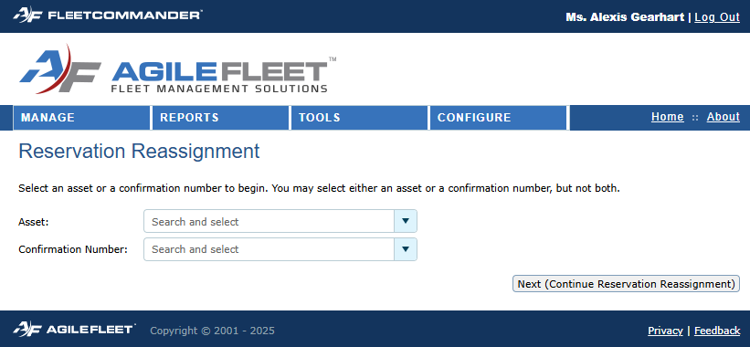
drag and drop reassignment
Phase 1 Use Case: One of your vehicles had a significant incident and needs to be taken out of the pool for a couple of weeks for repair.
You need to reschedule all the upcoming reservations.
Drag and Drop will make it easy with fewer clicks than the "Change Vehicle" feature.

Slide 13
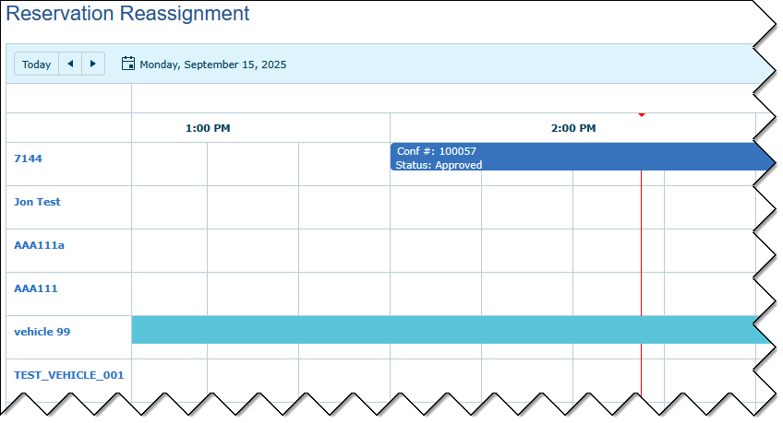
drag and drop reassignment
Start with an asset or the confirmation number for an upcoming reservation.
The related vehicle will remain pinned to the top, even if you change your filter set.
This will make it easy to find a different vehicle, even if you need to switch to a different site.

Slide 14
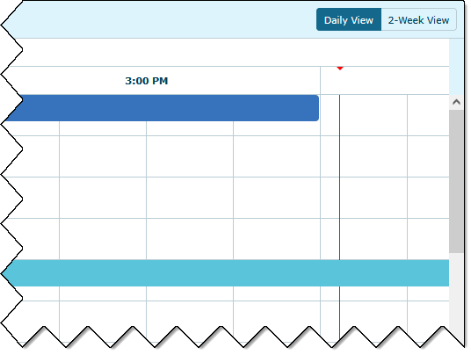
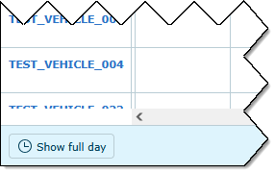
drag and drop reassignment
Toggle between daily view and a two-week view.
A vertical line shows your current time.
Daily view starts at 7 am. A "Show full day" button will show all 24 hours.

Slide 15
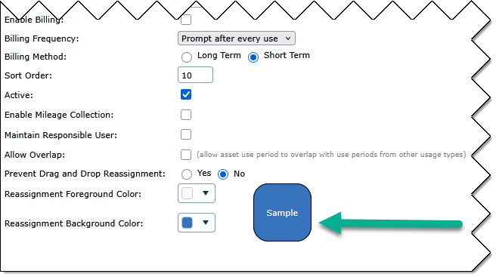
drag and drop reassignment
Color code your usage types.
Pick a background color and a text color on the usage type configuration screen.
Expect to see this color coding show up in more places in the future!

Slide 16
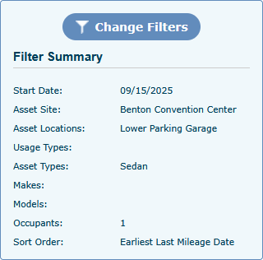
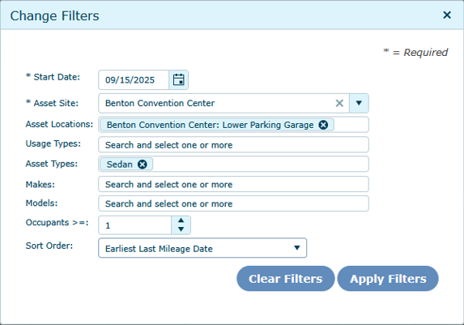
drag and drop reassignment
Refine your filter set to find the best match for your reassignment.
Filters which support multiple selections are also searchable.
Refine the sort order. Vehicles with the most availability should also appear near the top of your preferred sort.

Slide 17
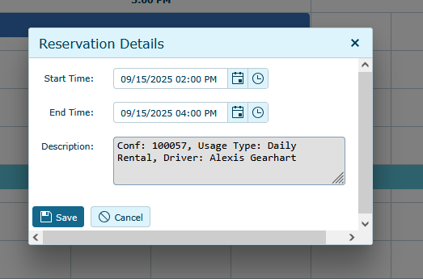
drag and drop reassignment
Double-click the reservation to adjust the start and end time, if needed.
For example, if you needed to shorten the reservation by 15 minutes to fit it in, this short form makes it quick and easy.

Slide 18
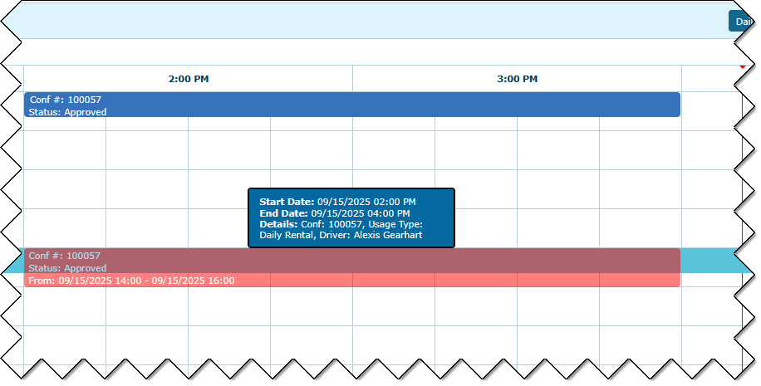
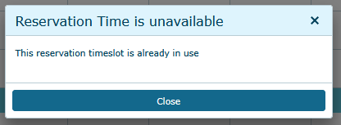
drag and drop reassignment
Basic reservation information is visible when hovering over a reservation.
Get instant feedback when you can't drop your reservation into a timeslot.

Slide 19
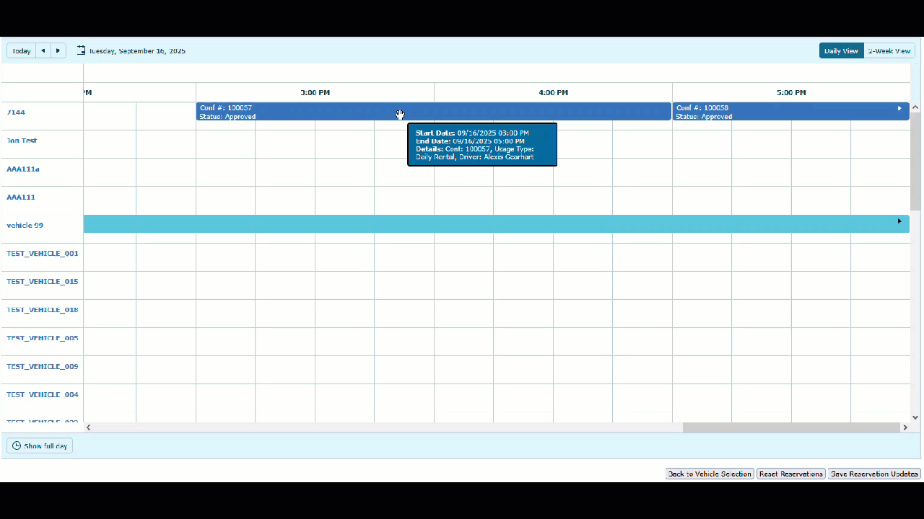
drag and drop reassignment
Drag and drop multiple reservations at a time before committing your changes.
Reset your changes or save all updates at once.
"Change Vehicle" confirmation emails are sent for each reservation.
Avoid sending multiple emails until you're ready to commit your changes.

Slide 20
Drag and drop reassignment
Other highlights:
  New setting to enable/disable admin email notifications by site.
    The standard change request email will be sent.
  Additional phases of functionality will be coming in upcoming releases.
  Don't forget to send us your feedback!
  We'd like to hear about additional use cases, additional filters you need, or anything which would make this feature more useful.

Slide 21

samsara gps integration
Events which trigger mileage include ignition off and enter/leave geofence.
Data will include state of charge, engine hours, and fuel for supported vehicles.
  To be added to reports in a later phase.
Available now! No need to wait for an upcoming release if you would like to integrate with Samsara.

Slide 22
v6.01 highlights
Themes: Maintenance, TCO

Slide 23
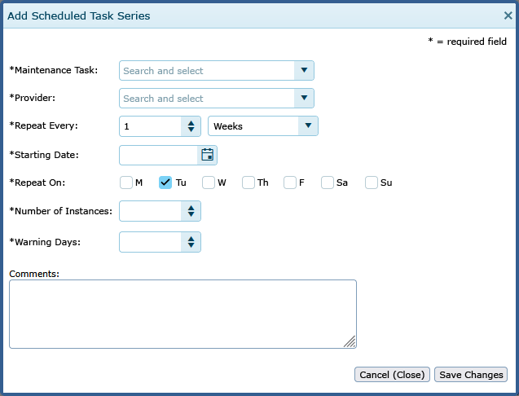
scheduled task enhancements
Creating a scheduled task series will be closer to setting up recurring events in an Outlook calendar.
  Existing data will be automatically transitioned.
Scheduled task series will be editable, even if some instances in the series have been completed.

Slide 24
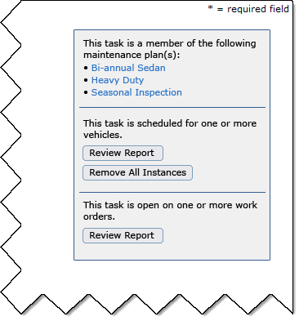
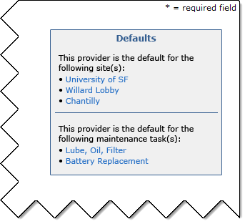
deactivating tasks, default providers
Better communication to understand the impact of deactivating tasks and default providers.
Information and links provided to review relationships and remove them.

Slide 25
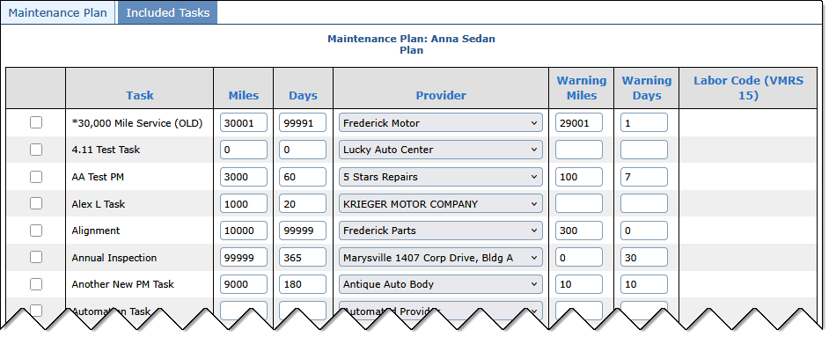
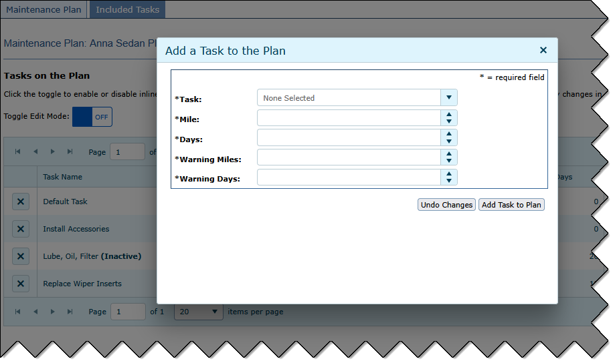
easier maintenance plan set-up
Only the tasks on the plan appear in a grid.
Add a task to the plan in a window with a short form.
Fewer fields on screen, better performance when many tasks are in the system.

Slide 26
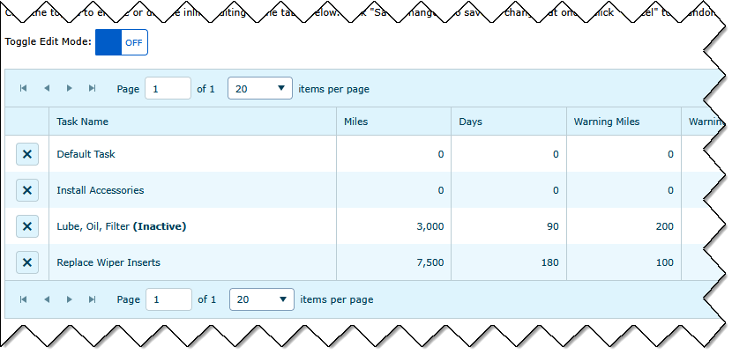
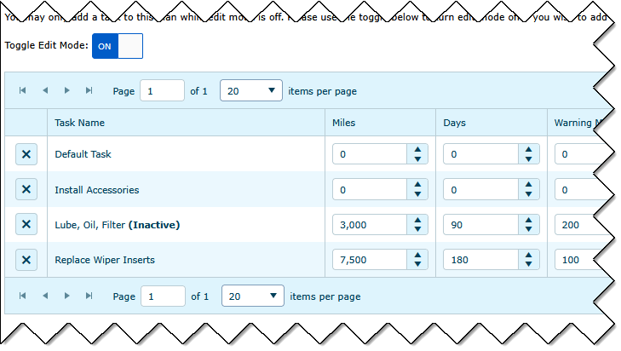
easier maintenance plan set-up
Switch "edit mode" toggle to on position to edit multiple fields at a time.
Even if you don't use maintenance, these types of changes reflect the future of FleetCommander:
  More modern controls.
  Fewer clicks, easier to use.

Slide 27
Work order enhancements
Configurable work order status reasons.
Status + reason work together to provide more detail.
  On hold: Waiting on estimate.
  On hold: Waiting on parts.
Parts history link in work order header.
Search for assets by VIN (in addition to name and license number).
Odometer validation on the work order.
  Odometer threshold configured by site.

Slide 28
new maintenance reports
Maintenance History Report
  See a list of all work performed in history.
  Report by Date, Plan, Task, Site, Provider, Asset, Asset Type, Year, Make, Model, and more.
Overhauled Maintenance Schedule Report
  See all upcoming work in a tabular format, not forced into "printer friendly" format.
  Filters similar to Maint. History.
  Available in HTML or Excel, not only HTML.
  Also replaces Maintenance Due Summary Report by filter offered to only show
  "Near Due/Due" tasks.

Slide 29
TCO enhancements
New Manage TCO interface.
  Delete unposted transactions, multiples at one time.
  Toggle to enable editing of multiple records for some common data points.
Posting Tool option to post all unposted transactions via one click.
Posted filter added to TCO Expense Summary Report.
License plate number added to TCO Data Dump Report.
Missing timestamp added for TCO transactions on Asset Profile.

Slide 30
API ENHANCMENTS
New endpoints to add, edit, and get users in batches.
Makes integrations with HR systems more efficient.
Particularly mindful of security.
  Requires separate API account with an elevated permission.
  Data points returned in batches are limited to protect users.
  Batches are limited to 40 at a time.
More changes like this are coming in the future to support "data in" and "data out" of the system.
Contact your Client Success representative if interested.

Slide 31
v6.02 and beyond
Themes: Maintenance, Enhanced Reporting, UI

Slide 32
Maintenance
Automated notifications.
Multiple meters.
Multiple plans per vehicle.
  Set up/remove by year, make, model, asset type, etc.
Trouble tickets/sticky notes.
Configurable labor and reason codes.
Dedicated fields for Cause, Concern, Correction.
Defaults for Shop Supplies.

Slide 33
enhanced reporting
Start with a template.
Add and remove columns.
Set your filters.
Pick a format (HTML, CSV, Excel).
Pick a delivery mechanism (run it now, email every Monday at 8 AM, come back to pick it up later).
Save your report.
Multi-phased approach.
API enhancements coming, too!

Slide 34
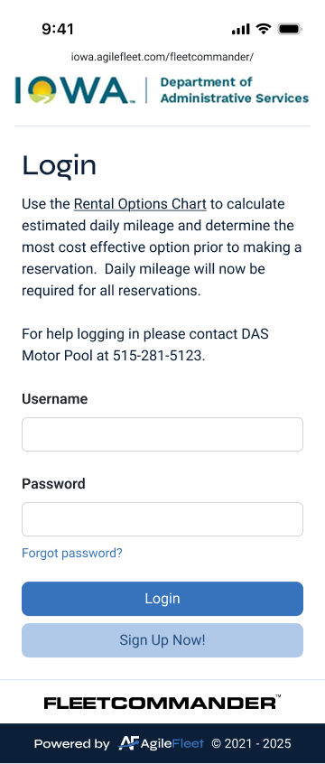
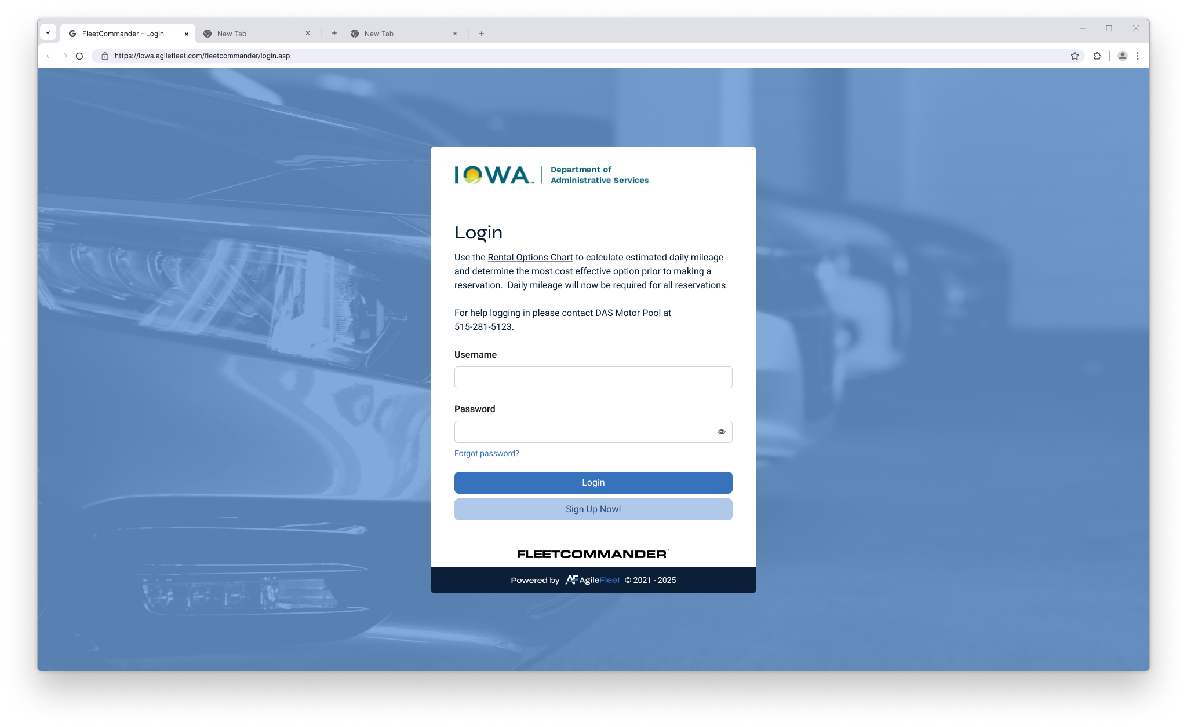
ui/ux eNHANCEMENTS
UI = user interface; UX = user experience
Phased approach. User side is Phase 1.
Accessibility (WCAG 2.2)
Usability, especially fewer clicks
Responsive: Gracefully adjusts to mobile, tablet, or desktop.
Note: Any automated tools (bots) may break.

Slide 35
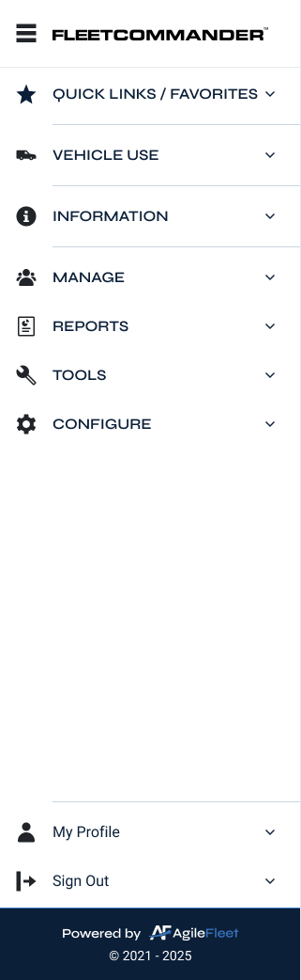
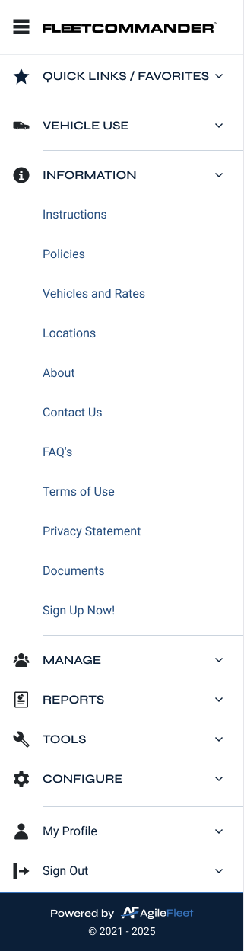
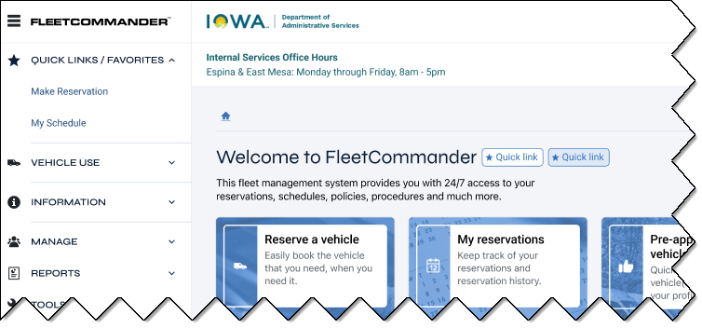
ui/ux eNHANCEMENTS
Left navigation will persist across the entire application (after all phases).
It will include the user-side and admin-side links.
Add a quick link/favorite from any page with the click of a button near the title.

Slide 36
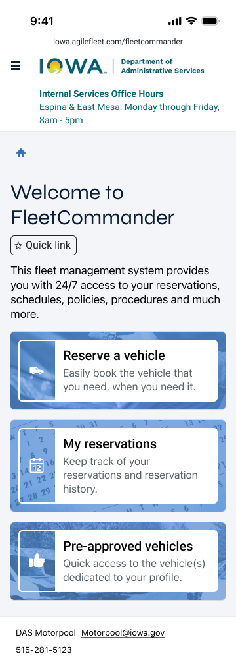
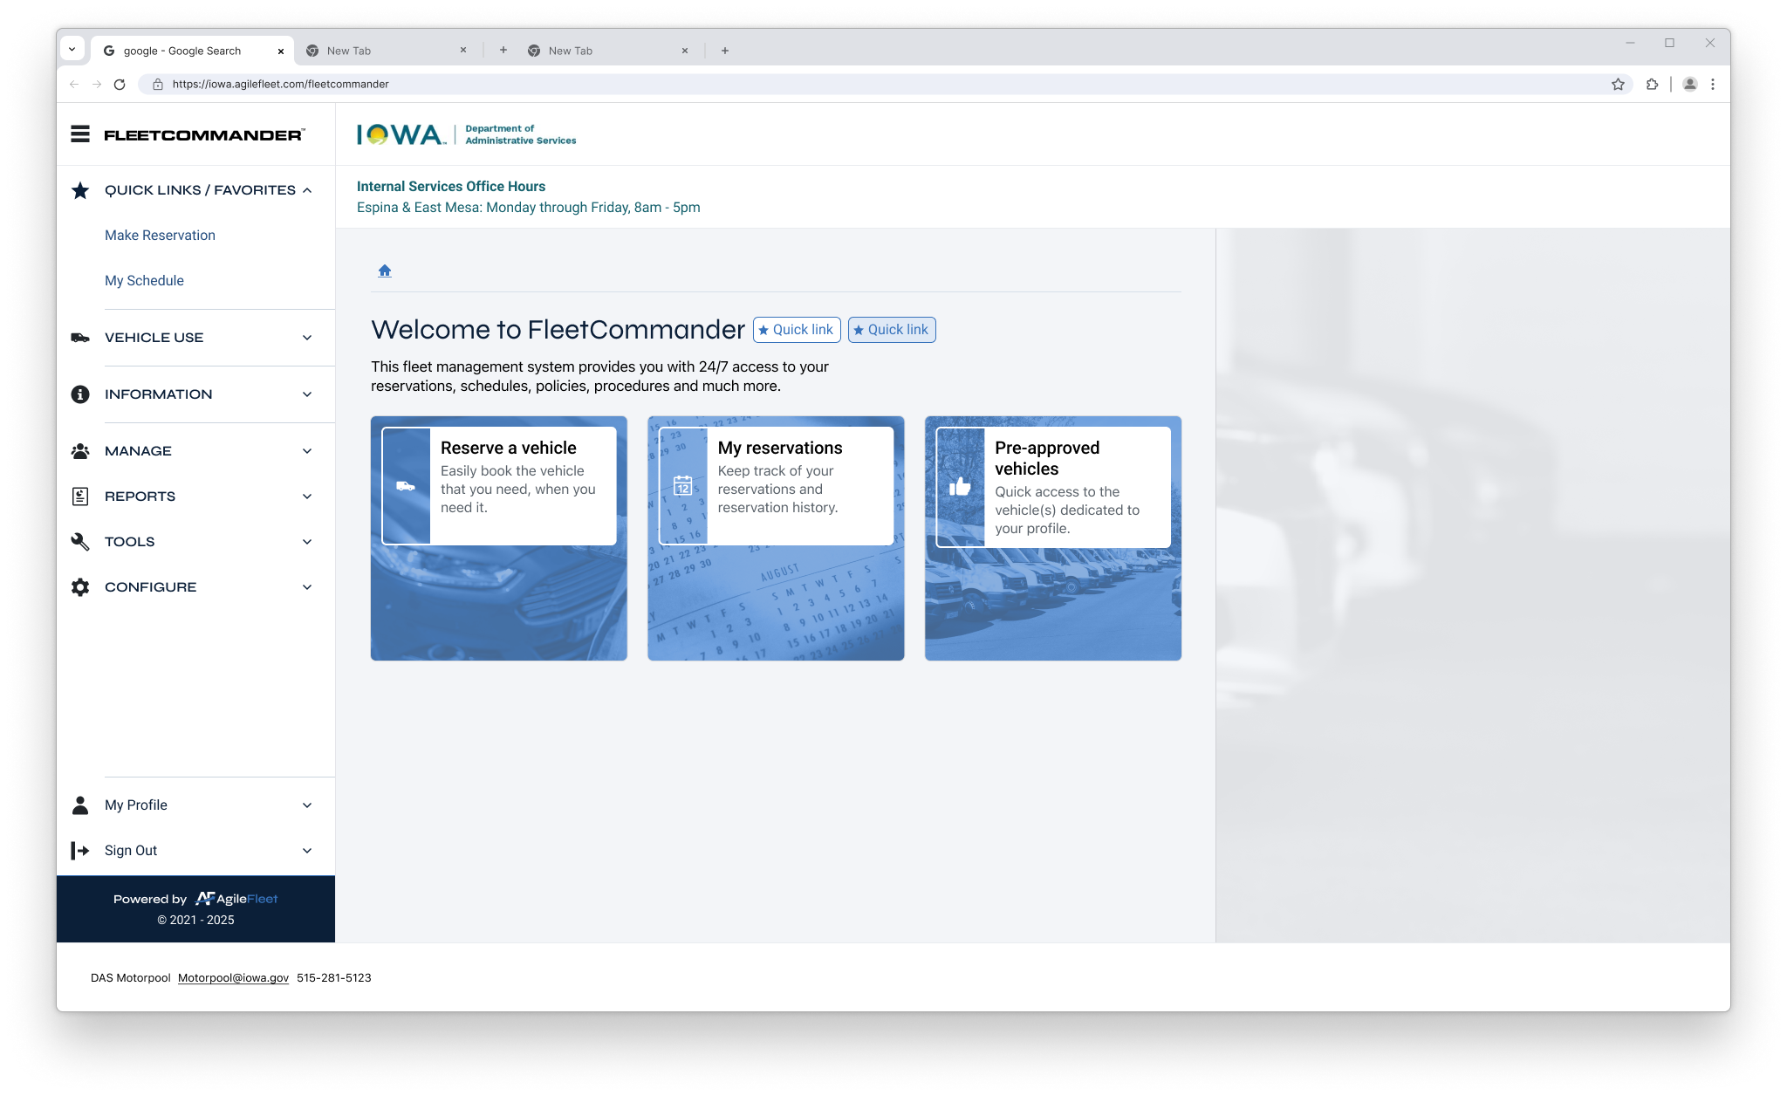
ui/ux eNHANCEMENTS
Logos which are oriented horizontally will work best on a small mobile screen.
  Seals and round logos may be difficult to read.
Your customizable text and/or headers and footers may need some TLC to conform to a responsive design.
Contact Support for assistance. These changes can be made in advance.

Slide 37
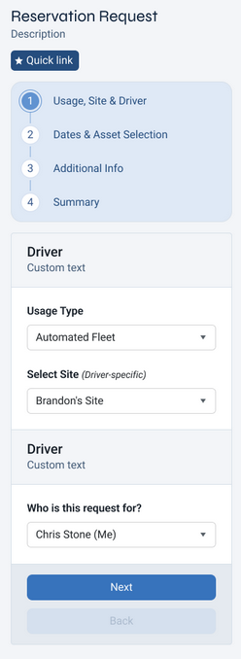
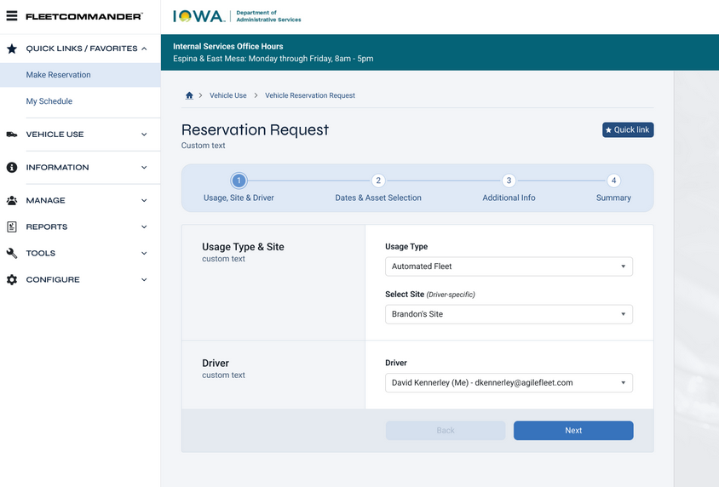
ui/ux eNHANCEMENTS
Make a reservation on your desktop, tablet, or mobile device.
The overall reservation functionality will be the same, but the workflow will be improved.

Slide 38
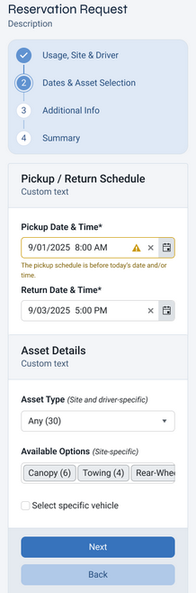
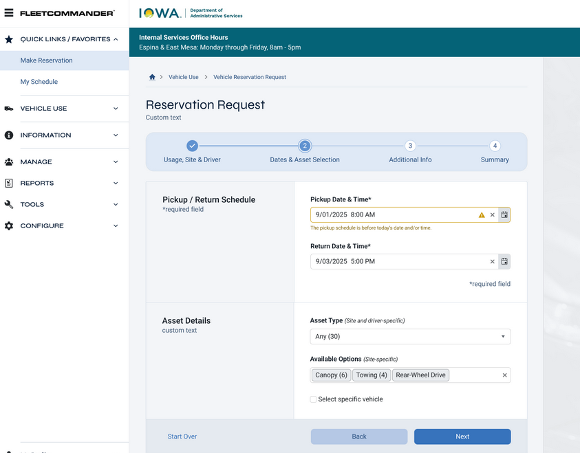
ui/ux eNHANCEMENTS
You'll get instant feedback on any invalid input, inline with the relevant field.
As you progress through the form, the fields downstream will be filtered to exclude unavailable selections.
The number of assets available for each selection will appear in parentheses.
Asset Type will be required (always).

Slide 39
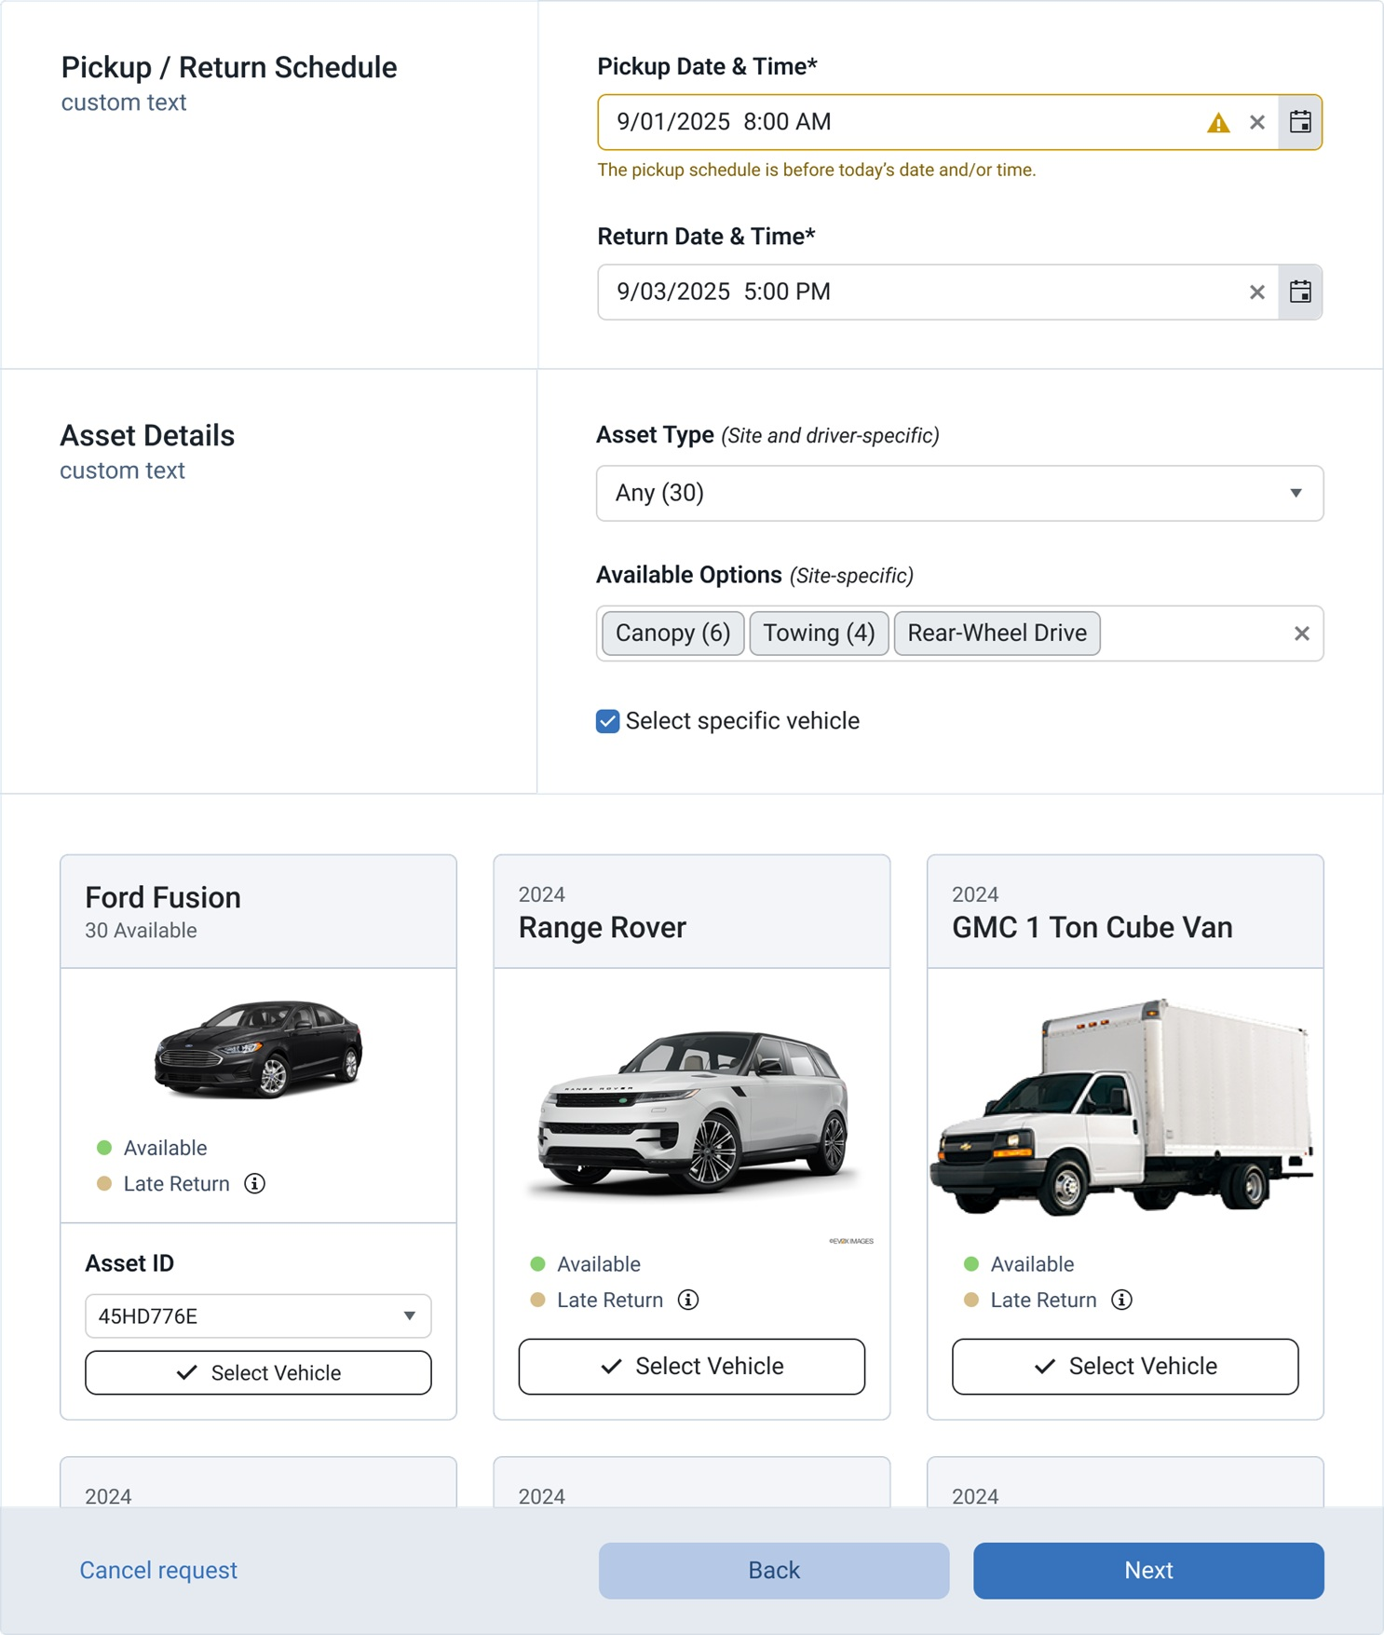
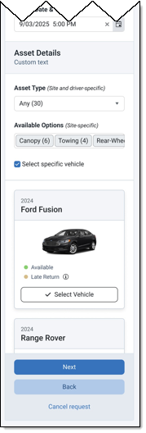
ui/ux eNHANCEMENTS
Viewing or selecting available vehicles will be a "card-based" view--similar to the screenshot pictured.
Only see vehicles which are available.
More visual appeal, simpler, easier than the current chart with green and red boxes.

Slide 40
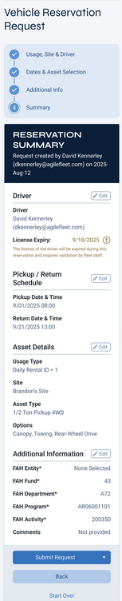
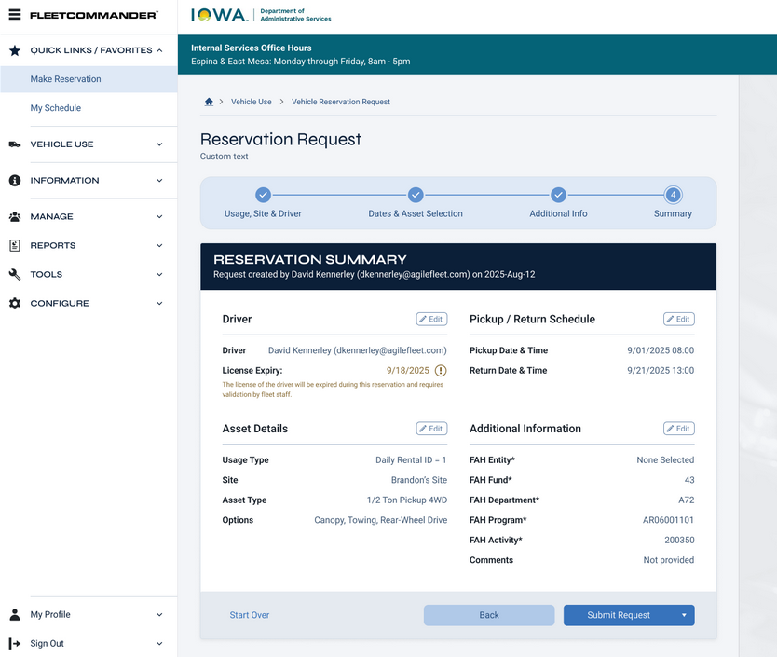
ui/ux eNHANCEMENTS
Quickly jump back to any section via the breadcrumb navigation or "Edit" buttons to make changes before submitting your reservation.
One submit button will offer all the choices you're accustomed to seeing: Submit, Submit and Make Similar, etc.

Slide 41
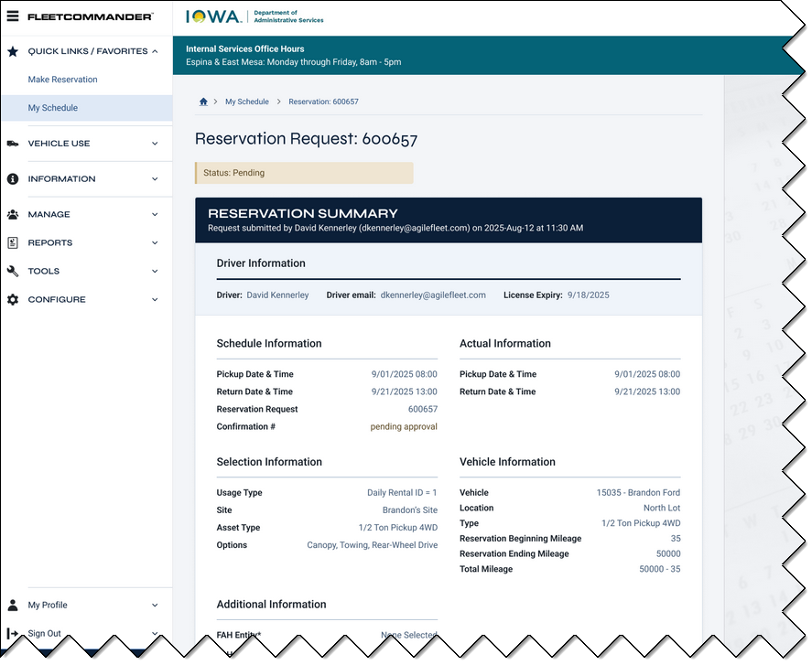
ui/ux eNHANCEMENTS
The reservation confirmation screen will include all of the same information you are accustomed to seeing.
It will be well-organized and easy to read across all of your devices.

Slide 42
the new horizon
Product Management and Client Success are collaborating to define and establish processes for better and more frequent communication.
  Upcoming Releases: What's included, what are the benefits?
  Product Gaps: What works, what doesn't work, what needs are not being met?
  Post-Release Follow-ups: Close the feedback loop. Now that the release is in your hands, what do you think?

Slide 43
the new horizon
The future of FleetCommander will be:
  More modern: We'll keep what works and update what doesn't work in the context of today's expectations for a modern web-based application.
  More configurable: Make personal choices about things like reports and dashboard KPIs and save your preferences.
  More flexible: We'll start phasing in support for bulk edits of common data points and build imports which allow any Excel file to be used as the data template.

Slide 44
the new horizon
The future of FleetCommander will be:
  More automated: From emails and reports which are automatically sent to long-term billing charges which are automatically generated on a recurring basis, expect to spend less time using manual tools.
  More integrated: We'll make it easier to integrate with our API through batching the data exchanged and allow more data out of the system through new reporting endpoints, putting more of your data directly into your hands.
  Thank you for a great 25 years. We're looking forward
  to the future!

Slide 45
Thank you!
Alexis Gearhart
agearhart@agilefleet.com

