Slide 1
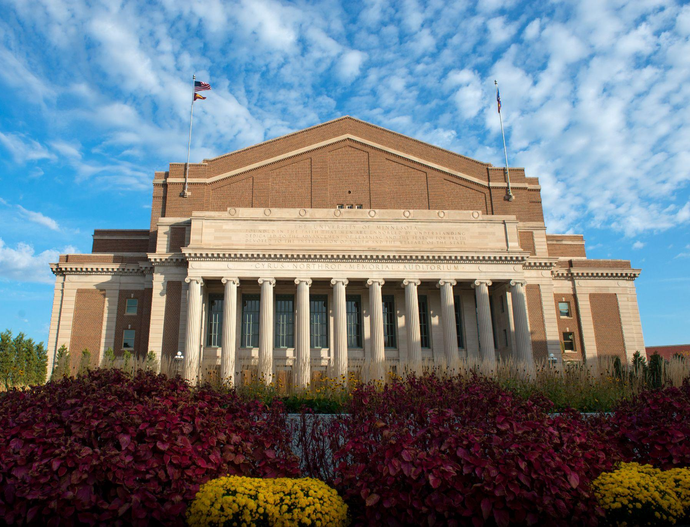
Welcome to the
UNIVERSITY OF MINNESOTA
FLEET SERVICES
COMMAND 2025

Slide 2

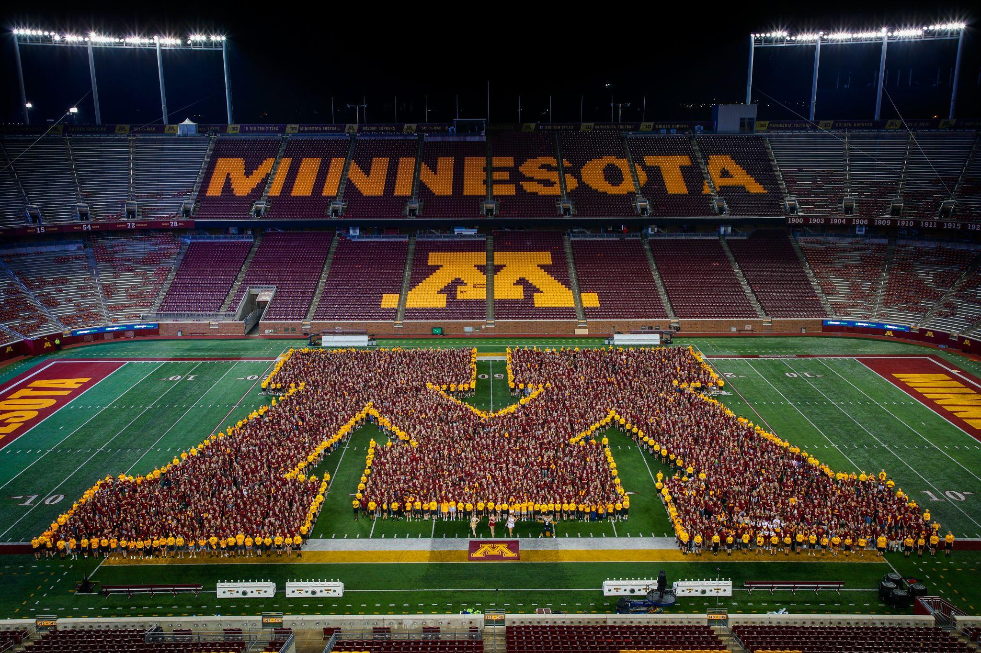
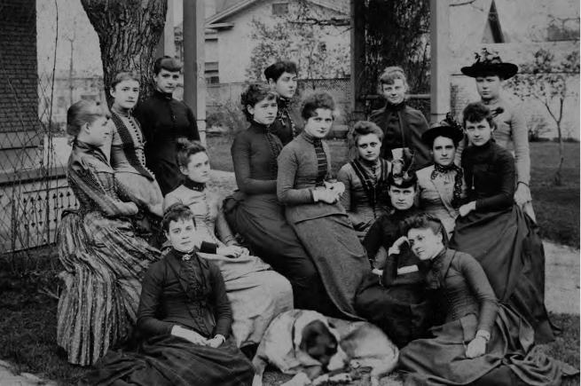
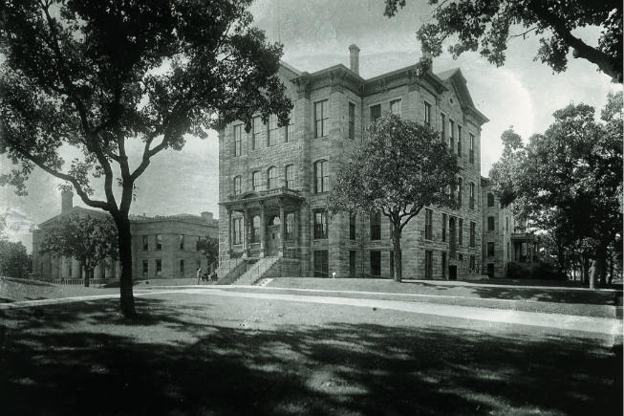
1851
The University of Minnesota was founded
1862
UMN became a land-grant university
1858
The state of Minnesota was founded
TODAY
UMN is home to about 50,000 students

Slide 3

Big Ten Conference

Slide 4
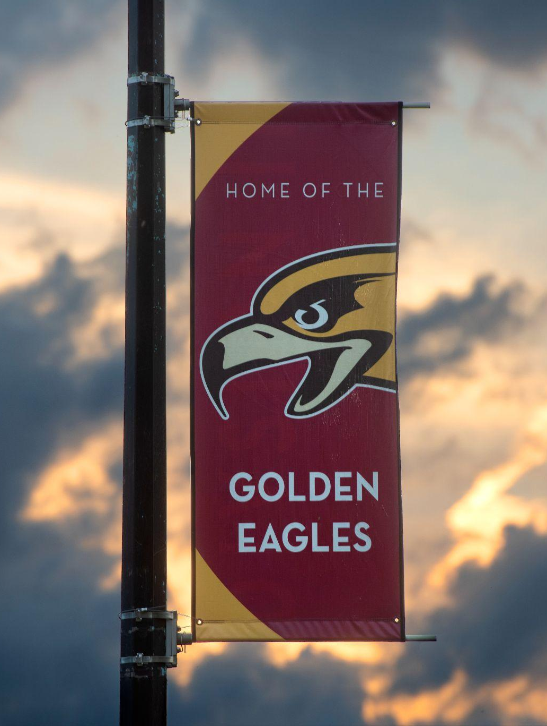
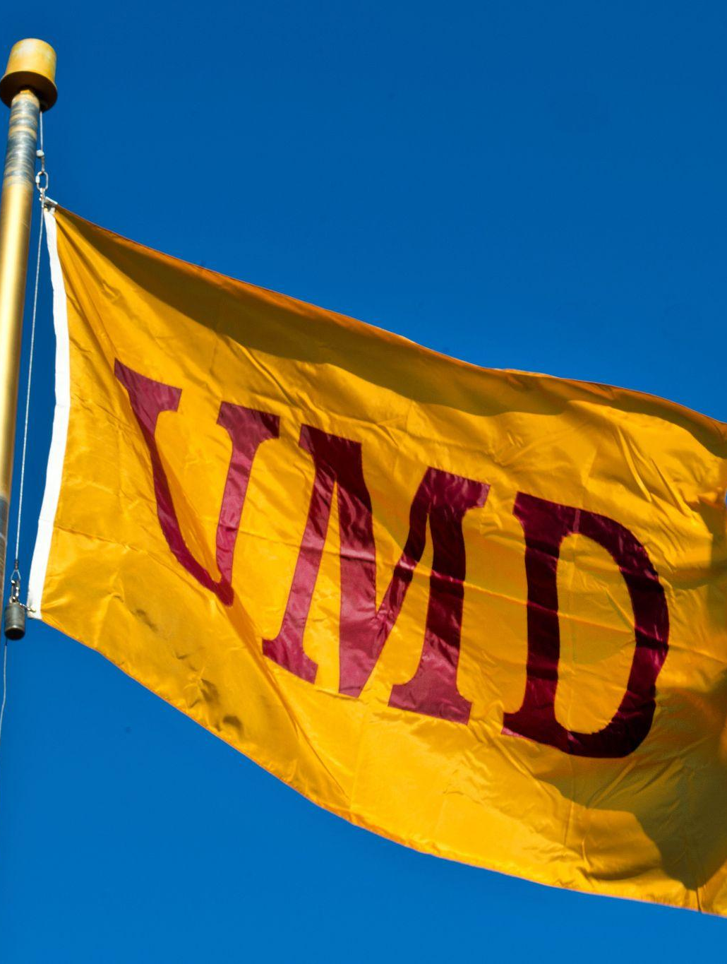
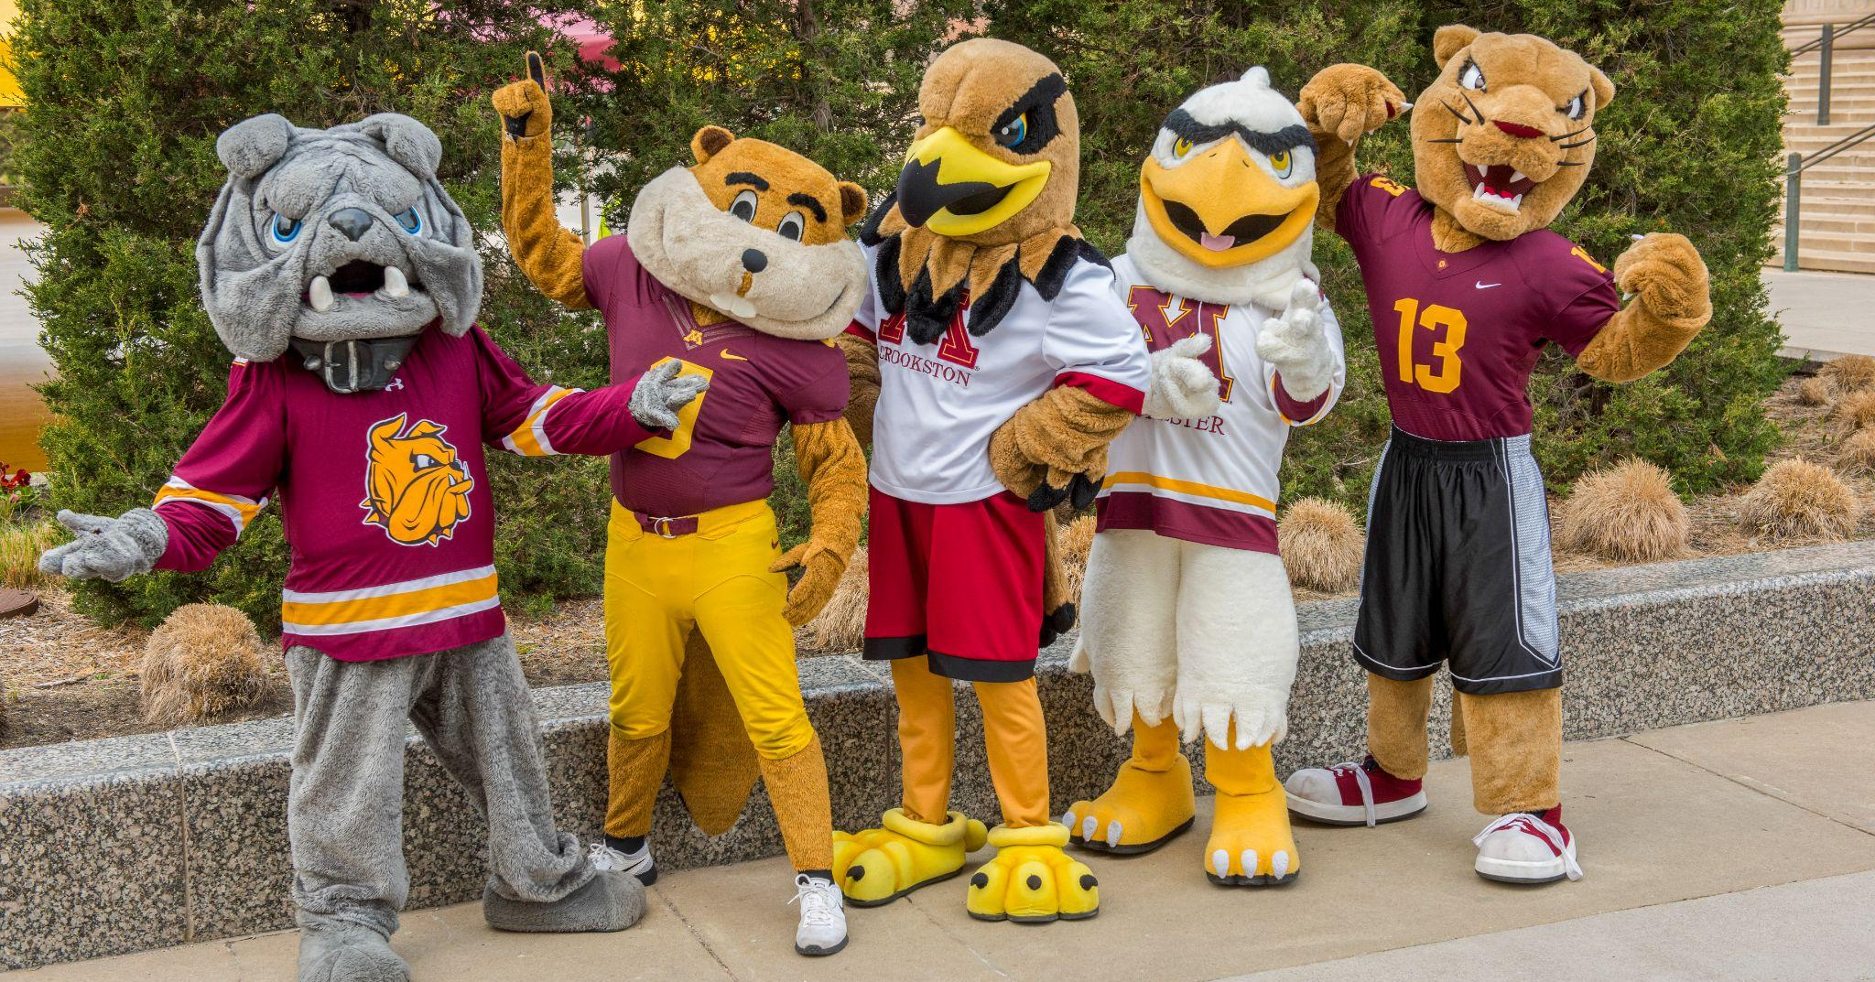
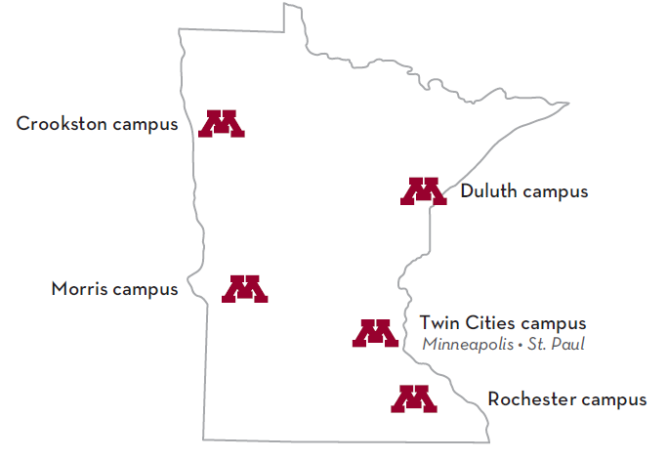
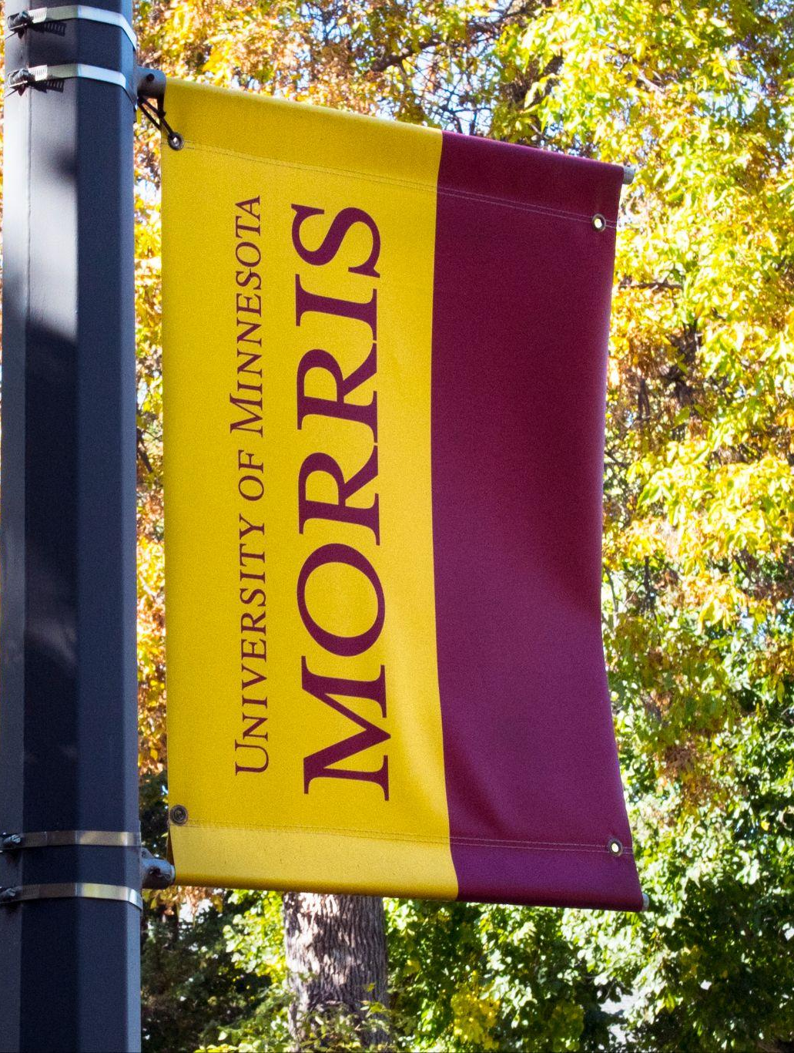
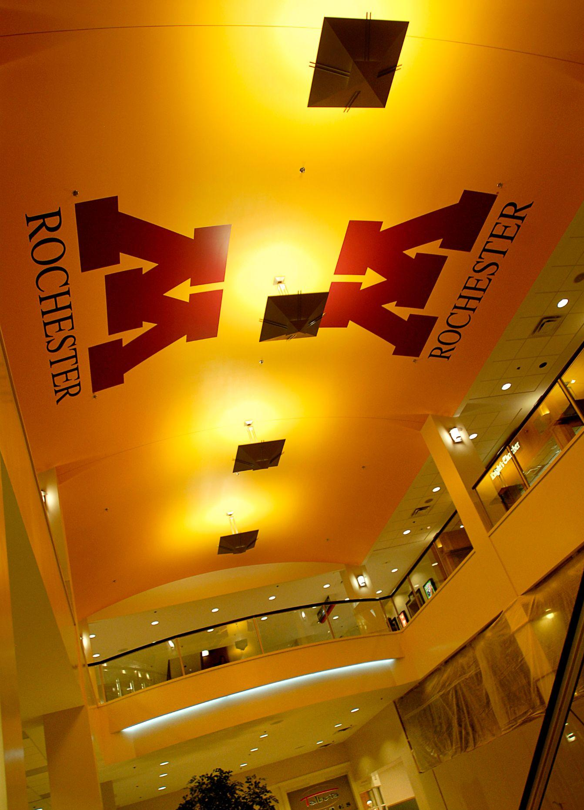
SYSTEM CAMPUSES
Crookston
Duluth
Morris
Rochester

Slide 5
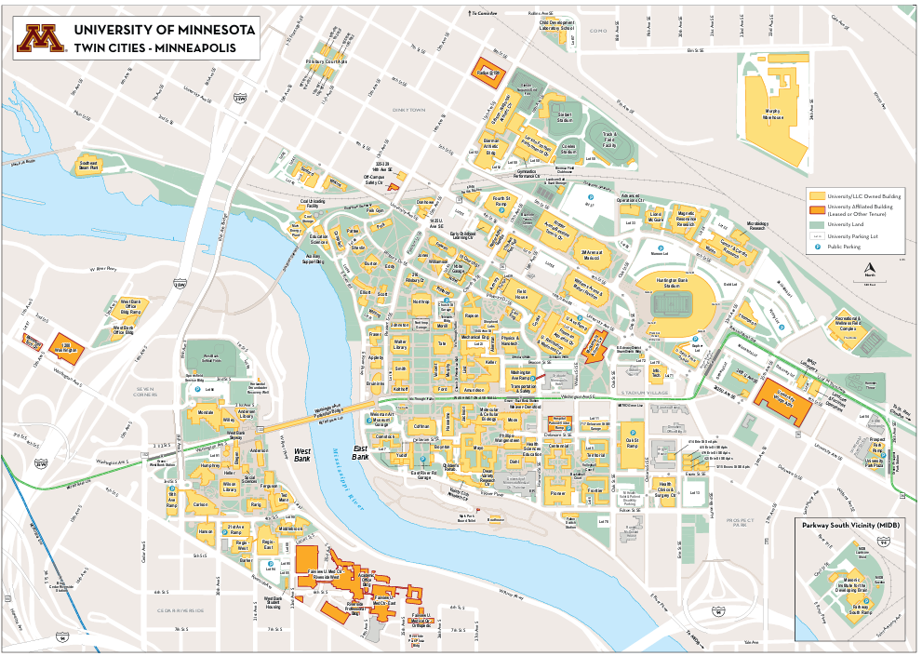
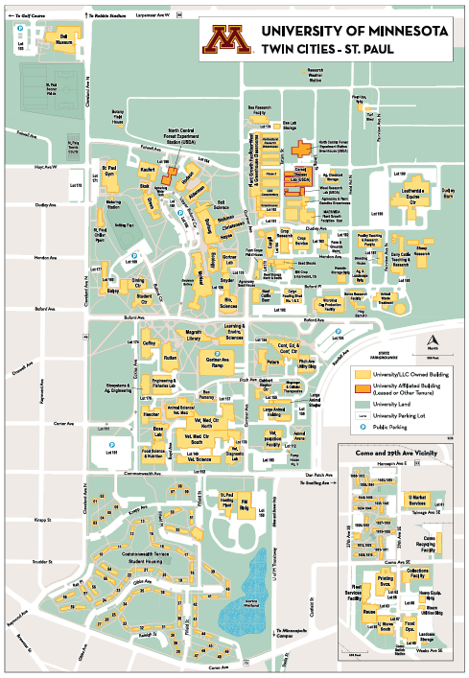

Slide 6
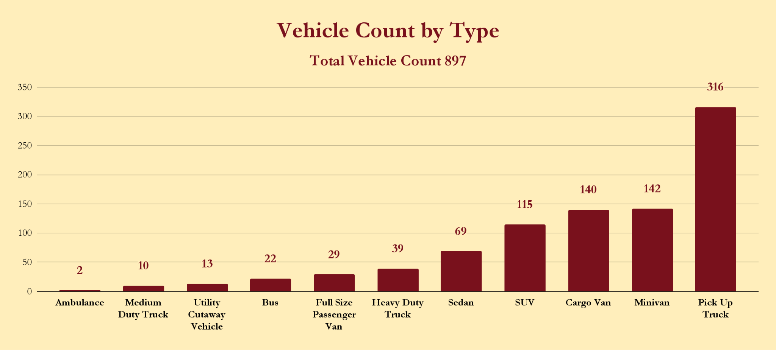

Slide 7
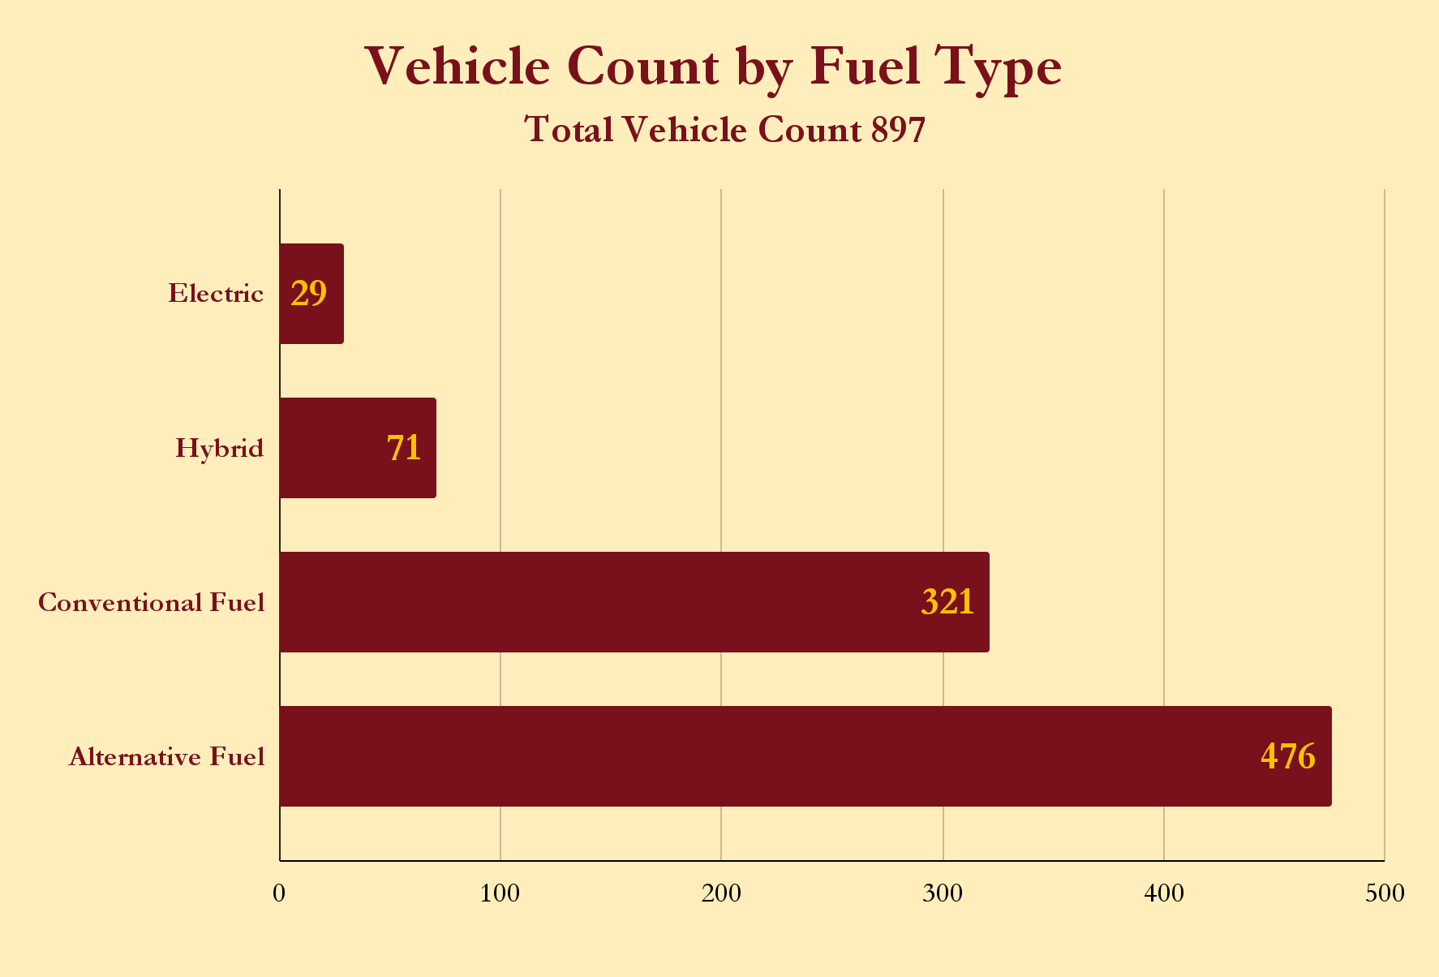

Slide 8
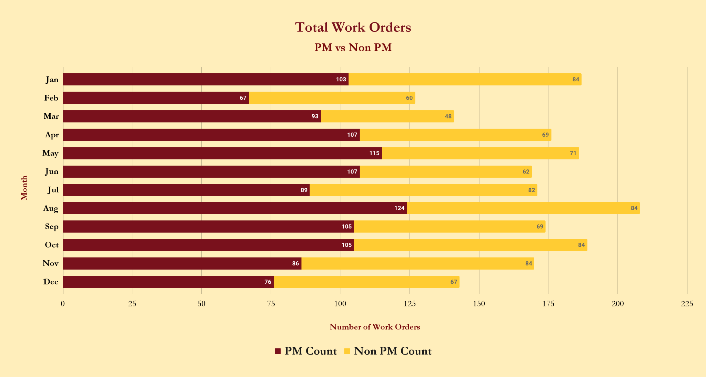

Slide 9
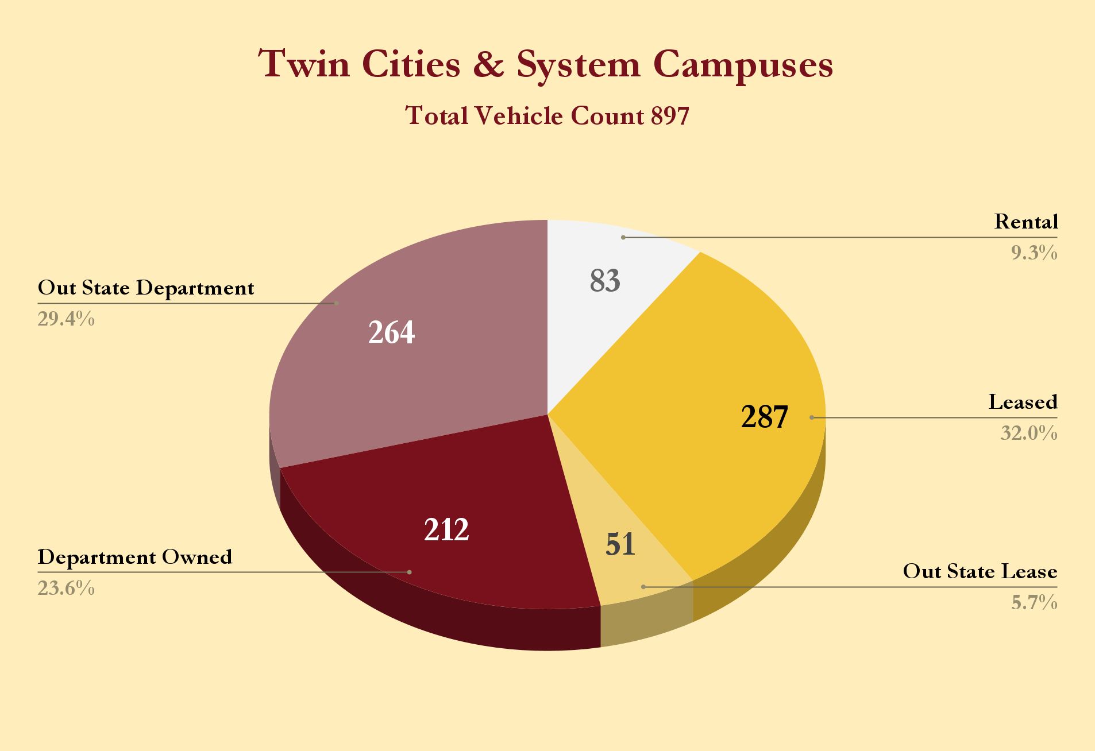

Slide 10
FLEET SERVICES
Twin Cities
Vehicle Acquisition & Disposal
Onsite Fuel
Fleet Fuel Card Management
Onsite Car Wash
Insurance and Subrogation
Rental Fleet
Leased Vehicles
Department Owned Vehicles
Full Service Shop (Maintenance & Minor Repairs / Upfits)

Slide 11
RENTAL STATISTICS January 1, 2024 - December 31, 2024
TOTAL RENTAL RESERVATIONS
TOTAL MILES DRIVEN
TOTAL GALLONS DISPENSED
TOTAL RENTAL DAYS
1,439,669
3,778
59,740
13,258

Slide 12
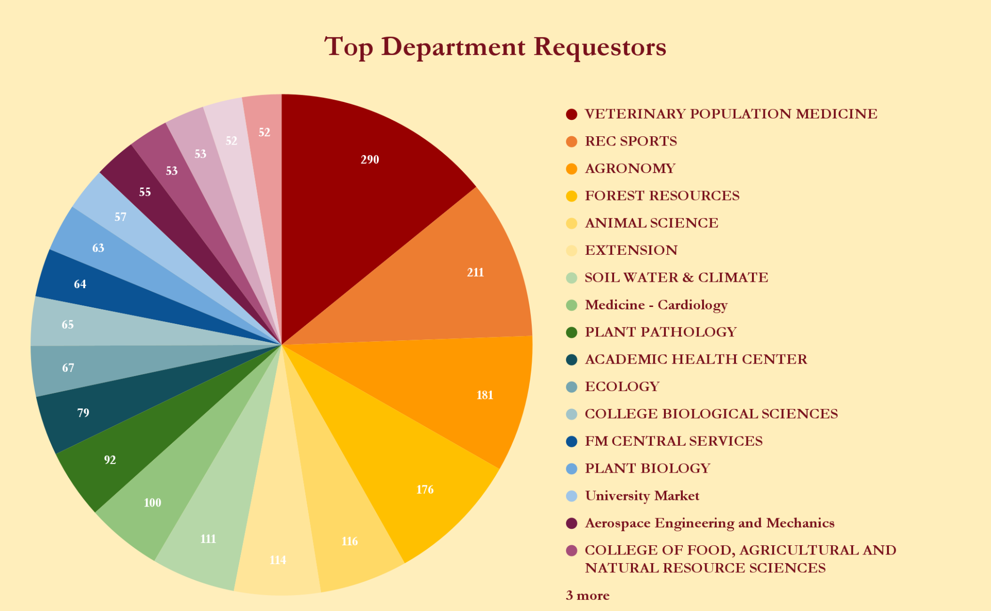

Slide 13
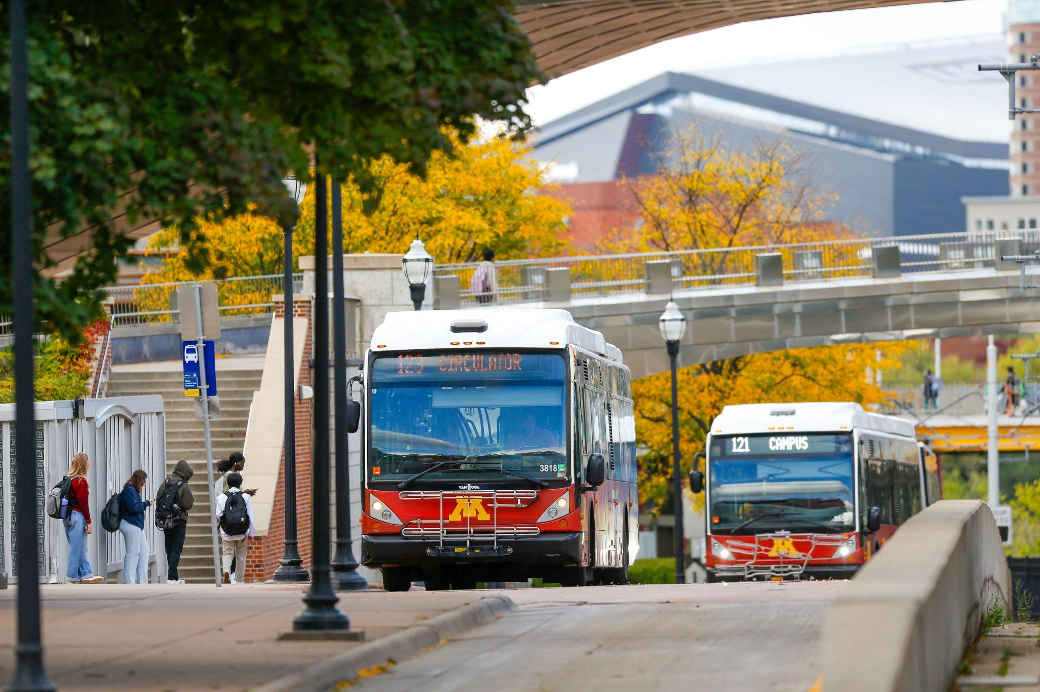
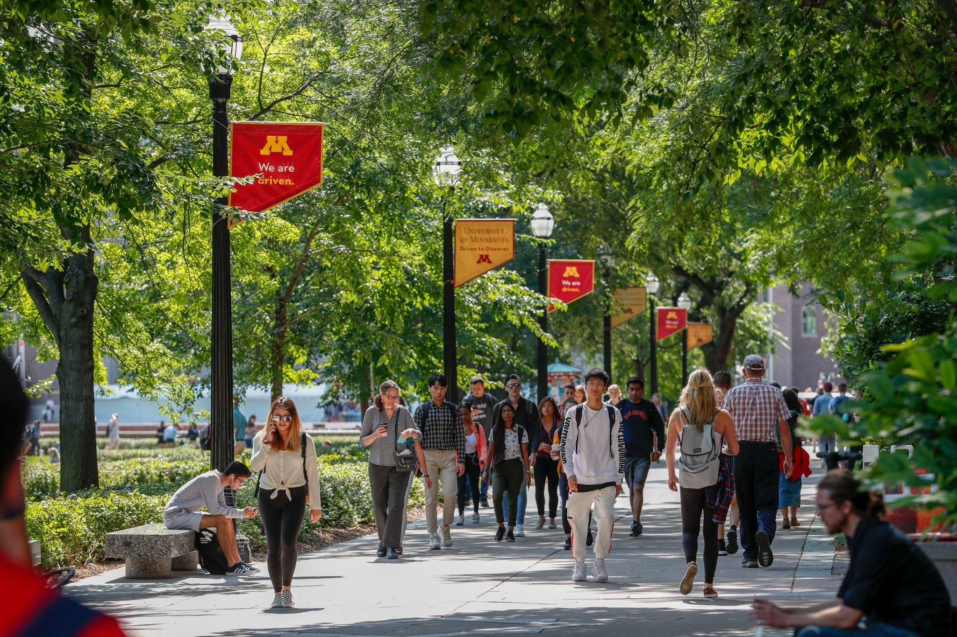
CAMPUS TOUR

Slide 14
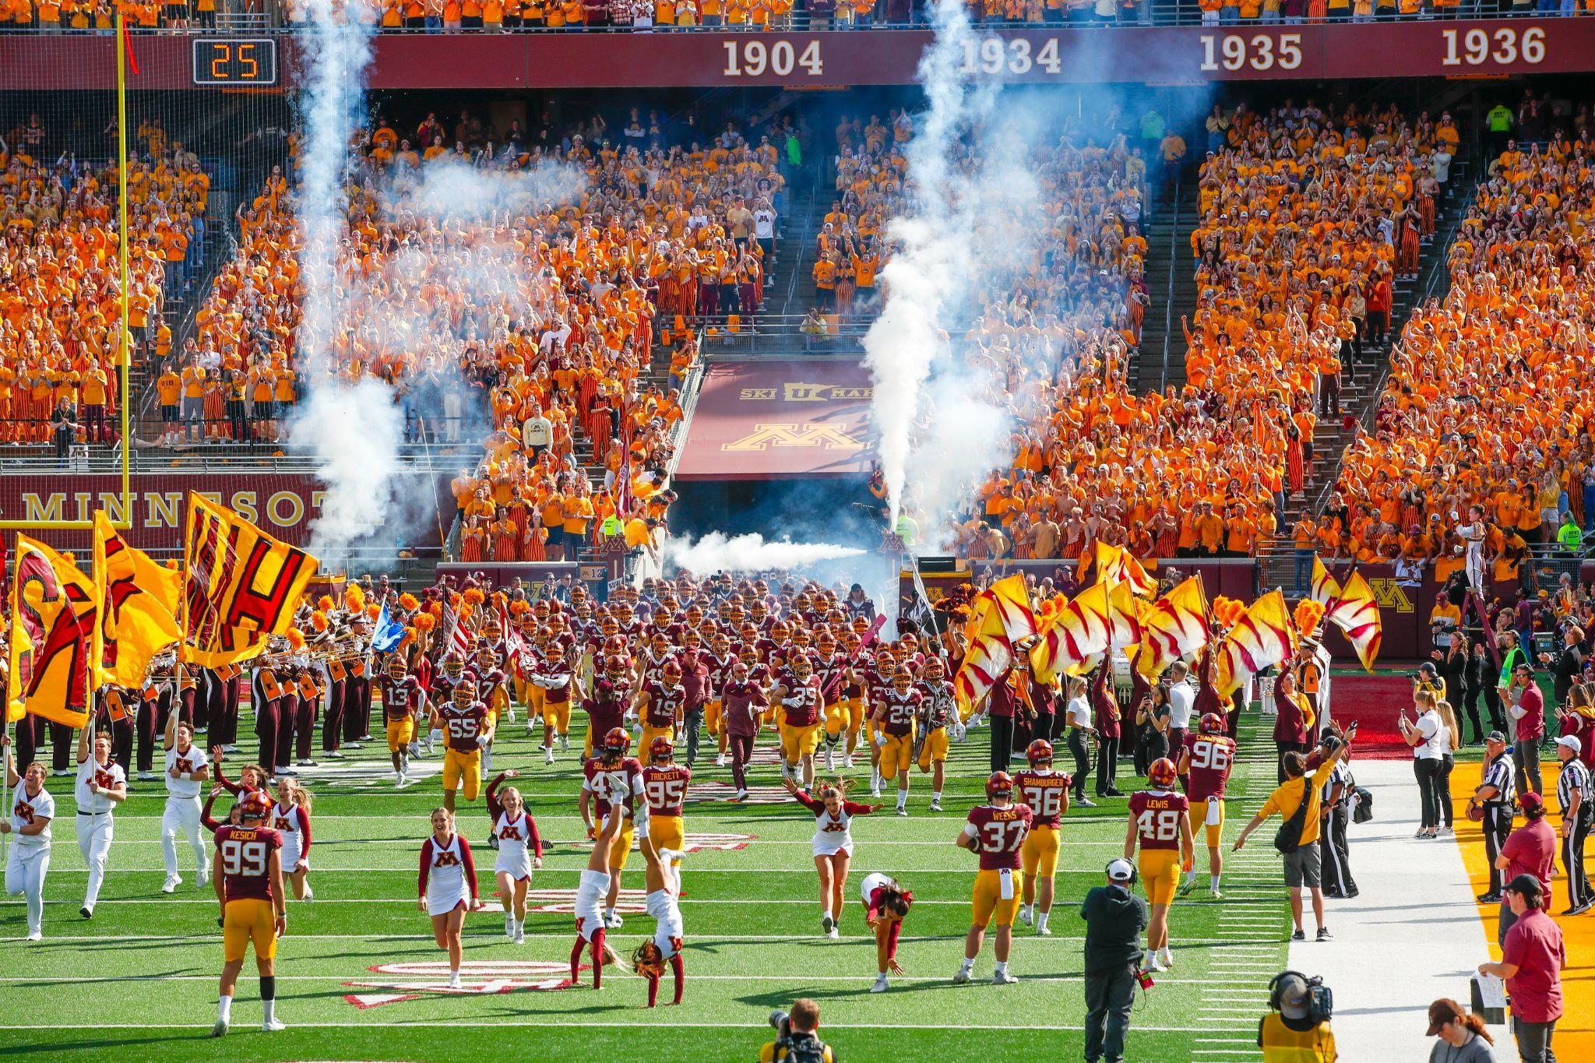
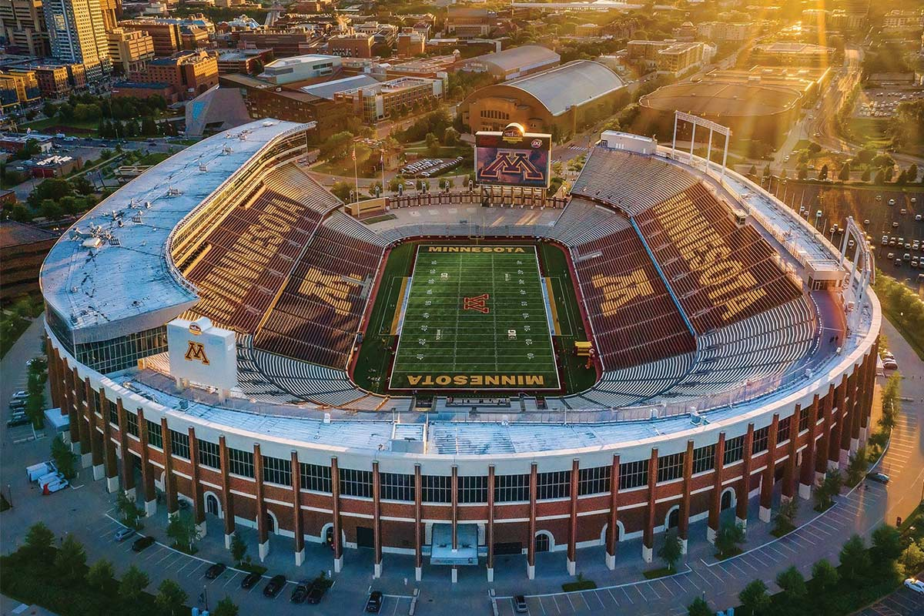
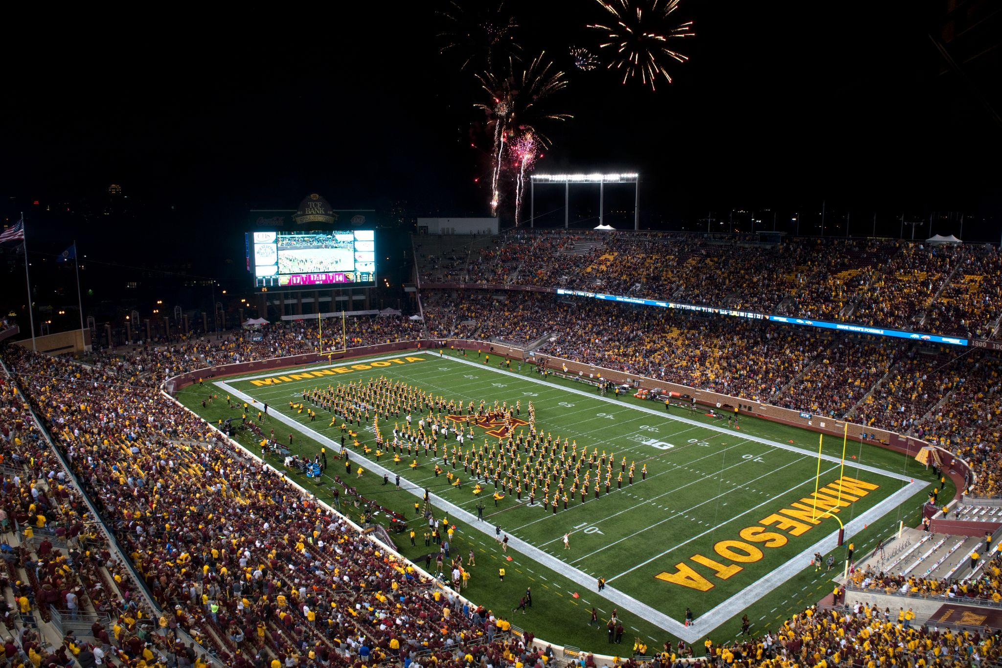
Huntington Bank Stadium

Slide 15
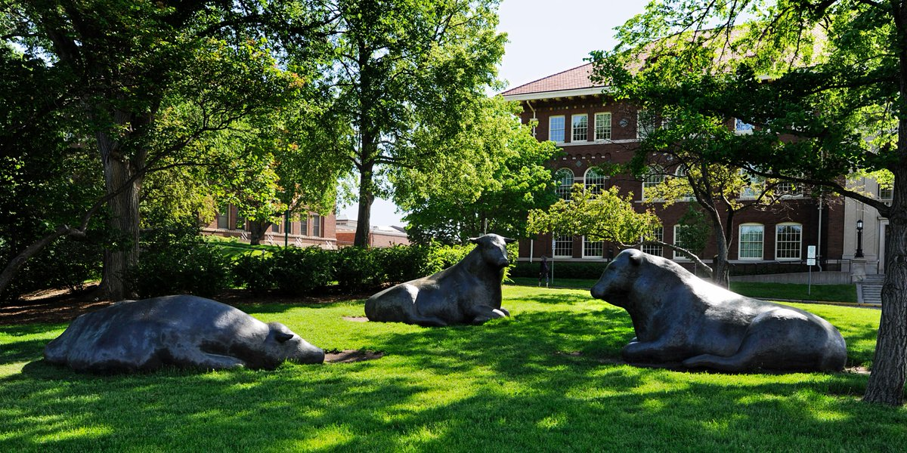
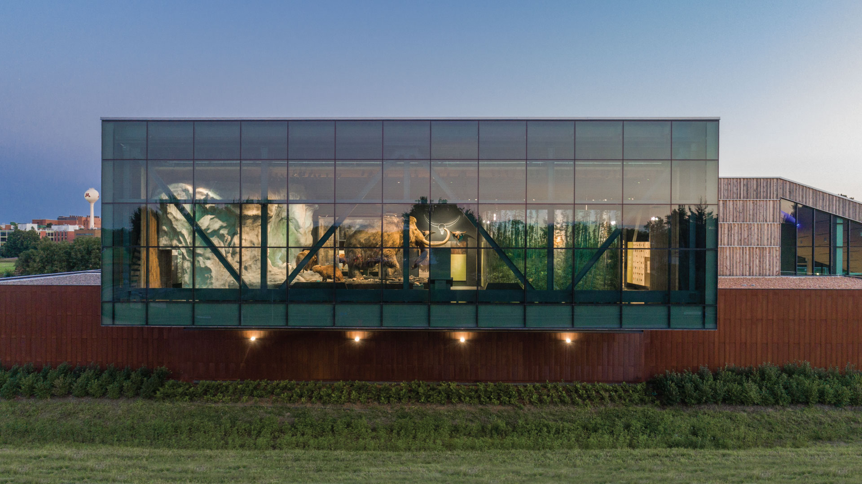
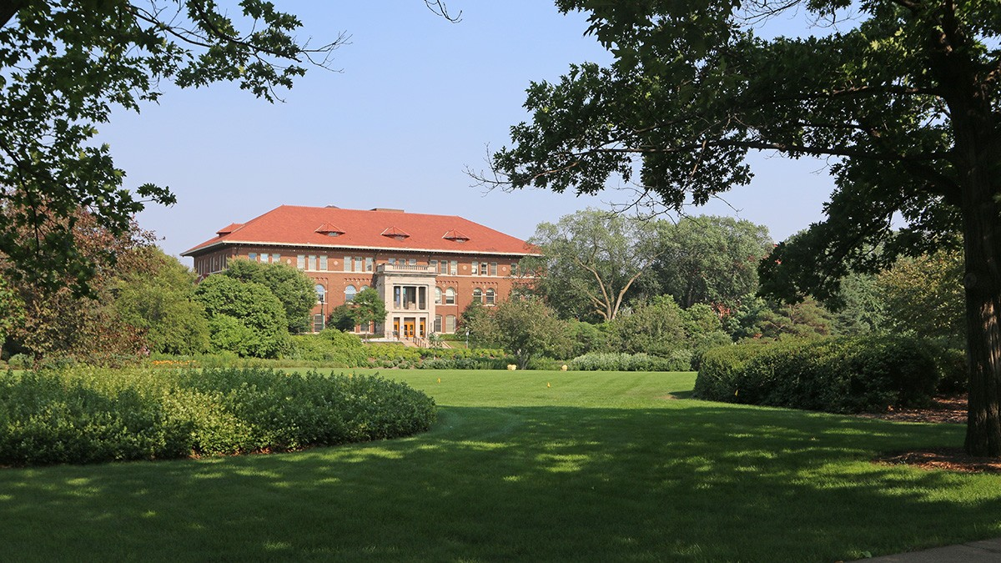
St. Paul Campus

Slide 16
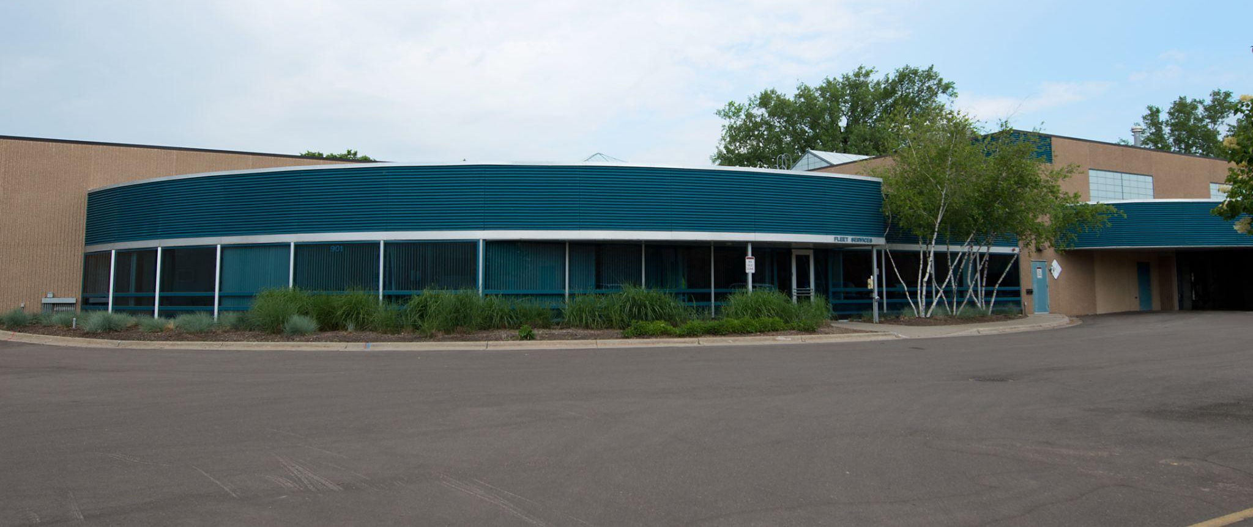
Fleet Services

Slide 17
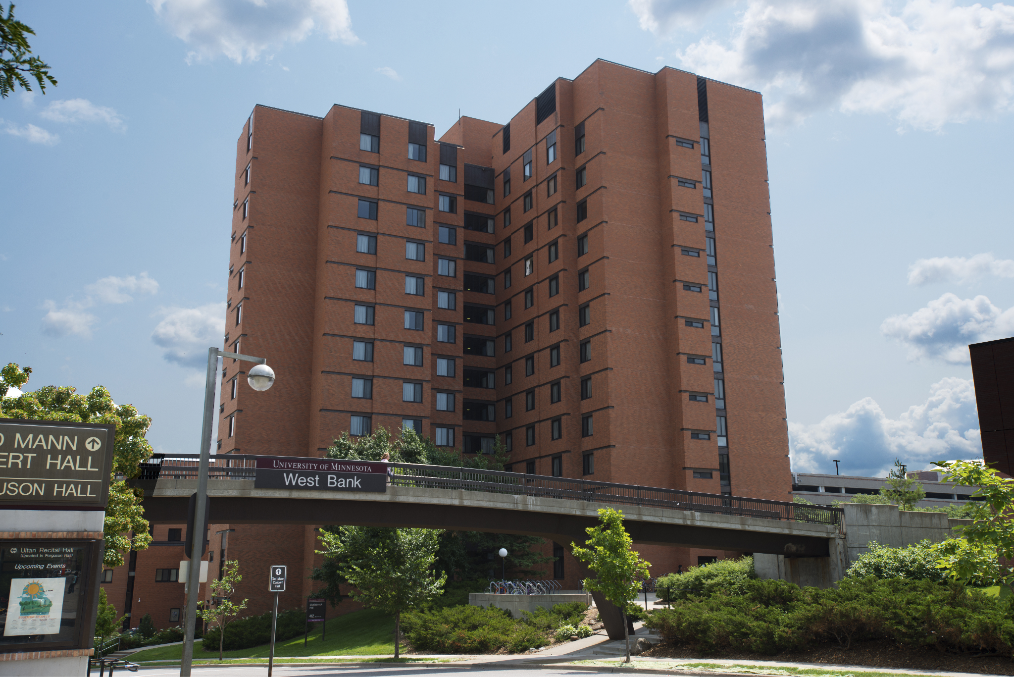
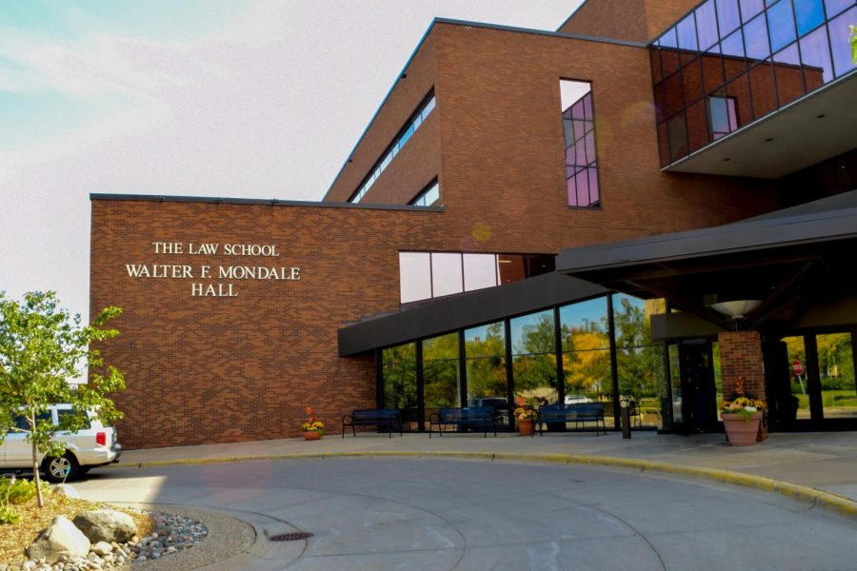
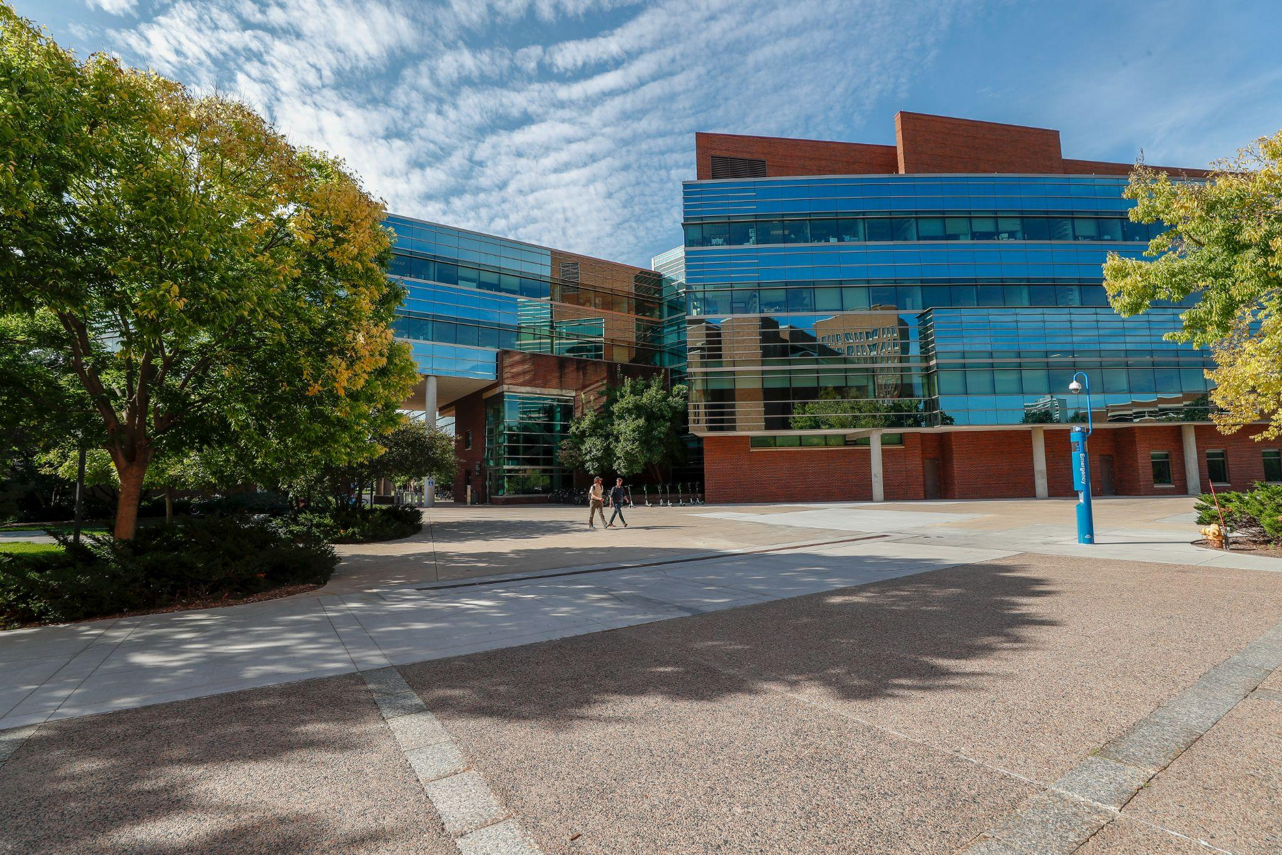
West Bank

Slide 18
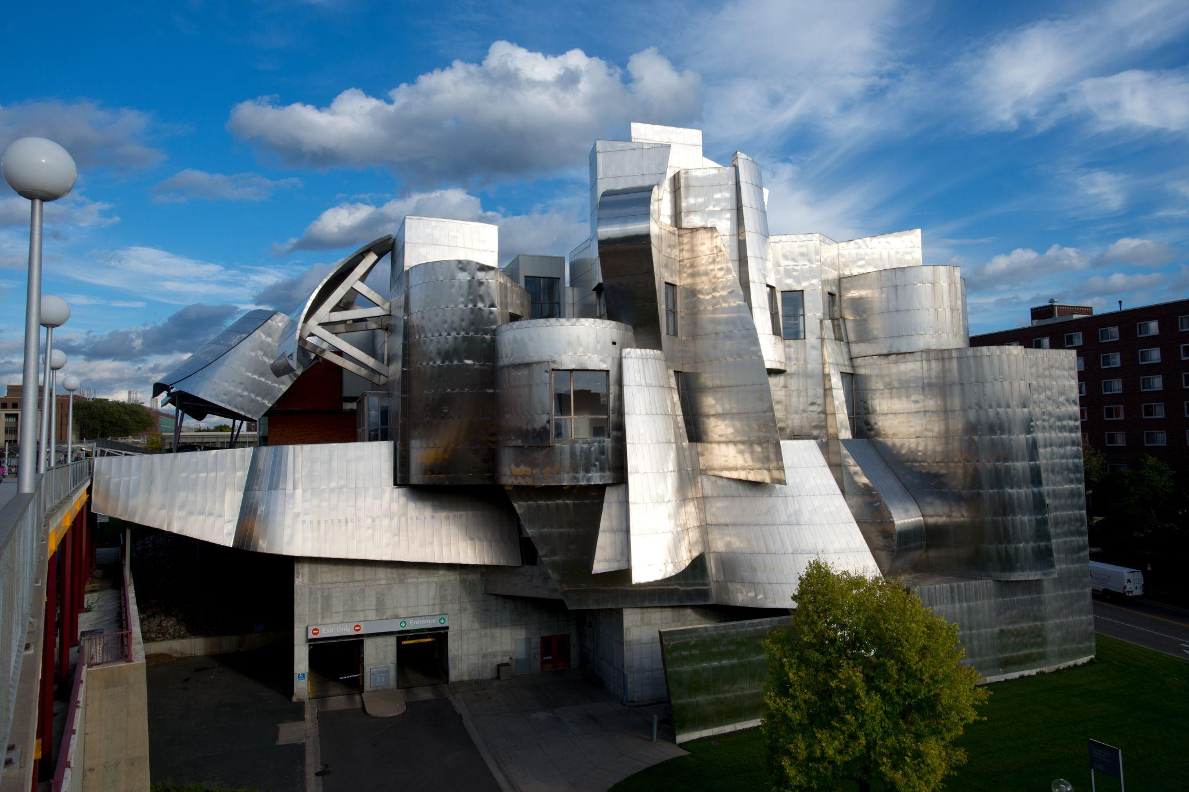
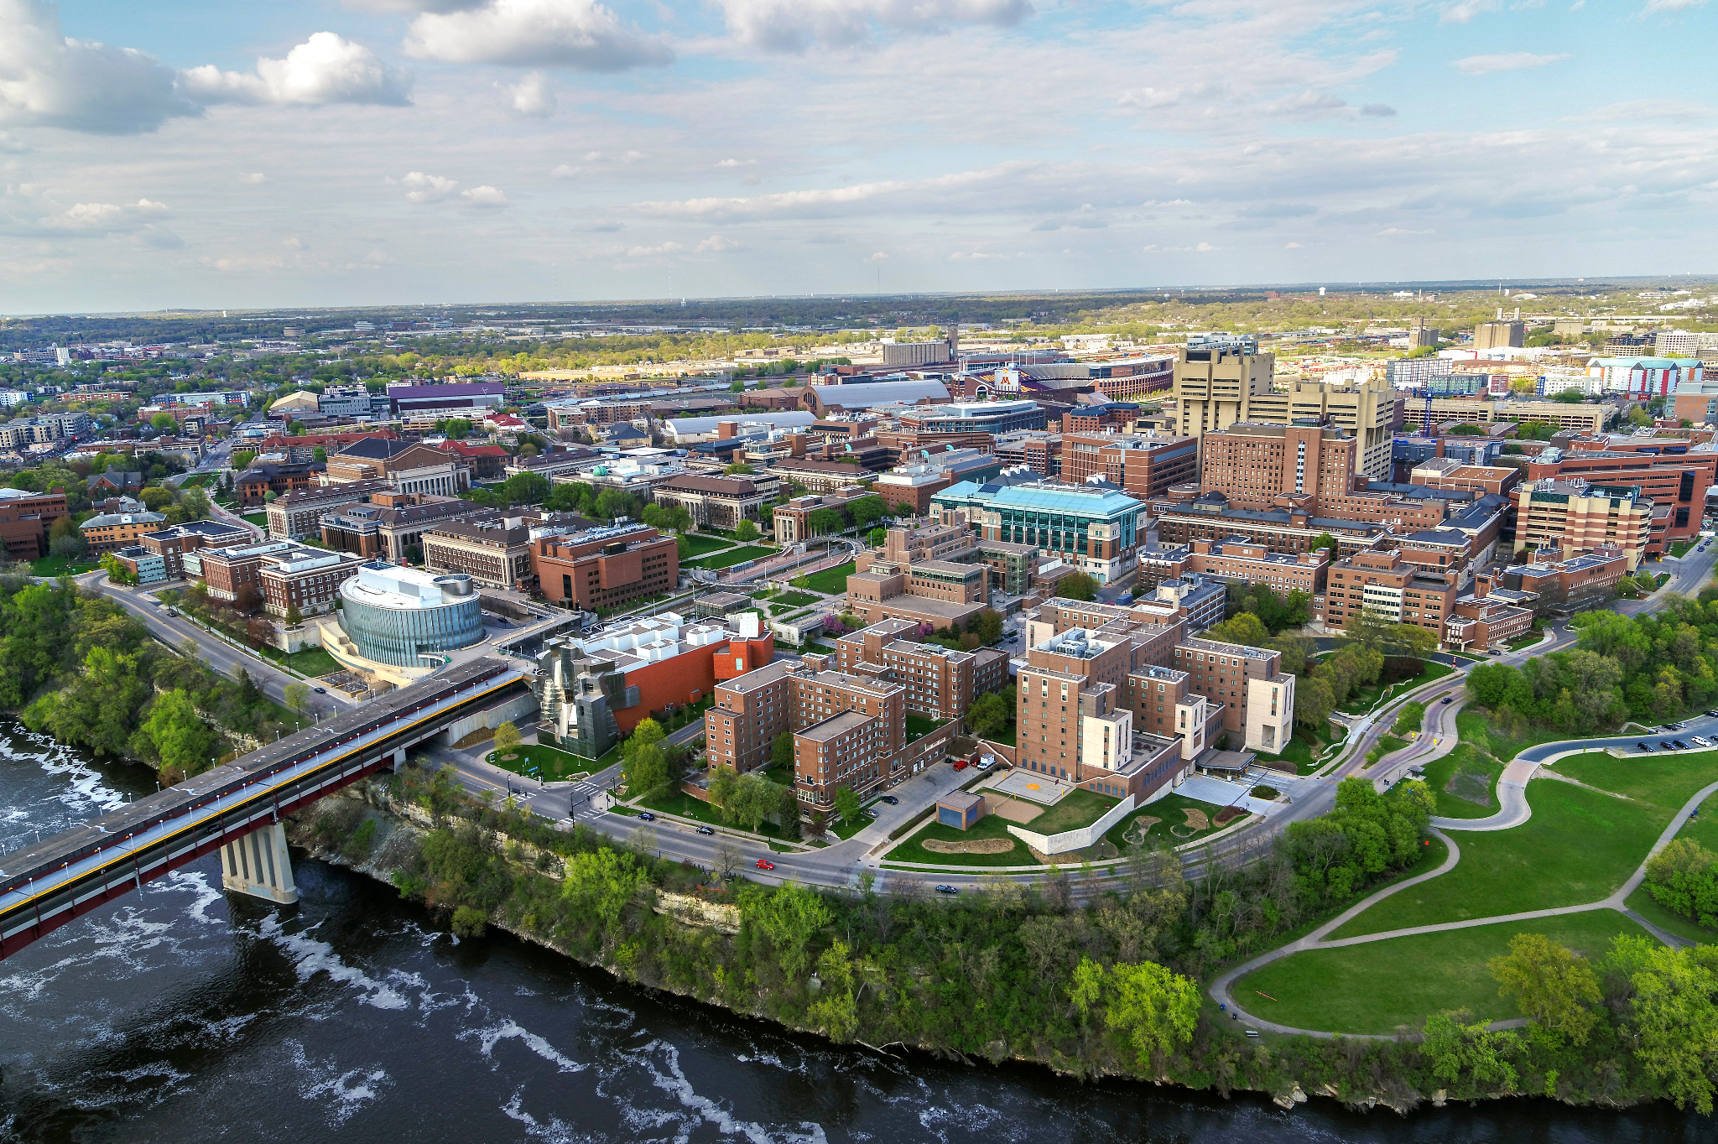
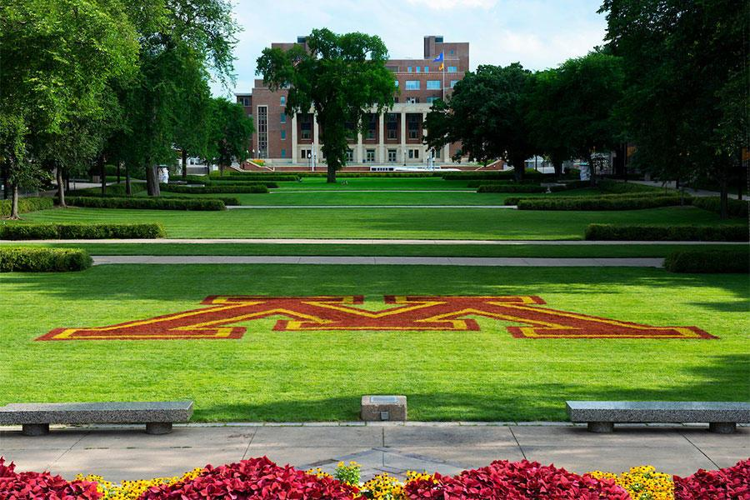
East Bank

Slide 19


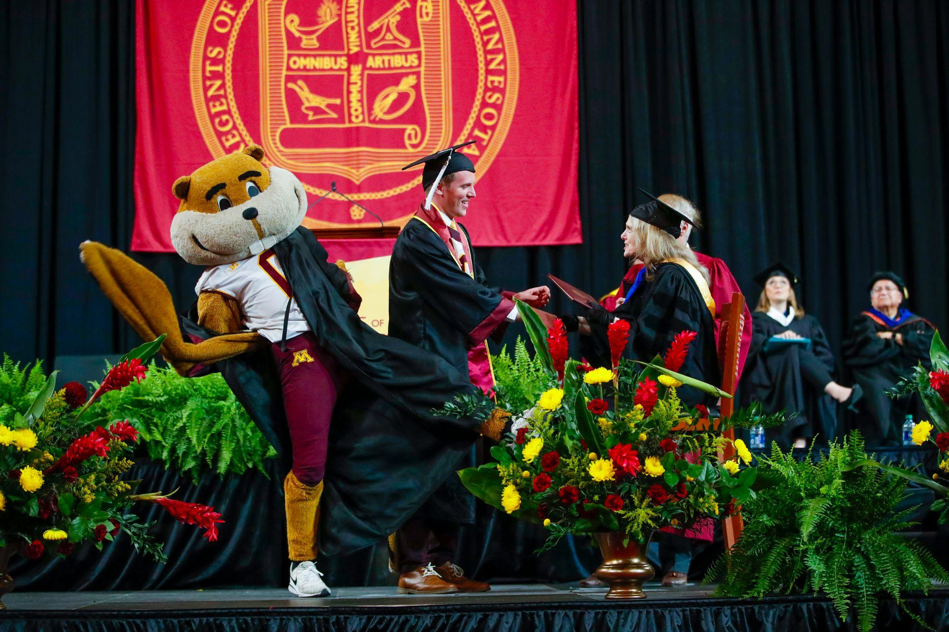
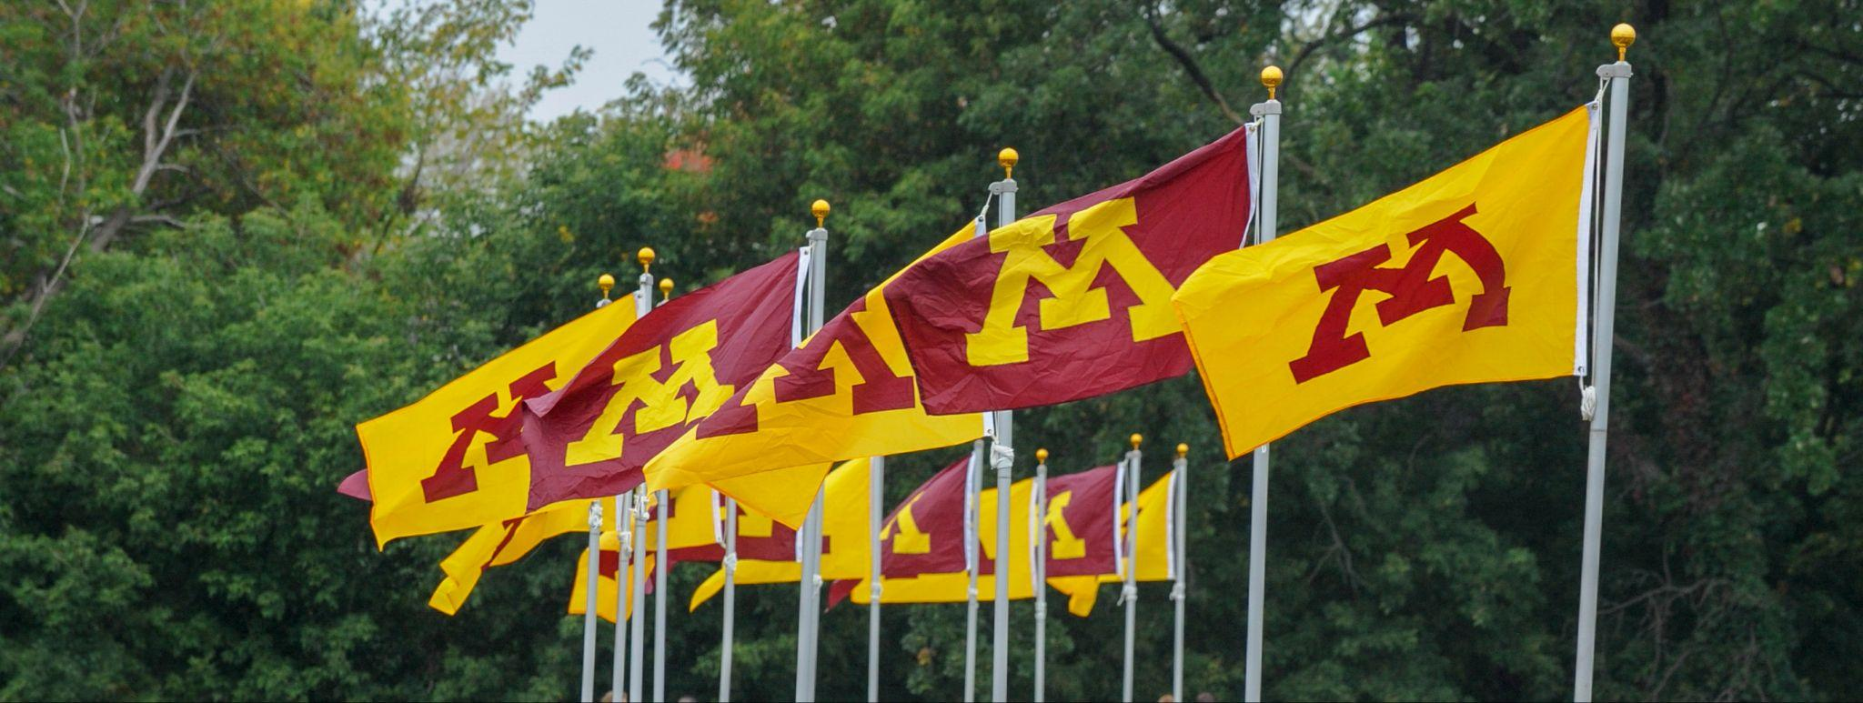
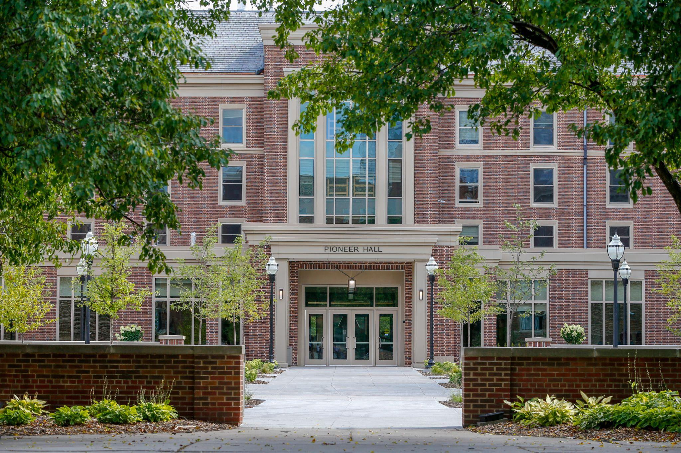
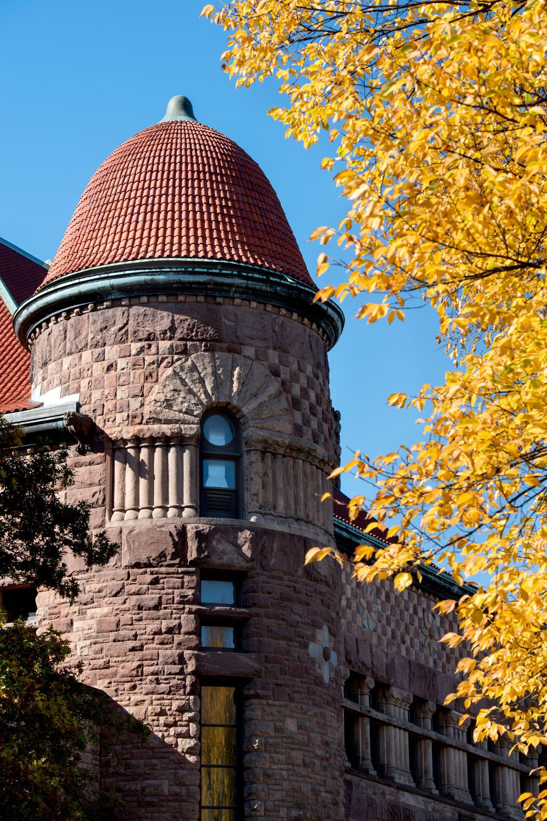


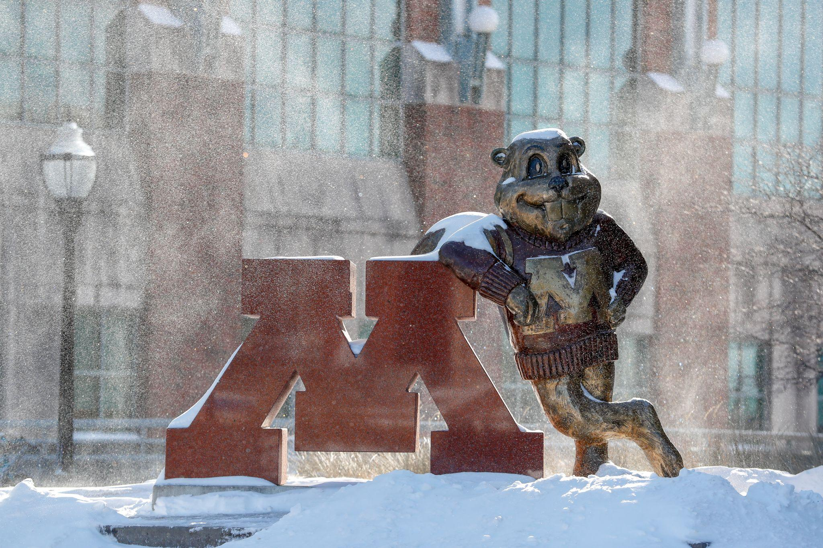
UNIVERSITY OF MINNESOTA
FLEET SERVICES
COMMAND 2025

