Slide 1

Welcome to command 2025

Slide 2
agenda
Overview of Maintenance
  Outsourcing
  Small Shop
  Large Shop
The Future of Maintenance
  Agile Maintenance
  The Plan for Maintenance
  Strengthening the Foundation
  Building on the Foundation
Feedback

Slide 3

Maintenance- OutSourced
Not in my house

Slide 4
OutSourced Maintenance
Get maintenance data from vendors
Import Maintenance Data into FleetCommander
Data creates work orders
Data is added to vehicle
Preventative Maintenance Reminders are reset.

Slide 5
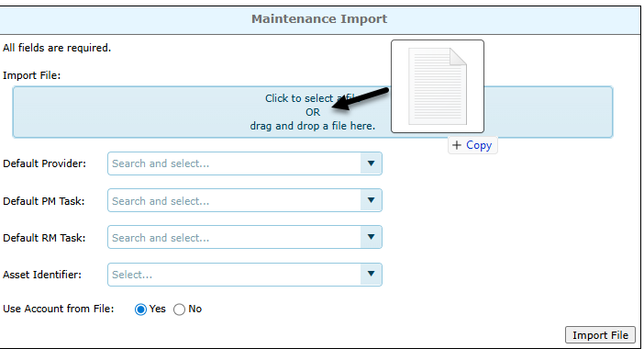
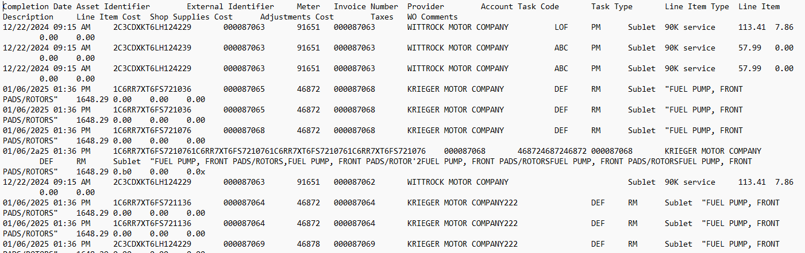
OutSourced Maintenance

Slide 6
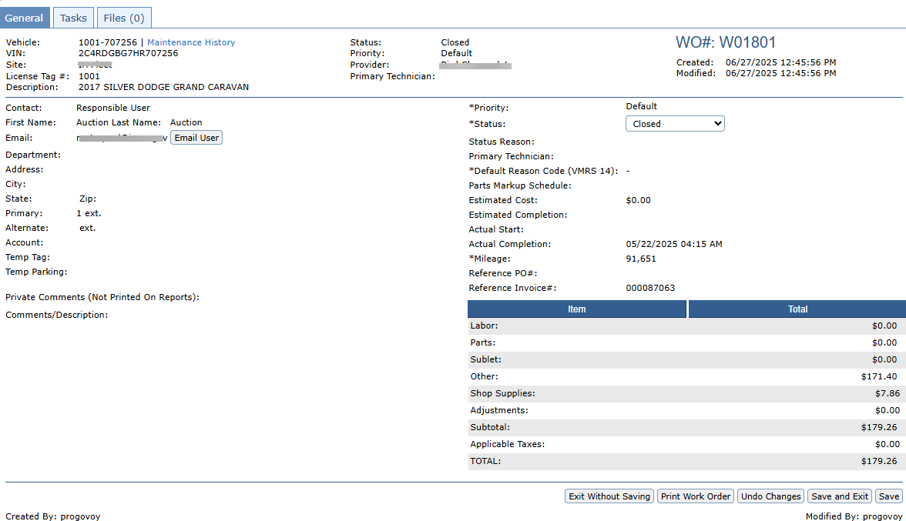
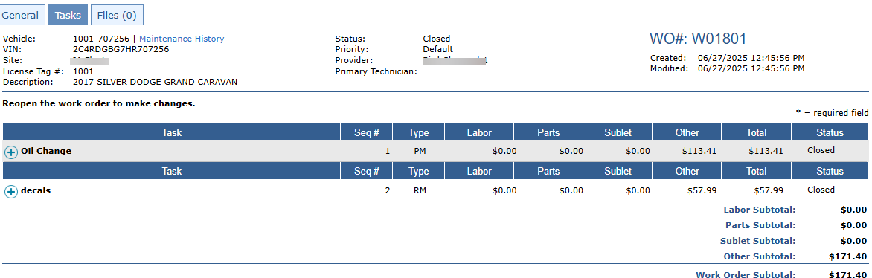
OutSourced Maintenance

Slide 7
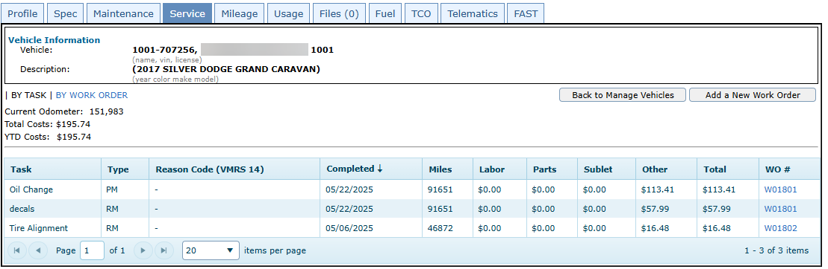
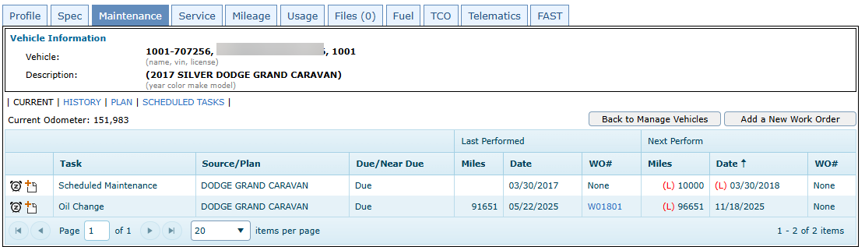
OutSourced Maintenance

Slide 8

Maintenance – SmalL Shop
Small but Mighty

Slide 9
Maintenance- SmALL Shop
Create Work Order
Data is added to vehicle
Preventative Maintenance Reminders are reset.

Slide 10
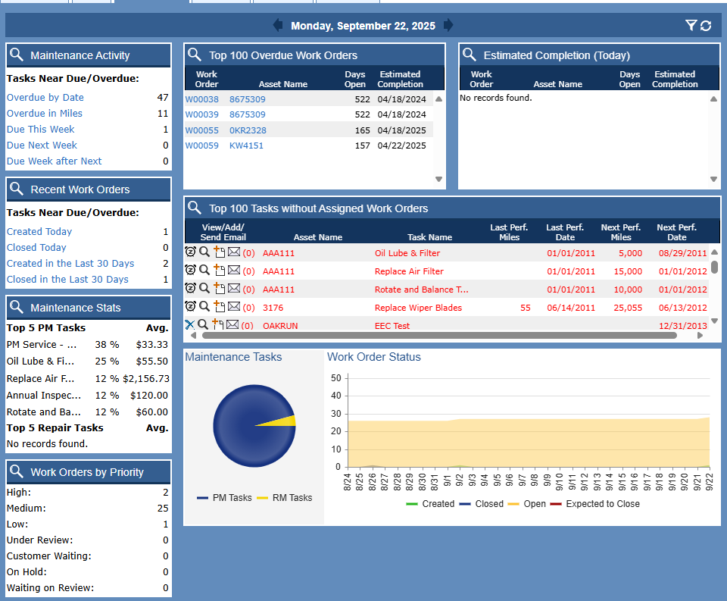
Maintenance- SmALL Shop

Slide 11

Maintenance – LArge Shop
Large and In Charge

Slide 12
Maintenance- LArge Shop
Shop Manager Assigns Work Orders
Technician Tracks time and updates Work Order
Parts are added to Work Order and removed from Inventory
Data is added to vehicle
Shop Manager Reviews and Closes Work Order
Preventative Maintenance reminders are reset

Slide 13
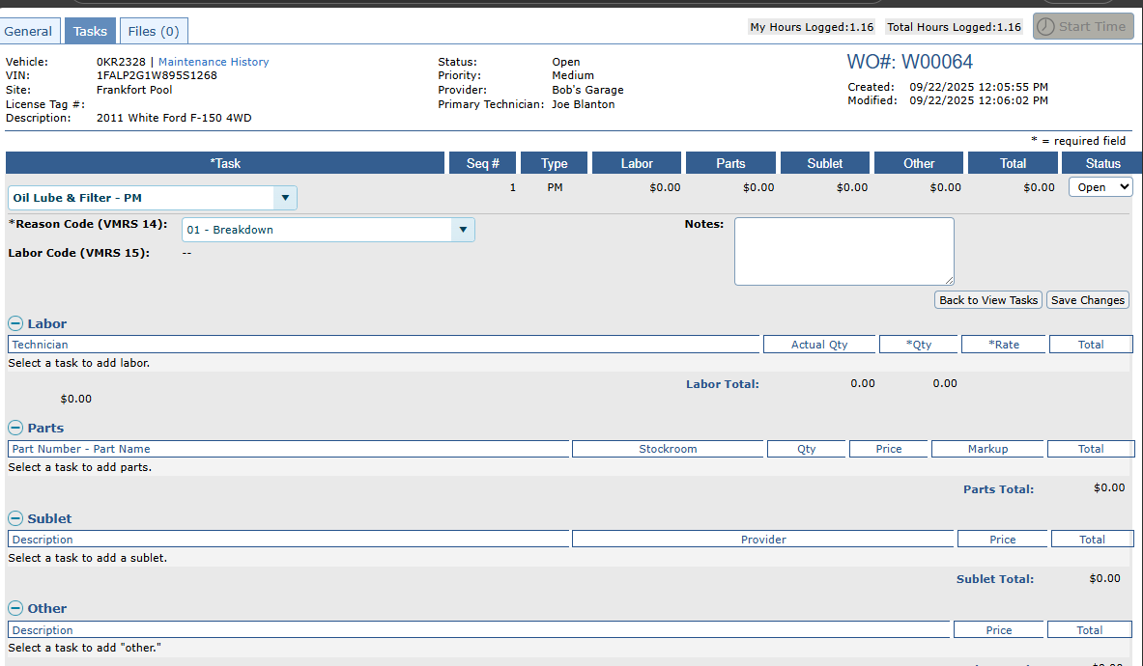
Maintenance- LArge Shop

Slide 14
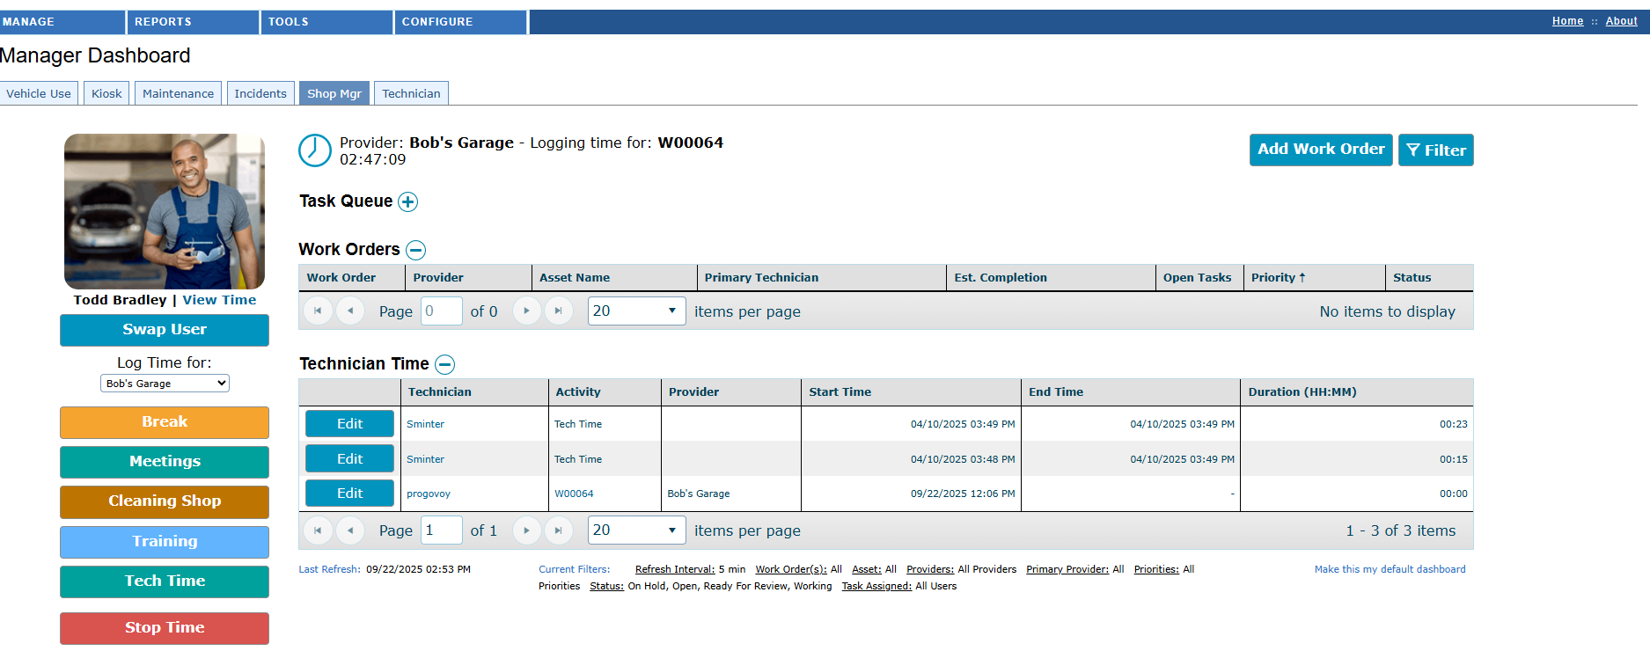
Maintenance- LArge Shop

Slide 15
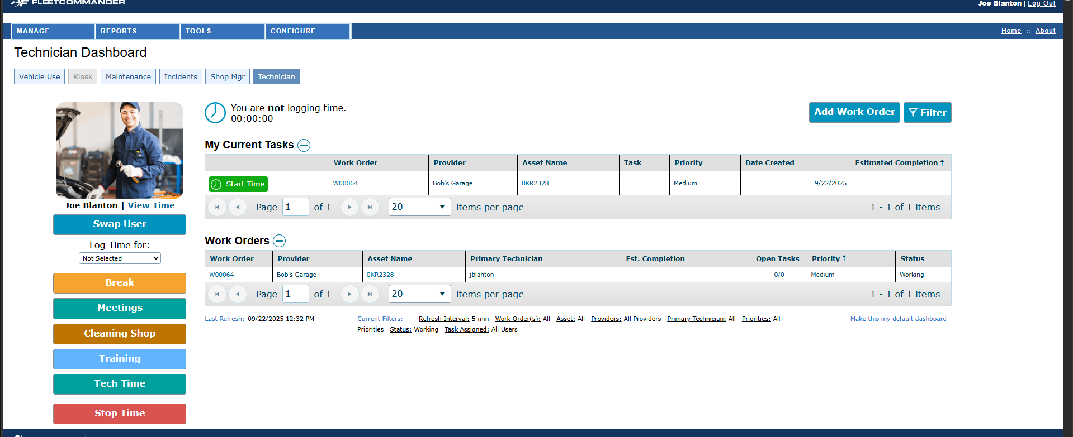
Maintenance- LArge Shop

Slide 16
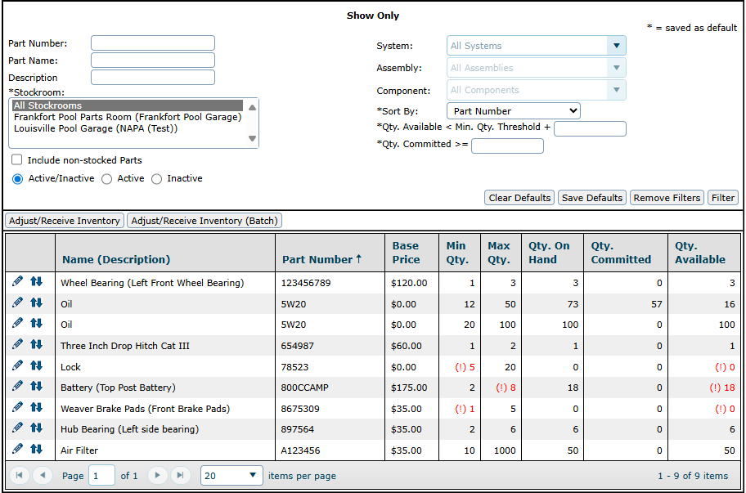
Maintenance- LArge Shop

Slide 17


the future of maintenance
Navigating the future

Slide 18
agile Maintenance
We're striving to meet more of your needs, all in one place.
As the system of record for your vehicles, we recognize the importance of tracking your maintenance costs and schedules, even if our maintenance module isn't a perfect fit (yet).
Through TCO, your maintenance costs can be tracked per vehicle.
Through our maintenance import, TCO transactions will be generated, and maintenance schedules will be automatically updated.
We're continuing to push forward on our maintenance and parts inventory modules, as well, to improve their quality and capabilities.
We're reviewing existing feedback, reviewing RFPs, revisiting best practices with SMEs on staff, and planning/conducting deep dives with clients to get more input.

Slide 19
the plan for maintenance
Maintenance will be enhanced over a series of several releases.
Earlier phases will prepare the module for greater enhancements.
  Bug fixes will be addressed.
  Interfaces and processes which haven't aged well will be updated to improve ease-of-use and to better conform to common standards.
Cracks in the foundation will be addressed so that we can build a strong future.

Slide 20
strengthening the foundation
More robust scheduled tasks.
  Better scheduling options.
  Define a scheduled tasks series and assign it to/remove it from multiple vehicles at a time (by year, make, model, and/or asset type).
Easier data clean-up when deactivating entities like tasks and providers which might be associated with multiple plans and schedules.
Easier data set-up:
  Configure maintenance plans (not tasks) by miles, days, or engine hours. (How do you do it today?)
  Add multiple plans to a vehicle, creating a sequential maintenance strategy which minimizes costs and optimizes performance over time. (Is anyone satisfied with how it is done today? Would you not want to see this change? )

Slide 21
strengthening the foundation
More standardization of work order features:
  Search for assets by VIN;
  Access parts history from the WO;
  Capture the "three Cs": Concern, Cause, Correction.
Use configurable reason and labor codes.
Set a default value for shop supplies by provider.
Who uses VMRS and would be sad to see it go?

Slide 22
building on the foundation
New schedule and history reports which will serve as maintenance report templates for Report Center.
New configurable Maintenance Dashboard.
Automated maintenance notifications.
Parts inventory enhancements:
  Build parts lists to order;
  Receive parts from the list or track vendor inventory status, such as backordered;
  LIFO/FIFO;
  Multiple part numbers/aliases.
Trouble tickets/"sticky notes."

Slide 23
Exploring further potential
Beyond what is already in the roadmap, we're exploring some big ideas and opportunities for integrations.
Other idea which are not yet committed to the roadmap include:
  Predictive maintenance;
  Parts lookup by VIN;
  OEM data available for integration, such as default maintenance plans.
We want to hear your ideas, too!

Slide 24

Thank you
Phelps Rogovoy & Alexis Gearhart
phelps@agilefleet.com, agearhart@agilefleet.com

