Slide 1


Welcome to command 2025
Total Cost of Ownership (TCO)

Slide 2

Agenda
TCO Subcategories
Cost Allocation Tool
5.13 Changes
Reports
Future Changes

Slide 3
Total Cost of ownership (Tco)
TCO is the sum of net acquisition costs, direct or indirect operating costs, incidental costs, and disposal /salvage necessary to support the vehicle or asset
It levels the playing field allowing for the direct comparison of similar assets

Slide 4

Total cost of ownership default categories
Category | Subcategory
Fixed | Insurance
 | Depreciation
 | Overhead (General Fixed)
Incidental | Other/Miscellaneous (Incidental)
Acquisition | General Acquisition
Category | Subcategory
Operating | Maintenance
 | Fuel
 | Warranty Refund
 | Other/Miscellaneous (Operating)
Non-Operating | Risk Management
TCO Subcategories can be configured under Configure > Vehicles > TCO Subcategories.
Default values allows for the Code and Taxes to be edited.

Slide 5
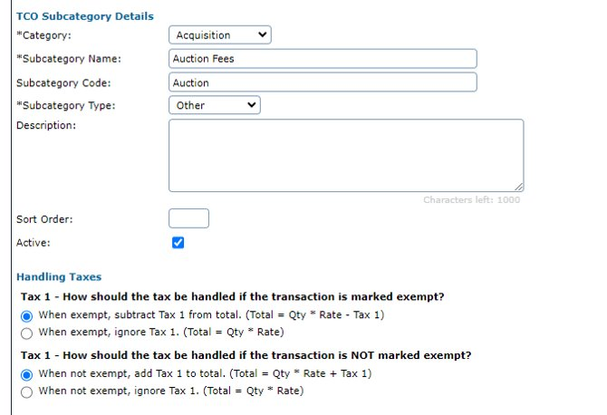
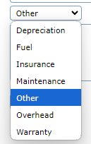
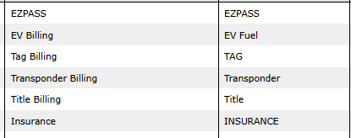
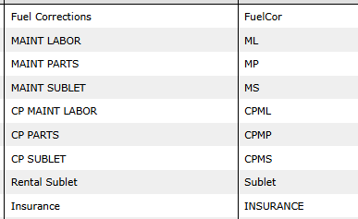
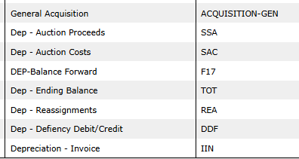
Custom subcategories
Create custom subcategories based on your reporting needs
Example #3
Example #1
Example #2

Slide 6
Cost allocation tool

Slide 7
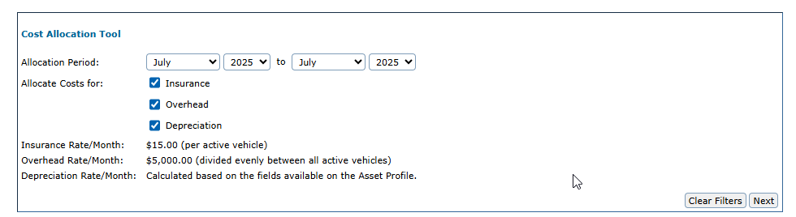
Cost allocation tool
Add TCO Subcategories to assets in FleetCommander in mass for:
Insurance
Overhead
Depreciation (Replacement Fund)

Slide 8
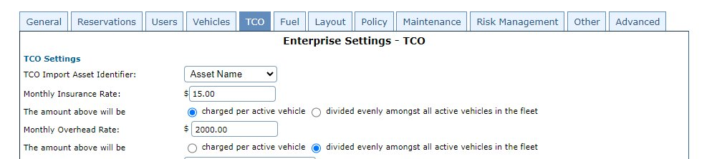
Cost allocation tool
Insurance & Overhead - Set charges by adding a rate and selecting calculation: ​
Charges will be added to every active vehicle. Active means:​​
The Asset Profile First Available Date is before or equal to the last date of the ending month from the filter interface. ​​
The Asset Profile Last Available Date is after the first date of the starting month/year from the filter interface (or blank). ​​
The Asset Profile is not in a Deleted status.

Slide 9
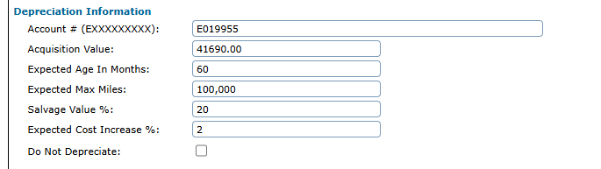
Cost allocation tool
Depreciation - Set values on vehicle profile.
Depreciation Calculation:
Fully Depreciated = ([[Acquisition Value +(Expected Cost Increase % * Acquisition Value)] – ​(Salvage Value % * Acquisition Value)])
$34185.80 = ([[41690 +(2% * 41690)] – ​(20% * 41690)])
Notes:
41690 + 833.80 – 8338.0

Slide 10
Cost allocation tool
Depreciation - Set values on vehicle profile.
Depreciation Calculation:
Monthly Depreciation = ([[Acquisition Value +(Expected Cost Increase % * Acquisition Value)] – ​(Salvage Value % * Acquisition Value)]) / Expected Age in Months
$569.76 = ([[41690 +(2% * 41690)] – ​(20% * 41690)])/60
Notes:
41690 + 833.80 – 8338.0

Slide 11
Cost allocation tool - depreciation
Monthly Depreciation will be charged::
For the month of 1st Available Date
For the month of Last Available Date
Until posted depreciation transactions reach fully depreciated total
Last month could be a partial amount to fully reach expected total
Monthly Depreciation will not be charged::
After the Last Available Date
“Deleted” status
“Do not depreciate” flag is checked
Once fully depreciated

Slide 12
New Changes
TCO Posting Utility

Slide 13
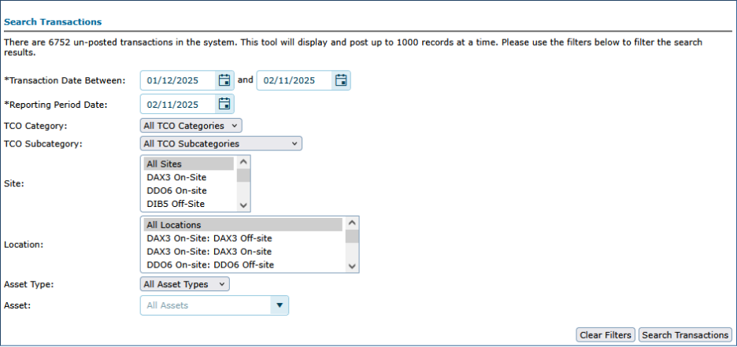
TCO posting utility
5.12 and before:
Only 1000 transactions could be posted at a time
Date range was limited to 30 days
TCO subcategory filter was a single selection

Slide 14
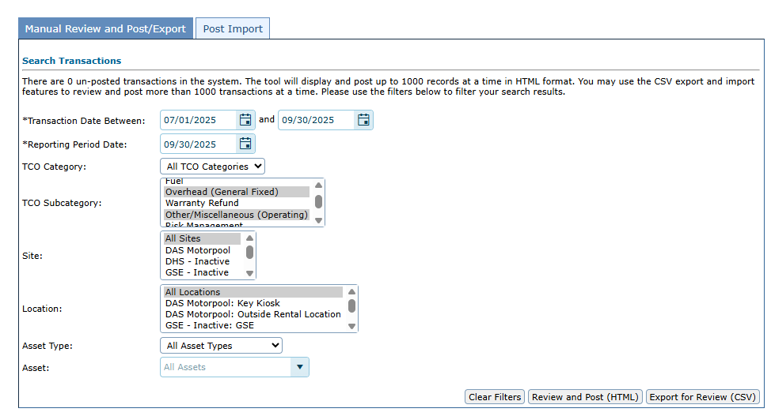
TCO posting utility
Now with 5.13
Transaction date has been increased to 93 days
TCO Subcategory filter is now multi-select

Slide 15
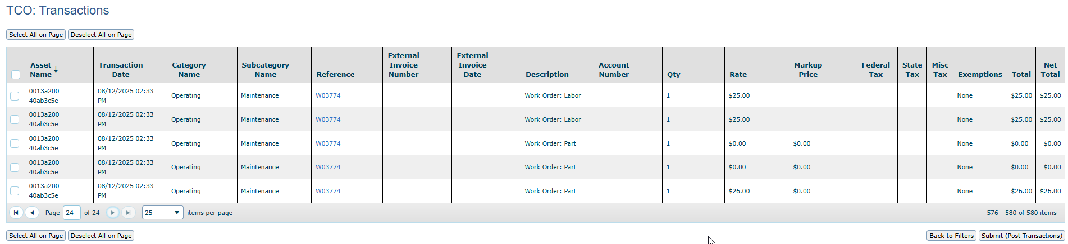
TCO posting utility
Now with 5.13
Review & Post in HTML
Same behavior as 5.12 – review up to 1000 transactions in HTML

Slide 16
TCO posting utility
Now with 5.13
Export to CSV for Review
Click “export for Review” to get a CSV file of transactions that match the filter set
Can be opened in Excel
No maximum transaction limit
Delete transactions from the file that you don’t want posted at the time
Save as CSV and import to post the transactions in the file

Slide 17
TCO posting utility

Slide 18
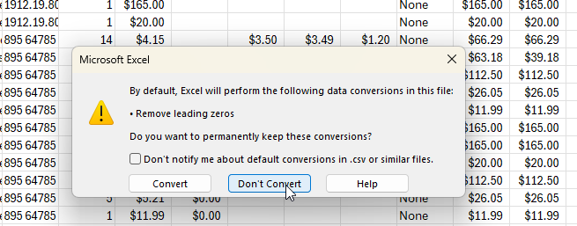
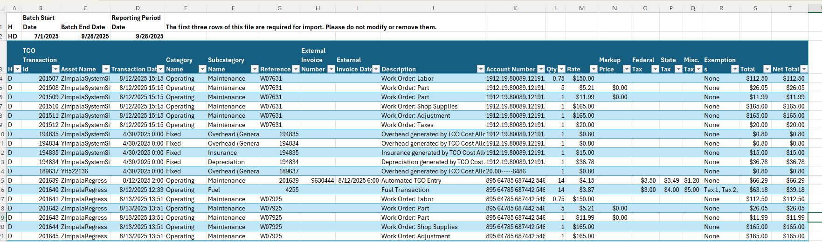
TCO posting utility
Can be opened in Excel
Don’t convert the leading zeroes
Keep the 3 header rows
H = header
HD = header detail
D = detail

Slide 19
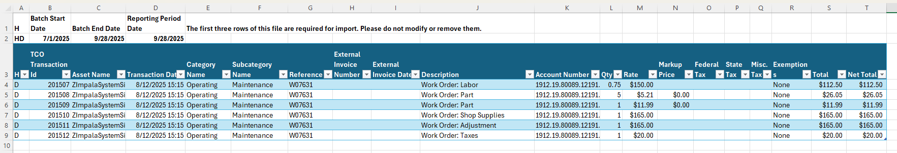
TCO posting utility
Delete transactions from the file that you don’t want to post
This leaves them unposted in FleetCommander

Slide 20
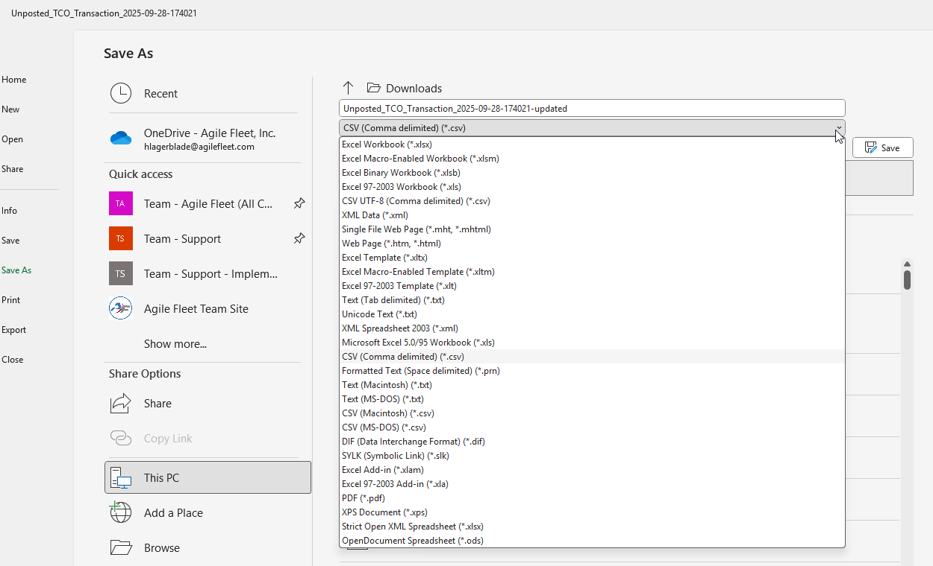
TCO posting utility
Save as a csv

Slide 21
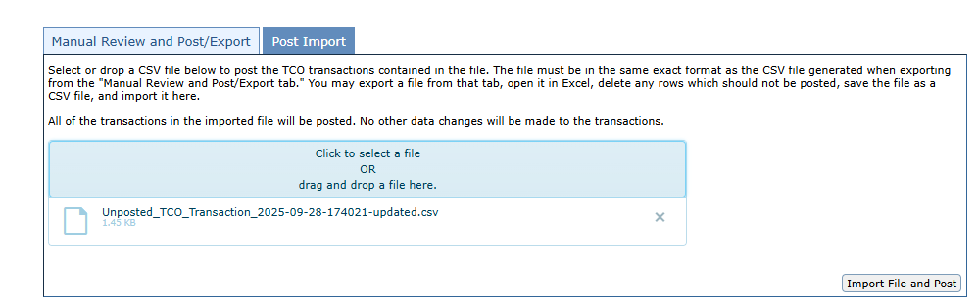
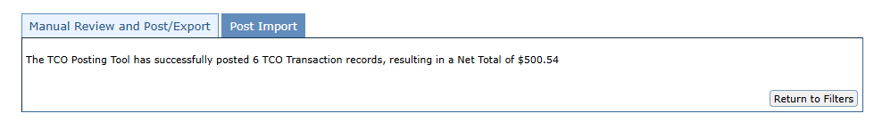
TCO posting utility
Go to “Post Import” tab
Drag & Drop or Browse for File
Click “Import File and Post”
Success message will show

Slide 22
Using the TCO Reports
TCO Data Dump

Slide 23
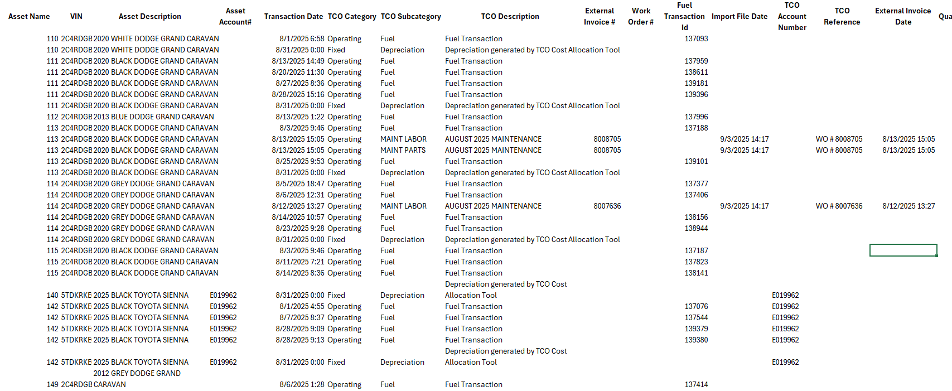
TCO Data Dump
1 TCO transaction for per line that fits the filter set

Slide 24
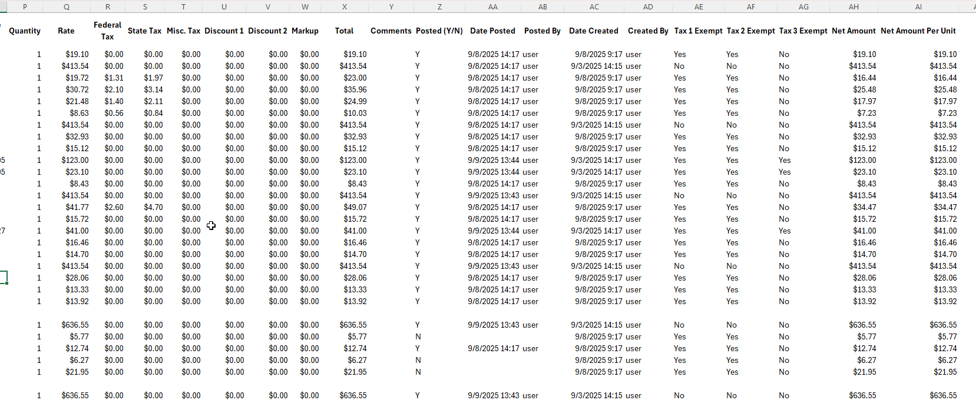
TCO Data Dump
Numbers match
Use as a way to verify billing with “Date Posted” and “Posted Y/N”

Slide 25
Using the TCO Reports
TCO Expense Summary

Slide 26
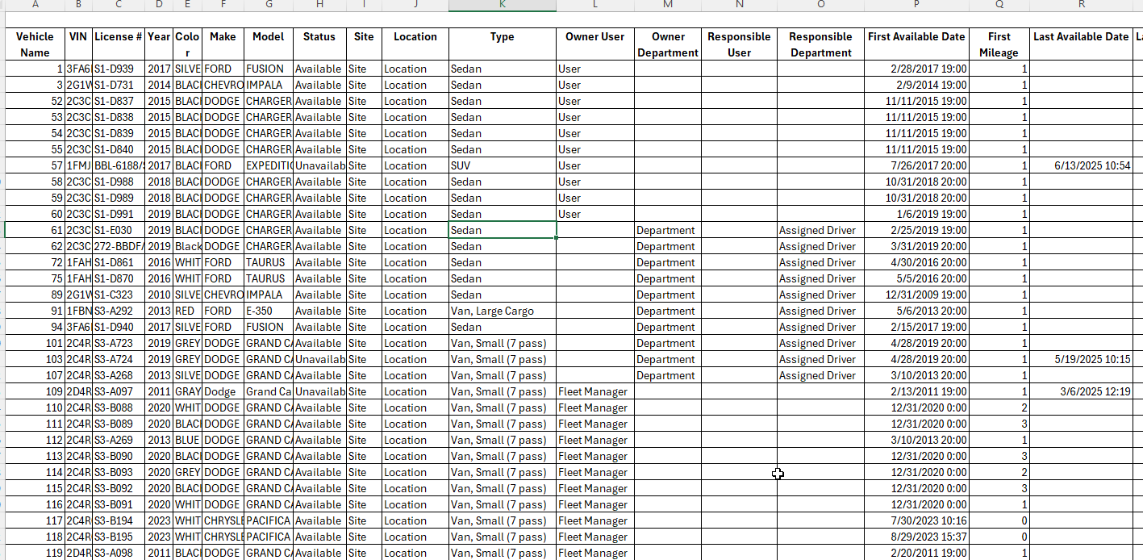
TCO expense summary
Summarizes posted TCO transactions for a time period and life to date of vehicle
One line per vehicle

Slide 27
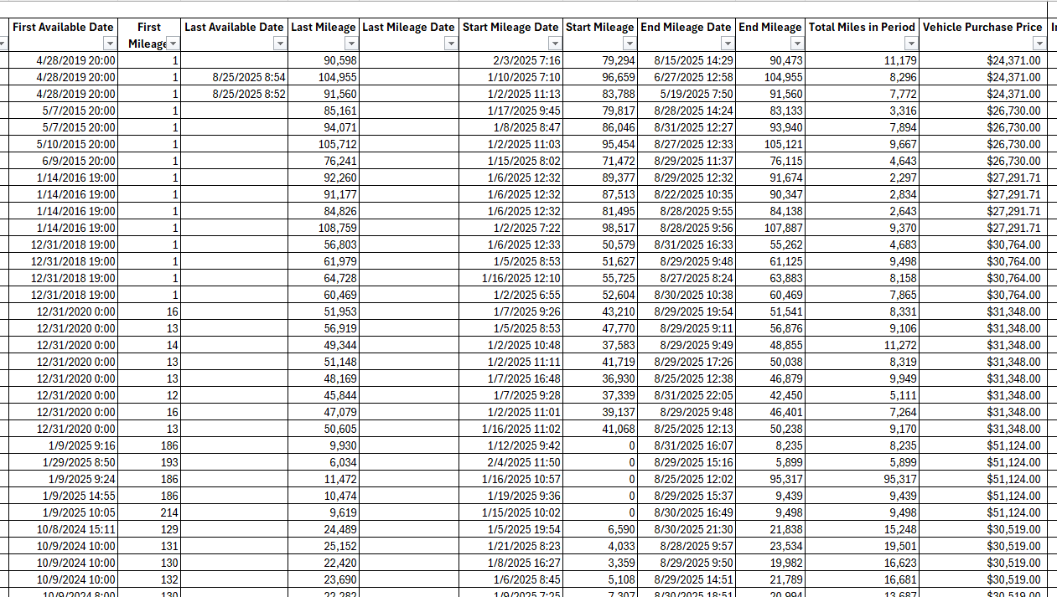
TCO expense summary
Acquisition & Mileage information

Slide 28
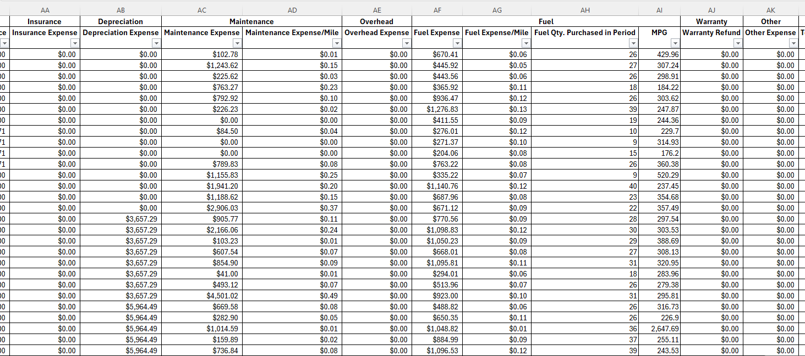
TCO expense summary
Summarizes expenses during time frame

Slide 29
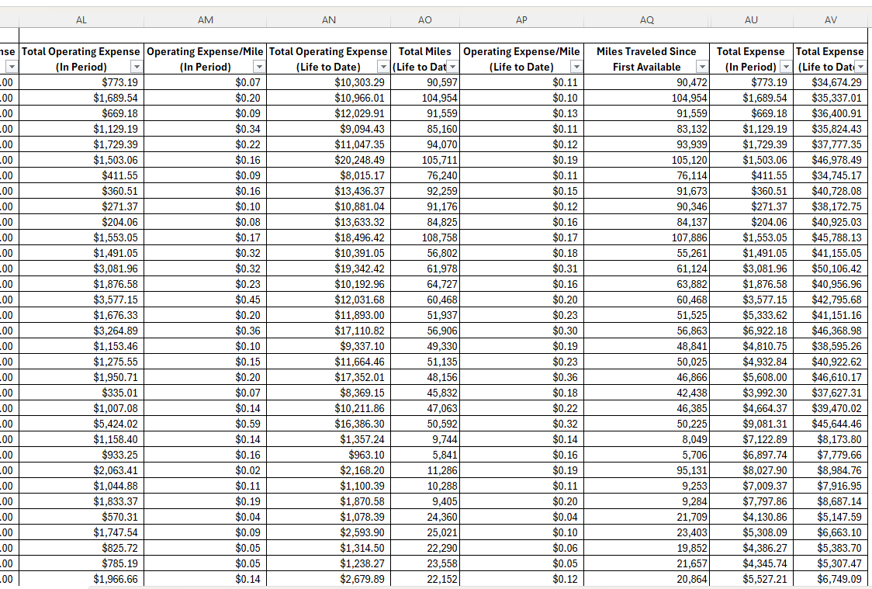
TCO expense summary
Summarizes

Slide 30
future Changes
6.0 and beyond

Slide 31
Future TCO enhancements
Posting Tool option to post all unposted transactions via one click.
Posted filter added to TCO Expense Summary Report.
License plate number added to TCO Data Dump Report.
Missing timestamp added for TCO transactions on Asset Profile.

Slide 32
Future TCO enhancements
New Manage TCO interface.
Delete unposted transactions, multiples at one time.
Toggle to enable editing of multiple records for some common data points.

Slide 33
Thank you

