Slide 1

Welcome to command 2025
Core Value Awards

Slide 2
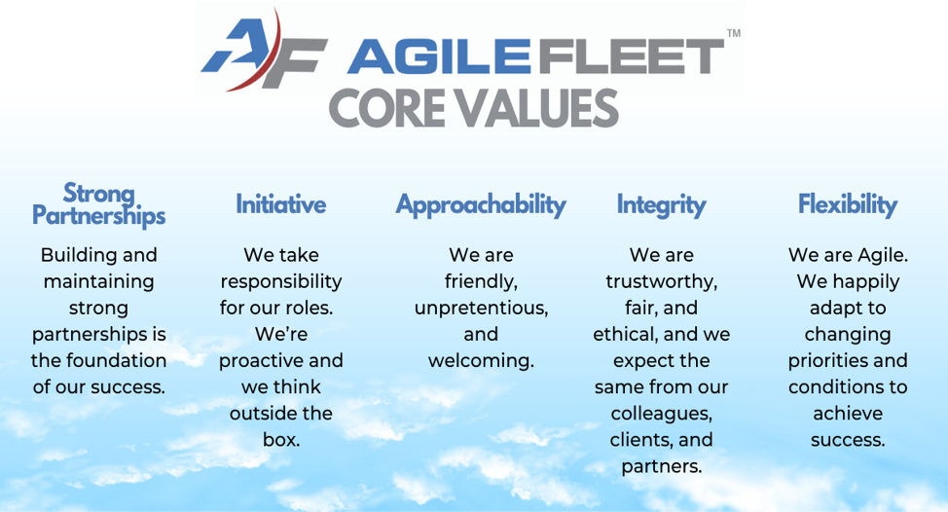

A LITTLE BIT ABOUT Core values
“People don’t quit jobs, they quit toxic or unhealthy cultures”.
100% of employees hired at Agile Fleet since 2000 cited our core values as a reason they landed here.

Slide 3

Agenda
Strong Partnerships
Initiative
Integrity
Approachability
Flexibility

Slide 4

Strong partnerships
Building and maintaining strong partnerships is the foundation of our success.

Slide 5
And the award goes to…
Oak Ridge National Laboratory
ORNL has demonstrated what true partnership means by collaborating with Agile Fleet while navigating unique challenges. As part of the Department of Energy, they face the complexities of operating within a highly secure environment while rapidly expanding their use of the FleetCommander platform. This includes managing configuration challenges and coordinating communication across strict security frameworks. Through it all, ORNL has remained committed to working closely with our team, ensuring solutions are effective and sustainable. Their ability to grow with us and maintain open collaboration embodies the very essence of Strong Partnerships.

Slide 6

initiative
We take responsibility for our roles. We're proactive and we think outside the box.

Slide 7
And the award goes to…
Texas State Technical College
TSTC has embodied Initiative since day one, fully embracing FleetCommander as their FMIS system across their entire organization. With 11 motor pool locations spread across multiple campuses, they have implemented motor pool, fuel, and maintenance management to streamline operations. Recently, TSTC added key control to automate the dispatch process, designed a new vehicle availability view for drivers, and integrated FleetCommander with Geotab for more accurate mileage. By continuously innovating and proactively expanding their capabilities, TSTC demonstrates how initiative leads to transformation and lasting impact.

Slide 8

integrity
We are trustworthy, fair, and ethical, and we expect the same from our colleagues, clients and partners.

Slide 9
And the award goes to…
State of Michigan, DTMB
The State of Michigan exemplifies Integrity in every interaction. They consistently share their honest experiences with prospects and clients, offering candid insights into both the benefits of FleetCommander and the challenges to anticipate during implementation. Recently, they spoke with the State of Washington’s Department of Enterprise Services, providing valuable, transparent guidance as Washington prepared to launch the platform. By always leading with openness and honesty, Michigan demonstrates the trustworthiness and responsibility that define integrity.

Slide 10

approachability
We are friendly, unpretentious, and welcoming.

Slide 11

flexibility
We are Agile. We happily adapt to changing priorities and conditions to achieve success.

Slide 12
And the award goes to…
Melina Helgeson, University of Minnesota
Melina Helgeson and the University of Minnesota team truly embody Flexibility. This year, they didn’t hesitate to step forward as the first to volunteer to host our Command event, dedicating their time and energy to create a welcoming environment for all. Their willingness to adapt, take on new responsibilities, and serve as gracious hosts highlights the spirit of flexibility and agility. By embracing opportunities and challenges with positivity, UMN shows how flexibility drives both community and collaboration.

Slide 13
Thank you

