Slide 1

Analyze & Advocate with AI
COMMAND 2026 · THURSDAY SESSION
From fleet data, to insight, to influence.
Dave Kennerley & Mike Hicks · Thursday, November 5 · 9:00 AM
Sponsored by:
Notes:
Mike opens. Quick intro of both presenters. "For the next hour, we're going to talk about two things: finding the story in your data, and making sure the right people hear it."

Slide 2

Let's Start With You
SHOW OF HANDS
Question 1
Question 2
How often are you using AI tools to help manage your fleet?
Does your organization allow AI tools? Do they provide licenses?
Notes:
Question 1: Ask everyone to raise a hand first, then lower it if leadership has NOT asked about the fleet when nothing was wrong. Most hands drop. That's the point. Question 2: Count roughly and react. "Everyone who raised a hand, this session is going to give you time back."

Slide 3
Let's Start With You
SHOW OF HANDS
Question 3
Question 4
Has your leadership asked about the fleet when nothing was wrong in the last six months.
Raise your hand if building a report for your boss takes you more than a day.
Notes:
Question 1: Ask everyone to raise a hand first, then lower it if leadership has NOT asked about the fleet when nothing was wrong. Most hands drop. That's the point. Question 2: Count roughly and react. "Everyone who raised a hand, this session is going to give you time back."

Slide 4


Fleets Are Judged by Their Problems
THE PROBLEM
Your fleet's best story is sitting in a spreadsheet nobody reads.
PART 1 · ANALYZE
PART 3 · ADVOCATE
Find the story
Tell the story
Use AI to surface what your data is already telling you, in minutes instead of days.
Put your wins in front of the people who fund, approve, and depend on your fleet.
Notes:
"Fleet departments only get noticed when something breaks. Today we fix both halves of that." Mention that Part 2, in the middle, is Dave's preview of what's coming natively in FleetCommander.

Slide 5
AI as Your Fleet Analyst
PART 1 · ANALYZE
Notes:
No software demos here. Everything in this section uses tools most attendees already have access to, with data they can export today.

Slide 6







Don’t Be Like Bob
A CAUTIONARY TALE
Talks like a robot
A 3-page yes or no
“Certainly! Let’s delve into the multifaceted landscape of tire pressure.”
“Is the van free Tuesday?” gets an executive summary and an appendix.
“The AI wrote it”
Treats it like an oracle
Blames the bot when the memo is wrong. His name was on it.
Asked AI whether to buy 40 trucks. Bought 40 trucks.
Never checks the math
Feeds it everything
Meet Bob.
Fleet manager. Hasn't written his own email since March.
Proudly reported 312% utilization to the city council.
Pasted every driver’s license number into a free chatbot.
Notes:
Have fun with this one. Introduce Bob like he’s a colleague everyone has met: “Some of you work with Bob. Some of you ARE Bob. No judgment.”
Read each sign with a beat for laughs. Show of hands: “Who’s gotten an email from Bob?”
Land the point: AI is the assistant; you’re the fleet manager. Your name goes on the work, so the judgment, the voice, and the accuracy are yours.
Optional ad-libs: his thank-you notes start with “Certainly!”; he asks AI what to have for lunch; every email opens with “I hope this email finds you well.”

Slide 7





What AI Is Good At for Fleets
WHERE AI HELPS
Right-sizing
Anomalies
Explaining trends
When to replace
What-if questions
Find underused vehicles and pooling candidates.
Flag odd fuel, mileage, or maintenance costs.
Ask why a number moved, not just that it did.
Model when to replace, and what it costs to wait.
Test scenarios without waiting on an analyst.
Notes:
Keep it practical. Ask: "Show of hands: who has already tried an AI tool on fleet data?" Acknowledge both groups.

Slide 8
What's the Headline Here?
SPOT THE STORY
Department | Units | Trips/mo | Util. | Annual cost
Facilities | 32 | 41 | 71% | $238,000
Central Motor Pool | 25 | 52 | 84% | $186,000
Grounds | 22 | 37 | 66% | $161,000
Research | 18 | 16 | 38% | $134,000
Athletics | 14 | 9 | 22% | $104,000
Housing | 9 | 8 | 19% | $67,000
Hands up for your pick:
A. Fuel costs are climbing
B. Facilities needs more vehicles
C. Low-use vehicles are quietly costing six figures
D. The motor pool is overbooked
Illustrative sample data: Mesa State University (fictional)
Notes:
Read each option and take a show of hands for each. Don't reveal yet. "This is the kind of table every one of you has. The story is in there. Let's see what AI pulls out of it."

Slide 9
What AI Found in Three Minutes
THE REVEAL
41
THE PROMPT
vehicles under 40% utilization
"You're a fleet analyst. Here's our utilization by department. Which vehicles are candidates for removal or pooling, and what would that save? Give me three takeaways for a budget meeting."
Research, Athletics, and Housing account for $305K a year.
14
can move to the shared motor pool
Departments keep access; booking replaces ownership.
$105K
a year in operating savings
Plus $420K in avoided replacements over five years.
Illustrative sample data: Mesa State University (fictional)
Notes:
The answer was C. "Six figures a year was hiding in a table that looked perfectly ordinary." Point out that the prompt asked for budget-meeting takeaways: AI does the analysis AND frames it for an audience. Remind them to verify every number before it leaves their desk.

Slide 10
A Prompt Formula You Can Reuse
STEAL THIS
1
2
3
4
Role
Data
Question
Format
"You're a fleet analyst."
Attach the export or paste the table.
"Which vehicles are candidates for removal?"
"A table and three takeaways for my CFO."
Then keep going: "Why did Athletics drop?" "What if we pooled six instead of 14?" The follow-up questions are where the insight lives.
Notes:
Tell them to photograph this slide; it's also on the prompt card they'll get at the end. Emphasize that the first answer is a starting point. The best results come from the second and third questions.

Slide 11




Four Guardrails
USE IT RESPONSIBLY
Use approved tools
Strip personal data
Follow your organization's AI policy. Ask IT which tools are cleared for work data.
Remove driver names, license numbers, and anything personal before you upload.
Verify every number
Analyst, not oracle
AI can be confidently wrong. Check figures against the source before they leave your desk.
Treat AI like a sharp junior analyst: fast and useful, but you own the conclusions.
Notes:
Most of this room is public sector, so don't rush this. A single bad number in front of a council or board can undo a year of credibility. Hand off to Dave: "Everything I just showed you takes some copying and pasting. Dave's going to show you what happens when it's built in."

Slide 12
Native AI, Built In
PART 2 · PRESENTED BY DAVE KENNERLEY
Notes:
Dave's segment, about 15 minutes. Dave's opening line: "Everything Mike just showed you with copy and paste? Here's what happens when it's built in."

Slide 13
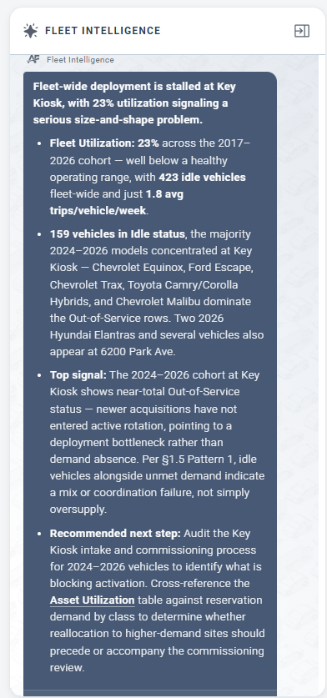
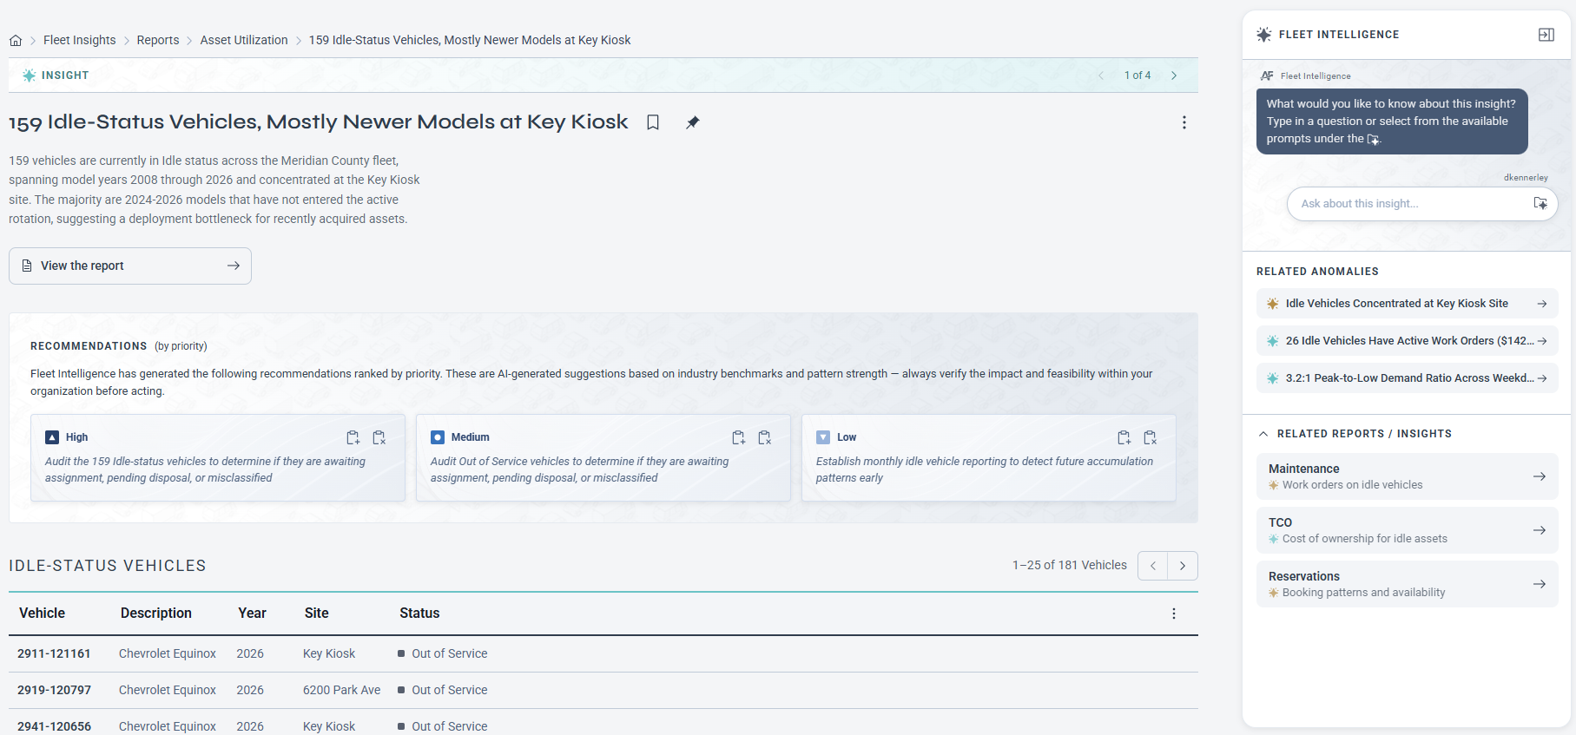
What's Coming: Insights into Your Data Including Recommended Actions and Interaction
Insights
Notes:
Dave: close your segment by pointing to the 11:15 Report Center & AI Insights session, then hand back to Mike for the Advocate section.

Slide 14
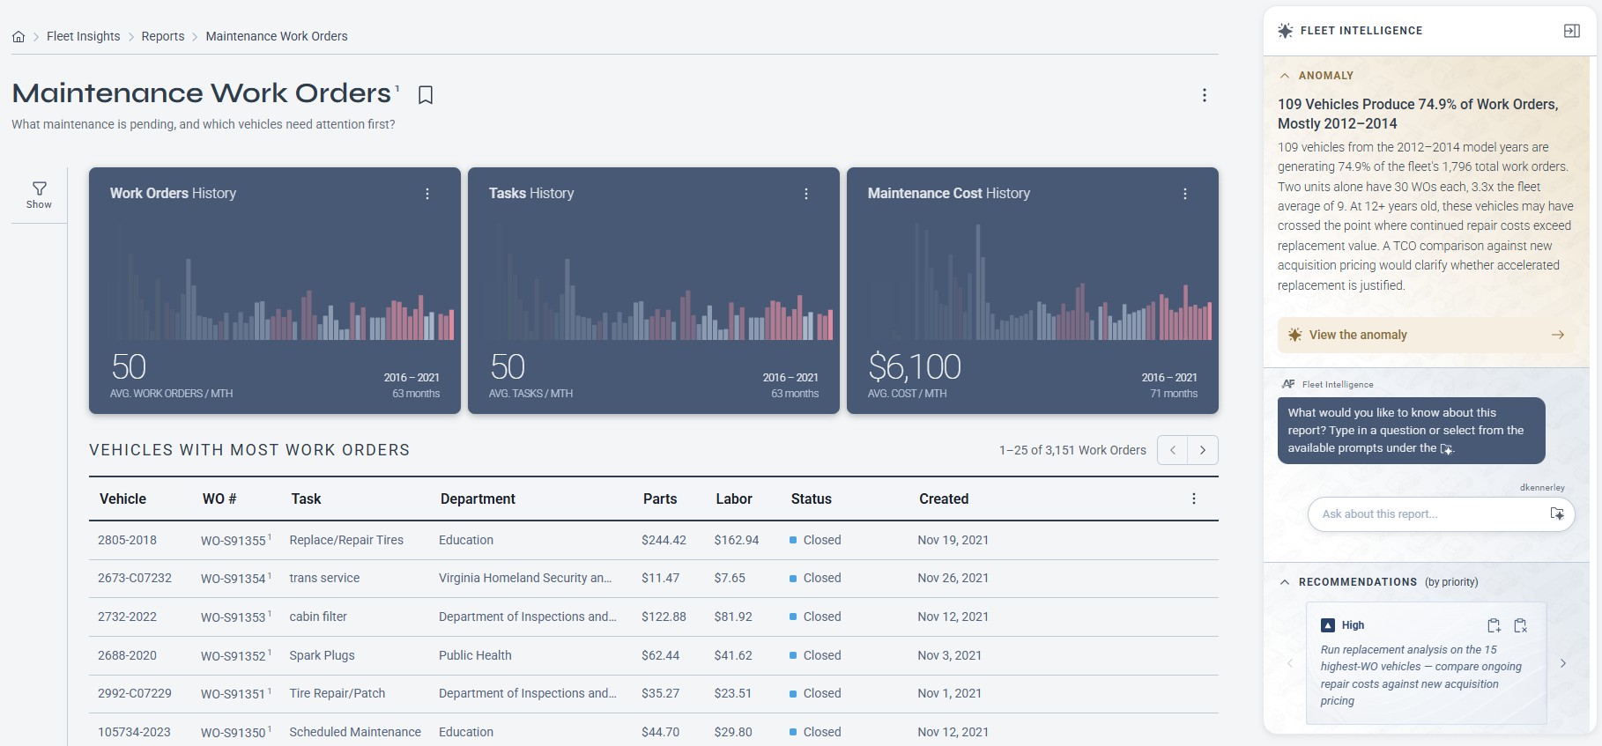
What's Coming: Insights into Your Data
Insights
Notes:
Dave: close your segment by pointing to the 11:15 Report Center & AI Insights session, then hand back to Mike for the Advocate section.

Slide 15
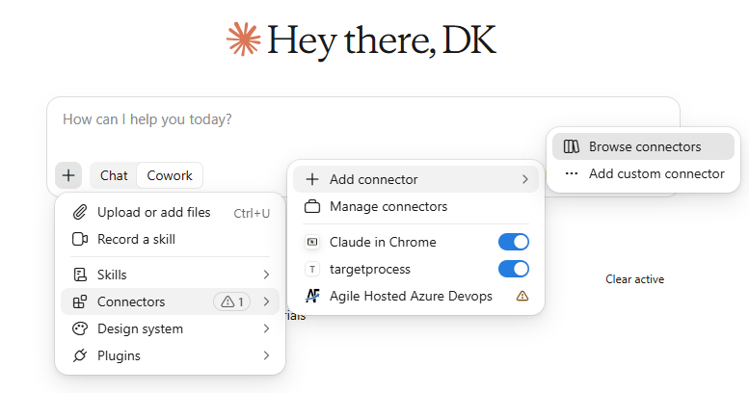
Feedback Requested: FleetCommander Connector
Enhanced Access to Your Data
An MCP server (Model Context Protocol) is a small service that exposes your product’s data and actions to AI assistants in a standard way. Think of it as a “USB port for AI”: you build it once, and any MCP-compatible client (Claude, ChatGPT, Copilot, Cursor and others) can plug into it. Your customers can then ask their assistant things like “Which vehicles are overdue for maintenance?” and get answers straight from your system.
What a server exposes
Tools: actions the AI can call, such as search_reservations, get_vehicle, create_work_order.
Resources: read-only data the AI can pull in as context, such as a fleet list or a policy document.
Prompts: optional pre-built templates, such as “Summarize this month’s utilization.”
Notes:
Dave: close your segment by pointing to the 11:15 Report Center & AI Insights session, then hand back to Mike for the Advocate section.

Slide 16
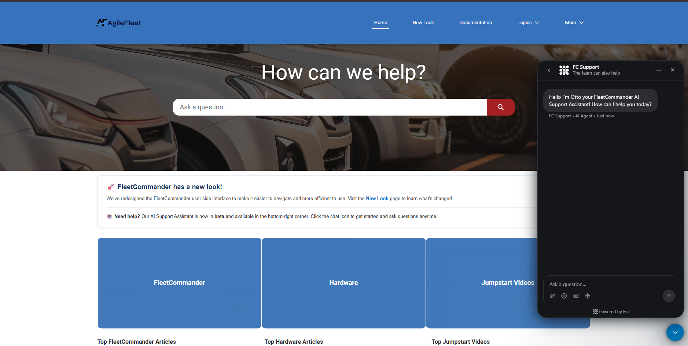






Meet Otto, your AI support assistant
Get Help 24x7
Self-help answers, any time of day — right on the FleetCommander knowledge base.
Available 24/7
Ask a question any time — no waiting for business hours.
On the knowledge base
Open the knowledge base and click the chat icon in the bottom-right corner.
Fast answers
Get help in seconds, in plain language.
OTTO CAN HELP YOU WITH
Reports
Settings
Emails
Issues
fcdrive.agilefleet.com chat icon, bottom-right
Notes:
Dave: close your segment by pointing to the 11:15 Report Center & AI Insights session, then hand back to Mike for the Advocate section.

Slide 17
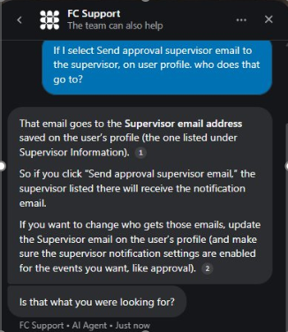
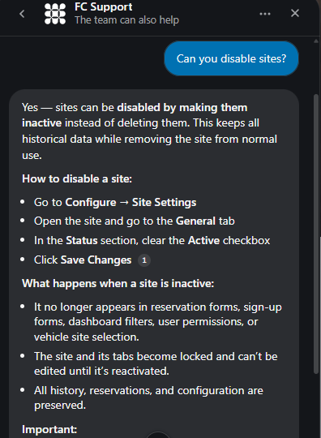




Otto works alongside our support team
Get Help 24x7
Use Otto when you need a quick answer. Our team is still here when you need a person.
1
Ask Otto
Type your question and get an answer right away.
2
Escalate to a case
If Otto can’t answer your question, escalate it to create a support case.
3
A support rep gets back to you
A Customer Support representative follows up with you by email or phone.
Otto doesn’t replace our support team — they’re always available to you.
Real questions answered by Otto
Notes:
Dave: close your segment by pointing to the 11:15 Report Center & AI Insights session, then hand back to Mike for the Advocate section.

Slide 18
Be Your Own Hype Person
PART 3 · ADVOCATE
Notes:
Mike back on stage. "You've found the story. Now let's make sure the people who matter actually hear it."

Slide 19
Same Data, Different Stories
KNOW YOUR AUDIENCE
Audience | What they care about | Lead with
CFO & budget office | Dollars and cost avoidance | "Retiring 14 vehicles saves $105K a year"
Executives, boards, regents | Mission, risk, reputation | Safety, compliance, sustainability
Departments & drivers | Availability and convenience | "A vehicle is there when you need it"
The public, peers, awards | Leadership and innovation | NAFA 100 Best Fleets, case studies, press
Notes:
Ask: "Show of hands: who has a different person they report to than the person who approves their budget?" Most will. That's why one report never works for everyone.

Slide 20
Climb Every Metric to the Mission
THE SO WHAT LADDER
MISSION
So $105K a year went back to student services
OUTCOME
So we retired 14 underused vehicles
METRIC
Utilization rose from 58% to 72%
Nobody outside the fleet office cares about utilization. Everyone cares about what it paid for.
Notes:
Walk the ladder bottom to top. "Every metric you report should be able to answer 'so what?' twice. If it can't, it doesn't belong in front of leadership."

Slide 21
Build Your Own Ladder
YOUR TURN · 4 MINUTES
1
2
3
Pick one metric
Climb it twice
Share it out loud
Something you already track: utilization, cost per mile, downtime, reservations filled.
Write the outcome, then the mission. Ask "so what?" at each step.
Read it out loud. Does it sound like something your boss would repeat?
Use the So What Ladder card on your table. We'll hear two or three out loud.
Notes:
Set a visible four-minute timer. Walk the room. Then invite two or three volunteers to read theirs aloud. Celebrate each one. This sets up the 30-day challenge at the end.

Slide 22
AI Tailors the Message
ONE DATASET, THREE STORIES
FOR THE CFO
FOR LEADERSHIP
FOR THE PUBLIC
Budget memo
Executive one-pager
LinkedIn post
Subject: FY27 fleet right-sizing
Retiring 14 underused vehicles cuts operating cost by $105K a year and avoids $420K in replacement purchases over five years, with no loss of service.
Smarter fleet, same service.
14 fewer vehicles
96% availability maintained
$105K a year back to the mission
Proud of our fleet team! By sharing vehicles across campus, we freed up $105K a year for students while keeping a ride available whenever departments need one. #FleetManagement
Illustrative sample data: Mesa State University (fictional)
Notes:
Build this one card at a time. "Same 14 vehicles. Same spreadsheet. Three completely different stories, each in the language its audience speaks. Each took one prompt: 'Rewrite this for my CFO,' 'for my vice president,' 'as a LinkedIn post.'"

Slide 23
Before and After
REPORT MAKEOVER
BEFORE
AFTER
Unit | Dept | Odo | Trips | Days | Util | Fuel | Maint | Cost
V-1040 | FAC | 18000 | 8 | 4 | 19% | $310 | $120 | $5400
V-1047 | ATH | 21417 | 21 | 11 | 36% | $407 | $331 | $6213
V-1054 | RES | 24834 | 34 | 18 | 53% | $504 | $542 | $7026
V-1061 | HSG | 28251 | 47 | 25 | 70% | $601 | $753 | $7839
V-1068 | GRD | 31668 | 15 | 10 | 21% | $698 | $964 | $8652
V-1075 | MP | 35085 | 28 | 17 | 38% | $795 | $275 | $5465
V-1082 | FAC | 38502 | 41 | 24 | 55% | $892 | $486 | $6278
V-1089 | ATH | 41919 | 9 | 9 | 72% | $389 | $697 | $7091
V-1096 | RES | 45336 | 22 | 16 | 23% | $486 | $908 | $7904
V-1103 | GRD | 48753 | 35 | 23 | 40% | $583 | $219 | $8717
Utilization up 14 points
72%
vs. 58% last year
14 retired · $105K/yr saved · 96% available
Accurate. Complete. Unread.
Notes:
Hold on the BEFORE side for a beat. "Raise your hand if you've sent a report that looks like this." Then reveal the AFTER. Walk through what changed: a headline that states the finding, one big number, a baseline, a trend, and a single line that ties it to dollars.

Slide 24
Five Rules to Get Noticed
DESIGN RULES
1
Headline first
State the finding in the title. Data supports it.
2
One big number
Give each view a single hero figure.
3
Always a baseline
Last year, last quarter, or a target.
4
Trends over snapshots
Show direction, not a single moment.
5
Steady cadence
Same format, same day, every month.
Notes:
The fifth rule matters most. When leadership knows your update arrives on the first Monday of every month, they start looking for it. That's when the fleet stays top of mind.

Slide 25



Four Ways to Stay Top of Mind
FORMATS THAT WORK
Monthly scorecard
Live dashboard
One page, five KPIs, sent on the same day every month.
Three to five KPIs that leadership can check anytime.
Success story
Award submissions
One department's win each quarter, told in their words.
NAFA 100 Best Fleets and peer recognition build credibility.
Notes:
Award submissions are an underused advocacy tool. Winning gives leadership something to brag about, and it puts the fleet department's name in front of executives in a positive way.

Slide 26


Let AI Do the Heavy Lifting
AI AS YOUR COMMS TEAM
Executive summaries
Budget justifications
Talking points
Turn a 40-row table into three sentences.
Draft the narrative behind every request.
Prep for a council, board, or cabinet meeting.
Chart suggestions
Data into story
Audience rewrites
Ask which visual tells this story best.
"Write this as a story about the Housing team."
"Now say it for the public, in 50 words."
Notes:
Every one of these prompts is on the prompt card. The same guardrails apply: approved tools, no personal data, verify the numbers.

Slide 27
Ship One Thing in 30 Days
THE 30-DAY CHALLENGE
1
1
1
Pick one audience who should know your fleet's story. Choose one metric and climb the ladder. Put it in one format and send it.
audience
metric
format
Then send it to your Client Success manager. The best ones may star at COMMAND 2027.
Take it with you: the prompt slides shared here will be shared in our post-Command communications.
Notes:
Ask for a show of hands: "Who's taking the challenge?" Encourage everyone to send their work to their Client Success manager, and mention that standout examples could become Client Spotlights at next year's COMMAND.

Slide 28
Find the Story. Tell the Story.
Questions? · Dave Kennerley & Mike Hicks
Sponsored by:
Notes:
Open for questions. If time is short, invite people to find Dave or Mike at the break, and remind them about the 11:15 Report Center & AI Insights session.

