Slide 1
Key Dispatching Options
Five ways to dispatch keys in and out with FleetCommander — how each works, what it needs, and how what’s new.
Agile Fleet • FleetCommander

Slide 2





Five ways to dispatch keys
From fully secured, kiosk-driven key boxes to a person handing out keys at a counter — each option fits a different mix of security, location, and budget.
Original Key Control
FleetCommander Go
Keyless
Kiosk Only
Dispatcher
KSI
Key Café
Invers
Keys not secured
No hardware
Keys locked in a secured box, dispatched at a kiosk.
Secure key box, no kiosk — phone scans an on-screen QR.
In-vehicle hardware; unlock by RFID card or phone.
Keys on hooks; check in/out at the kiosk or by phone.
A staff member hands out and collects the keys.

Slide 3

2
CHOOSING A DISPATCH MODEL
One family, three ways to dispatch keys
Same FleetCommander platform underneath — the difference is how many key control points you deploy, and how close they sit to your drivers.
FleetCommander
FleetCommander GO
FleetCommander Keyless
One large, centralized motor pool for major campuses and citywide fleets.
Several smaller pools placed close to where drivers actually are.
No hubs at all — vehicles live wherever they're parked.

Slide 4
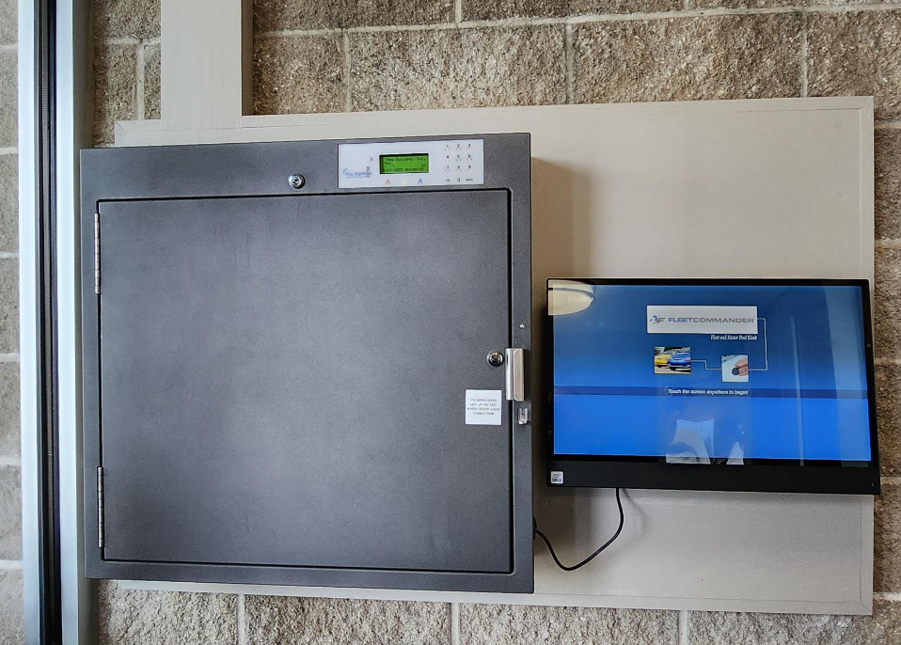
Original Key Control
KSI key box 24×7 availability
HOW IT WORKS
Keys are locked behind a secured door in a wall-mounted box. Drivers dispatch and return keys at a kiosk, or by scanning a QR code with their phone.
ADVANTAGES
Highest security — keys stay locked behind a door
Kiosk adds SSO and RFID; integrates with your existing access-control cards
Captures check-in / check-out data at dispatch
SmartFob (tamper-proof ring) returns to any open position; scales 8–192 key positions
WHAT'S REQUIRED
Kiosk (or a printed QR code + phone used as the kiosk)
OpenVPN with a few basic network settings in place
Notes:
Original Key Control (KSI) is the flagship, most-secure option. Box styles: standard key, or key + fuel-card secure positions. Sizes: 8–192 key positions, 8–112 key-card positions. The kiosk enables SSO, an RFID card reader, integration with the customer's access-control cards, and data capture on check-in. It can run without a kiosk using a printed QR code that the driver scans to use their phone as the kiosk — but note there is no PIN/keypad fallback to open the box in that mode. Network uses OpenVPN and requires some basic network settings.

Slide 5
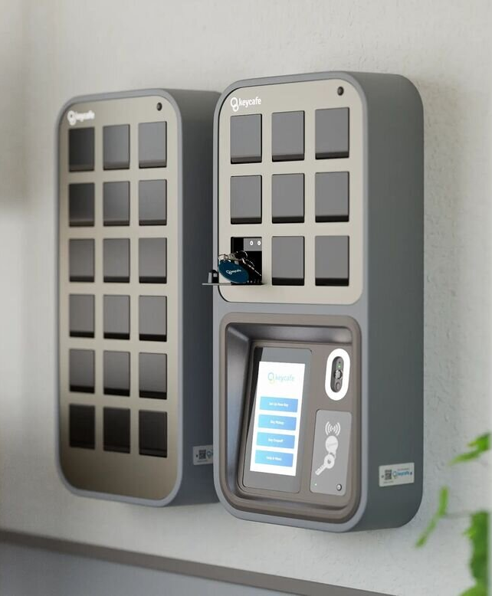
FleetCommander Go
Key Café 24×7 availability
HOW IT WORKS
A wall-mounted key box with no kiosk. Drivers scan the on-screen QR code with their phone (the screen mirrors to the phone), or use a QR code / PIN entered at the box.
ADVANTAGES
No kiosk — less hardware, lower cost, fewer points of failure
Easy install — 15 lb box locks onto a wall mount (about as hard as hanging a shelf)
Plug-and-play network — wired or wireless, no firewall rules; box is auto-recognized
Swap-and-ship support; scales 9–429 positions, daisy-chain boxes; outdoor enclosure to 29
WHAT'S REQUIRED
An internet connection (wired or wireless)
A phone for the QR scan — or configure a QR / PIN at the box
Notes:
FleetCommander Go (Key Café) trades the kiosk for a lighter, lower-cost box. If drivers don't have a phone, you can configure the system to present a QR code or PIN at the box — a good fit when you don't need to collect check-in details. Maintenance is swap-and-ship: a replacement box is sent out and the old one shipped back. Expansion: 9 up to 429 positions, multiple boxes daisy-chained; outdoor enclosure available for up to 29 positions.

Slide 6
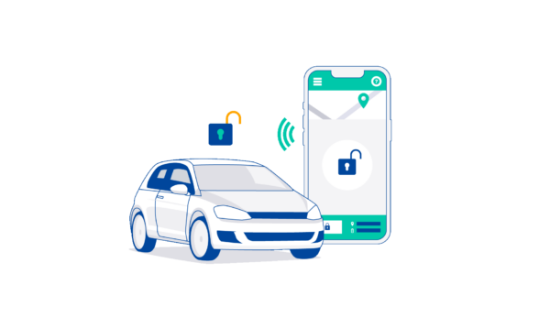
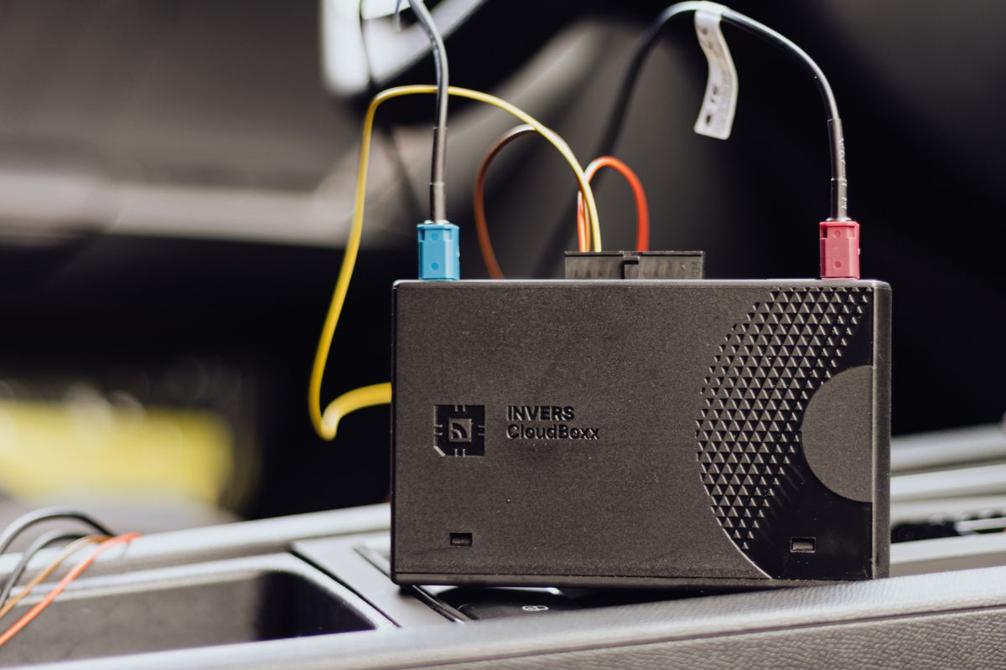
Keyless
Invers in-vehicle hardware 24×7 availability
HOW IT WORKS
No key box and no kiosk — hardware is installed in each vehicle. Drivers unlock the vehicle with an RFID card or their phone; a geofence and timer detect the return and end the reservation.
ADVANTAGES
No box or kiosk footprint to site or maintain
Ideal for remote locations, or small pools spread across many sites
Contactless access by RFID card or phone
Reservations close out automatically via geofence + timer
WHAT'S REQUIRED
In-vehicle hardware installation per vehicle
Cellular signal at the vehicle. Can also use RFID or Bluetooth.
Immobilizer
Notes:
Keyless (Invers) puts the access hardware in the vehicle instead of in a box, so cost scales with the number of vehicles rather than key positions. It's the natural fit for remote sites or small pools scattered across locations. Requires a cellular signal; uses a geofence and timer to know when the vehicle is back and to end the reservation.

Slide 7
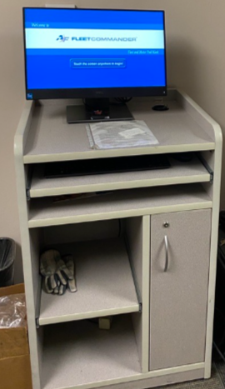

Kiosk Only
Keys are not secured
HOW IT WORKS
Keys sit on hooks or in a drawer — they are not locked. Drivers check vehicles in and out at the kiosk, or from a phone using the check-in URL.
ADVANTAGES
Low hardware footprint and simple to run
Captures check-in / check-out data at the kiosk
Phone check-in / check-out supported via URL
WHAT'S REQUIRED
A kiosk (or phone + the check-in URL)
Relies on drivers to self-serve
Watch-out Keys aren't secured — drivers can bypass check-in/out and just grab a key, which can throw off reservation accuracy.
Notes:
Kiosk Only is the lightest hardware footprint that still captures data. Keys live on hooks or in a drawer and are not secured. The honest downside: nothing forces a driver to use the kiosk — they can bypass it and grab a key, which can impact reservation accuracy. Drivers can also check in/out from a phone if they know the URL.

Slide 8
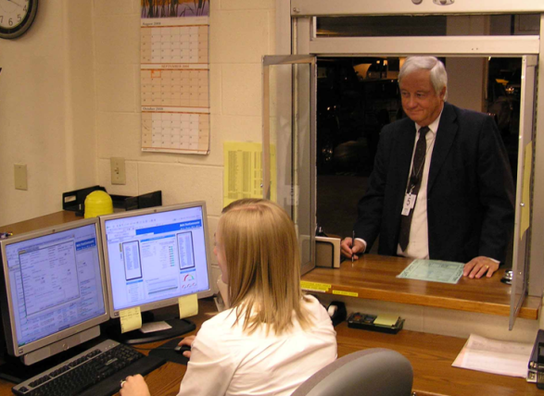
Dispatcher
No hardware required
HOW IT WORKS
A staff member hands out and collects the keys in person, checking vehicles in and out on the driver's behalf.
ADVANTAGES
No hardware to buy, install, or maintain
Human oversight and flexibility at the counter
Simple way to start dispatching
WHAT'S REQUIRED
A person available on-site during dispatch hours
Watch-out Requires staffing and doesn't work for remote or unattended locations — coverage is limited to when someone is there.
Notes:
Dispatcher is the no-hardware option: a person hands out keys. The trade-off is ongoing labor, and it can't cover remote or unattended locations. Useful as a staffed-counter model or a starting point before adding automated options.

Slide 9

Compare the options at a glance
Option | Keys secured | Hardware | Kiosk | Best for
Original Key Control (KSI) | Yes | Secure box + kiosk | Yes* | High-security, high-traffic sites
FleetCommander Go (Key Café) | Yes | Key box, no kiosk | No | Fast, lower-cost secure rollout
Keyless (Invers) | In-vehicle | In-vehicle unit / vehicle | No | Remote sites & scattered pools
Kiosk Only | No | Kiosk only | Yes | Low-security, trusted pools
Dispatcher | By staff | None | No | Staffed depots & counters
* KSI can run without a kiosk using a printed QR code (no PIN fallback to open the box).
Mix and match. All five options are interchangeable — run different methods at different locations within one organization. Relative cost only; contact Agile Fleet for current pricing.

Slide 10


A closer look at what's new
Recent additions to how you dispatch keys — a walkthrough of the Key Café experience, phone-based login, and the keyless flow.
Phone / QR login
FleetCommander Go, end to end
Keyless
Scan a QR to open the kiosk on your phone — no RFID needed.
Check-out & return, admin setup, hardware, and coverage.
Reserve, walk up, and badge in to start the vehicle.

Slide 11
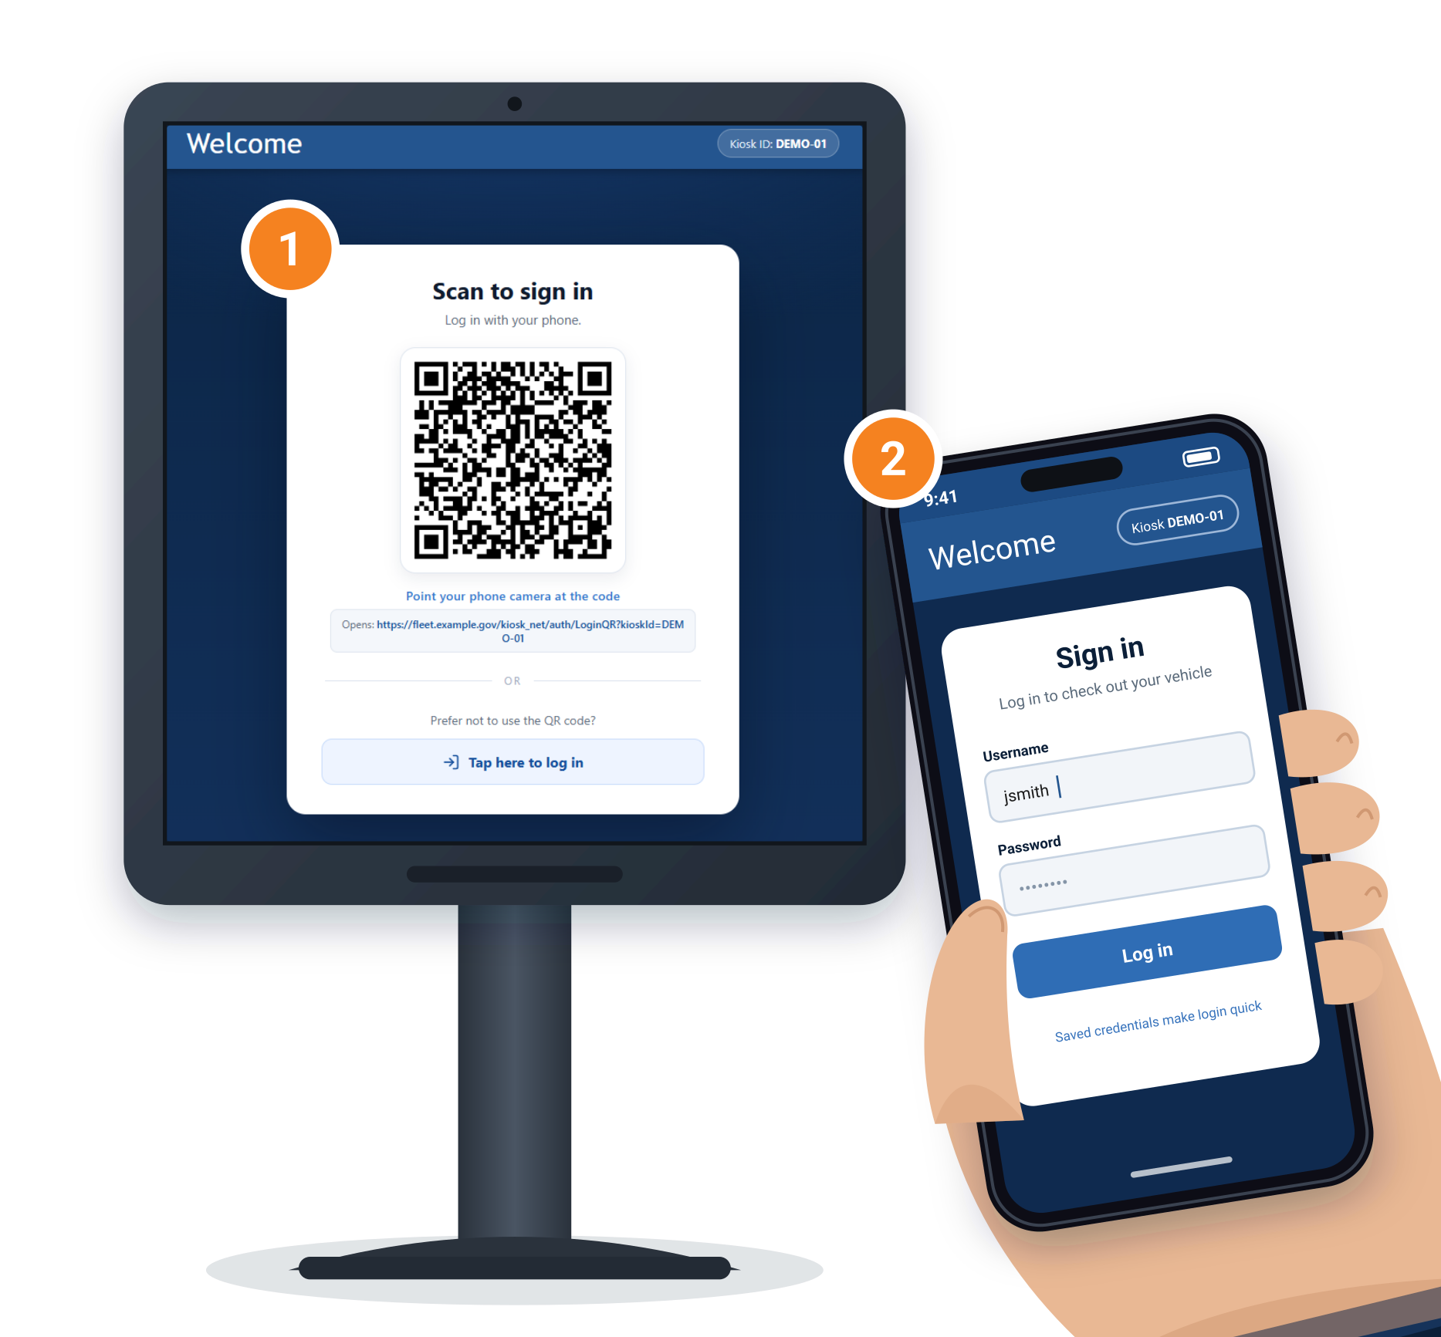
Log in by phone at kiosk — scan a QR
QR code at kiosk
AN ALTERNATIVE TO THE KIOSK LOGIN
Scan a QR code to open the kiosk on your phone
Use as an alternative to logging in at a physical kiosk
Works well for clients with long logins who don't use RFID
Don’t have phone, can still select Tap here to log in.
① Scan the QR on the kiosk ② Log in on your phone
Notes:
QR code / kiosk-on-phone login is an option instead of using the kiosk login. The driver scans a QR to open the kiosk on their phone. It works well for clients with long logins who don't use RFID.

Slide 12

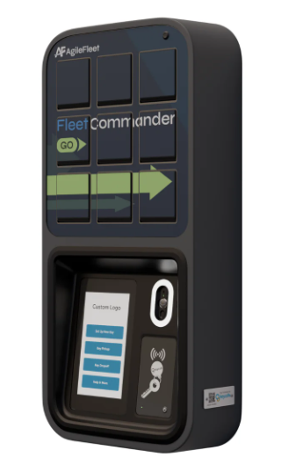
Introducing
FleetCommander GO
Key control, reimagined — easier to use, easier to implement, and built for every fleet.
Notes:
KRISTIN: Now let's switch gears to key management. You May have seen email communication earlier this week regarding Command and our new product offering. Brian and I would like to introduce to you FleetCommander Go.
As we are working to enhance the user experience with our software, we are also enhancing our hardware options to be more Key box agnostic. Expanding to other solutions gives us the ability to offer more options to support diverse use cases and budgets.
Brian – show the video

Slide 13
1
WHY WE BUILT IT
GO means freedom to implement motor pool your way
No more designing your program around the constraints of your key-control hardware.
1
2
3
Easy to use
Easy to implement
Budget-friendly
Drivers’ phones are the kiosk. Drivers reserve, unlock, and return without learning a new device.
Wall-mount or freestanding hardware that connects over Ethernet, Wi-Fi, or cellular — live in days, not months.
A fraction of the cost of traditional key-control hardware, so more locations fit the budget.
Notes:
KRISTIN: Why did we build GO? So you can implement your motor pool your way, instead of designing the program around the limits of your key-control hardware.
Talking points: easy to use — drivers' phones are the kiosk; easy to implement — wall-mount or freestanding hardware over Ethernet, Wi-Fi or cellular, live in days; budget-friendly — a fraction of the cost of traditional key-control hardware.

Slide 14
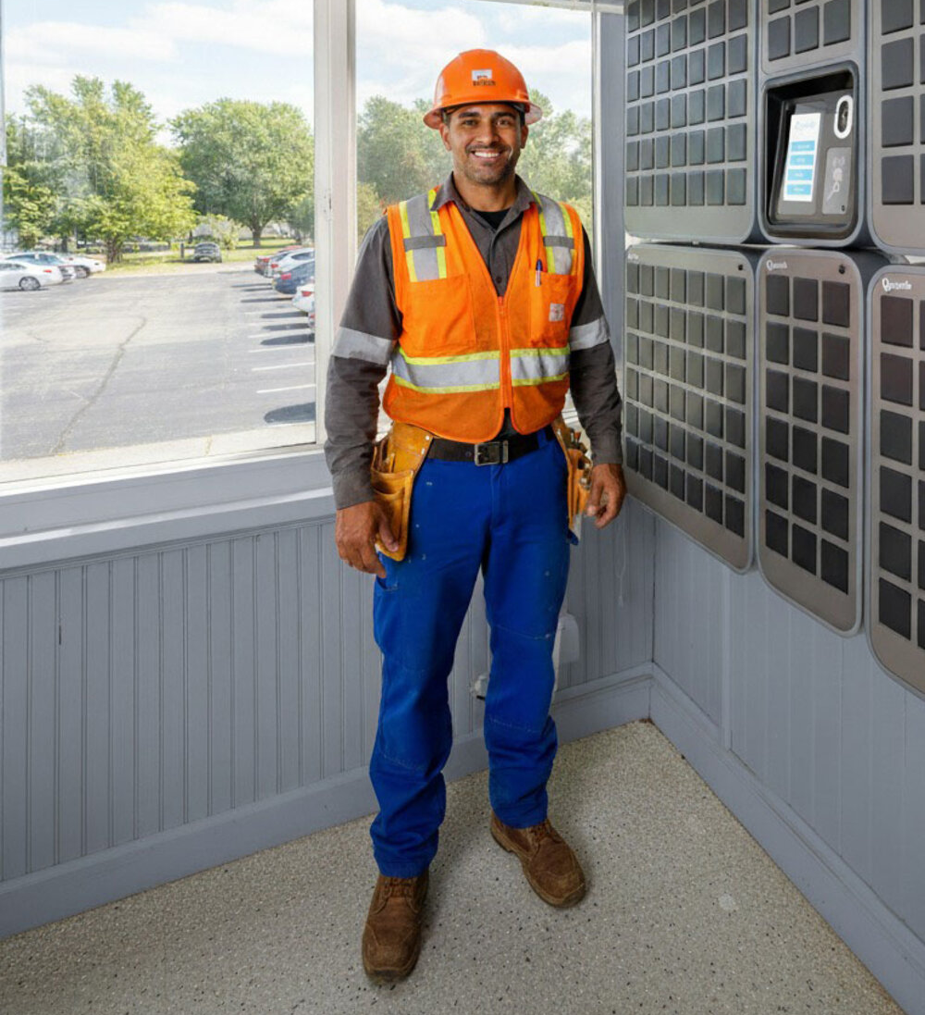
2
THE VALUE OF LOWER-COST HARDWARE
Meet drivers where they are
GO hardware costs a fraction of traditional key boxes — as little as a fifth, depending on scale and configuration. That changes what's possible.
One location no longer has to serve everyone
Spread pickup points across buildings, lots, and campuses instead of funneling every driver to a single key desk.
Add a location without adding a budget line
Lower hardware cost means a department, a satellite lot, or a remote site can get its own SmartBox – possibly out of your OpEx budget.
Grow coverage as the program grows
Start where it matters most and expand deployment right alongside fleet growth.
Notes:
KRISTIN: Lower-cost hardware changes what's possible.
Talking points: one location no longer has to serve everyone; add a location without adding a budget line; grow coverage as the program grows.

Slide 15
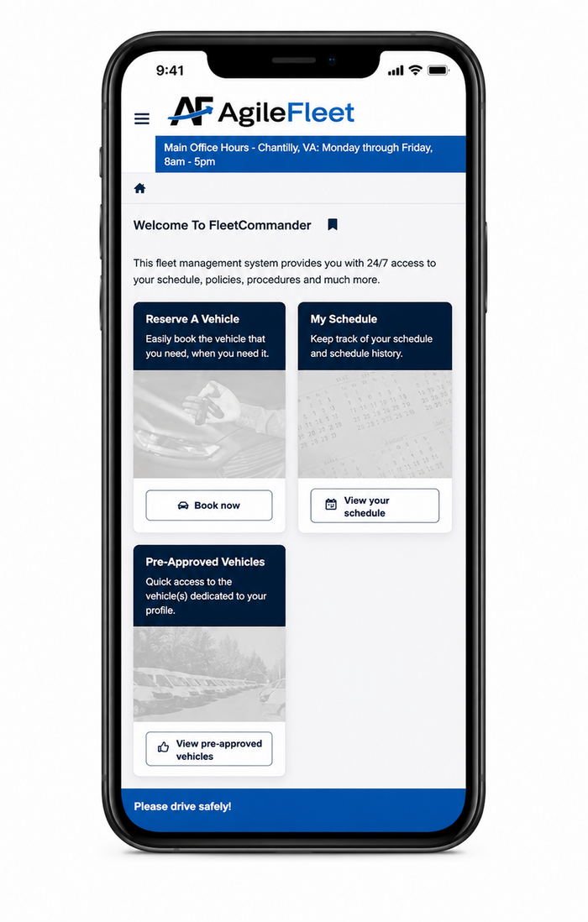
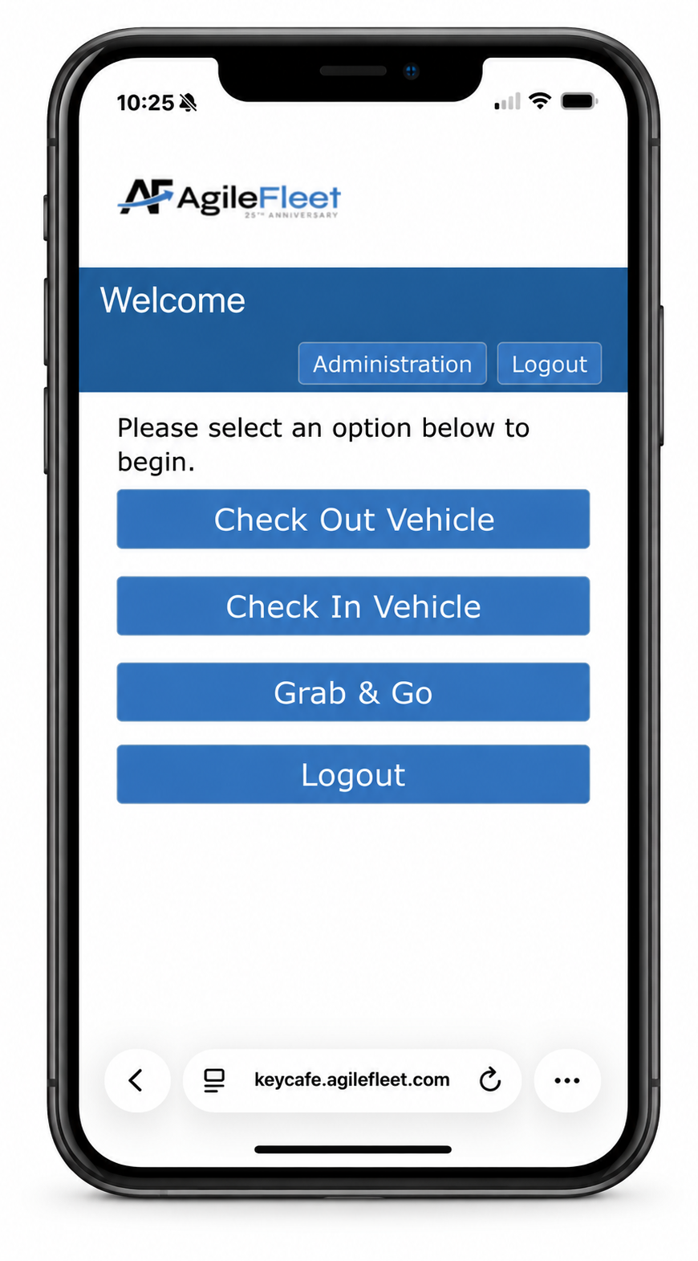
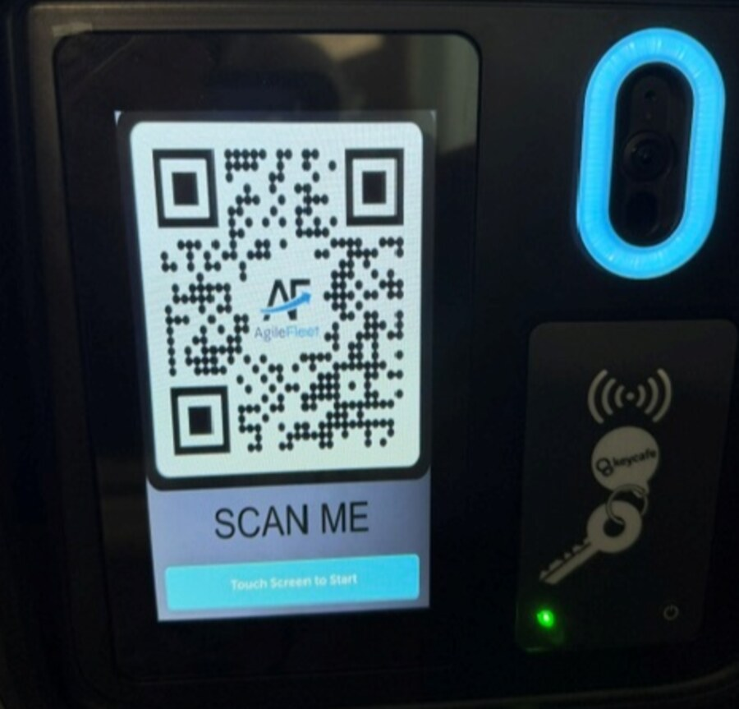
FleetCommander Go: check out & return
FleetCommander Go
FROM YOUR PHONE
1
Scan the barcode on screen — it's also on your reservation and confirmation email
2
The kiosk opens on your phone; saved credentials make login quick
3
Tap Check Out — the bin button lights up; select it to open the bin
4
Take your keys and head out on your trip
Scan to access kiosk interface on mobile device— no separate kiosk required
5
On return: scan the QR, tap Check In, and enter any required details (mileage, fuel, etc.)
Notes:
Key Café check-out flow: scan the barcode/QR on the kiosk screen (also delivered on the reservation and confirmation email); the kiosk UI opens on the driver's phone; saved credentials speed login; tapping Check Out illuminates the bin button; selecting it opens the bin. On return the driver scans the QR, chooses Check In, and enters any required details such as mileage and fuel.

Slide 16
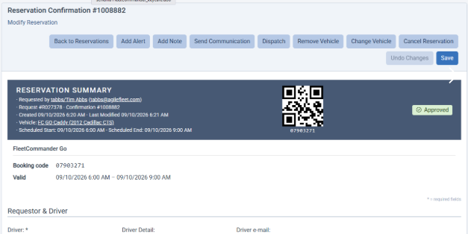
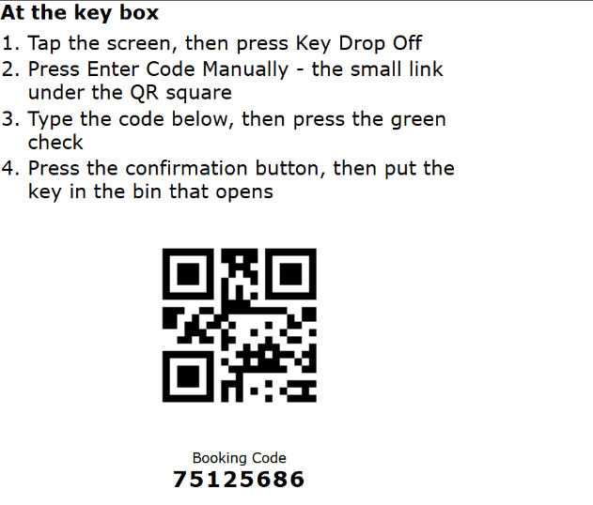
No phone? No problem
FleetCommander Go
Drivers without a phone can still check keys in and out two ways:
1
QR on the reservation form
Add a QR code to the reservation form for the driver to scan at the box.
2
A code at the box
Enter a code to open the box — it's included on the confirmation email.
A good fit when you don't need to collect check-in details.
Notes:
No-phone options for Key Café: (1) add a QR code to the reservation form for the driver to scan, or (2) let the driver enter a code at the box to open it — the code is included on the confirmation email. Best when you don't need to collect check-in details.

Slide 17

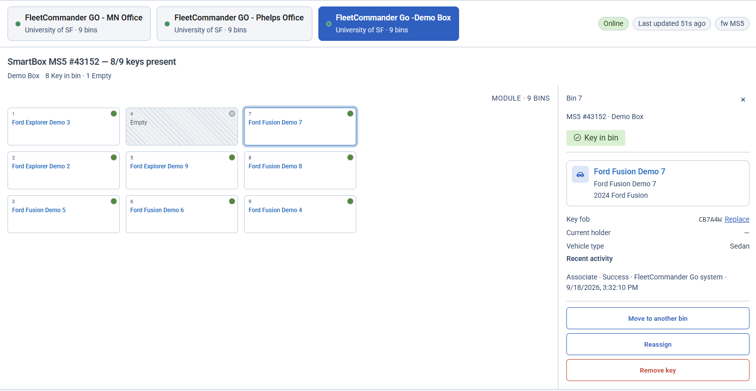
Assign keys to bins
Admin · Key Café
HOW TO ASSIGN A KEY
Go to Configure ▸ Kiosk/Key Box ▸ the Key icon
In the new interface, pick the bin you want the key assigned to
Or assign it right from the vehicle profile — the new FleetCommander Go option
New key-assignment interface — choose the bin
Notes:
Key registration/assignment (admin): assign keys under Configure > Kiosk/Key Box > Key icon. The new interface lets you select the bin to assign the key to. Keys can also be assigned directly from the vehicle profile via the new FleetCommander Go option.

Slide 18
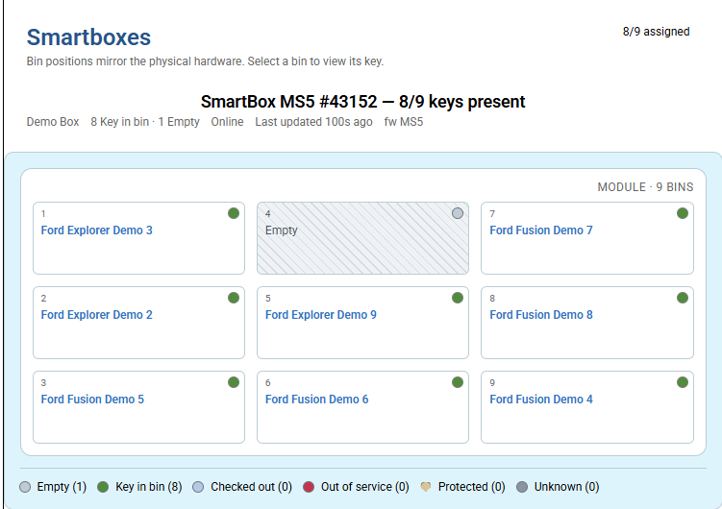
The FleetCommander Go dashboard
See and control every bin
AT A GLANCE
See which vehicle is in which bin, in real time
Open bins remotely — just like your other FleetCommander dashboards
Live status across all of your SmartBoxes
Live bin status on the FleetCommander Go dashboard
Notes:
The FleetCommander Go dashboard clearly shows which vehicle is in which bin and lets you open bins remotely, consistent with the other FleetCommander dashboards.

Slide 19
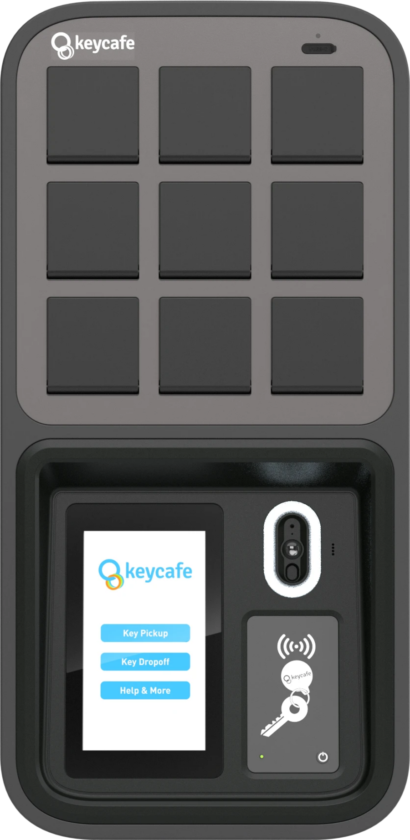
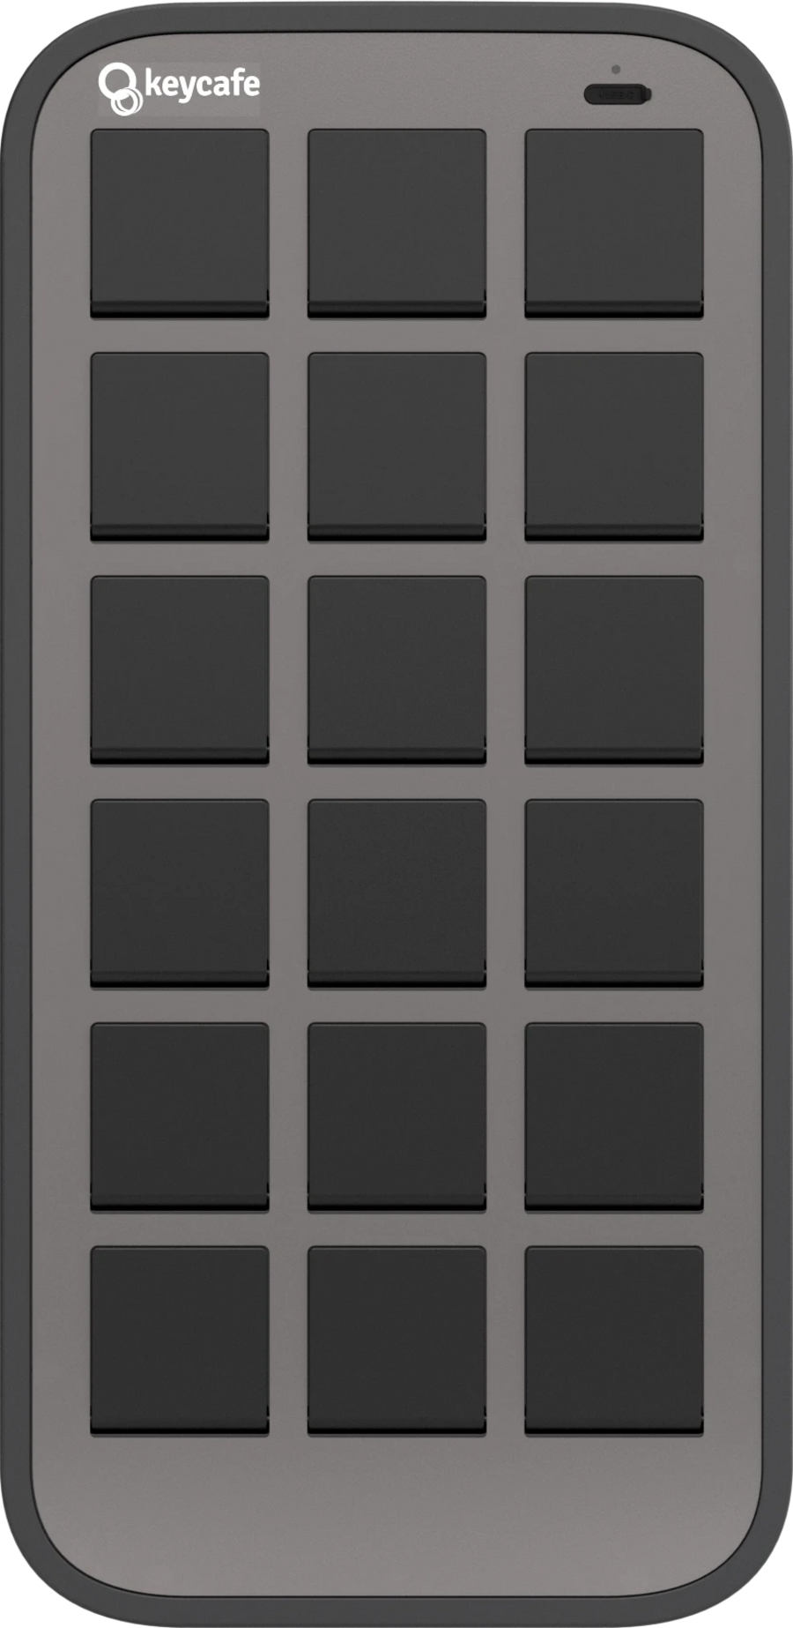

5
THE HARDWARE
One base station. Two ways to expand.
Every deployment starts with the MS5 Base Station and grows using MS5E-18 and MS5E-42 expansion SmartBoxes — no new base unit required with support for up to 429 keys.
9
18
42
KEY BINS
KEY BINS
KEY BINS
MS5 Base Station
MS5E-18 Expansion
MS5E-42 Expansion
The starting point for every deployment — always required.
Add one or more to grow in smaller increments.
Add one or more for faster growth to larger fleets.
Notes:
KRISTIN: The hardware starts with the MS5 Base Station, which holds 9 keys, and expands with the MS5E-18 and MS5E-42 SmartBoxes — up to 900 keys without a new base unit.

Slide 20
6
SIZING THE DEPLOYMENT
Configurations, sized to the fleet
Combine the base station with expansions to land on the right key-bin count for each location.
Configuration | Composition | Typical Fit
9-Key | MS5 Base Station | Single department, small pilot
27-Key | MS5 + 1× MS5E-18 | One building, a few departments
45-Key | MS5 + 2× MS5E-18 | Campus wing or multi-lot site
51-Key | MS5 + 1× MS5E-42 | Growing motor pool
69-Key | MS5 + 1× MS5E-18 + 1× MS5E-42 | Large department or campus
93-Key | MS5 + 2× MS5E-42 | Campus / enterprise motor pool
Notes:
KRISTIN: Here are some typical configurations, from a 9-key single-department pilot up to a 93-key campus or enterprise motor pool.

Slide 21
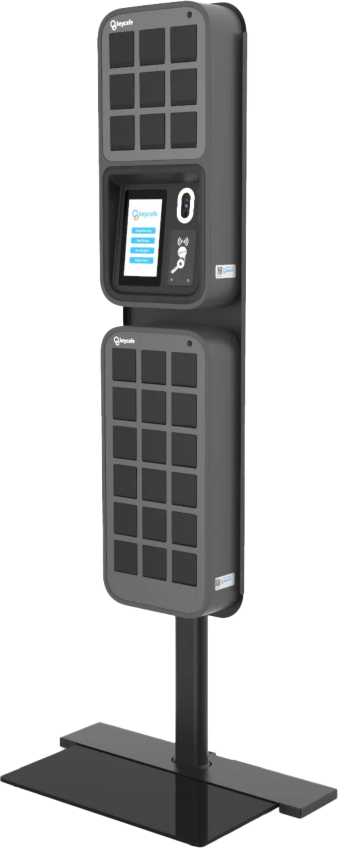
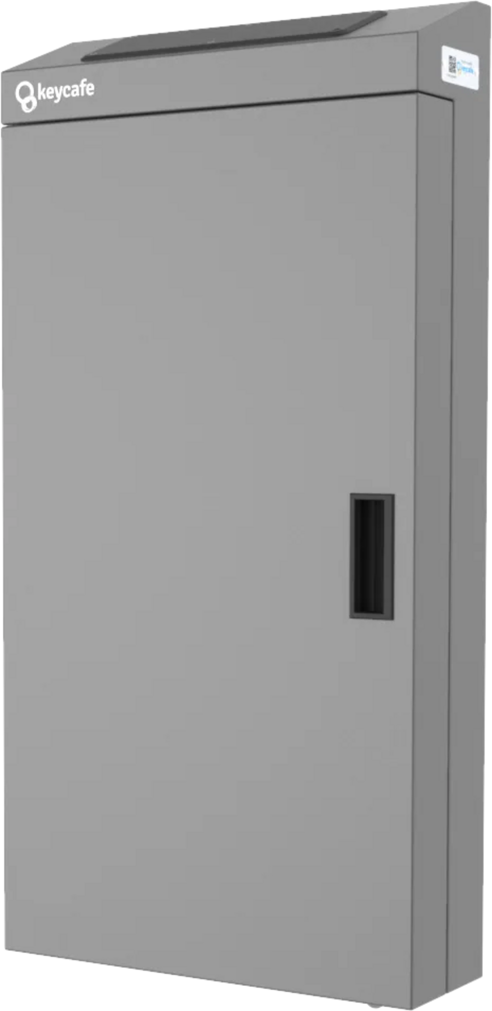
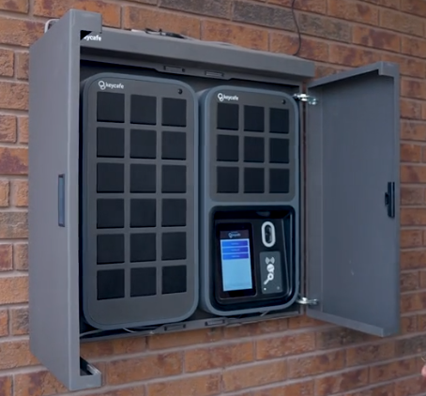
9
WHEREVER IT'S NEEDED
Wall, floor, indoors, or out
No wall space? No problem. Exposed to weather? Also no problem.
SmartBox Stand
Single Outdoor Enclosure
Double Outdoor Enclosure
Freestanding — no wall required
Ideal for lobbies and open lots
Weatherproof, IP56 rated
For a base station in the open
Weatherproof, IP56 rated
Houses a base + one expansion
Notes:
KRISTIN: No wall space or installing outdoors? There's a freestanding SmartBox stand plus single and double outdoor enclosures rated IP56.

Slide 22

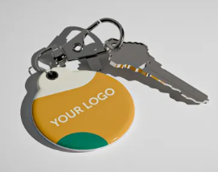
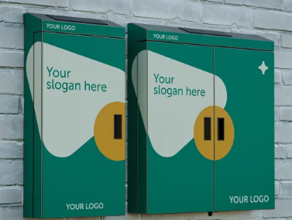
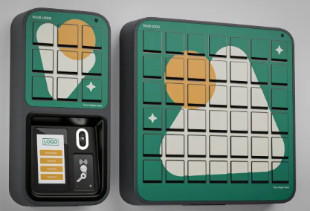
Make it yours — custom branding
Key Café
Brand the box, the fobs, and the outdoor enclosure with your own logo, colors, and slogan.
Custom-branded box
Branded key fobs
Branded outdoor enclosure
Notes:
Custom branding options are available for the box, the fobs, and the outdoor enclosure — logo, colors, and slogan.

Slide 23
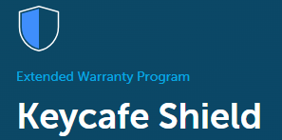




Key Café Shield
Optional coverage & upgrade plan
An optional plan that extends SmartBox coverage beyond the standard warranty and adds upgrade benefits that cut long-term equipment cost — keeping service uninterrupted and your hardware current.
Perpetual Warranty
Free Hardware Upgrades
50% Off Early Upgrades
Standard one-year coverage is extended indefinitely for every SmartBox while enrolled.
Base stations that reach 5 years in service earn a free upgrade to the latest-generation equivalent. End-of-life units with a replacement are covered at no cost.
Prefer to move sooner? Upgrade to the latest-generation base station any time at 50% off retail.
Notes:
Key Café Shield (Keycafe Shield) is an optional plan extending SmartBox coverage beyond the standard warranty, with upgrade benefits that reduce long-term equipment cost. Perpetual Warranty: standard one-year coverage extended indefinitely while enrolled. Free Hardware Upgrades: base stations reaching 5 years in service are eligible for a free upgrade to the latest-generation equivalent; end-of-life products with a replacement available are covered at no cost. 50% Discount on Early Upgrades: upgrade to the latest-generation base station any time at 50% off retail.

Slide 24
Keyless: how a trip works
Invers
1
2
3
›
›
Make a reservation
Go to the vehicle
Badge in & drive
Book the vehicle in FleetCommander as usual.
Head to the reserved vehicle at pickup time.
Scan your badge — the doors unlock and you can start the vehicle.
Notes:
Keyless (Invers) driver flow: make a reservation, go to the vehicle, and scan your badge — the doors open and you can start the vehicle. (Access can also be by phone as noted on the Keyless option slide.)

Slide 25





Keyless: a reservation, start to finish
Invers · Current phase
EXAMPLE · 8:00AM – 12:00PM RESERVATION
7:50 — Too early
9:01 — Returned
12:00PM — Dispatched in
Unlock is refused before the reservation start time.
Driver locks the vehicle. The last badge scan is recorded as the return time.
Reservation closes at its end time, with the 9:01 return time.
8:00AM — Start
If never picked up
Badge in to unlock and drive.
With a 2-hour rule, the reservation auto-cancels at 10:01.
Returned early? The vehicle stays reserved until 12:00 — unless an admin dispatches it in sooner.
Notes:
This walks through the reservation lifecycle rules for keyless (Invers) vehicles in the current phase, using an 8:00 to 12:00 reservation.
Pickup: the vehicle cannot be unlocked before the reservation start time. A badge scan at 7:50 for an 8:00 start is refused.
Standard FleetCommander auto-cancel applies. With a 2-hour rule, an 8:00 to 12:00 reservation that is never picked up cancels at 10:01.
Return: the reservation stays open for its full length even if the vehicle comes back early. If the driver returns and locks at 9:01, the reservation is dispatched in at 12:00 with 9:01 recorded as the return time.
The vehicle is not available to others until the reservation end time, unless an admin manually dispatches it in.

Slide 26

Keyless: pickup & return rules
Invers · Current phase
Pickup & auto-cancel
Return & dispatch-in
The vehicle can’t be unlocked before the reservation start time
Standard FleetCommander auto-cancel rules apply if the vehicle isn’t picked up
Location isn’t checked at pickup — start wherever the vehicle is parked
The reservation stays open for its full length, even if returned early
The last badge scan (lock) is recorded as the dispatch-in time
The vehicle isn’t available to others until the end time — unless an admin dispatches it in
The return must be within 100 yards of home (configurable) — if it isn’t, the reservation stays open until the vehicle is back and locked
Known gap Drivers can’t end a trip early in this phase. Early return is planned for the upcoming mobile app.
Notes:
Pickup: no unlocking before the start time, and standard FleetCommander auto-cancel applies. Location is not checked at pickup.
Return: the reservation stays open for its full length even if returned early. The last badge scan (lock) is the dispatch-in time. The vehicle stays unavailable to others until the end time unless an admin dispatches it in.
The return is validated against the home location geofence: within 100 yards of the landmark.
The main known gap in this phase: there is no driver-initiated early return. That is planned for the mobile app.
If the vehicle is not at its home location, the reservation does not end. It stays open until the driver returns to the home location and locks the door, so the driver is never stranded.

Slide 27





Keyless: location & geofence
Invers · Location only matters at return
HOME LOCATION
Set the home location
Assign a site and location on the vehicle profile — that landmark becomes the vehicle’s home.
Location only matters at return
If the vehicle isn’t at its home location, the reservation won’t end. It stays open until the driver returns and locks the door — so no driver is left stranded.
Landmark
One-way trips(e.g., drop-off at airport; drive to home location)
100-yard return zone
An admin ends the reservation manually; the next driver picks up remotely and returns the vehicle to home base.
One home location per vehicle
Not home yet? The reservation stays open until the vehicle is back inside the geofence and locked.
Multiple home locations per vehicle (true one-way or multi-site) isn’t supported today.
Notes:
The home location is a landmark. Assigning the site and location on the vehicle profile sets the vehicle’s home.
Location is not checked for pickup, so a reservation can start wherever the vehicle is parked. Admin intervention works anywhere too.
Returns are validated against the home location geofence, within 100 yards of the landmark. Reservations must end at home base so no driver is stranded.
Workaround for one-way trips such as an airport drop-off: the admin manually ends the reservation, and the next driver picks up remotely and returns the vehicle to home base.
Multiple home locations per vehicle (true one-way or multi-site) is not supported today.
Key point: if the driver is not at the home location, the reservation will not end. It remains open until they return to the home location and lock the door, so the driver will not be stranded.

Slide 28


Keyless: badge enrollment
Invers · Card setup is the only step on the Invers side
1
2
3
4
›
›
›
Scan the card
UID created
Reserve
Badge in
Invers reads the card value.
Invers hashes it into a UID on its whitelist. FleetCommander stores the same UID on the user profile.
FleetCommander sends Invers the start time, end time, and UID.
The badge unlocks the vehicle during the reservation window.
WHICH BADGES WORK?
ENROLLING TODAY
Standard cards: use your existing employee badges.
The user scans their card at any keyless vehicle (or an office cloud box)
An admin copies the UID from Invers FleetControl into FleetCommander
Randomized or encrypted cards: will not work. We can recommend a generic RFID card to issue.
Notes:
Only card setup touches the Invers side. Everything else is configured in FleetCommander.
Invers reads the card value and hashes it into a UID kept on their whitelist. FleetCommander stores the same UID on the user profile. When a reservation is created, FleetCommander sends Invers the start time, end time, and UID to whitelist.
Customers can use existing employee badges if the card is standard. Randomized or encrypted cards require new cards from Invers.
Enrollment today: the user scans at any keyless vehicle or an office cloud box, and an admin copies the UID from Invers FleetControl into FleetCommander.
The goal is automatic UID capture so admins do not have to work in two applications, similar to RFID keyboard-wedge or key-box self-registration today. The enrollment process is still being finalized.

Slide 29
What’s next
Invers
Coming next: mobile app
Cards are RFID today
Bluetooth access through the phone app
Early return at the home location — dispatched in on confirmation
Are you finished, or do you want to extend?
Finish trip
Extend
Notes:
Lost card mid-trip: an admin manually dispatches in the reservation, creates a reservation for themselves, and badges in to recover the vehicle.
Card access is RFID today. Invers supports Bluetooth, which is for the upcoming phone app.
The mobile app should solve early return. The planned flow: when the driver is at the home location, the app asks "Are you finished, or do you want to extend?" and dispatches the vehicle in on confirmation.

Slide 30
Mix and match across your organization
The five options are interchangeable — pick the right one location by location. Three questions usually decide it:
1
2
3
Security
Location
Budget & scale
How locked-down do the keys need to be — fully secured, or is a trusted, self-serve pool fine?
Is the site staffed, unattended, or fully remote? Remote pools point toward Keyless or Key Café.
Weigh upfront hardware against ongoing labor, and how the option scales as the fleet grows.

