Slide 1

From Custom Code to Configuration
COMMAND 2026 · THURSDAY SESSION
The New Billing Export Module
Helen Lagerblade · Thursday, November 5 · 1:00 PM
Sponsored by:

Slide 2
BILLING OVERVIEW
PART 1

Slide 3
Current Billing Options
Billing Reporting
Standard functionality
No export, just reporting
Does not post
No long term/recurring option
Custom Billing Exports
Per client custom work
Documentation to match each data point to billing file format
Any changes requires another Change Request and development time
Long term/recurring charges are not posted or included in standard reports
Most written in .ASP which is being removed 12/31/2027 (14 months from now)
Notes:
Raise hand if you bill
Keep raised if you have a billing export
.net rewrite?

Slide 4

From Custom to Configurable
Notes:
Question 1: Ask everyone to raise a hand first, then lower it if leadership has NOT asked about the fleet when nothing was wrong. Most hands drop. That's the point. Question 2: Count roughly and react. "Everyone who raised a hand, this session is going to give you time back."

Slide 5
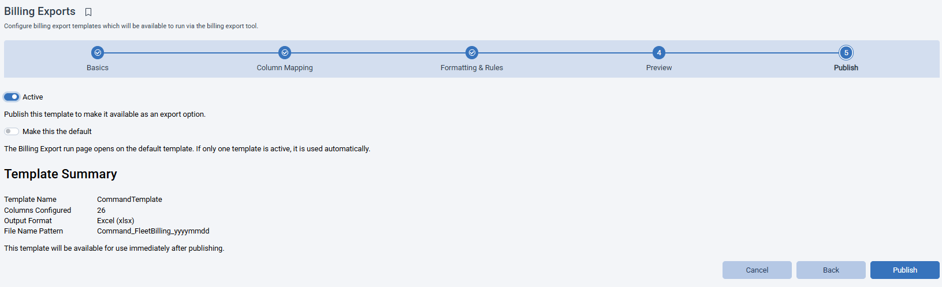
Configurable Billing Export Module
Build reusable billing export templates in a five-step wizard
Highlights:
No per-client custom work, in most cases
Allows for changes by administrators as needed
Long term/recurring charges can now be posted
In .NET

Slide 6
BUILD YOUR EXPORT
PART 2 · BUILD

Slide 7
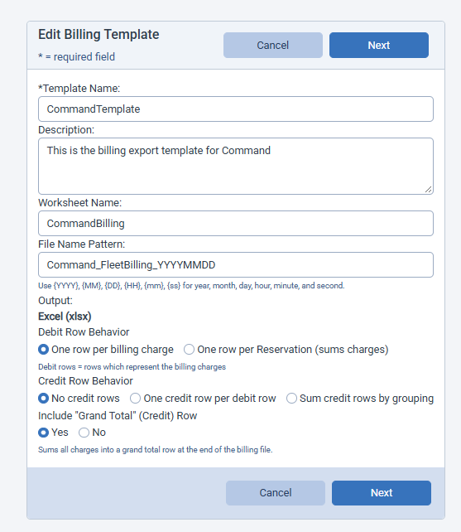
Step 1 - Basics
Name the Template and Set Row Behavior:
Identity & File: Template name, description, worksheet name, and a file name pattern using {YYYY} {MM} {DD} {HH} {mm} {ss}.
Debit Rows: One row per billing charge, or one row per reservation that sums its charges.
Credit Rows: None, one per debit row, or summed by grouping (charge type, department, location, site, usage type).
Grand Total Row: Optional credit row that sums every charge at the end of the file. Output is Excel (.xlsx).

Slide 8
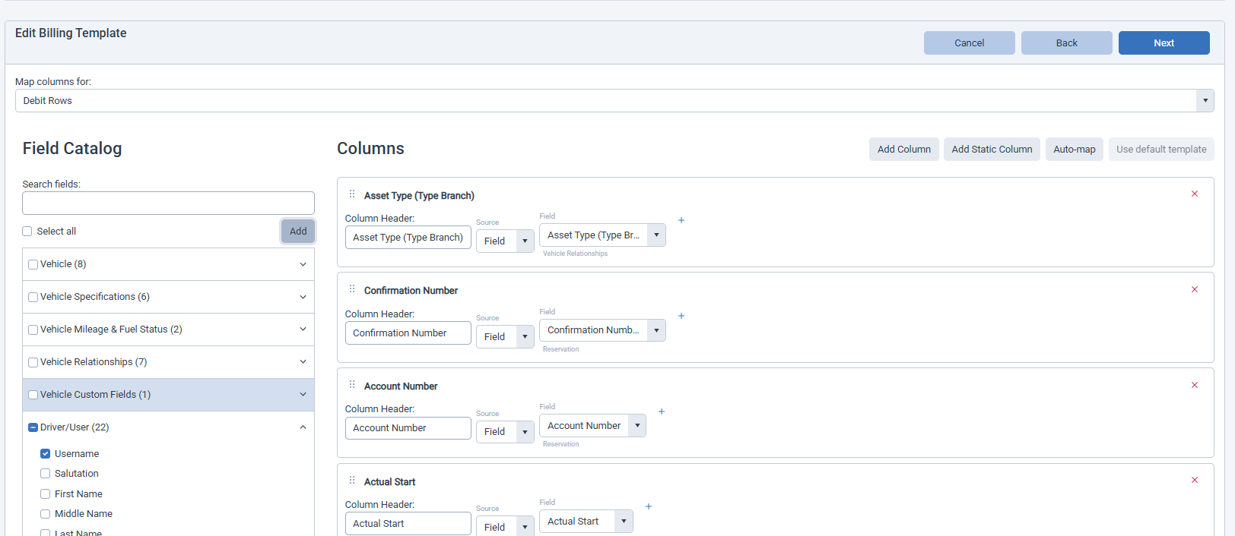
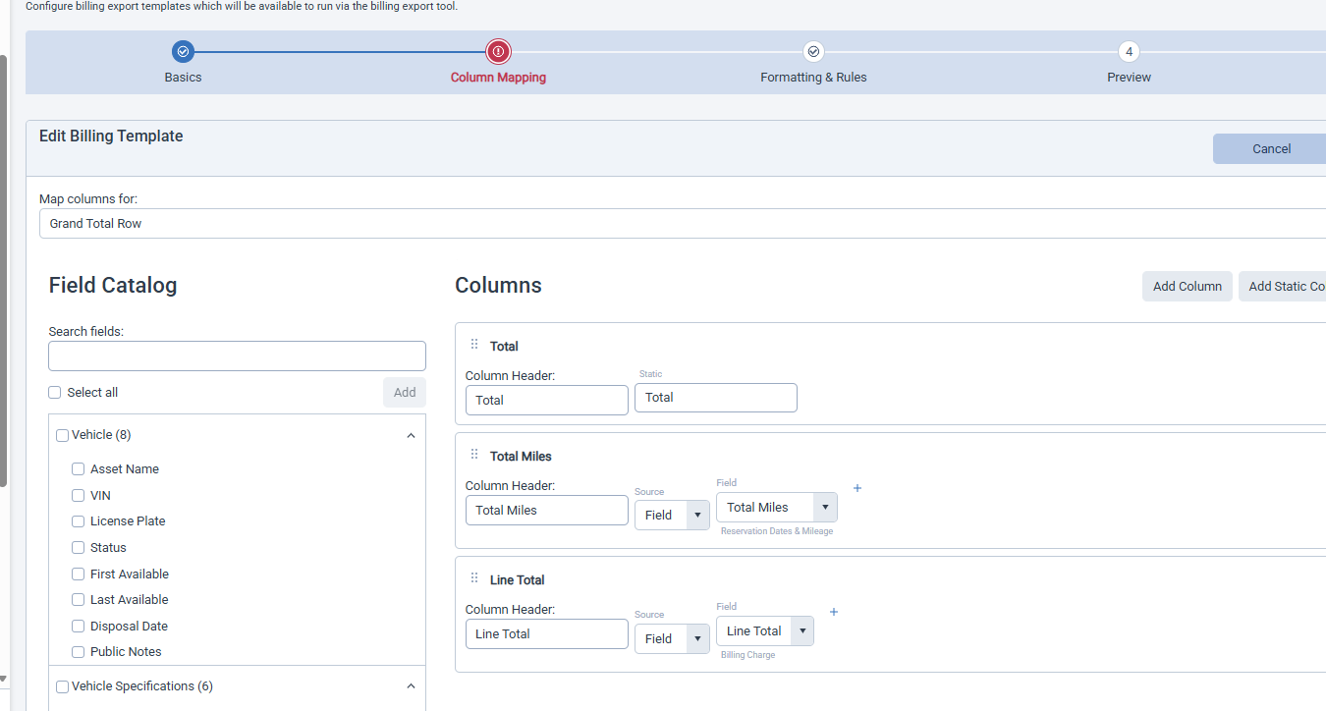
Step 2 – Column Mapping
Map columns for each row type
Debit Rows
Credit & Grand Total Rows
Always available. Each card sets a column header, a source (Field or Static) and the field it pulls.
Appear in “Map columns for” only when turned on in Step 1 — e.g. a static “Total” label plus summed miles and line total.
Credit Rows mapping: This is where fixed GL accounts usually go

Slide 9
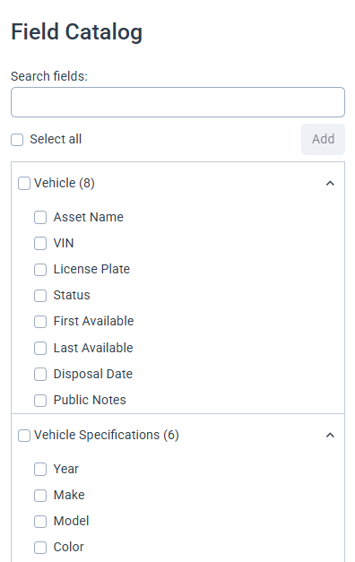
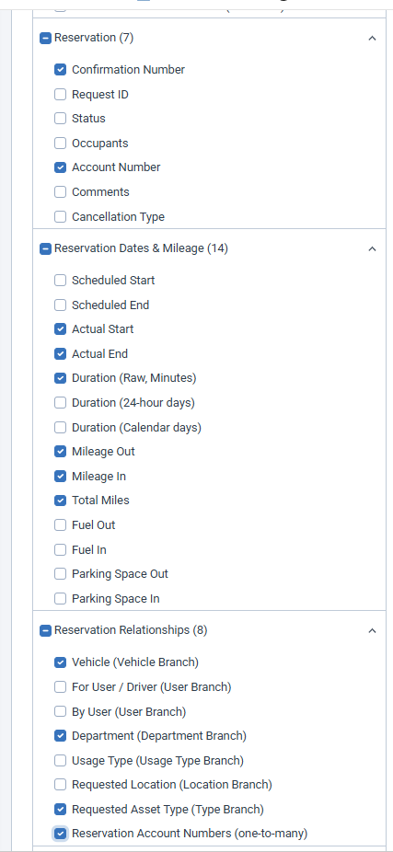
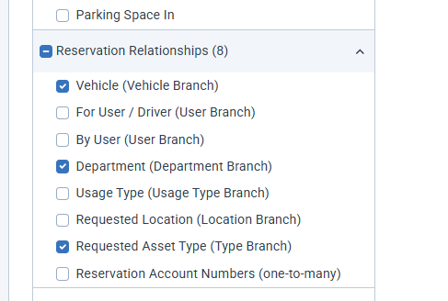
Step 2 – Column Mapping
Fields are grouped by subject area, with a count on each group
Search, click boxes or Select all, then Add to create columns in one step
Relationship branches
Pull from records linked to the reservation — vehicle, driver, department, usage type, location or asset type.

Slide 10
200 Billing Fields, Ready to Map
Step 2 · Column Mapping
Reservation (30)
Driver / User (28)
Vehicle (24)
Confirmation Number
Actual Start / End
Total Miles
Department
Usage Type
Username
Full Name
Email
Account Number
Supervisor Name
Asset Name
VIN
License Plate
Make / Model
Asset Type
+ 24 more
+ 23 more
+ 18 more
Departments, Sites & Accounts (59)
Billing Charges & Rates (22)
TCO, Fuel & Maintenance (33)
Department Code
Account Number
Chart of Accounts
Site Code
Location Name
Charge Type
Quantity
Cost
Line Total
Rate per Day / Mile
TCO Subcategory
Transaction Date
Fuel Vendor / Amount
Work Order Number
Provider
+ 54 more
+ 16 more
+ 27 more
*Fields subject to change

Slide 11
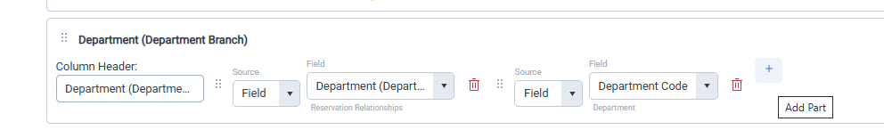
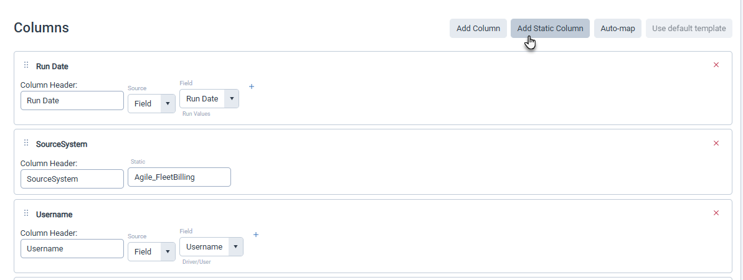
Step 2 – Column Mapping
Combine fields & follow relationships
Compound columns
Use + Add Part to merge up to five fields or static text into one column.
Static Fields
A static column writes the same fixed text into every row of a billing export, instead of pulling a value from FleetCommander data. It covers values the receiving finance system expects but that don't exist on the reservation or billing charge, such as a label, a source-system code or a fixed account segment.
Static columns can also be added to compound columns

Slide 12
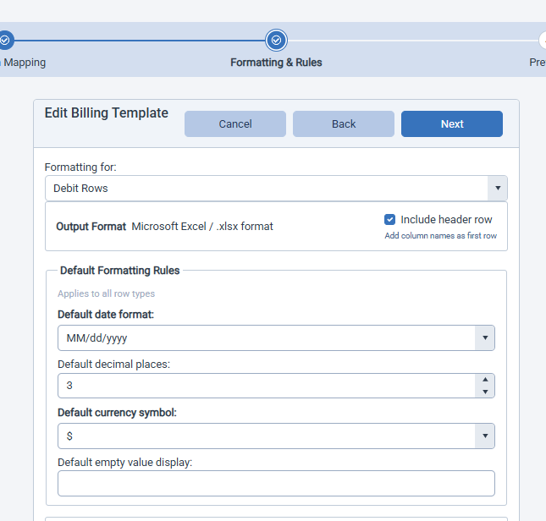
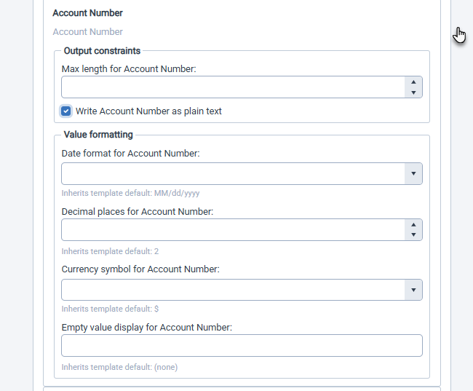
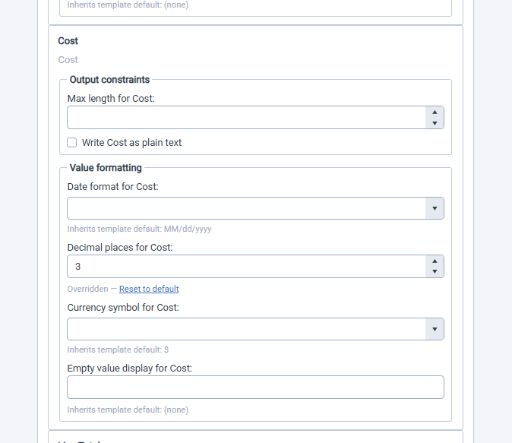
Step 3 – Formatting & Rules
Set defaults once, override per column
1 · Template defaults
2 · Output constraints
3 · Per-column overrides
Header row, date format, decimals, currency and empty-value display.
Cap a column’s length or write it as plain text, e.g. account numbers.
Blank fields inherit the default; overrides show Reset to default.

Slide 13
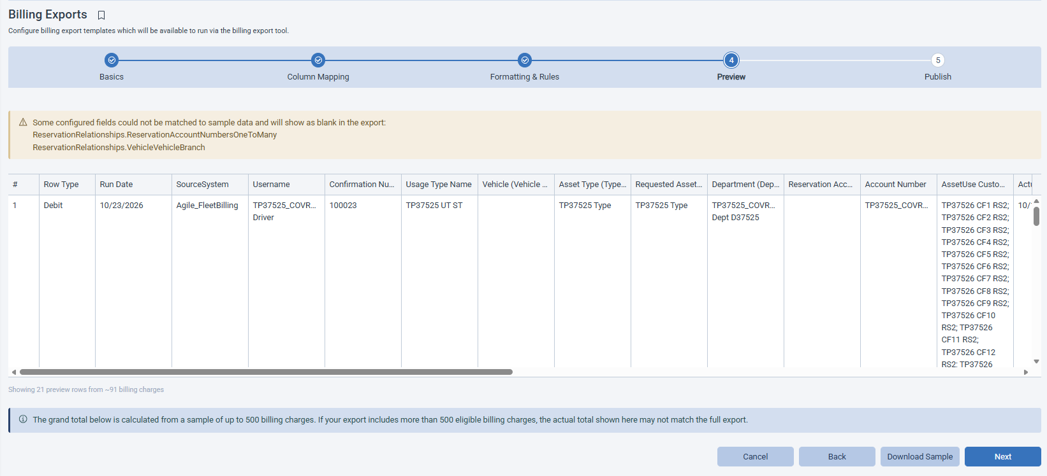
Step 4 - Preview
Check the output on real billing data
Sample Grid: Rows built from your own billing charges, in column order.
Unmatched Fields: A warning lists fields that will export blank.
Download Sample: Grab an .xlsx to review before publishing.

Slide 14
Step 5 - Publish
Activate template and it’s ready to run!
Active
Default
Summary
Makes the template an option in the billing export tool, right away.
The run page opens on it; a lone active template is used automatically.
Confirms name, column count, format and file name pattern.

Slide 15
BILLING ALGORITM
PART 3 · CONFIGURATION

Slide 16
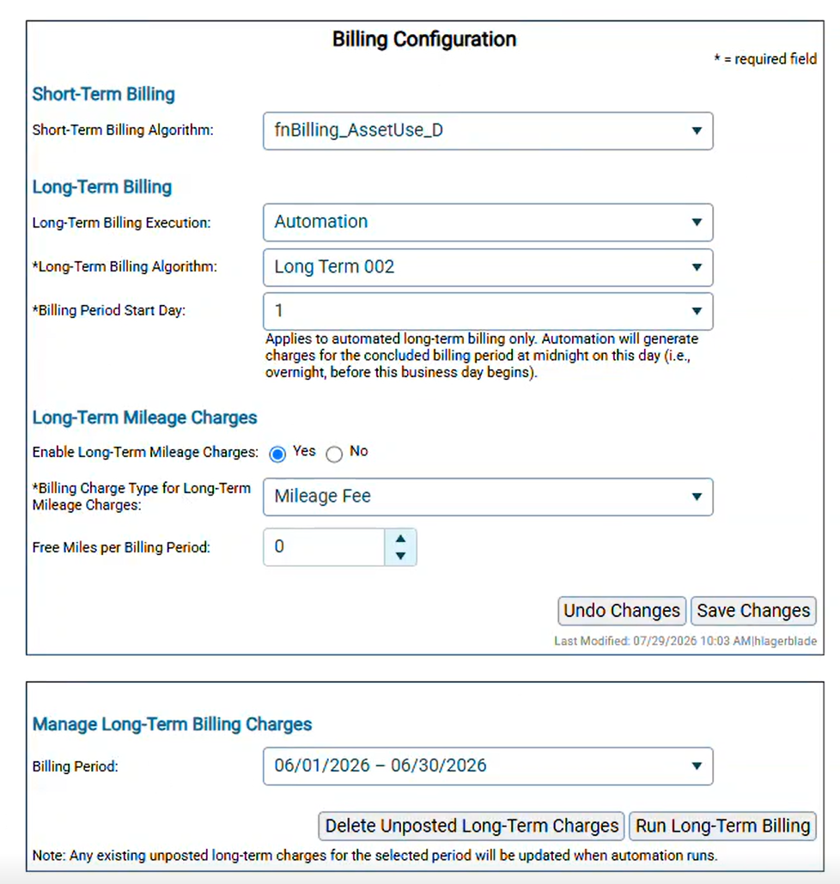
Billing Algorithm Configuration
Billing Configuration – More Options:
Short-term Algorithm: Choose the billing function used for short-term reservations.
Long-term Execution: None or Automation creates charges on its own each period
Long-term Algorithm: Choose the billing function used for long-term reservations.
  Example: It bills only usage types with “Enable Billing” turned on, still creates $0 charges, and writes “/month” invoice comments with the full month name.
Period Start Date: Day 1–28 or the last day of the month. Automation runs at midnight on this day for the period that just ended, using the enterprise’s time zone.

Slide 17
Billing Algorithm Configuration
Billing Configuration – More Options:
Enable Mileage: Bills miles driven in each period, using the starting and ending odometer readings.
Free Miles: 0–9,999 per period. Free miles are prorated for partial periods, and the charge never goes below zero.
Manage Long-Term Billing Charges: Last 6 billing periods
  Run Long-Term Billing: Run billing on demand to catch up, re-bill after fixing data, or bill outside the automation schedule.
  Delete Unposted Charges: Asks for confirmation, then clears that period’s unposted long-term charges so you can start fresh. Each delete is recorded in the activity log.
Notes:
Whenever billing runs, automatically or with Run Long-Term Billing, the code does this:
Unposted charge already exists for that reservation and period: it updates that charge in place instead of adding a second one.
Charge is already posted: it skips it, so posted charges never change and never get duplicated.
No charge exists yet: it creates a new one.

Slide 18
What’s Next
1
2
3
Export Development
Feedback
Testing
The export file itself is in development
Communicate any feedback from CAB and this week to development
Finalize testing – builder testing has started, testing will continue as development is completed

Slide 19
FEEDBACK
PART 3 ·

Slide 20



RANKING
Rank & Vote Please
Complete the following survey:
https://forms.cloud.microsoft/r/9HiJVMreEf

Slide 21
THANK YOU!
Questions?
COMMAND User Conference 2026 • Glendale, AZ

