Slide 1
Customer Advisory Board
COMMAND USER CONFERENCE 2026
November 3-5, 2026 · Glendale, AZ

Slide 2
Agenda
TODAY'S SESSION
1
2
3
Intros
Since last year
Feedback
Icebreaker
Your direct feedback is going / went here
4
5
6
Open forum
Prioritization
Wrap up
Vote / Rank
2

Slide 3
Lets Meet Everyone!
Introductions
Name,
Organization,
# of Command Attendances,
Go-to Karaoke Song

Slide 4
What You Said, What We Did
SECTION 01

Slide 5






What's New in FleetCommander
WHAT YOU SAID, WHAT WE DID
FleetCommander Go, QR code at Kiosk
FleetCommander Keyless
INVERS CloudBoxx mobile access
FedRAMP-authorized
Deployment path for federal fleets
KeyCommander
Secure key asset management
Default Return Times
New options at the Kiosk
Copy URL button
Added to Content Manager & Documents
Sites
Inactive & Clone
Emails
Only 1 email for auto approved/assigned new requests
Mileage Import
5
Notes:
Helen

Slide 6
Product Roadmap
SECTION 02

Slide 7





Current High-Level Plan for 1H 2027
PRODUCT ROADMAP · 1H 2027
Notification Center
Build / Customize and Manage Your Notifications
UI Modernization
More FleetCommander Screens re-designed in the new UI
Report Center
More Templates (Data) and AI Assisted Intelligent Insights
Enhanced Keyless Dispatch
Enhanced Features and Digital Keys
Configurable Billing
Customize your Billing Files
Digital Inspections
7

Slide 8



Current High-Level Plan for 2H 2027
PRODUCT ROADMAP · 2H 2027
UI Modernization
More FleetCommander Screens re-designed in the new UI
Report Center
Build from Scratch and AI Assisted Workflows
Digital Inspections
Damage Detection and Related Workflows
Telematics Data Enhancements
More Telematics Data and Intelligence
API Enhancements
Additional Data, Features and Endpoints
Asset Tracking
8

Slide 9
Product Roadmap · Q4 2026 to Q4 2027
Three groups: Revenue · Moat · Run. Track C restored: AutoMatch is the moat. Q3 2026 delivered: Motor Pool UI migration, FleetCommander GO Ph 1, OttO AI support assistant (live).
Initiative
Q4 2026
Q1 2027
Q2 2027
Q3 2027
Q4 2027
REVENUE
Report Center + AI Insights
P1 GA
P2 Sched. & insights
P3 Enhanced insights
P4 Insights
Keyless Dispatch
P1 INVERS
P2 Digital key
P3 Geotab
FleetCommander GO key box
P2 RFID reader
Key Mgmt & Asset Tracking
Key Mgmt
Asset Tracking
Configurable Billing
P1 Core
P2 Chargeback
Tiers & Packaging (Core/Pro/Ent.) ◆
Launch
Anywhere Return
Launch
Digital Inspections
P1 Inspections
P2 AI damage
Internationalization
P1 Currency/lang.
P2 GDPR/hosting
Telematics Data (EV, fuel, Other)
Launch
Self-Contained AI (public sector) ◆
Design
Launch
MOAT
AutoMatch P1: Multi-level Approvals ◆
Design
Build
Launch
AutoMatch P2: Reservation Recurrence ◆
Build
Launch
Fleet Ledger: Foundation (2027 bet)
Build
Launch
Cross-Fleet Benchmarking ◆
POC
RUN
Core UX Modernization
Admin tools
Config tools
Config tools
Kiosk
Workflow Friction Improvements
Phase 1
Phase 2
Phase 3
Notification Center
Launch
Permissions Restructuring ◆
Design
Launch
Platform: .NET 10 · Telemetry · Gating
.NET 10
Usage telemetry ◆
Feature gating
API Robustness
Launch
FedRAMP / TX-RAMP 20X
Design
Launch
Launch
Design/Build
◆ Restored from the Sept v5 plan (Track C and prerequisites). Dates are planning targets for Dave to confirm against capacity.

Slide 10
We Want Your Feedback
SECTION 03

Slide 11




Rescheduling the fleet, right from the grid
PREVIEW · MANAGE FLEET · WHAT'S CHANGING
Drag and drop reservations
Drag along a row to change the time, or to another vehicle to reassign it. Clicking a reservation just opens it.
Review before you save
Make several moves, then save once. You'll see every change and any warnings before it goes through.
A cleaner grid and filters
Daily and hourly views, a compact filter bar, and active filters you can clear in one click
Status at a glance
Inspection, prep and late flags sit on the same line as the reservation, with colors for status
Plus: the reservation's audit history will show the change was made in Manage Fleet.
11
Notes:
Helen

Slide 12

Your input
PREVIEW · MANAGE FLEET · LET'S DISCUSS
1
Is reviewing changes before saving helpful, or an extra click when you move just one?
2
Which statuses should stand out by color: completed, late, no-go, others?
LET'S DISCUSS
We want to hear from you
There are no wrong answers. Real examples help most.
3
When you move a reservation, should you be able to note why?
4
Are short labels with hover text clear enough, or would icons work better?
5
Anything we are missing? Red flags?
12
Notes:
Helen

Slide 13
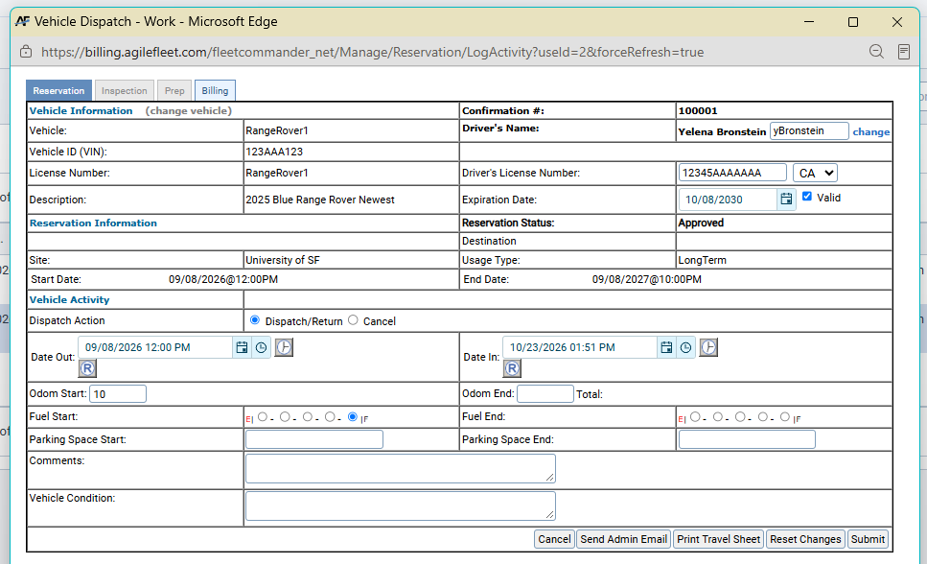



Dispatch UX
FEEDBACK · DISPATCH
Anything to remove?
What do you want to see removed?
Anything to add?
What do you want to see added?
IDEA
Send completed reservation email button
13
Notes:
Dave

Slide 14


Dashboards
FEEDBACK · DASHBOARDS
START WITH A TEMPLATE?
Templates
What's a must keep?
What's missing?
What's needed?
BUILD YOUR OWN WITH CARDS?
Your layout
Do you need separate tabs, or all on one?
Can you share with your admins, or individual only?
KEY CONTROL
The “keyaudit=all” risk
Mail-slot boxes impact
14
Notes:
Dave

Slide 15



Key Commander
NEW IN v6.04
TRACK
ASSIGN
AUDIT
Not just vehicles
Access groups by key
Who had it, and when
Spare keys, mailrooms, equipment, lockers, offices — anything you secure, with its own grid and asset profiles.
Alongside vehicle access groups, assign keys to people and departments straight from the asset profile.
Every check-out and check-in recorded, with In/Out and Asset Detail reports behind it.
Notes:
Helen

Slide 16

KeyCommander – Remaining Questions
KEY COMMANDER · LET'S DISCUSS
SPARE KEYS
If it's a spare of a Motor Pool vehicle
Can you access it when the main is out on a reservation and it just says it's out?
Or does it stop it?
OVERALL INTEREST
What types of assets would you use this for?
LOCATION & BILLING
Tracking these assets
Do you have GPS in these types of assets?
Do you want to bring location into FleetCommander?
Do you bill on these types of assets?
What would you need to capture?
16
Notes:
Helen

Slide 17


Recurring Reservations
COMING SOON
Booking window
Limit only out for 1 year (or in advance of setting)
How far in advance to auto-assign vehicles?
Pending until they hit the window
Scheduler would then kick in to auto-assign
Emails
Only 1 email that says recurring, then when assigned, send a specific email
Editing
Edit in future: one or all
Nearing the end of the series
Auto-trigger an email?
How far out?
17
Notes:
Dave

Slide 18


Automated Reshuffling
MOTOR POOL OPTIMIZATION
THE PROBLEM
If the optimization sort criteria is configured for earliest dispatch date, the same vehicle will be assigned to every reservation created until that vehicle gets dispatched, unless there's a schedule conflict.
For example, if someone needs a vehicle every Tuesday for the next four weeks and the reservations are created sequentially, it may well be the same vehicle each time. That breaks the intended sort criteria: after the first reservation, the vehicle no longer has the oldest dispatch date.
Scheduled
Reshuffle reservations automatically at a given time each day.
On demand
Reshuffle reservations with the click of a button.
RESHUFFLE CRITERIA
Reassign vehicles based on variable criteria, for example:
Lowest / highest mileage
Earliest / latest dispatch date
State of charge, incl. thresholds to assign a different vehicle if the assigned vehicle's charge is < X
18
Notes:
Helen

Slide 19
Changing the usage type clears the trip details
RESERVATION EDITS · WHAT HAPPENS TODAY
STEP 1
Edit an existing reservation
STEP 2
Change the usage type, site or vehicle type
RESULT
Destination, purpose, account and worktags are cleared
OPTIONS WE'RE WEIGHING
A
Keep shared fields
Keep a value if the field exists on both usage types
B
Keep everything
Go back to the earlier behavior and clear nothing
C
Make it a setting
Each organization chooses clear or keep
19
Notes:
Dave
Source: TP Request #34999 (Needs Review, reported in 6.03), from UC Davis, Iowa State, UTK and UW (SF 46997, 48335, 47825, 48577). The current behavior came from #34146, which cleared all downstream data consistently after the "Data Loss" warning. Product’s original intent (per Maggie) was option A: keep values for fields configured on both the old and new usage type. UW called the data loss "a big issue for our reports." David is holding the card for this feedback.

Slide 20
Your input
RESERVATION EDITS · LET'S DISCUSS
1
Which fields must survive a change: destination, purpose, account, others?
2
Option A, B or C? Would one behavior work for everyone?
LET'S DISCUSS
We want to hear from you
There are no wrong answers. Real examples help most.
3
How often do you change a usage type after booking, and why?
4
Would a warning that lists exactly which fields will clear help?
5
Is this hurting your billing or reporting today, or mainly extra typing?
20
Notes:
Backup questions: If a kept dropdown value isn’t valid for the new usage type or site, should we clear just that field, flag it, or block the save? Should drivers editing their own reservations see the same behavior as admins? Do you need a record of the original values (an audit trail) for billing or reporting? Consider a quick show of hands for A / B / C.

Slide 21



Mileage
FEEDBACK · MILEAGE
Errant mileage records
Should the threshold apply to all mileage records?
At dispatch / kiosk: stop check-in until a good value, flag it, or both?
Will people go back and get the real odometer?
Fuel thresholds
Threshold for each vehicle at fuel, but only fuel. It should have stopped these
Should the threshold be used all the time?
Should we not allow an override on fuel imports?
Crazy values
Log but not apply? Across the board?
Expand the GPSI threshold to everything?
The issue at the kiosk: does it stop the check-in?
Fuel import
Over threshold: no mileage added?
21
Notes:
Another person to add?

Slide 22
Emails / Notification Center
FEEDBACK · NOTIFICATIONS
TEMPLATES
Do you still want templates?
TRIGGERS
Are multiple triggers per email required?
What are your most common triggers?
Is scheduling required?
FOR EXAMPLE
Reservation Email
Goes out with a new request, request approved, and request changes approved?
22
Notes:
Dave

Slide 23
Circle Check Process
FEEDBACK · CIRCLE CHECK & MOBILE
LET'S TALK THROUGH THE USE CASE!
Circle check
Is it the driver? Fleet team?
What's the flow?
If you give keys at the box, how do you see enforcing the check before they drive?
Would you stop a dispatch in if a check isn’t completed?
MOBILE APP
Getting it on phones
Can your drivers download apps?
Android, iOS?
How to sync / auth to your domain?
Is this too complicated?
23
Notes:
Dave

Slide 24

Permissions / Hierarchy
FEEDBACK · PERMISSIONS
THE IDEAS
Permissions tab as a table
Permission levels across the top, sites as rows
Introduce Permission Groups
Introduce Permission Cloning
CONCEPT SKETCH
Admin
Dispatcher
Driver
Requestor
Site 1
Site 2
Site 3
Any heartburn?
Site 4
24

Slide 25




One permission model can't fit every organization
PERMISSIONS · WHAT WE'VE HEARD
WHAT WE'VE HEARD
14
related requests
from about 20 organizations
Department-level access
A department owner who manages only their own vehicles and people
More granular control
Let a maintenance or inspection user run specific reports, and nothing more
Boundaries that hold
Site admins should see only their site, in search, users, reports and kiosk keys
Easier setup
The permissions screen scrolls endlessly when you have many sites
25
Notes:
Source: TP Feature #22684 Permissions Enhancements (14 child stories). Department permissions (#9772) alone was requested by 8 clients. Also heard: a read-only enterprise "auditor" view (UTK). The "boundaries" card covers QwikFind, Manage Users, driver search and kiosk key access (#14459, #22690, #22689, #10534). Treat those as security issues, not just features.

Slide 26
Separate what you can do from what you can see
PERMISSIONS · AN EARLY IDEA
+
=
ROLE
What you can do
Admin, dispatcher, inspector, or roles you create, like “Asset Reporter”
SCOPE
Which data you see
Enterprise, specific sites, departments, providers or users
EXAMPLE
Asset Reporter for the North Site
Runs asset reports, only for that site's vehicles
Built-in starter roles would match today's permissions, so nothing breaks on day one.
YOUR INPUT
1
If you could define your own roles, which 3–5 would you create first?
2
Do some users need different scopes in different roles?
3
Is department scope essential, or would sites and providers cover most needs? Locations?
4
Who in your organization should be allowed to create or change roles?
5
How many people need to add mileage for vehicles? Who are these people? Driver, Dept Manager, Financial?
26
Notes:
Explain the split: today "admin vs dispatcher vs inspector" is tangled with "site vs enterprise". Pulling them apart lets clients define roles once and apply them at any scope. The User Profile > Permissions tab would become a compact grid with dropdowns. The API and navigation would enforce the same rules.
One more person to add mileage?

Slide 27
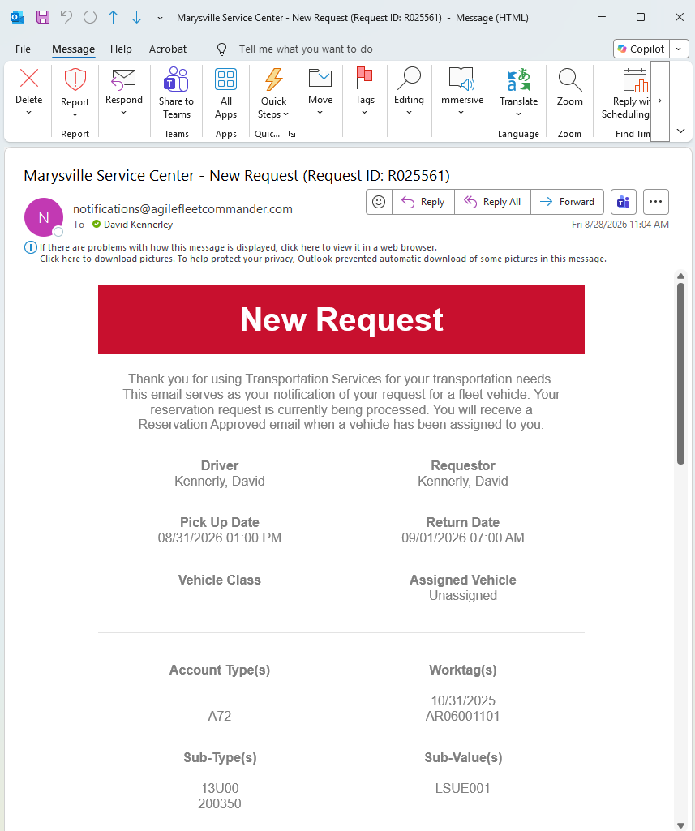


Approval should fit your chain of command
APPROVALS · TODAY AND WHAT WE'VE HEARD
YOU'VE ASKED FOR
TODAY
Auto-approve on or off by site, user and vehicle
Otherwise a request waits until an admin clicks Approve
Reservations only
Dispatchers and Administrators only; others are implicit approval
Supervisor approval
A driver's own supervisor approves the reservation
Department heads approve new users
Sign-ups go to the right department for review
Early idea: add approve / deny action buttons to emails
27
Notes:
Dave
Source: TP Feature #22720 Approval Enhancements. Supervisor approval (#7779): Honda, Nissan, UCLA, WSSC Water. Department-head approval of registrations (#22718): Yale, Cornell, GADJJ, Sonoma DHS. Policy acceptance (#28458): Illinois State. Multiple approval email addresses (#22722) is already completed. Requirements are still early; this is listening mode.

Slide 28
Your input
APPROVALS · LET'S DISCUSS
1
Which processes need approval: reservations, sign-ups, others?
2
Who approves, and how many approvers per user?
LET'S DISCUSS
We want to hear from you
There are no wrong answers. Real examples help most.
3
Should approval apply to every request, or only some (usage type, or another factor)?
4
How should approvers respond: an email link, mobile, or a queue?
5
If no one responds in time: escalate, auto-approve or cancel?
28
Notes:
Dave
Backup questions: Do you need multi-step approvals (supervisor, then fleet)? How should we handle approvers who are out of office: delegates, backups, escalation? Should denials require a reason and notify the requester? Should one approval cover a recurring or seasonal series? Do you need an audit trail of approvals? For policy acceptance, do users need to re-accept yearly or when the policy changes, with a report of who accepted which version? How would we know the supervisor: HR feed, SSO attribute, or a profile field?

Slide 29

Reject Changes
FEEDBACK · WORKFLOWS
What process steps are best for Reject Changes?
29
Notes:
Dave

Slide 30


Custom fields need to do more
CUSTOM FIELDS · WHAT WE'VE HEARD
TODAY
20
custom fields per record type
and more takes code changes
More field types
Dropdowns, numbers and multi-select, not just text
Fields on more records
Work orders, plus questions based on asset type
Rules
“Required if…”, fixed prefixes, stop-the-request answers
Values that follow the driver
Profile fields like Employee ID update with a new driver
30
Notes:
Helen
Source: TP #32744 (design story, v6.05) under Feature #22813 Custom and Configurable Field Enhancements. Requests from Iowa, South Dakota, TVA, UMD, UTK, Valley Water, LMDOE, UNI, UC Davis and others. Valley Water example: Reservation CF20 = Employee ID keeps the original driver’s value after a driver change, which breaks their reporting. Context: a competitor offers 50 fields on its middle tier and unlimited on its top tier.

Slide 31
Define a field once, use it anywhere
CUSTOM FIELDS · AN EARLY IDEA
ONE FIELD DEFINITION
Type: text, number, dropdown, combo box, multi-select
Label and allowed values
Rules: required, read-only, “required if…”
User profile
Reservation
Asset
Work order
YOUR INPUT
1
Have you hit the 20-field limit, or worked around it? How many do you need?
2
Beyond users and reservations, where would custom fields help most?
3
When a value comes from a profile, should it update if the driver changes?
4
Do you need “required if” or “show only if” rules? Share a real example.
5
Which custom fields feed your billing or outside systems?
6
Do you want a limit at the kiosk? Or is scrolling okay?
31
Notes:
Helen
Today user and reservation custom fields are configured differently and capped at 20. The idea: one model, each field defined once and attached to any form, with rules for when a value carries over (for example, Employee ID from the driver’s profile onto the reservation). Dropdowns capped around 10 values; longer lists become searchable combo boxes. The kiosk’s six-field limit would be replaced by paged screens. Field count may tie to pricing tiers; don’t commit to that in the room.

Slide 32

Prep & Inspect
FEEDBACK · PREP & INSPECT
USE
How do you use it today?
Does anyone prep? Inspect? Use both?
Do you need 2 options?
KEEP
What do you like?
CHANGE
What needs to change?
32
Notes:
Helen

Slide 33


AI
FEEDBACK · AI
POLICY & COMFORT
Can you use it?
Are you allowed to use it?
Are there restrictions around it?
What's your comfort level?
INTEREST
Where would it help?
Insights, data anomalies, workflow efficiency
Reporting vs. auto-reassigning the vehicles
MCP SERVER
Would you be interested?
How would you use it?
33
Notes:
Dave
Is there a budget for it?

Slide 34

System of Record
FEEDBACK · SYSTEM OF RECORD
Can FleetCommander be your System of Record?
TELEMATICS Rank these
1
Users: Safety Scorecard
Maintenance
Fuel
TCO
Including tolls
2
EV and fuel data to assign vehicles
3
Diagnostic events
Is there anything missing?
34
Notes:
Dave

Slide 35

Other Questions
FEEDBACK · QUICK QUESTIONS
KEYLESS
Vendors & hardware
What other vendors for keyless?
App for digital key?
Other key box options?
INTERNATIONAL IMPACT
Data points
Mileage
Language
Fuel units
Date format
Anything else?
35
Notes:
Dave

Slide 36
Open Discussion
SECTION 04

Slide 37
Open Discussion
OPEN DISCUSSION
What else do you need?
37

Slide 38
Ranking
SECTION 05

Slide 39


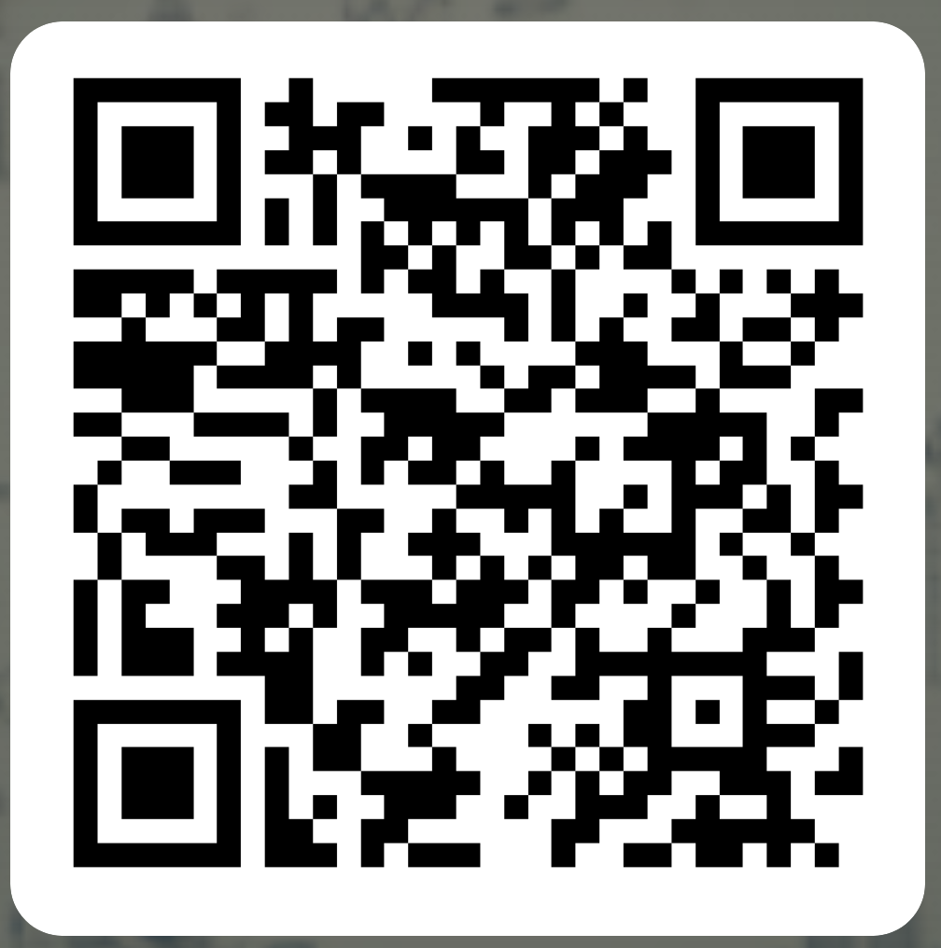
Rank & Vote Please
RANKING
Complete the following survey:
https://forms.cloud.microsoft/r/BBd42CMp9S
39

Slide 40
Thank You
Questions? · COMMAND User Conference 2026 · Glendale, AZ

