Slide 1

FLEET COMMANDER FOUNDATIONS:
New User Bootcamp
Fleet Intelligence, Reimagined
Sponsored by:
November 3–5, 2026 • Glendale, AZ

Slide 2
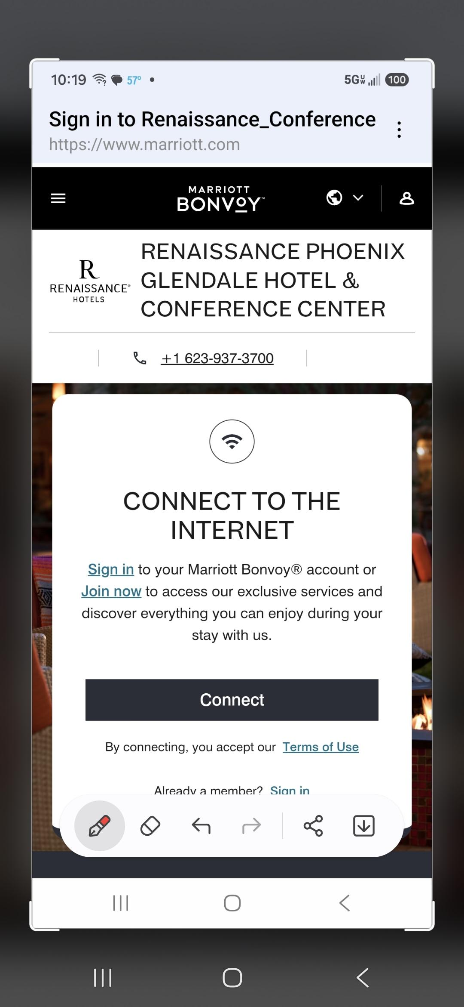
HOW TO CONNECT:
Pull up Settings and Navigate to “Network and Internet”
Select WiFi
Find the network labeled Renaissance_Conference and enter password "Command26."
This should take you to a pop-up page. if it does not, do this:
    Restart your computer to clear pop up blockers
      OR, Copy and paste this into a browser: http://neverssl.com. This should force the pop up page
      OR
      OR, Turn off MAC (Media Access Controller) Randomization in the WiFi Privacy settings
If the pop-up does come up, click “I Accept Terms of Use”. You may need to open your browser to get the prompt.

Slide 3
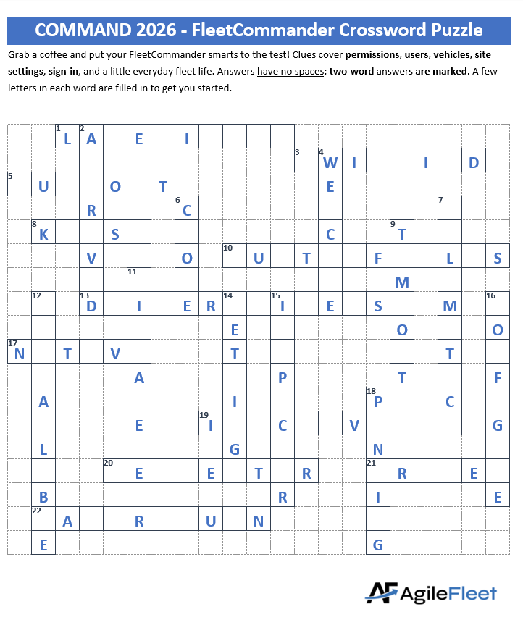
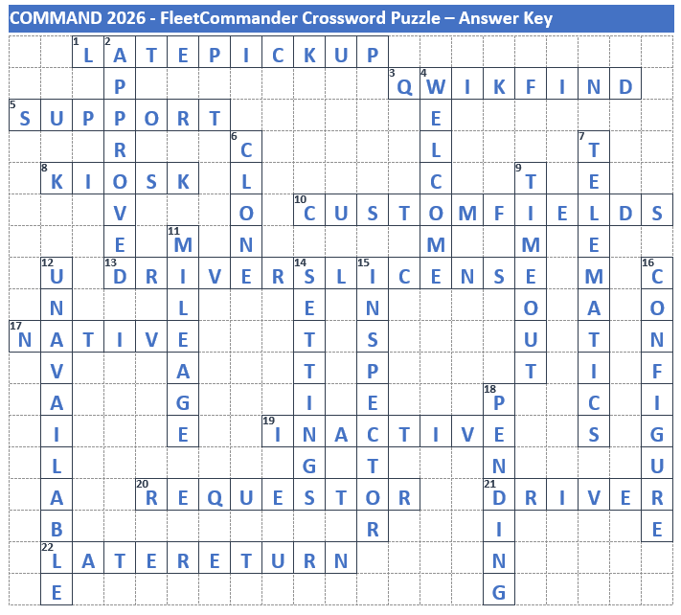
Did you figure it out?
FLEETCOMMANDER
Crossword

Slide 4
FLEET COMMANDER FOUNDATIONS:
New User Bootcamp
Fleet Intelligence, Reimagined
Sponsored by:
November 3–5, 2026 • Glendale, AZ

Slide 5

Raise your DoT!
DOT = Discussion Or Thoughts
Have a question, concern, or idea? Just hold up your DOT —and we’ll happily pause to address it!
P
Your voice matters — let’s make this session a conversation.

Slide 6
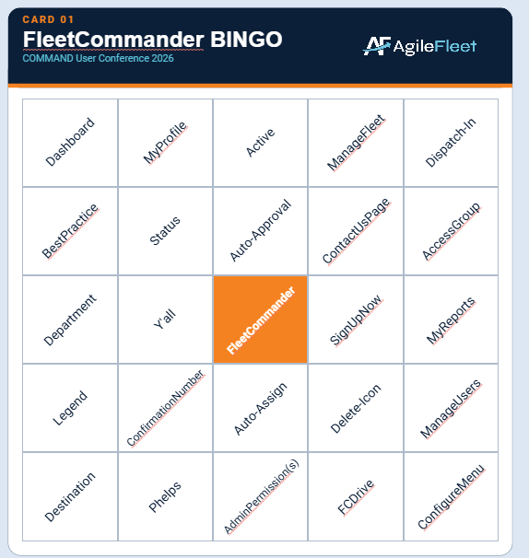

Follow along with…
FLEETCOMMANDER
BINGO

Slide 7
What We’ll Learn Today
What is FleetCommander?
Accessing FleetCommander
Driver/Requestor Experience
Administrator Experience – Part 1

Slide 8
What is FleetCommander?
FLEETCOMMADER FOUNDATIONS: NEW USER BOOTCAMP

Slide 9
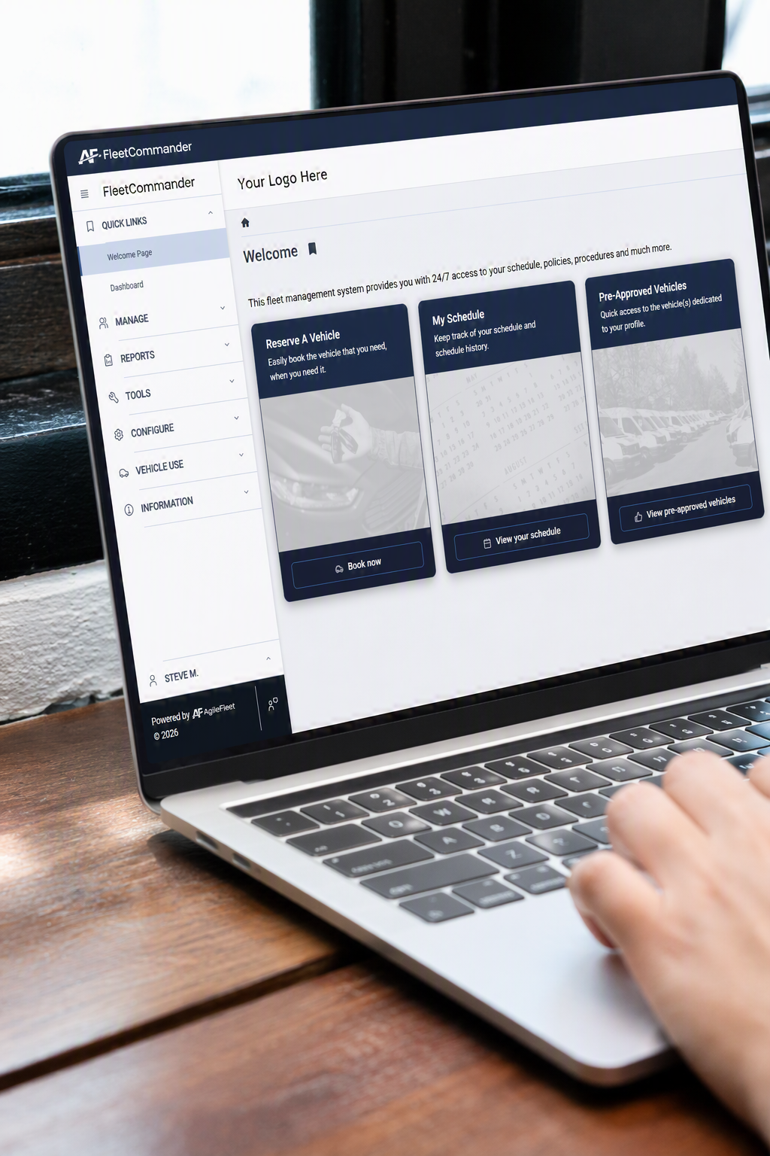
FleetCommander Overview
Cloud-based Fleet Management Solution
Can oversee centralized or disbursed operations
Scalable from 25 to 25,000+ vehicles
Able to administer unlimited drivers/users
configurable to support precise
business needs
MotorPool/Vehicle Sharing
Maintenance & Parts
Fuel Management
Risk Management
Telematics

Slide 10
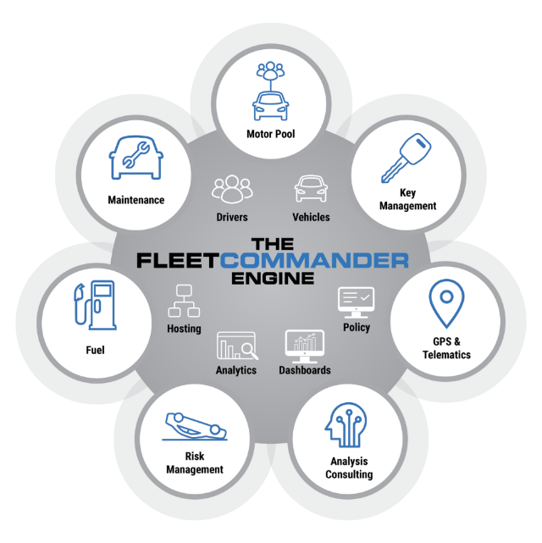
What is FleetCommander?
FleetCommander Core Product Engine
  User/Driver Management
  Vehicle/Asset Management
  Analytics & Reports
  Policy Enforcement
  Admin Interface/Dashboards
  Hosting
FleetCommander Modules
  Motor Pool/Vehicle Sharing
  Key Management
  Maintenance
  Fuel
  Risk Management
  GPS & Telematics

Slide 11
What is FleetCommander?
FleetCommander Core Product Engine
  User/Driver Management
  Vehicle/Asset Management
  Analytics & Reports
  Policy Enforcement
  Admin Interface/Dashboards
  Hosting
FleetCommander Modules
  Motor Pool/Vehicle Sharing
  Key Management
  Maintenance
  Fuel
  Risk Management
  GPS & Telematics

Slide 12

What is a profile in FleetCommander?
A profile is a centralized repository of your fleet data and is unique to each associated user and asset/vehicle.
Profiles are essential components of
the “FleetCommander Engine”

Slide 13








FleetCommander Users PROFILES
There are EIGHT MAIN USER/PERMISSION levels within FleetCommander
Each permission level determines how far a user can access FleetCommander and what they can do once they get there
8

Slide 14
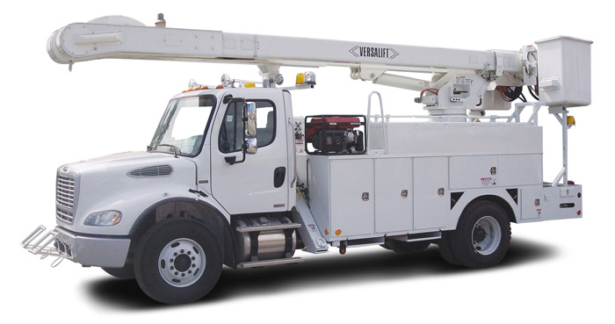
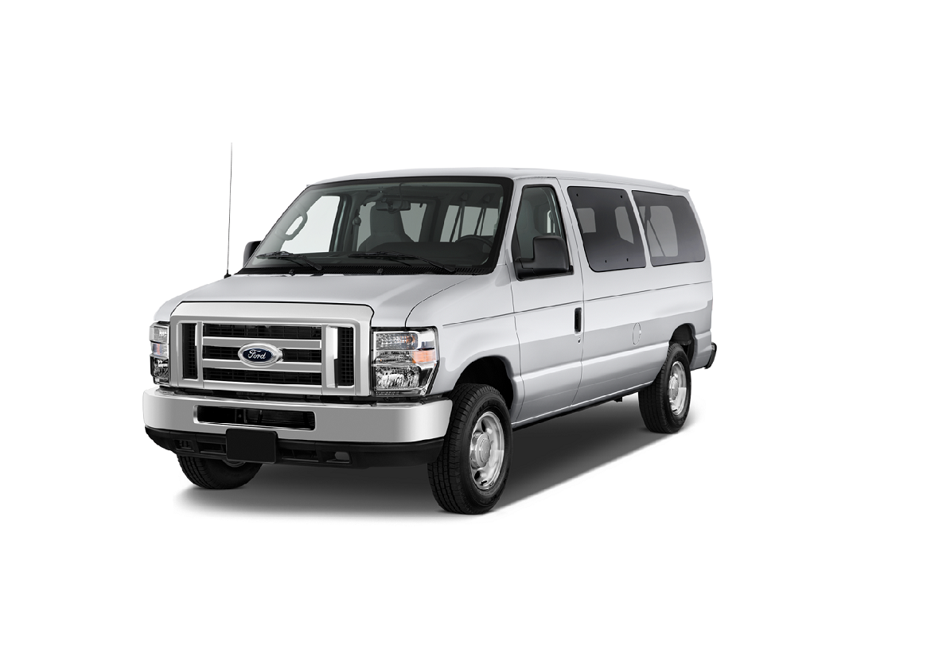

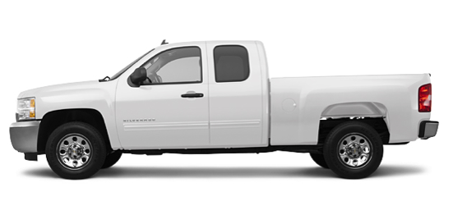

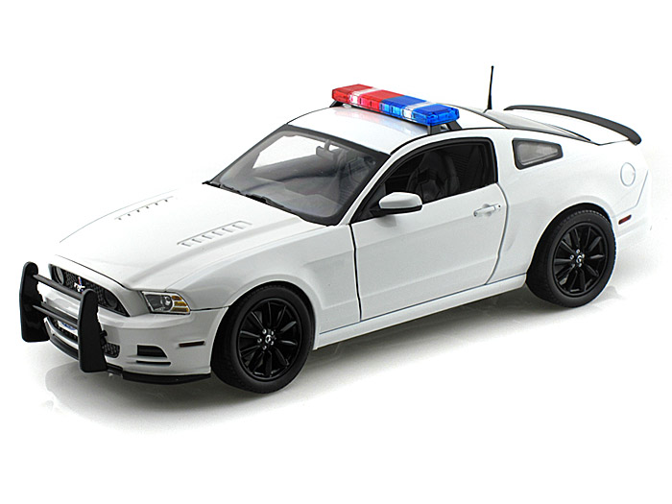
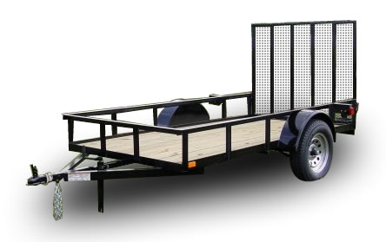
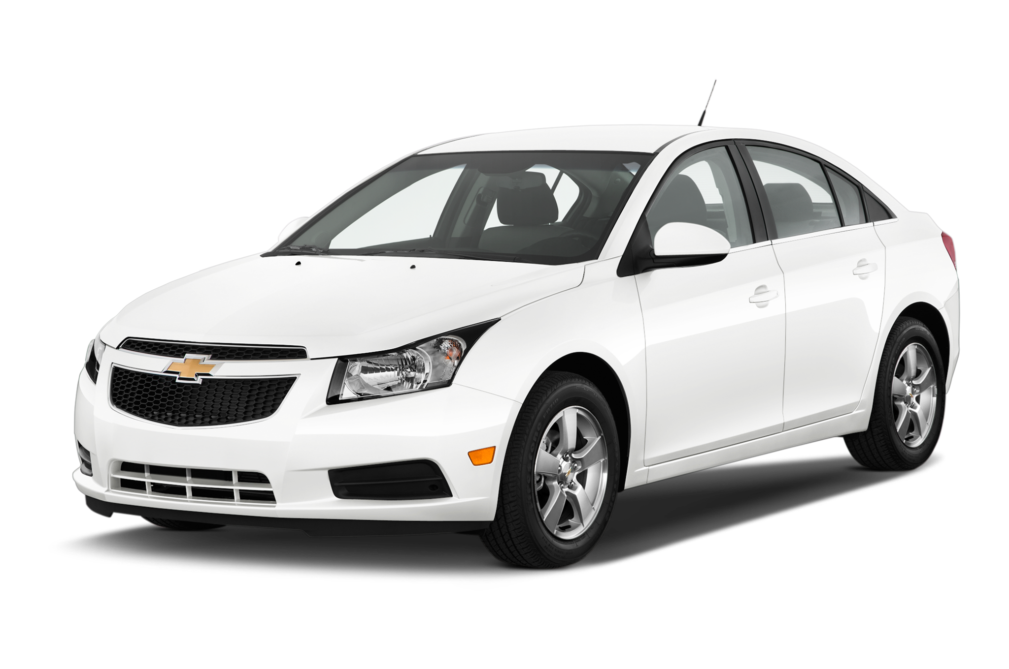
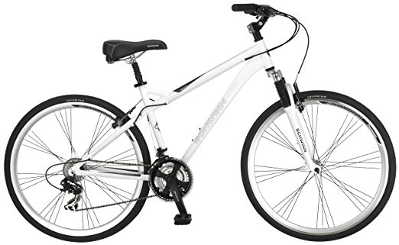
What assets can you place in FleetCommander?
Answer: ALL OF THEM!

Slide 15
Accessing FleetCommander
FLEETCOMMADER FOUNDATIONS: NEW USER BOOTCAMP

Slide 16
Accessing
FleetCommander:
LOGIN PAGE

Slide 17
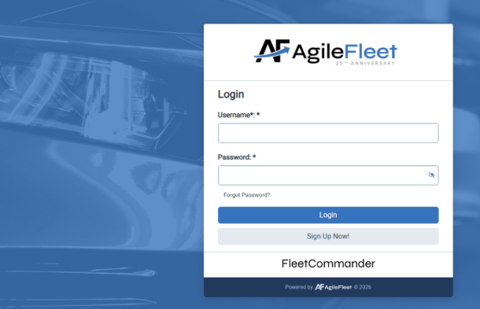
ACCESSING FLEETCOMMANDER: LOGIN PAGE
Go to
COMMAND.agilefleet.com
EXAMPLE:
“Native- login”

Slide 18
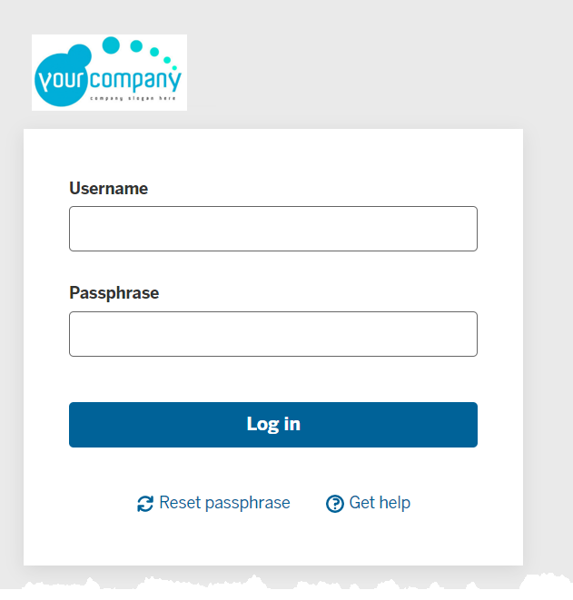
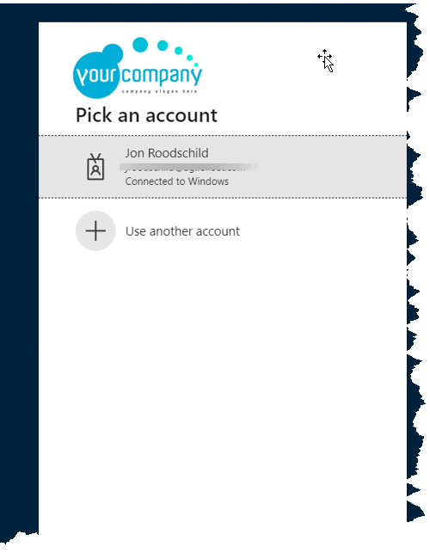

ACCESSING FLEETCOMMANDER: LOGIN PAGE
EXAMPLE:
“Custom Authentication”

Slide 19
Accessing
FleetCommander:
FORGOT PASSWORD

Slide 20
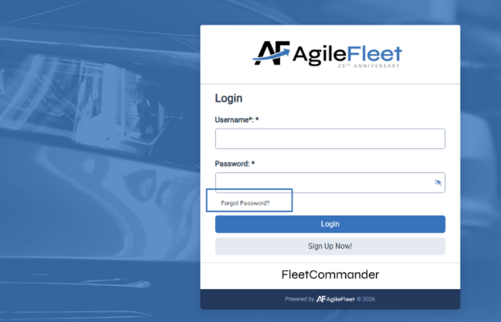
ACCESSING FLEETCOMMANDER: FORGOT PASSWORD
TIP:
If you forgot your password, you can receive a reset prompt

Slide 21
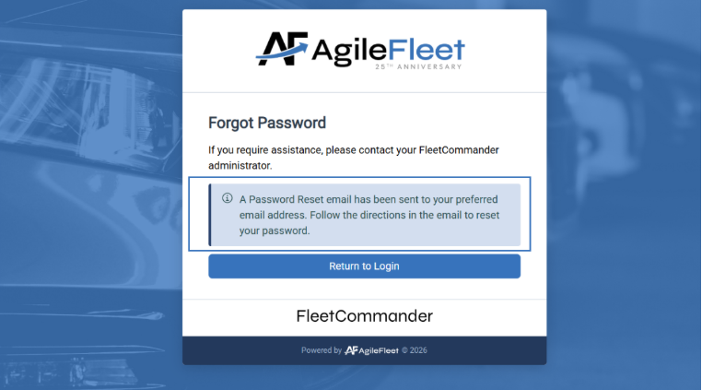
ACCESSING FLEETCOMMANDER: FORGOT PASSWORD
TIP:
If you forgot your password, you can receive a reset prompt

Slide 22
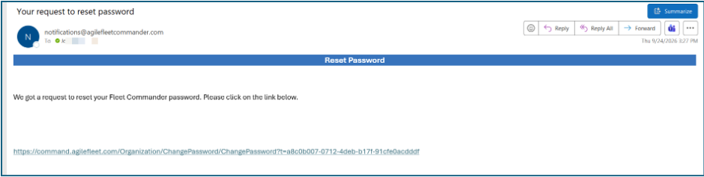
ACCESSING FLEETCOMMANDER: FORGOT PASSWORD
TIP:
If you forgot your password, you can receive a reset prompt
EXAMPLE:
receive a reset prompt
EXAMPLE:
Request to Reset Password email

Slide 23
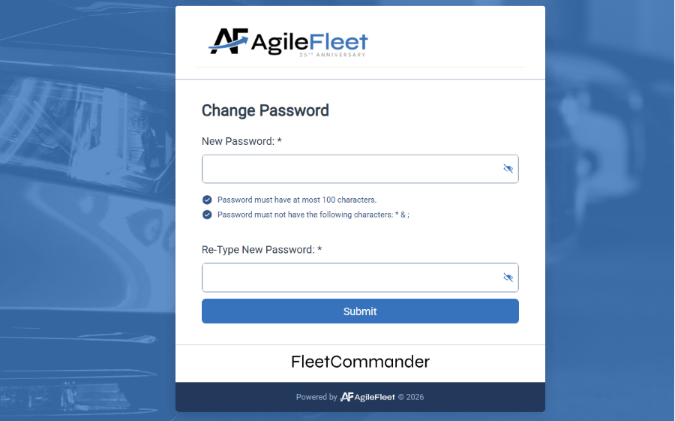
ACCESSING FLEETCOMMANDER: FORGOT PASSWORD
TIP:
If you forgot your password, you can receive a reset prompt
EXAMPLE:
receive a reset prompt
EXAMPLE:
Request to Reset Password email

Slide 24
ACCESSING FLEETCOMMANDER: FORGOT PASSWORD
TIP:
If you forgot your password, you can receive a reset prompt
EXAMPLE:
Request to Reset Password email

Slide 25
Accessing
FleetCommander:
WELCOME PAGE

Slide 26
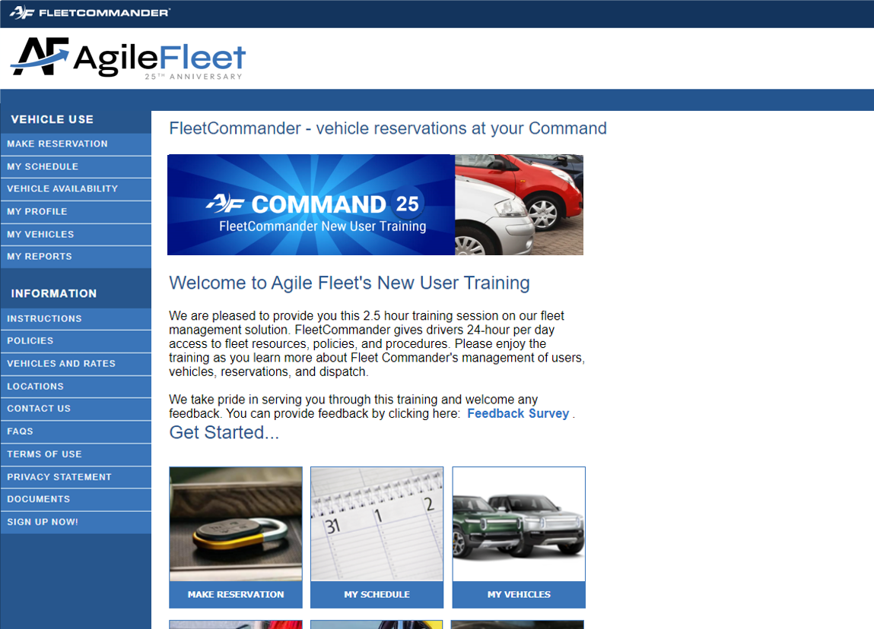
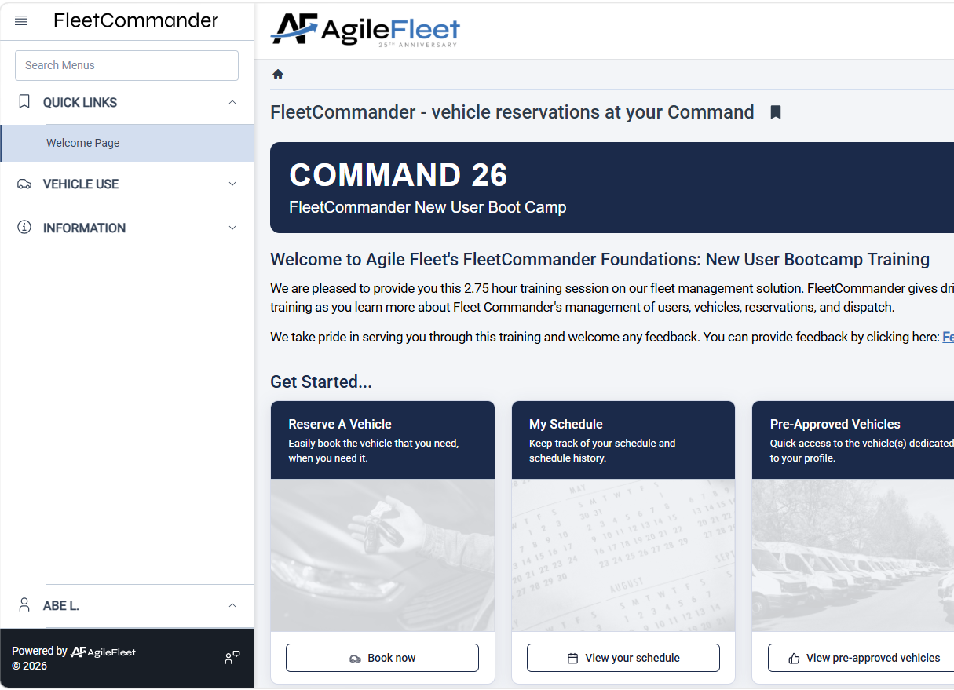
ACCESSING FLEETCOMMANDER: WELCOME PAGE
Successful login brings you to FleetCommander
Welcome Page
Welcome Page highlights important information including fleet policies

Slide 27
Driver/Requestor Experience
FLEETCOMMADER FOUNDATIONS: NEW USER BOOTCAMP

Slide 28
Driver/Requestor Experience
  Information Links
    Instructions
    Policies
    Vehicles and Rates
    Locations
    Contact Us
    FAQs
    Terms of Use
    Privacy Statement
    Documents
  Vehicle Use Links
    Make a Reservation
    My Schedule
    Vehicle Availability
    My Profile
    My Vehicles
    My Reports
The WELCOME PAGE is the launching point for
all Driver/Requestor interaction with FleetCommander
Interfaces includes:
INFORMATION LINKS
and
VEHICLE USE LINKS

Slide 29
Driver/Requestor
experience:
Information Links

Slide 30
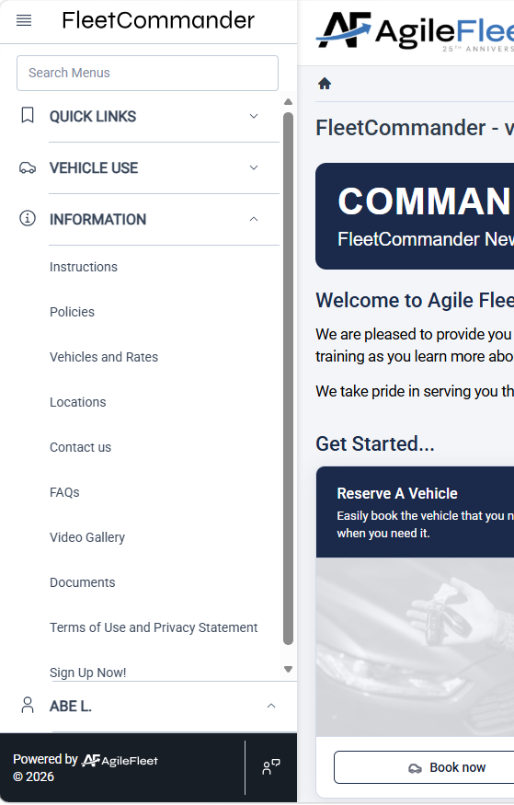










DRIVER/REQUESTOR EXPERIENCE:
INFORMATION LINKS
  Information links share specific information regarding your fleet with requestors/drivers
INSTRUCTIONS: “how to’s”
of making reservations

Slide 31
DRIVER/REQUESTOR EXPERIENCE:
INFORMATION LINKS
  Information links share specific information regarding your fleet with requestors/drivers
POLICIES: the “must agrees”
of using vehicles

Slide 32
DRIVER/REQUESTOR EXPERIENCE:
INFORMATION LINKS
  Information links share specific information regarding your fleet with requestors/drivers
VEHICLES AND RATE:
what types of vehicle are offered & the cost to rent.

Slide 33
DRIVER/REQUESTOR EXPERIENCE:
INFORMATION LINKS
  Information links share specific information regarding your fleet with requestors/drivers
LOCATIONS: where
to go to get vehicle

Slide 34
DRIVER/REQUESTOR EXPERIENCE:
INFORMATION LINKS
  Information links share specific information regarding your fleet with requestors/drivers
CONTACT US: who
to ask for help

Slide 35
DRIVER/REQUESTOR EXPERIENCE:
INFORMATION LINKS
  Information links share specific information regarding your fleet with requestors/drivers
FAQ’s: answers
to popular questions

Slide 36
DRIVER/REQUESTOR EXPERIENCE:
INFORMATION LINKS
  Information links share specific information regarding your fleet with requestors/drivers
TERMS OF USE:
the rules of using application

Slide 37
DRIVER/REQUESTOR EXPERIENCE:
INFORMATION LINKS
  Information links share specific information regarding your fleet with requestors/drivers
DOCUMENTS:
additional important information to access

Slide 38
DRIVER/REQUESTOR EXPERIENCE:
INFORMATION LINKS
  Information links share specific information regarding your fleet with requestors/drivers
SIGN UP NOW:
register to use
FleetCommander

Slide 39
DRIVER/REQUESTOR EXPERIENCE:
INFORMATION LINKS
  Information links share specific information regarding your fleet with requestors/drivers
REPURPOSED LINK:
Get creative with content!

Slide 40
Driver/Requestor
experience:
vehicle use Links

Slide 41
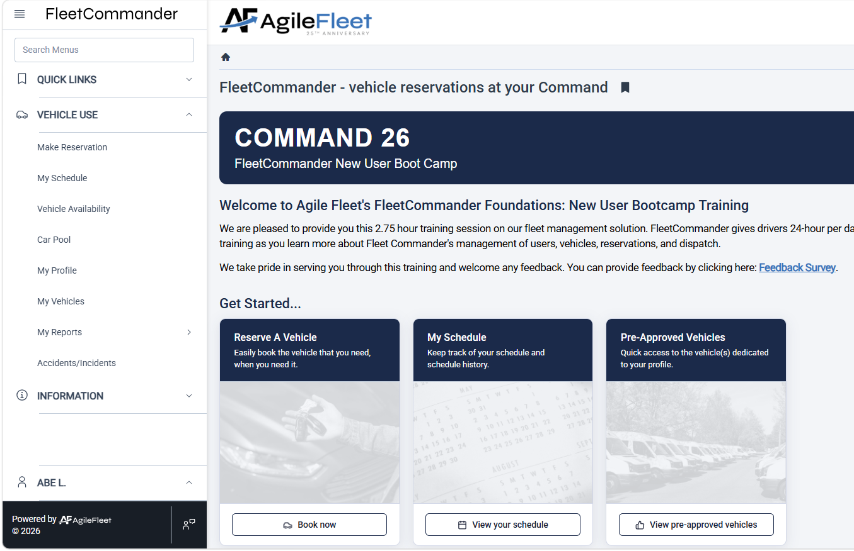








DRIVER/REQUESTOR EXPERIENCE:
VEHICLE USE LINKS
  Vehicle Use is the launch point for driver/requestor reservation interaction within FleetCommander.
We will cover four of these VEHICLE LINKS today

Slide 42
Driver/Requestor
experience:
make reservation

Slide 43
making reservations
Vehicle reservations CAN BE ENTERED into FleetCommander via SEVERAL LAUNCHING points.
The following process illustrates how your
END-USERS request vehicles.

Slide 44
DRIVER/REQUESTOR EXPERIENCE:
MAKE RESERVATION
To begin the reservation
process, click on the
MAKE RESERVATION link

Slide 45
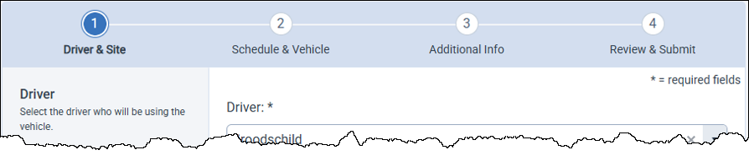
DRIVER/REQUESTOR EXPERIENCE:
MAKE RESERVATION
Reservations are captured in FOUR STEPS
Step 1
Driver
& Site
Step 2
Schedule
& Vehicle
Step 3
Additional
Information
Step 4
Review
& Submit

Slide 46
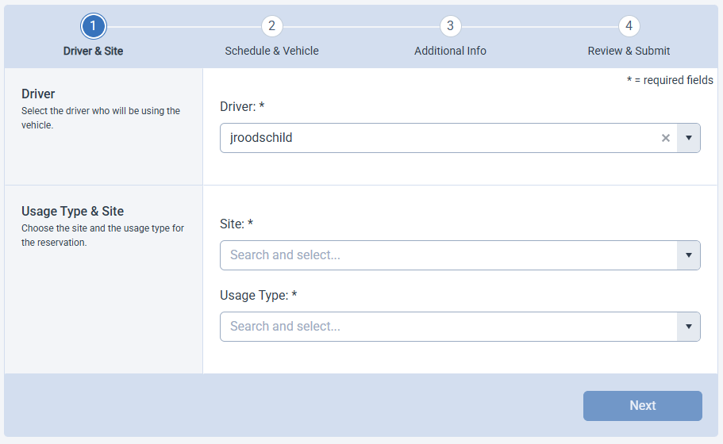
DRIVER/REQUESTOR EXPERIENCE:
MAKE RESERVATION
Step 1
Driver & Site
Enter intended Driver.
HELPFUL HINT:
You can search the Combo Box using your choice of USERNAME, FIRST NAME, or LAST NAME

Slide 47
DRIVER/REQUESTOR EXPERIENCE:
MAKE RESERVATION
Step 1
Driver & Site
Site determines the location a reservation will leave from.
Select the Site

Slide 48
DRIVER/REQUESTOR EXPERIENCE:
MAKE RESERVATION
Step 1
Driver & Site
Usage Type determines “how” the vehicle will be used
Select the Usage Type
Select “Next”

Slide 49
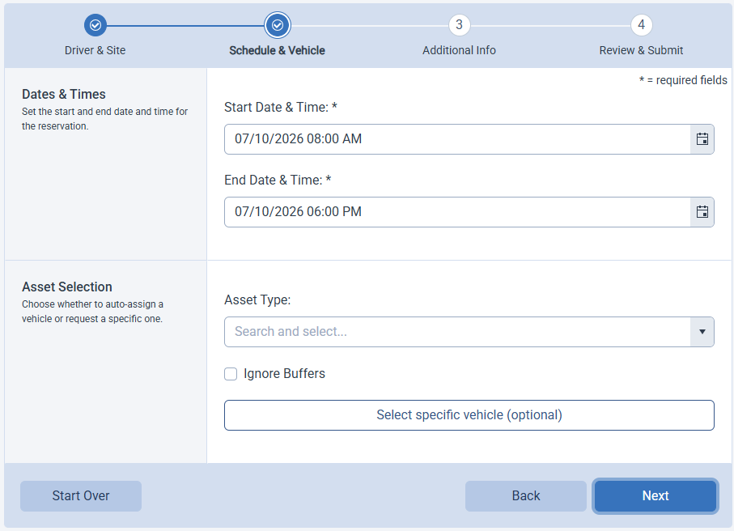
DRIVER/REQUESTOR EXPERIENCE:
MAKE RESERVATION
Step 2
Schedule & Vehicle
Enter Start Date & Time
Enter End Date & Time
Select Vehicle Type

Slide 50
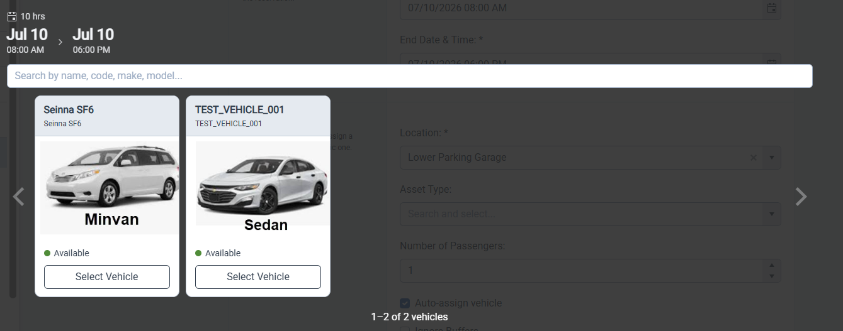
DRIVER/REQUESTOR EXPERIENCE:
MAKE RESERVATION
Step 2
Schedule & Vehicle
If enabled, driver may have the option to select a specific vehicle
Select “Next”

Slide 51
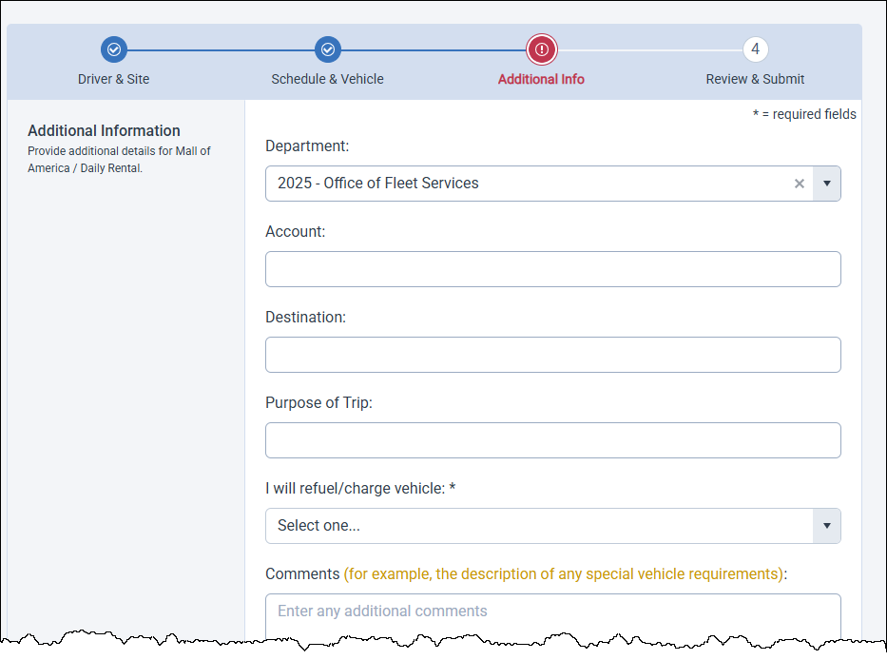
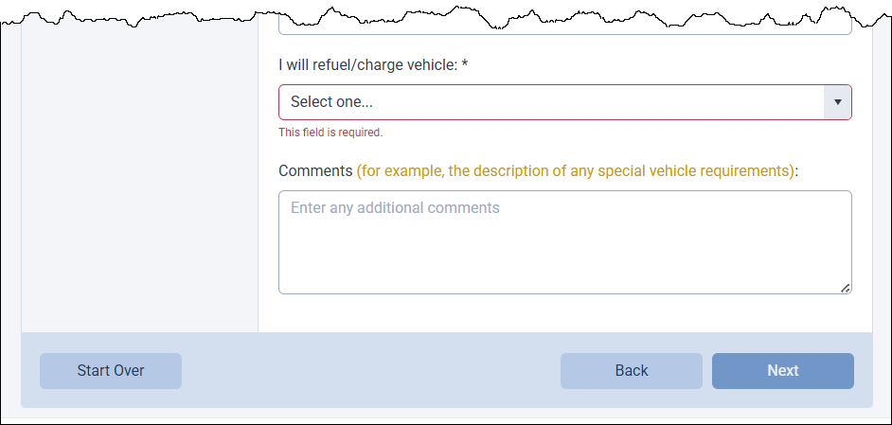
DRIVER/REQUESTOR EXPERIENCE:
MAKE RESERVATION
Step 3
Additional Information
Enter the requested details of your reservation
NOTE: All fields with leading “*” are required
Reservations submitted with MISSING REQUIRED FIELDS will generate
a prompt

Slide 52
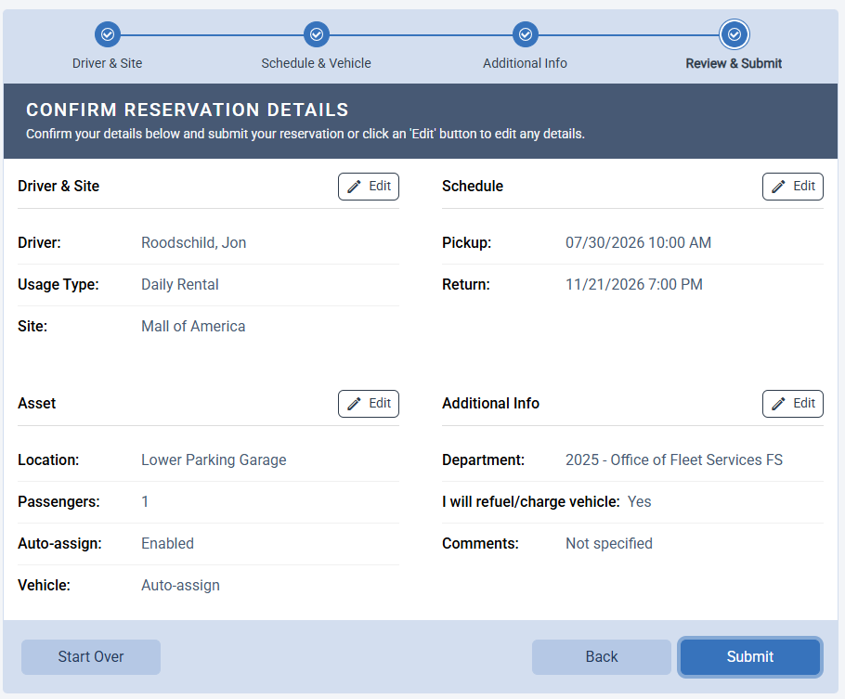
DRIVER/REQUESTOR EXPERIENCE:
MAKE RESERVATION
Step 4
Review & Submit
If changes need to be made, select either an Edit icon or “Back”
When reservation information is correct, select “Submit”

Slide 53
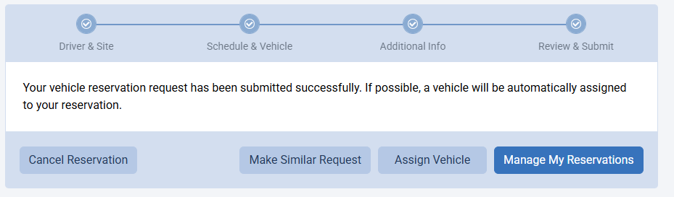
DRIVER/REQUESTOR EXPERIENCE:
MAKE RESERVATION
Once the reservation request is completed,
you will receive this confirmation notification.
“Make Similar Request” submits the current request and takes the Requestor back to start another request.
Reservation fields will be pre-populated.
Selecting “Manage My Reservations”
will redirect the you to view
“My Schedule”

Slide 54
Driver/Requestor
experience:
MY SCHEDULE

Slide 55
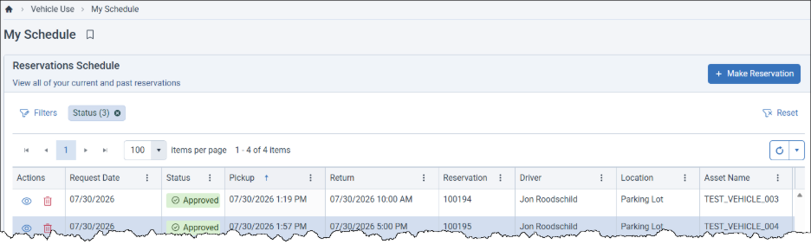
DRIVER/REQUESTOR EXPERIENCE:
My Schedule
The Status of your reservation
The Request ID
or Confirmation Number
Vehicle information location and type
From your schedule you can
“View Your Reservation” or “Cancel”
The scheduled Pick-up and Return date and times

Slide 56
Driver/Requestor
experience:
MY SCHEDULE
REQUEST A CHANGE TO
A RESERVATION

Slide 57
DRIVER/REQUESTOR EXPERIENCE:
MY SCHEDULE
From the Navigation
select “My Schedule”

Slide 58
DRIVER/REQUESTOR EXPERIENCE:
MY SCHEDULE
From “My Schedule”, select “View Your Reservation” (the eye icon)

Slide 59
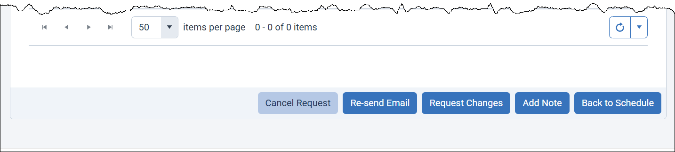
DRIVER/REQUESTOR EXPERIENCE:
MY SCHEDULE
At the bottom of the page, select “Request Changes”

Slide 60
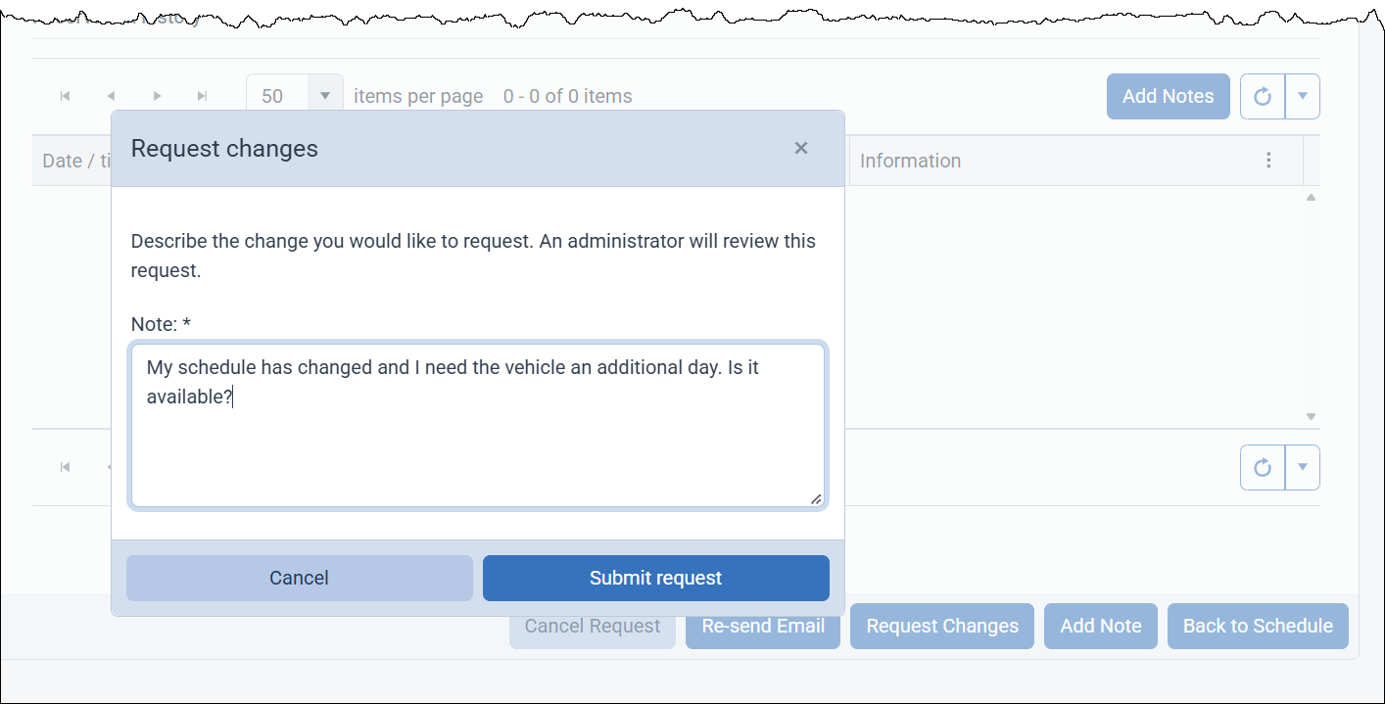
DRIVER/REQUESTOR EXPERIENCE:
MY SCHEDULE
Note: when submitted, the reservation will go into a PENDING STATUS for the Administrator to review.
Express your requested change to the reservation and select “Submit Request”

Slide 61
Driver/Requestor
experience:
MY SCHEDULE
CANCEL A RESERVATION

Slide 62
DRIVER/REQUESTOR EXPERIENCE:
MY SCHEDULE
From “My Schedule”, select “Cancel Reservation” (the red trash can icon)

Slide 63
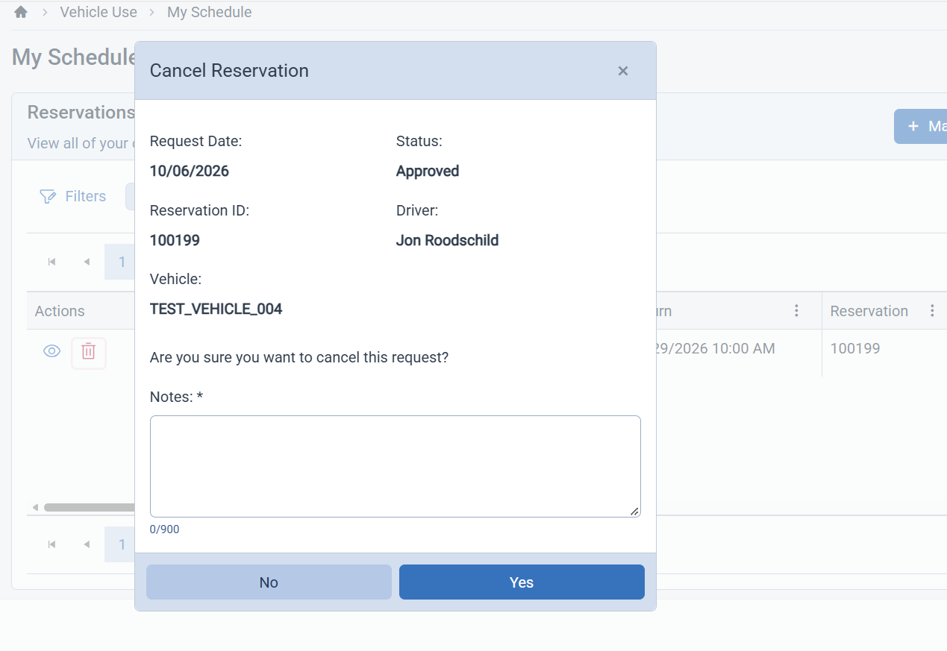
DRIVER/REQUESTOR EXPERIENCE:
MY SCHEDULE
Type in reason for cancelation
and select “Yes”

Slide 64
Driver/Requestor
experience:
MY PROFILE

Slide 65
DRIVER/REQUESTOR EXPERIENCE:
MY PROFILE
From the Navigation select “My Profile”

Slide 66
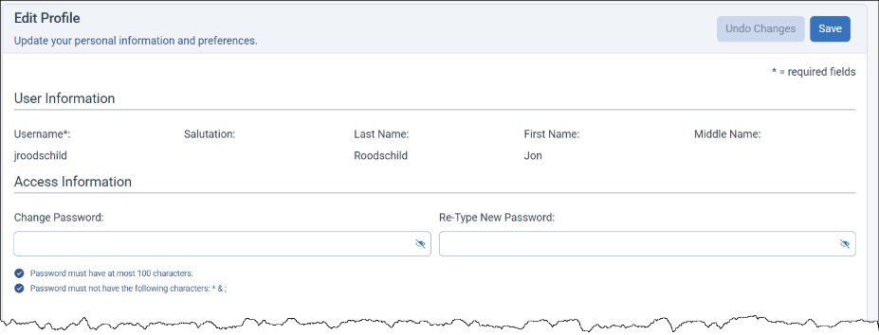
DRIVER/REQUESTOR EXPERIENCE:
MY PROFILE
Update your profile as needed to assure accurate contact information
Select ”Save Profile” to finalize edits

Slide 67
Driver/Requestor
experience:
VEHICLE AVAILABILITY

Slide 68
DRIVER/REQUESTOR EXPERIENCE:
VEHICLE AVAILABILITY
From the Navigation select “Vehicle Availability”

Slide 69
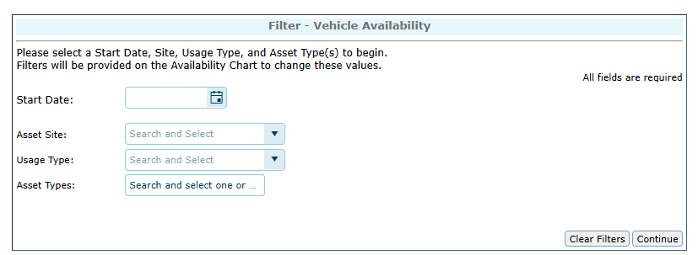
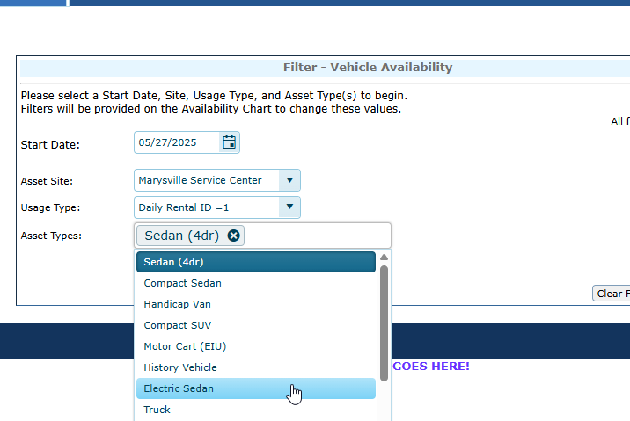
DRIVER/REQUESTOR EXPERIENCE:
VEHICLE AVAILABILITY
On the User side, set filters.
Date, Site, Usage Type and Asset Type are the starting filters.
Multi select is available for Asset Type.

Slide 70
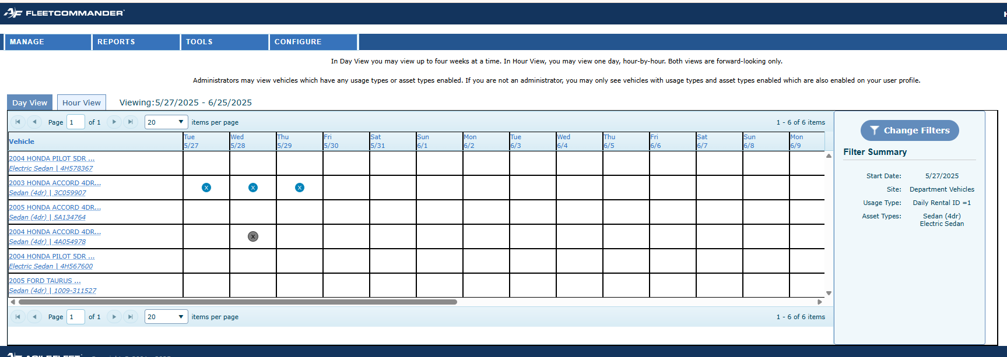
DRIVER/REQUESTOR EXPERIENCE:
VEHICLE AVAILABILITY
Chart view shows that there are vehicles available.
Results will also be filtered based on user’s permissions, access groups, and usage types.
“See and Select” Availability

Slide 71
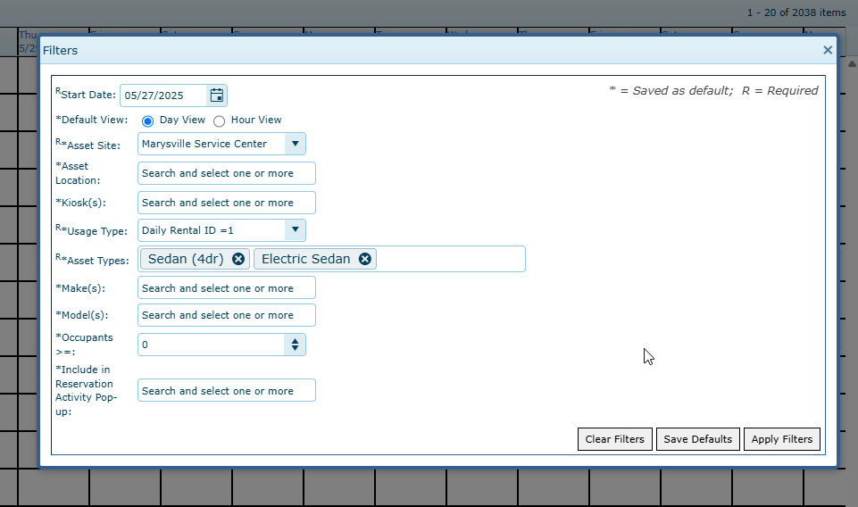
DRIVER/REQUESTOR EXPERIENCE:
VEHICLE AVAILABILITY
Additional Filters are available to use:
  Location
  Kiosk
  Make
  Model
  Occupancy
  Custom Fields
ADDITIONAL
FILTERS

Slide 72
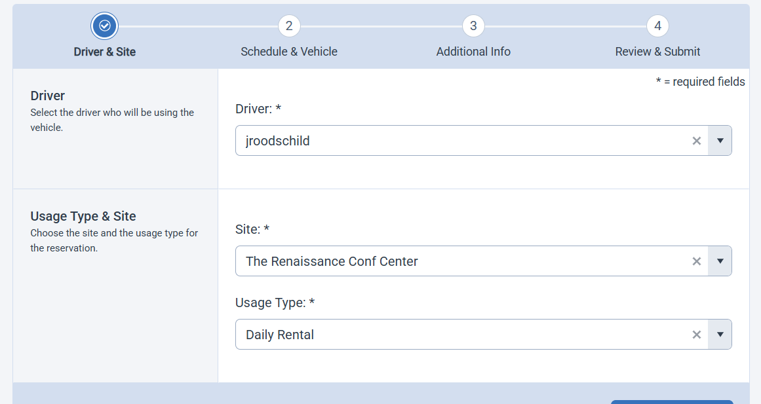
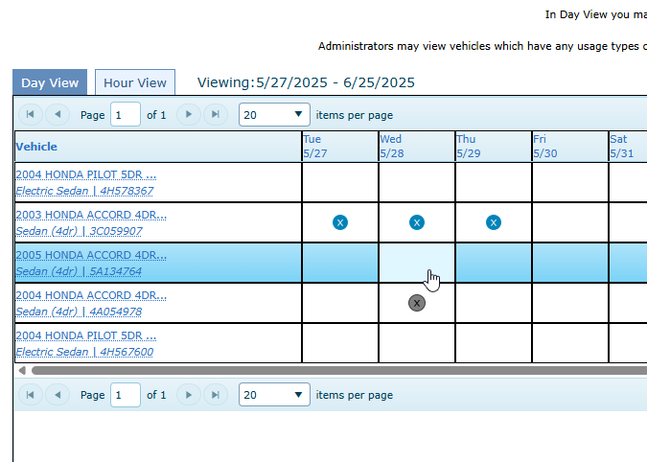
DRIVER/REQUESTOR EXPERIENCE:
VEHICLE AVAILABILITY
Click in a box and user will be taken directly to the reservation form with some details already completed

Slide 73
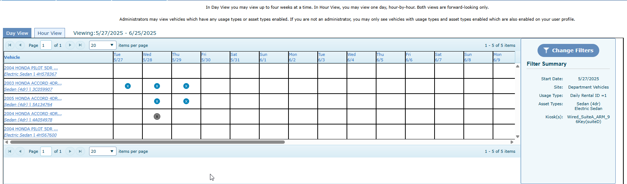
DRIVER/REQUESTOR EXPERIENCE:
VEHICLE AVAILABILITY
Updates in real time
Refresh and you see the newly approved reservation

Slide 74
Administrator Experience
FLEETCOMMADER FOUNDATIONS: NEW USER BOOTCAMP

Slide 75
Accessing
FleetCommander:
ADMIN Interface

Slide 76
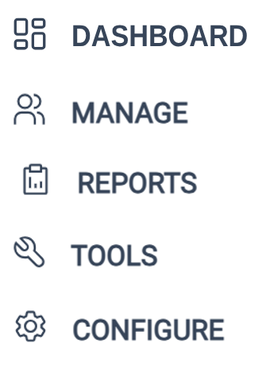
ADMINISTRATOR Experience
  Five Notable Sections of the Admin Interface

Slide 77
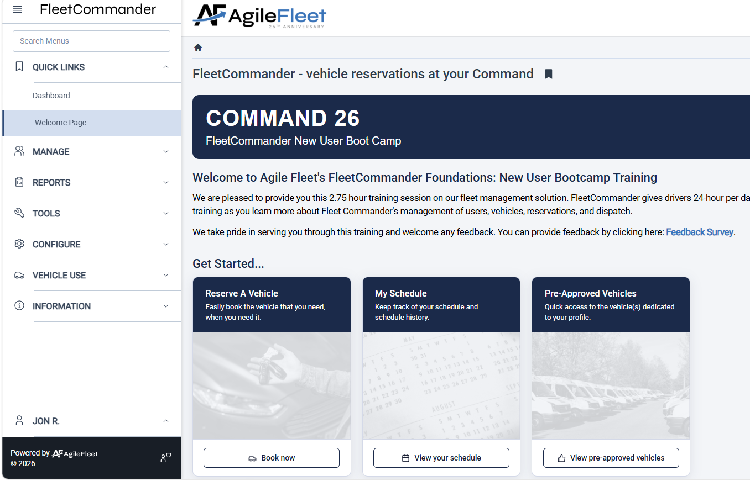
ACCESSING FLEETCOMMANDER: ADMIN PAGE

Slide 78
ADMINISTRATOR
EXPERIENCE:
DASHBOARD

Slide 79
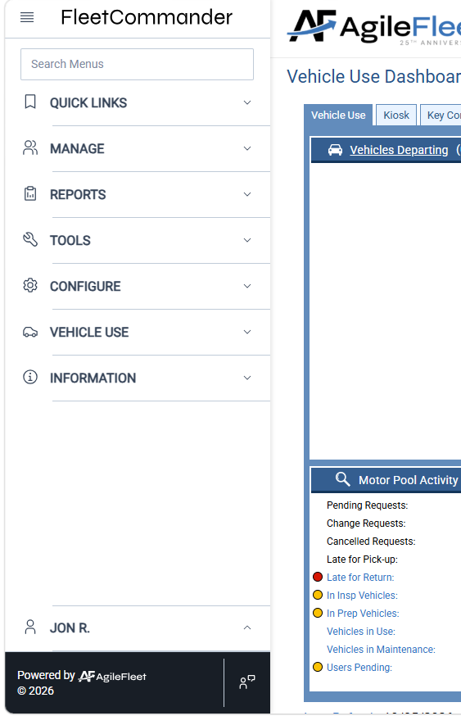
ADMINISTRATOR Experience
  FleetCommander’s DASHBOARD
  is the primary workspace for Admins/Dispatchers to
  interface with the system

Slide 80
ADMINISTRATOR
EXPERIENCE:
MANAGE menu

Slide 81
ADMINISTRATOR Experience
  FleetCommander’s MANAGE MENU is your LAUNCHING POINT for engaging with the various profile and module data.
  The links shown vary with the
  modules you purchased.

Slide 82
ADMINISTRATOR
EXPERIENCE:
MANAGE USERS AND VEHICLES

Slide 83
Administrator
experience:
MANAGE MENU
BENEFITS OF USER
AND ASSET PROFILES

Slide 84

Administrator
experience:
MANAGE MENU
BENEFITS OF USER PROFILES
All of your driver and fleet staff information in one place
Standard, demographic data (e.g. name, contact info)
System and vehicle permissions
Accountability for vehicle use
Policy acceptance, certifications, training, etc.
Default billing & charge-back info

Slide 85
Administrator
experience:
MANAGE MENU
BENEFITS OF ASSET PROFILES
All of your vehicle information in one location
Standard data across the enterprise
Establish rules-of-use through permissions, access, & usage
Clear visibility of vehicle-related costs
(e.g. maintenance & fuel)
Manage custody of vehicles through the life-cycle

Slide 86
ADMINISTRATOR
EXPERIENCE:
MANAGE > USERS & VEHICLES

Slide 87
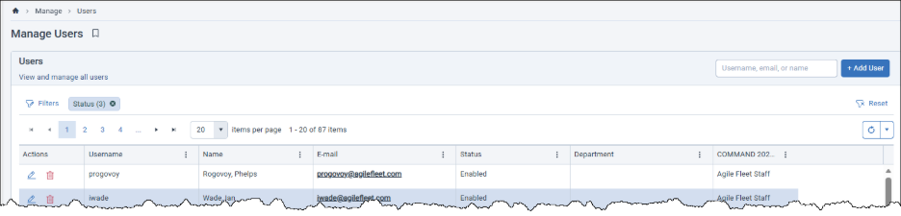
ADMINISTRATOR EXPERIENCE:
MANAGE USERS
Use Manage Users
to search for Users

Slide 88
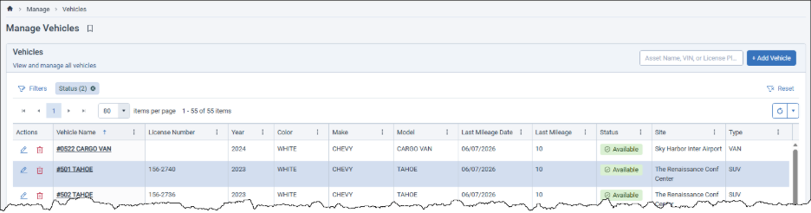
ADMINISTRATOR EXPERIENCE:
MANAGE VEHICLES
Use Manage Vehicles
to search for Vehicles

Slide 89
ADMINISTRATOR
EXPERIENCE:
REPORTS> USERS & VEHICLES

Slide 90
ADMINISTRATOR Experience
  FleetCommander’s MANAGE MENU is your LAUNCHING POINT for engaging with the various profile and module data.
  The links shown vary with the
  modules you purchased.

Slide 91

Administrator
experience:
Reports > Users & Vehicles
User Reports
Asset Reports
Asset Summary
Asset Details
Asset Data Dump
Mileage-Cost
Asset Mileage
Asset In/Out
Tag/Vehicle Exception
Owner/Responsible Asset Summary
Maintenance and Fuel
Cost
Inspections & Prep
Accident Summary
Accident Detail
TCO Data Dump
TCO Expense Summary
User Summary
User Details
User Details Extra
Account Summary
Department Summary
Driver Eligibility
Drivers License Currency
Invalid Driver
Lost and Found
User Citations
User HR
User Certification Currency
User System Activity

Slide 92
ADMINISTRATOR EXPERIENCE:
REPORTS > USERS & VEHICLES
Report Name | What it Does | Type | Navigation
User Detail Extra Report | Exports almost all of the fields (citations and courses are excluded) in the Profile tab of the User’s profile. | User Data Integrity | Reports > Users> User Detail Extra Report
Driver Eligibility | Lists the eligibility and validity of each user’s license. | User Currency | Reports > Users> Driver Eligibility
Drivers License Currency | Driver's license information found in the User's profile | User Currency | Reports > Users > Drivers License Currency
Asset Data Dump | Dumps all the information found on the vehicle’s Profile tab. | Asset Data Integrity | Reports> Assets > Asset Data Dump
Mileage-Cost | Lists vehicle’s distance and expenses in a specified date range and calculates the cost-per-mile for that timeframe | Asset Data | Reports > Assets > Mileage-Cost
Asset Mileage | Lists vehicle’s mileage data in a specified date range and by data source. | Asset Data | Reports> Assets > Asset Mileage
Asset In/Out | List of vehicles leaving, returning, or in maintenance by day | Asset Data | Reports> Assets > Asset In/Out

Slide 93
ADMINISTRATOR
experience:
MANAGE>MAKE RESERVATIONS

Slide 94
ADMINISTRATOR Experience
  Admins/Dispatchers can make vehicle reservations in multiple places within FleetCommander.
  Following section demonstrates reservations entered via MANAGE>MAKE RESERVATION

Slide 95
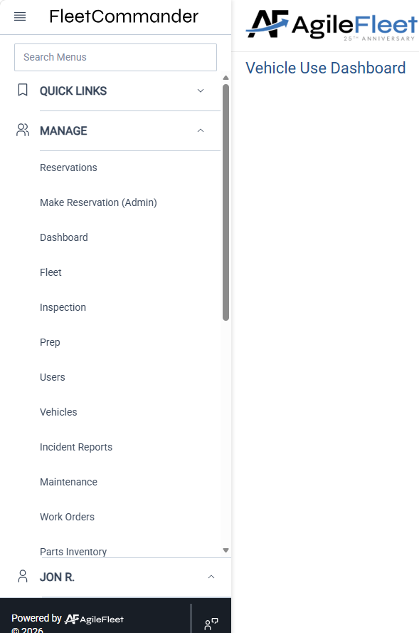

ADMINISTRATOR EXPERIENCE:
MAKE RESERVATION
Select
Make Reservation

Slide 96
ADMINISTRATOR EXPERIENCE:
MAKE RESERVATION
Just like the End User’s Vehicle Use > Make Reservation, Manage > Make Reservation is captured in FOUR STEPS
Step 1
Driver
& Site
Step 2
Schedule
& Vehicle
Step 3
Additional
Information
Step 4
Review
& Submit

Slide 97
ADMINISTRATOR EXPERIENCE:
MAKE RESERVATION
Step 1
Driver & Site
Enter intended Driver.
HELPFUL HINT:
You can search the Combo Box using your choice of USERNAME, FIRST NAME, or LAST NAME

Slide 98
ADMINISTRATOR EXPERIENCE:
MAKE RESERVATION
Step 1
Driver & Site
Site determines the location a reservation will leave from.
Select the Site

Slide 99
ADMINISTRATOR EXPERIENCE:
MAKE RESERVATION
Step 1
Driver & Site
Usage Type determines “how” the vehicle will be used
Select the Usage Type
Select “Next”

Slide 100

ADMINISTRATOR EXPERIENCE:
MAKE RESERVATION
Step 1
Driver & Site
Usage Type determines “how” the vehicle will be used
NOTE: As an Admin, you can override the notification if a driver’s profile is not currently set-up with the selected Usage Type

Slide 101

ADMINISTRATOR EXPERIENCE:
MAKE RESERVATION
Step 2
Schedule & Vehicle
Enter Start Date & Time
Enter End Date & Time
Select Location,
Vehicle Type,
and Number of Passengers

Slide 102
ADMINISTRATOR EXPERIENCE:
MAKE RESERVATION
Step 2
Schedule & Vehicle
Two VEHICLE ASSIGNMENT ELEMENTS appear for Admins/Dispatchers on this page
Auto-assign vehicle
Ignore buffers?
HINT: uncheck if you want to assign a specific vehicle to reservation

Slide 103

ADMINISTRATOR EXPERIENCE:
MAKE RESERVATION
Step 2
Schedule & Vehicle
Two VEHICLE ASSIGNMENT ELEMENTS appear for Admins/Dispatchers on this page
Buffer setting is configured at the Site level
Auto-assign vehicle
Ignore buffers?
HINT: check if you want to ignore reservation Buffer time

Slide 104
ADMINISTRATOR EXPERIENCE:
MAKE RESERVATION
Step 3
Additional Information
Enter the requested details of your reservation
NOTE: All fields with leading “*” are required
Reservations submitted with MISSING REQUIRED FIELDS will generate
a prompt

Slide 105
ADMINISTRATOR EXPERIENCE:
MAKE RESERVATION
Step 4
Review & Submit
If changes need to be made, select either an Edit icon or “Back”
When reservation information is correct, select “Submit”

Slide 106

ADMINISTRATOR EXPERIENCE:
MAKE RESERVATION
Once the reservation request is completed,
you will receive this confirmation notification.
“Make Similar Request” submits the current request and takes the Requestor back to start another request.
Reservation fields will be pre-populated.
Selecting “Manage Reservations”
will redirect the you to view
Manage > Reservations

Slide 107
ADMINISTRATOR EXPERIENCE:
MAKE RESERVATION
Once the reservation request is completed,
you will receive this confirmation notification.
“Assign Vehicle” allow you to select/make changes to the vehicle assignment before finalizing the reservation submission.

Slide 108

ADMINISTRATOR EXPERIENCE:
MAKE RESERVATION
Click on the OK (Assign Vehicle) action button to finalize vehicle selection
HELPFUL HINT: See SLIDES ## for more info on Assigning Vehicles

Slide 109

ADMINISTRATOR EXPERIENCE:
MAKE RESERVATION
Concluding “Make Reservation” brings you to “Manage > Reservations”

Slide 110
ADMINISTRATOR
experience:
MANAGE>RESERVATIONS

Slide 111
Administrator
experience:
Manage>Reservations
  As needed, Admins/Dispatchers can make edits to vehicle reservations in FleetCommander.
  Following section demonstrates this process in MANAGE> RESERVATIONS

Slide 112
ADMINISTRATOR EXPERIENCE:
MANAGE> RESERVATIONS
Manage> Reservations Main Page is a launch point from which to view reservation details

Slide 113


ADMINISTRATOR EXPERIENCE:
MANAGE> RESERVATIONS
Filters allow you to narrow the reservations presented on the Manage > Reservations Main Page

Slide 114
Administrator
experience:
Manage>Reservations
VIEW A RESERVATION

Slide 115
ADMINISTRATOR EXPERIENCE:
MANAGE> RESERVATIONS
To view a specific reservation, select Edit Request (pencil icon)

Slide 116

ADMINISTRATOR EXPERIENCE:
MANAGE> RESERVATIONS
The Manage > Reservations > Detail View

Slide 117

ADMINISTRATOR EXPERIENCE:
MANAGE> RESERVATIONS
Action buttons allows you to interact with reservation

Slide 118

ADMINISTRATOR EXPERIENCE:
MANAGE> RESERVATIONS
The top of the Manage > Reservation > Edit Reservation page presents a summary of the reservation

Slide 119


ADMINISTRATOR EXPERIENCE:
MANAGE> RESERVATIONS
Manage > Reservations > edit Reservation also presents
Request information and vehicle specifics

Slide 120


ADMINISTRATOR EXPERIENCE:
MANAGE> RESERVATIONS
Manage > Reservations > edit Reservation also presents
Request information and vehicle specifics (continued)

Slide 121

ADMINISTRATOR EXPERIENCE:
MANAGE> RESERVATIONS
At the bottom of the page, the Reservation History logs the step-by-step progression of the Reservation Request

Slide 122
Administrator
experience:
Manage>Reservations
MODIFY RESERVATION

Slide 123
Sometimes it is necessary to make changes to a reservation.
ADMINISTRATOR EXPERIENCE:
MANAGE> RESERVATIONS
This is done through Manage>Reservation
Select Edit Reservation

Slide 124
ADMINISTRATOR EXPERIENCE:
MANAGE> RESERVATIONS
Enter changes into the desired field and hit save.
NOTE: modifications include items like:
DRIVER
DATE / TIMES
VEHICLE TYPE
NUMBER OF OCCUPANTS
DESTINATION
ETC.

Slide 125

ADMINISTRATOR EXPERIENCE:
MANAGE> RESERVATIONS
NOTE: You may be prompted to send a confirmation email. Select “Yes” if you want the requestor & driver receive the email.
If an email is not necessary, hit “No”.

Slide 126
Administrator
experience:
Manage>Reservations
ASSIGN A VEHICLE

Slide 127


ADMINISTRATOR EXPERIENCE:
MANAGE> RESERVATIONS
Manage> Reservations is the best way to work with reservations
Select Assign Vehicle action icon

Slide 128
Administrator
experience:
Manage>Reservations
CANCEL A RESERVATION

Slide 129
Sometimes it is necessary to cancel a reservation.
ADMINISTRATOR EXPERIENCE:
MANAGE> RESERVATIONS
This is done through Manage>Reservation
Select Cancel Reservation

Slide 130

ADMINISTRATOR EXPERIENCE:
MANAGE> RESERVATIONS
Select a Cancelation Type from the drop down and insert a comment.
Select “Yes

Slide 131
Administrator
experience:
Manage>Reservations
DISPATCH A RESERVATION
Manage > Reservations is one of several places in FleetCommander where reservations can be dispatched

Slide 132
ADMINISTRATOR EXPERIENCE:
MANAGE> RESERVATIONS
To dispatch a vehicle via Manage> Reservations…
…select Dispatch icon

Slide 133

ADMINISTRATOR EXPERIENCE:
MANAGE> RESERVATIONS
To dispatch a vehicle via Manage> Reservations…
…select Dispatch icon
Dispatch Pop-up Window appears

Slide 134
ADMINISTRATOR EXPERIENCE:
MANAGE> RESERVATIONS
To dispatch a vehicle via Manage> Reservations…
DISPATCH HINTS:
…select Dispatch icon
Make sure you’re in the right reservations!
Use Dispatch Window to
verify reservation details including NAME OF DRIVER, END DATE, VEHICLE TYPE, etc.
Dispatch Pop-up Window appears

Slide 135
ADMINISTRATOR EXPERIENCE:
MANAGE> RESERVATIONS
A vehicle can also be dispatched from with in the Resevation > Detail View among many other locations with FleetCommander

Slide 136
Administrator
experience:
Manage>Reservations
If you discover changes that need to be made, you can accomplish this from the Dispatch Window!

Slide 137




ADMINISTRATOR EXPERIENCE:
MANAGE> RESERVATIONS
Change a VEHICLE
within Dispatch:
Click “Change Vehicle”
Window view changes to show available vehicles
Adjust vehicle filters and “Refresh List” as needed

Slide 138

ADMINISTRATOR EXPERIENCE:
MANAGE> RESERVATIONS
To change a DRIVER
within Dispatch:
Click “Change” next to Driver’s Name
Locate Driver and click the Select button
User pop-up
window appears

Slide 139
Administrator
experience:
Manage>Reservations
When it comes to the “when” a reservation
is dispatched, you have the choice of two
time considerations:
Current Date/Time
Request Date/Time

Slide 140
ADMINISTRATOR EXPERIENCE:
MANAGE> RESERVATIONS
Two Dispatch Options
Current Date and Time

Slide 141
ADMINISTRATOR EXPERIENCE:
MANAGE> RESERVATIONS
Two Dispatch Options
Original Reservation Date and Time

Slide 142
Administrator
experience:
Manage>Reservations
Additional Dispatch
Window Items

Slide 143
ADMINISTRATOR EXPERIENCE:
MANAGE> RESERVATIONS
Odometer Fields
Departure/Start Mileage
auto-populates from the most recent record

Slide 144
ADMINISTRATOR EXPERIENCE:
MANAGE> RESERVATIONS
DISPATCH HINTS:
Watch out for information or instructions in COMMENTS before submitting
Click Submit to finalize Dispatch Out
Communicate to driver any previous damage noted in
VEHICLE CONDITION

Slide 145
Administrator
experience:
Manage>Reservations
Return Vehicle/
Dispatch-In

Slide 146
ADMINISTRATOR EXPERIENCE:
MANAGE> RESERVATIONS
Choose from the same options to CHECK a vehicle BACK IN
Current Date and Time
Original Reservation Date and Time

Slide 147
ADMINISTRATOR EXPERIENCE:
MANAGE> RESERVATIONS
Odometer Fields
End Mileage MUST be typed in
Total mileage
self-calculates based on Odom End

Slide 148
ADMINISTRATOR EXPERIENCE:
MANAGE> RESERVATIONS
DISPATCH HINTS:
Type any NEW DAMAGE on the vehicle in
VEHICLE CONDITION.
Details will appear here again with next reservation

Slide 149
ADMINISTRATOR EXPERIENCE:
MANAGE> RESERVATIONS
DISPATCH HINTS:
Send email to
ADMIN STAFF if you need to relay any information to them regarding this reservation/vehicle
(example: damages)
Click Submit to finalize Dispatch In

Slide 150
Administrator
experience:
Manage>Reservations
Other places vehicles can be dispatched include:
  Dashboard - considered best practice
  (see Slide 154)
  Manage > Reservations (Vehicle Icon)
  Manage Vehicles
  Manage Users
  QwikFind - Assets
  QwilkFind - Users

Slide 151
ADMINISTRATOR
experience:
MANAGE>FLEET

Slide 152
Administrator
experience:
Manage>FLEET
  As needed, Admins/Dispatchers can make edits to vehicle reservations in FleetCommander.
  Following section demonstrates this process in MANAGE> FLEET

Slide 153

ADMINISTRATOR EXPERIENCE:
MANAGE> FLEET
Use the filters to narrow your view

Slide 154
ADMINISTRATOR EXPERIENCE:
MANAGE> FLEET
Search by Site

Slide 155
ADMINISTRATOR EXPERIENCE:
MANAGE> FLEET
Search by Vehicle Type

Slide 156
ADMINISTRATOR EXPERIENCE:
MANAGE> FLEET
Search by specific vehicle information

Slide 157
ADMINISTRATOR EXPERIENCE:
MANAGE> FLEET
You can change your chart view from Day View to Hour View
Notice the view on the chart is a two-week period

Slide 158

ADMINISTRATOR EXPERIENCE:
MANAGE> FLEET
You can change your chart view from Day View to Hour View
Notice the view on the chart is a two-day period

Slide 159

ADMINISTRATOR EXPERIENCE:
MANAGE> FLEET
Use the legend to understand the status of vehicles
The status of vehicles will appear in the first column

Slide 160
Administrator
experience:
Manage>FLEET
  Manage > Fleet is one of several places in FleetCommander where reservations can be entered.

Slide 161
ADMINISTRATOR EXPERIENCE:
MANAGE> FLEET
To start a reservation, select the date and time to the corresponding vehicle in either day view or hour view

Slide 162

ADMINISTRATOR EXPERIENCE:
MANAGE> FLEET
Follow the steps for Making a Reservation

Slide 163
Administrator
experience:
Manage>FLEET
  Manage > Fleet is also one of several places in FleetCommander where reservations can be modified.

Slide 164
ADMINISTRATOR EXPERIENCE:
MANAGE> FLEET
Modifying a request
Select the reservation that you would like to modify the request

Slide 165

ADMINISTRATOR EXPERIENCE:
MANAGE> FLEET
Select Modify Request and follow the steps for modifying a reservation.

Slide 166
Administrator
experience:
Manage>FLEET
  Vehicle assignments can even be modified via Manage > Fleet.

Slide 167
ADMINISTRATOR EXPERIENCE:
MANAGE> FLEET
Changing the vehicle assigned to a reservation
NOTE: Reservations that have been dispatched are not able to have the vehicle changed

Slide 168
ADMINISTRATOR EXPERIENCE:
MANAGE> FLEET
While in hour view select the first time in the chart to change the vehicle

Slide 169

ADMINISTRATOR EXPERIENCE:
MANAGE> FLEET
Select the radio button beside Change Vehicle the select Submit

Slide 170

ADMINISTRATOR EXPERIENCE:
MANAGE> FLEET
Select the vehicle to move the reservation to then select “Submit”

Slide 171
ADMINISTRATOR
experience:
DASHBOARD (Continued)

Slide 172
Administrator
experience:
Dashboard
  FleetCommander’s Dashboard
  is the primary workspace for Admins/Dispatchers to
  interface with the system

Slide 173

ADMINISTRATOR EXPERIENCE:
DASHBOARD
Dashboard helps you see reservation schedule for the day
Various sections of the dashboard include:
Departing Reservations
Returning Reservations

Slide 174


ADMINISTRATOR EXPERIENCE:
DASHBOARD
Dashboard helps you see reservation schedule for the day
Various sections of the dashboard include:
Mouseover for RESERVATION DETAILS

Slide 175
ADMINISTRATOR EXPERIENCE:
DASHBOARD
Dashboard helps you see reservation schedule for the day
Various sections of the dashboard include:
Click hyper-link to access Manage Reservation view of this reservation

Slide 176
ADMINISTRATOR EXPERIENCE:
DASHBOARD
Dashboard helps you see reservation schedule for the day
Various sections of the dashboard include:
Motor Pool Activity:
gives you real time status
of Reservations & Users
HINT: click on hyperlinks
as they appear to take
action on that item

Slide 177
Administrator
experience:
Dashboard
  FleetCommander’s QwikFind Search interface allows access to data without having to navigate away from the Dashboard.

Slide 178

ADMINISTRATOR EXPERIENCE:
QWIKFIND
QwikFind: allows you
to search for Assets, Reservations, and Users

Slide 179

ADMINISTRATOR EXPERIENCE:
QWIKFIND
QwikFind: select “Asset
Type vehicle’s NAME or LICENSE
Click “Go” to view Vehicle Profile

Slide 180

ADMINISTRATOR EXPERIENCE:
QWIKFIND
QwikFind takes you to “Asset Lookup”
Dispatch Vehicle Out on scheduled
reservation
Update Vehicle Mileage
Make a Reservation for this Vehicle
Dispatch Vehicle Out on scheduled
reservation
NOTE: Dispatcher Permission DOES NOT allow editing a Vehicle Profile
(this link is deactivated)

Slide 181

ADMINISTRATOR EXPERIENCE:
QWIKFIND
QwikFind: select “User”
Type USERNAME or LAST NAME
Click “Go”
to view
User Profile

Slide 182

ADMINISTRATOR EXPERIENCE:
QWIKFIND
Start a new QwikFind
NOTE: Dispatcher Permission DOES NOT allow viewing
a User Profile
(this link is deactivated)
QwikFind takes you to “User Lookup”
Make a new Reservation
Dispatch a Reservation

Slide 183

ADMINISTRATOR EXPERIENCE:
QWIKFIND
QwikFind: select
“Reservation”
Click “Go” to view Reservation
Type either Request ID (example R000029) or Confirmation Number (example 100017)

Slide 184
ADMINISTRATOR EXPERIENCE:
QWIKFIND
QwikFind takes you
to the Reservation’s Schedule/View Request

Slide 185
Administrator
experience:
Dashboard
  FleetCommander’s Dashboard is the PRIMARY interface for vehicle Dispatch.

Slide 186
ADMINISTRATOR EXPERIENCE:
DISPATCH
Double-click line to
Dispatch Out
Same function to
Dispatch In

Slide 187
Administrator
experience:
Dashboard
  Like other places within FleetCommander, you can customize the Dashboard default and filters.

Slide 188
ADMINISTRATOR EXPERIENCE:
DEFAULTS
Bottom of page show current filters for this
Dashboard view

Slide 189

Dashboard Filter:
refines what and how items are shown
on the Dashboard
ADMINISTRATOR EXPERIENCE:
DEFAULTS
TIP: use Two-line Display to enhance your Dashboard view
Sponsored by:

Slide 190

Jon Roodschild
jroodschild@agilefleet.com
Sponsored by:

