Slide 1

Roadmap
Fleet Intelligence, Reimagined
Sponsored by:
November 3-5, 2026 • Glendale, AZ

Slide 2
Agenda
What’s Coming the Next Few Months
A Few Reminders
Top Initiatives For 2027

Slide 3
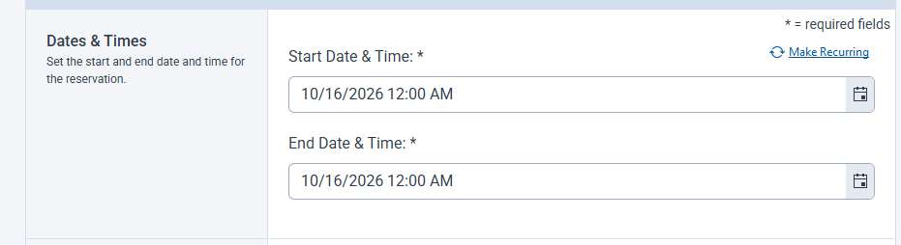
Top 6 Enhancements Coming Soon: Recurring Reservations
Make Your Reservations Recurring
  Configurable Option
  Create/Manage a series of Reservations

Slide 4
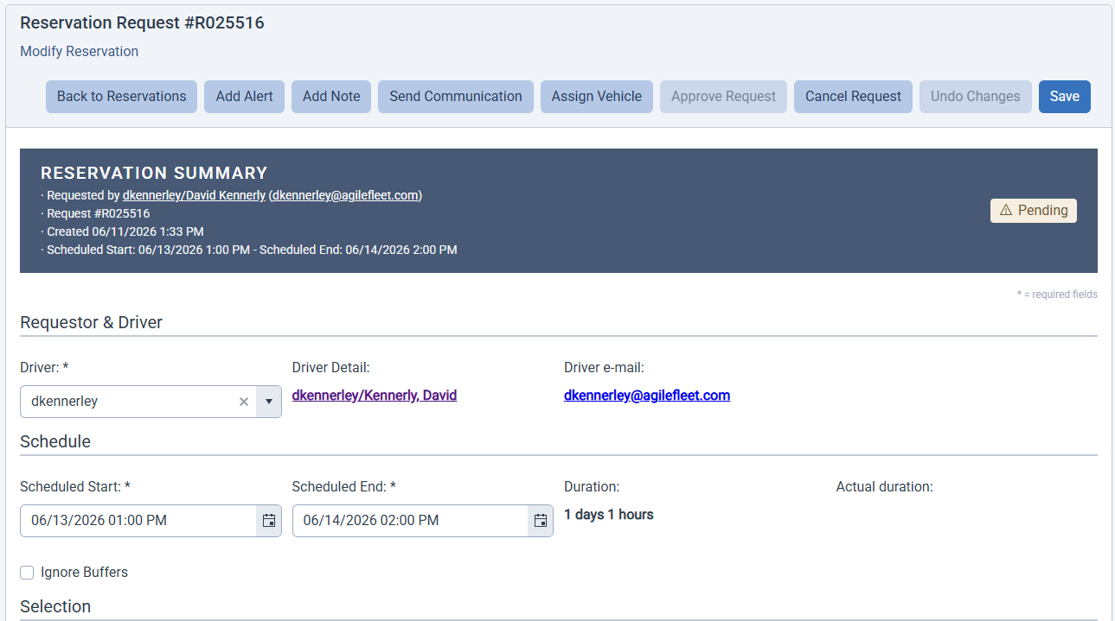
Top 6 Enhancements Coming Soon: User Initiated Changes to Reservations
Make Changes to Your Reservations (non-Admins)
  Configurable Option
  Requestors and Drivers Can Directly Make Changes to Reservations

Slide 5

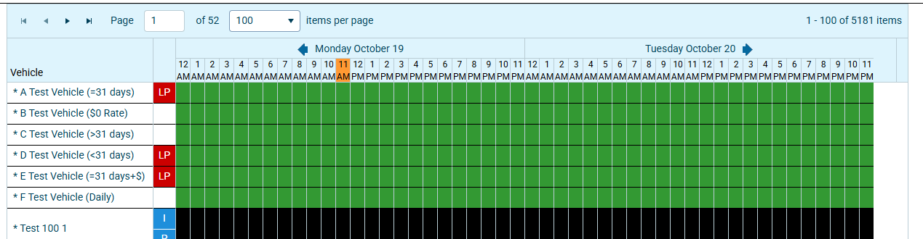
Top 6 Enhancements Coming Soon: A New Manage Fleet Experience
Modernized to Align to the New FleetCommander UI/UX
Combined with a Modernized Reservation Reassignment
Optional Smart Automation for Reassignments

Slide 6
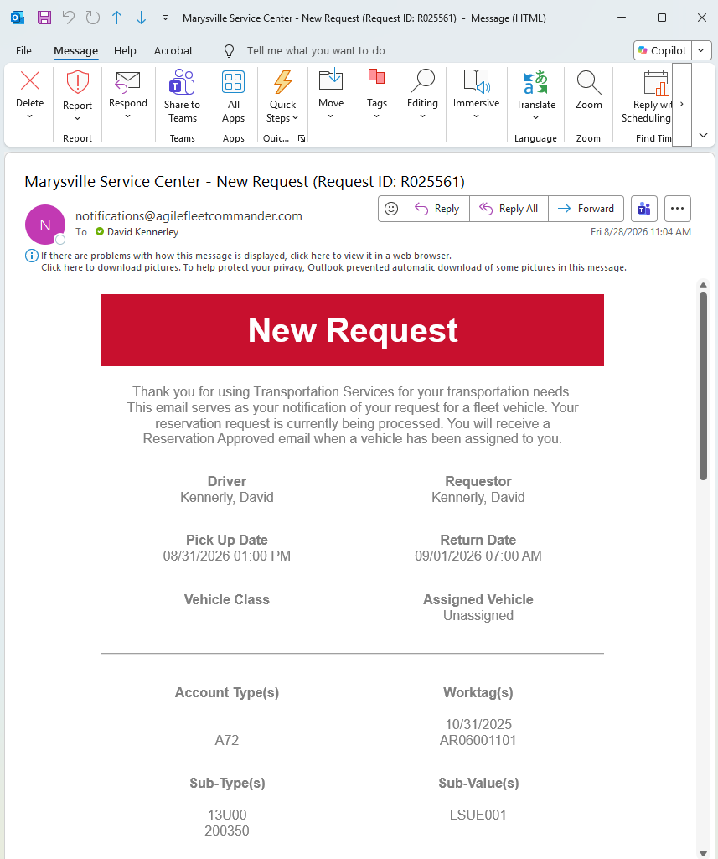
Top 6 Enhancements Coming Soon: Email Approvals
Add Email Approval / Reject Buttons
Configure Approvers

Slide 7
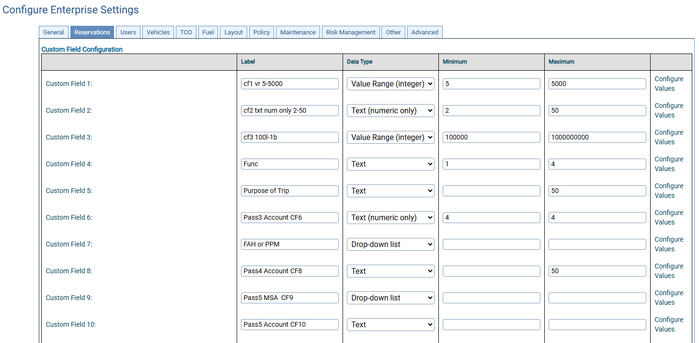
Top 6 Enhancements Coming Soon: Custom Field Upgrades
Additional Fields and Targeting
Upgraded Sorting
Upgraded Configuration

Slide 8
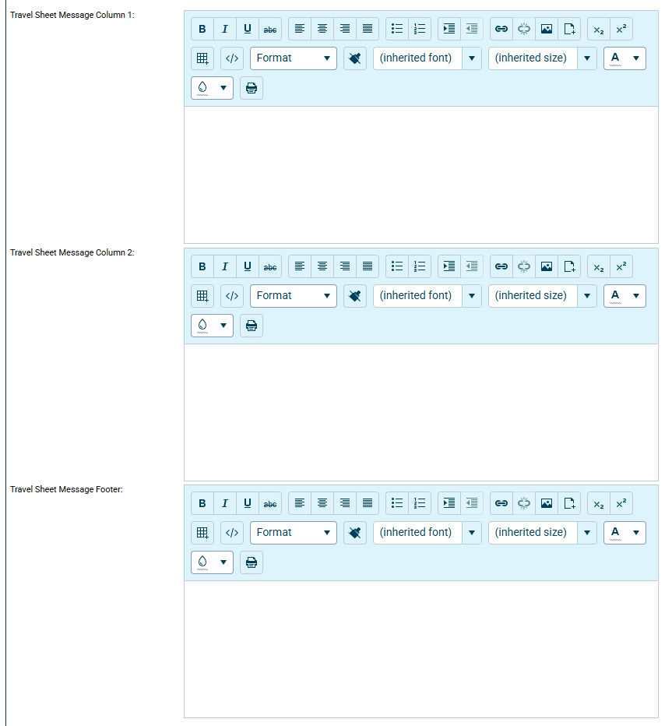
Top 6 Enhancements Coming Soon: A Better Travel Sheet
More Options to Customize your Travel Sheets

Slide 9

REMINDER: Upgrade Your VBScript Code Before 12/31/2026
Microsoft has Deprecated VBScript
If you utilize Microsoft VBScript in any of your custom processes, you should have received several emails from Agile Fleet
Agile Fleet will Discontinue Support of VBScript on 12/31/2026
Please reach out to your Client Success representative if you have questions
VBScript deprecation: Timelines and next steps | Windows IT Pro Blog

Slide 10


REMINDER: Maintenance Window Scheduled for December 5, 2026
FleetCommander is moving to Microsoft Azure!
A Maintenance Window is Scheduled for December 5, 2026 Starting at 9am ET for the Migration
Please reach out to Support at fcsupport@agilefleet.com with questions

Slide 11
NOTIFICATION: Classic ASP Deprecating 12/31/2027
Microsoft is not actively developing this framework
Security and compliance support is becoming more difficult
Agile Fleet is planning to deprecate Classic ASP code from FleetCommander on 12/31/2027
If you are using .asp pages in your navigation, please plan to upgrade
Please reach out to your Client Success representative if you have questions

Slide 12
Roadmap: Current High-Level Plan for 1H 2027
Notification Center – Build / Customize and Manage Your Notifications
UI Modernization – More FleetCommander Screens re-designed in the new UI
Report Center – More Templates (Data) and AI Assisted Intelligent Insights
Enhanced Keyless Dispatch – Enhanced Features and Digital Keys
Configurable Billing – Customize your Billing Files
Digital Inspections
Mobile Applications

Slide 13
Roadmap: Current High-Level Plan for 2H 2027
UI Modernization – More FleetCommander Screens re-designed in the new UI
Report Center – Build from Scratch and AI Assisted Workflows
Digital Inspections – Damage Detection and Related Workflows
Telematics Data Enhancements – More Telematics Data and Intelligence
API Enhancements – Additional Data, Features and Endpoints
Asset Tracking

Slide 14
CAB Survey – Summarized Feedback from Yesterday
Top priority: Motor Pool Optimization had the best average rank (3.5) and was ranked #1 four times.
Lowest priority: Vehicle Circle Check / Digital Inspections averaged 8.0, behind every other feature.
Releases every 2–3 weeks: no one responded negatively.
New interface: 9 of 12 are comfortable with it.
How CAB should run: most prefer open sign-up, virtual meetings and about 1–2 hours a quarter.

Slide 15
Thank You
Questions?
Sponsored by:
COMMAND User Conference 2026 • Glendale, AZ

