Slide 1

Power User Playbook
Tips & Tricks That Matter
Kristin Sondermann & Brian Hall
Sponsored by:
COMMAND User Conference 2026 • November 3-5, 2026 • Glendale, AZ
Notes:
PRESENTER: Kristin & Brian | TIME: Part 1 · ~1 min
SCRIPT
KRISTIN: Good morning, everyone, and welcome to COMMAND 2026! I'm Kristin Sondermann with the Client Success team.
BRIAN: And I'm Brian Hall. Very excited to have you all here and we look to the next few days spending some time with all of you. Looks like the temperature and weather is going to be amazing for the next few days. Over the next hour or so we're going to share the tips and tricks that matter most — the things that will help you retain your power user title.
KRISTIN: Some of this is brand new, and some of it has been in the system for a while and may have quietly snuck past you. Either way, we want you walking out of here with ideas you can use next week.
CUES
• Both presenters on stage for the welcome.
• Smile, pause for applause, then advance.
HANDOFF → Kristin continues.

Slide 2
Agenda
01
What's new (or new to you)?
Agile Fleet module overview
A preview of what’s new and what’s coming
UI/UX updates that might have snuck right past you
02
From Measuring to Benchmarking
How to leverage FleetCommander and your accurate data
Notes:
PRESENTER: Kristin | TIME: Part 1 · ~1 min
SCRIPT
Here's how today is laid out. In part one, we'll walk through what's new — or new to you — in FleetCommander: a quick module overview, a preview of what's new and what's coming, and some UI updates that might have snuck right past you. Just a high level overview for today....tomorrow we will have a more in depth review or how far we've come in the last year with Jon.
In part two, we move from measuring to benchmarking. That's a working session on how to use FleetCommander and your accurate data — and I'll keep stressing the word accurate — to make better decisions about your fleet.
CUES
• Emphasize "accurate" — it sets up the data-quality message in Part 2.

Slide 3
Get comfortable and talk Fleet!
THE NECESSITIES
Room layout, restrooms, beverages, and designated break areas
NEED ANYTHING THIS WEEK?
Just ask.
Kristin
314-471-5448
Brian
630-440-9377
WI-FI
Network (SSID): Renaissance_Conference
Passcode: Command26 (case sensitive)
TODAY’S SCHEDULE
11:30 am Registration • 12:00 pm Lunch • 1:00 pm Sessions
4:00 pm Break • 6:00 pm Group Reception, Dinner & Swag Swap
Notes:
PRESENTER: Kristin | TIME: Part 1 · ~2 min
SCRIPT
Before we dive in, let's get you comfortable — you're going to spend a few days talking fleet with us.
Quick housekeeping: [point out the room layout, restrooms, beverages, and designated break areas]. The Wi-Fi network is Renaissance_Conference, and the passcode is Command26 — capital C, and it's case sensitive. Here's the rest of today: lunch is at noon, breakout sessions start at 1:00 — that's where we are now — we'll break at 4:00, and the group reception, dinner and Swag Swap kicks off at 6:00.
If you need anything at all this week, just ask. Brian and I have put our cell numbers on the screen — please don't hesitate to call or text, but if you do text, please tell us who you are because we may not have your numbers saved.
Now, quick show of hands: who is at their very first COMMAND? [Pause.] Welcome! And who has been to three or more? [Pause.] Great — make sure you meet someone from the other group at the next break.
CUES
• ICEBREAKER: "Is this your first COMMAND?" — show of hands.
Agenda is subject to change — confirm times the morning of.
• Leave this slide up long enough for people to photograph the phone numbers.

Slide 4
What's New (to You) in FleetCommander?
PART 1
Notes:
PRESENTER: Kristin | TIME: Part 1 · ~15 sec
SCRIPT
So let's start with what's new — or new to you — in FleetCommander.
CUES
• Transition slide — keep moving.

Slide 5
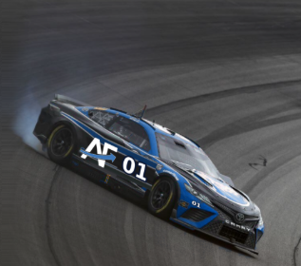
Agile Fleet modules: start your engines
Motor Pool
Vehicle sharing and reservations — the core of FleetCommander
Fleet Maintenance and Parts
Keep vehicles in top shape; track on-site parts inventory
Fuel
Import fuel transactions and watch for fuel fraud
API integrations
Connect systems like PeopleSoft — no manual driver data entry
Telematics / GPS webhooks
Pull vehicle mileage from your GPS provider automatically
Hardware options
KSI smart fob panels, FleetCommander Go, INVERS
KeyCommander
Key management beyond the driver’s seat: spares, offices, cabinets, facility rooms, and more
COMING SOON
Report Center
A new home for FleetCommander reporting
Notes:
PRESENTER: Kristin | TIME: Part 1 · ~3 min
SCRIPT
We all know Motor Pool and vehicle sharing are at the heart of what we do — but FleetCommander can do a lot more than that, so let's start our engines.
Fleet Maintenance and Parts helps tracking to keep your vehicles in the best working order possible, and if you run an on-site shop you can track the parts you keep in stock.
The Fuel module lets you import all of your fuel transactions so you can watch for fuel fraud — which always seems to tick up when fuel prices climb.
API integrations are a growing need: connecting systems like PeopleSoft eliminates manual entry of driver information. And telematics or GPS webhooks pull vehicle mileage straight from your GPS provider. Both free your team for higher-value work.
On the hardware side, we have new key box options — KSI smart fob panels, FleetCommander Go, and INVERS — in-vehicle dispatch is in early testing now.
KeyCommander...hot off the presses! takes key management beyond the driver's seat: offices, cabinets, computer servers racks...key security that needed and may need to be audited but may not require a reservation.
And keep an eye out for Report Center — it's coming soon as a new home for FleetCommander reporting.
CUES
• Ask the room: "Which of these modules are you using today?"
• Point to the COMING SOON badge on Report Center — it comes back in Part 2.
HANDOFF → "Brian, let's talk hardware — starting with key boxes."

Slide 6
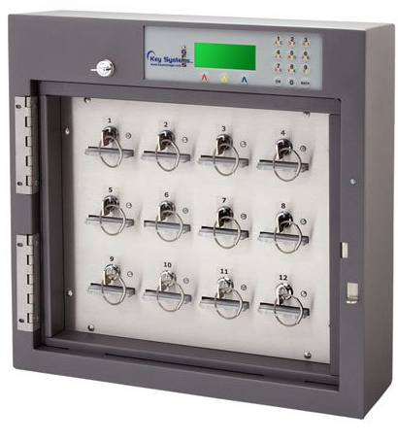
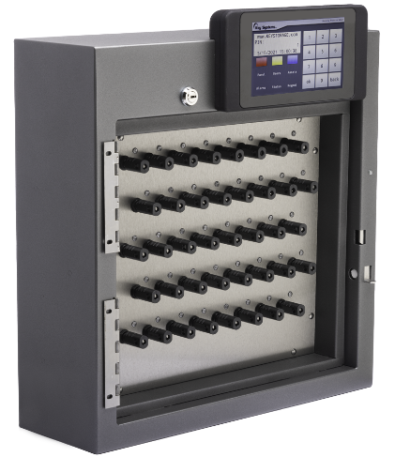

Key boxes: from keys to smart fobs
TODAY · KEYS ON HOOKS
NEXT GENERATION · SMART FOB BOXES
No key to turn
Plug in, pull out — easy in and out, and key rings don’t bind.
Any slot works
Return a fob to any open position; the box knows where every key is.
Generic fobs
Lost a fob? No custom replacement needed — any standard fob works.
Notes:
PRESENTER: Brian | TIME: Part 1 · ~3 min
SCRIPT
Thanks, Kristin. Key boxes have come a long way, and we're excited to have new, modern options for you.
On the left is what most of you have today — keys that secure assets keys into the boxes. On the right is the next generation: KSI's SmartFob boxes.
Couple benefits of the smart fob boxes, there's no key to turn. Drivers simply plug the fob in and pull it out ….for my generation of people....resembles an old fashioned headphone jack— easy in and out, and key rings don't bind.
Second, a fob can go back into any open position. The box knows where every key is based on a chip inside the fob, so drivers don't have to hunt for the right slot or try to recall where they removed the key from.
And third, the fobs are universal. If one gets lost, you don't need a custom replacement — any standard fob works, so you're back up and running quickly.
One more improvement for those of you with mail-slot boxes: the mail slot no longer has a switch in the card holder.
CUES
• Gesture left to right across the slide to show the progression from old to new.
• Ask the room: "Who has had a key ring jam or a lost fob slow things down this year?"
• Optional: show the SmartFob GIF or a demo unit at the booth.

Slide 7
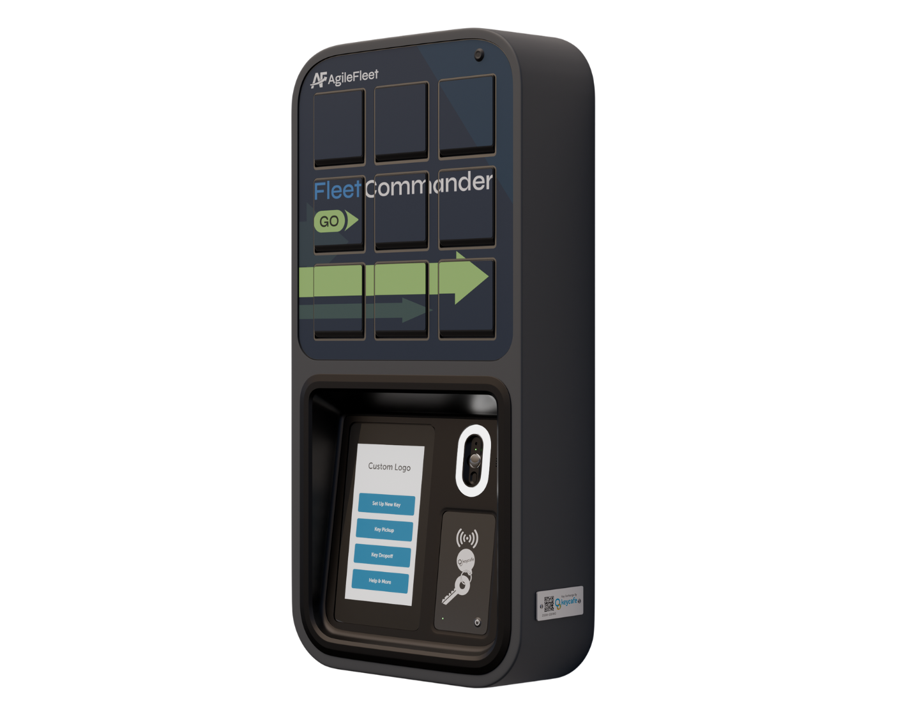
FleetCommander Go
The same FleetCommander software, with a simplified hardware option sized and priced for smaller fleets.
BUILT FOR
Departments, small campuses or businesses, and satellite offices running a handful to several dozen shared vehicles.
Micro-pools
Set up in multiple locations
Integrated kiosk
Kiosk functions built in
Quick, easy install
Faster setup; Wi-Fi included
Room to grow
Expandable to 400+ slots; no parts to swap
Notes:
PRESENTER: Brian | TIME: Part 1 · ~3 min
SCRIPT
And here's a very exciting new option: FleetCommander Go.
The key message is that this is the same FleetCommander software you already know — what's simplified is the hardware. It's sized and priced for smaller fleets: departments, small campuses or businesses, and satellite offices running anywhere from a handful to several dozen shared vehicles.
You can set up micro-pools in multiple locations, kiosk functions are built in, setup and implementation are quicker, and installation is easy — Wi-Fi included. It's expandable to 400-plus slots, with no parts to change out.
There's much more to come on this from Phelps and the team, but couldn't leave him all the fun....so consider this a little sneak peak. .
CUES
• Stress: same software, simplified hardware.
• If you have a physical unit at the booth, mention it here.

Slide 8
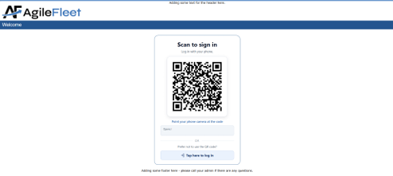
Kiosk Access: log in with a QR code
Log in from a phone
An optional QR code login page lets drivers sign in on their mobile device — ideal for tricky logins, phone-ready users, and sites without an RFID reader.
No queue
More than one person can use the QR code at the same time, and requests aren’t queued.
Note: drivers must be at the box — the QR code opens a standard URL. If several drivers are at the kiosk together, they need to coordinate to get the correct key.
Simple setup
Switch to the new page with a simple URL change in the KioWare settings.
Notes:
PRESENTER: Brian | TIME: Part 1 · ~2 min
SCRIPT
Another kiosk update: kiosk login now includes an optional QR code that will link a user to a login page, so drivers can log in on their own phone.
It's perfect for sites with tricky login user names or IT departments that require you to have a 37 character passwords that user may have a stored password on their handheld device, phone-ready users, or no RFID reader. There's no queue — more than one person can use the QR code at the same time. And setup is simple: it's just a URL change in your KioWare settings.
Two cautions. Because the QR code opens a standard URL, drivers need to be at the box when they use it. And if several drivers are at the kiosk together, they'll need to coordinate so everyone grabs the right key.
CUES
• Read the note on the slide aloud — it's the most important operational point.
HANDOFF → "Kristin, tell them about how often the software itself is changing."

Slide 9
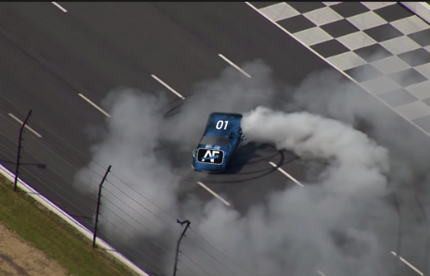
UI/UX updates: 2-week release cycle
2-week release intervals
The initial release, then adjustments and enhancements two weeks later.
Send in suggestions, recommendations, and issues so they can be addressed quickly.
Gone are the days of waiting years for enhancements.
We're building the car as we drive it!
Notes:
PRESENTER: Kristin | TIME: Part 1 · ~2 min
SCRIPT
Thanks, Brian. On the software side, we're pressing ahead with a release every two weeks.
You'll see the initial release, and then two weeks later, adjustments and enhancements based on what we hear. So please keep sending your suggestions, recommendations, and issues — they can be addressed quickly now. Gone are the days of waiting years for an enhancement.
We like to say we're building the car as we drive it!
CUES
• Land the closing line with energy — it matches the race-car image.

Slide 10
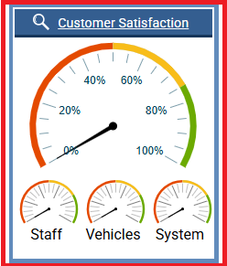
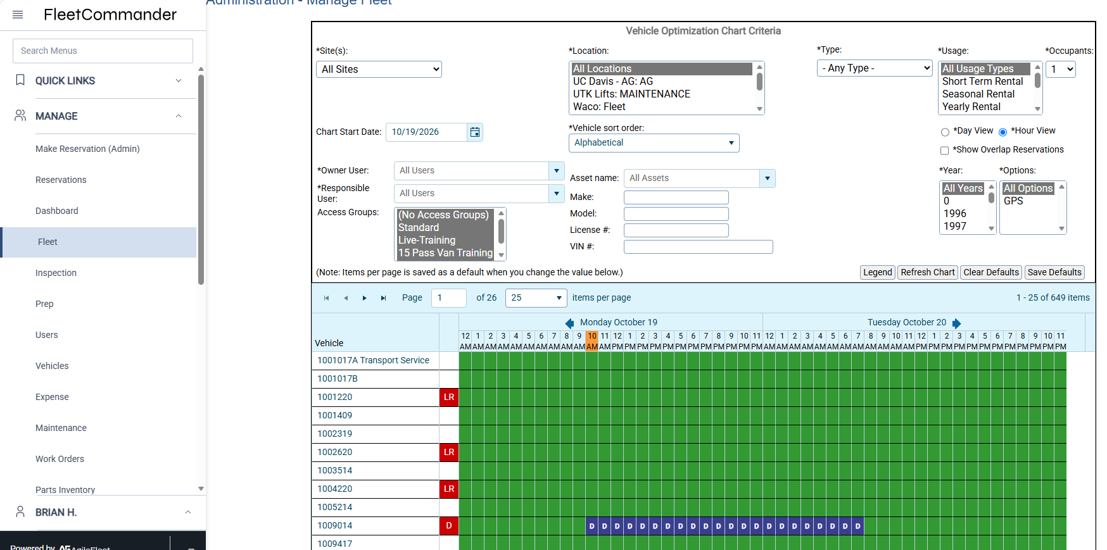
Features you might have missed
01
Reservation Reassignment
Move a vehicle’s reservations to a replacement vehicle with drag and drop.
02
Feedback tool
Ask drivers for feedback and track satisfaction scores. Get Feedback
03
Color-coded usage types
Simple, and very helpful for reading charts at a glance. Edit Usage Type
Notes:
PRESENTER: Kristin | TIME: Part 1 · ~3 min
SCRIPT
Here are three features you might have missed.
First, Reservation Reassignment. If a vehicle goes out of service, you can move its reservations to a replacement vehicle with drag and drop.
Second, the Feedback tool. How many of your dashboards look like this, with feedback scores? Asking drivers for feedback significantly improves the user experience, because your drivers want to be heard. And those positive scores are a feather in the cap for you and your team — a great metric when performance review season comes around.
Third, color-coded usage types. It's simple, and it's very helpful for reading charts at a glance.
CUES
• The "Get Feedback" and "Edit Usage Type" links open the demo site if you want to show them live.
• Ask the room: "Who's using the Feedback tool today?"
HANDOFF → "Brian, walk us through what's changed on screen."

Slide 11
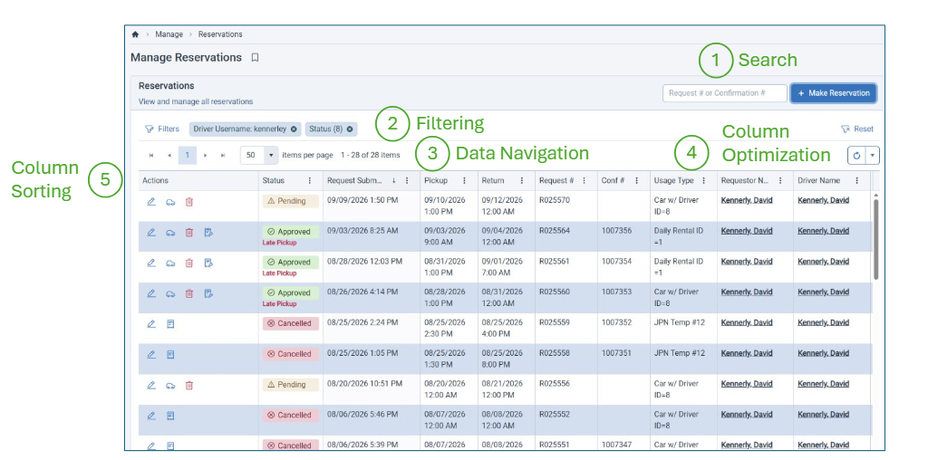
UI/UX updates: smarter grid pages
1
Search
Quick search starts hunting as soon as you type.
2
Filtering
Filter the page and save a custom view.
3
Data navigation
Links in the data jump to driver and requestor profiles.
4
Column optimization
Move columns into the order you want.
5
Column sorting
Sort any column as needed.
Notes:
PRESENTER: Brian | TIME: Part 1 · ~2 min
SCRIPT
Thanks, Kristin. Of course you've all been working in the software and you know it like the back of your hand....in most instances better than Kristin and I do. But just like any software or your iphone....there are items you may have forgotten about or may not be using...and maybe they can make your life a little easier so here are a couple reminders or what is now available to you.
Let's walk through what it gives you.Of course you've noticed the new grid format on FleetCommander pages.
One, search: the quick search starts hunting as soon as you type.
Two, filtering, and you can save a custom view based on whatever filtering values you need.
Three, data navigation: links embedded in the data take you straight to driver and requestor profiles.
Four, column optimization: move columns into the order you want to see them.
And five, sort any column as needed.
CUES
• Point to each numbered callout on the screenshot as you go.

Slide 12
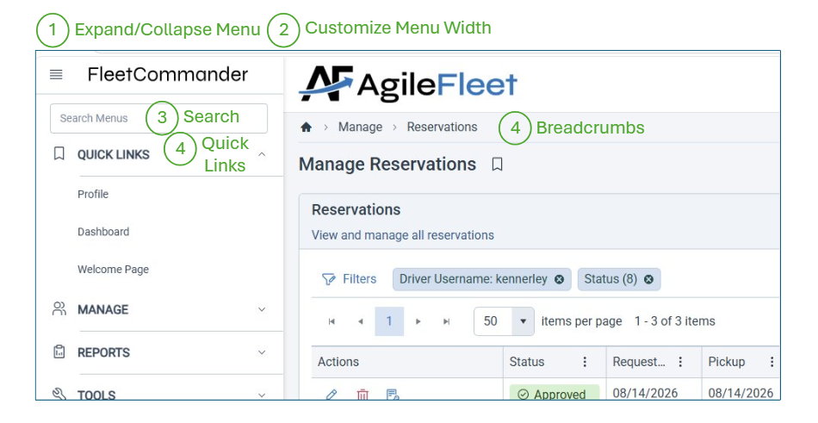
UI/UX updates: easier navigation
1
Expand / collapse menu
Collapse the menu for full-screen viewing.
2
Customize menu width
Set the menu width to your liking.
3
Search
Menu search starts hunting as soon as you type.
4
Quick links and breadcrumbs
Bookmark favorite pages; breadcrumbs take you back.
Notes:
PRESENTER: Brian | TIME: Part 1 · ~2 min
SCRIPT
Navigation got easier, too.
One, you can expand and collapse the menu for full-screen viewing.
Two, customize the menu width to your liking.
Three, the menu search starts hunting as soon as you type.
And four, quick links let you bookmark your favorite pages, and breadcrumbs take you right back to where you were.
Always looking to give you the tools you need that make life easier for you.
CUES
• Optional: show this live if you have the demo site open.

Slide 13
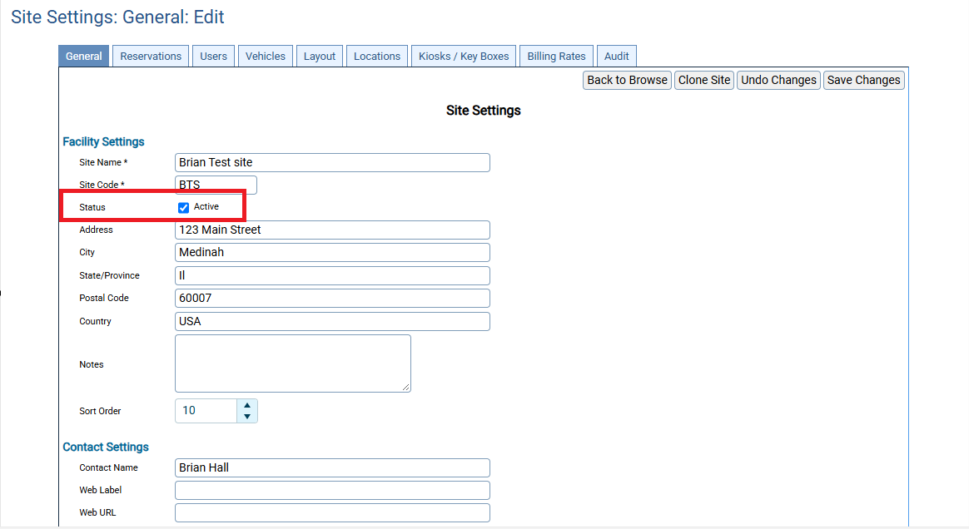
Most requested: deactivate a site
NEW
Mark a site active — or not
Site Settings → General
Uncheck Active to deactivate a site and remove it from driver navigation.
Reassign the site’s vehicles first.
Finally!
Notes:
PRESENTER: Brian | TIME: Part 1 · ~2 min
SCRIPT
And speaking of the tools you need— possibly one of the most requested changes, and it's finally here: you can now mark a site active or inactive.
[CLICK] In Site Settings, on the General tab, uncheck Active. That deactivates the site and removes it from driver navigation.
There are a few specifics to think through first — like reassigning any vehicles assigned to that site — but yes: you can now take down sites when they're no longer in use.
CUES
• [CLICK] once: the Active checkbox is highlighted and the "Finally!" burst pops.
• Pause for the reaction — this one usually gets applause.

Slide 14
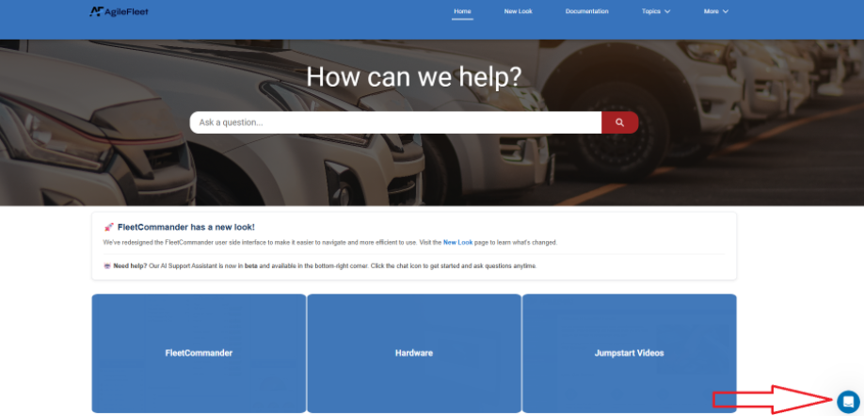
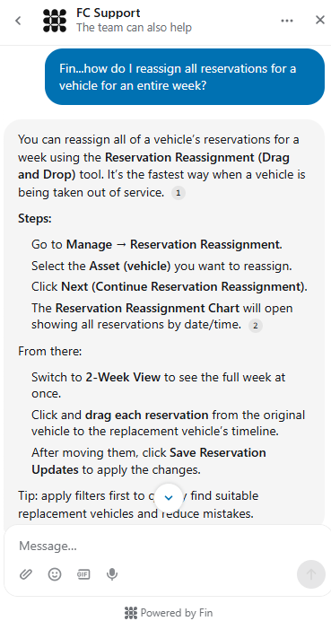
  FC Drive and FIN: help built in
YOUR PERSONAL ASSISTANT
OTTO
Ask how-to questions and get step-by-step answers for navigating FleetCommander.
FC Drive
Open it from Help in FleetCommander: release notes every 2 weeks, White Pages, Case Studies, Jump Start Video's and more!
Notes:
PRESENTER: Brian | TIME: Part 1 · ~2 min
SCRIPT
Last stop in part one: help that's built in.
The FC Drive page has changed, and you can now open it right from the Help section in FleetCommander. Release notes are updated every two weeks, White Pages, Jump Start Videos, How to pages....there a ton of valuable documentation there. It's a simple change to be able to link to it from your FC Site, but certainly makes it much easier to keep up to date on those release notes that are very important.
And now we have OTTO — your personal assistant. Ask OTTO a how-to question, like how to reassign all of a vehicle's reservations for a week, and you'll get step-by-step answers. It's another tool in your arsenal for getting the most out of FleetCommander.
Kristin – share 2 ways OTTO has been helpful; Enterprise/Site setting search and which reports are best for a particular outcome.
CUES
• [CLICK] if the phone screenshot animates in.
• Optional: ask FIN a live question if you have a connection.
HANDOFF → "Kristin, take us into part two."

Slide 15
From Measuring to Benchmarking
Fleet Utilization and Benchmarking
Kristin Sondermann & Brian Hall • November 3-5, 2026 • Glendale, AZ
Notes:
PRESENTER: Kristin | TIME: 0:00 – 0:01
SCRIPT
Welcome to part two: From Measuring to Benchmarking.
Following this presentation, we'll be sharing a few different documents with you to assist in your benchmarking process.
Those items will include the Fleet Utilization Benchmarking Guide as well as worksheet documents.
CUES
• Make sure worksheets are on every table before starting.

Slide 16
Which of these have you heard?
“That vehicle is always in use.”
“We need more vehicles.”
“No one ever uses that truck.”
“Department A can't share vehicles with Department B.”
“How busy are our vehicles?”
Keep your hand up if you had data to back it up.
Notes:
PRESENTER: Kristin | TIME: 0:01 – 0:04
SCRIPT
Let's start with a show of hands. Keep your hand up if you've heard any of these in the last year.
"That vehicle is always in use." "We need more vehicles." "No one ever uses that truck." "Department A can't share vehicles with Department B." "How busy are our vehicles?"
[Pause.] Lots of hands. Now — keep your hand up only if you had data to back it up.
[Pause.] That's the point of today. These statements feel accurate, but they're usually anecdotal. Benchmarking replaces assumptions with objective data.
CUES
• Read each quote and pause for hands (or use the event polling tool).
• Let the hands drop on the last line — don't rush it.

Slide 17
What is your fleet’s mission?
YOU ARE THE EXPERT
Nobody knows your fleet better than you.
FleetCommander is the tool that turns your data into operational value against your organization’s goals.
EXAMPLE 1
Improve availability
Watch: reservation denial rate, availability, utilization by location
EXAMPLE 2
Cut costs and right-size
Watch: idle time, utilization rate, cost per utilized vehicle
EXAMPLE 3
Meet sustainability targets
Watch: miles per vehicle, fuel costs, fleet size over time
Notes:
PRESENTER: Kristin | TIME: 0:04 – 0:06
SCRIPT
Before we talk about numbers, let's talk about purpose. Every fleet has a different mission — public safety, campus transportation, field work, sustainability commitments — and the right benchmarks depend on yours.
You are the subject matter expert. Nobody knows your fleet better than you. FleetCommander is the tool that turns your data into operational value against your organization's goals.
Here are three examples. If your goal is to improve availability, you'll watch denial rate, availability, and utilization by location. If it's to cut costs and right-size, you'll watch idle time, utilization rate, and cost per utilized vehicle. If it's sustainability, you'll watch miles per vehicle, fuel costs, and fleet size over time.
Take 30 seconds right now and write your number-one goal at the top of your worksheet.
CUES
• Give 30 seconds of quiet writing time.
• Tie-back: "Benchmarking without clear goals" is one of the seven mistakes later.

Slide 18
Why Benchmark
SECTION 01
Notes:
PRESENTER: Kristin | TIME: 0:06
SCRIPT
So — why benchmark at all?
CUES
• Transition slide — keep moving.

Slide 19
Measuring vs. benchmarking
MEASURING ASKS
“What happened?”
18 reservations this month
1,250 miles driven
26 operating days
14 maintenance events
BENCHMARKING ASKS
“Is this good, bad, or changing?”
Compared against previous months and years, other vehicles, other locations, vehicle classes, departments, and organizational goals.
Notes:
PRESENTER: Kristin | TIME: 0:06 – 0:09
SCRIPT
Many organizations measure utilization. Far fewer benchmark it.
Measuring asks, "What happened?" Eighteen reservations this month. 1,250 miles driven. Twenty-six operating days. Fourteen maintenance events. Those numbers are useful, but on their own they don't tell you much.
Benchmarking asks, "Is this good, bad, or changing?" It compares those numbers against something: previous months and years, other vehicles, other locations, vehicle classes, departments, or your organization's goals.
Let me show you what that looks like with just one number.
CUES
• Point left, then right.

Slide 20
One number, three contexts
Looks well utilized. But what if…
Similar vehicles average 35
Demand has declined 40% over the past year
Another location has a waiting list for this vehicle type
The number didn't change. Your understanding of it did.
Illustrative example from The Fleet Utilization Benchmarking Guide
20
reservations this month
Notes:
PRESENTER: Kristin | TIME: 0:09 – 0:10
SCRIPT
Twenty reservations this month. Looks well utilized, right? But what if similar vehicles average 35? What if demand for this vehicle has declined 40% over the past year? What if another location has a waiting list for this same vehicle type?
The number didn't change. Your understanding of it did. That's the power of benchmarking.
These are illustrative numbers from the guide, not a customer's data — but I bet each of you can think of a vehicle like this.
CUES
• Pause after each "what if."
NEXT → Kristin continues: "So where does FleetCommander fit in all of this?"

Slide 21
Where FleetCommander fits in the process
01
Capture
Reservations, check-out and check-in times, odometer readings, cancellations, and maintenance are recorded as they happen.
Reservations · Maintenance · Fuel · TCO · GPS
02
Measure
Standard reports turn those records into utilization, idle time, denials, miles, and cost.
Reports → Statistics, Reservations, Assets
03
Compare
Rerun any report by date range, site, department, or vehicle type for context.
Report filters · export to Excel
04
Act
Rebalance and right-size with tools that are already built in.
Reservation Reassignment · Site Settings · Cancellation Types
05
Review
Repeat monthly with the same reports and filters; share results with leadership.
Report Center (coming soon) · Excel or AI dashboards
You: set the goal and act. FleetCommander: captures, calculates, and reports.
Notes:
PRESENTER: Kristin | TIME: 0:10 – 0:12
SCRIPT
So how do you actually do this without spending your week building spreadsheets? This is where FleetCommander comes in — at every step of the process.
Step one, capture. Every reservation, every check-out and check-in, every odometer reading, cancellation, and maintenance booking is recorded as it happens. If you use the Maintenance, Fuel module, TCO, or GPS webhooks, cost and mileage flow in too. Most of the data the guide tells you to gather already lives in FleetCommander.
Step two, measure. Standard reports turn those records into utilization, idle time, denials, miles, and cost per vehicle — FleetCommander does the math.
Step three, compare. That's what turns measuring into benchmarking. Rerun the same report for last month, last quarter, or last year, or filter by site, department, usage type, or vehicle type.
Step four, act. The tools to rebalance are built in — Reservation Reassignment, marking a site active or inactive, and the cancellation types that track unmet demand.
And step five, review. Run the same reports with the same filters every month and share the results — Report Center is coming soon to make that even easier.
Your part is setting the goal and acting on what you find. FleetCommander's part is capturing, calculating, and reporting the data.
CUES
• This is the anchor for the rest of Part 2 — refer back to these five steps as you go.
• Guide tie-in: modern fleet systems automatically capture the information needed to evaluate utilization, so fleet managers spend less time building reports and more time improving operations.
HANDOFF → "Brian's going to walk us through the 10 metrics — and where each one lives in FleetCommander."

Slide 22
The 10 Metrics
SECTION 02
Notes:
PRESENTER: Brian | TIME: 0:10
SCRIPT
Thanks, Kristin. Let's get into the metrics.
CUES
• Transition slide.

Slide 23
Start with the data you have
Consistent data beats perfect data.
Most of what the guide asks you to gather is already in FleetCommander.
Source | What to collect | Where it lives in FleetCommander
Vehicle inventory | Type, department, home location, model year, status | Vehicle profiles (Admin → Manage Vehicles)
Reservations | Count, length, denials, cancellations, peak periods | Every reservation, cancellation, and Turned Down request
Usage | Miles, hours, days in service, idle time | Check-out/check-in times, odometer readings, GPS webhooks
Maintenance | Downtime, PM compliance, repairs, out-of-service days | Fleet Maintenance; maintenance reservations
Cost | Fuel, maintenance, insurance, licensing, depreciation | Vehicle TCO tab; Fuel module imports
Notes:
PRESENTER: Brian | TIME: 0:12 – 0:13
SCRIPT
Thanks, Kristin.
The one misconception we hear is that you need perfect data before you can start. You don't. Consistent data beats perfect data, so don't let that be a source of paralysis for you. Set a baseline now, and it improves over time.
The guide lists five kinds of data to gather: vehicle inventory, reservations, usage, maintenance, and cost. Look at the right-hand column — most of it already lives in FleetCommander. Your vehicle profiles are your inventory. Every reservation, cancellation, and turned-down request is recorded. Check-out and check-in times and odometer readings give you usage, and GPS webhooks can fill in mileage automatically, or its being entered by your drivers and team. Maintenance comes from Fleet Maintenance and maintenance reservations, and cost lives on each vehicle's TCO tab and in Fuel module imports.
So the question isn't "Where do I find the data?" — it's "Is the data we're entering consistent?" We'll come back to that.
CUES
• Emphasize the right-hand column — it's the "FleetCommander already has it" moment.

Slide 24
How ready is your fleet?
1
Up-to-date inventory of active vehicles
FleetCommander: Admin → Manage Vehicles
5
Track maintenance-related downtime
FleetCommander: Motor Pool Utilization → Vehicles in Maintenance
2
Reservation activity reported by vehicle
FleetCommander: Vehicle Usage Report
6
Have mileage or usage data
FleetCommander: Odometer at check-in; Vehicle Usage Report
3
Know your highest- and lowest-demand vehicles
FleetCommander: Vehicle Usage Report, sorted by trips
7
Can compare this month to previous months
FleetCommander: Rerun any report for any date range
4
Can spot vehicles idle for extended periods
FleetCommander: Motor Pool Utilization → Idle Vehicles
8
Have a regular utilization review process
FleetCommander: Same reports monthly; Report Center coming soon
Several “no” answers? That’s normal — every one has a FleetCommander answer, and the 30-day plan starts right here.
Notes:
PRESENTER: Brian | TIME: 0:13 – 0:14
SCRIPT
Quick self-check. Read these eight statements and count how many are true for your fleet — on your fingers or on your worksheet.
[Pause about 45 seconds.]
Who has seven or eight? [Hands.] Who has three or fewer? [Hands.]
Here's the good news: look under each one. Every item on this list has a FleetCommander answer. Your inventory is in Manage Vehicles. Reservation activity and your highest- and lowest-demand vehicles are in the Vehicle Usage Report. Idle vehicles and maintenance downtime are columns in Motor Pool Utilization. And comparing months is just rerunning the same report for a different date range.
So if you had several "no" answers, that's completely normal — and maybe this is something you want to start putting in place in the next 30-days.... This is where that kicks off.
CUES
• Give quiet time to count.
• Point to the orange "FleetCommander:" lines — the point is that the gaps are closable with tools they already own.

Slide 25
10 metrics, three questions
Demand
Who needs vehicles, and where?
1 Reservations per vehicle
5 Reservation denial rate
7 Utilization by department or location
Capacity
Are vehicles ready and in use?
2 Vehicle utilization rate
3 Vehicle idle time
4 Vehicle availability
8 Vehicle downtime
Value
Is it worth it, over time?
6 Miles traveled per vehicle
9 Operating cost per utilized vehicle
10 Utilization trends over time
Notes:
PRESENTER: Brian | TIME: 0:13 – 0:14
SCRIPT
The guide lists 10 metrics. To make them easier to remember, we've grouped them into three questions.
Demand: who needs vehicles, and where?
Capacity: are vehicles ready and in use?
And value: is it worth it, over time?
The numbers match the guide so you can find each one later. And the key message: no single metric tells the story. A high-mileage vehicle may sit idle for days, and a low-mileage one may be your busiest asset. It all depends on how your motor pool functions and what you need these vehicles to do.
CUES
• Point to each column as you name it.

Slide 26
Demand: reservations show need
1 · Reservations per vehicle
How often people rely on a vehicle — the clearest demand signal.
Watch for: similar vehicles with very different counts.
Tip: review monthly — trends surface before the annual review.
Find it: Vehicle Usage Report (Reports → Statistics)
5 · Reservation denial rate
Direct insight into unmet demand.
Watch for: rising denials concentrated in one department or class.
Tip: a few denials don’t mean buy more — redistribution often fixes it.
Find it: Motor Pool Utilization → Requests Turned Down; Cancellations (Reports → Reservations)
7 · By department or location
Reveals imbalances that fleet-wide averages hide.
Watch for: idle vehicles at one site while another asks for more.
Tip: sharing across departments often reduces vehicles needed.
Find it: Usage by Department; Reservation Details (Reports → Reservations)
Notes:
PRESENTER: Brian | TIME: 0:14 – 0:17
SCRIPT
Let's start with demand.
Reservations per vehicle is the clearest demand signal — it shows how often people rely on a vehicle, and that something that mileage alone can't. Watch for similar vehicles with very different counts. You'll find it in the Vehicle Usage Report.
Reservation denial rate gives you direct insight into unmet demand — reservations that didn't happen or went to personal vehicles. A few denials don't automatically mean you need more vehicles; redistribution often fixes it. You'll find it in Motor Pool Utilization, under Requests Turned Down, and the Cancellations report tells you why.
And utilization by department or location reveals imbalances that fleet-wide averages hide — like idle vehicles at one site while another asks for more. That's Usage by Department and Reservation Details.
Quick hands: who tracks denials today?
CUES
• Read each "Find it" line — attendees want the report names.
• Quick show of hands on denials.
BACKGROUND / DETAIL
Demand metrics. Reservations show how frequently people depend on a vehicle — which mileage can't. Denials tell you about work that didn't happen or went to personal vehicles. Department/location views stop averages from hiding a starved site next to an overstocked one. Ask: "Who tracks denials today?" Quick hands.
Where to find each (detail comes in Section 03):
1 — Vehicle Usage Report (Reports → Statistics → Vehicle Usage Report): Total # of Trips per vehicle. Reservation Detail Report gives the raw records for a single vehicle.
5 — Motor Pool Utilization (Reports → Statistics): Requests Turned Down. Only counts cancellations whose Cancellation Type has "Turned Down" checked. For the reasons behind cancellations, use the Cancellations report (Reports → Reservations → Cancellations), which shows Cancellation Reason, Turned Down and No Show.
7 — Usage by Department (Reports → Reservations) for demand by group; Reservation Details filtered by Site/Location for geographic imbalances.

Slide 27
Capacity: ready and in use?
2 · Utilization rate
Share of available time actually spent in service.
Watch for: high utilization combined with rising denials.
Tip: there’s no single “ideal” % — follow the trend.
Find it: Motor Pool Utilization → Hours Used vs. Total Hours Available
3 · Idle time
Idle vehicles still cost insurance, depreciation, storage.
Watch for: long idle stretches at one site or class.
Tip: review several months first — seasons matter.
Find it: Motor Pool Utilization → Idle Vehicles
4 · Availability
Can vehicles meet demand when it peaks?
Watch for: scheduling conflicts and vehicles unavailable at peak times.
Tip: always read it next to utilization.
Find it: Vehicle Availability Report or Chart
8 · Downtime
Scheduled vs. unscheduled out-of-service time.
Watch for: repeat failures on the same vehicle; long repairs.
Tip: not all downtime is bad — PM prevents costlier repairs.
Find it: Motor Pool Utilization → Vehicles in Maintenance
Notes:
PRESENTER: Brian | TIME: 0:17 – 0:20
SCRIPT
Next, capacity: are vehicles ready and in use?
Utilization rate is the share of available time a vehicle is actually in service. There's no single ideal percentage — follow the trend.
Idle time matters because idle vehicles still cost insurance, depreciation, and storage — but review several months before acting, because seasons matter.
Availability asks whether vehicles can meet demand when it peaks.
And downtime separates scheduled from unscheduled time out of service — not all downtime is bad, since preventive maintenance prevents costlier repairs.
Here's the key pairing: high availability with very low utilization can often suggest excess capacity.
Low availability with frequent denials suggests unmet demand.
Three of these four come from one report — Motor Pool Utilization. We'll dig into it shortly.
CUES
• Name the seasonal examples relevant to the room: weather, academic calendars, storm response, fieldwork.
BACKGROUND / DETAIL
Capacity metrics. Key pairing from the guide: high availability with very low utilization suggests excess capacity; very low availability with frequent denials suggests unmet demand. Idle vehicles keep costing money. Seasonal demand — weather, academic calendars, storm response, fieldwork — means you look at several months before acting.
Where to find each:
2 — Motor Pool Utilization: compare Hours Used with Total Hours Available (vehicles available × hours per day). % of Vehicles Used is also shown.
3 — Motor Pool Utilization: Idle Vehicles = Vehicles Available − Vehicles in Use. Export and sort to spot vehicles that sit.
4 — Vehicle Availability Report (Reports → Reservations) for analysis; Vehicle Availability Chart (Vehicle Use → Vehicle Availability) for forward-looking planning.
8 — Motor Pool Utilization: Vehicles in Maintenance. Relies on maintenance being booked with a Maintenance usage type.

Slide 28
Value: activity, cost, and time
6 · Miles per vehicle
The most familiar metric — and the easiest to misread.
Watch for: high miles on a few vehicles while others sit.
Tip: never keep or cut a vehicle on mileage alone.
Find it: Vehicle Usage Report → Total Miles
9 · Cost per utilized vehicle
Fuel, maintenance, insurance, licensing, depreciation vs. use.
Watch for: high cost paired with low use.
Tip: “underused and expensive” is the strongest case for leadership.
Find it: TCO Expense Summary (Reports → Assets) + Vehicle Usage Report
10 · Trends over time
Month, quarter, year, and seasonal comparisons.
Watch for: gradual declines, or shifts with no operational change.
Tip: benchmark monthly or quarterly, never once a year.
Find it: Vehicle Usage Report, run for each period
Notes:
PRESENTER: Brian | TIME: 0:20 – 0:22
SCRIPT
And finally, value: which looks at activity, cost, and time.
Miles per vehicle is the most familiar metric — and the easiest to misread. As an example:
A sedan doing local inspections may log few miles but many trips;
a pickup on regional travel may log hundreds of miles in one reservation.
Both may be doing their Exact job....so be sure to keep that in mind. And whenever possible base your decisions on multiple data points...not just mileage alone.
Cost per utilized vehicle turns activity into a business case. "Underused and expensive" is the strongest case you can bring to leadership.
And trends over time separate a bad month from a lasting change — so benchmark monthly or quarterly, never once a year.
HANDOFF → "Now that we know what to measure, let's find it."
BACKGROUND / DETAIL
Value metrics. A sedan doing local inspections may log few miles but many trips; a pickup on regional travel may log hundreds of miles on one reservation — both may be doing their job. Cost turns activity into a business case. Trends separate a bad month from a lasting change.
Where to find each:
6 — Vehicle Usage Report: Total Miles, Average Miles Per Trip, Total # of Trips. Export and sort by Total Miles descending.
9 — TCO Expense Summary (Reports → Assets) for cost per vehicle, combined with the Vehicle Usage Report for miles and hours. Calculate cost per mile, per hour used, per vehicle in Excel.
10 — Run the Vehicle Usage Report for each month/quarter/year and compare. Completed Reservation Summary (My Reports) is an optional supplement for mileage, fuel, duration and cost.

Slide 29
Reports: Where Your Data Lives
SECTION 03
Five FleetCommander reports answer all 10 metrics.
Where they live, how the numbers are built, and what can throw them off.
Notes:
PRESENTER: Brian | TIME: 0:22
SCRIPT
In this section we are going to touch on those reports — where your data lives.
Five FleetCommander reports answer all 10 metrics.
For each one, we'll cover where it lives, how FleetCommander builds the numbers, and what can quietly throw them off.
CUES
• Transition slide.

Slide 30
10 metrics, five reports
Metric | Report | Look at
1 · Reservations per vehicle | Vehicle Usage Report | Total # of Trips
2 · Utilization rate | Motor Pool Utilization | Hours Used vs. Total Hours Available
3 · Idle time | Motor Pool Utilization | Idle Vehicles
4 · Availability | Vehicle Availability Report / Chart | Available vs. reserved by day or hour
5 · Reservation denial rate | Motor Pool Utilization; Cancellations | Requests Turned Down; Cancellation Reason
6 · Miles per vehicle | Vehicle Usage Report | Total Miles, Avg Miles Per Trip
7 · By department or location | Usage by Department; Reservation Details | Department, Account, Site, Location
8 · Downtime | Motor Pool Utilization | Vehicles in Maintenance
9 · Cost per utilized vehicle | TCO Expense Summary + Vehicle Usage | Cost per mile, per hour, per vehicle
10 · Trends over time | Vehicle Usage Report, by period | Month, quarter, year comparisons
Notes:
PRESENTER: Brian | TIME: 0:22 – 0:24
SCRIPT
Here's your cheat sheet. Every metric, the report that answers it, and the column to look at.
Notice that the Motor Pool Utilization report alone answers four of the ten metrics, and the Vehicle Usage Report answers three. If you're not looking at these regularly, these 2 reports are a perfect place to start.
Go ahead and take a picture of this slide.
CUES
• Pause for photos.

Slide 31
Vehicle Usage Report
FIND IT
Reports → Statistics → Vehicle Usage Report
ANSWERS METRICS
1 · Reservations per vehicle
6 · Miles per vehicle
10 · Trends over time
Export to Excel for deeper analysis.
Column | How FleetCommander builds it
Total # of Trips | Count of reservations on the vehicle in the date range
Total Hours Used | Actual check-out and check-in times on each reservation
Total Miles | Start and end odometer readings entered on each reservation
% Days Used | Days the vehicle had at least one reservation in the period
Avg Trip Per Day | Total trips compared with days used in the timeframe
Watch out: missing or mistyped odometer readings and check-in times skew miles and hours.
Tip: run it for each month or quarter and compare periods to see trends.
Notes:
PRESENTER: Brian | TIME: 0:24 – 0:27
SCRIPT
First, the Vehicle Usage Report — Reports, Statistics, Vehicle Usage Report. It answers reservations per vehicle, miles per vehicle, and trends over time.
Here's how FleetCommander builds it. Total trips is a count of reservations on that vehicle in your date range. Hours used comes from the actual check-out and check-in times. Total miles comes from the start and end odometer readings entered on each reservation. Percent days used is the share of days with at least one reservation.
Here's where it can go wrong: if drivers skip odometer entries, or check-ins aren't recorded, miles and hours are understated — and a busy vehicle can look idle.
Tip: run it for each month or quarter and compare periods to see trends. If you need the raw records, the Reservation Detail Report can be filtered to a single vehicle.
CUES
• Optional: show the report live or add a screenshot.
BACKGROUND / DETAIL
The clearest demand signal: how many trips each vehicle has and how often it's used. Under the hood, FleetCommander aggregates reservation records (time, usage type, status) and mileage entries (start/end odometer), then summarizes them per vehicle for the selected date range.
Where it can go wrong: if drivers skip odometer entries or check-ins aren't recorded, miles and hours are understated — and a busy vehicle can look idle.
Need raw records instead of a summary? The Reservation Detail Report can be filtered to a single vehicle and exported. For trends, run this report for each period; Completed Reservation Summary (My Reports) adds mileage, fuel, duration and cost.

Slide 32
Motor Pool Utilization Report
FIND IT
Reports → Statistics → Motor Pool Utilization
ANSWERS METRICS
2 · Utilization rate
3 · Idle time
5 · Denial rate (next slide)
8 · Downtime
Export to Excel for deeper analysis.
Column | How FleetCommander builds it
Active Vehicles | Vehicles matching your filters, excluding unavailable ones
Vehicles in Maintenance | Maintenance reservation that day and no other reservation
Vehicles Available | Active Vehicles − Vehicles in Maintenance
Vehicles in Use | At least one reservation that day, counted once per day
Hours Used / Hours Available | Time in use (capped per day) vs. Vehicles Available × Hours Per Day
Idle Vehicles | Vehicles Available − Vehicles in Use
Utilization rate = Hours Used ÷ Total Hours Available.
Watch out: downtime only shows when maintenance is booked as a reservation with a Maintenance usage type.
Notes:
PRESENTER: Brian | TIME: 0:27 – 0:30
SCRIPT
Next, the workhorse: the Motor Pool Utilization report, under Reports, Statistics. It answers utilization rate, idle time, downtime — and denial rate, which we'll cover next.
FleetCommander starts with your active vehicles, subtracts those in maintenance to get vehicles available, and then counts vehicles with at least one reservation each day as vehicles in use. Idle vehicles is simply available minus in use.
Your utilization rate is hours used divided by total hours available. One key point: Hours Per Day is a filter on this report, so set it to match your real operating day — otherwise your utilization rate will be off.
And downtime only shows up when maintenance is booked as a reservation with a Maintenance usage type.
CUES
• Emphasize the Hours Per Day filter — a common source of confusion.
BACKGROUND / DETAIL
The workhorse report: it answers four of the ten metrics. FleetCommander aggregates reservation and vehicle data for the selected date range and filters: it counts active vehicles, separates those in maintenance, counts vehicles with at least one reservation each day, and calculates utilization and idle vehicles from those values.
Key point: Hours Per Day is a report filter, so set it to match your real operating day or the utilization rate will be off.
Idle Vehicles = vehicles that were eligible for use but had no reservation that day. Export and sort by Idle Vehicles to see which vehicles consistently sit.
Downtime: Vehicles in Maintenance relies on maintenance reservations booked with a Maintenance usage type. Compare Vehicles in Maintenance, Vehicles in Use and Idle Vehicles to spot repeat repairs or long maintenance periods.

Slide 33
Tracking reservation denials
FIND IT
Reports → Statistics → Motor Pool Utilization
ANSWERS METRIC
5 · Reservation denial rate
DENIAL RATE
Requests Turned Down ÷ total requests (calculate in Excel)
1
A reservation is cancelled
2
It’s given a Cancellation Type
3
If that type has “Turned Down” checked, it counts
SET IT UP ONCE
Configure → Reservations → Cancellation Types
Click the pencil icon to edit a type (or Add New), then check “Turned Down” for every reason that means “no vehicle was available.”
Watch out: if no cancellation type is marked Turned Down, this column stays at zero — and unmet demand stays invisible.
Notes:
PRESENTER: Brian | TIME: 0:30 – 0:31
SCRIPT
Now, denials. In that same Motor Pool Utilization report, there's a column called Requests Turned Down.
Here's how it works: a reservation is cancelled, it's given a cancellation type, and if that type has the "Turned Down" box checked, it counts.
The checkbox isn't on the report — it lives on the cancellation reason. Go to Configure, Reservations, Cancellation Types, click the pencil to edit — or Add New — and check Turned Down for every reason that means "no vehicle was available."
Watch out: if no cancellation type is marked Turned Down, that column stays at zero, and your unmet demand stays invisible.
Show of hands — who has checked their cancellation types?
CUES
• Show of hands on cancellation types.
• Tip: filter by department or vehicle type to see where unmet demand is concentrated.
BACKGROUND / DETAIL
FleetCommander builds Requests Turned Down directly from cancellation records: it aggregates reservations in the date range and counts those cancelled with a cancellation type that has the Turned Down checkbox enabled.
The checkbox isn't on the report — it lives on the cancellation reason. Path: Configure tab → hover over Reservations → Cancellation Types. That opens Cancellation Types: Browse; use the pencil icon to edit or Add New to create one. Ask the room: "Who has checked their cancellation types?"
Tip: filter by department or vehicle type to see where unmet demand is concentrated.

Slide 34
The Cancellations report
FIND IT
Reports → Reservations → Cancellations
OUTPUT
HTML or Excel, one row per cancelled reservation
ANSWERS METRIC
5 · Reservation denial rate — and why
Pulls directly from reservation records marked as cancelled, with the reason selected at the time.
Key field | What it tells you
Cancellation Reason | The reason selected when the reservation was cancelled
Comments | Any notes entered during cancellation
Cx Hours Prior to Departure | How far in advance the cancellation happened
Turned Down | Requests marked as turned down (no vehicle available)
No Show | Reservations marked as no-show
Spot patterns: filter or group by Cancellation Reason — for example “No Vehicle Available,” “Duplicate Request,” or “Late for Pickup.”
Quick flags: the Turned Down and No Show columns surface availability rejections and drivers who didn’t show up.
Notes:
PRESENTER: Brian | TIME: 0:31 – 0:32
SCRIPT
Motor Pool Utilization tells you how many requests were turned down. The Cancellations report tells you why.
It's under Reports, Reservations, Cancellations, and you can run it as HTML or Excel. It pulls directly from reservations marked as cancelled, with the reason selected at the time.
Key fields include the cancellation reason, comments, how many hours before departure the cancellation happened, and Turned Down and No Show columns.
Filter or group by cancellation reason to spot patterns — "No Vehicle Available," "Duplicate Request," "Late for Pickup." And the Turned Down and No Show columns quickly flag availability problems and drivers who didn't show up.
HANDOFF → "Kristin, take us through demand by department and availability."
BACKGROUND / DETAIL
The Cancellations report pulls directly from reservation records that were marked as cancelled and includes the cancellation reason selected at the time. Path: Reports → Reservations → Cancellations; output is HTML or Excel with cancelled reservation details.
Key fields: Cancellation Reason, Comments, Cx Hours Prior to Departure (how far in advance the cancellation happened), Turned Down, and No Show.
How it helps: filter or group by Cancellation Reason to see patterns (for example "No Vehicle Available," "Duplicate Request," "Late for Pickup"). The Turned Down and No Show columns quickly flag requests rejected for availability and drivers who didn't show up. In short, it aggregates all cancelled reservations and their configured reasons, so you can see why reservations were turned down or cancelled.
Pairs with the previous slide: Motor Pool Utilization gives the count of Requests Turned Down; Cancellations tells you why.

Slide 35
Demand by department and location
METRIC 7 · BY GROUP
Usage by Department
Reports → Reservations → Usage by Department
Groups reservations by the Department and Account (cost center) on each reservation
Those values come from the reservation form at booking
Shows which groups use the fleet most
METRIC 7 · BY PLACE
Reservation Details
Reports → Reservations → Reservation Details
One row per reservation: requestor, driver, times, vehicle, location, custom fields
Filter by Sites and Locations
Export the full list to Excel
Watch out: both reports are only as accurate as the department, account, and location chosen at booking.
Tip: spot demand by group with Usage by Department, then filter Reservation Details by site to find imbalances.
Notes:
PRESENTER: Kristin | TIME: 0:32 – 0:34
SCRIPT
Thanks, Brian. To see demand by department or location, you'll use two reports, both under Reports, Reservations.
Usage by Department groups reservations by the department and account — the cost center — chosen on the reservation form at booking. It shows you which groups use the fleet most.
Reservation Details is one row per reservation, and you can filter it by site and location, then export the full list to Excel.
The workflow: spot demand by group with Usage by Department, then filter Reservation Details by site to find imbalances — like one site sitting idle while another is slammed.
Watch out: both reports are only as accurate as what's chosen at booking. If people pick a default or the wrong department, demand gets credited to the wrong group.
BACKGROUND / DETAIL
Usage by Department is a grouped summary based on the Department and Account fields stored on each reservation — selected on the reservation form when the request is created. Reservation Details is a filtered list of individual reservation records.
Typical workflow: use Usage by Department to spot demand by group, then Reservation Details filtered by Site/Location to find geographic imbalances — for example, one site idle while another is busy.
Where it can go wrong: if users pick a default or wrong department at booking, demand gets credited to the wrong group. Drop-downs and required fields help.

Slide 36
Vehicle availability: report and chart
METRIC 4 · ANALYZE
Vehicle Availability Report
Reports → Reservations → Vehicle Availability
Shows which vehicles are available for a selected timeframe
Use it to check whether the fleet can meet demand at peak times
Export to Excel for analysis
METRIC 4 · PLAN AHEAD
Vehicle Availability Chart
Vehicle Use → Vehicle Availability
Filter by Start Date, Asset Site, Usage Type, Asset Type
Day view = four weeks; Hour view = 24 hours
No icon = free · Blue X = reserved · Gray X = unavailable or maintenance
Watch out: the chart is forward-looking only — it doesn’t show past availability.
Tip: use the report for analysis and the chart for quick planning and spotting peak-time conflicts.
Notes:
PRESENTER: Kristin | TIME: 0:34 – 0:36
SCRIPT
For availability, there's a report and a chart.
The Vehicle Availability Report, under Reports, Reservations, shows which vehicles are available for a timeframe — use it for analysis, especially around peak times.
The Vehicle Availability Chart, under Vehicle Use, is for planning ahead. Filter by start date, site, usage type, and asset type, and switch between a four-week day view and a 24-hour view. No icon means the vehicle is free, a blue X means reserved, and a gray X means unavailable or in maintenance.
Keep in mind the chart is forward-looking only — it won't show past availability.
CUES
• Optional: show the chart live.
BACKGROUND / DETAIL
The chart is built by comparing vehicle records with reservation and maintenance activity for the selected timeframe: each row is a vehicle matching your filters, and each cell shows whether it's free, reserved (blue X) or unavailable/in maintenance (gray X). Select your filters and click Continue to open it.
Pair with utilization: high availability with low utilization suggests excess capacity; low availability with rising denials suggests unmet demand.

Slide 37
TCO Expense Summary
FIND IT
Reports → Assets → TCO Expense Summary
ANSWERS METRICS
9 · Cost per utilized vehicle
Pair with the Vehicle Usage Report for miles and hours
Export to Excel for deeper analysis.
Column | How FleetCommander builds it
Vehicle profile TCO tab | Admin → Manage Vehicles → open a vehicle → TCO tab: fuel, maintenance, manual entries, imports
TCO transactions | Each needs Asset Name, Transaction Date, TCO Subcategory, Quantity, Rate (cost = Quantity × Rate)
TCO Subcategories | Configure → Vehicles → TCO Subcategories: how costs are grouped on the report
Cost vs. use: export TCO Expense Summary and Vehicle Usage Report, then calculate cost per mile, per hour used, and per vehicle in Excel.
Watch out: vehicles with no TCO transactions show no cost — the report summarizes only what’s entered.
Notes:
PRESENTER: Kristin | TIME: 0:36 – 0:38
SCRIPT
Last report: the TCO Expense Summary, under Reports, Assets. This is how you get to cost per utilized vehicle.
It summarizes ownership costs per vehicle, grouped by subcategory. Those costs come from the TCO tab on each vehicle profile — fuel, maintenance, manual entries, and imports. Each transaction needs an asset, a date, a subcategory, a quantity, and a rate.
To compare cost against use, export the TCO Expense Summary and the Vehicle Usage Report, and calculate cost per mile, per hour used, and per vehicle in Excel.
Watch out: vehicles with no TCO transactions show no cost. The report summarizes only what's entered.
Quick question for the room: whose fuel and maintenance costs flow into FleetCommander today?
CUES
• Show of hands on TCO data.
BACKGROUND / DETAIL
The TCO Expense Summary shows total ownership costs per vehicle grouped by subcategory. It works only if TCO transactions are recorded for each vehicle with the required fields and proper subcategories.
Workflow: export the TCO Expense Summary (cost per vehicle) and the Vehicle Usage Report (usage per vehicle), then calculate cost per mile, cost per hour used and cost per vehicle. That surfaces expensive vehicles that sit most of the time — the strongest business case for leadership.
Ask the room: "Whose fuel and maintenance costs flow into FleetCommander today?"

Slide 38
Reports are only as good as your data
PICK ONE WAY TO WRITE IT
Inconsistent entries split one thing into many rows on your reports.
Use drop-downs, not open fields
Where drop-downs are available, they keep values consistent — free text invites variations.
TOYO · Toyota · TOYOTA
→
Toyota
Integrate instead of typing
API pulls from your ERP or HR system can load users, assets, and more with no manual entry.
F-150 · F150
→
F-150
Protect the fields reports rely on
Odometer readings, actual times, department and account, cancellation type, TCO subcategory.
St. Louis · Saint Louis
→
St. Louis
Notes:
PRESENTER: Kristin | TIME: 0:38 – 0:40
SCRIPT
Which brings us to the most important slide in this section: your reports are only as good as your data.
Look at these examples. TOYO, Toyota, and TOYOTA. F-150 and F150. St. Louis and Saint Louis. To a report, those are different things — and your counts get split across multiple rows. So pick one way to write it, document it, and make sure everyone follows it.
Where drop-downs are available, use them instead of open text fields. If your team keys in users or assets by hand, consider an API integration with your ERP or HR system. And protect the fields your reports rely on: odometer readings, actual times, department and account, cancellation type, and TCO subcategory.
Remember what I said at the very beginning — accurate data.
CUES
• Callback to the agenda's "accurate data."
• Internal only: a VIN decoder is on our wish list — don't promise it.

Slide 39
“The most valuable fleet metric isn't a single number — it's the story your data tells when the right metrics are viewed together.”
The Fleet Utilization Benchmarking Guide
THE BIG IDEA
Notes:
PRESENTER: Kristin | TIME: 0:40 – 0:41
SCRIPT
[Pause and let the quote land.]
"The most valuable fleet metric isn't a single number — it's the story your data tells when the right metrics are viewed together."
That's what everything we've covered adds up to.
CUES
• Slow down. Let the room read it.
HANDOFF → "Brian, let's see which mistakes are getting in the way."

Slide 40
Seven mistakes: which is yours?
Mistake | A better approach | How FleetCommander helps
1 · Relying on a single metric | Review several metrics together | Motor Pool Utilization shows use, idle, maintenance, and denials in one view
2 · Looking at one month | Compare month, quarter, and year | Rerun any report for any date range and compare
3 · Ignoring vehicle purpose | Benchmark like with like | Filter by usage type, asset type, and site
4 · Activity vs. efficiency | Could demand shift to overlooked vehicles? | Compare % Days Used across similar vehicles
5 · Data without action | Set a review rhythm | Same reports, same filters, every month
6 · Assuming more vehicles fix it | Check distribution, policies, downtime first | Cancellations, Vehicle Availability, and Idle Vehicles before you buy
7 · Benchmarking without goals | Define success first | Match your report set to your goal
Notes:
PRESENTER: Brian | TIME: 0:41 – 0:43
SCRIPT
Here are the seven most common benchmarking situations we see that hinder this for our clients —and this offers you options of a better approach, and how FleetCommander helps with each.
Do you feel like any of these are accurate ...are any of you operating within this fashion now? Let's make this a poll: which one is your fleet most guilty of? Hold up the number of fingers.
[Read the room and name the top vote. Spend a minute on it using the right-hand column.]
Here is the good news though....that last column: the fix is almost always already in FleetCommander. One report — Motor Pool Utilization — shows use, idle time, maintenance, and denials side by side. Any report can be rerun for any date range. Filters let you compare like with like. And before anyone asks for more vehicles, the Cancellations report, Vehicle Availability, and Idle Vehicles tell you whether the problem is fleet size or distribution.
CUES
• Run the poll by finger count or the polling tool.

Slide 41
Put It Into Practice
SECTION 04
Notes:
PRESENTER: Brian | TIME: 0:43
SCRIPT
Section four: let's put it into practice.
CUES
• Transition slide.

Slide 42
One monthly dashboard, three ways
COMING SOON
IN FLEETCOMMANDER
Report Center
Run the same core reports each month
Use the same filters and date ranges every time
Core set: Vehicle Usage, Motor Pool Utilization, TCO
Best for: a fast, consistent monthly check.
EXPORT AND BUILD
Excel
Export each report to Excel
Join reports on vehicle (XLOOKUP or Power Query)
Pivot by month, department, or class; add rates like cost per mile
Best for: custom KPIs and trends over time.
EXPORT AND ASK
AI-created dashboard
Export reports to Excel or CSV
Upload to your approved AI tool
Ask for charts and a summary; check the numbers
Best for: fast visuals and executive summaries.
Track the same items every month: reservations, utilization, idle vehicles, availability and downtime, denials, cost per utilized vehicle, department demand, and trend vs. last month and year.
Notes:
PRESENTER: Brian | TIME: 0:43 – 0:47
SCRIPT
Instead of reviewing reports one by one, summarize your fleet's performance in one place each month. Here are a few ways to get there.
First, Report Center — coming soon. Run the same core reports every month, with the same filters and date ranges. Until Report Center arrives, you can do this today from the Reports menu. Consistency is what makes month-to-month comparisons possible.
Second, Excel. Export the reports, join them on vehicle with X or VLOOKUP or Power Query, and build pivot tables by month, department, or vehicle class. That's where you calculate utilization percentage, denial rate, and cost per mile.
Third, an AI-created dashboard. Export the reports, upload them to your organization's approved AI tool, and ask it for charts and an executive summary. For example: "Using these Vehicle Usage and Motor Pool Utilization exports for October, build a one-page fleet dashboard and summarize three trends for leadership." Always check the numbers against the source reports, and follow your organization's data-sharing policy.
Whichever you choose, track the same items every month. The thing to remember though is that There's not one silver bullet to this....it requires multiple data sources compiled and analyzed in a consistent fashion.
CUES
• Optional: a 2-minute live demo of Excel or the AI approach.
• Make sure "coming soon" is clear for Report Center.
HANDOFF → "Kristin, how do we make this stick?"
BACKGROUND / DETAIL
Instead of reviewing reports one by one, summarize fleet performance in one place each month. Three ways to get there, from least to most effort to set up:
1) Report Center (coming soon) — run the core FleetCommander reports with the same filters and date ranges each month. Consistency is what makes month-to-month comparison possible.
2) Excel — export the reports, join them on vehicle (for example TCO Expense Summary + Vehicle Usage Report), and build pivot tables and charts by month, department or vehicle class. Calculate utilization %, denial rate (Requests Turned Down ÷ total requests), cost per mile and cost per hour used.
3) AI-created dashboard — export the reports and upload them to your organization's approved AI tool. Example prompt: "Using the attached Vehicle Usage and Motor Pool Utilization exports for [month], build a one-page fleet dashboard with charts for trips per vehicle, idle vehicles and requests turned down by site. List the 10 least-used vehicles and summarize three trends for leadership." Always spot-check figures against the source reports, and follow your organization's data-sharing policy.
Report Center is coming soon; until then, run the same reports from the Reports menu. Optional: a 2-minute live demo of Excel or the AI approach.

Slide 43
Make benchmarking a habit
Monthly
Review the utilization dashboard
Identify unusual trends
Monitor idle vehicles
Review reservation denials
In FleetCommander: Vehicle Usage + Motor Pool Utilization; Cancellations by reason
Quarterly
Compare department performance
Evaluate vehicle distribution
Review operating costs
Identify reassignment opportunities
In FleetCommander: Usage by Department; TCO Expense Summary
Annually
Support replacement planning
Evaluate right-sizing
Review long-term trends
Update fleet policies as needed
In FleetCommander: Year-over-year Vehicle Usage + TCO for replacement planning
Notes:
PRESENTER: Kristin | TIME: 0:47 – 0:48
SCRIPT
Thanks, Brian. The secret is to make benchmarking a habit, not a project — and FleetCommander makes the habit easy, because the reports are the same every time.
Monthly: review your dashboard, look for unusual trends, monitor idle vehicles, and review denials. In FleetCommander, that's the Vehicle Usage Report, Motor Pool Utilization, and the Cancellations report by reason.
Quarterly: compare departments, evaluate distribution, review operating costs, and look for reassignment opportunities — that's Usage by Department and the TCO Expense Summary.
Annually: support replacement planning, evaluate right-sizing, review long-term trends, and update policies — year-over-year Vehicle Usage plus TCO gives you the evidence.
If reports are created every month but never discussed, opportunities are being missed. The guide includes a monthly checklist and quarterly review questions you can use as-is.
CUES
• Point to the orange "In FleetCommander" line at the bottom of each card.

Slide 44
Your 30-day benchmarking plan
WEEK 1
Set the baseline
Inventory, reservation history, mileage, downtime, availability
In FleetCommander: Manage Vehicles; last month’s Vehicle Usage and Motor Pool Utilization; check Cancellation Types
WEEK 2
Find the trends
Busiest vehicles, idle assets, denials, department differences, seasons
In FleetCommander: Rerun reports by month; Cancellations by reason; Usage by Department
WEEK 3
Spot opportunities
Redistribute? Expand sharing? Retirement candidates?
In FleetCommander: Vehicle Availability chart; Reservation Reassignment; TCO + usage for cost per mile
WEEK 4
Share and plan
Findings, trends, gaps, recommended actions, next month’s metrics
In FleetCommander: Excel or AI dashboard for leadership; set your monthly report routine
Take 3 minutes: write your Week 1 owner, start date, and the first report you’ll pull.
Notes:
PRESENTER: Kristin | TIME: 0:48 – 0:52
SCRIPT
Here's your take-home: a 30-day benchmarking plan — and each week has a FleetCommander step, so you know exactly where to start.
Week one, set your baseline. Confirm your active inventory in Manage Vehicles, run last month's Vehicle Usage and Motor Pool Utilization reports, and check that your cancellation types are marked Turned Down where they should be.
Week two, find the trends. Rerun those reports for the previous few months, look at the Cancellations report by reason, and check Usage by Department.
Week three, spot opportunities. Use the Vehicle Availability chart, Reservation Reassignment, and the TCO Expense Summary with your usage data to find vehicles that could move, be shared, or be retired.
Week four, share what you found with leadership — an Excel or AI-built dashboard works well — and set a monthly report routine so this becomes a habit.
Now, take three minutes and fill in your worksheet: your week-one owner, a start date, and the first report you're going to pull. Brian and I — and the whole Client Success team — will come around to help.
CUES
• Give 3 minutes of quiet worksheet time.
• Circulate with the CS team — a great moment to connect with your own accounts.

Slide 45
Consistent data beats perfect data.
Trends beat isolated numbers.
Small, consistent improvements add up.
REMEMBER
Notes:
PRESENTER: Kristin | TIME: 0:52 – 0:53
SCRIPT
If you remember only three things from today: consistent data beats perfect data. Trends beat isolated numbers. And small, consistent improvements add up.
Benchmarking isn't a one-time project — it's an ongoing management practice. As the guide puts it, the most effective fleet managers don't rely on intuition alone; they rely on visibility. FleetCommander gives you that visibility — your job is to keep the data consistent and keep looking.
CUES
• Slow down. One line at a time.

Slide 46

Next steps
01
Get the guide
Scan for The Fleet Utilization Benchmarking Guide: the metrics, checklists, and 30-day plan in one place.
02
Book a benchmarking review
Bring your 30-day plan to your Client Success Manager and we’ll help you set up the right reports.
Notes:
PRESENTER: Kristin | TIME: 0:53 – 0:55
SCRIPT
Two next steps.
First, scan this QR code to get The Fleet Utilization Benchmarking Guide. Everything we covered today — the metrics, the checklists, and the 30-day plan — is in one place.
Second, bring your 30-day plan to your Client Success Manager and book a benchmarking review. We'll help you set up the right reports for your fleet.
And remember, there's a survey at the end of the conference — we'd love your feedback.
CUES
• Leave the QR code up long enough for people to scan it.
HANDOFF → "Brian, let's open it up."

Slide 47
Questions?
Thank you. Find the Client Success team at the AgileFleet booth.
Sponsored by:
Kristin Sondermann & Brian Hall • COMMAND User Conference 2026 • Glendale, AZ
Notes:
PRESENTER: Kristin & Brian | TIME: 0:55 – 1:00
SCRIPT
BRIAN: Our hope is that this got the gears turning for you and helped you start thinking about ways this can help your organization. We appreciate you all being here and look forward to spending the next few days together.
KRISTIN: Thanks so much for spending this time with Brian and I —If you would like to talk through this more, we will be back here for the afternoon....happy to connect and talk through this or anything else you might have questions on.
CUES
• Repeat each question into the mic before answering.
• If time is short, invite people to the booth.

Slide 48
What’s next?
TODAY · TUESDAY, NOVEMBER 3
4:00 pm Break
Recharge before tonight.
6:00 pm Group Reception, Dinner & Swag Swap
Bring your wrapped swag item to trade!
TOMORROW · WEDNESDAY, NOVEMBER 4
8:00 am Breakfast
8:30 am Welcome to COMMAND 2026!
Don Dymont
Need anything? Find the Client Success team at the AgileFleet booth or email clientsuccess@agilefleet.com.
Notes:
PRESENTER: Kristin | TIME: ~1 min
SCRIPT
Before you head out, here's what's next. We'll take a break at 4:00, and then at 6:00 we'll all get together for the group reception, dinner, and the Swag Swap — so don't forget your wrapped swag item from your organization.
Tomorrow, Wednesday, breakfast starts at 8:00 am, and Don Dymont kicks off with the official Welcome to COMMAND 2026 at 8:30.
If you need anything at all, find us at the AgileFleet booth or email clientsuccess@agilefleet.com.
CUES
• Agenda is subject to change — confirm times the morning of.

