Slide 1
GPS Insight and Agile Fleet
November 5, 2026

Slide 2
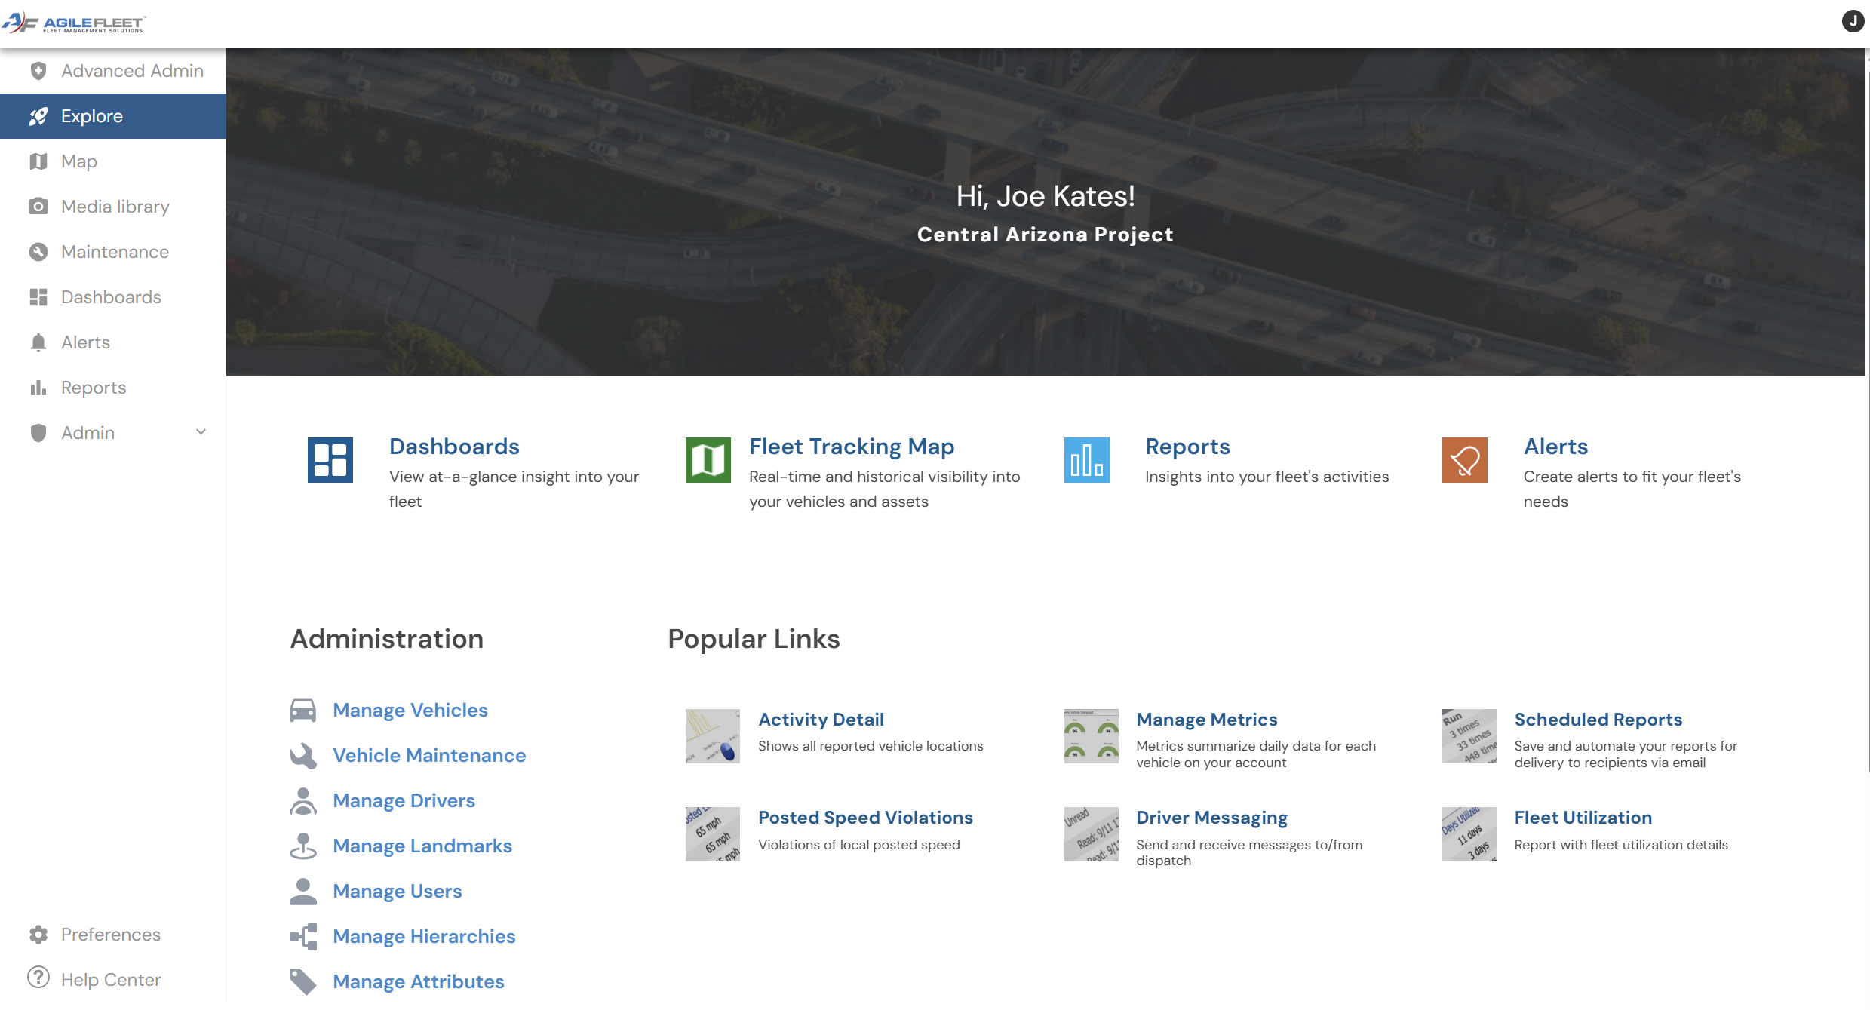
Your Agile/GPS Insight Portal

Slide 3
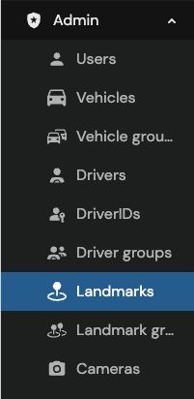
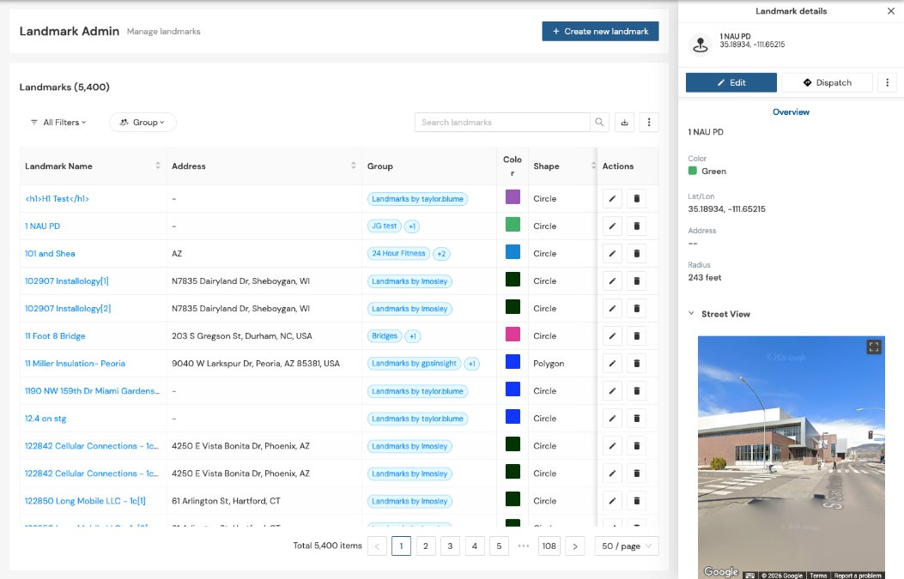
Landmarks
A Landmark Admin page sits inside the existing New Portal Admin section, consisting of:
A metadata-rich, sortable/filterable landmarks table with global search, column filters (type, group),pagination, and ability to export.
A landmark details panel when selecting a landmark.
Create and edit flows for landmark name, address(with reverse-geocode), vertices/area, color, owner/lock, and groups.
An expanded color picker (beyond the old 8 colors)that also feeds the map color filter.
The existing map landmark panel updated to match the new edit flow.

Slide 4
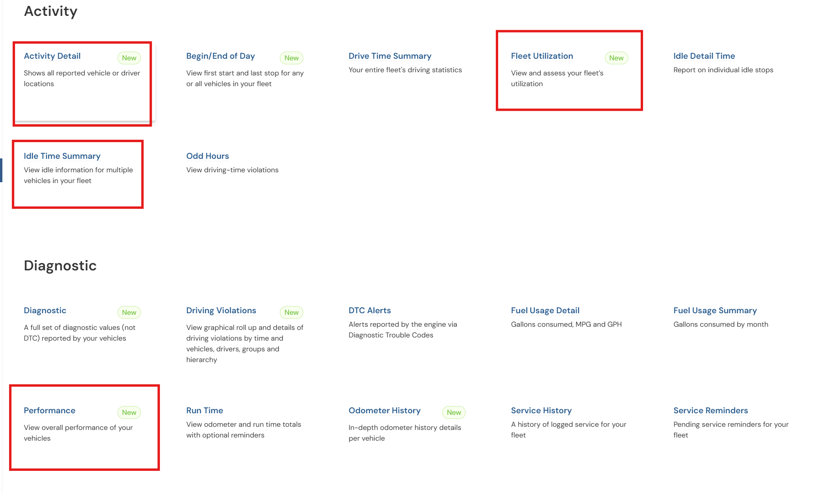
Reports

Slide 5
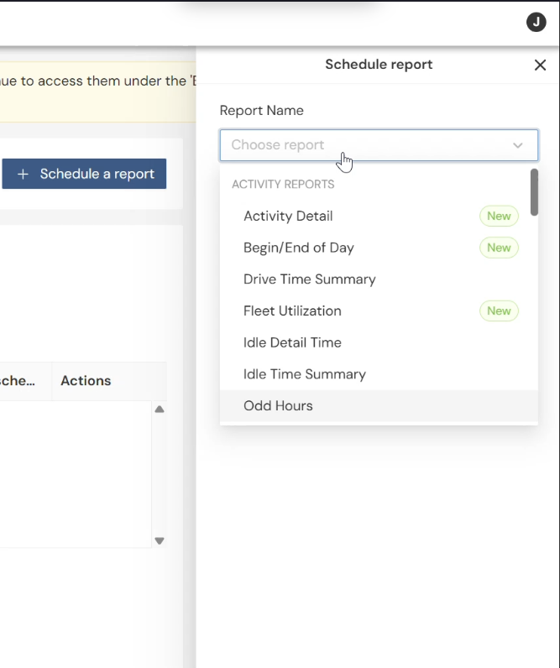
Scheduling Reports

Slide 6

Upcoming Releases

Slide 7

All In-One-Camera – Air II

