Slide 1
How Far We've Come
COMMAND 2026 · WEDNESDAY SESSION
What's New Since Command 2025
Jon Roodschild · Wednesday, November 4 · 8:45 AM
Notes:
Anybody else gettting 80's arcade vibes from this dessert title…
──────────────────────────────────────────────
INTRODUCTION — 5 minutes (8:45 - 8:50 AM)
Welcome & Walk-in · Slides 1-4
• Title card holds while the room fills; slides 2 and 3 are the walk-in images.
• Slide 3 carries tonight's 6:00 - 9:00 PM cocktails note - one click.
• Welcome, name, role, and what the next 55 minutes are. Three sentences.
• Deliberately low-stakes. Do not start real content until people are seated.

Slide 2


Notes:
…it's like some sort of racing games….
──────────────────────────────────────────────
INTRODUCTION — 5 minutes (8:45 - 8:50 AM)
Welcome & Walk-in · Slides 1-4
• Transitional slide. It adds the closing line and needs no extra time.
• Full notes are on slide 1.

Slide 3
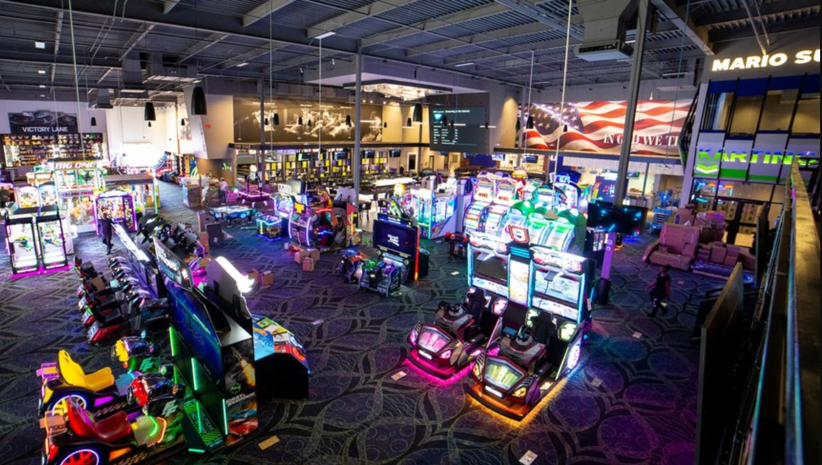

Tonight 6:00 – 9:00PM
Cocktails and Fun!
Notes:
…which is appropriate since tonight we're going to be going to Andretti's for some fun…..
──────────────────────────────────────────────
INTRODUCTION — 5 minutes (8:45 - 8:50 AM)
Welcome & Walk-in · Slides 1-4
• Transitional slide. It adds the closing line and needs no extra time.
• Full notes are on slide 1.

Slide 4

How Far We've Come
COMMAND 2026 · WEDNESDAY SESSION
What's New Since Command 2025
Jon Roodschild · Wednesday, November 4 · 8:45 AM
Notes:
…but also, cause FleetCommander has traveled a long way over the course of a year, so I'm going to stick with this Arcade/Roadtrip/Roadmap idea as we talk about What's new Since Command 2025.
──────────────────────────────────────────────
INTRODUCTION — 5 minutes (8:45 - 8:50 AM)
Welcome & Walk-in · Slides 1-4
• Transitional slide. It adds the closing line and needs no extra time.
• Full notes are on slide 1.

Slide 5


True or False?
SHOW OF HANDS
More than 1,300 changes have been made to FleetCommander since Command 2025.
True
False
More than one change for every working day since we were last together.
There's no way that much got shipped without me noticing it!
Notes:
INTRODUCTION — 5 minutes (8:45 - 8:50 AM)
True or False? · Slide 5
• Read the claim aloud: more than 1,300 changes since Command 2025.
• Hands for True, then hands for False. Count them out loud - it makes the reveal land.
• Do not tip your hand. The False side needs to commit before you turn the slide.

Slide 6
True.
THE ANSWER
14
+1,346
releases in twelve months
v6.02 through v6.04 — a new build roughly every two weeks.
3
platform rebuilds underneath
completed items delivered since Command 2025
Counted in TargetProcess. Bug fixes excluded.
.NET 10, the API, and the kiosk application.
0
things you had to do
All of it arrived in your existing site.
Notes:
INTRODUCTION — 5 minutes (8:45 - 8:50 AM)
The Answer · Slide 6
• Four click builds.
• 1,346 items / 14 releases / 3 platform rebuilds / 0 things you had to do.
• The fourth is the point of the whole section. Land it, then stop talking for a beat.

Slide 7



Two Kinds of Work
THOSE 1,346 CHANGES
870
476
TECH STUFF
COOL STUFF
290 support and customer requests
13 API enhancements
The .NET 10 platform rebuild
Performance and security work
A long tail of individual fixes
185 the new look and feel
97 key control and dispatch
87 less everyday friction
65 accounts and billing
25 maintenance · 17 reporting
What do YOU want to hear about?
QWIK POLL
Notes:
INTRODUCTION — 5 minutes (8:45 - 8:50 AM)
Two Kinds of Work · Slides 7-8
• Three click builds.
• 870 tech stuff, 476 cool stuff, then the Qwik Poll: what do you want to hear about?
• Slide 8 adds the line that justifies the running order - the next 50 minutes come from the 476, but the 870 is why the 476 was possible.
• The poll reads the room; it is not a vote he must honour. It decides where slack goes later.

Slide 8
Two Kinds of Work
THOSE 1,346 CHANGES
870
476
TECH STUFF
COOL STUFF
The next 50 minutes are almost entirely drawn from the 476 — but the 870 is why the 476 was possible.
290 support and customer requests
13 API enhancements
The .NET 10 platform rebuild
Performance and security work
A long tail of individual fixes
185 the new look and feel
97 key control and dispatch
87 less everyday friction
65 accounts and billing
25 maintenance · 17 reporting
What do YOU want to hear about?
QWIK POLL
Notes:
INTRODUCTION — 5 minutes (8:45 - 8:50 AM)
Two Kinds of Work · Slides 7-8
• Transitional slide. It adds the closing line and needs no extra time.
• Full notes are on slide 7.

Slide 9


COMMAND 2026 · WEDNESDAY SESSION
How Far We've Come
What's New Since Command 2025
Jon Roodschild · Wednesday, November 4 · 8:45 AM
Notes:
INTRODUCTION — 5 minutes (8:45 - 8:50 AM)
Transition · Slide 9
• Title reprise, one click. A breath, then straight into the agenda.

Slide 10
50 Minutes, 4 Parts + Much More To Come
WHAT WE'LL COVER
1
Under the hood
90 seconds on what changed that you can't see.
2
The new FleetCommander
Navigation, search, and screens that work on a phone — live.
3
Sites, settings and guardrails
Cloning, switching a site off, auditing, and a smarter kiosk.
4
Easing the workload
Maintenance, mileage, and reservations with less typing.
5
Digging deeper together
Other sessions this week — the details are there.
Notes:
WHAT WE'LL COVER — 90 seconds (8:50 - 8:51:30 AM)
Agenda · Slide 10
• Five rows. Read them briskly - this is a map, not content.
• Row 5, Digging deeper, is the promise that allows going shallow on key control, billing and reporting later. The detail is in other sessions this week.

Slide 11
Under the Hood
PART 1 · NINETY SECONDS
Notes:
PART ONE · UNDER THE HOOD — 90 seconds (8:51:30 - 8:53 AM)
Section divider · Slide 11
• Say the section name and move. The slide already promises ninety seconds.

Slide 12





The Platform Was Rebuilt Beneath You
WHAT YOU CAN'T SEE
.NET 10
API rebuilt
Performance
Security
You asked
Moved to .NET 10 — the API in September, the kiosk right behind it.
Thirteen enhancements,
plus batch for Departments and Accounts.
Faster page loads and grid rendering across the screens you use most.
Hardening and dependency work that never reaches a release note headline.
290 of the 870 came straight from support tickets and customer requests.
Notes:
PART ONE · UNDER THE HOOD — 90 seconds (8:51:30 - 8:53 AM)
The Platform Was Rebuilt Beneath You · Slides 12-13
• Five click builds.
• .NET 10 / API rebuilt / performance / security / you asked - 290 of the 870 came straight from support tickets.
• Slide 13 adds the payoff: no migration, no downtime, no project plan.
• This is the cut section. If behind at 8:53, skip to slide 13 and move on.

Slide 13
The Platform Was Rebuilt Beneath You
WHAT YOU CAN'T SEE
.NET 10
API rebuilt
Performance
Security
You asked
You didn't have to do a thing. No migration, no downtime, no project plan — it arrived in the site you already had.
Moved to .NET 10 — the API in September, the kiosk right behind it.
Thirteen enhancements, plus batch for Departments and Accounts.
Faster page loads and grid rendering across the screens you use most.
Hardening and dependency work that never reaches a release note headline.
290 of the 870 came straight from support tickets and customer requests.
Notes:
PART ONE · UNDER THE HOOD — 90 seconds (8:51:30 - 8:53 AM)
The Platform Was Rebuilt Beneath You · Slides 12-13
• Transitional slide. It adds the closing line and needs no extra time.
• Full notes are on slide 12.

Slide 14
The New FleetCommander
PART 2 · THE BIG ONE
Notes:
PART TWO · THE NEW FLEETCOMMANDER — 16 minutes (8:53 - 9:09 AM)
Section divider · Slide 14
• Flag it as the big one. This is the section nobody else at Command is covering.

Slide 15



Five Things to Try the Moment You Log In
EVERY GRID, EVERY SCREEN
Search
Filter and save
Your columns
Links in the data
On a phone
Quick search starts hunting as soon as you type — no Go button.
Filter a page the way you want it, then save it as your own view.
Move columns into the order you want, and sort on any one of them.
Names and numbers are links straight into the profile behind them.
The same screens, usable on a tablet or a phone without pinching.
Notes:
PART TWO · THE NEW FLEETCOMMANDER — 16 minutes (8:53 - 9:09 AM)
Five Things to Try · Slides 15-16
• Five click builds.
• Search / filter and save / your columns / links in the data / on a phone.
• Build all five, then slide 16's line is the cue to stop presenting and open the browser.

Slide 16
Five Things to Try the Moment You Log In
EVERY GRID, EVERY SCREEN
Search
Filter and save
Your columns
Links in the data
On a phone
Rather than show you screenshots of this — let's do it live.
Quick search starts hunting as soon as you type — no Go button.
Filter a page the way you want it, then save it as your own view.
Move columns into the order you want, and sort on any one of them.
Names and numbers are links straight into the profile behind them.
The same screens, usable on a tablet or a phone without pinching.
Notes:
PART TWO · THE NEW FLEETCOMMANDER — 16 minutes (8:53 - 9:09 AM)
Five Things to Try · Slides 15-16
• Transitional slide. It adds the closing line and needs no extra time.
• Full notes are on slide 15.
LIVE DEMO - grids and search - 7 minutes (8:55:30 - 9:02:30)
• Mirror the five cards in order, so the slide acts as the demo script.
• Quick search hunting as you type, with no Go button.
• Filter a grid, save the view, reload to prove it stuck.
• Drag a column, sort on it, click a name straight through to the profile.
• Finish on a phone or narrow window - the strongest single moment in the session.
• Hard stop 9:02:30. If over, drop the phone view; it reappears on slide 17.

Slide 17
The Screens You Live In
REBUILT, NOT RESKINNED
EVERYONE
EVERYONE
EVERYONE
Native Login
Vehicle Use
Information
The sign-in page, rebuilt in the new UI.
Every page under the menu, moved to the new UI.
Every page under the menu — Help, FAQs, Rates, Terms, Policy — in the new UI.
END-USER & ADMIN
ADMIN
ADMIN
ADMIN
Make Reservation
Manage Users
Manage Vehicles
Manage Reservations
Rebuilt end to end: five steps, with scheduled and actual times on the summary.
Permissions as a searchable tree, an Assigned Assets tab, one-click restore.
Easy Search by name, plate or VIN. Seven new columns. TCO exclusions.
Quick search by request or confirmation number — and both are links.
Notes:
PART TWO · THE NEW FLEETCOMMANDER — 16 minutes (8:53 - 9:09 AM)
The Screens You Live In · Slides 17-18
• Three click builds.
• Grouped by who touches them: Everyone / End-user and Admin / Admin only.
• Do not read all seven. Name the group, then point at the two that matter to this room - Manage Users and Manage Vehicles.

Slide 18
The Screens You Live In
REBUILT, NOT RESKINNED
EVERYONE
EVERYONE
EVERYONE
Native Login
Vehicle Use
Information
The sign-in page, rebuilt in the new UI.
Every page under the menu, moved to the new UI.
Every page under the menu — Help, FAQs, Rates, Terms, Policy — in the new UI.
We'll walk through these live — the detail is easier to show than to list.
END-USER & ADMIN
ADMIN
ADMIN
ADMIN
Make Reservation
Manage Users
Manage Vehicles
Manage Reservations
Rebuilt end to end: five steps, with scheduled and actual times on the summary.
Permissions as a searchable tree, an Assigned Assets tab, one-click restore.
Easy Search by name, plate or VIN. Seven new columns. TCO exclusions.
Quick search by request or confirmation number — and both are links.
Notes:
PART TWO · THE NEW FLEETCOMMANDER — 16 minutes (8:53 - 9:09 AM)
The Screens You Live In · Slides 17-18
• Transitional slide. It adds the closing line and needs no extra time.
• Full notes are on slide 17.
LIVE DEMO - the screens you live in - 4 minutes 30 seconds (9:04:30 - 9:09:00)
• Make Reservation end to end - five steps, scheduled and actual times on the summary.
• Manage Users - searchable permission tree, Assigned Assets tab, one-click restore.
• Manage Vehicles - Easy Search by name, plate or VIN.
• Hard stop 9:09:00. Manage Users is the one to keep if short.

Slide 19
Sites, Settings, and Guardrails
PART 3 · CONTROL
Notes:
PART THREE · SITES, SETTINGS AND GUARDRAILS — 11 minutes (9:09 - 9:20 AM)
Section divider · Slide 19
• Shift of register - from what you see to what you control.

Slide 20


Auditing, Privacy and Email Control
QUIETLY IMPORTANT
AUDIT
PRIVACY
EMAIL
Site changes tracked
Acceptance on file
Fewer surprises
Site name, site code, contact email, vehicle availability and kiosk active state — all recorded when they change.
Acceptance date and version now sit on the user profile, and the kiosk checkbox meets accessibility standards.
Pending request emails to admins, and cancellation notes you can make optional per usage type.
Notes:
PART THREE · SITES, SETTINGS AND GUARDRAILS — 11 minutes (9:09 - 9:20 AM)
Auditing, Privacy and Email Control · Slide 22
• Three short beats, no demo.
• Audit now records site name, site code, contact email, vehicle availability and kiosk active state.
• Acceptance date and version sit on the user profile; the kiosk checkbox meets accessibility standards.

Slide 21


Clone a Site. Or Switch One Off.
MOST REQUESTED
NEW
NEW
Clone Site
Inactive Sites
Stand up a new site pre-populated from an existing one — reservations, users, vehicles, layouts, billing rates and weekday hours.
Switch a site off without deleting it. No new reservations, all history preserved, and it disappears from Make Reservation, dashboards and filters.
Notes:
PART THREE · SITES, SETTINGS AND GUARDRAILS — 11 minutes (9:09 - 9:20 AM)
Clone a Site. Or Switch One Off. · Slides 20-21
• Both labelled most requested. Say that out loud - this room asked for them.
• Clone carries reservations, users, vehicles, layouts, billing rates and weekday hours.
• Slide 21 adds the guardrail: a site with upcoming or dispatched reservations cannot be deactivated, and the warning names them.

Slide 22
Clone a Site. Or Switch One Off.
MOST REQUESTED
NEW
NEW
The guardrail: you can't deactivate a site that still has upcoming or dispatched reservations — and the warning names them.
Clone Site
Inactive Sites
Stand up a new site pre-populated from an existing one — reservations, users, vehicles, layouts, billing rates and weekday hours.
Switch a site off without deleting it. No new reservations, all history preserved, and it disappears from Make Reservation, dashboards and filters.
Notes:
PART THREE · SITES, SETTINGS AND GUARDRAILS — 11 minutes (9:09 - 9:20 AM)
Clone a Site. Or Switch One Off. · Slides 20-21
• Transitional slide. It adds the closing line and needs no extra time.
• Full notes are on slide 20.
LIVE DEMO - clone and deactivate - 4 minutes (9:12:00 - 9:16:00)
• Clone a site and show what came across with it.
• Try to deactivate a site that still has reservations, so the room sees the warning name them. This is the moment that earns trust.
• Hard stop 9:16:00.

Slide 23



The Kiosk Grew Up
AT THE BOX
Enforce Policy
QR code login
Mileage In
Tablet ready
Grab and Go
Require drivers to accept your fleet policy before a check-out or check-in.
Drivers sign in with their phone — no RFID badge reader required.
Now included in the check-in confirmation email.
Responsive kiosk screens that work properly on a tablet.
A configurable default return time, set per kiosk.
Notes:
PART THREE · SITES, SETTINGS AND GUARDRAILS — 11 minutes (9:09 - 9:20 AM)
The Kiosk Grew Up · Slide 23
• Five click builds.
• Enforce Policy / QR code login / Mileage In / tablet ready / Grab and Go.
• QR code login is the headline - drivers sign in with their phone, no RFID badge reader.
• Keep moving. Key control hardware belongs to the 9:45 session.

Slide 24
Easing the Workload
PART 4 · LESS TYPING
Notes:
PART FOUR · EASING THE WORKLOAD — 6 minutes (9:20 - 9:26 AM)
Section divider · Slide 24
• Frame it as less typing. That is what this room actually wants.

Slide 25

Smarter Work Orders
MAINTENANCE
NEW
NEW
Part warranties
Configurable status reasons
A warranty notice displays when a part added to a work order — directly or through a task template — is still under warranty.
The status reasons available for each status are now yours to configure, with inline editing.
Notes:
PART FOUR · EASING THE WORKLOAD — 6 minutes (9:20 - 9:26 AM)
Smarter Work Orders · Slides 25-26
• Part warranties, and configurable status reasons with inline editing.
• Slide 26 is the honest one: closed work orders were locked in v6.01 to protect TCO and billing, and reopened in v6.04 with warnings and difference-only posting.
• Tell that story properly - admitting a reversal buys more credibility than any feature on the slide.

Slide 26
Smarter Work Orders
MAINTENANCE
NEW
NEW
And the one we reversed: closed work orders were locked in v6.01 to protect TCO and billing — reopened again in v6.04, with warnings and difference-only posting.
Part warranties
Configurable status reasons
A warranty notice displays when a part added to a work order — directly or through a task template — is still under warranty.
The status reasons available for each status are now yours to configure, with inline editing.
Notes:
PART FOUR · EASING THE WORKLOAD — 6 minutes (9:20 - 9:26 AM)
Smarter Work Orders · Slides 25-26
• Transitional slide. It adds the closing line and needs no extra time.
• Full notes are on slide 25.

Slide 27


Four Things You No Longer Type Twice
FEWER KEYSTROKES
Clone work orders
Smarter scheduling
Mileage in bulk
Reservations that run themselves
Duplicate a work order instead of rebuilding it line by line.
Task templates and providers that know in-house from external.
Update odometer readings for many vehicles in one pass.
Recurring patterns, clearer defaults, and less re-entry.
Notes:
PART FOUR · EASING THE WORKLOAD — 6 minutes (9:20 - 9:26 AM)
Four Things You No Longer Type Twice · Slide 27
• Four click builds.
• Clone work orders / smarter scheduling / mileage in bulk / reservations that run themselves.
• One sentence each. If running late, this is the second thing to compress.

Slide 28
Digging deeper together
ALSO AT COMMAND
Notes:
DIGGING DEEPER TOGETHER — 14 minutes (9:26 - 9:40 AM)
Section divider · Slide 28
• The handoff section. The job here is to point, not to teach.

Slide 29
Hardware-Agnostic Key Control
KEY CONTROL
Groundwork laid in v6.02 — FleetCommander no longer cares which box you own.
Original Key Control
FleetCommander Go
Keyless
Kiosk Only
Dispatcher
KSI. Keys locked behind a door, dispatched at a kiosk. 8–192 positions.
Key Café. Secure box, no kiosk — the driver's phone is the kiosk. 9–429 positions.
Invers. In-vehicle hardware; unlock by RFID card or phone.
Keys on hooks, checked in and out at the kiosk or by phone.
A person at a counter. No hardware at all.
Notes:
DIGGING DEEPER TOGETHER — 14 minutes (9:26 - 9:40 AM)
Hardware-Agnostic Key Control · Slides 29-30
• Five click builds.
• Original Key Control / FleetCommander Go / Keyless / Kiosk Only / Dispatcher.
• Name them and stop. Slide 30 hands to Phelps at 9:45 today.
• Do not get drawn into hardware pricing or driver flow - that session owns it.

Slide 30
Hardware-Agnostic Key Control
KEY CONTROL
Groundwork laid in v6.02 — FleetCommander no longer cares which box you own.
Phelps takes all five apart in Beyond the Software: KeyCafe, Invers & the Connected Fleet
Original Key Control
FleetCommander Go
Keyless
Kiosk Only
Dispatcher
KSI. Keys locked behind a door, dispatched at a kiosk. 8–192 positions.
Key Café. Secure box, no kiosk — the driver's phone is the kiosk. 9–429 positions.
Invers. In-vehicle hardware; unlock by RFID card or phone.
Keys on hooks, checked in and out at the kiosk or by phone.
A person at a counter. No hardware at all.
NEXT · 9:45 AM
Notes:
DIGGING DEEPER TOGETHER — 14 minutes (9:26 - 9:40 AM)
Hardware-Agnostic Key Control · Slides 29-30
• Transitional slide. It adds the closing line and needs no extra time.
• Full notes are on slide 29.

Slide 31

Key Commander
NEW IN v6.04
TRACK
ASSIGN
AUDIT
Not just vehicles
Access groups by key
Who had it, and when
Spare keys, mailrooms, equipment, lockers, offices — anything you secure, with its own grid and asset profiles.
Alongside vehicle access groups, assign keys to people and departments straight from the asset profile.
Every check-out and check-in recorded, with In/Out and Asset Detail reports behind it.
Notes:
DIGGING DEEPER TOGETHER — 14 minutes (9:26 - 9:40 AM)
Key Commander · Slides 31-32
• Four click builds.
• New in v6.04: track anything you secure, assign access groups by key, audit who had it and when.
• Slide 32 hands to Phelps, Thursday 10:00.

Slide 32
Key Commander
NEW IN v6.04
Phelps gives Key Management its own session — the dashboard, the kiosk button, relations back to vehicles, and the reports.
TRACK
ASSIGN
AUDIT
Not just vehicles
Access groups by key
Who had it, and when
Spare keys, mailrooms, equipment, lockers, offices — anything you secure, with its own grid and asset profiles.
Alongside vehicle access groups, assign keys to people and departments straight from the asset profile.
Every check-out and check-in recorded, with In/Out and Asset Detail reports behind it.
THURSDAY · 10:00 AM
Notes:
DIGGING DEEPER TOGETHER — 14 minutes (9:26 - 9:40 AM)
Key Commander · Slides 31-32
• Transitional slide. It adds the closing line and needs no extra time.
• Full notes are on slide 31.

Slide 33

Account Handling, Rebuilt
ACCOUNTS
Fields your way
Multiple accounts
Classification
One place
A dropdown or free text, applied consistently across reservations, work orders, assets, profiles and kiosks.
Per entity — across usage types, locations, departments and site settings.
Account Type Classification, with account labels you configure yourself.
Centralised account and billing settings, with the Billing tab always reachable.
Notes:
DIGGING DEEPER TOGETHER — 14 minutes (9:26 - 9:40 AM)
Account Handling, Rebuilt · Slides 33-34
• Four click builds.
• Fields your way, multiple accounts per entity, classification, one place for settings.
• Slide 34 hands to Helen, Thursday 1:00.

Slide 34
Account Handling, Rebuilt
ACCOUNTS
Helen's Configurable Billing Exports session builds a reusable export template in a five-step wizard — mapping, rules, preview, publish.
Fields your way
Multiple accounts
Classification
One place
A dropdown or free text, applied consistently across reservations, work orders, assets, profiles and kiosks.
Per entity — across usage types, locations, departments and site settings.
Account Type Classification, with account labels you configure yourself.
Centralised account and billing settings, with the Billing tab always reachable.
THURSDAY · 1:00 PM
Notes:
DIGGING DEEPER TOGETHER — 14 minutes (9:26 - 9:40 AM)
Account Handling, Rebuilt · Slides 33-34
• Transitional slide. It adds the closing line and needs no extra time.
• Full notes are on slide 33.

Slide 35

Seventeen Changes, One Coming
REPORTING
SHIPPED
NEXT
Reports you already have
Report Center
Seventeen reporting changes landed in the last year — Vehicle Usage, Motor Pool Utilization, Cancellations and TCO all answer more than they used to.
Build custom reports, run them on demand, schedule delivery, share them. Initial release mid-November to select clients.
Notes:
DIGGING DEEPER TOGETHER — 14 minutes (9:26 - 9:40 AM)
Seventeen Changes, One Coming · Slides 35-36
• Seventeen reporting changes shipped; Report Center is next, initial release mid-November to select clients.
• Slide 36 hands to Dave, Thursday 11:15, and flags Analyze & Advocate with AI.

Slide 36
Seventeen Changes, One Coming
REPORTING
Dave demos Report Center — and at 9:00 he and Mike run Analyze & Advocate with AI, on turning any of this into a story your leadership reads.
SHIPPED
NEXT
Reports you already have
Report Center
Seventeen reporting changes landed in the last year — Vehicle Usage, Motor Pool Utilization, Cancellations and TCO all answer more than they used to.
Build custom reports, run them on demand, schedule delivery, share them. Initial release mid-November to select clients.
THURSDAY · 11:15 AM
Notes:
DIGGING DEEPER TOGETHER — 14 minutes (9:26 - 9:40 AM)
Seventeen Changes, One Coming · Slides 35-36
• Transitional slide. It adds the closing line and needs no extra time.
• Full notes are on slide 35.

Slide 37
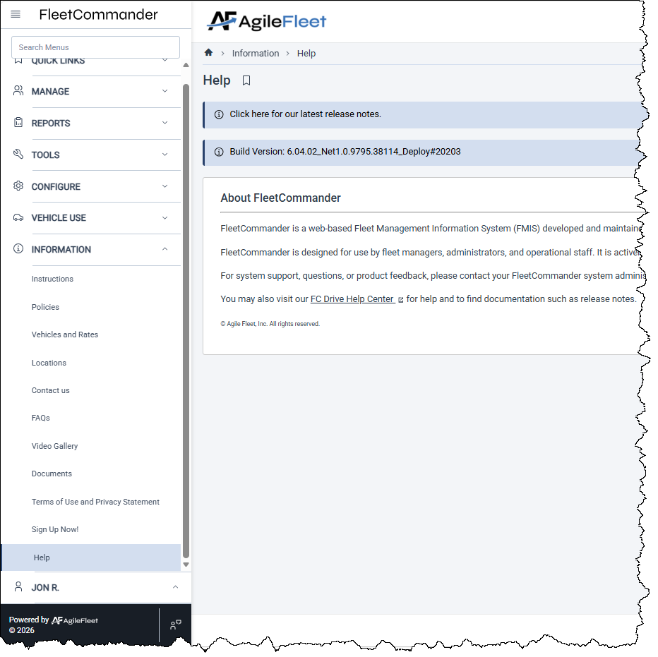
Find All of It Yourself
NO WAITING ON US
01 WHERE TO LOOK
Information, then Help
Only available to users with Admin-level permission.
02 EVERY RELEASE
The release notes link
“Click here for our latest release notes” — always current.
03 WHAT YOU’RE RUNNING
Your build version
Shown right below the release notes link.
04 KNOWLEDGE BASE
FC Drive Help Center link
Documentation, articles, videos, and chat-bot.
Notes:
DIGGING DEEPER TOGETHER — 14 minutes (9:26 - 9:40 AM)
Find All of It Yourself · Slide 37
• Information, then Help - admin permission required.
• The release notes link is always current, the build version sits right below it, and FC Drive Help Center holds documentation, articles, videos and the chat-bot.
• This is the slide people photograph. Pause on it and say so.
• OPEN ITEM: the FC Drive Help Center link has no URL behind it yet.

Slide 38

You've Seen Phase One
WHERE THIS GOES
PHASE 1 · SHIPPED
PHASE 2 · NEXT
The last fifty minutes
More of the same, faster
1,346 items. A rebuilt platform, a new interface, hardware-agnostic key control, and a maintenance module that asks you to type less.
More screens in the new UI, a Notification Center, Report Center templates and AI insights, enhanced keyless dispatch, configurable billing files.
Notes:
DIGGING DEEPER TOGETHER — 14 minutes (9:26 - 9:40 AM)
You've Seen Phase One · Slides 38-39
• Two click builds.
• Phase 1 shipped - the last fifty minutes. Phase 2 next - more screens, Notification Center, Report Center templates, AI insights, keyless dispatch, configurable billing files.
• Slide 39 hands to Dave at 11:10 today for the full roadmap.

Slide 39

You've Seen Phase One
WHERE THIS GOES
Dave lays out the whole thing in Built for What's Next: The FleetCommander Roadmap — including six enhancements landing before 2027.
PHASE 1 · SHIPPED
PHASE 2 · NEXT
The last fifty minutes
More of the same, faster
1,346 items. A rebuilt platform, a new interface, hardware-agnostic key control, and a maintenance module that asks you to type less.
More screens in the new UI, a Notification Center, Report Center templates and AI insights, enhanced keyless dispatch, configurable billing files.
TODAY · 11:10 AM
Notes:
DIGGING DEEPER TOGETHER — 14 minutes (9:26 - 9:40 AM)
You've Seen Phase One · Slides 38-39
• Transitional slide. It adds the closing line and needs no extra time.
• Full notes are on slide 38.

Slide 40
How Far We've Come.
Any thing we can clarify?
Notes:
DIGGING DEEPER TOGETHER — 14 minutes (9:26 - 9:40 AM)
Questions & Close · Slide 40
• Close on the title, then open the floor. Budget the full two and a half minutes.
• If no questions come, name one - the one asked most this year - and answer it.
• Finish at 9:40 on the clock.

