Slide 1


Future Proof
Sharing Vehicles 201
COMMAND 2026 • Glendale, AZ
Chris Anderson • INVERS
Notes:
Chris, INVERS, again. Some of what we build looks like overkill. Until a customer needs it. Here’s why we built it.

Slide 2

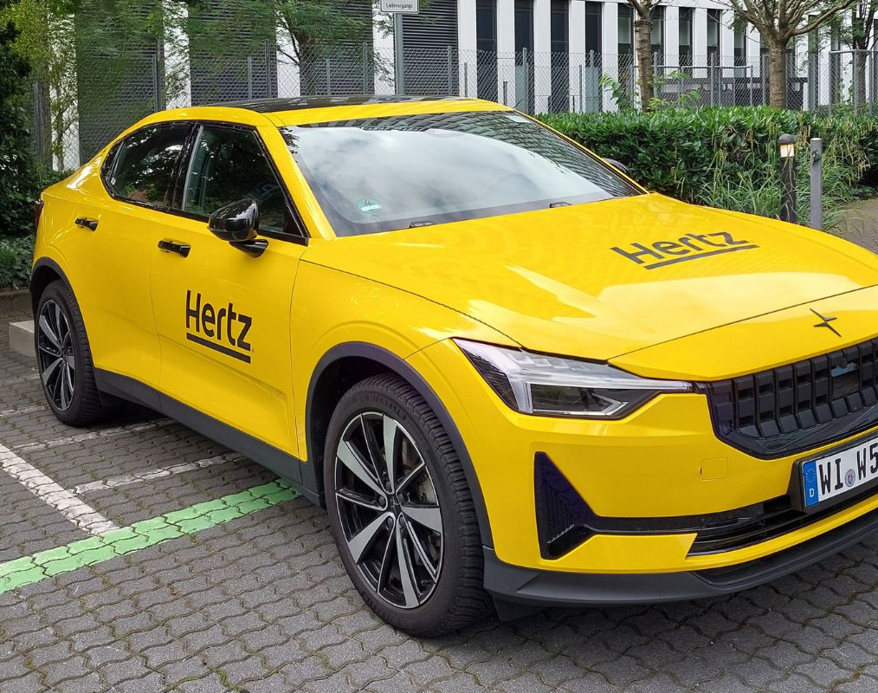



30 years of keyless sharing
30 years, from Germany
Vehicle Access
Nobody stranded
Our focus is the customer experience.
Our own hardware
We build it ourselves.
Europe hits the hard problems first. We bring the fixes here.
Notes:
INVERS. 30 years. Based in Germany, serving the European market. Our focus: the customer experience. Nobody stranded in a parking lot. We build our own hardware. Europe hits the hard problems first. We bring the fixes here. Here are a few.

Slide 3


How to steal a car?
Note: the starter has been immobilized.
The problem
What we built
Bump Starts
Speed limiting
Roll a manual car, pop the clutch, and it runs.
The vehicle can’t go faster than the speed you set.
Notes:
Immobilization. No booking, no start. In some cases, that means cutting the starter circuit. But a manual car? Push it, pop the clutch. There’s a YouTube video. So we built a speed limiter. The vehicle can’t go above a set speed.

Slide 4
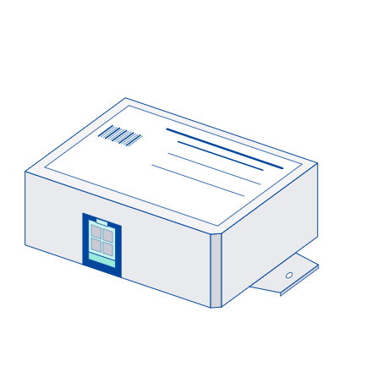
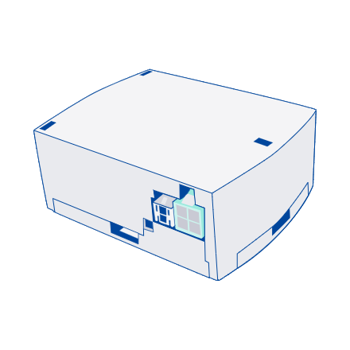
How to steal a car?
The key fob isn’t sending a signal?
The problem
What we built
Bridge the pins
The SKM
Bridge its pins with a battery, and a push-button car gets the signal it needs to start.
It talks to the CloudBoxx. A battery on the pins doesn’t start the car.
Notes:
Our old LOMO key holder. Bad actors bridged the pins with a battery. That gave a push-button car the signal to start. Our new SKM talks to the CloudBoxx. That trick doesn’t work anymore.

Slide 5
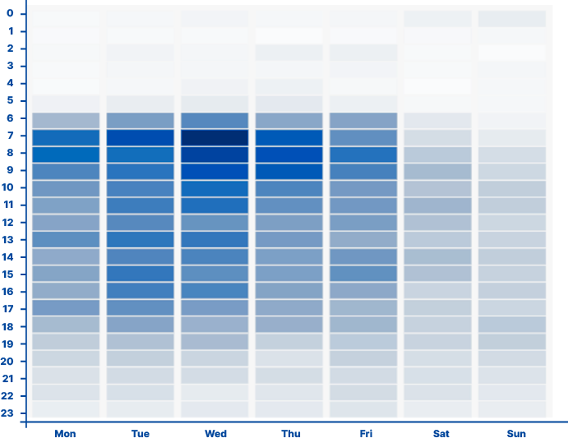
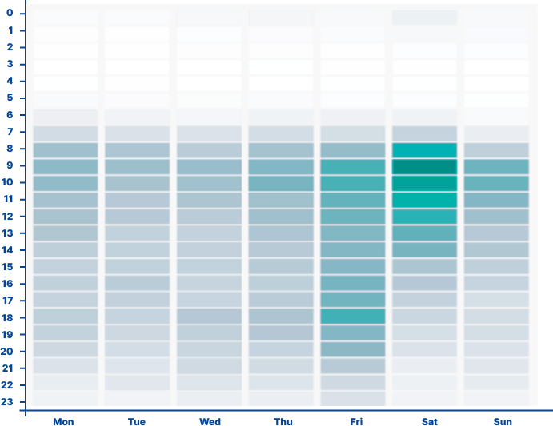

Busy weekdays, quiet weekends
Weekend demand is the reverse of weekday demand.
Mon–Fri: work trips
Weekends: private trips
Fleet Share: move vehicles onto another platform, or between your own teams.
Notes:
Weekend use is the reverse of weekday use. Work trips in the week. Private trips on the weekend. One of our larger projects in Europe worked with us to build Fleet Share. Move your vehicles onto a different platform. Seamlessly. Maximize utilization. You don’t have to leave your own fleet. Move vehicles between locations, or teams.

Slide 6



Updates without touching the car
Firmware and settings go out over the air.
Firmware
New features and fixes reach every vehicle remotely.
Over the air
Settings
Vehicle configurations. Thresholds settings.
One vehicle or the whole fleet.
no site visit
Notes:
Nobody drives to the car. Firmware updates go out over the air. Vehicle configurations too. Thresholds, like speeding or harsh braking. One car or the whole fleet, from a desk.

Slide 7



Know what your fleet is doing
From the box that’s already in the car.
Driver behaviour
Crash detection
Unusual events
Monitor how your drivers drive.
Protect your assets.
Spot what shouldn’t be happening.
Notes:
Driver behaviour: monitor your drivers. Crash detection: protect your assets. And unusual events. Like this one.

Slide 8

A vehicle is moving. There’s no booking.
Your guess?
And it’s sitting at an angle. What’s happening?
It’s being towed.
Customers find it at the tow yard, and get it back faster.
Notes:
Your turn. A vehicle is moving. No booking. And it’s sitting at an angle. What’s going on? Guesses? It’s being towed. Some customers use this to find their vehicles in the tow yard. And get them back faster.

Slide 9
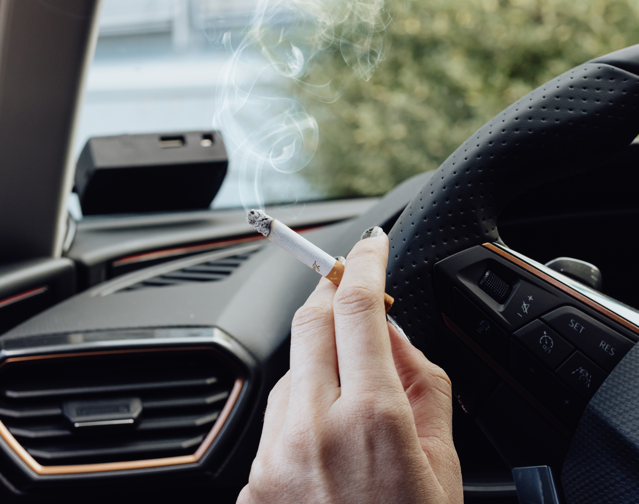



Smoke detection changes behaviour
The goal is clean vehicles, not cleaning fees.
Drivers know it’s there
So they don’t light up.
The next driver wins
A clean car, every trip.
Not about the fee
Behaviour change is the point.
Notes:
Smoke detection. It’s not about recovering cleaning costs. It’s about behaviour. Drivers know it’s there, so they don’t smoke. The next driver gets a clean car.

Slide 10



Carmakers are connecting their cars
So we expanded our API: one umbrella, any vehicle.
CloudBoxx, any make
FleetCommander
connects once
Tesla, no box
One API
Other carmakers
Notes:
Carmakers are connecting their own cars. That’s a big consideration. So we expanded our API to a new model. One umbrella. FleetCommander connects once. Behind it: our box, Tesla, and others. So what do carmakers actually give you?

Slide 11
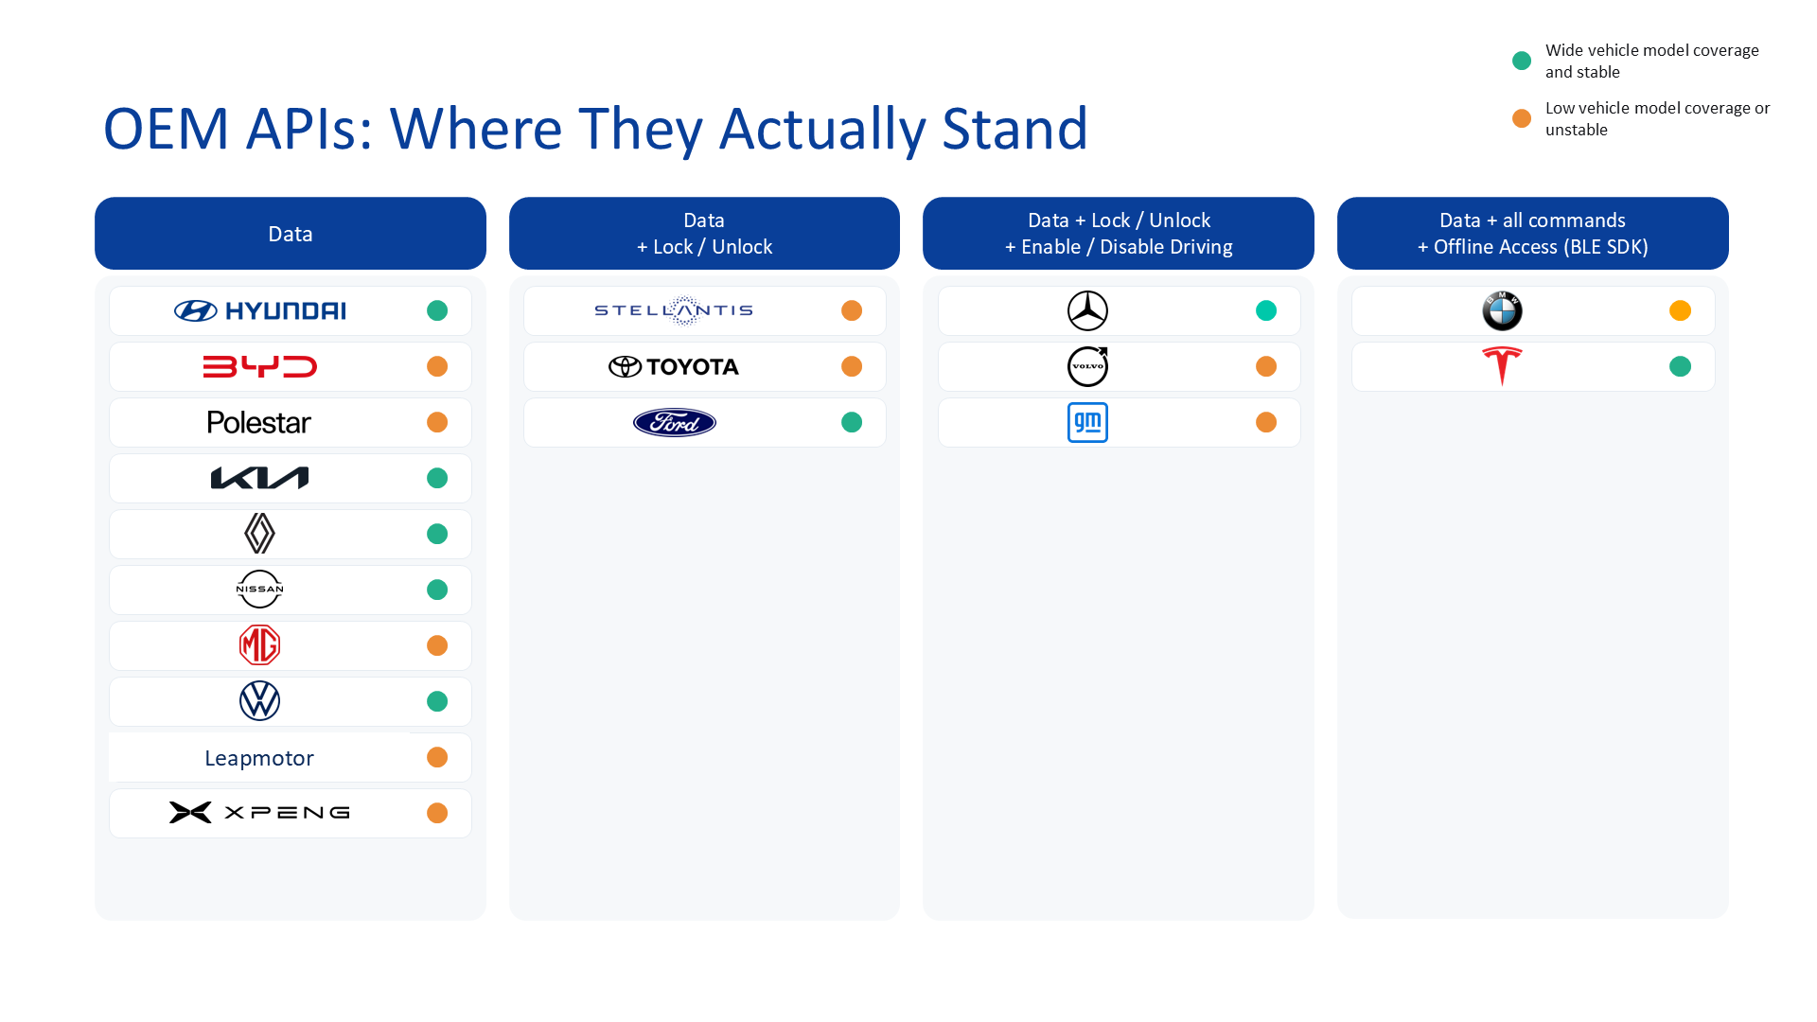
Notes:
Carmakers are opening up their cars. Mostly for data. Lock and unlock: a handful. Shut off driving: fewer. Full control, even offline: Tesla, BMW. Look where Ford, GM and Toyota sit. That’s most of a motor pool.

Slide 12


Your key, on your phone
Digital keys: what’s coming.
Connected Car Consortium
Google & Apple Pay
Time bounded
Existing infrastructure.
Like your hotel key.
Co-ordinated access.
No app to install.
Notes:
Digital keys. A future consideration. The Connected Car Consortium: co-ordinated access. Google and Apple Pay: infrastructure that already exists. Time bounded. Like your hotel key. No app to install. So where does it stand today?

Slide 13
Rarely available
Phone keys, by vehicle type.
Why? Built-in hardware.
Smartphones
UWB antennas around the vehicle
Premium cars
+
Fleet core
NFC sensors on door handles
Volume cars
=
High cost per vehicle
Vans & older
Notes:
Phone keys in your wallet are coming. But rare in the cars fleets actually buy. Why? The hardware has to be built in. Antennas around the car. Sensors in the door handles. High cost per vehicle. We’re working inside the standard to make it fleet-ready.

Slide 14
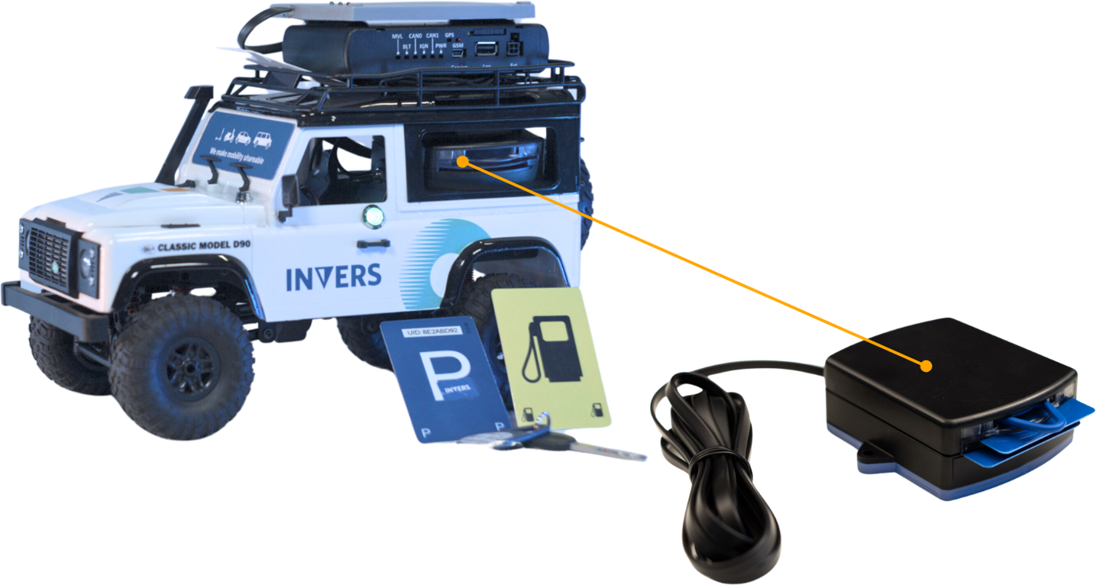
Questions?
Chris Anderson
christopher.anderson@invers.com
Notes:
Questions? Overkill, until you need it. Find me any time this week.

