Slide 1


Keyless Sharing
Safe, reliable access to every vehicle in your motor pool
COMMAND 2026 • Glendale, AZ
Chris Anderson • INVERS
Notes:
Thanks, Phelps. I’m Chris, INVERS. Phelps showed you the booking side. I’ll show you the vehicle side, and why you can trust it.

Slide 2

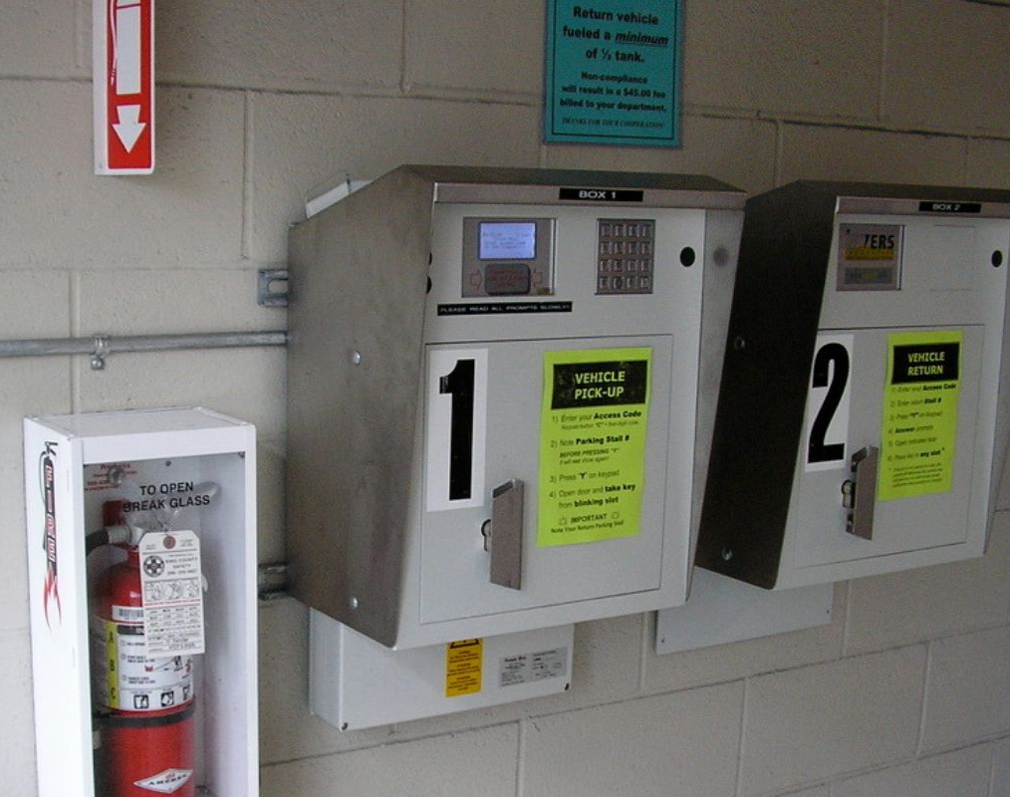
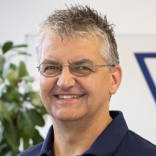
Sharing vehicles since ’93
We’ve been where you are.
30+
years in business
20+
years in NA motor pool
3
softwares, and a key box
Today, one focus: the technology in the vehicle.
Our key boxes, King County motor pool
Notes:
INVERS. Over 30 years in business. 20-plus years in North America, in motor pool. You may know our CEO, Rudy Six. We built three versions of motor pool software. And a key box. That’s ours, at King County. Then we chose one focus: the technology in the vehicle. FleetCommander runs the pool. We make the vehicle safe to share.

Slide 3




















Trusted by
Carsharing, utilities, cities and counties.
Notes:
Carsharing, utilities, cities, counties. Many of them run motor pools like yours.

Slide 4


Trackers & Sharing Have Different Goals
ON, or OFF – when does it need to work?
GPS tracker
INVERS
Misses a beat?
Misses a beat?
You lose a data point.
Someone can’t get home.
Notes:
Our goal: a great experience for your drivers. The doors open. Every time. You could keep your GPS tracker. If it misses a beat, you only lose a data point. If we miss, someone’s standing in the parking lot. So it has to work. King County: it always works, even underground, with no signal.

Slide 5



We work with you. Just like Agile.
That’s why we like working together.
Customers Experience
If the end user isn't happy, neither are we.
Our hardware
Lifetime
Our best ideas come from you
Customers ask. We build it.
warranty
Support
Through pilots, installs, and scaling.
Notes:
Our hardware has a lifetime warranty. We bend over backwards for customers. So does Agile. That’s why we like working together. King County has been with us since 2007. Our best ideas come from customers. And you know who to call.

Slide 6




Five questions
What everyone asks about keyless.
01
02
03
04
05
Will it work in my vehicle?
Will it drain the battery?
What if I lose my badge?
How long does the install take?
What happens when I re-fleet?
Notes:
You’ve heard of keyless. Fair questions come with it. These five come up every time.

Slide 7





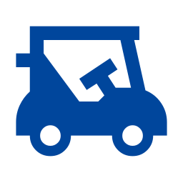
Will it work in my vehicle?
Yes.
Bladed key
OR
Push-button start
EV
OR
ICE
Bulldozers
&
Golf carts
Notes:
Will it work in my vehicle? Yes. Bladed key or push-button. Electric or ICE. Bulldozers and golf carts. One of the hardest parts of my job: curbing the enthusiasm of 200 engineers. They live for problems like: what about a bulldozer, with no doors, in a spot with no coverage?

Slide 8
Will it drain the battery?
Built to sip power, not drain it.
Parked for weeks
Up to several weeks, depending on the vehicle.
~23 mA
with the ignition off
If a car sits long enough to go flat…
the problem isn’t the battery. Nobody needs that car.
Notes:
About 23 milliamps with the ignition off. A parked car lasts up to several weeks. Depends on the car. If a car sits long enough to go flat, the battery isn’t the problem. Nobody needed that car.

Slide 9
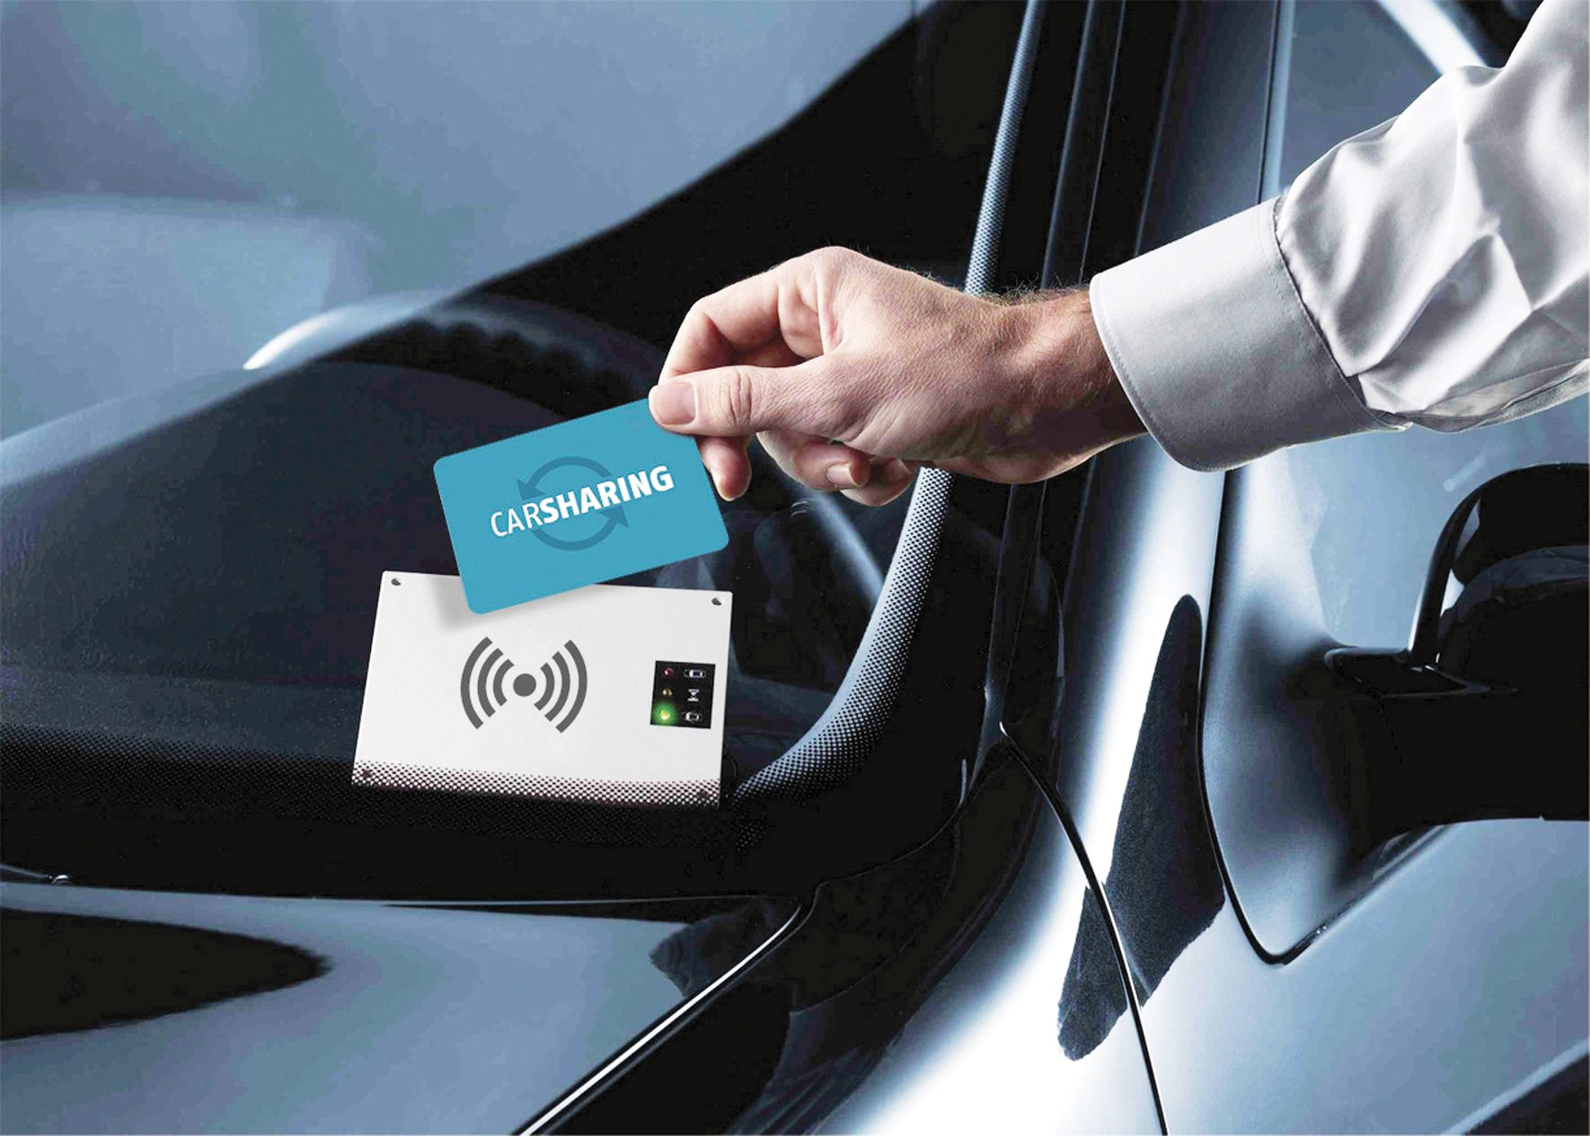



Remote Control
Lost your key, or card?
We unlock the vehicle remotely.
Someone else needs it
Enable it for anyone you choose.
An emergency
Open your vehicles to first responders.
“Being able to help people after hours, even if we’re not on site, has been huge.”
Gabriel Goings, Seattle City Light
Notes:
Lost your badge? Forgot it? Call. We unlock it from a desk. Want someone else to use a vehicle? Enable it for them. Remotely. Last year at NASUF, there was a discussion on emergency vehicles. With remote access, you can open your vehicles to emergency responders. Or anyone you want. Seattle City Light: helping people after hours, not on site, has been huge.

Slide 10
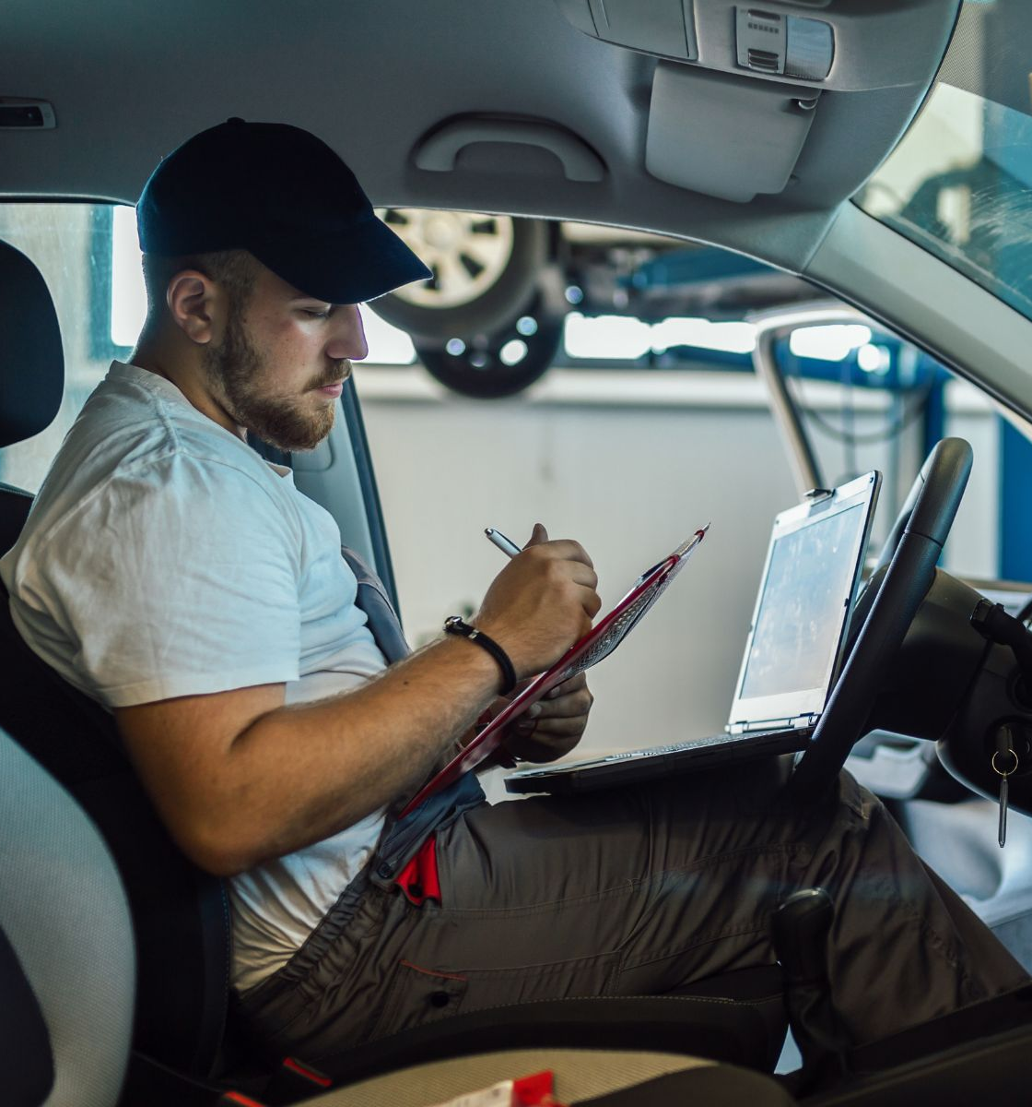
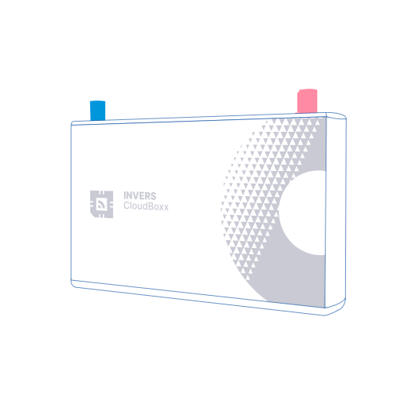
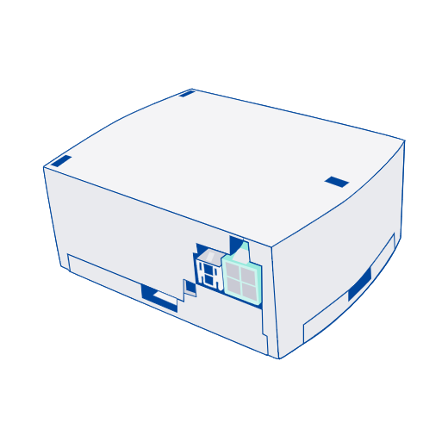
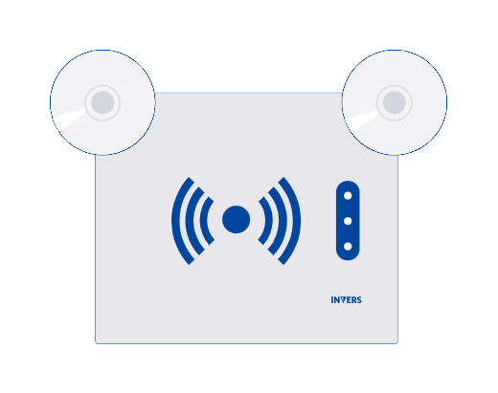
Installed in 30–60 minutes
Per vehicle. Three parts.
CloudBoxx
Smart Key Module (SKM)
Card reader
Plugs into the OBD port
Most cards integrated
Your key, soldered inside
Notes:
30 to 60 minutes a vehicle. The CloudBoxx plugs into the OBD port. The SKM: your key, soldered inside. The RFID card reader. Twelve types of card.

Slide 11

What happens when I re-fleet?
Built to last. The box moves on.
Take the box out
10+
years: some customers’ boxes are still running
Recover the key
Move IoT into the next vehicle
Lifetime hardware warranty
Notes:
It has to work. And it has to last. Selling the car? The box comes out. The key goes back with the car. In most cases, restored to the original. The box goes into the next vehicle. Some customers’ boxes are still running after ten-plus years. And our hardware has a lifetime warranty.

Slide 12

Clasp your hands.
Now switch thumbs.
Who has a user that books a car all day to use it for one hour?
Notes:
Everyone, clasp your hands. Fingers interlocked. Look which thumb is on top. Now switch. Other thumb on top. Feels wrong, right? That’s day one for your drivers. Hands up: who has a user that books a car all day, to use it for one hour?

Slide 13



Reluctance to change is normal. It fades.
Two county motor pools that made the switch.
Ventura County
King County
Before: booked Monday to Friday
Just in case. Car not used.
95%
Idle for an hour? The booking closes.
The car enforces it. Nobody chases anyone.
of users positive after 5 months
After: 2–3 uses a day
On some vehicles.
Notes:
Reluctance to change is normal. It fades. Ventura County. Staff booked a car Monday to Friday. Just in case. The car didn’t move. The fix: idle for an hour, the booking closes. Now some vehicles get two, three uses a day. King County: five months in, 95% of users were positive. That’s the utilization you’re paying for.

Slide 14
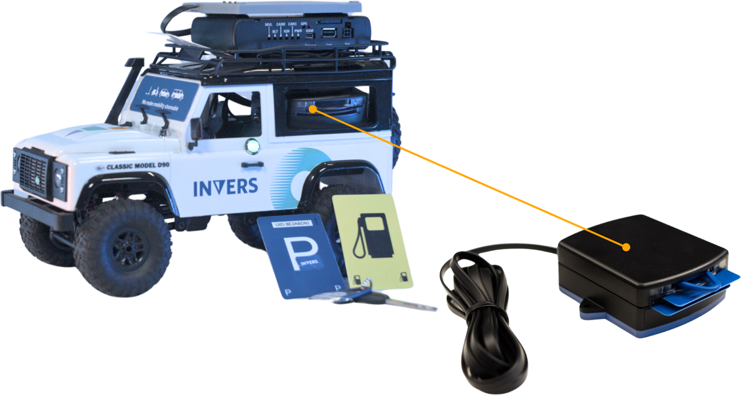
Questions?
Chris Anderson
christopher.anderson@invers.com
Notes:
Questions? We’ve been at this since ’93. We’ll support you. You’re safe. Come try it yourself. Find me any time this week. Next talk: what’s coming.

