Slide 1

KeyCommander
Manage assets and keys — vehicles, spare keys, mailrooms, equipment, lockers — in FleetCommander.
Sponsored by:
COMMAND User Conference 2026 • Glendale, AZ
Notes:
Welcome. This session introduces KeyCommander, our new product for managing assets and keys in FleetCommander: tracking keys for any secured asset, not just vehicles, in the same system you already use for reservations.

Slide 2




Benefits
KeyCommander keeps track of who has every key — in the same system you already use for your fleet.
Know who has what key
Audit log of possession
Use your current key box — or add more
Vehicles and keys in one system
See who has each key, and when they took it.
Every check-out and check-in is recorded, so a key’s history is always on file.
Put the open positions in your existing key box to work, or add more as you grow.
Track your vehicles and your keys together in FleetCommander.
Notes:
Benefits of managing keys in FleetCommander:
Know who has what key and when. There is an audit log of who has possession of each key.
Use the existing open positions in your current key box, or add more.
Keep track of your vehicles and keys in one system.

Slide 3
Asset tracking without a reservation
A simpler way to track assets — no reservation required
Manage vehicles, keys, and other assets from one place
No need to run two separate systems for reservations and assets
1
system for reservations and assets
FleetCommander + KeyCommander
Notes:
This is the more simplistic way of tracking assets without a reservation.
You can do it all from one system. There is no need to have two separate systems to track reservations and assets.

Slide 4
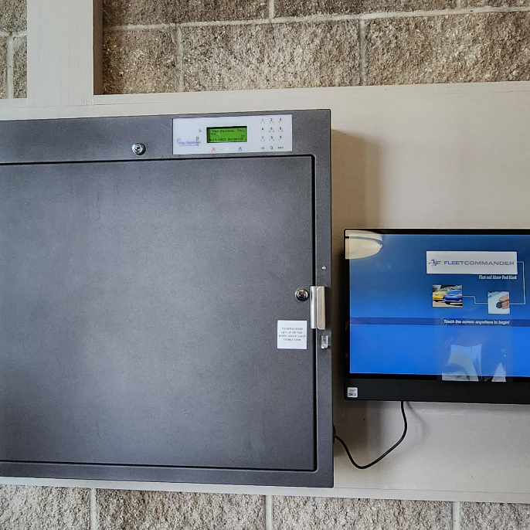
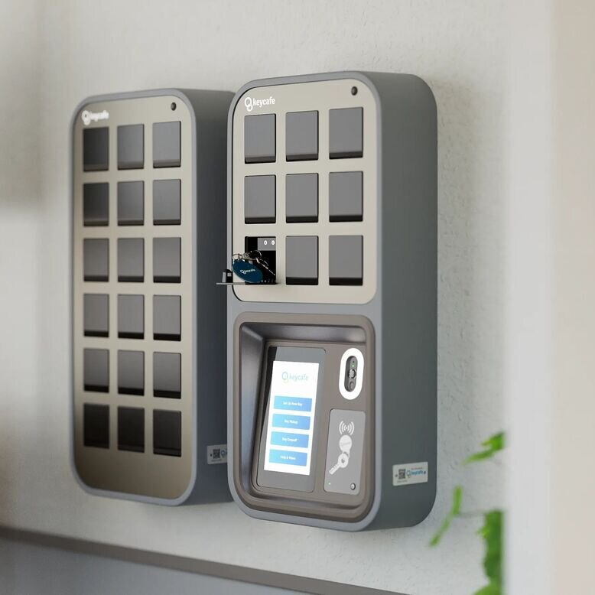
Built to scale
Start with one key box and grow to many locations — KeyCommander works with the hardware you already have.
WORKS WITH
WORKS WITH
Key Systems
Key Café
Original Key Control (KSI) key boxes
FleetCommander Go SmartBoxes
8–192 key positions per box
9–429 positions, daisy-chained
Use both. Mix Key Systems and Key Café boxes across your locations — all managed in one FleetCommander system.
Notes:
KeyCommander is very scalable. You can start with a single key box and grow across locations.
It works with both Key Systems (Original Key Control) boxes and Key Café (FleetCommander Go) SmartBoxes, and you can use both in the same organization.

Slide 5
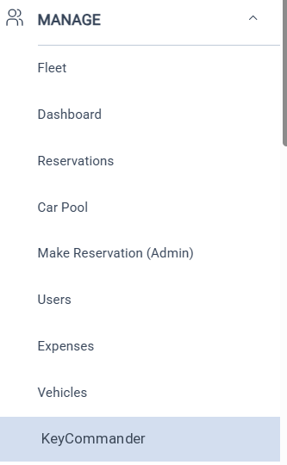
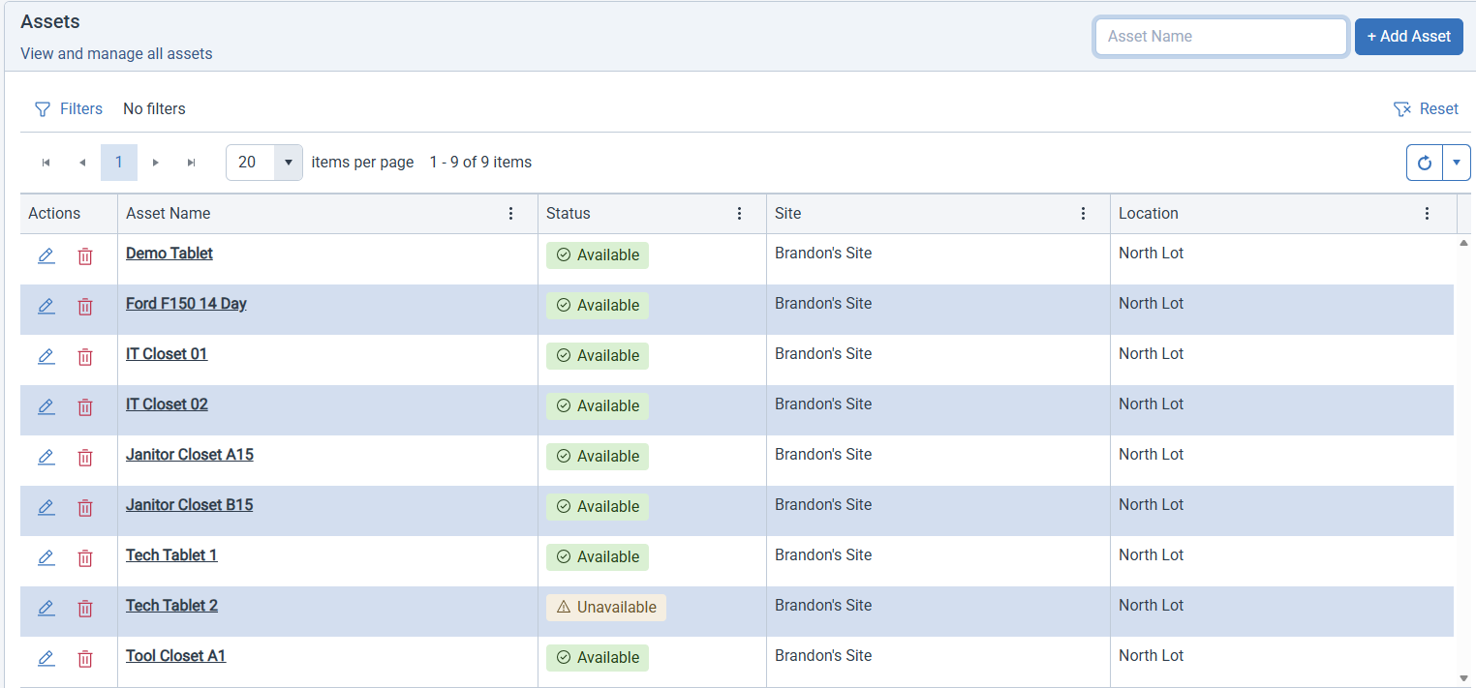





KeyCommander – Manage Assets
Create assets and keys in the KeyCommander section of FleetCommander
Give permissions to a key right from the asset profile
Keys can be anything you secure — they aren’t limited to vehicles
WHAT CAN YOU TRACK?
Vehicles
Spare Keys
Mailrooms
Equipment
Lockers
Notes:
There is a Manage Assets section in the application where you can create assets and keys.
You can give permissions to the keys right from the asset profile.
The keys can be anything you want. They do not have to be limited to vehicles: spare keys, mailrooms, equipment, lockers, any type of asset that is secured.

Slide 6
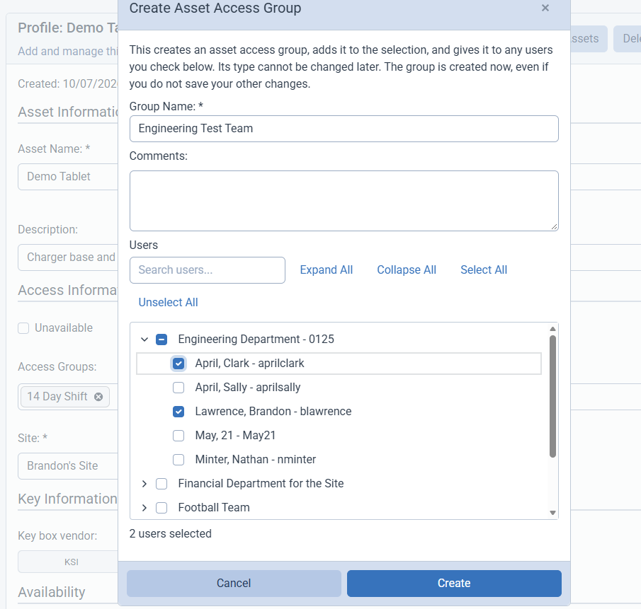


Key Assignment
Associate keys with individuals or departments using access groups
New: choose the access group type — by vehicle or by key
Grant key permissions right from the asset profile
›
›
Key
Access group
People & departments
Notes:
You can associate keys with individuals or departments by using access groups.
There is a new access group option that lets you select the type of access group: either by vehicle or by key.
This makes it easy to give permissions to the keys right from the asset profile.

Slide 7
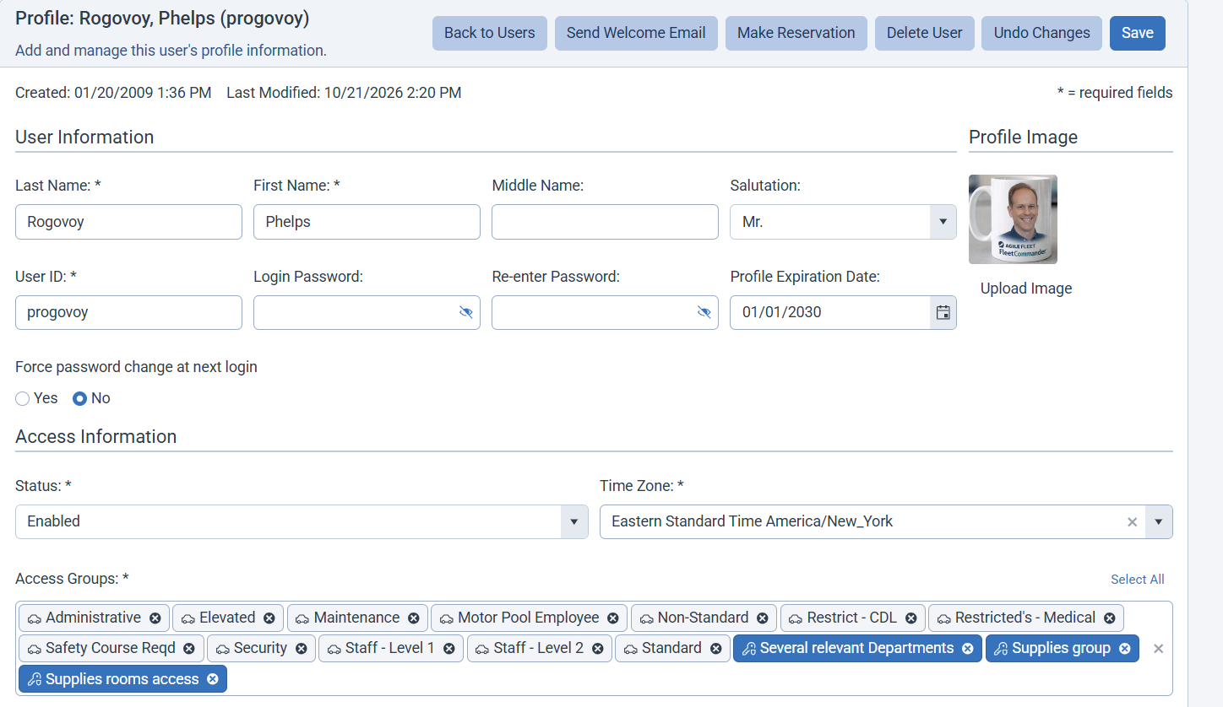
User Profile – Access Group
On the user profile, a car icon and gray tile marks a vehicle access group (used for reservations). A key icon and blue tile mark a KeyCommander access group.
Notes:
You can associate keys with individuals or departments by using access groups.
There is a new access group option that lets you select the type of access group: either by vehicle or by key.
This makes it easy to give permissions to the keys right from the asset profile.

Slide 8
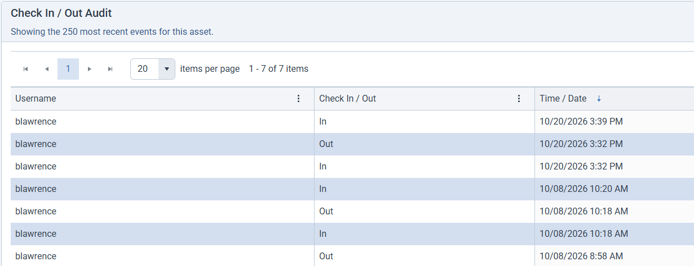


Audit Log
A complete history of who had each key.
Who
The person who has the key
What
Which key or asset
When
When it was checked out and returned
Notes:
The audit log shows possession of each key: you know who has what key and when.

Slide 9
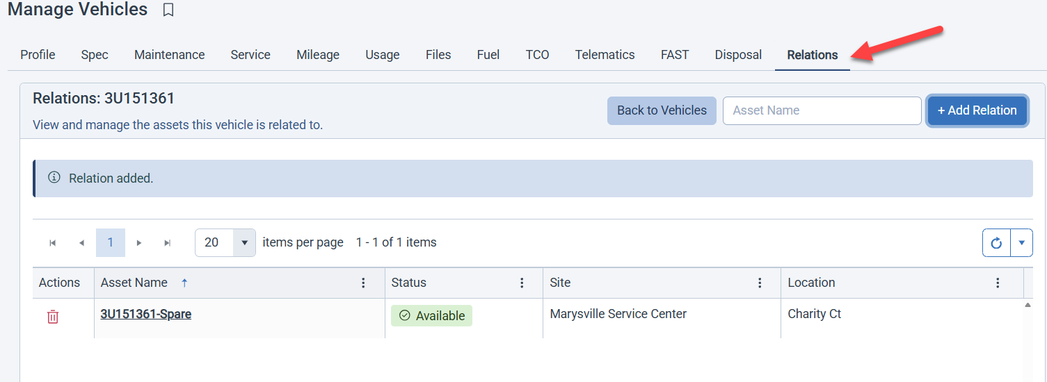
Relations – Vehicles and Keys
Relate keys back to a vehicle — for example, a vehicle’s spare key — so you can track the relationship.
Notes:
You can associate keys with individuals or departments by using access groups.
There is a new access group option that lets you select the type of access group: either by vehicle or by key.
This makes it easy to give permissions to the keys right from the asset profile.

Slide 10
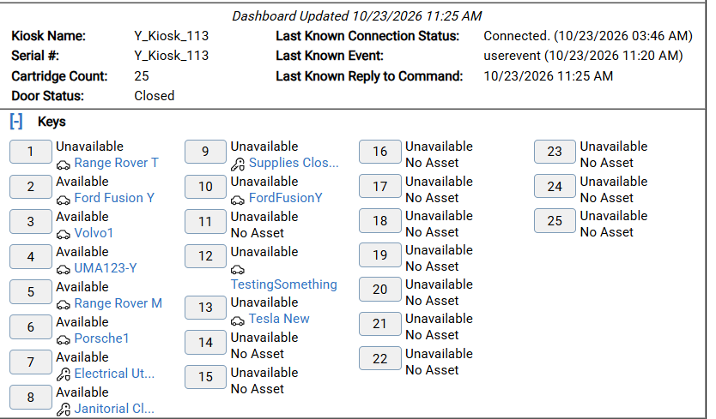
Key Control Dashboard
The dashboard now shows both vehicles and keys. A car icon marks a vehicle that can be reserved; a key icon marks a key-only asset.
Notes:
You can associate keys with individuals or departments by using access groups.
There is a new access group option that lets you select the type of access group: either by vehicle or by key.
This makes it easy to give permissions to the keys right from the asset profile.

Slide 11
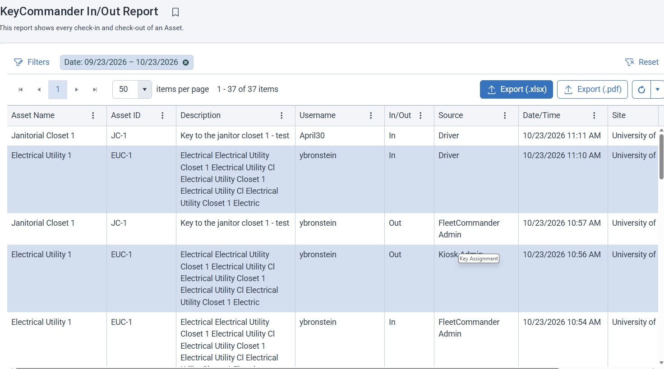
Reports – In/Out
The KeyCommander In/Out Report shows every key removal and return.
Notes:
You can associate keys with individuals or departments by using access groups.
There is a new access group option that lets you select the type of access group: either by vehicle or by key.
This makes it easy to give permissions to the keys right from the asset profile.

Slide 12
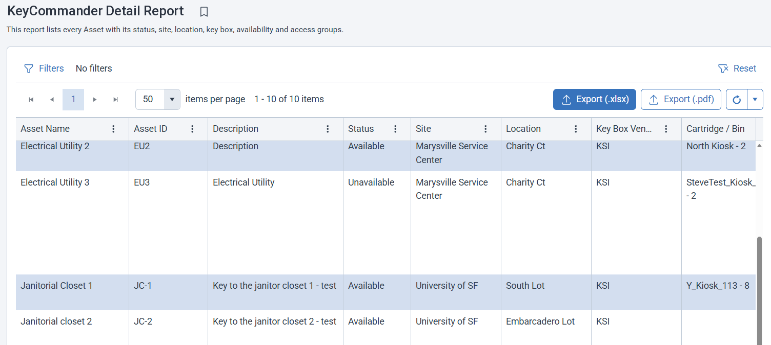
Reports – Asset Detail
The KeyCommander Detail Report lists every asset and key with its status, site, location, key box, availability, and access groups.
Notes:
You can associate keys with individuals or departments by using access groups.
There is a new access group option that lets you select the type of access group: either by vehicle or by key.
This makes it easy to give permissions to the keys right from the asset profile.

Slide 13
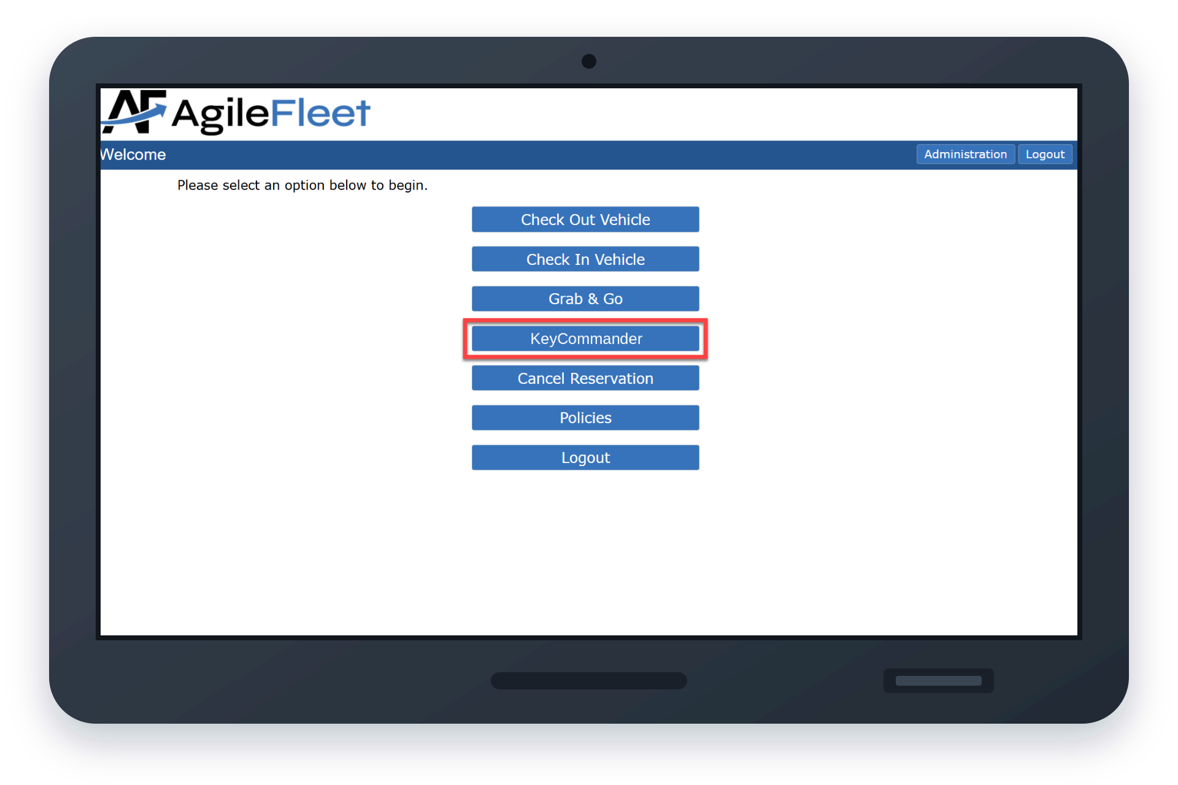
At the Kiosk – KeyCommander
NEW KIOSK OPTION
KeyCommander
The KeyCommander button appears only for people who have keys assigned to them.
Notes:
Users only see keys that they have access to.
They can easily scroll or use the search to find their key.
The mobile version scales nicely.

Slide 14
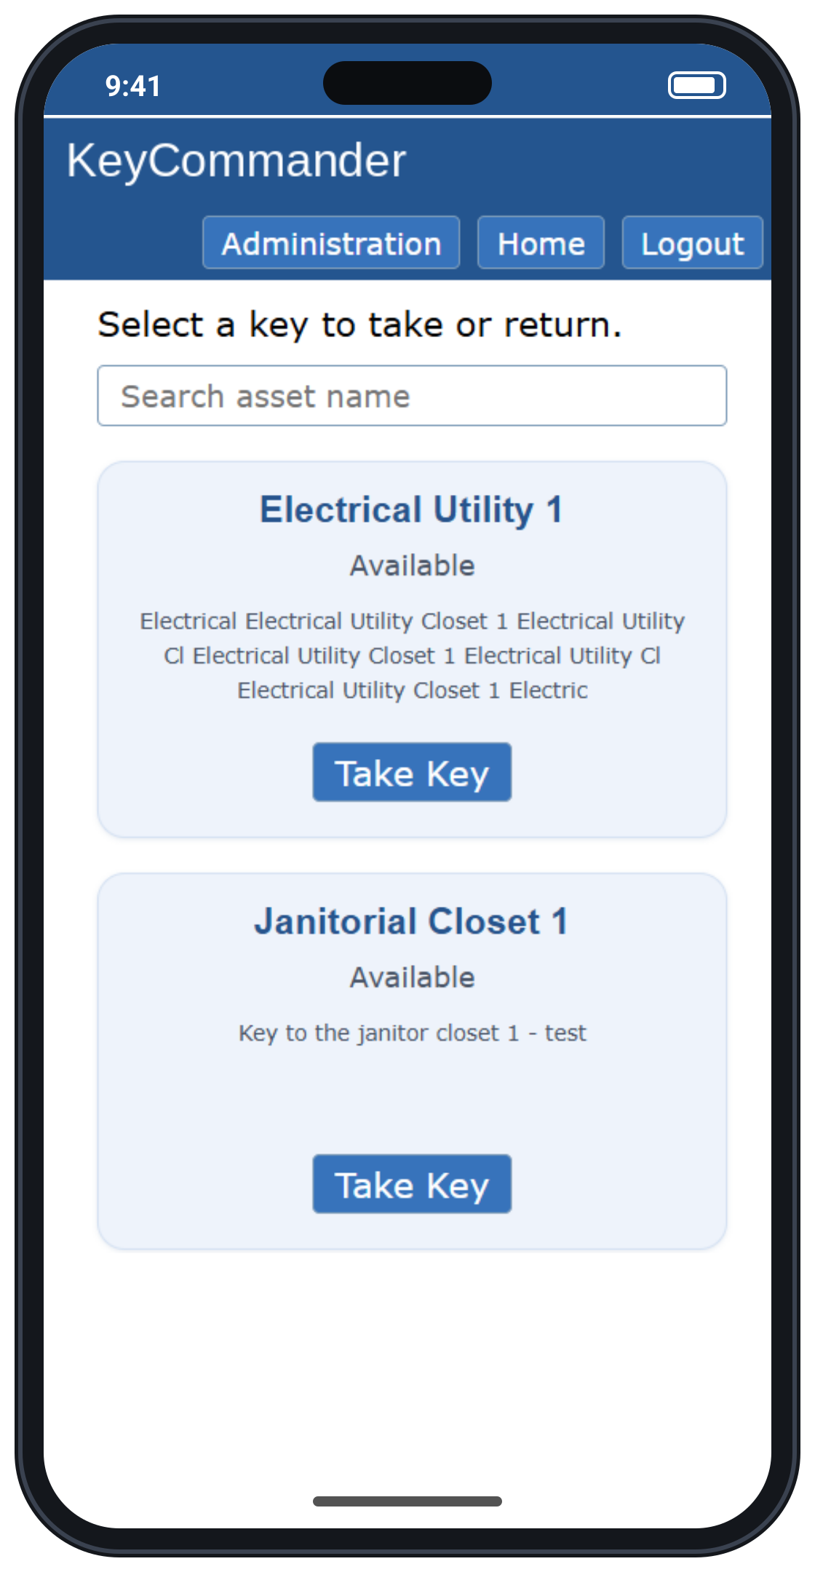

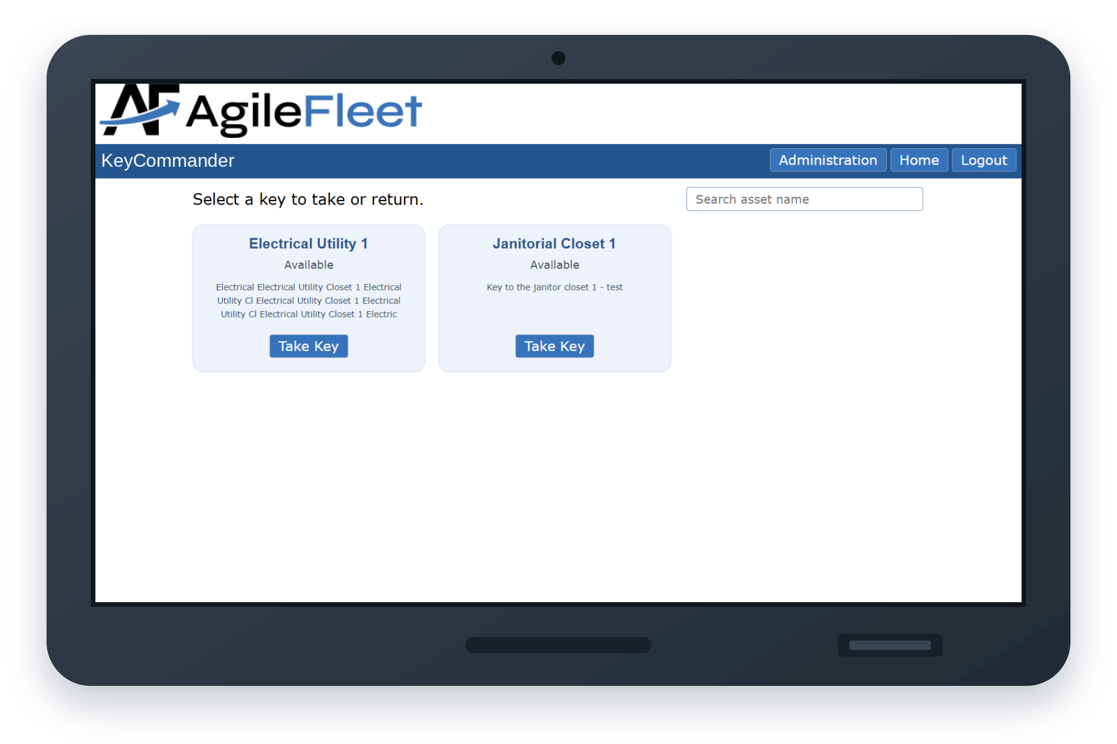


Check Out / Check In
Only your keys
Users only see the keys they have access to.
Find it fast
Easily scroll, or use search to find your key.
Works on mobile
The mobile version scales nicely to any phone.
Notes:
Users only see keys that they have access to.
They can easily scroll or use the search to find their key.
The mobile version scales nicely.

Slide 15
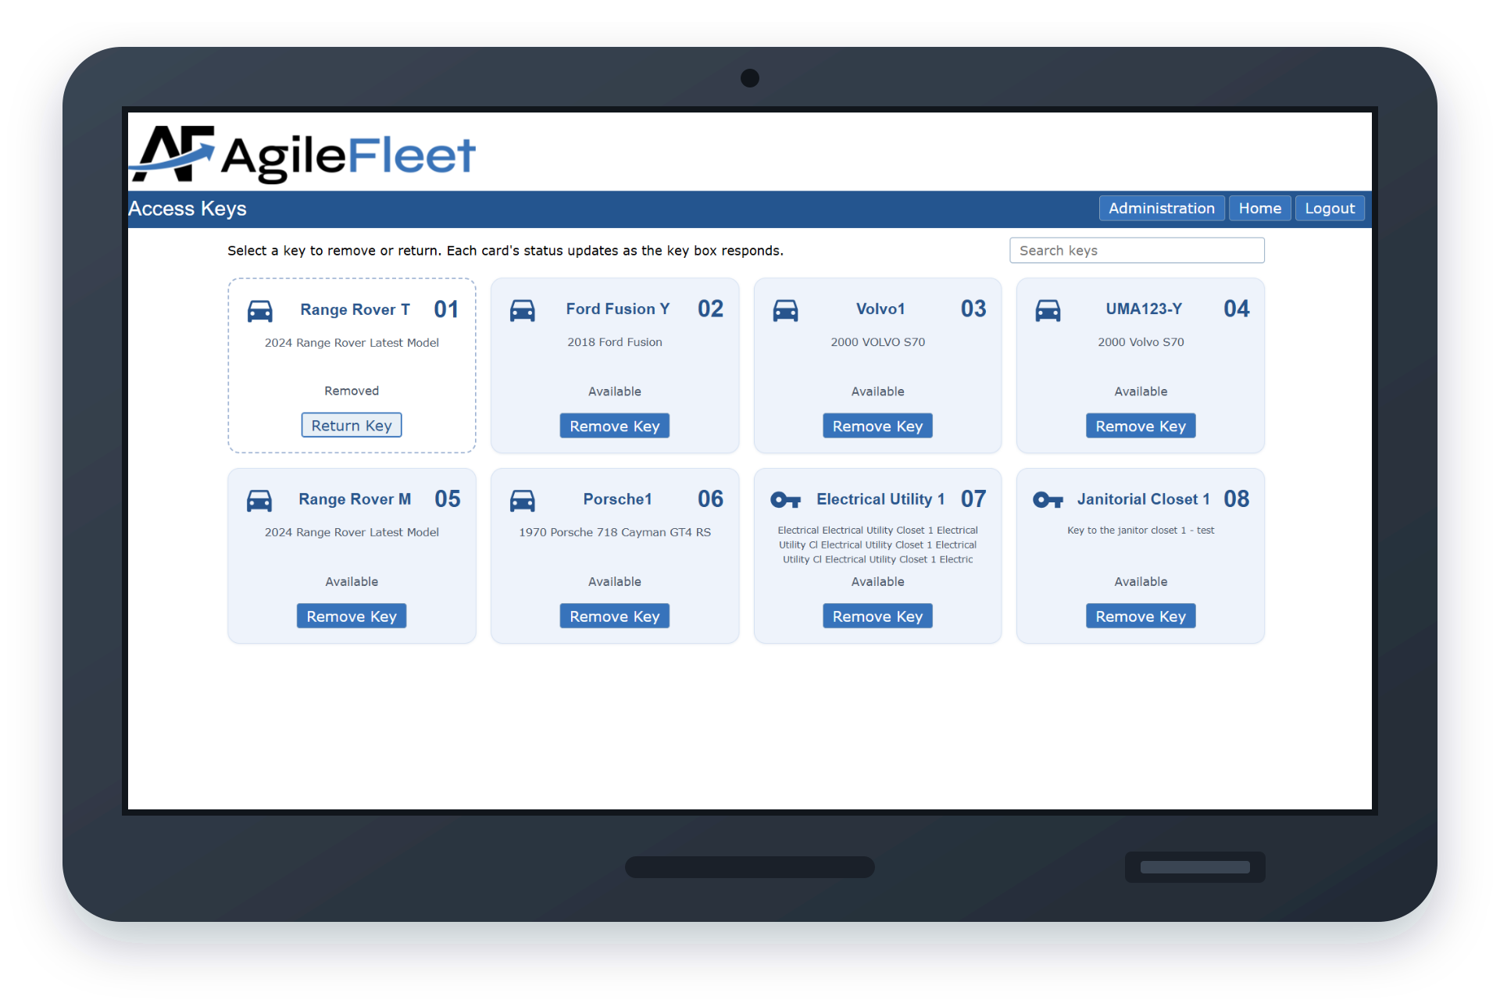
Access Keys
Shows both vehicles and keys, and now tracks when an admin removes a vehicle or key. A new search option means no more scrolling.
Notes:
You can associate keys with individuals or departments by using access groups.
There is a new access group option that lets you select the type of access group: either by vehicle or by key.
This makes it easy to give permissions to the keys right from the asset profile.

Slide 16
Want to see it in action?
Stop by the Tech Tuneup desk for a demo, or reach out to your Client Success rep.
Sponsored by:
COMMAND User Conference 2026 • Glendale, AZ
Notes:
If you are interested, I can give you a demo at the Tech Tuneup desk, or reach out to your Client Success rep.

