Slide 1

Report Center
Fleet Intelligence, Reimagined
Sponsored by:
October 13–15, 2026 • Glendale, AZ

Slide 2
Agenda
Introducing Report Center
Live Demo!
Status
What’s Next for Report Center
Adding AI-assisted Intelligence

Slide 3
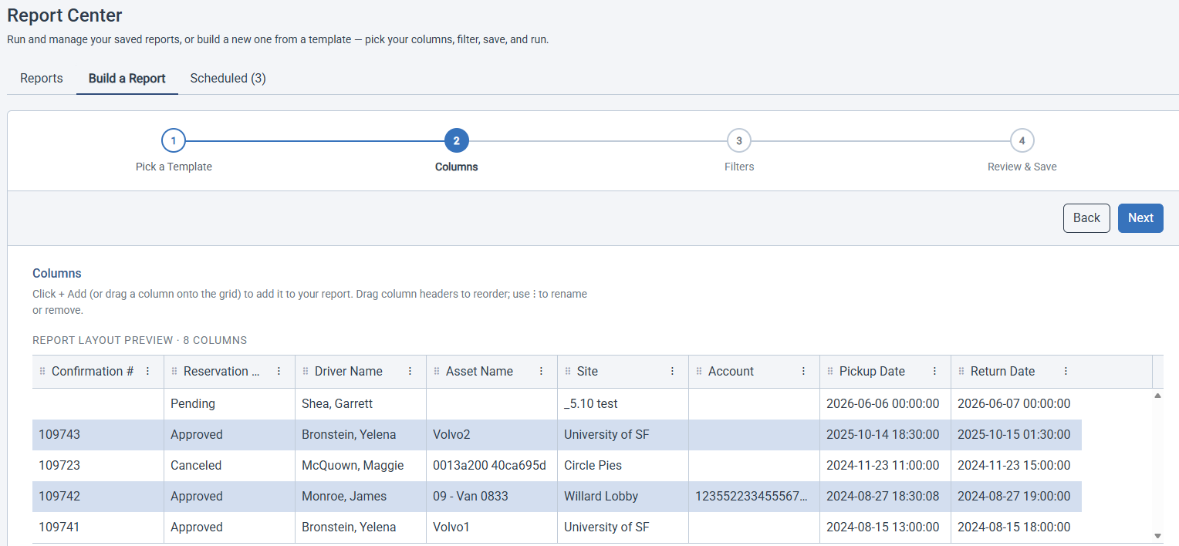
Introducing Report Center
Your “one-stop shop” for customized access to your data!
High Level Features
  Build custom reports for yourself and your colleagues
  Run reports on-demand
  Schedule delivery
  Share your reports
  Manage your reports

Slide 4

Report Center Demo

Slide 5

Report Center - Status
Two product tiers
  Build Custom Reports and Run on Demand
  Schedule (and coming soon AI-Assisted Insights)
Initial Release will be Mid-November to Select Clients
  Please reach out if you’d like to be one of the first to get Report Center!

Slide 6
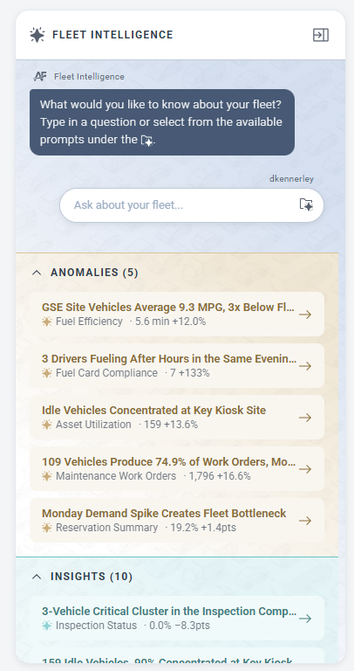
Report Center – What's Planned Next
AI-Assisted Fleet Intelligence
  Customized Insights and Anomalies from Your Data
  Recommendations for Improving Operations
  On-demand Analysis
Additional Templates
Customized ‘From Scratch’ Report Creation
AI-Assisted Workflows

Slide 7
Thank You
Questions?
Sponsored by:
COMMAND User Conference 2026 • Glendale, AZ

