Slide 1
FleetCommander town hall tips for Operating and re-opening your motor pool May 27, 2020

Slide 2
Operating and Re-Opening
Agenda
Introductions
Guidance for this Zoom meeting
Where are we now with respect to Covid-19?
FleetCommander settings
NAFA Communities
Rental Car Agencies
Publications
Open forum

Slide 3
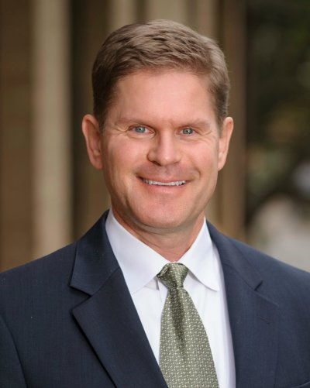
Introductions
Matt Wade VP, Client Success
Phelps Rogovoy Director, Implementation & Support
Jen Thomas
Implementation Manager
Helen Lagerblade
Technical Support Specialist

Slide 4
Operating and Re-Opening
Zoom Meeting Tips and Etiquette
Only use your computer audio or your phone audio. Don’t use both.
Please mute yourselves when others are speaking
It’s up to you if you want to use your video camera
When asking a question or making a comment:
Unmute yourself
For the first time, please tell us your first name and the name of your organization
Mute yourself when you’re done speaking
This meeting will be recorded
The recording, PPT, and publications will be available for download
Some Zoom functions you should know about…

Slide 5
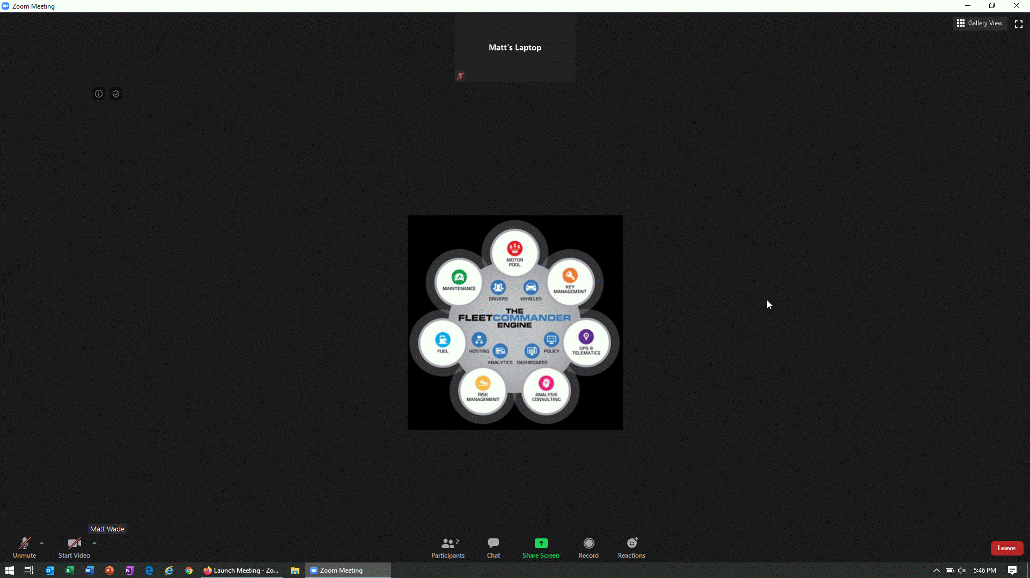
Operating and Re-Opening

Slide 6
Operating and Re-Opening

Slide 7
Operating and Re-Opening
You can use the chat window to ask a question or make a statement…

Slide 8
Operating and Re-Opening

Slide 9
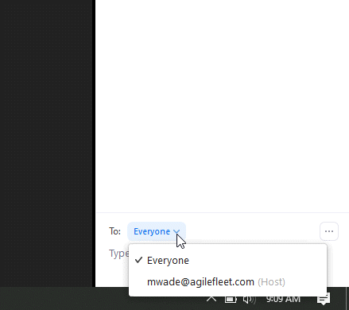
Operating and Re-Opening

Slide 10
Operating and Re-Opening

Slide 11
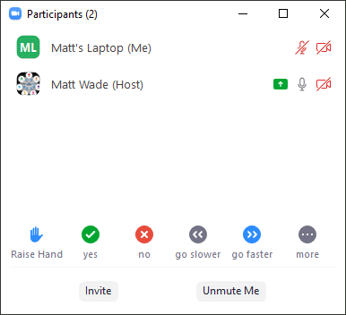
Operating and Re-Opening

Slide 12
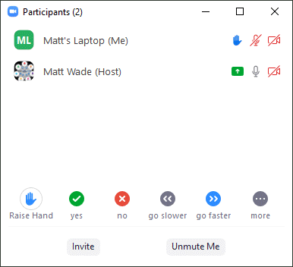
Operating and Re-Opening

Slide 13
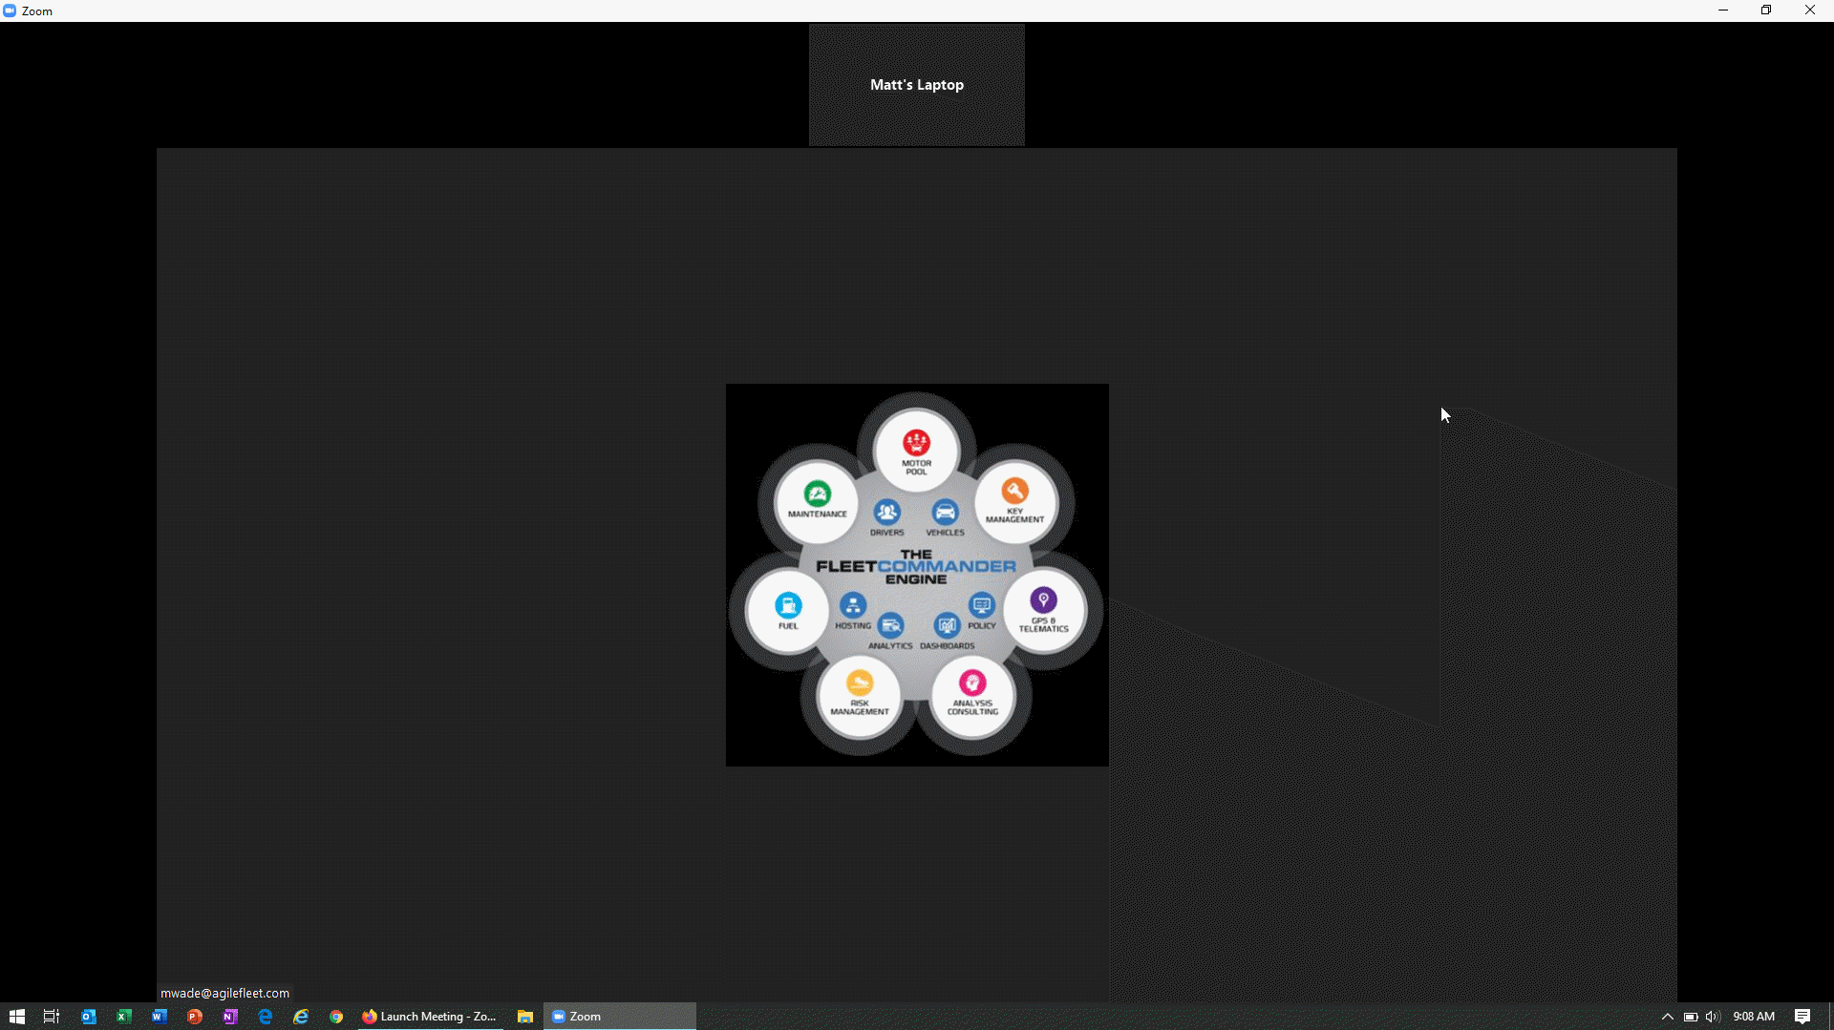
Operating and Re-Opening

Slide 14
Where are we now?

Slide 15
Where are we now?
No vaccine for Covid-19
No widespread, intensive testing for Covid-19
Can’t count on shared responsibility amongst users
Therefore, your users need to trust that you’re doing everything you can to protect them
Hopefully, low usage at first will allow you to acclimate to the situation

Slide 16
Adapting your FleetCommander environment

Slide 17
Operating and Re-Opening
Optimizing FleetCommander for changing conditions
Communicate with your users
Disable and/or restrict reservations
Key control system changes
Add GPSI alerts and reports
Enforce cleaning procedures

Slide 18
Operating and Re-Opening
Communication with Users

Slide 19
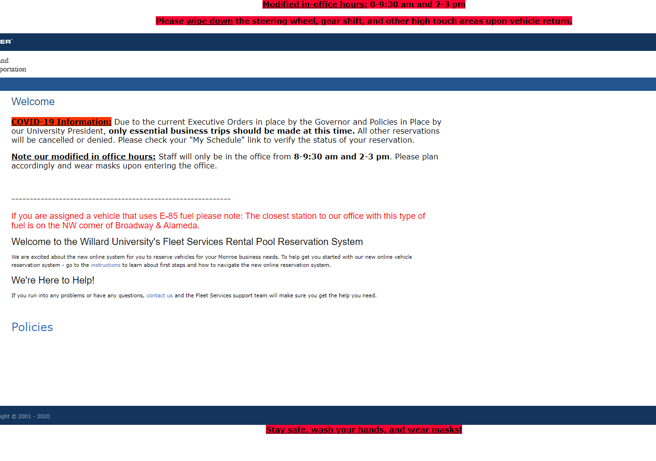
Communication with users
Update Layouts:
Login page
Welcome text
Header and/or footer text for all main website pages
Notes:
Configure > Enterprise Settings > Layout tab
If your company has any websites with updates, include the hyperlink
Make Reservations are Site Settings > Site > Layout tab. Form for before reservation is submitted, Confirm is for after – if reviewing all reservations a note would be good on the confirm page

Slide 20
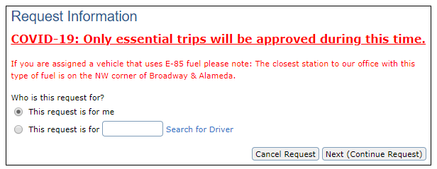
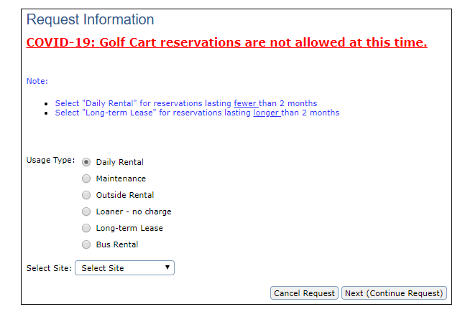
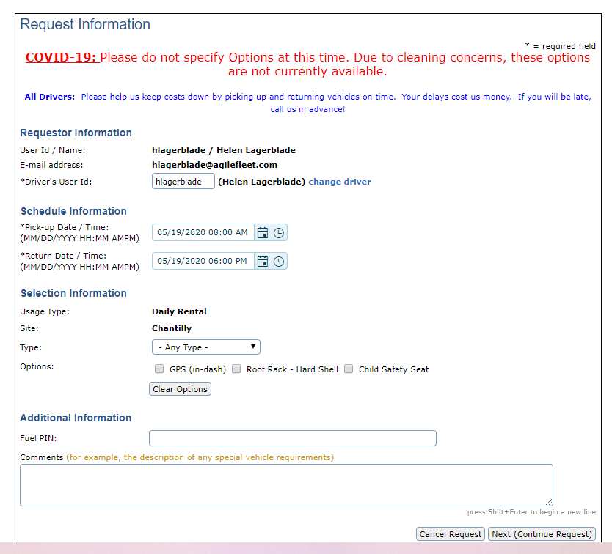
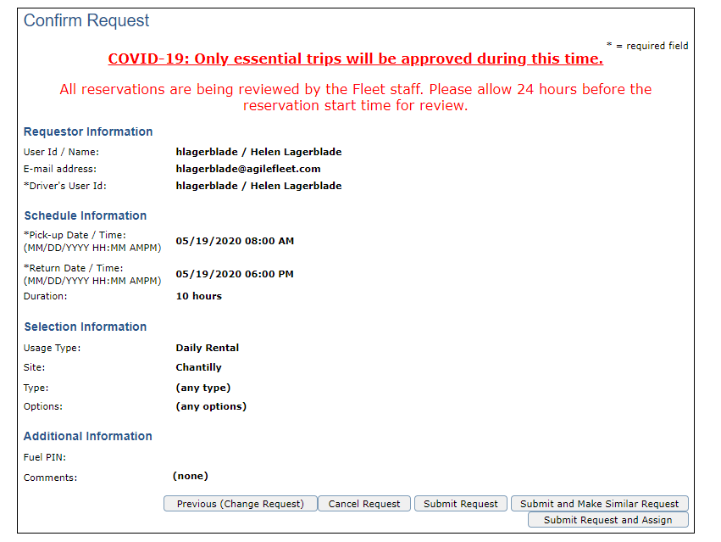
Communication with users
Update Layouts:
Make Reservations help text
Request page
Usage type
Reservation form
Confirmation page
Notes:
Configure > Enterprise Settings > Layout tab
If your company has any websites with updates, include the hyperlink
Make Reservations are Site Settings > Site > Layout tab. Form for before reservation is submitted, Confirm is for after – if reviewing all reservations a note would be good on the confirm page

Slide 21
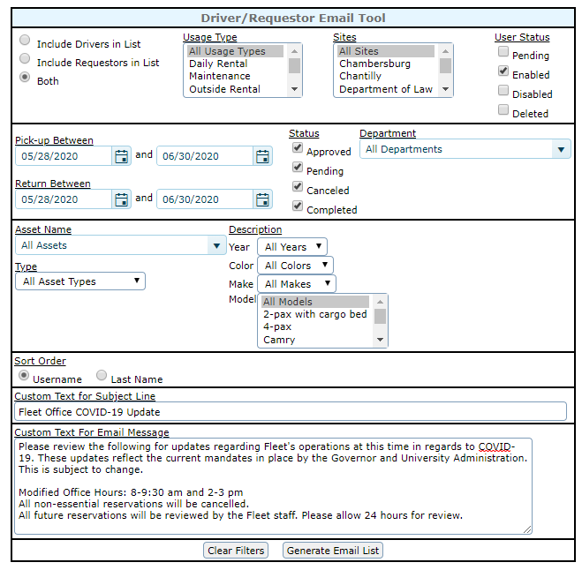
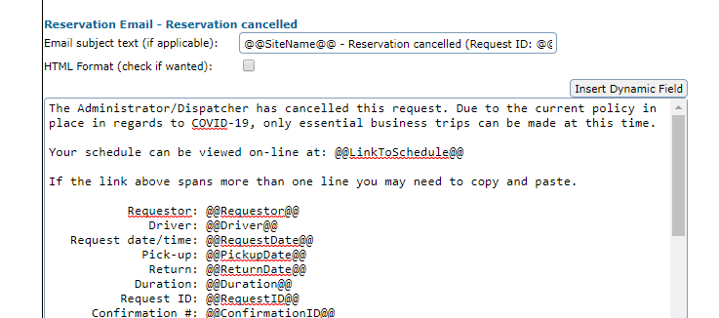
Communication with users
Emails:
Update layout of cancellation emails
Use Email User Tool or Driver/Requestor Email
Notes:
Update by Site Settings > Site > Layout > Reservation Email – Reservation Cancelled
Tools > Send Email > Email User Tool or Driver/Requestor Email
Type your message, generate list, review users, and send

Slide 22
Operating and Re-Opening
Disable and Restrict Reservations

Slide 23
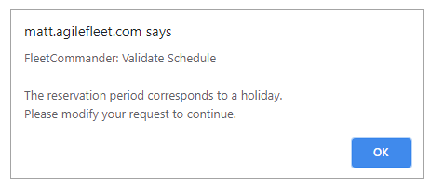
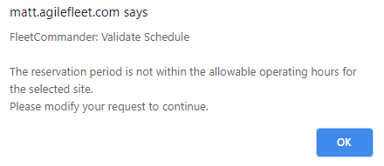
Disable and Restrict reservations
Holidays
Weekdays
Add a daily holiday if closures are infrequent or for short periods of time
For extended time periods, change the Reservation Start and End Between hours for affected sites and days.
*Administrators can bypass these restrictions*
Notes:
Both from Configure menu.
Admins have the ability to ignore the warnings – maybe have essential needs emailed in so admins can make them
Weekdays – top two show some standard options (key control and manual dispatch), yellow highlight is what it should be changed to, to stop all reservations from being made

Slide 24
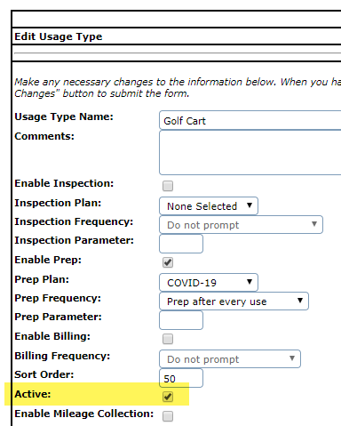
Disable and Restrict reservations
Review all reservations
Disable Usage Types
For affected sites and usage types, turn off:
Auto-approval
Auto-assign
Manual-assign
All reservations will go into a pending status to be reviewed and approved or cancelled.
For each usage type that should not be on reservations, uncheck “Active.” This will deactivate the usage type for all users.
Notes:
Configure > Site Settings > Site > Reservations tab
Configure > Usage Types > edit - keep one usage type active, such as maintenance or a courtesy, that most users don't have access to - keeping one active prevents any system error messages.

Slide 25
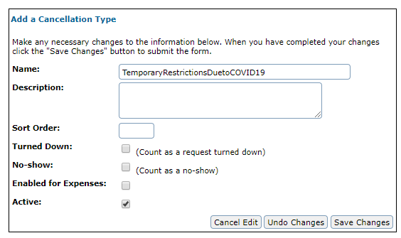
Disable and Restrict reservations
Cancel Reservations
Create new cancellation type i.e. “Cancelled due to COVID-19”
Review any current reservations with “Approved” status using Reservation Detail report
Cancel those that need to be or decline pending reservations with the COVID-19 cancellation type
Unavailable Vehicles
Make specific vehicles “Unavailable” under the vehicle’s profile
Review Reports
Review your Vehicle Usage report to make sure your vehicles are rotating through
Notes:
Configure > Reservations > Cancellation Types (for 5.05 sites)
Cancellation can now be used for both cancelling and declining future requests
Reports – utilization – not reusing the same vehicles, unless intentionally

Slide 26
Operating and Re-Opening
Key Control System Changes

Slide 27
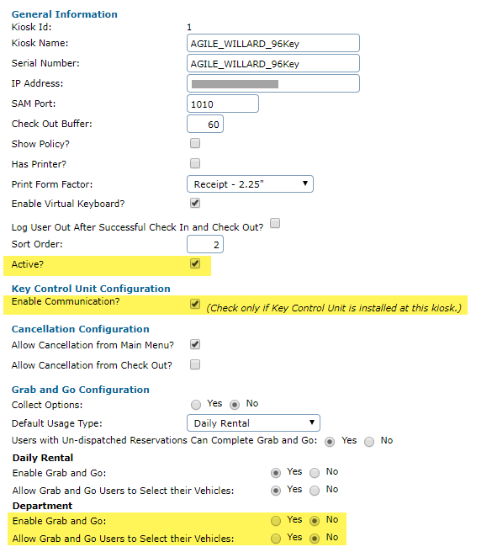
Key control system updates
No Vehicle Use:
Disable Kiosk:
If no keys and vehicles should be accessed, disable affected kiosks
Uncheck both boxes
Restricted Use of Vehicles:
Disable Grab-and-Go:
If all reservations should be reviewed, disable Grab-and-Go by usage type
Notes:
Configure > Site Settings > Site > Kiosk tab
Maybe point out the “un*dispatched” make no to ensure they are using their reviewed reservations

Slide 28
Operating and Re-Opening
GPSI Alerts and Reports

Slide 29
GPSI Alerts and Reports
Establish Reports/Alerts
“Odd hours” report or alert can notify admins if vehicles are operating outside of business hours or authorized trips
“Ignition Alert” can notify when a vehicle when a vehicle turns on, if vehicles aren’t supposed to be used during this time
“Begin/End of Day” report can show first start and last stop each day
Diagnostic (DTC) and Switch Alerts and Reports can help notify of diagnostic trouble codes, low battery voltage, external power lost, etc. which can help you maintain your fleet
Speeding Reports and Alerts: if policy is in place, review these alerts and reports. Law enforcement is seeing increased speeding with less-crowded roads.

Slide 30
Operating and Re-Opening
Cleaning Procedures

Slide 31
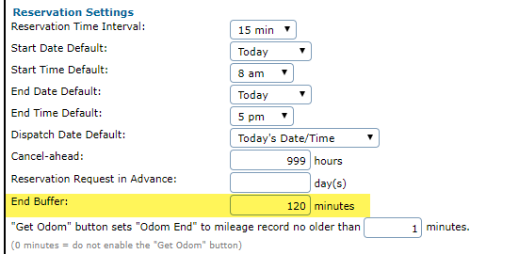
Cleaning procedures
Extend Buffer Time:
Cleaning Wipes:
Extend the End Buffer to allow for cleaning or the virus to die on surfaces – up to 5 days depending on the surface
Have screen-safe, disinfectant wipes at key control systems
On screens, remove excess liquid before wiping
Notes:
Configure > Site Settings > Site > Reservation tab
3 days = 4320 minutes – no commas
https://www.webmd.com/lung/how-long-covid-19-lives-on-surfaces

Slide 32
Cleaning procedures
Enable Prep and/or Inspection Plans
Create an COVID-19 Inspection and/or Prep Plan
Add the Inspection/Prep Steps
Sanitize interior high touch areas
Door handles
Steering wheel, mirrors, and shift lever
Locks and window buttons
Wiper and turn signal stalks
Seat belts and arm rests
Climate control and radio buttons
Sanitize exterior high touch areas
Keys and Fuel Card
Door handles
Fuel door and cap
Let vehicle sit and dry for 60 minutes
Notes:
Configure > Vehicles > Inspection/Prep Plans
Enable Plans by Usage Type and Frequency
http://blog.agilefleet.com/the-agile-customer/did-you-know-using-fleetcommander-inspection-and-prep-plans-to-manage-vehicle-sanitization

Slide 33
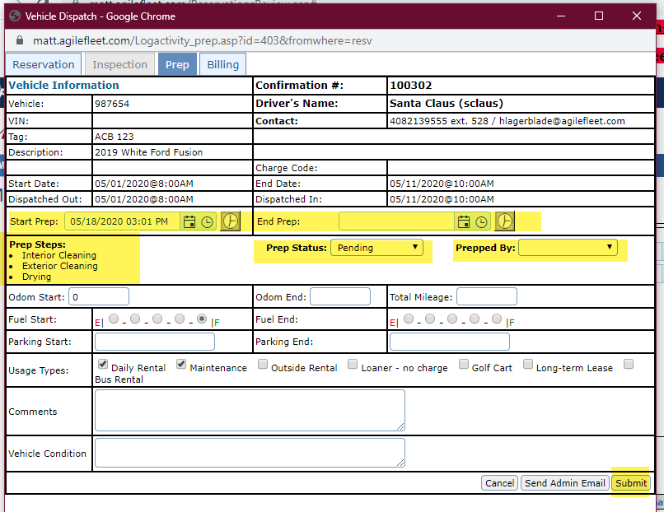
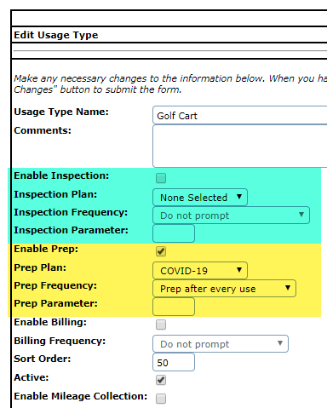
Cleaning procedures
Enable Prep and/or Inspection Plans
Enable Plans by Usage Type
Set Plan Frequency: “Prompt after every use”
Notes:
Configure > Vehicles > Inspection/Prep Plans
Enable Plans by Usage Type and Frequency
http://blog.agilefleet.com/the-agile-customer/did-you-know-using-fleetcommander-inspection-and-prep-plans-to-manage-vehicle-sanitization

Slide 34
NAFA Communities

Slide 35
NAFA Communities
National Association of Fleet Administrators (NAFA)
Communities to discuss fleet-related issues
Much discussion about COVID-19
Foggers
May be the most efficient way to disinfect vehicles
Some available that don’t require PPE to apply
Needs to be sized correctly for the vehicle
May take months to get them
Brands: Ryobi, Vector Fog, GenEon bMist, Clorox 360, Victory
Hire an outside vendor to perform the cleaning

Slide 36
NAFA Communities
Disinfect high-touch points, including but not limited to:
Exterior driver side door handle
Steering wheel - including buttons
Center console - outside only
Gear selector (dial/handle)
Radio/HVAC areas
Touchscreen
Start/Stop button or the place where the key is inserted
Driver door armrest and center console
Window/seat/mirror controls
Rear view mirror
Seatbelt buckle & anchor
Key fob (place in satchel bag or envelope when done disinfecting)
Place signage inside and/or outside the vehicle indicating it’s been cleaned

Slide 37
Rental Car Agencies

Slide 38
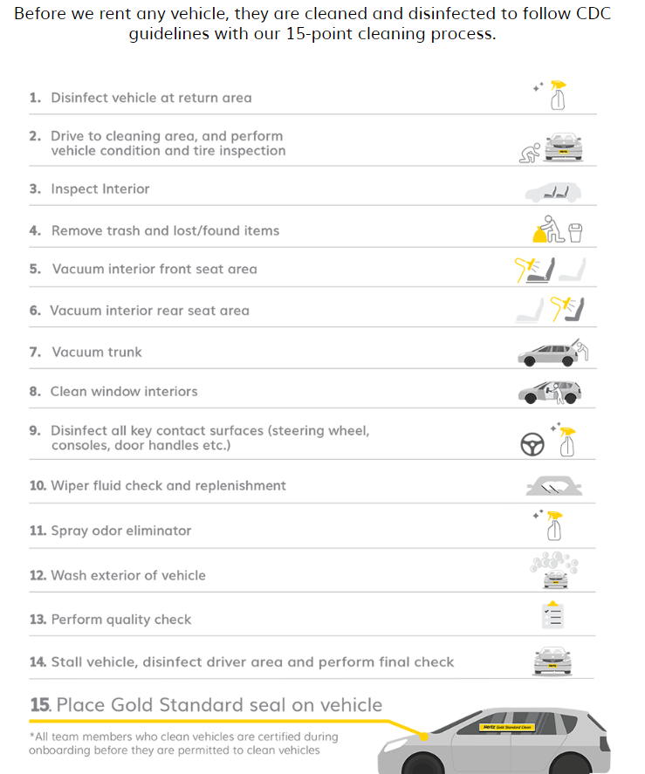
Rental Car Agencies
Hertz Gold Standard Clean Program

Slide 39
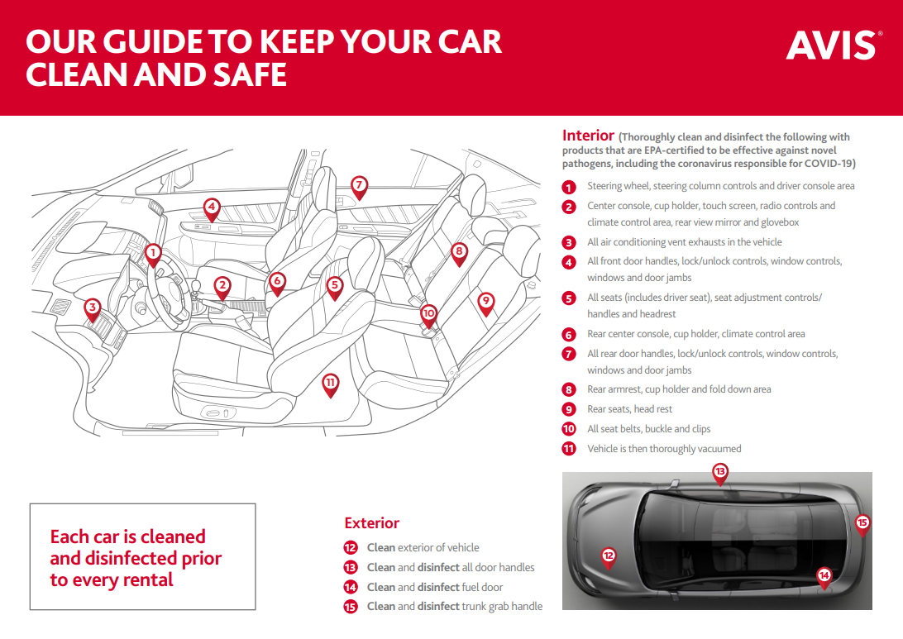
Rental Car Agencies
AVIS Safety Pledge

Slide 40
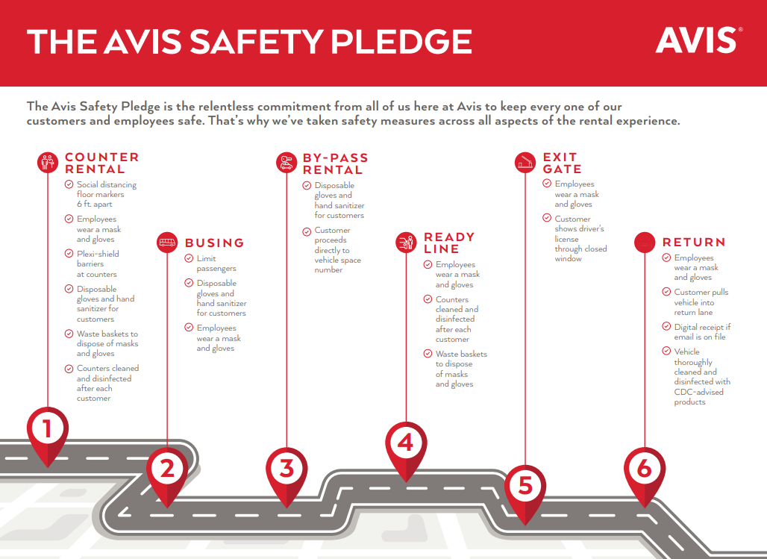
Rental Car Agencies
AVIS Safety Pledge

Slide 41
Publications

Slide 42
Publications
OSHA Guide: https://www.osha.gov/Publications/OSHA3990.pdf
GSA Fleet Vehicle Accidents Procedures under COVID-19
GSA Vehicle Cleaning Disinfecting Guidance for COVID-19
GSA Vehicle Storage Guidance for COVID-19
Recovery Readiness - How to Guide-1.0 (Reopen Office)
Recovery Readiness - Huntington (Re-opening Together) May 2020
Recovery Readiness - Safe Work (Opening Plant)
…also refer to your local government resources for guidance

Slide 43
Open Forum

Slide 44
Open Forum
Questions/Comments from FleetCommander administrators:
Do you see possible pushback against vehicle sharing and what strategies do you anticipate could be used to counter that pushback?
Do you have unmanned sites? If so, how are you ensuring vehicles are sanitized before the next use? Have you increased the buffer between reservations as to how soon a car can go back out after use?
We are in a location where we have been through the first wave and are anticipating a 2nd wave in the fall in conjunction with the regular flu season. Would short health surveys and/or temperature scans be something to incorporate for casual rentals now or in the fall?

Slide 45
Open Forum
Questions/Comments from FleetCommander administrators:
If driver's refuse to follow new cleanliness guidelines and/or choose to skip requirements of having vehicle wiped down properly by the driver before exiting the vehicle, will there be any type of privileges or restrictions taken against driver to reserve a vehicle?
Should changes in they way we need to operate due to Covid-19 be incorporated into our policies?
Is there a way to reconfigure the hours of your motor pool? For example, our motor pools are 24/7. Can we set specific hours instead? If you increase the reservation end buffers to 72 hours, can you easily make the vehicle available before the buffer time?

